Slide 1
ME 6202 STRENGTH OF MATERALS
STRESS AND STAIN

Slide 2
Introduction
Strength of Materials
Strength of the materials refers to the ability of a material to resist the externally applied forces without breaking or yielding
There is a great relationship when describing strength of materials and its stress and strain
Figure 1 shows the stress and strain relationship. Stress and strain
curve of the material obtained during tensile test describe its ductility and yield strength .
According to figure 1, up to the elastic limit, the elasticity of material, that means the material would return to its original dimension, would be maintained, over it the plasticity would follow

Slide 3
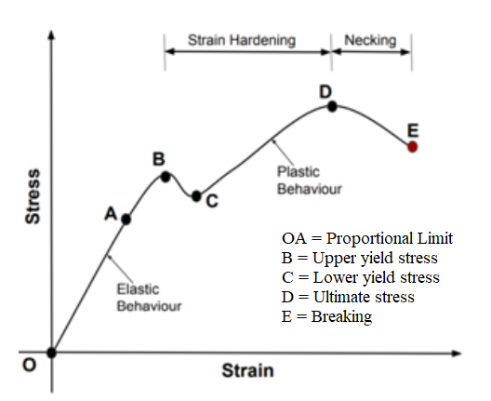
Figure1. Stress- strain relationship curve

Slide 4
Introduction cont…
Once the material exceeds the ultimate stress point (D), necking starts to have on the specimen
The strain hardening is kept between yield points to ultimate tensile strength.
A material obeys hooks law up to proportional limit accurately. The stress and strain curve is used to obtain Young‘s modulus of materials by comparing stress and strain value up to elastic limit

Slide 5
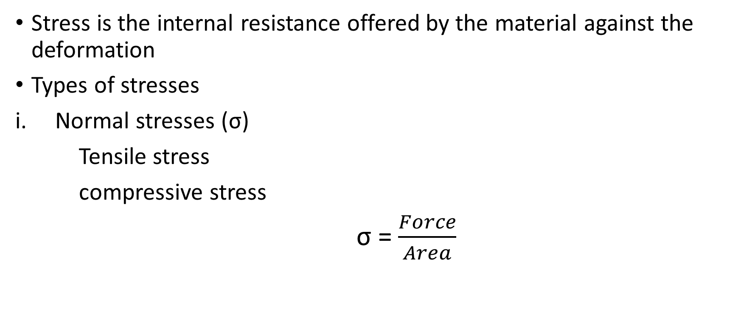
Stress

Slide 6
Stress cont..
ii. Shear stress (τ)
Shear stress is the stress state caused by the combined energy of a pair of opposing forces acting along parallel lines of action through the material.
It is the stress caused by faces of the material sliding relative to one another

Slide 7
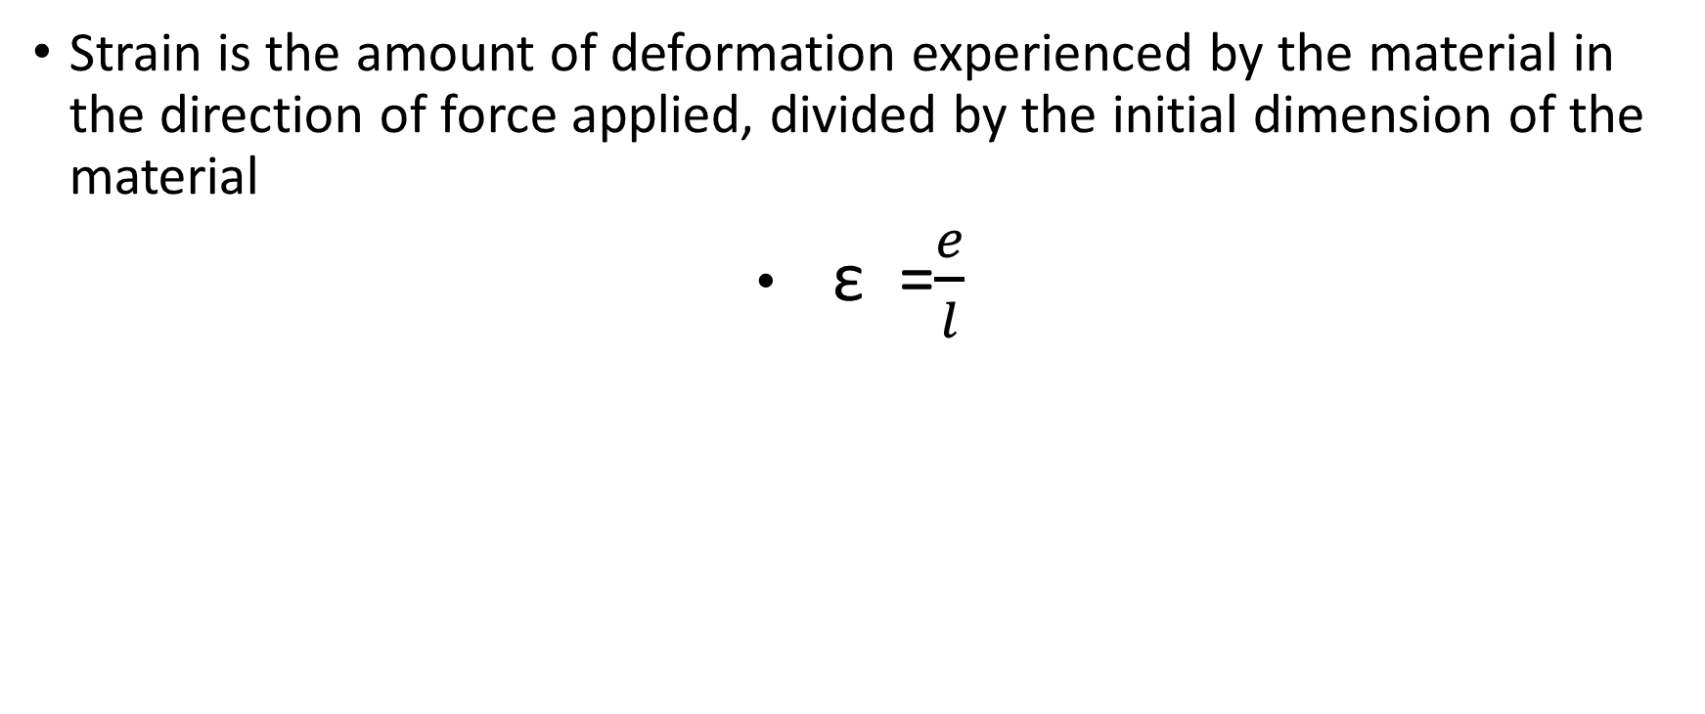
Strain (ε)

