Slide 1

OBJECT ORIENTED PROGRAMMING
MBEYA UNIVERSITY OF SCIENCE AND TECHNOLOGY
CoICT
DEPARTMENT OF INFORMATICS

Slide 2
Fundamental Data Types and Operators

Slide 3
C++ supports the most common basic storage units with the following.
  bool—This is used to represent Boolean values. It can be True or False
  char—It is used to represent a single character.
  int—This is used to represent integers
  float, double—floating-point numbers
The void type is a special type that is used to specify functions that return no value.
Notes:
A type is a set of values, together with a collection of operations on those values. Associating each entity with a type makes it possible to check whether an object is appropriate in a certain context.
Hence, it constitutes an error when a function receives as input an object of the wrong type. Automatically detecting these errors is a process called type checking.
C++ provides a rich type structure and checks types very carefully, making it, as it is called, a strongly typed language
First, the first three of the above types (that is, bool, char, and int) are called integral types, and all four are called arithmetic types. Second, there are some variations of these types—such as signed char and unsigned long int. Third, a large set of operations for these data types is available in the language.
Finally, there is a special type known as the void type that is used to specify functions that return no value.
However, unlike other types, there are no entities of type void, and there are no operations on type void. The void type is also important in connection with pointers.

Slide 4
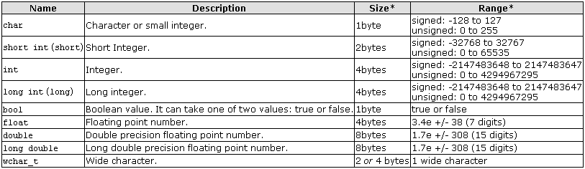
Summary of the basic fundamental data types in C++, as well as the range of values that can be represented with each one:
Notes:
A type is a set of values, together with a collection of operations on those values. Associating each entity with a type makes it possible to check whether an object is appropriate in a certain context.
Hence, it constitutes an error when a function receives as input an object of the wrong type. Automatically detecting these errors is a process called type checking.
C++ provides a rich type structure and checks types very carefully, making it, as it is called, a strongly typed language
First, the first three of the above types (that is, bool, char, and int) are called integral types, and all four are called arithmetic types. Second, there are some variations of these types—such as signed char and unsigned long int. Third, a large set of operations for these data types is available in the language.

Slide 5
Operation
Operations can be grouped as follows:
  arithmetic operations
  logical operations
  relational operations
  bitwise operations
  equality operations

Slide 6
By using the operators and functions associated with these types, in conjunction with variables and constants, one can build expressions.
// assume n and m are type int
n * (m + 123) // type int
n <= m // type bool
Notes:
The operations used and the types of variables or constants involved determine the type of expression.
Each expression has an associated value.

Slide 7
Variables, Identifiers, Declarations, and Initialization
In order to use a variable in C++, we must first declare it specifying which data type we want it to be. Every variable has a fixed type and is comprised of an identifier and a value.
  The values are constrained to range only over the type of the variable.
  The syntax to declare a new variable is to write the specifier of the desired data type (like int, bool, float...) followed by a valid variable identifier.
  A variable definition tells the compiler where and how much storage to create for the variable.
  Variables are containers for storing data values.
Notes:
In order to use a variable in C++, we must first declare it specifying which data type we want it to be. The syntax to declare a new variable is to write the specifier of the desired data type (like int, bool, float...) followed by a valid variable identifier.
If you are going to declare more than one variable of the same type, you can declare all of them in a single statement by separating their identifiers with commas.
The integer data types char, short, long and int can be either signed or unsigned depending on the range of numbers needed to be represented. Signed types can represent both positive and negative values, whereas unsigned types can only represent positive values (and zero). This can be specified by using either the specifier signed or the specifier unsigned before the type name. For example:
unsigned short int NumberOfSisters;
signed int MyAccountBalance;
By default, if we do not specify either signed or unsigned most compiler settings will assume the type to be signed, therefore instead of the second declaration above we could have written:
int MyAccountBalance;
short and long can be used alone as type specifiers. In this case, they refer to their respective integer fundamental types: short is equivalent to short int and long is equivalent to long int. The following two variable declarations are equivalent:
short Year; short int Year;

Slide 8
In C++, there are different types of variables (defined with different keywords), for example:
  int - stores integers (whole numbers), without decimals, such as 123 or -123
  float / double - stores floating point numbers, with decimals, such as 19.99 or -19.99
  char - stores single characters, such as 'a' or 'B'. Char values are surrounded by single quotes
  string - stores text, such as "Hello World". String values are surrounded by double quotes
  bool - stores values with two states: true or false

Slide 9
  The type and identifier of a variable are established in its declaration in the following way:
  bool flag;
  char c;
  int i;
  float pi;

Slide 10
Variables, Identifiers, Declarations, and Initialization
  Initialization of variables → appending an equal sign followed by the value to which the variable will be initialized
  Syntax:
  type identifier = initial_value ;
  Constructor initialization
  Syntax:
  type identifier (initial_value) ;
Notes:
Once a variable is declared, we can assign values to it.
In the example above, single quotation marks delimit the value A, which is assigned to the char variable c. On the other hand, the numeric values 12 and 3.14159 are assigned to the int and float variables without being enclosed in quotation marks. Needless to say, the type of the value on the right must match that of the variable ("must match" in this context does not mean "must be identical to," because some conversions are reasonable and are performed automatically).
There is another, slightly surprising form of initialization that will become clearer in the chapter on object-based programming. float x1(5.3678); // initialize x1 to 5.3678;

Slide 11
  Example:
  c = 'A';
  i = 12;
  pi = 3.14159;
  unsigned long int num = 1234567890;
  float x1(5.3678); // initialize x1 to 5.3678;

Slide 12
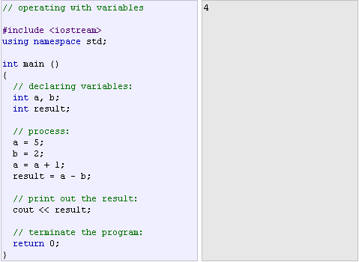
The example of the C++ code

Slide 13
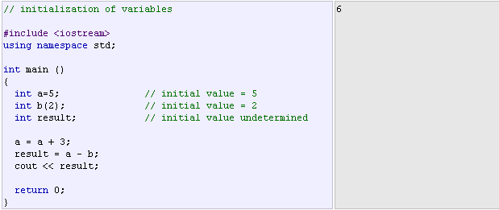
Another Example:

Slide 14
Scope of variables
A scope is a region of the program and broadly speaking there are three places, where variables can be declared:
  Inside a function or a block which is called local variables,
  In the definition of function parameters which is called formal parameters.
  Outside of all functions which is called global variables.
We will learn what is a function and it's parameter in subsequent chapters. Here let us explain what are local and global variables.
Notes:
All the variables that we intend to use in a program must have been declared with its type specifier in an earlier point in the code, like we did in the previous code at the beginning of the body of the function main when we declared that a, b, and result were of type int.
Variable can be either of global or local scope.

Slide 15
Local Variables
Variables that are declared inside a function or block are local variables. They can be used only by statements that are inside that function or block of code.
Local variables are not known to functions outside their own. Following is the example using local variables

Slide 16
#include <iostream>
using namespace std;
int main ( ) {
// Local variable declaration:
int a, b;
int c;
// actual initialization
a = 10;
b = 20;
c = a + b;
cout << c;
return 0;
}

Slide 17
Global Variables
Global variables are defined outside of all the functions, usually on top of the program. The global variables will hold their value throughout the life-time of your program.
A global variable can be accessed by any function. That is, a global variable is available for use throughout your entire program after its declaration.
Following is the example using global and local variables

Slide 18
#include <iostream>
using namespace std;
// Global variable declaration:
int g;
int main ( ) {
// Local variable declaration:
int a, b;
// actual initialization
a = 10;
b = 20;
g = a + b;
cout << g;
return 0;
}

Slide 19
Constants
Constants are expressions with a fixed value
    Literals - are used to express particular values within the source code of a program.
    Literal constants can be divided:
      Integer Numerals
      Floating Point Numbers
      Character and string literals
      Boolean literals
Notes:
Literal constants can be divided in Integer Numerals, Floating-Point Numerals, Characters, Strings and Boolean Values.

Slide 20
Integer Numerals – are numerical constants that identify integer decimal values.
  We can force them to either be unsigned by appending the u character to it, or long by appending l:
  Ex.
  75 // int
  75u // unsigned int
  75l // long
  75ul // unsigned long
Notes:
If we want to express an octal number we have to precede it with a 0 (zero character). And in order to express a hexadecimal number we have to precede it with the characters 0x (zero, x).
All the examples represent the same number: 75 (seventy-five) expressed as a base-10 numeral, octal numeral and hexadecimal numeral, respectively.

Slide 21
Floating Point Numbers
  They express numbers with decimals and/or exponents.
Examples:
3.14159 // 3.14159
6.02e23 // 6.02 x 10^23
1.6e-19 // 1.6 x 10^-19
3.0 // 3.0
Notes:
They can include either a decimal point, an e character (that expresses "by ten at the Xth height", where X is an integer value that follows the e character), or both a decimal point and an e character:
These are four valid numbers with decimals expressed in C++. The first number is PI, the second one is the number of Avogadro, the third is the electric charge of an electron (an extremely small number) -all of them approximated- and the last one is the number three expressed as a floating-point numeric literal.
If you explicitly want to express a float or long double numerical literal, you can use the f or l suffixes respectively
Any of the letters than can be part of a floating-point numerical constant (e, f, l) can be written using either lower or uppercase letters without any difference in their meanings.

Slide 22
Character and string literals - non-numerical constants
Examples:
'z'
'p'
"Hello world"
"How do you do?"
Boolean literals
There are only two valid Boolean values: true and false.
Notes:
The first two expressions represent single character constants, and the following two represent string literals composed of several characters. Notice that to represent a single character we enclose it between single quotes (') and to express a string (which generally consists of more than one character) we enclose it between double quotes (").
When writing both single character and string literals, it is necessary to put the quotation marks surrounding them to distinguish them from possible variable identifiers or reserved keywords.

Slide 23
Defined constants (#define)
Its format is:
#define identifier value
For example:
#define PI 3.14159265
#define NEWLINE '\n'
Notes:
You can define your own names for constants that you use very often without having to resort to memory-consuming variables, simply by using the #define preprocessor directive.

Slide 24
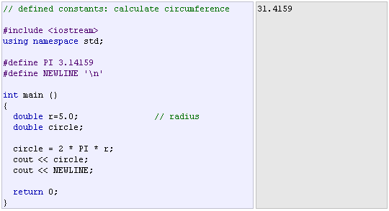
For example:
Notes:
This defines two new constants: PI and NEWLINE. Once they are defined, you can use them in the rest of the code as if they were any other regular constant.
In fact the only thing that the compiler preprocessor does when it encounters #define directives is to literally replace any occurrence of their identifier (in the previous example, these were PI and NEWLINE) by the code to which they have been defined (3.14159265 and '\n' respectively).
The #define directive is not a C++ statement but a directive for the preprocessor; therefore it assumes the entire line as the directive and does not require a semicolon (;) at its end. If you append a semicolon character (;) at the end, it will also be appended in all occurrences within the body of the program that the preprocessor replaces.

Slide 25
Declared constants (const)
With the const prefix you can declare constants with a specific type in the same way as you would do with a variable:
const int pathwidth = 100;
const char tabulator = '\t';
Notes:
Here, pathwidth and tabulator are two typed constants. They are treated just like regular variables except that their values cannot be modified after their definition.

Slide 26
Operators --- Assignment Operators
There are following assignment operators supported by C++ language. The Assignment assigns a value to a variable
Operator | Description | Example
= | Simple assignment operator, Assigns values from right side operands to left side operand. | C = A + B will assign value of A + B into C
+= | Add AND assignment operator, It adds right operand to the left operand and assign the result to left operand. | C += A is equivalent to C = C + A
-= | Subtract AND assignment operator, It subtracts right operand from the left operand and assign the result to left operand. | C -= A is equivalent to C = C - A
Notes:
Once we know of the existence of variables and constants, we can begin to operate with them. For that purpose, C++ integrates operators.
The part at the left of the assignment operator (=) is known as the lvalue (left value) and the right one as the rvalue (right value).

Slide 27
Operator | Description | Example
*= | Multiply AND assignment operator, It multiplies right operand with the left operand and assign the result to left operand. |  | C *= A is equivalent to C = C * A
/= | Divide AND assignment operator, It divides left operand with the right operand and assign the result to left operand. |  | C /= A is equivalent to C = C / A
%= | Modulus AND assignment operator, It takes modulus using two operands and assign the result to left operand. |  | C %= A is equivalent to C = C % A
<<= | Left shift AND assignment operator. |  | C <<= 2 is same as C = C << 2
>>= | Right shift AND assignment operator. |  | C >>= 2 is same as C = C >> 2
&= | Bitwise AND assignment operator. |  | C &= 2 is same as C = C & 2
^= | Bitwise exclusive OR and assignment operator. |  | C ^= 2 is same as C = C ^ 2
|= | Bitwise inclusive OR and assignment operator. |  | C |= 2 is same as C = C | 2

Slide 28
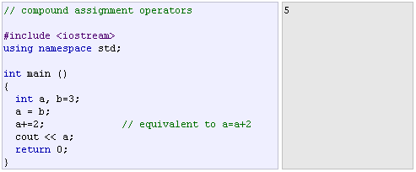
For example:

Slide 29

Arithmetic operators: There are following arithmetic operators supported by C++ language. Assume variable A holds 10 and variable B holds 20
Operator | Description | Example
+ | Adds two operands | A + B will give 30
- | Subtracts second operand from the first | A - B will give -10
* | Multiplies both operands | A * B will give 200
/ | Divides numerator by de-numerator | B / A will give 2
% | Modulus Operator and remainder of after an integer division | B % A will give 0
++ | Increment operator, increases integer value by one | A++ will give 11
-- | Decrement operator, decreases integer value by one | A-- will give 9

Slide 30
Relational Operators: There are following relational operators supported by C++ language. Assume variable A holds 10 and variable B holds 20
Operator | Description | Example
== | Checks if the values of two operands are equal or not, if yes then condition becomes true. | (A == B) is not true.
!= | Checks if the values of two operands are equal or not, if values are not equal then condition becomes true. | (A != B) is true.
> | Checks if the value of left operand is greater than the value of right operand, if yes then condition becomes true. | (A > B) is not true.
< | Checks if the value of left operand is less than the value of right operand, if yes then condition becomes true. | (A < B) is true.
>= | Checks if the value of left operand is greater than or equal to the value of right operand, if yes then condition becomes true. | (A >= B) is not true.
<= | Checks if the value of left operand is less than or equal to the value of right operand, if yes then condition becomes true. | (A <= B) is true.

Slide 31


Examples:

Slide 32
Logical operators ( !, &&, || )
There are following logical operators supported by C++ language. Assume variable A holds 1 and variable B holds 0
Operator | Description | Example
&& | Called Logical AND operator. If both the operands are non-zero, then condition becomes true. | (A && B) is false.
|| | Called Logical OR Operator. If any of the two operands is non-zero, then condition becomes true. | (A || B) is true.
! | Called Logical NOT Operator. Use to reverses the logical state of its operand. If a condition is true, then Logical NOT operator will make false. | !(A && B) is true.
Notes:
The Operator ! is the C++ operator to perform the Boolean operation NOT, it has only one operand, located at its right, and the only thing that it does is to inverse the value of it, producing false if its operand is true and true if its operand is false. Basically, it returns the opposite Boolean value of evaluating its operand.

Slide 33

Examples:

Slide 34
Conditional operator ( ? )
evaluates an expression returning a value if that expression is true and a different one if the expression is evaluated as false.
Its format is:
condition ? result1 : result2
If condition is true the expression will return result1, if it is not it will return result2.

Slide 35
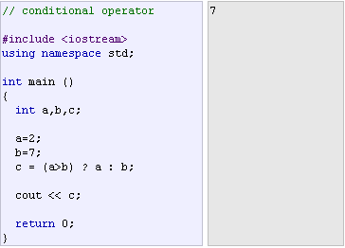
Example:

Slide 36
Comma operator ( , )
used to separate two or more expressions that are included where only one expression is expected. When the set of expressions has to be evaluated for a value, only the rightmost expression is considered.
For example, the following code:
a = (b=3, b+2);

Slide 37
Bitwise Operators - Bitwise operator works on bits and perform bit-by-bit operation. The truth tables for &, |, and ^ are as follows:
p | q | p & q | p | q | p ^ q
0 | 0 | 0 | 0 | 0
0 | 1 | 0 | 1 | 1
1 | 1 | 1 | 1 | 0
1 | 0 | 0 | 1 | 1
Notes:
Bitwise operators modify variables considering the bit patterns that represent the values they store.

Slide 38
Assume if A = 60; and B = 13; now in binary format they will be as follows −
A = 0011 1100
B = 0000 1101
-----------------
A&B = 0000 1100
A|B = 0011 1101
A^B = 0011 0001
~A = 1100 0011
The Bitwise operators supported by C++ language are listed in the following table. Assume variable A holds 60 and variable B holds 13.

Slide 39
Operator | Description | Example
& | Binary AND Operator copies a bit to the result if it exists in both operands. | (A & B) will give 12 which is 0000 1100
| | Binary OR Operator copies a bit if it exists in either operand. | (A | B) will give 61 which is 0011 1101
^ | Binary XOR Operator copies the bit if it is set in one operand but not both. | (A ^ B) will give 49 which is 0011 0001
~ | Binary Ones Complement Operator is unary and has the effect of 'flipping' bits. | (~A ) will give -61 which is 1100 0011 in 2's complement form due to a signed binary number.
<< | Binary Left Shift Operator. The left operands value is moved left by the number of bits specified by the right operand. | A << 2 will give 240 which is 1111 0000
>> | Binary Right Shift Operator. The left operands value is moved right by the number of bits specified by the right operand. | A >> 2 will give 15 which is 0000 1111

Slide 40
Explicit type casting operator:
Type casting operators - allow you to convert a datum of a given type to another. For Example:
int i;
float f = 3.14;
i = (int) f; //convert the value of f (which is float) into integer
  Here, the typecasting operator was (int).
  Another way to do the same thing in C++ is:
  i = int ( f );
Notes:
There are several ways to do this in C++. The simplest one, which has been inherited from the C language, is to precede the expression to be converted by the new type enclosed between parentheses (()):
int i;
float f = 3.14;
i = (int) f;
The previous code converts the float number 3.14 to an integer value (3), the remainder is lost. Here, the typecasting operator was (int). Another way to do the same thing in C++ is using the functional notation: preceding the expression to be converted by the type and enclosing the expression between parentheses:
i = int ( f );

Slide 41
sizeof( )
This operator accepts one parameter, which can be either a type or a variable itself and returns the size in bytes of that type or object: a = sizeof (char);
  This will assign the value 1 to a because char is a one-byte long type.
  The value returned by sizeof is a constant, so it is always determined before program execution.

Slide 42
Basic Input/Output
The standard C++ library includes the header file iostream, where the standard input and output stream objects are declared.
  Standard Output (cout)
    By default, the standard output of a program is the screen, and the C++ stream object defined to access it is cout.
    cout is used in conjunction with the insertion operator, which is written as << (two "less than" signs) which inserts the data that follows it into the stream preceding it.
Notes:
Using the standard input and output library, we will be able to interact with the user by printing messages on the screen and getting the user's input from the keyboard.
C++ uses a convenient abstraction called streams to perform input and output operations in sequential media such as the screen or the keyboard.
A stream is an object where a program can either insert or extract characters to/from it. We do not really need to care about many specifications about the physical media associated with the stream - we only need to know it will accept or provide characters sequentialy.
By default, the standard output of a program is the screen, and the C++ stream object defined to access it is cout.
cout is used in conjunction with the insertion operator, which is written as << (two "less than" signs).
cout << "Output sentence"; // prints Output sentence on screen
cout << 120; // prints number 120 on screen
cout << x; // prints the content of x on screen
The << operator inserts the data that follows it into the stream preceding it. In the examples above it inserted the constant string Output sentence, the numerical constant 120 and variable x into the standard output stream cout. Notice that the sentence in the first instruction is enclosed between double quotes (") because it is a constant string of characters. Whenever we want to use constant strings of characters we must enclose them between double quotes (") so that they can be clearly distinguished from variable names. For example, these two sentences have very different results:
cout << "Hello"; // prints Hello
cout << Hello; // prints the content of Hello variable
The insertion operator (<<) may be used more than once in a single statement:
cout << "Hello, " << "I am " << "a C++ statement";
This last statement would print the message Hello, I am a C++ statement on the screen. The utility of repeating the insertion operator (<<) is demonstrated when we want to print out a combination of variables and constants or more than one variable:
cout << "Hello, I am " << age << " years old and my zipcode is " << zipcode;
If we assume the age variable to contain the value 24 and the zipcode variable to contain 90064 the output of the previous statement would be:
Hello, I am 24 years old and my zipcode is 90064
It is important to notice that cout does not add a line break after its output unless we explicitly indicate it, therefore, the following statements:
cout << "This is a sentence.";
cout << "This is another sentence.";
will be shown on the screen one following the other without any line break between them:
This is a sentence.This is another sentence.
even though we had written them in two different insertions into cout. In order to perform a line break on the output we must explicitly insert a new-line character into cout. In C++ a new-line character can be specified as \n (backslash, n):
cout << "First sentence.\n ";
cout << "Second sentence.\nThird sentence.";
This produces the following output:
First sentence.
Second sentence.
Third sentence.
Additionally, to add a new-line, you may also use the endl manipulator. For example:
cout << "First sentence." << endl;
cout << "Second sentence." << endl;
would print out:
First sentence.
Second sentence.
The endl manipulator produces a newline character, exactly as the insertion of '\n' does, but it also has an additional behavior when it is used with buffered streams: the buffer is flushed. Anyway, cout will be an unbuffered stream in most cases, so you can generally use both the \n escape character and the endl manipulator in order to specify a new line without any difference in its behavior.

Slide 43
    Example:
    cout << "Output sentence"; // prints Output sentence on screen
    cout << 120; // prints number 120 on screen
    cout << x; // prints the content of x on screen
    cout << "Hello, I am " << " age " << " years old and my zipcode is " << " zipcode ";

Slide 44
#include <iostream>
using namespace std;
int main( )
{
cout << "Hello World! " <<endl;
cout << "I am learning C++ " <<endl;
return 0;
}
#include <iostream>
using namespace std;
int main( )
{
cout << "Hello World!";
return 0;
}

Slide 45
#include <iostream>
using namespace std;
int main( )
{
cout << "Hello World! \n";
cout << "I am learning C++";
return 0;
}
#include <iostream>
using namespace std;
int main( )
{
cout << "Hello World! \n\n";
cout << "I am learning C++";
return 0;
}

Slide 46
#include <iostream>
using namespace std;
int main( )
{
char array[ ] = "Welcome to C++ programming";
cout << "Value of array is: " << array << endl;
return 0;
}

Slide 47
#include <iostream>
using namespace std;
int main()
{
char str[ ] = "Hello C++";
cout << "Value of str is : " << str << endl;
}

Slide 48
  Standard Input (cin).
The standard input device is usually the keyboard.
Handling the standard input in C++ is done by applying the overloaded operator of extraction (>>) on the cin stream.
The operator must be followed by the variable that will store the data that is going to be extracted from the stream.
    For example:
  int age;
  cin >> age;
Notes:
The standard input device is usually the keyboard. Handling the standard input in C++ is done by applying the overloaded operator of extraction (>>) on the cin stream. The operator must be followed by the variable that will store the data that is going to be extracted from the stream. For example:
int age;
cin >> age;
The first statement declares a variable of type int called age, and the second one waits for an input from cin (the keyboard) in order to store it in this integer variable.
cin can only process the input from the keyboard once the RETURN key has been pressed. Therefore, even if you request a single character, the extraction from cin will not process the input until the user presses RETURN after the character has been introduced.
You must always consider the type of the variable that you are using as a container with cin extractions. If you request an integer you will get an integer, if you request a character you will get a character and if you request a string of characters you will get a string of characters.

Slide 49
Creating a Simple Calculator
#include<iostream>
using namespace std;
int main()
{
int x, y, sum;
cout << "Enter the first number: ";
cin >> x;
cout << "Enter the second number: ";
cin >> y;
sum = x + y;
cout << "Sum is: " << sum;
return 0;
}
In this example, the user must input two numbers. Then program print the sum by calculating (adding) the two numbers:

Slide 50
#include <iostream>
using namespace std;
int main()
{
char name[50];
cout << "Please enter your name: ";
cin >> name;
cout << "Your name is: " << name << endl;
}

Slide 51
#include<iostream>
using namespace std;
int main( )
{
int age;
cout<<"Enter your age\n";
cin>>age;
cout<<"Your are "<<age<<" years old\n";
return 0;
}

Slide 52
#include<iosteam>
using namespace std;
int main( ) {
  int yourAge = 0;
  double yourWeight = 0.0;
  string yourName = " ";
  cout<<"Enter your name, age and weight.\n";
  cout<<"After each, press enter\n";
  cin>>yourName>>yourAge>>yourWeight;
  cout<<"Hi, "<<yourName<<endl;
  cout<<"Your are "<<yourAge<<" years old and “<<endl;
  cout<<"Your are weight is "<<yourWeight<<" kgs";
  return 0;
}

