Slide 1
Code Reviews on the Platform Team
11. 02 . 20 19

Slide 2
What is a code review?

Slide 3
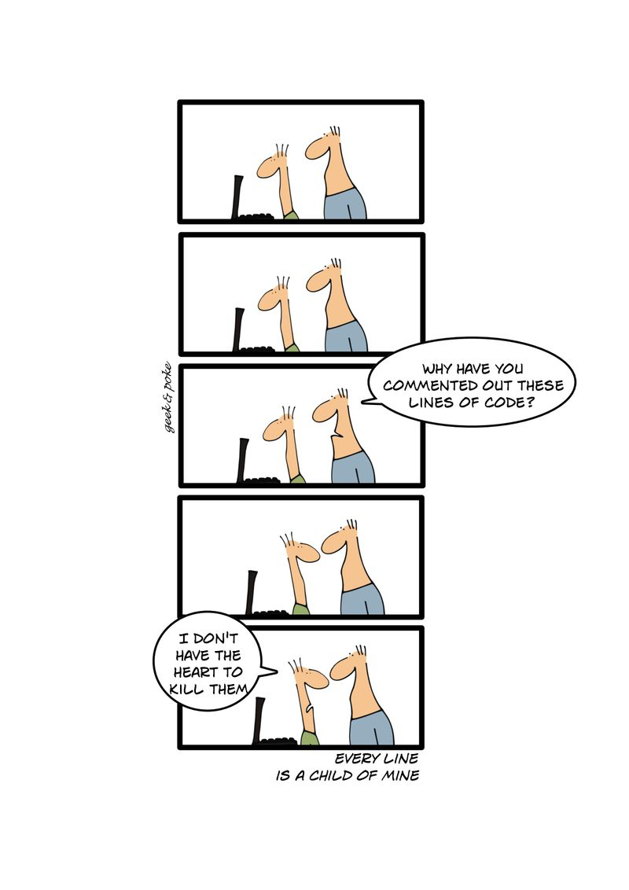
Notes:
we all know what it is
it requires changes to be made
if you never submit code, it never improves.
likewise, if we make it too hard to get approved, it never improves
on the other hand, we have to make sure code health is never decreasing

Slide 4
Why do we do them?

Slide 5
For better code.

Slide 6
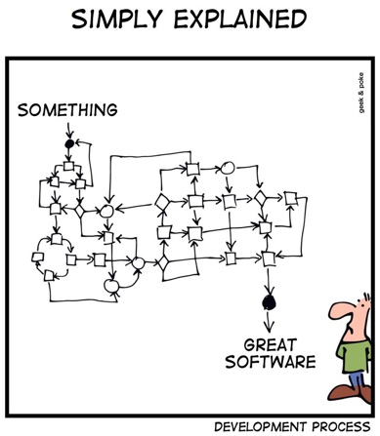
Notes:
code owners know things you don't
a fresh perspective is great

Slide 7
For better devs.
Notes:
FYI, here’s something maybe you didn’t know. Here’s a way to improve.

Slide 8
Codebases degrade through
small decreases in code health over time.
Google eng-practices

Slide 9
Who should do them?

Slide 10
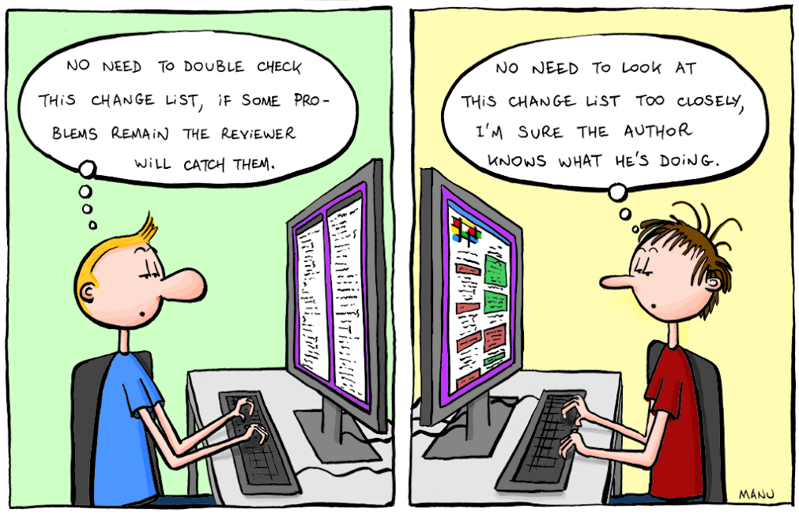
Notes:
Not this guy.

Slide 11
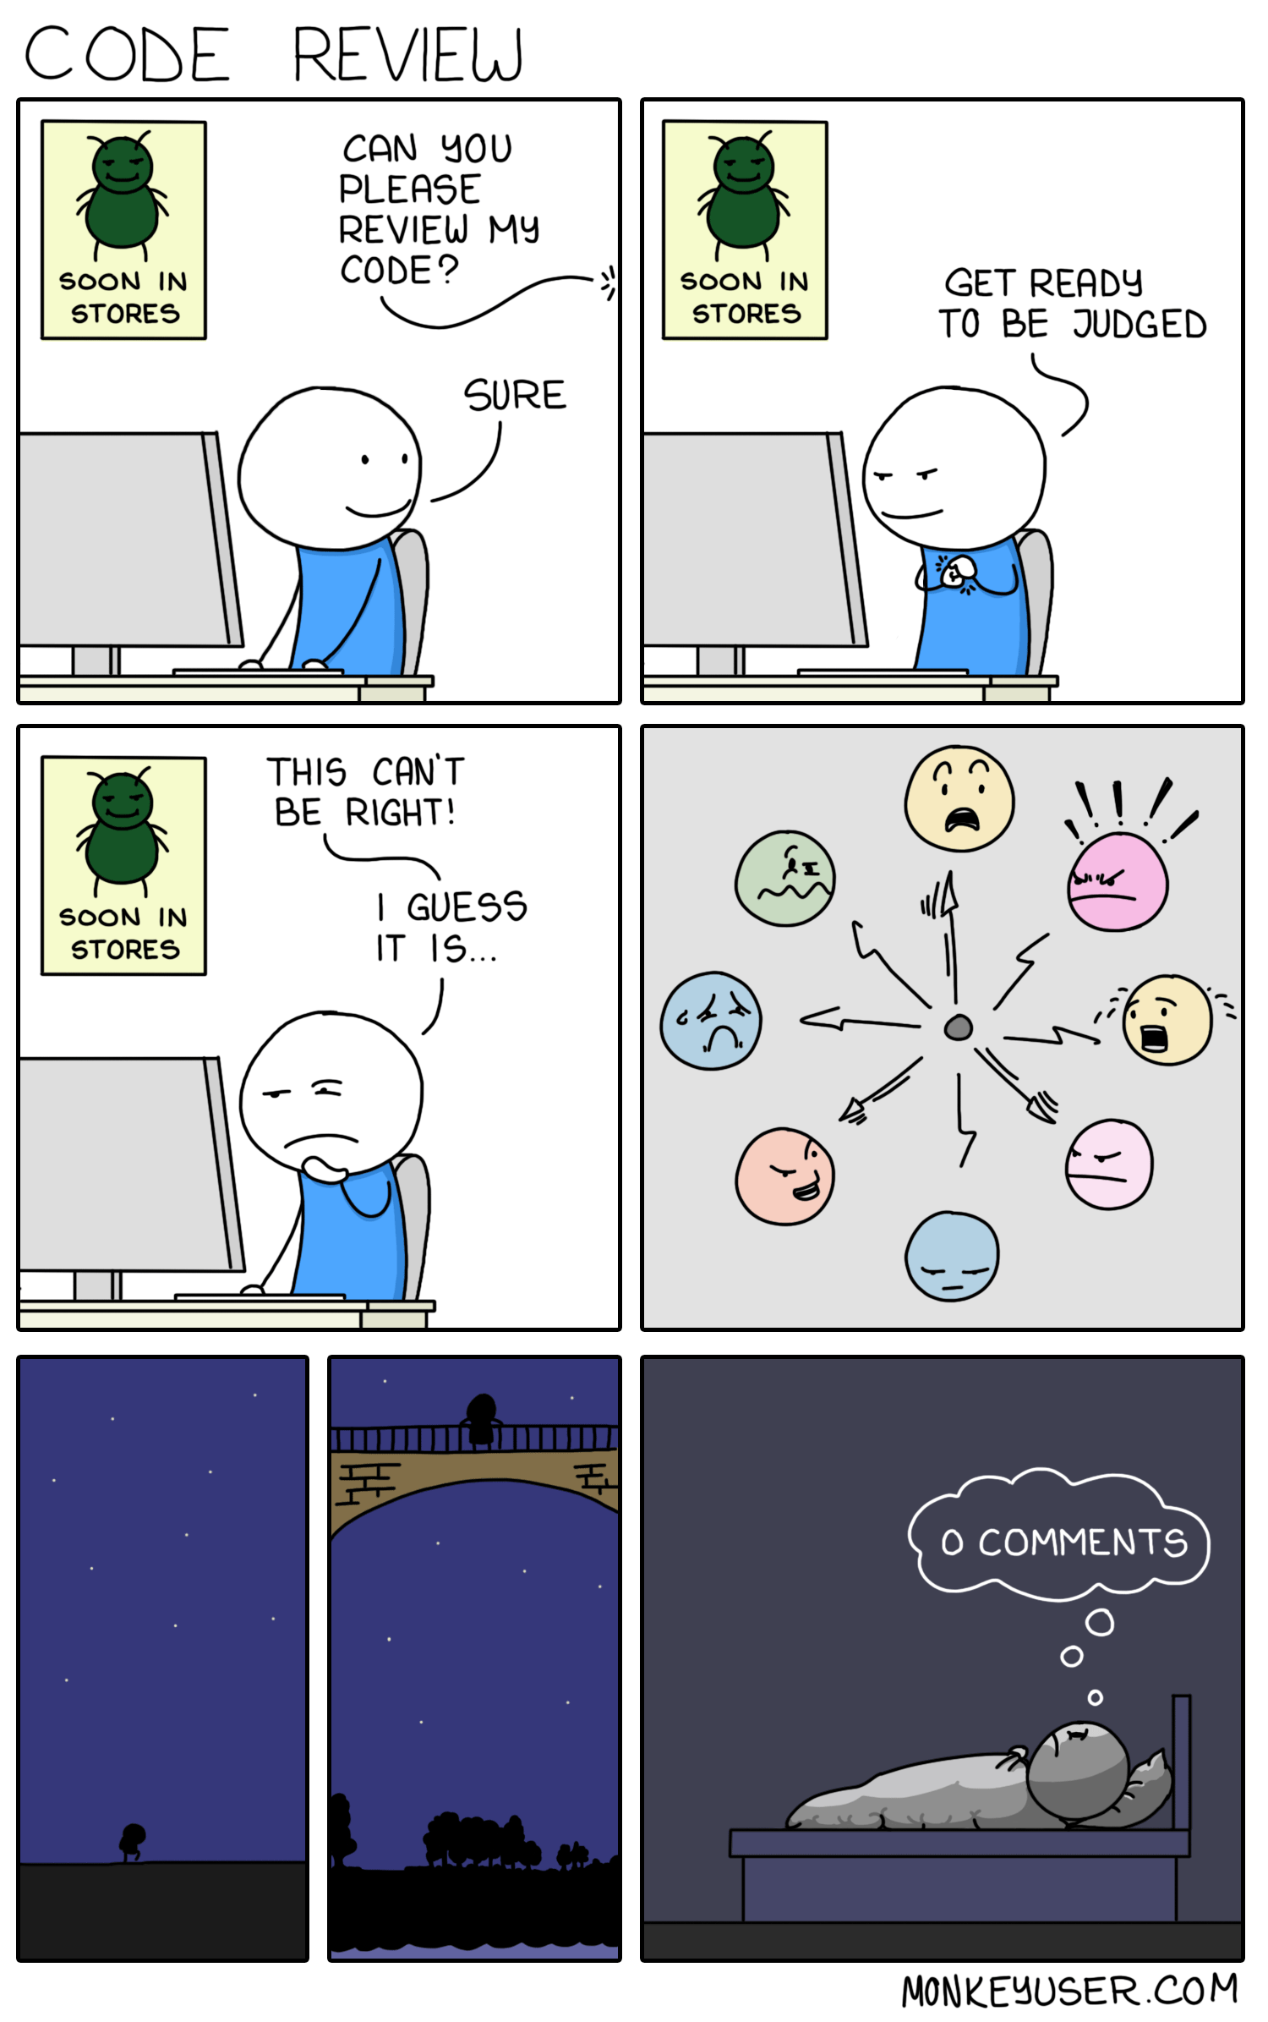
Notes:
Not this guy, either.
But I’d rather you be this guy, than the other guy
Get the best possible reviewer capable of doing it within a reasonable amount of time.
The best reviewer is the person who will be able to give you the most thorough and correct review for the piece of code you are writing.
Danielle does not have to review every PR. But if you do API things, Spanner things, BigTable things, she probably should.

Slide 12
How do I do it?

Slide 13
A reviewer has ownership and responsibility over the code they are reviewing.
Notes:
If only git blame also blamed reviewers. Cause it totally should.

Slide 14
In general, reviewers should favor approving a PR once it is in a state where it definitely improves the overall code health of the system being worked on, even if the PR isn’t perfect.
Google eng-practices
Notes:
There is no such thing as perfect code, only better code
feel free to leave 'nit's, and FYIs
We need to push to get things merged. PRs that languish in review hell (yeah, you all know), they’re worse than not writing code. It wastes the authors time, it wastes the reviewers time, and still nothing gets ship.
The most important thing, is that things get shipped. Things include bugs. We don’t like tech debt, but shipping things for the customer is better than avoiding tech debt.
Tech debt tickets, with in-code comments linking them are a great way around this.

Slide 15
Facts & data overrule opinions
On matters of style, only style guides matter
The author is the author, not you
Failing all other rules, be consistent
Principles
Notes:
The author is the author:
If the author can demonstrate (either through data or based on solid engineering principles) that several approaches are equally valid, then the reviewer should accept the preference of the author. Otherwise the choice is dictated by standard principles of software design.

Slide 16
Try to come to a consensus
Have a face to face conversation
Record the result of the conversation
Escalate
Resolving Conflicts
Notes:
Escalate to a team discussion, or a manager.

Slide 17
Design
Functionality
Complexity
Tests
Naming
Comments
Style
Documentation
What should a code reviewer look for
Notes:
Let’s go through each of these…
Non-exhaustive Checklist: https://github.com/OwletCare/platform-team-documentation/blob/master/team-standards/pull-request-checklist.md

Slide 18
Design
Does it make sense?
Does it belong?
Does it integrate?
Is now the right time?
What should a code reviewer look for
Notes:
Design: (Is the code well-designed and appropriate for your system?)
This should be brought up with someone else as early as possible. Often in a design session before a TRD is written down. Draft PRs. The worst time to find out about design flaws is at PR time.

Slide 19
Design
Functionality
Does it do what was intended?
Is the intention good for users?
Are there edge cases?
Was it demoed (if needed)?
What should a code reviewer look for
Notes:
Functionality: (Does the code behave as the author likely intended? Is the way the code behaves good for its users?)
Users are consumers and future developers
We should expect that they are tested well enough that they work, but sometimes we miss things. Think like a user. Think like a consumer. Think about exceptions. Think about race conditions. Think about security. Think about bugs.
Sometimes it's hard to tell the impact from the code. Here's looking at you frontend. Bring up and run the branch, or ask for a demo if needed.

Slide 20
Design
Functionality
Complexity
Is this code too complex?
Are classes too complex?
Are functions too complex?
Are individual lines too complex?
What should a code reviewer look for
Notes:
Complexity: (Could the code be made simpler? Would another developer be able to easily understand and use this code when they come across it in the future?)

Slide 21
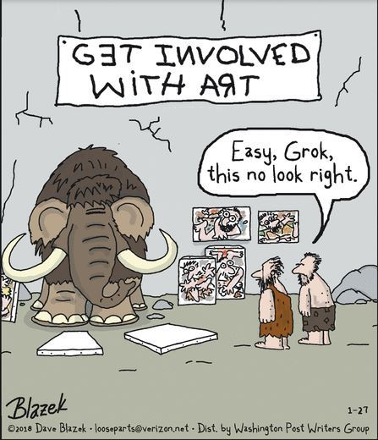
Notes:
Too complex means I should be able to GROK it.
Everyone knows what grok means?
It also could mean "developers are likely to introduce bugs when they try to call or modify this code."
Is it over-engineered?

Slide 22
Design
Functionality
Complexity
Tests
Does it have unit tests?
Remember, tests are production code.
What should a code reviewer look for
Notes:
Tests: (Does the code have correct and well-designed automated tests?)
Good tests are another topic, but generally
* Will the tests actually fail when the code is broken? I.e. Does it execute and assert the right things?
* Are the properly isolated?
* If the code changes beneath them, will they start producing false positives?
* Does each test make simple and useful assertions?
* Are the tests separated appropriately between different test methods?
Is this launching to production? Are the runscope tests ready to go? Are alerts set up?

Slide 23
Design
Functionality
Complexity
Tests
Naming
Don’t be clever
Do be searchable
Explain clearly, and succinctly
What should a code reviewer look for
Notes:
Naming: (Did the developer choose clear names for variables, classes, methods, etc.?)
DumpsterFirebase is not a good name. Understandable, but not good.
A good name is long enough to fully communicate what the item is or does,
without being so long that it becomes hard to read.

Slide 24
Design
Functionality
Complexity
Tests
Naming
Comments
What should a code reviewer look for
Notes:
Comments: (Are the comments clear and useful?)
Are they good comments?
Are they necessary?
Do they explain why, not what?
Is there a missing TODO?
A completed TODO left in?
Comments are NOT documentation

Slide 25
Design
Functionality
Complexity
Tests
Naming
Comments
Style
Google’s. Learn it. Follow it.
What should a code reviewer look for
Notes:
Style: (Does the code follow our style guides?)
We have noted acceptable exceptions. Disagree? Propose a change.
Personal style is a nit
Who here has read Google’s style guide?

Slide 26
Design
Functionality
Complexity
Tests
Naming
Comments
Style
Documentation
What should a code reviewer look for
Notes:
Documentation: (Did the developer also update relevant documentation?)
Was the README updated? (added or removed)
Do classes/methods/functions have appropriate documentation?
Is the on-call documentation up to date?
Any other external documentation.

Slide 27
K, but how do I do it?
Notes:
If you, as an author, have thought through all of that during development, and the reviewer thinks through it in review, we’re off to a great start.

Slide 28
Seek to understand
Notes:
Look at EVERY line. If you skipped it, you didn't review it.
UNDERSTAND it. If you don't understand it, you didn't review it.
If you understand it, but don't feel qualified to review it, bring it up.
The next person that comes along should be able to grok it. And if they can’t, that absolutely MUST be able to figure it out.
If you can't understand it, there's a good chance neither will someone else. Bring it up.

Slide 29
Look for context.
Notes:
Look at the context around code you’re reviewing. Sometimes you'll need to look at code not in the diff. Sometimes files that are not included. Sometimes third part code or documentation.
For example, you might see only four new lines being added, but when you look at the whole file, you see those four lines are in a 50-line method that now really needs to be broken up into smaller methods.

Slide 30
Look for good things.
Notes:
Call them out. Code reviews focus on mistakes or improvements, but they should offer encouragement as well.

Slide 31
Don’t accept PRs that degrade the code health of the system.
Notes:
Don’t author code that degrades the health of the system. Bias to approve, but system health should improve.
If we have an API that now handles widgets in addition to doohickeys, but there’s a theoretical bug, please note it, ask for improvement, but balance blocking with the value of getting it in customers hands.
If that bug would bring down the system, or destroy the widgets, yeah, block that.
It’s an art, not a science.

Slide 32
The code is well-designed.
The functionality is good for the users of the code.
Any UI changes are sensible and look good.
The code isn’t more complex than it needs to be.
The developer isn’t implementing things they might need in the future but don’t know they need now.
Code has appropriate unit tests.
Tests are well-designed.
The developer used clear names for everything.
Comments are clear and useful, and mostly explain why instead of what.
Code is appropriately documented.
The code conforms to our style guides.
A code review should make sure that

Slide 33
Yeah… but HOW?

Slide 34
High level overview
Examine the main parts
Evaluate the rest
The 3 steps:

Slide 35
High level overview
Examine the main parts
Evaluate the rest
The 3 steps:
Notes:
Read the description. Is this change something we're after?

Slide 36
High level overview
Examine the main parts
Evaluate the rest
The 3 steps:
Notes:
A PR should have a pretty visible MAINness. If not, it might not have been properly split.
Are there any design issues?
If you see design issues here, send those for review first, even if you can't get to the rest

Slide 37
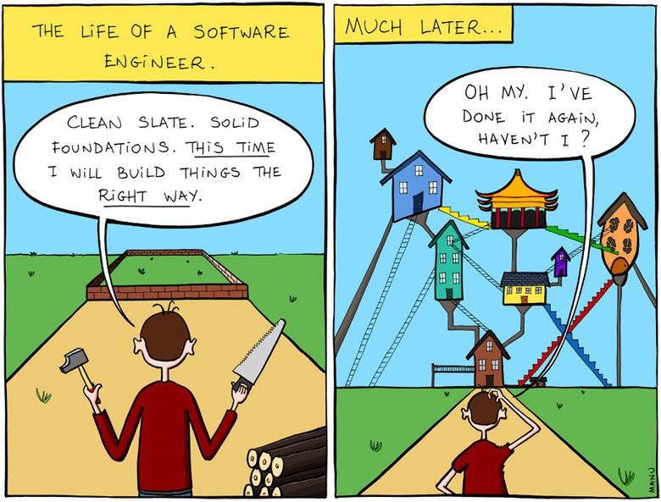
Notes:
Most importantly

Slide 38
High level overview
Examine the main parts
Evaluate the rest
The 3 steps:
Notes:
Main parts look good, time to pull out the nit fork

Slide 39
Speed is important
Notes:
* The velocity of the team as a whole is decreased.
* Developers start to protest the code review process.
* Code health can be impacted. (refactors are discouraged, etc.)
Last time we talked about this, we were here. We’re still here.
I care a lot about quality, but ultimately quality that isn’t in customers hands is worthless.

Slide 40
1 business day.
Notes:
PR reviews should be returned within 1 business day. i.e. first thing tomorrow morning.
Focus > speed. Dont’ drop what you’re doing if you’re focused. Do if you’re not.
speed = response time, not time to complete.
if you can't get to it, let the dev know

Slide 41
Large PRs should be split.
Notes:
If it will take too long to review, ask for it to be split.
If it can't be split, do a quick 1st pass.

Slide 42
Speed improves over time.
Notes:
If we consistently follow these guidelines and are strict with our code reviews, the entire code review process tends to go faster and faster over time.
We learn what is required for healthy code, and send PRs that are great from the start, requiring less and less review time.
Reviewers learn to respond quickly and not add unnecessary latency into the review process.

Slide 43
PR Comments

Slide 44
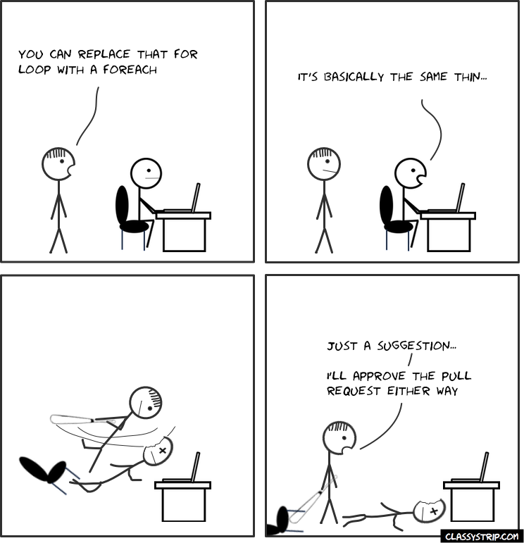
Notes:
No.

Slide 45
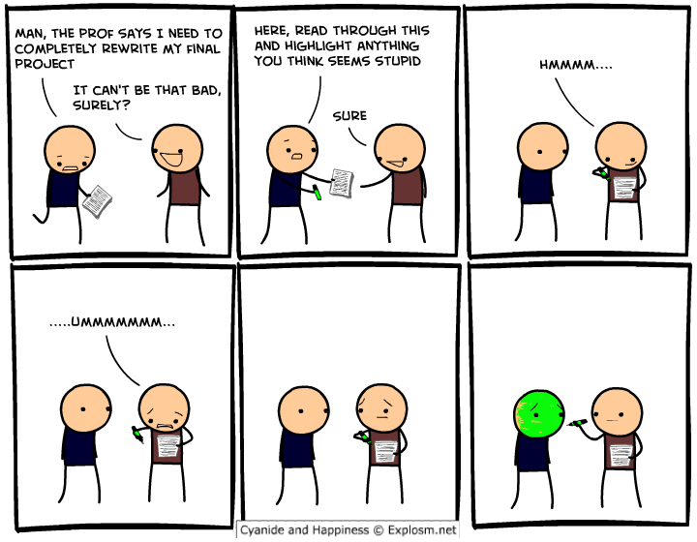
Notes:
No.

Slide 46
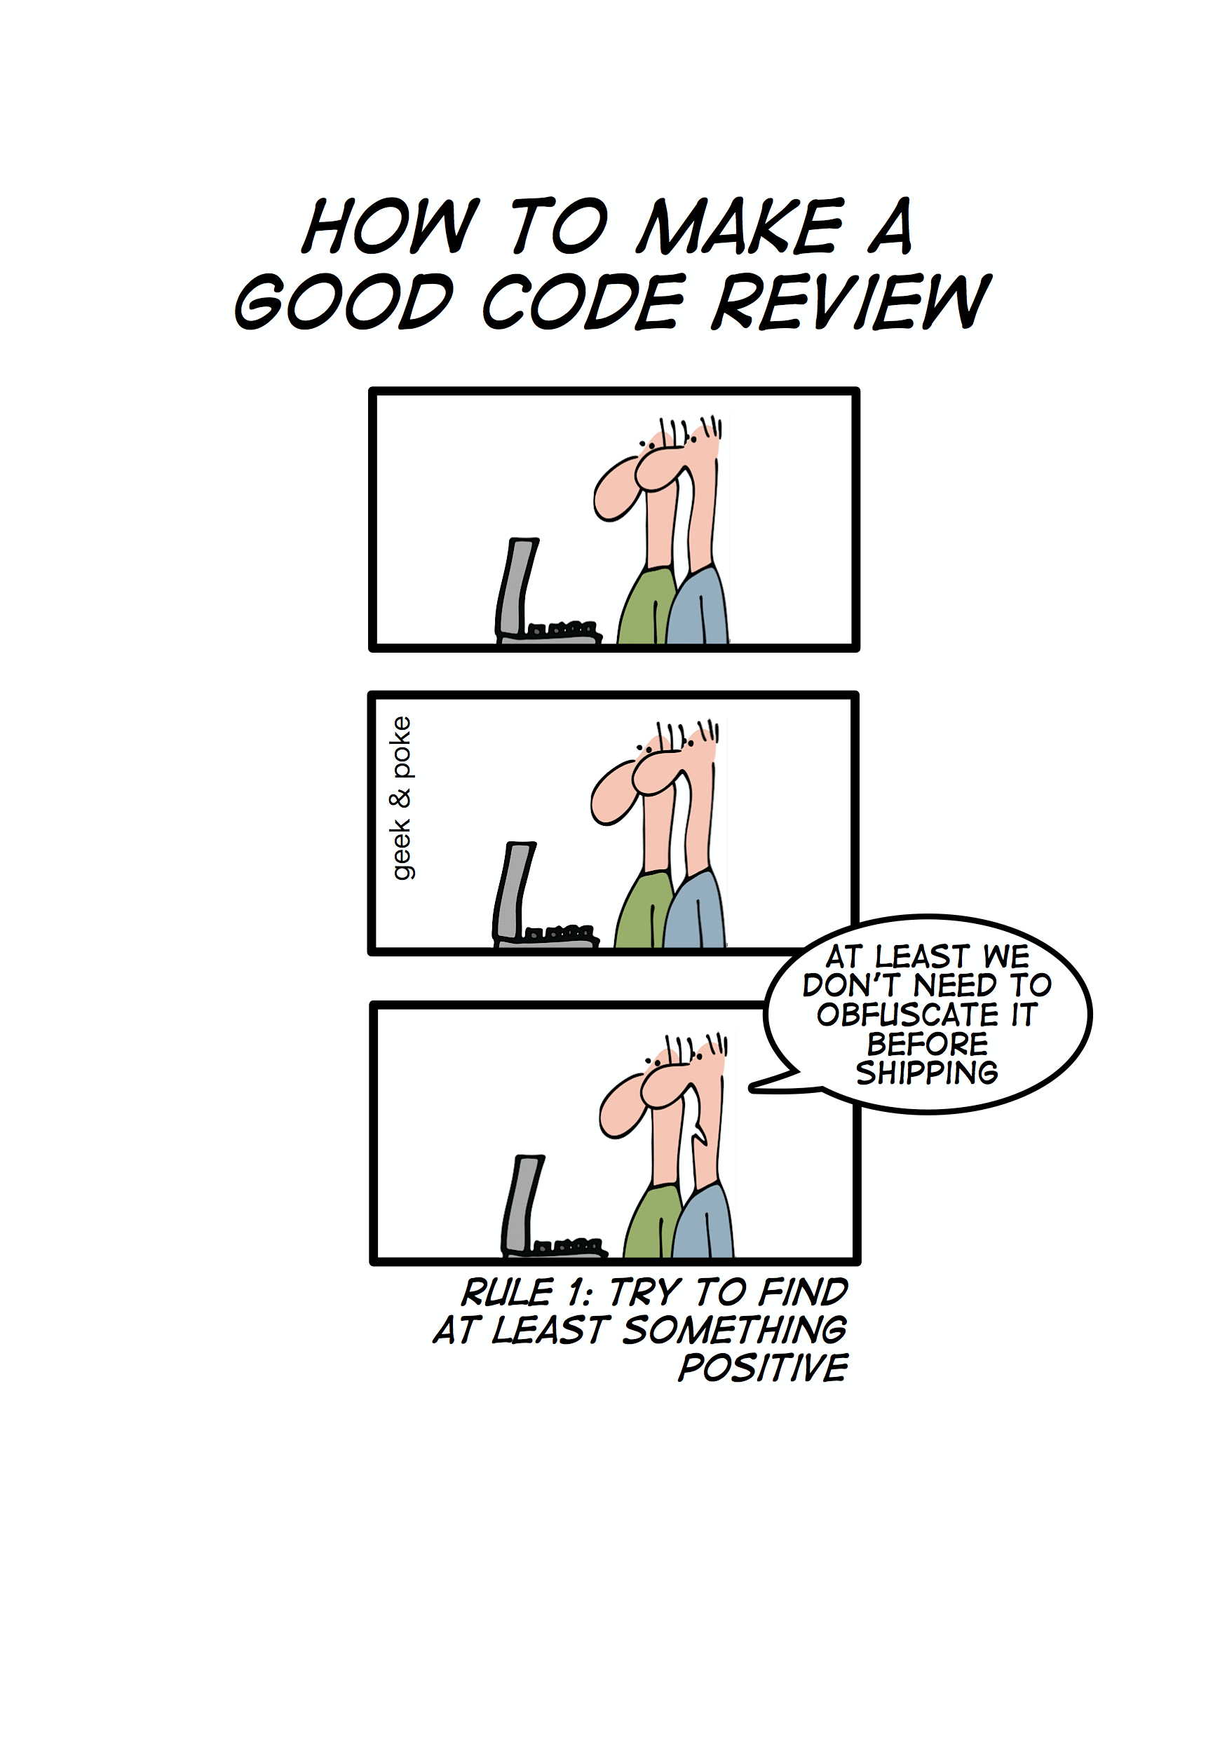
Notes:
Yeah, maybe.

Slide 47
PR reviews are not about the developer, they are about the code.
Notes:
* Be kind
* Explain your reasoning.
* Balance directions, with letting the dev decide. (Balance giving explicit directions with just pointing out problems and letting the developer decide.)
* Explanation should be explained by code or comments.

Slide 48
Be Kind
Explain your reasoning.
Balance directions, with letting the dev decide.
Explanation should be explained by code or comments.
PR Comments
Notes:
Bad: “Why did you use threads here when there’s obviously no benefit to be gained from concurrency?”
Good: “The concurrency model here is adding complexity to the system without any actual performance benefit that I can see. Because there’s no performance benefit, it’s best for this code to be single-threaded instead of using multiple threads.”

Slide 49
Be Kind
Explain your reasoning.
Balance directions, with letting the dev decide.
Explanation should be explained by code or comments.
PR Comments
Notes:
Don’t just give a statement. Give a reason. Or point to the style guide. Explain yourself.

Slide 50
Be Kind
Explain your reasoning.
Balance directions, with letting the dev decide.
Explanation should be explained by code or comments.
PR Comments
Notes:
In general it is the developer’s responsibility to fix a PR, not the reviewer’s
But be helpful and offer suggestions. Find a balance.

Slide 51
Be Kind
Explain your reasoning.
Balance directions, with letting the dev decide.
Explanation should be explained by code or comments.
PR Comments
Notes:
Developer explanations should result in code changes (code written more clearly) or documentation.
code review comments don't help future devs.

Slide 52
It’s okay to push back.
Notes:
Is ok. Maybe it's correct. Take time to explain.
Temporary changes are permanent. Changes asked for in PR review should be fixed, or have a TODO added, and be returned to immediately.

Slide 53
If you previously had fairly lax code reviews and you switch to having strict reviews, some developers will complain very loudly. Improving the speed of your code reviews usually causes these complaints to fade away.
Sometimes it can take months for these complaints to fade away, but eventually developers tend to see the value of strict code reviews as they see what great code they help generate. Sometimes the loudest protesters even become your strongest supporters once something happens that causes them to really see the value you’re adding by being strict.
Google eng-practices
Notes:
Just gonna read this direct from google’s eng-practices.

Slide 54
Writing a good PR

Slide 55
Write a good description.
Notes:
We have guidelines for that!
Review it before merge.

Slide 56
Reviewed more quickly.
Reviewed more thoroughly.
Less likely to introduce bugs.
Less wasted work if they are rejected.
Easier to merge.
Easier to design well.
Less blocking on reviews.
Simpler to roll back.
Keep it small
Notes:
Reviewed more quickly.
(It’s easier for a reviewer to find five minutes several times to review small PRs than to set aside a 30 minute block to review one large PR.)
Reviewed more thoroughly.
(With large changes, reviewers and authors tend to get frustrated by large volumes of detailed commentary shifting back and forth—sometimes to the point where important points get missed or dropped.
Less likely to introduce bugs.
(Since you’re making fewer changes, it’s easier for you and your reviewer to reason effectively about the impact of the PR and see if a bug has been introduced.
Less wasted work if they are rejected.
(If you write a huge PR and then your reviewer says that the overall direction is wrong, you’ve wasted a lot of work.
Easier to merge.
(Working on a large PR takes a long time, so you will have lots of conflicts when you merge, and you will have to merge frequently.
Easier to design well.
(It’s a lot easier to polish the design and code health of a small change than it is to refine all the details of a large change.
Less blocking on reviews.
(Sending self-contained portions of your overall change allows you to continue coding while you wait for your current PR in review.
Simpler to roll back.
(A large PR will more likely touch files that get updated between the initial PR submission and a rollback PR, complicating the rollback (the intermediate PRs will probably need to be rolled back too).

Slide 57
Reviewers can reject a PR based on size alone.
Notes:
What does small mean?
small = 1 self-contained change.
While I’m in here, I should probably… submit a new PR.

Slide 58
Don’t Take it Personally
Fix the code
Think for yourself
Resolve any conflict
Handling PR comments
Notes:
Think to yourself, is the reviewer correct?
Don’t understand? Ask to clarify.
Disagree? Offer pushback.

Slide 59
This is not a review of you. It's a review of code.
Notes:
Equally, you’re not reviewing the engineer, you’re reviewing the code.

Slide 60
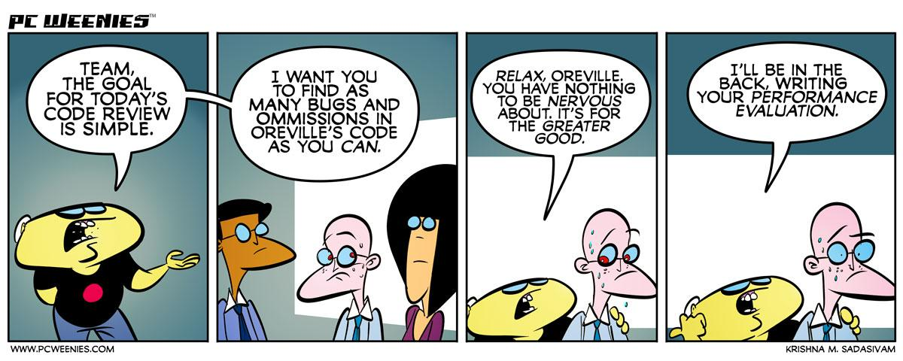

Slide 61
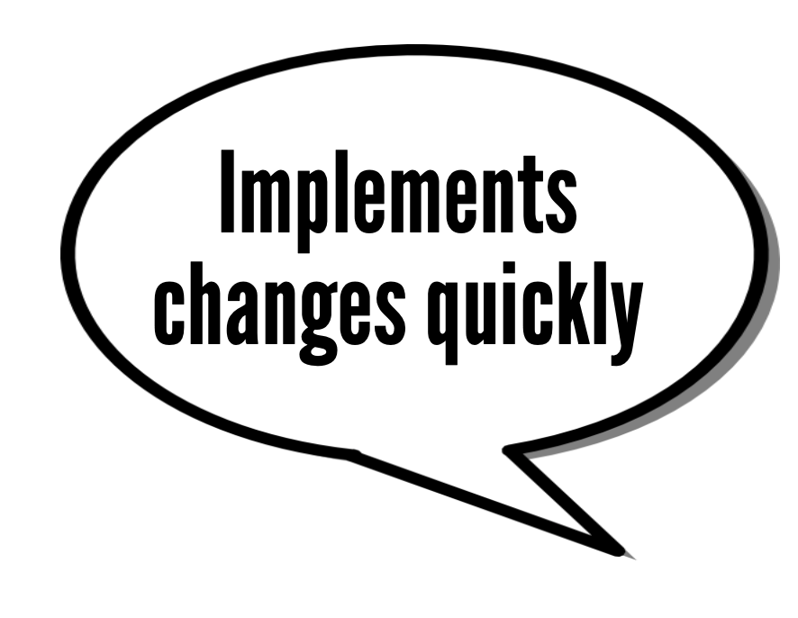
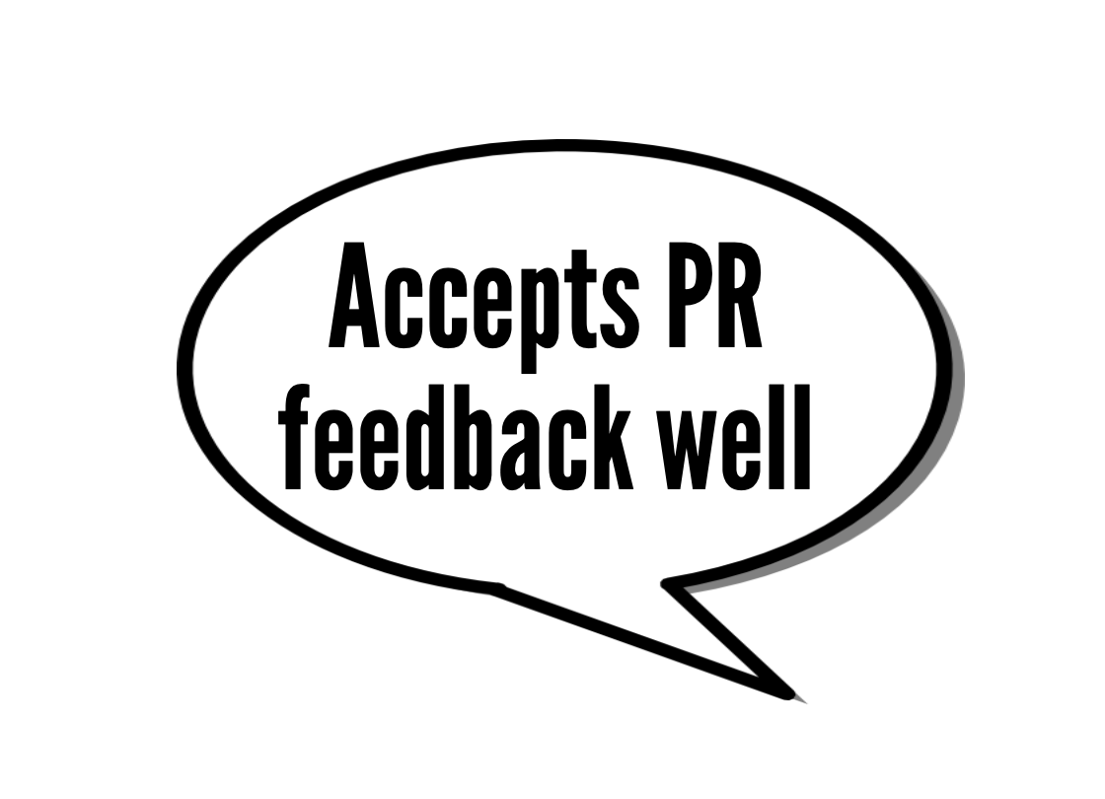

Slide 62
http://geek-and-poke.com/geekandpoke/2009/11/25/every-line-is-a-child-of-mine.html
http://geek-and-poke.com/geekandpoke/2012/1/28/simply-explained.html
https://www.monkeyuser.com/2019/code-review/
https://www.gocomics.com/looseparts
http://explosm.net
http://geek-and-poke.com/geekandpoke/2010/11/1/how-to-make-a-good-code-review.html
https://pcweenies.com/comic/oreville-and-bugs/
https://google.github.io/eng-practices/
Sources

Slide 63
Thank You

