Slide 1

SA FINAL PROJECT
Group-Members
Ghidiom Nughusse
Meron Tedros
Samuel Melake
Yafet Weldegabir

Slide 2
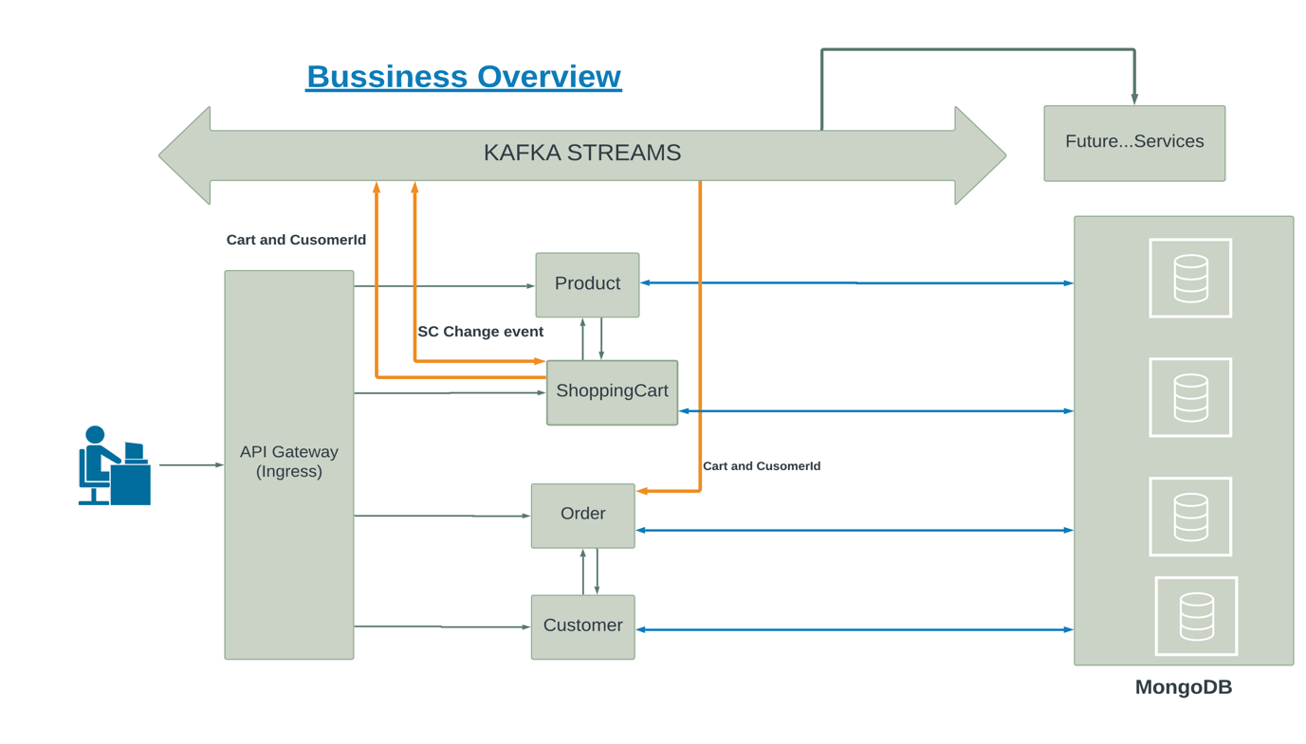

Slide 3
What would we do different?
Redis: for frequently searched product, shopping-cart
Elastic Search: for searching product using any related data of a product
Security: between microservices and client side
Add shipping, Product-Review and payment microservices
Add CI-CD: Jenkins

