Slide 1
Bayesian Modelling for Observational Data Workshop for the R Peer Mentoring Group
Gidon Frischkorn (with special thanks to Philipp Musfeld)
Spring Term 2024

Slide 2

Today’s Agenda
Introduction: Logic of Bayesian Statistics & Bayes Rule
Marcov-Chain Monte Carlo (MCMC) sampling – Why?
--- Break ---
Bayesian Regression Models using Stan (brms)
Statistical Inference in Bayesian Models
--- Break ---
Practical Exercises

Slide 3
Today’s Agenda
Introduction: Logic of Bayesian Statistics & Bayes Rule
What is the difference between a Bayesian and a Frequentist?
Unpacking Bayes Rule
Marcov-Chain Monte Carlo (MCMC) sampling – Why?
Bayesian Regression Models using Stan (brms)
Statistical Inference in Bayesian Models
Practical Exercises

Slide 4
1. What is the difference between a Bayesian and a Frequentist?
Frequentist | Bayesian
A hypothesis is either true or false | Hypothesis are probably true or false
We can discover truth with sufficiently large samples & large number of experimentes | We update our beliefs (i.e. the probabilities) in hypothesis by collecting data
Quantifies the probability of observing data or more extreme data assuming the null hypothesis is true | Quantifies the probability of a hypothesis being true given the observed data
Computationally inexpensive and very quick | Computationally expensive and slow (sometimes really slow…)

Slide 5
1. What is the difference between a Bayesian and a Frequentist?
A short thought experiment
We have designed a test for evaluating if a person is a genius. The test detects geniuses with 99% accuracy and provides negative results for normal people with 99.5% accuracy.
We tested a random person at Zurich HB and the result indicated that the tested person is a genius. What do we conclude?
Frequentist
Assuming the person is no genius (H₀), the result has a probability of 0.5% (p = .005), therefore the person is a genius ☺
Bayesian
→ I do not know; I need more information…

Slide 6
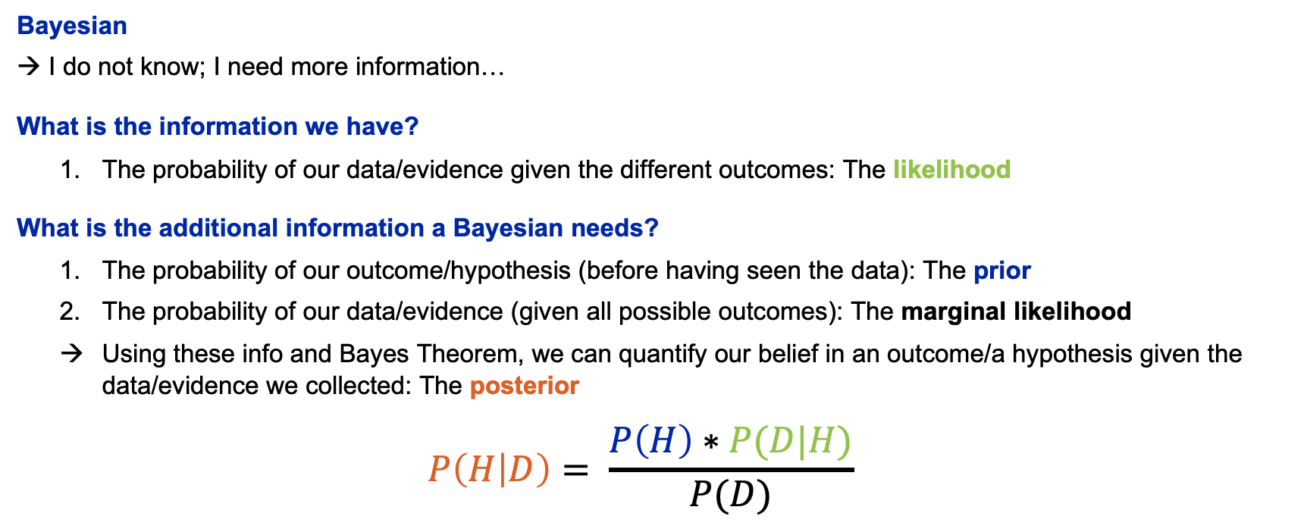
1. What is the difference between a Bayesian and a Frequentist?
Short thought experiment
We have designed a test for evaluating if a person is a genius. The test detects geniuses with 99% accuracy and provides negative results for normal people with 99.5% accuracy.
We tested a random person at Zurich HB and the result indicated that the tested person is a genius. What do we conclude?
Bayesian
→ I do not know; I need more information…
What is the information we have?
The probability of our data/evidence given the different outcomes: The likelihood
What is the additional information a Bayesian needs?
The probability of our outcome/hypothesis (before having seen the data): The prior
The probability of our data/evidence (given all possible outcomes): The marginal likelihood
Using these info and Bayes Theorem, we can quantify our belief in an outcome/a hypothesis given the data/evidence we collected: The posterior
$$P\left(H | D\right)= \frac{P\left(H\right)∗P(D|H)}{P(D)}$$
$$P\left(D\right)=P\left(H\right)∗P\left(D | H\right)+P\left(\text{¬}H\right)∗P\left(D\right|\text{¬}H)$$

Slide 7

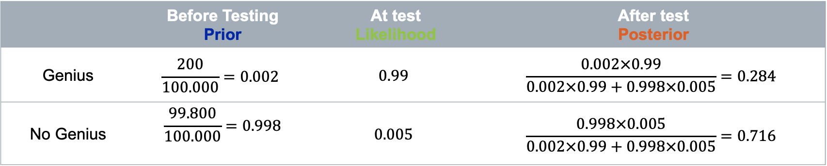
1. What is the difference between a Bayesian and a Frequentist?
Short thought experiment
We have designed a test for evaluating if a person is a genius. The test detects geniuses with 99% accuracy and provides negative results for normal people with 99.5% accuracy.
We tested a random person at Zurich HB and the result indicated that the tested person is a genius. What do we conclude?
Some additional assumptions:
- In 100.000 people there are about 200 geniuses.
$$P\left(H | D\right)= \frac{P\left(H\right)∗P(D|H)}{P(D)}$$
 | Before Testing Prior | At test Likelihood | After test Posterior
Genius | $$\frac{200}{100.000}=0.002$$ | $$0.99$$ | $$\frac{0.002×0.99}{0.002×0.99+0.998×0.005}=0.284$$
No Genius | $$\frac{99.800}{100.000}=0.998$$ | $$0.005$$ | $$\frac{0.998×0.005}{0.002×0.99+0.998×0.005}=0.716$$

Slide 8
1. What is the difference between a Bayesian and a Frequentist?
What are your questions?

Slide 9
1. What is the difference between a Bayesian and a Frequentist?
A short exercise
A shop for magicians' supplies sells fair and trick coins. The trick coins can be biased towards showing tails or heads in 80% of the flips. A friend got you a coin from this shop but did not tell you if it was fair or a trick coin.
So now we must find out for yourselves. The following steps should help:
Specify prior beliefs what kind of coin you might have
Find a distribution to simulate a coin flip given a certain probability
Simulate data for 5 flips for a coin randomly sampled from all possible outcomes
Evaluate how likely your results are given that the coin is fair or a trick coin
Use these likelihoods to update your prior beliefs
Repeat steps 3. to 5. for another 5 flips and update your belief again.

Slide 10
Today’s Agenda
Introduction: Logic of Bayesian Statistics & Bayes Rule
Marcov-Chain Monte Carlo (MCMC) sampling – Why?
What is a Sampler and why do we need them?
How does a (simple) sampler work?
Bayesian Regression Models using Stan (brms)
Statistical Inference in Bayesian Models
Practical Exercises

Slide 11
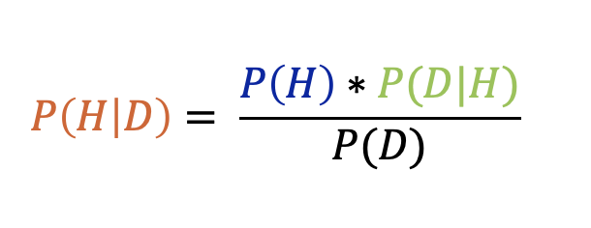
2. Marcov-Chain Monte Carlo (MCMC) sampling – Why? What is a Sampler and why do we need them?
Prior
Posterior
Likelihood
Marginal Likelihood
Often, we don’t know this. But why?

Slide 12
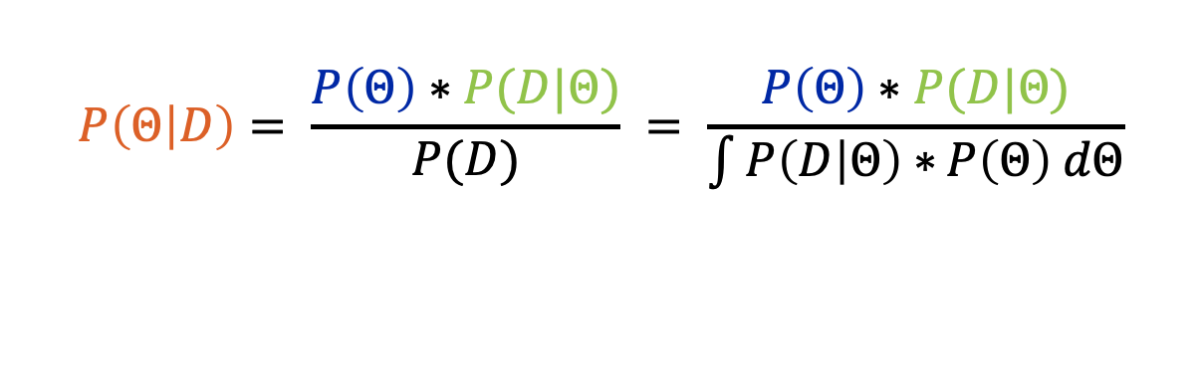
2. Marcov-Chain Monte Carlo (MCMC) sampling – Why? What is a Sampler and why do we need them?
Marginal Likelihood:
The Probability of generating the observed data for ALL possible values of the model parameters
In more technical terms: The Likelihood function when integrating over the whole parameter space
$$P\left(Θ | D\right)= \frac{P\left(Θ\right)∗P(D|Θ)}{P(D)} = \frac{P\left(Θ\right)∗P(D|Θ)}{\int{P\left(D | Θ\right)∗}P\left(Θ\right) dΘ}$$
In more practical terms: A constant which normalizes the Posterior distribution to make it a proper probability distribution (the area under the distribution has to integrate to 1)

Slide 13
2. Marcov-Chain Monte Carlo (MCMC) sampling – Why? What is a Sampler and why do we need them?
Example 1: Discrete space of possible parameter values: We have designed a test for evaluating if a person is a genius. The test detect geniuses with 99% accuracy and provides negative results for normal people with 99.5% accuracy.
We tested a random person at Zurich HB and the result indicated that the tested person is a genius. What do we conclude?
$$P\left(G | T=1\right)= \frac{P\left(Genius=1\right)∗P(Test=1|Genius=1)}{P(D)}$$
$$P\left(G | T=1\right)=\frac{P\left(G=1\right)∗P(T=1|G=1)}{P\left(T=1 | G=1\right)∗P\left(G=1\right)+P\left(T=1 | G=0\right)∗P\left(G=0\right)}$$

Slide 14
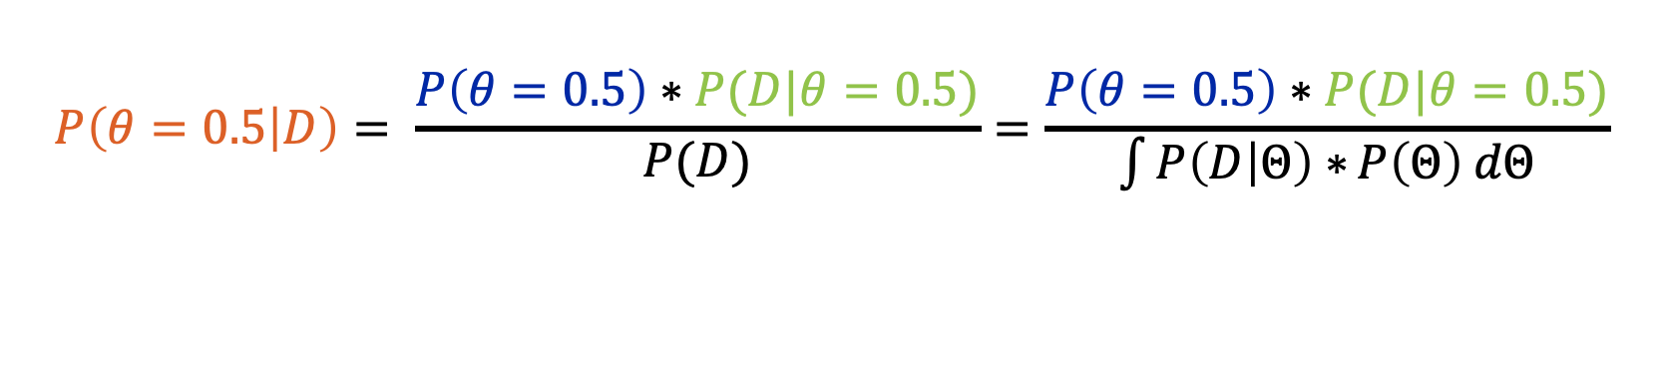
2. Marcov-Chain Monte Carlo (MCMC) sampling – Why? What is a Sampler and why do we need them?
Example 2: Continuous space of possible parameter values: We got a coin from a magician supply store. We have no idea whether the coin is fair, whether is has a bias, nor how big the bias could be. Thus, the probability 𝜃 for throwing heads could be any value between 0 and 1.
$$P\left(θ=0.5 | D\right)= \frac{P\left(θ=0.5\right)∗P(D|θ=0.5)}{P(D)}=\frac{P\left(θ=0.5\right)∗P(D|θ=0.5)}{\int{P\left(D | Θ\right)∗}P\left(Θ\right) dΘ}$$
→ To know the marginal likelihood, we must integrate the likelihood function over the continuous parameter space

Slide 15
2. Marcov-Chain Monte Carlo (MCMC) sampling – Why? What is a Sampler and why do we need them?
What does a Sampler do?
The marginal likelihood is a normalization constant. It is required to make the posterior distribution a proper probability distribution
Without knowing the marginal likelihood, we can still obtain the unnormalized posterior distribution:
$unP\left(Θ | D\right)=P\left(θ\right)∗P(D|Θ)$ or $P\left(Θ | D\right)∝P\left(θ\right)∗P(D|Θ)$
The unnormalized posterior distribution has the exact same shape as the normalized posterior distribution (just on a different scale)
By drawing a large number of samples from the unnormalized posterior distribution, we can approximate the normalized posterior distribution, without knowing the marginal likelihood
→ This is what a sampler does: It draws samples from the unnormalized posterior distribution to approximate the normalized posterior distribution, while ignoring the marginal likelihood

Slide 16
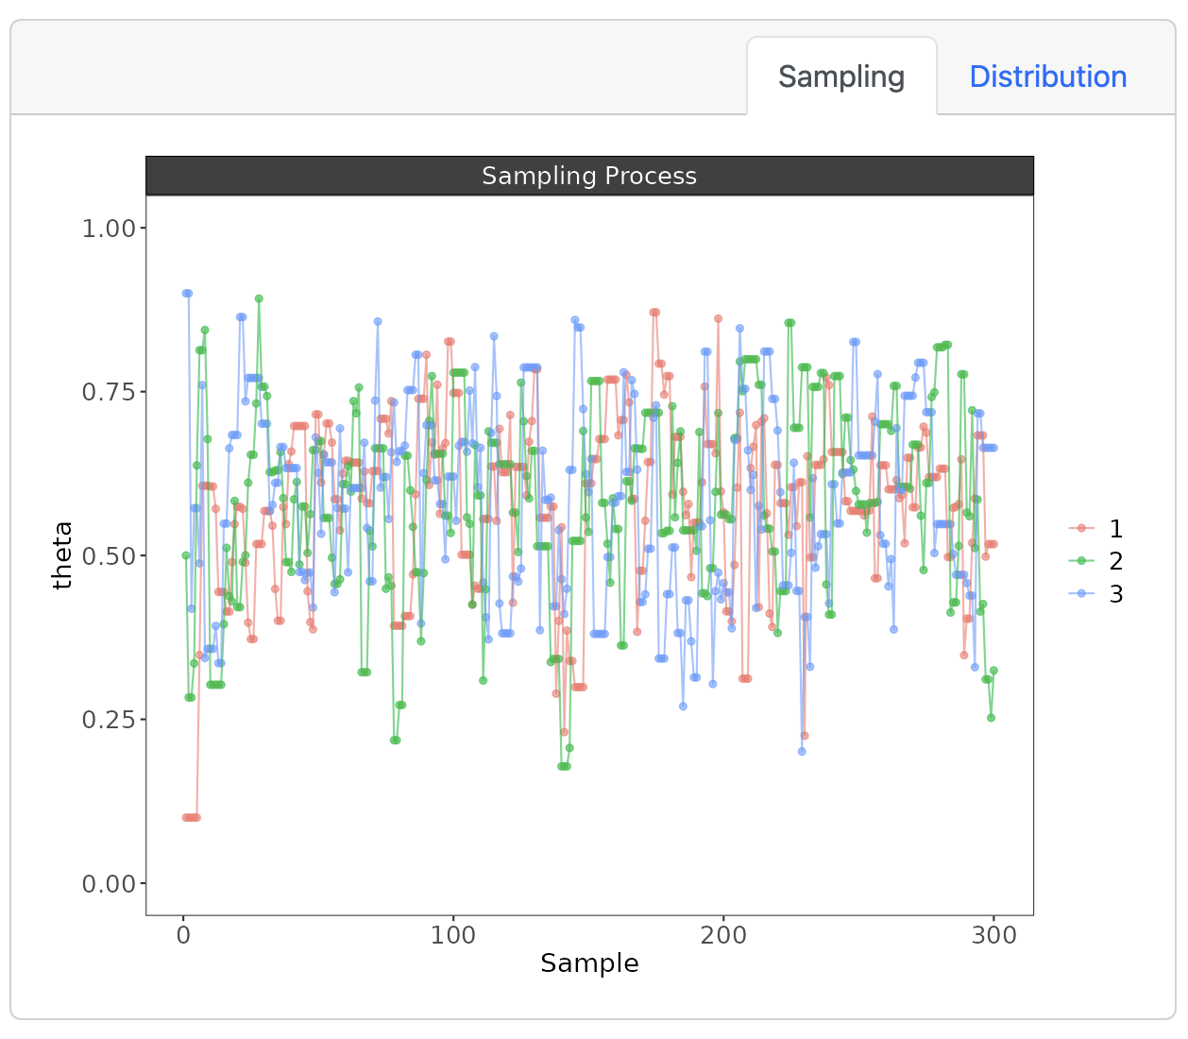
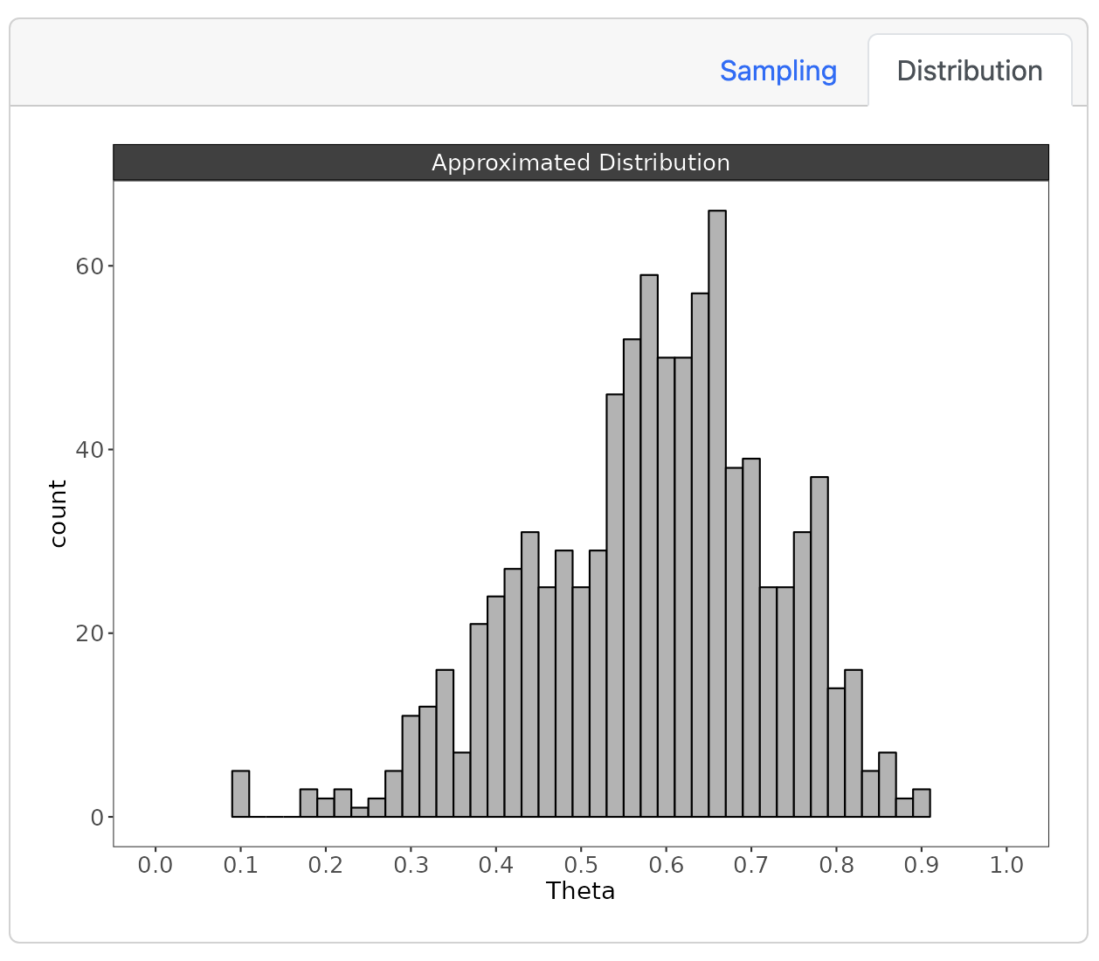
2. Marcov-Chain Monte Carlo (MCMC) sampling – Why? How does a (simple) sampler work?
Let’s have a look at an example: https://pmusfeld.shinyapps.io/Bayesian_Posterior_Sampling/

Slide 17
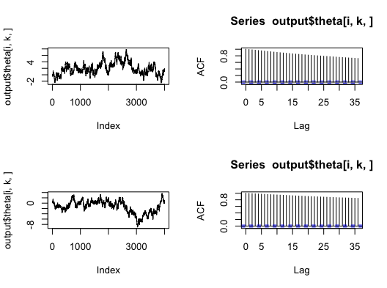
2. Marcov-Chain Monte Carlo (MCMC) sampling – Why? How does a (simple) sampler work?
Checking if sampling was successful
Convergence
did all chains (that started from different values) arrive at the same parameter estimate
R-hat = ratio of within chain variance / between chain variance → 1.00
Auto-Correlation / Effective Sample size
How strongly are samples correlated with the previous sampling steps → ideally this should be low
Effective Sample size = number of samples adjusted for auto-correlation between sampling steps
Other convergence issues (specific to the sampler in STAN
Divergent transitions = unusually large jumps during sampling (bad!)
reaching the maximum treedepth
→ Can be accommodated by adjusting sampler settings

Slide 18
2. Marcov-Chain Monte Carlo (MCMC) sampling – Why?
What are your questions?

Slide 19
Today’s Agenda
Introduction: Logic of Bayesian Statistics & Bayes Rule
Marcov-Chain Monte Carlo (MCMC) sampling – Why?
Bayesian Regression Models using Stan (brms)
A short intro to probabilistic models
brms: An easy way to specify (almost) any model
Statistical Inference in Bayesian Models
Practical Exercises

Slide 20
3. Bayesian Regression Models using Stan (brms) A short intro to probabilistic models
A short intro to probabilistic models
provides a formalized story of where the data can stem from
An example: We want to compare if the food portions handed out by Dora are smaller or larger than the portions handed out by Mario. To do so, we collect a random sample of portions by both Dora & Mario and compare them.
What do we need to know for specifying a formalized model for this example?
The type of observation we make → weight, volume, count (a continuous positive variable)
data generating process → some form of distribution
Parameters → the variables determining the shape and location of the distribution

Slide 21
3. Bayesian Regression Models using Stan (brms) A short intro to probabilistic models
Some background info on notation
Observed/random variables are denoted with Latin letters: X, Y, etc.
Parameters are denoted with Greek letters: μ, σ, λ
Distributions are denoted with short acronyms: 𝒩 (Normal distribution) or ℬ (Bernoulli, Binomial distribution)
The ~ denotes that something «stems» or «is drawn» from a distribution, for example:
X ~ 𝒩(μ, σ)
means, the random variable X follows a normal distribution with a mean μ and a standard deviation σ.

Slide 22
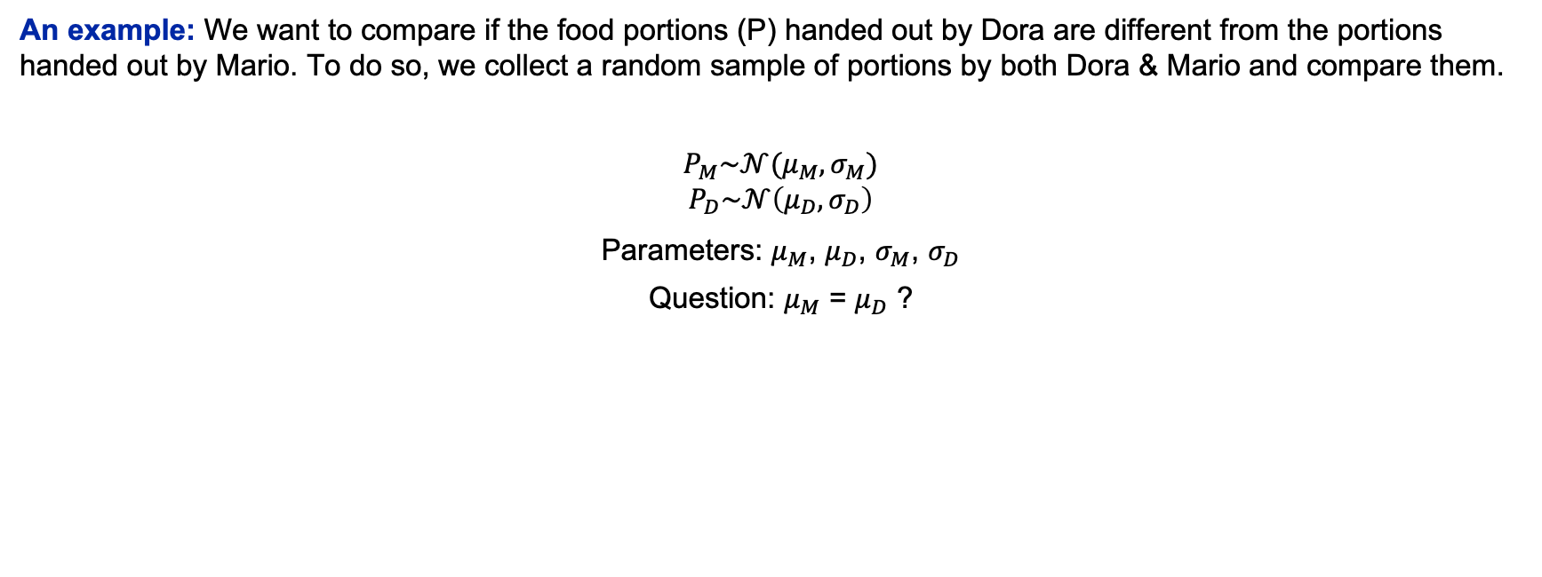
3. Bayesian Regression Models using Stan (brms) A short intro to probabilistic models
An example: We want to compare if the food portions (P) handed out by Dora are different from the portions handed out by Mario. To do so, we collect a random sample of portions by both Dora & Mario and compare them.
$P_{M}\sim 𝒩(μ_{M},σ_{M})$
$$P_{D}\sim 𝒩\left(μ_{D},σ_{D}\right)$$
Parameters: $μ_{M}$, $μ_{D}$, $σ_{M}$, $σ_{D}$
Question: $μ_{M}$ = $μ_{D}$ ?

Slide 23
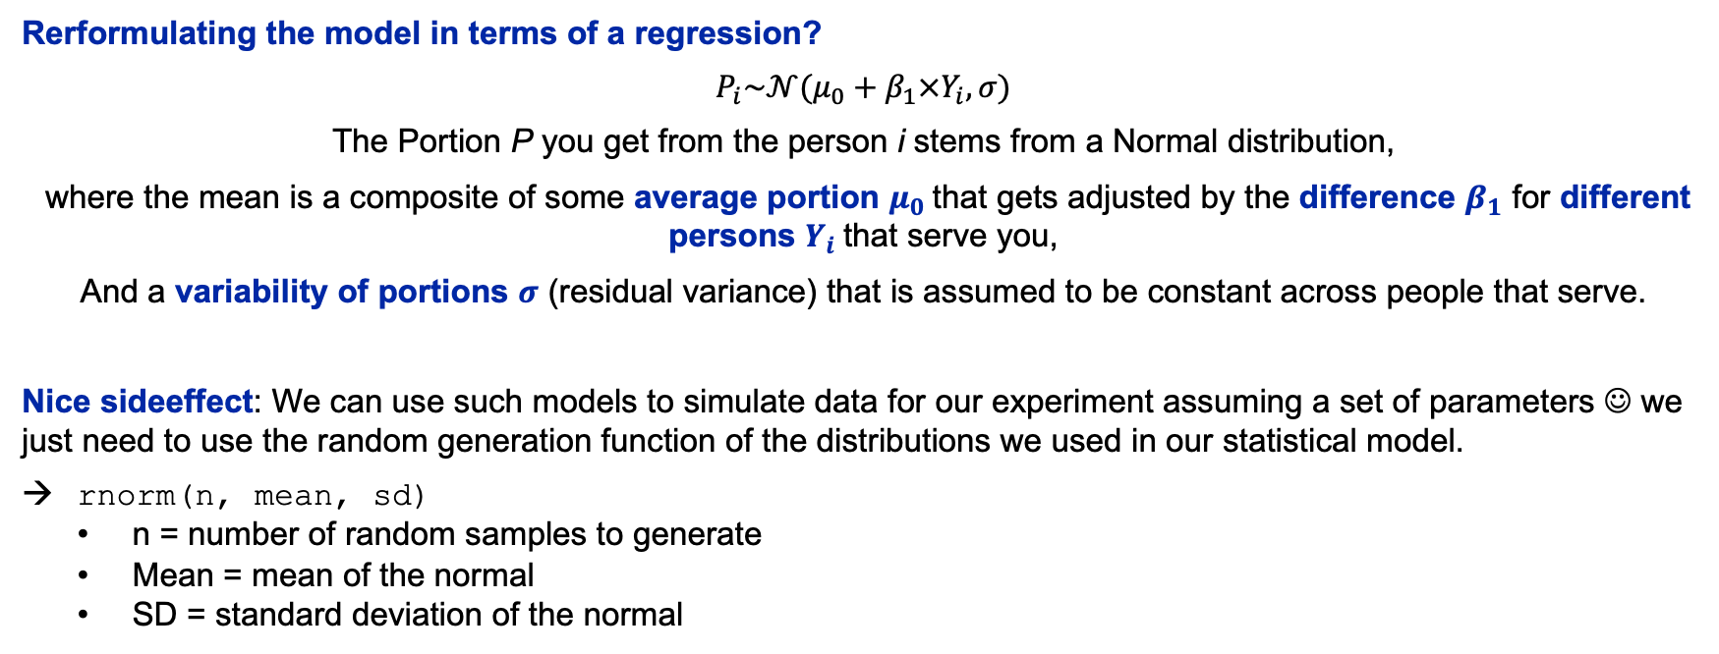
3. Bayesian Regression Models using Stan (brms) A short intro to probabilistic models
Rerformulating the model in terms of a regression?
$P_{i}\sim 𝒩(μ_{0}+β_{1}×Y_{i},σ)$
The Portion P you get from the person i stems from a Normal distribution,
where the mean is a composite of some average portion $μ_{0}$that gets adjusted by the difference $β_{1}$ for different persons $Y_{i}$that serve you,
And a variability of portions $σ$ (residual variance) that is assumed to be constant across people that serve.
Nice sideeffect: We can use such models to simulate data for our experiment assuming a set of parameters ☺ we just need to use the random generation function of the distributions we used in our statistical model.
rnorm(n, mean, sd)
n = number of random samples to generate
Mean = mean of the normal
SD = standard deviation of the normal

Slide 24
3. Bayesian Regression Models using Stan (brms)
What are your questions?

Slide 25
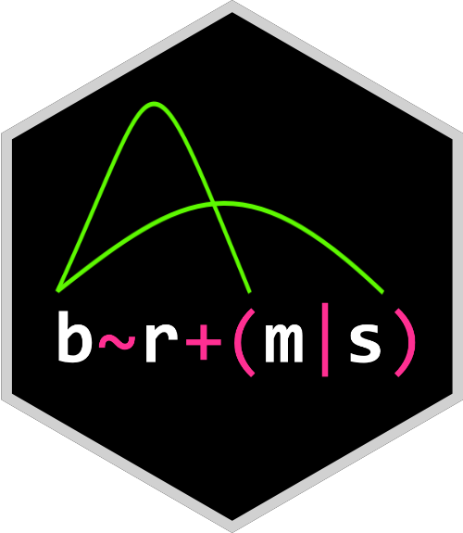
3. Bayesian Regression Models using Stan (brms) A (short) intro to brms (Bayesian regression models using Stan)
What does the brms R package provide?
interface to Stan → fit Bayesian generalized linear models
formula syntax similar to lme4 → provides familiar & simple regression analyses.
wide range of response distributions supported → fit wide range of data
lots of further modeling options:
non-linear and smooth terms,
auto-correlation structures,
censored data,
missing value imputation,
and quite a few more …
all parameters of response distribution can be predicted (means, standard deviations, etc.)
flexible prior specifications → encourages users to apply prior distributions that reflect their beliefs.
Model fit can easily be assessed → posterior predictive checks, cross-validation, and Bayes factors.
Notes:
Cognitive Measurement Models :
Distributional models of behavioral data (e.g., Multinomial, Mixtures of Von Mises Distributions, Multivariate Models of Response Time & Accuracy)
Latent Cognitive Processes are translated into distributional parameters

Slide 26
3. Bayesian Regression Models using Stan (brms) A (short) intro to brms
brm → main function to fit models using brms
required arguments:
formula → specifies the regression model to estimate
data → data set that contains all variables (important: match variable names to names in formula!)
defaults:
family = gaussian() → which probability distribution does the DV stem from
priors
sampler settings (number of warmup & post-warmup sample, number of MCMC chains, etc.)
brm(formula = DV ~ 1 + IV + (1 + IV | ID),
data = myData,
# optional arguments
family = gaussian(),
prior = myPriors,
iter = 4000, warmup = 1500,
nChains = 4)
Notes:
Cognitive Measurement Models :
Distributional models of behavioral data (e.g., Multinomial, Mixtures of Von Mises Distributions, Multivariate Models of Response Time & Accuracy)
Latent Cognitive Processes are translated into distributional parameters

Slide 27
3. Bayesian Regression Models using Stan (brms) A (short) intro to brms
Introduction to the brmsformula syntax
response | aterms ~ pterms + (gterms | group)
the dependent variable
additional response information terms (truncation, number of trials, decision information)
predictor terms
group specific terms (random effects)
grouping variables
Important: By default, this formula predicts the primary distribution parameter → mean, location, or probability parameters
You can specify additional formulae to predict other distributional parameters (e.g. sigma), like:
dist_parm ~ pterms + (gterms | group)
Notes:
Cognitive Measurement Models :
Distributional models of behavioral data (e.g., Multinomial, Mixtures of Von Mises Distributions, Multivariate Models of Response Time & Accuracy)
Latent Cognitive Processes are translated into distributional parameters

Slide 28
3. Bayesian Regression Models using Stan (brms) A (short) intro to brms
Introduction to the brmsformula syntax
response | aterms ~ pterms + (gterms | group)
As pterms and gterms you can use:
Categorical predictors, e.g. factors (mind their contrast coding!)
Continous predictors
As group variables you can use:
Integer IDs,
Factors
additionally, you can distinguish different groups (e.g., younger vs. Older adults) using an additional grouping variable
By default the formula includes an Intercept that you can code explicitly as 1 or suppress using 0
You can include interactions between predictors:
Either using * (pred1*pred2) → includes both, main effects of the predictors & their interaction
Or using : (pred1:pred2) → includes only their interaction without their main effects
Notes:
Cognitive Measurement Models :
Distributional models of behavioral data (e.g., Multinomial, Mixtures of Von Mises Distributions, Multivariate Models of Response Time & Accuracy)
Latent Cognitive Processes are translated into distributional parameters

Slide 29
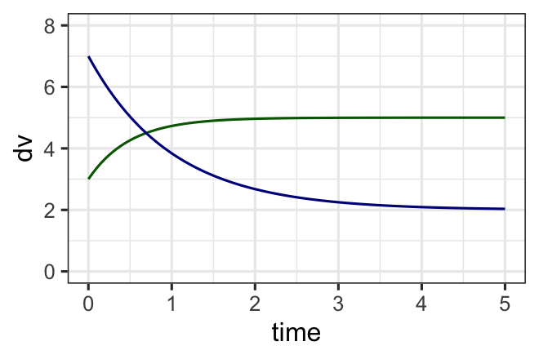
3. Bayesian Regression Models using Stan (brms) A (short) intro to brms
Introduction to the brmsformula syntax
response | aterms ~ pterms + (gterms | group)
You can specify linear & non-linear formulae of arbitrary complexity. For example:
y ~ asymptote + (start - asymptote) * exp(-slope * time)
start ~ 1 + pred1 + (1 | ID)
asymptote ~ 1 + pred2 + (1 | ID)
slope ~ 1 + (1 | ID)
For this you, need to set the option for non-linear formulae to
TRUE when setting up the formula, that is pass: nl = TRUE
Important: You should also consider setting adequate priors to
ensure identification and proper convergence
for more info see the documentation.
Notes:
Cognitive Measurement Models :
Distributional models of behavioral data (e.g., Multinomial, Mixtures of Von Mises Distributions, Multivariate Models of Response Time & Accuracy)
Latent Cognitive Processes are translated into distributional parameters

Slide 30
3. Bayesian Regression Models using Stan (brms)
What are your questions?

Slide 31
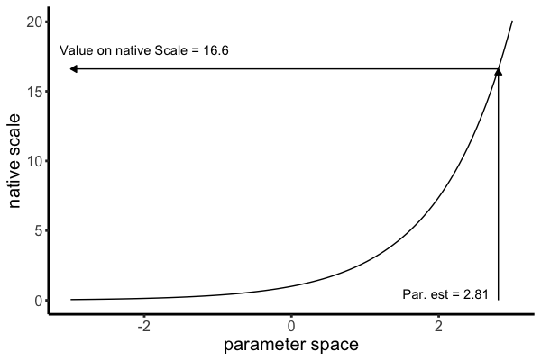
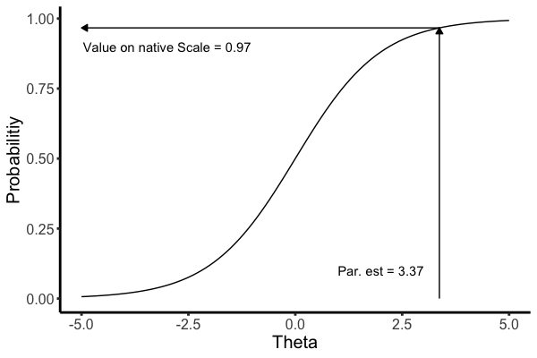
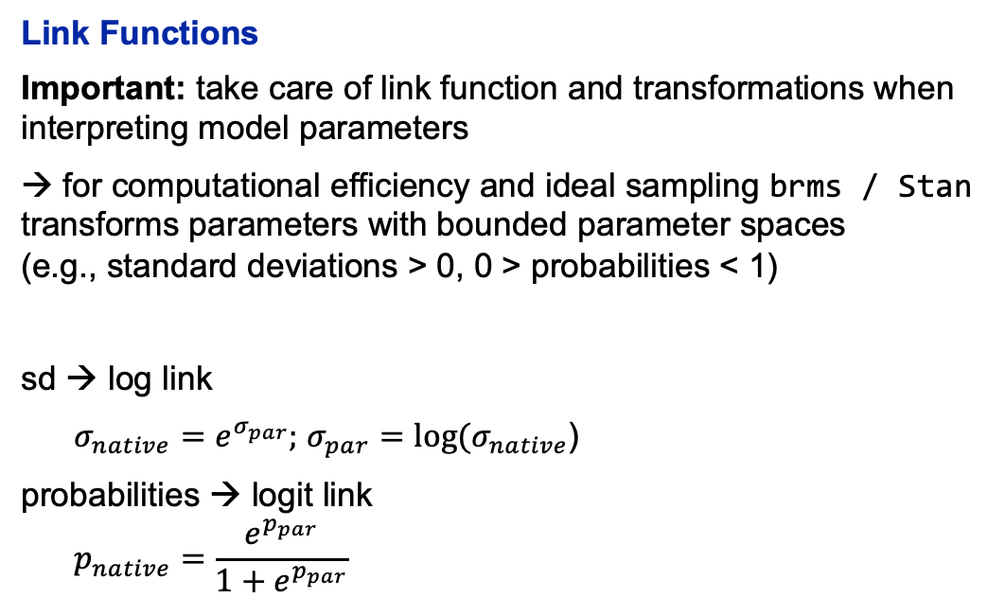
3. Bayesian Regression Models using Stan (brms) A (short) intro to brms
Link Functions
Important: take care of link function and transformations when interpreting model parameters
→ for computational efficiency and ideal sampling brms / Stan transforms parameters with bounded parameter spaces (e.g., standard deviations > 0, 0 > probabilities < 1)
sd → log link
$σ_{native}=e^{σ_{par}};$ $σ_{par}=log⁡(σ_{native}$)
probabilities → logit link
$$p_{native}=\frac{e^{p_{par}}}{1+e^{p_{par}}}$$
Notes:
Cognitive Measurement Models :
Distributional models of behavioral data (e.g., Multinomial, Mixtures of Von Mises Distributions, Multivariate Models of Response Time & Accuracy)
Latent Cognitive Processes are translated into distributional parameters

Slide 32
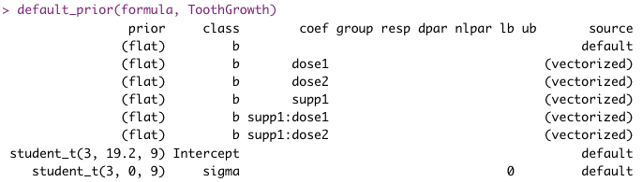
3. Bayesian Regression Models using Stan (brms) A (short) intro to brms
Default priors
Can be accessed using the default_prior function, given a formula and data:
default_prior(my_formula, data, family = gaussian())
brms does not impose strong priors:
no problem for parameter estimation,
Bayes Factors & model comparison require user priors!
User priors
You can set priors using the prior function:
prior(normal(0,1), class = b)
You need to pass at least:
the prior distribution
the parameter class it should be applied to
for more info see the documentation.
Notes:
Cognitive Measurement Models :
Distributional models of behavioral data (e.g., Multinomial, Mixtures of Von Mises Distributions, Multivariate Models of Response Time & Accuracy)
Latent Cognitive Processes are translated into distributional parameters

Slide 33
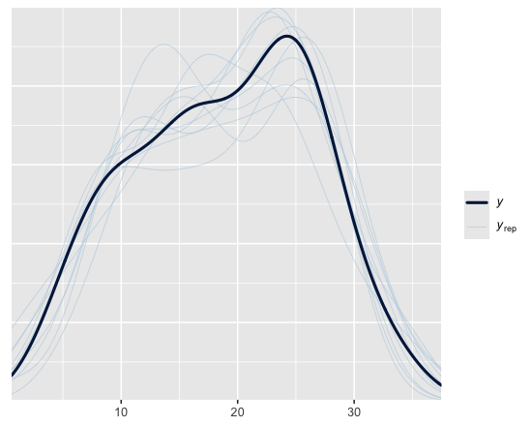
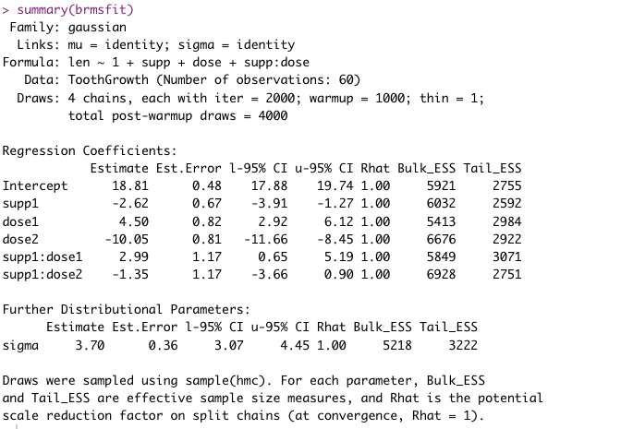
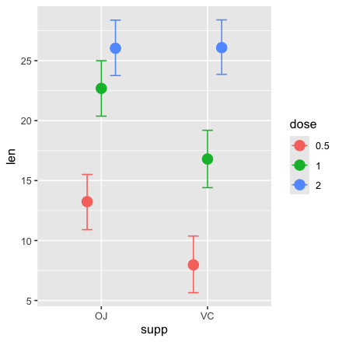
3. Bayesian Regression Models using Stan (brms) A (short) intro to brms
Accessing and Evaluating model results
pp_check(brmsfit) → posterior predictive plot to visually evaluate model fit
summary(brmsfit)→ overview of the estimated parameters
fixef(brmsfit) & ranef(brmsfit)→ get fixed and random effect estimates
conditional_effects(brmsfit) → obtain and plot conditional effects for estimated brms models
Notes:
Cognitive Measurement Models :
Distributional models of behavioral data (e.g., Multinomial, Mixtures of Von Mises Distributions, Multivariate Models of Response Time & Accuracy)
Latent Cognitive Processes are translated into distributional parameters

Slide 34
3. Bayesian Regression Models using Stan (brms)
What are your questions?

Slide 35
Today’s Agenda
Introduction: Logic of Bayesian Statistics & Bayes Rule
Marcov-Chain Monte Carlo (MCMC) sampling – Why?
Bayesian Regression Models using Stan (brms)
Statistical Inference in Bayesian Models
Evaluating Parameter estimates & Credibility Intervals
Bayes Factors & Model Comparison
Practical Exercises

Slide 36
4. Statistical Inference in Bayesian Models
What are your questions?

