Slide 1

Institute of Psychology
Analyzing data on the level of cognitive processes
Gidon Frischkorn, Ruhi Bhanap & Isabel Courage
Satellite Workshop at the 24th ESCoP conference

Slide 2


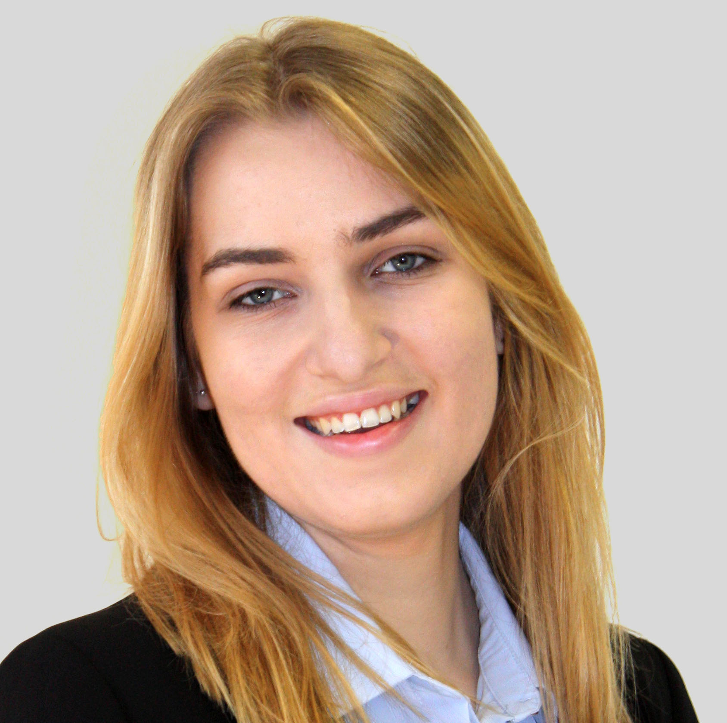
Who are we?
PostDoc & SNF Ambizione Fellow
Zurich
Mathematical Modelling of Cognition
PostDoc
TU Dresden
Topic 2
Individual Differences in cognitive
processes
Topic 1
PhD student
University of Zurich
Topic 2
Topic 1

Slide 3
Workshop: Overview
Monday
Tuesday
Data Analysis reflects (some) theory
Diffusion Decision Model
(bmm)
Materials are available via GitHub
Morning
Signal-Detection Models
(brms)
Practical
Exercises
30 Min. Coffee Breaks
10:30 & 15:00
60 Min. Lunch Break
12:30
Memory Measurement Model
(bmm)
Signal Discrimination
Model
Ask questions whenever something is not clear
☺
Afternoon
Reporting Results from Cognitive Modelling Analyses
Practical
Exercises

Slide 4
Data Analytic Model
Data Analysis reflects (some) theory
Linear Mixed Model
Responses
Accuracies
Data:
_{Observerd}
_{Behavior}
stems from
Underlying
Distribution
Gaussian
But why?
Reaction
Times
Gaussian
Nice
mathematical
properties
Good
Approximation
Confidence
Ratings
True
data
distribution
unknown

Slide 5
Data Analytic Model
Data Analysis reflects (some) theory
Important:
Level of data
aggregation
Linear Mixed Model
Average
Accuracy
Data:
_{Observerd}
_{Behavior}
stems from
Underlying
Distribution
Gaussian
But when?
Mean
Reaction
Times
Gaussian
Works for
aggregated
data
Not ideal
For process
Level data
analysis
Average
Confidence
Ratings
Agnostic to
Trial-level
generation
process

Slide 6
Data Analytic Model
Data Analysis reflects (some) theory
Bayesian Measurement Models (bmm) package
Generalized Linear Models (brms)
Sources
of Activation
Responses
Accuracies
Data:
_{Observerd}
_{Behavior}
stems from
Underlying
Distribution
parameters function of
Cognitive
Measurement
Model
Reaction
Times
Gaussian
Etc.
(von Mises,
Multinomial,
Lognormal,
…)
Response
Thresholds
Confidence
Ratings
Binomial
Noise

Slide 7
Model Specification Simulating Data: lavaan
0.35
Specifying SEM?
e1
X1
Model 1
0.8
0.2
0.9
1
e2
X2
Psi
Exercise:
Compare the implied covariance structures
1
0.65
0.6
e1
X1
Model 2
e3
X3
1
1
0.7
e1
X2
1
1
0.5
Psi
e4
X4
1
1
1
e1
X3
# implied cov.structure
fitted(sem(model))
1
1
0.25
e1
X4
Defaults for simulation
Model 3
SR1
1
Model 4
e1
X1
1
S1
1
Variances = 1
If not specified
e1
X1
1
S1
1
e1
X2
1
1
1
T
1
e1
X2
1
1.2
0.8
e2
X3
1
S2
1
1.2
e2
X3
1
S2
1.2
e2
X4
1
0.25
1.2
SR2
e2
X4
1
0.35
SR2

Slide 8
Psychologisches Institut
What are your questions so far?

