Slide 1
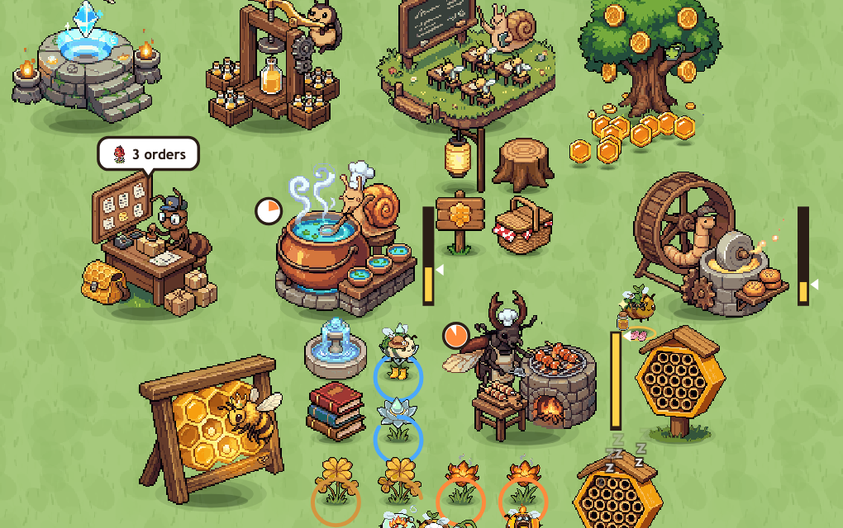
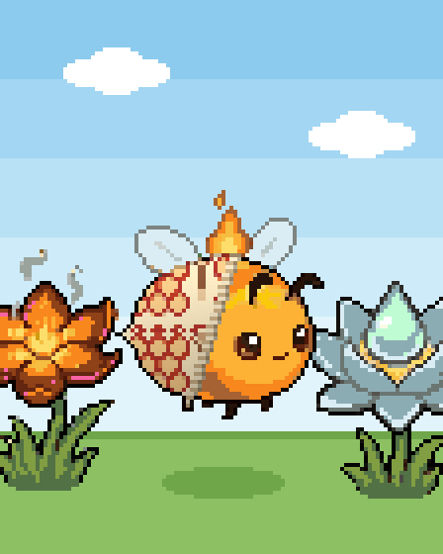

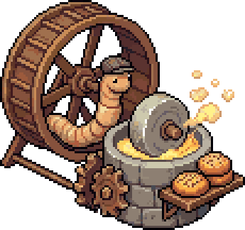
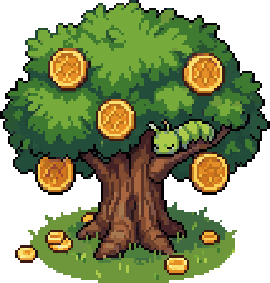

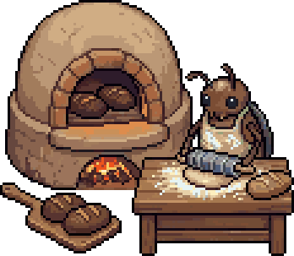

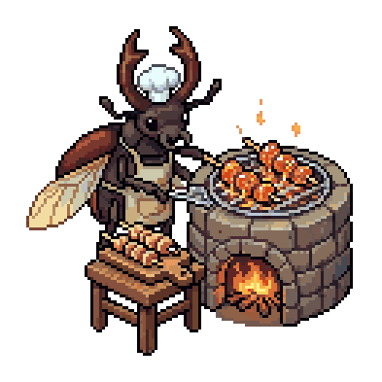
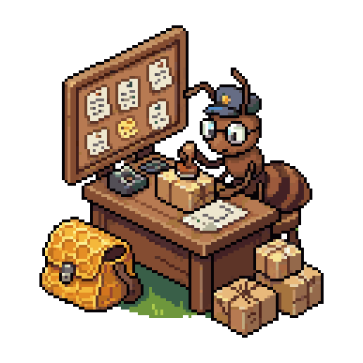
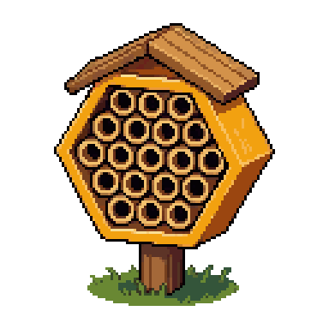
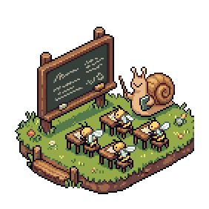
ELEMENTAL BEES
a cosy bee city builder where bugs do the cooking
You run a park for twelve bees and the insects who cook for them. The bees fly nectar in from the blossoms, a stag beetle grills it, a snail boils it into broth, and you sell the lot for honey coins.
1
Kitchens are the city. Each cooks one dish, so where you put it decides how far the bees fly.
2
Bees get tired. They crawl into the bee hotel and sleep it off, longer the more worn out they are.
3
You place everything. Research a kitchen, buy the plot, then put it down wherever you like.
Reference: Honey Bee Park, if its bees had a whole town to run.
CORE LOOP
1
2
3
4
5
Gather
Cook
Sell
Sleep
Grow
Bees carry nectar in from the blossoms
Each kitchen makes one dish
Tap to sell, or fill orders at the parcel desk
Tired bees nap in the hotel
Research, buy land, build more
Notes:
Elemental Bees is a cosy bee city builder. You've got twelve named bees and a park full of kitchens, each one run by a bug: the stag beetle on the grill, the snail on the cauldron, the worm at the mill. Bees fly the nectar about on their own. What you decide is what to research, where each kitchen goes, and when to buy the next bit of land. Tired bees go and sleep in the bee hotel. It keeps cooking while you're away.

