Slide 1



Building AI Agents with LangGraph in Python
Enric Domingo
Data & AI Community Coffee Session

Slide 2
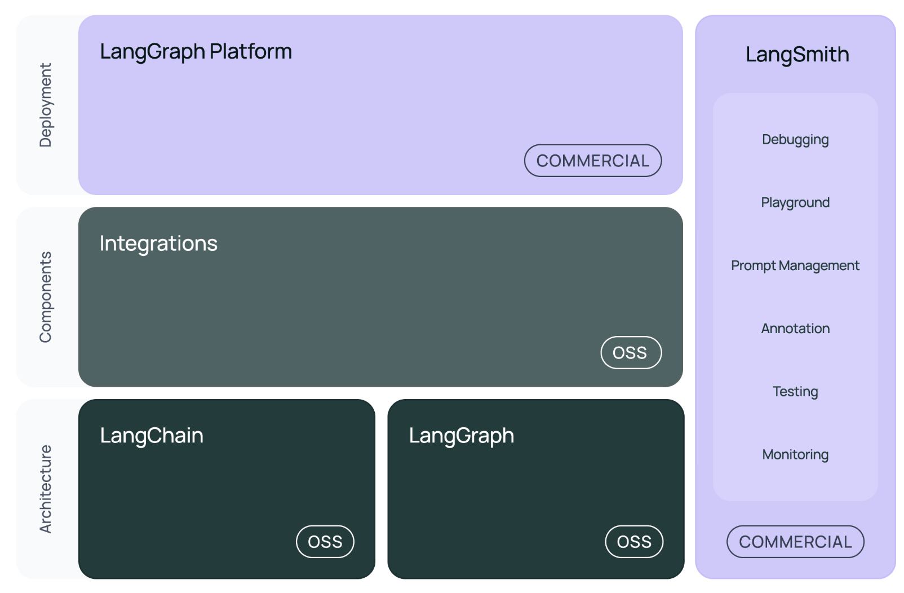
LangChain ecosystem

Slide 3
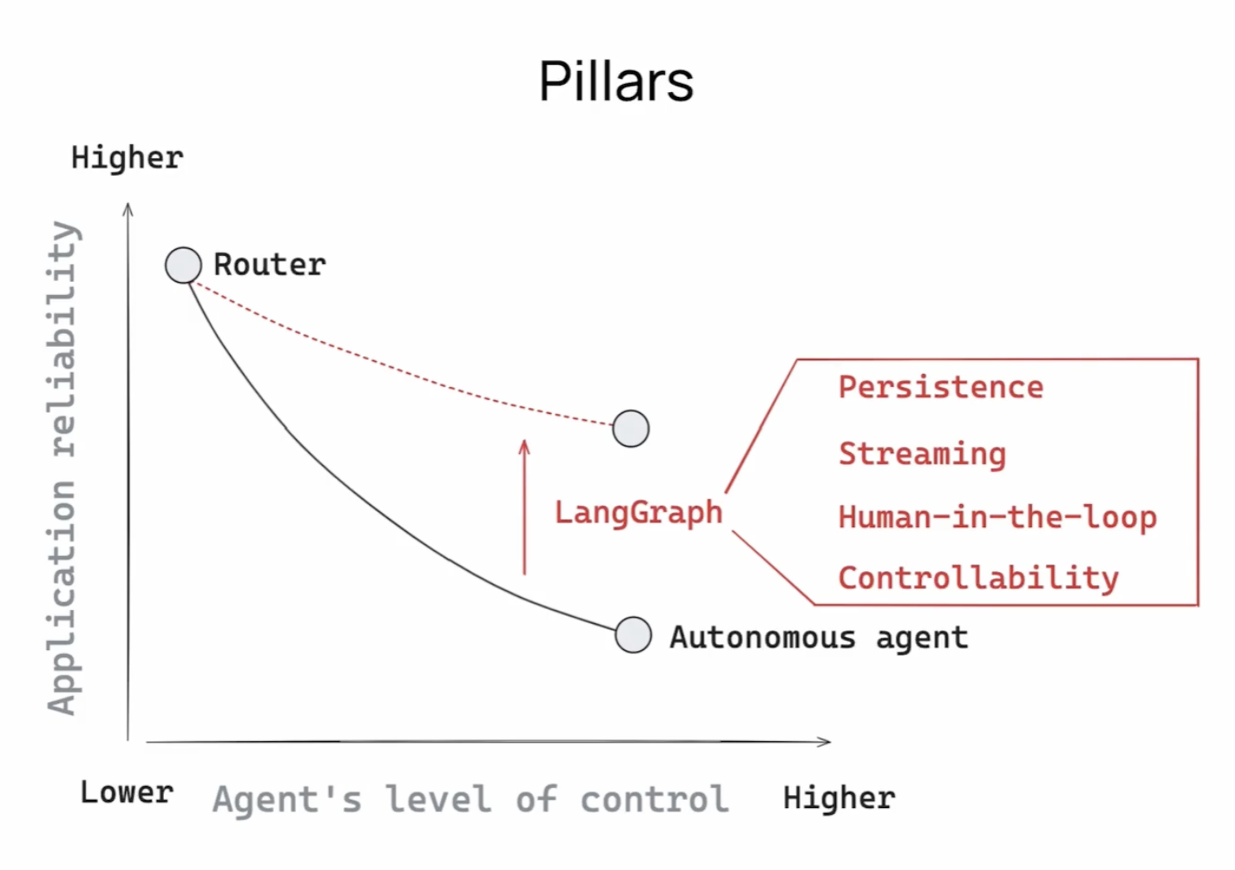
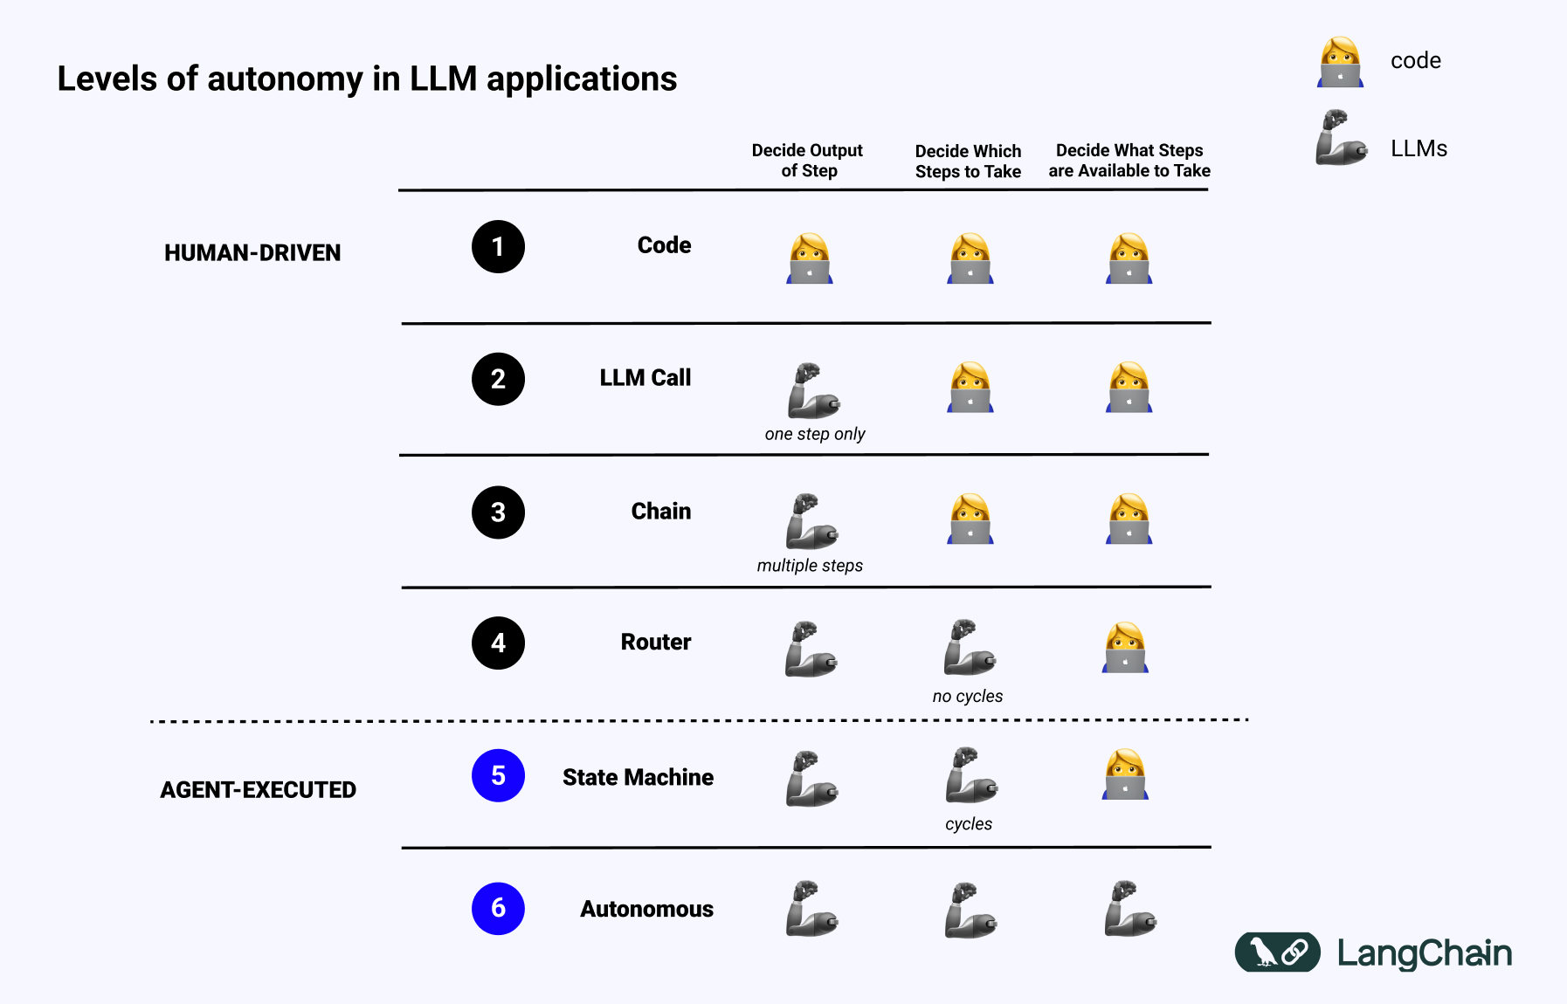
LangGraph motivation
💡 An AI Agent is a system that uses an LLM to decide the control flow of an application.
https://blog.langchain.com/what-is-an-agent/

Slide 4
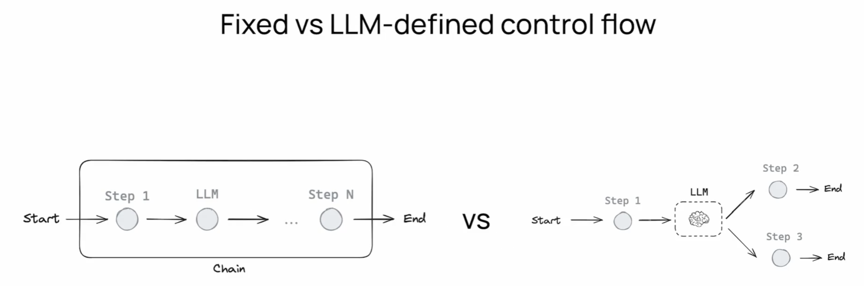
LangChain vs LangGraph
LangGraph is a workflow orchestration framework, it expresses custom control flows with graphs
https://blog.langchain.com/what-is-an-agent/

Slide 5
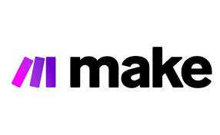
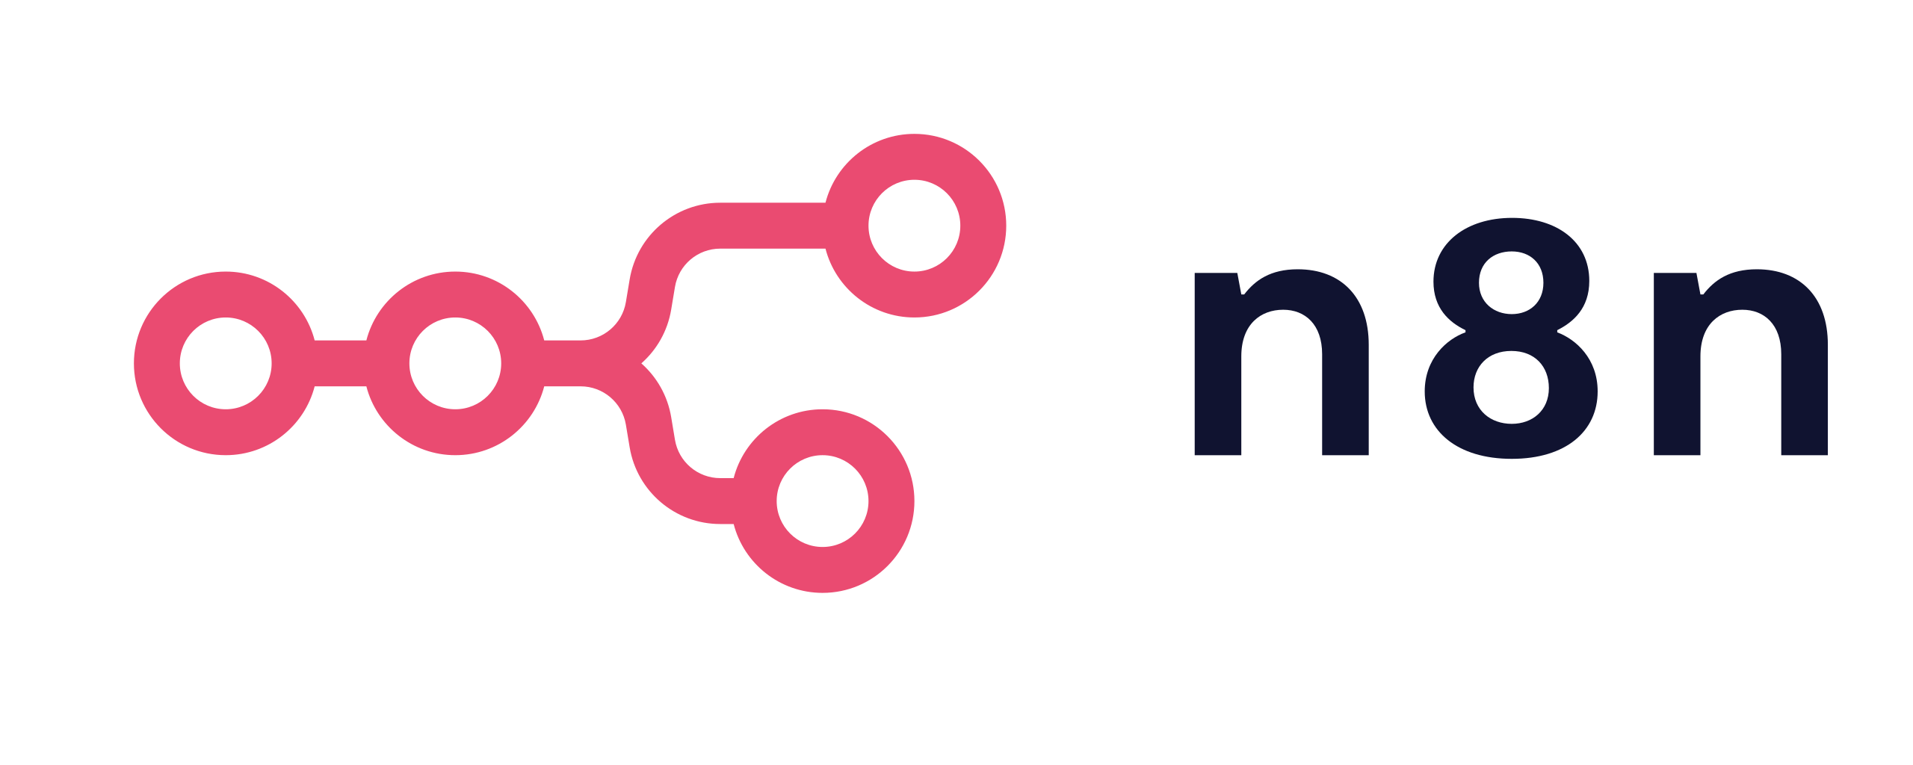

LangGraph vs other agentic tools
Other agentic frameworks can work for simple, generic tasks but fall short for complex tasks bespoke to a company’s needs.
LangGraph provides a more expressive framework to handle companies’ unique tasks without restricting users to a single black-box cognitive architecture.

Slide 6
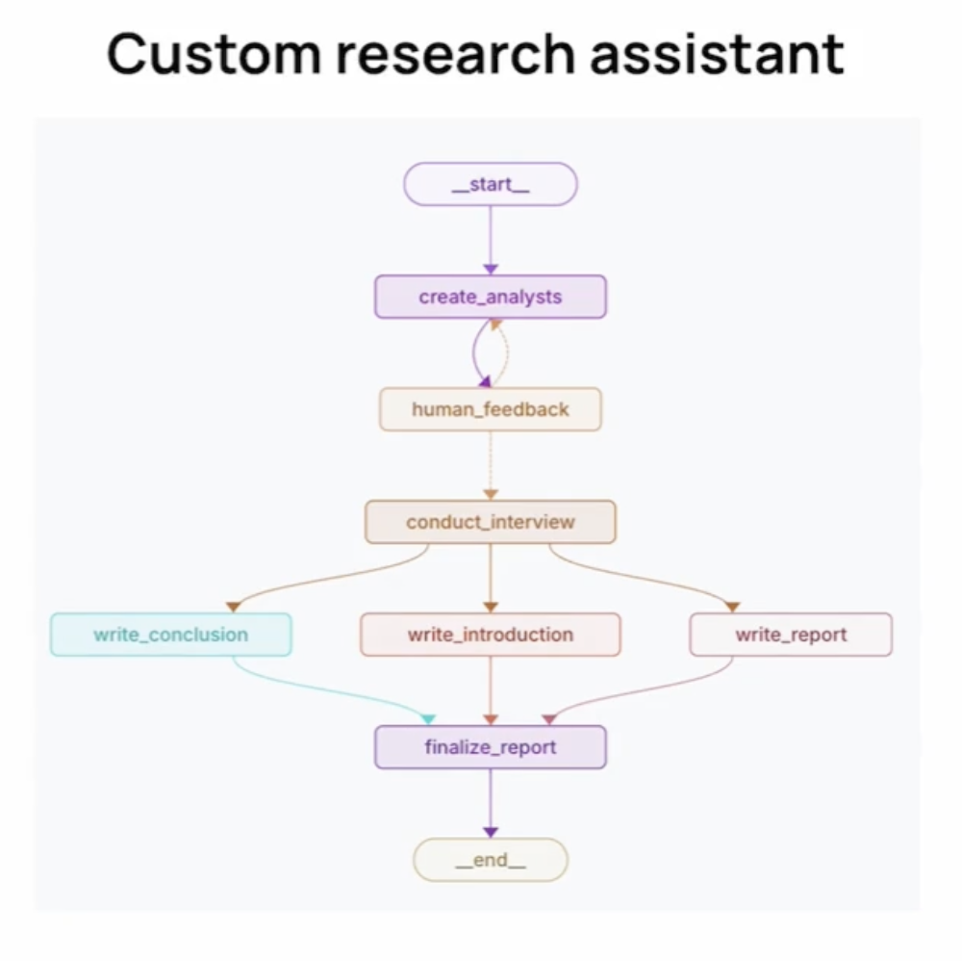
Example:

Slide 7
Code demo
- Messages
- Chat Models
- Tools
- State
- Graph
- Router
- Agents

Slide 8


