Slide 1

EXPANDABLES
ISC216D PRACTICAL PROJECT - 20252

Slide 2
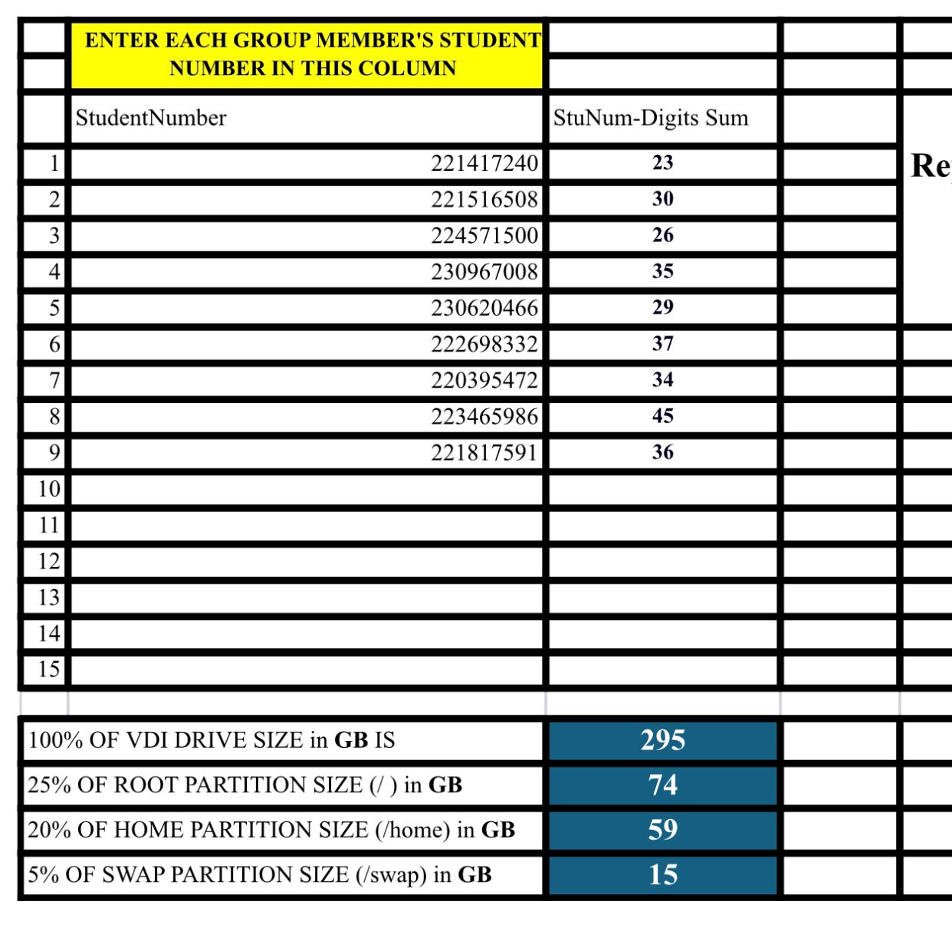
Expandable
CHAUKE MG 221417240

Slide 3
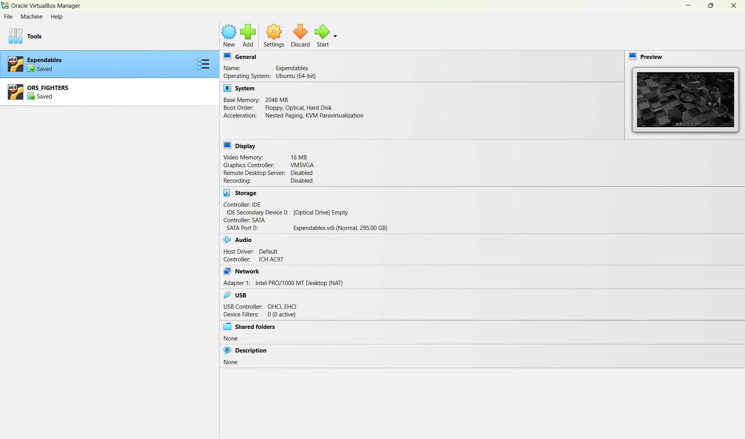
Q1:SCREENSHOT 1

Slide 4
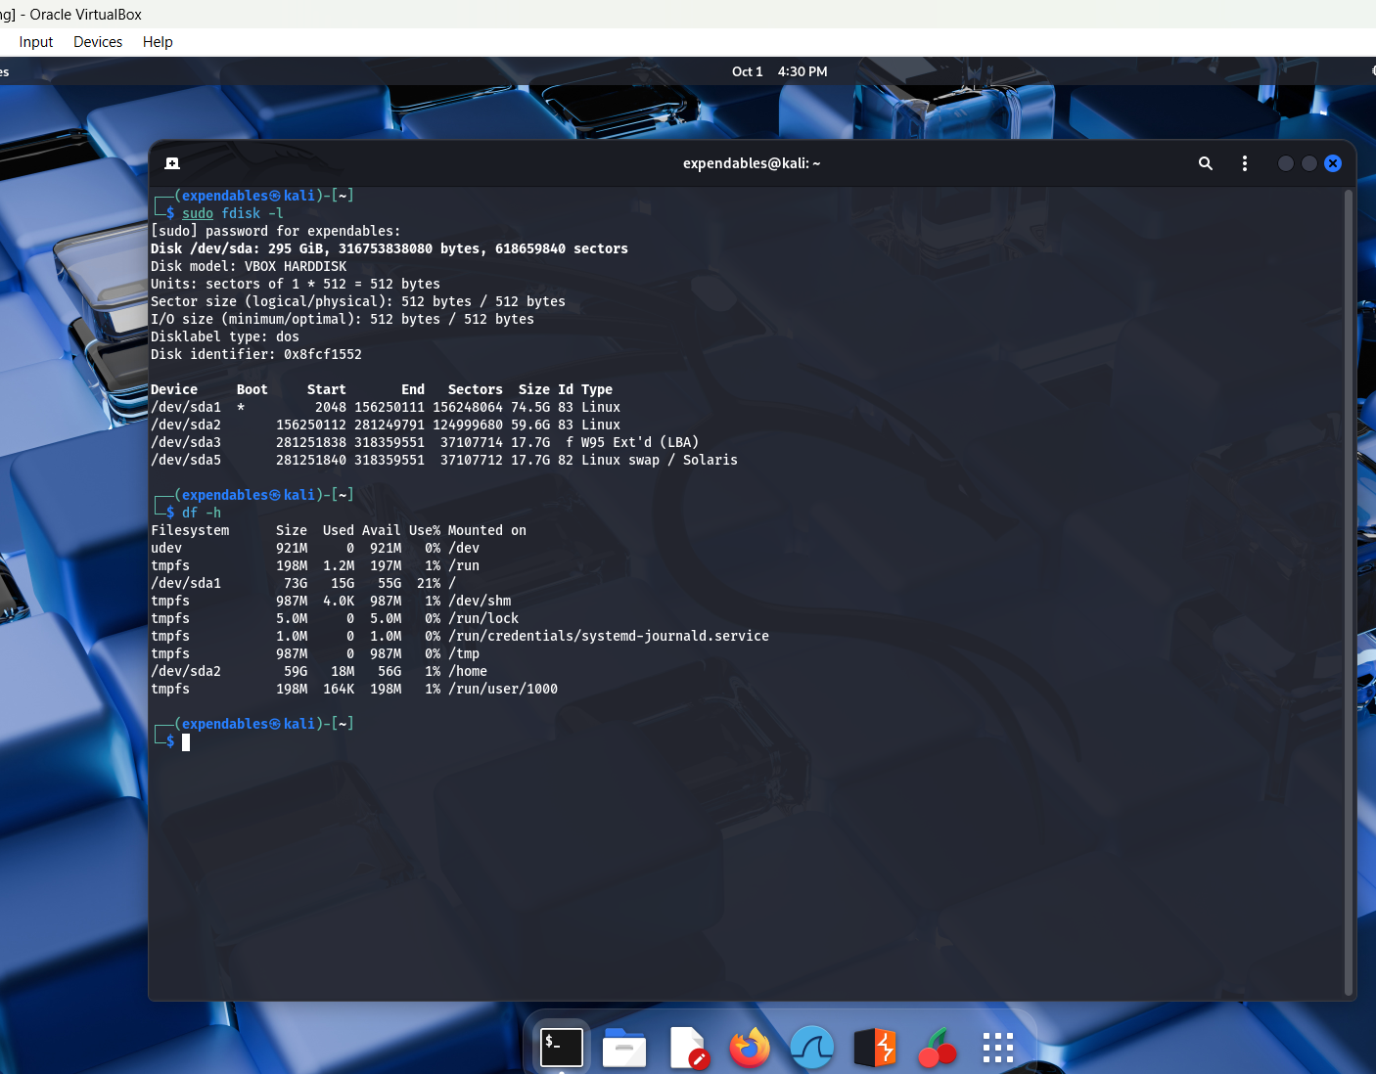
SCREENSHOT 2

Slide 5
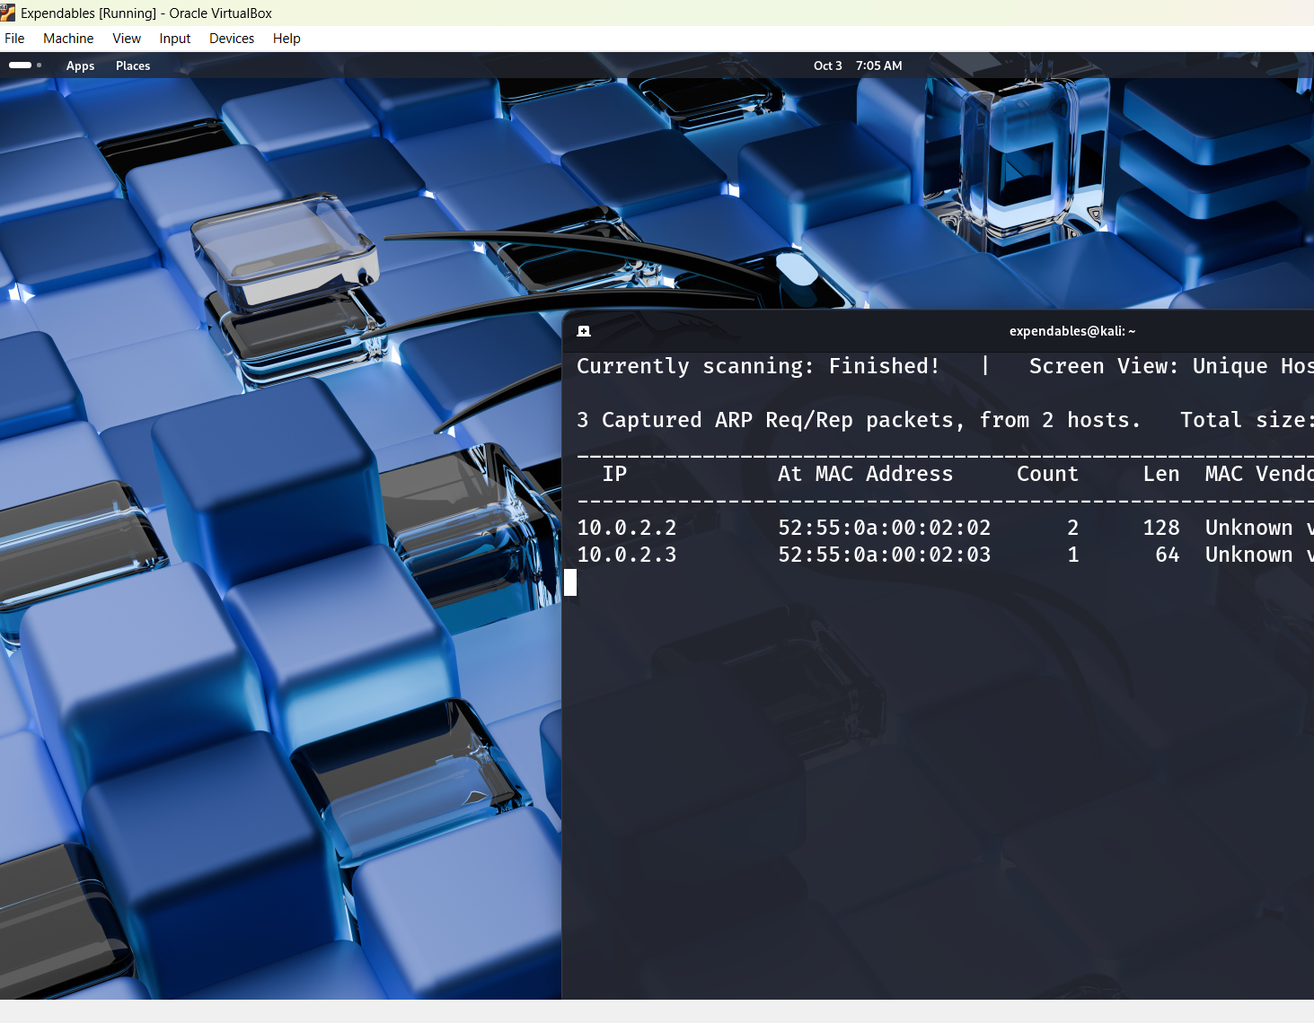
Q2:Tool One-netdiscover

Slide 6
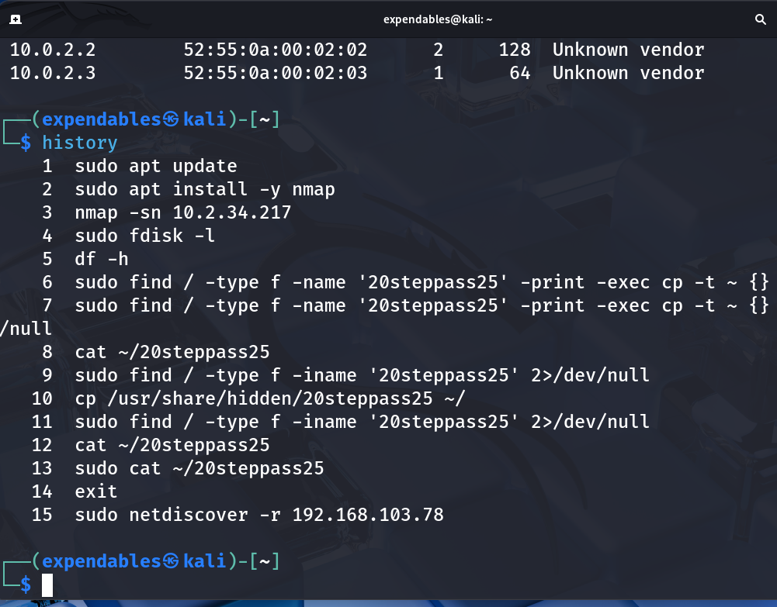
Tool One:list of commans

Slide 7
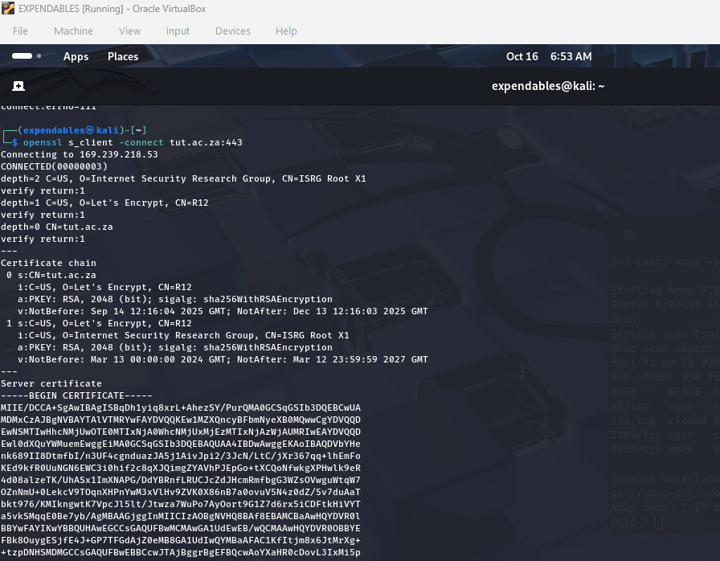
Q2:Tool Two-openssl

Slide 8
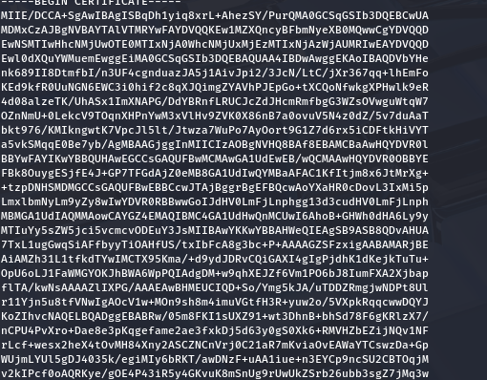
Cont-d

Slide 9
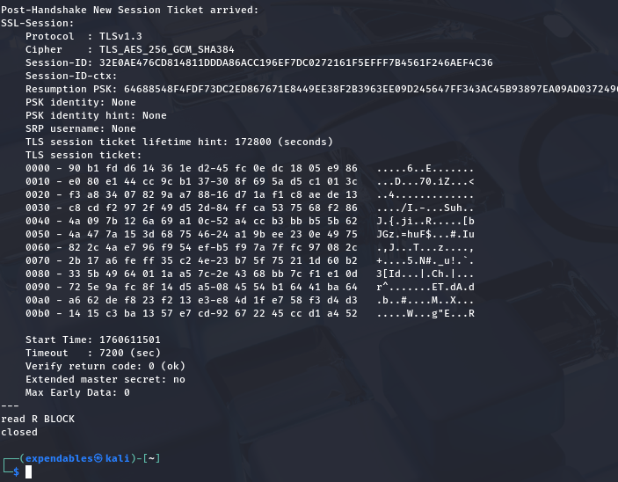

Slide 10

Tool Descriptions
Tool: netdiscover (netdiscover -r <network/mask>) Purpose: Network reconnaissance — perform an ARP scan to discover live hosts on the local network. What we did: Scanned the target subnet to collect IP addresses, MAC addresses and vendor/hostname hints. Key findings: Identified active hosts, the network gateway, and unknown/third-party MAC vendors for further investigation.
Tool: OpenSSL (`openssl s_client -connect tut.ac.za:443 -showcerts`)
Purpose: Reconnaissance — inspect the target's TLS/SSL configuration and certificate chain.
What we did: Connected to tut.ac.za:443 and retrieved the certificate chain and server certificate PEM.
Key findings: Server uses Let’s Encrypt certificate (CN=R12), listed validity dates and public-key info.

Slide 11
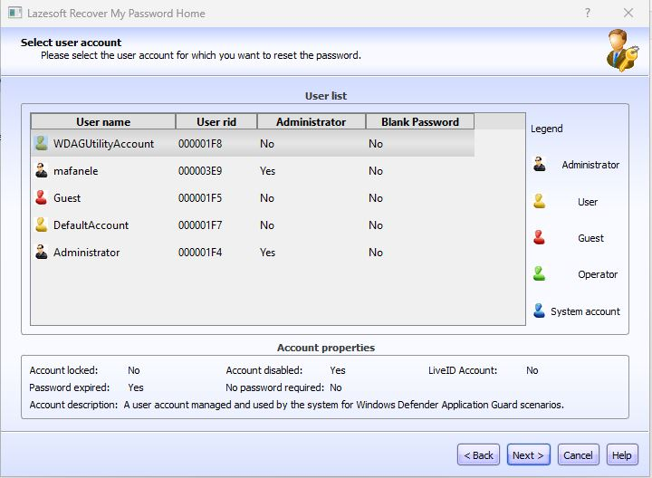
3. VENTOY TOOL 3.1 3a

Slide 12
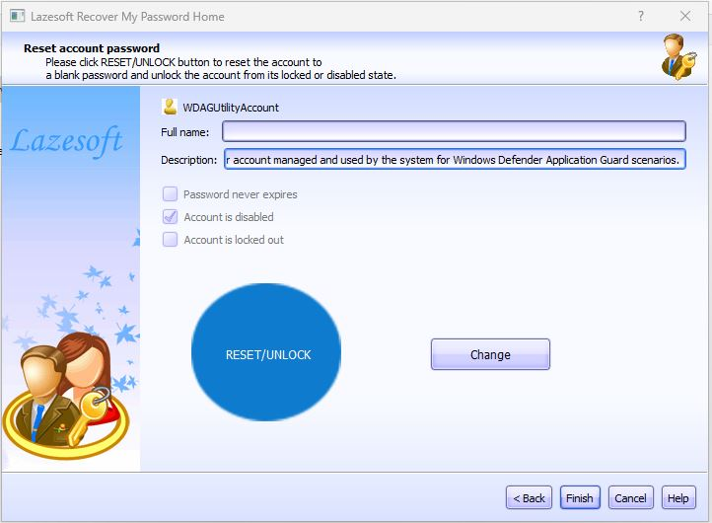
3b

Slide 13
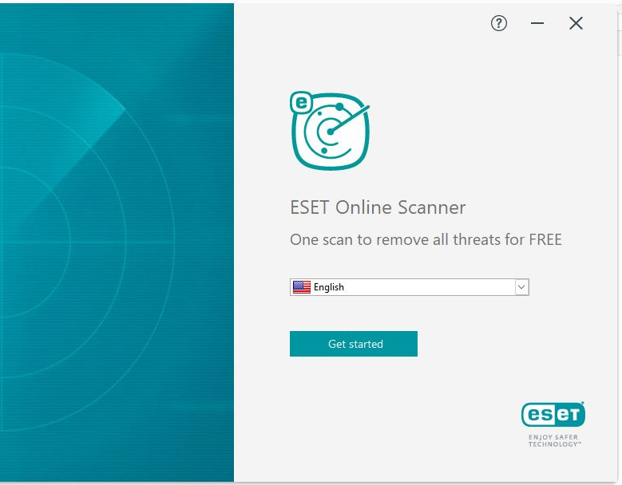
3.2 4a

Slide 14
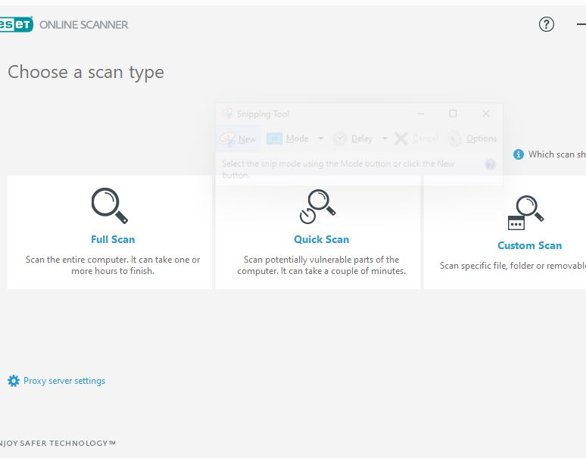
4b

Slide 15
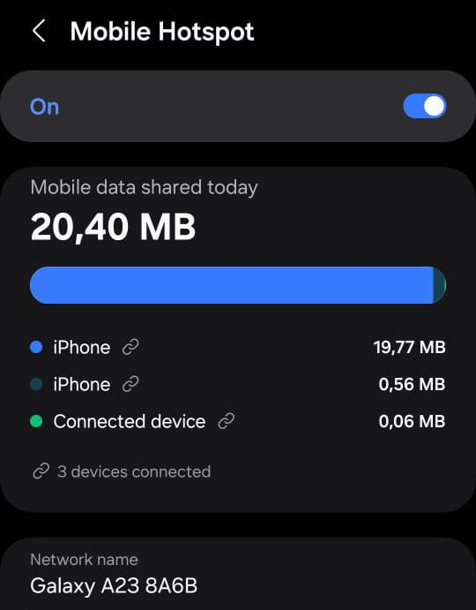
4. fing app 4.1

Slide 16
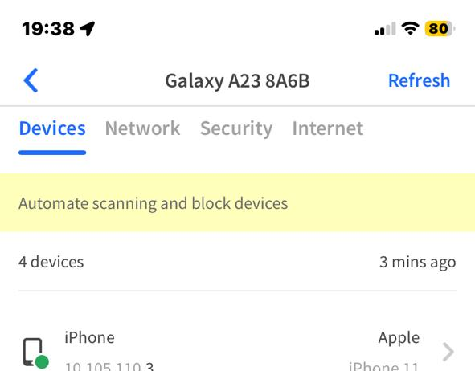
4.2

Slide 17
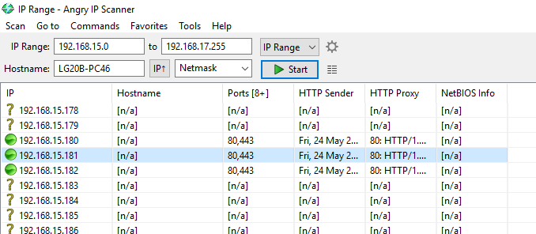
5.1

Slide 18
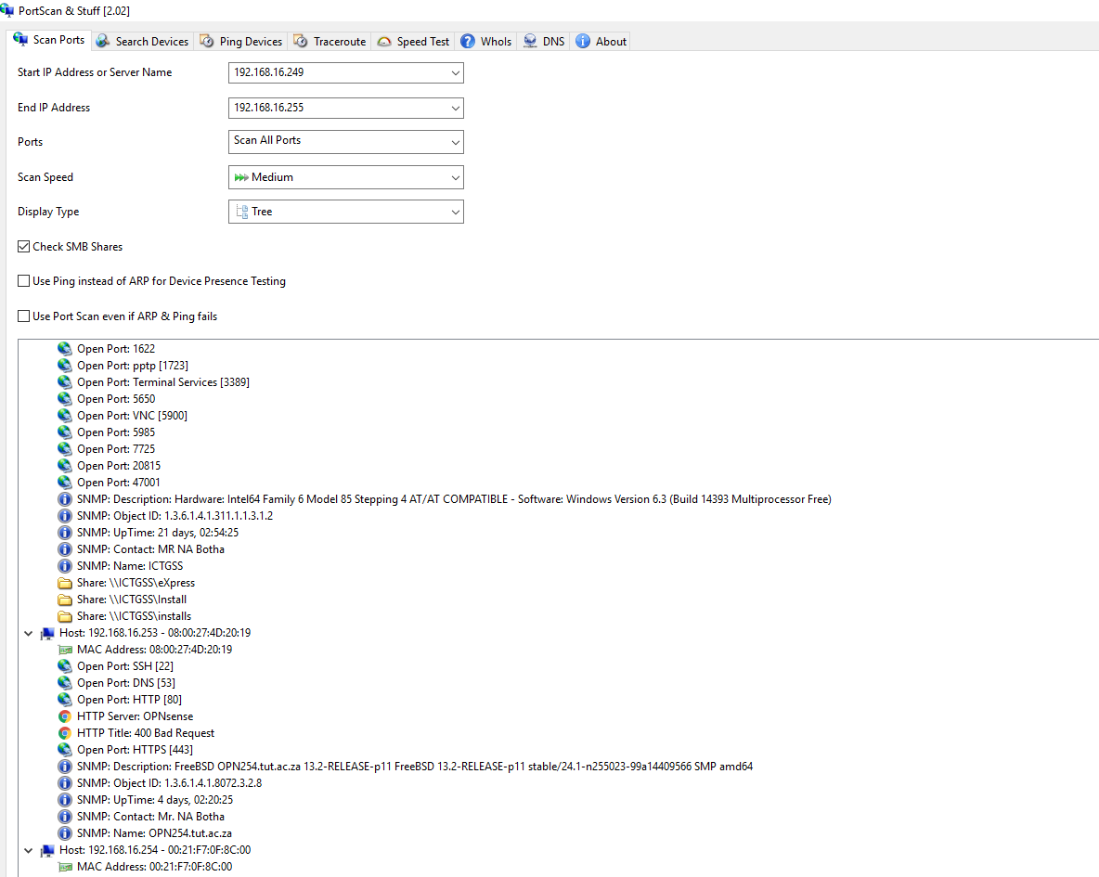
5.2 screenshot 6
SZ PortScan quickly locates all active devices on your network and ascertains the IP address and open services per network device. Scan Ports PortScan shows all open ports and additional information like hostname, MAC address, HTTP, FTP, SMB, iSCSI, SMTP, and SNMP services. It uses up to 100 threads for scanning large IP address ranges. Search Devices Easily search for UPnP-enabled devices, Netgear routers, Samsung printers, Freecom network devices, and Bonjour services - making it easy to encounter them regardless of not knowing the specific IP address. Ping Devices Perform a Ping to any computer with three standard-sized packets, three different sizes, each for ten times, or continuously ping the computer

Slide 19
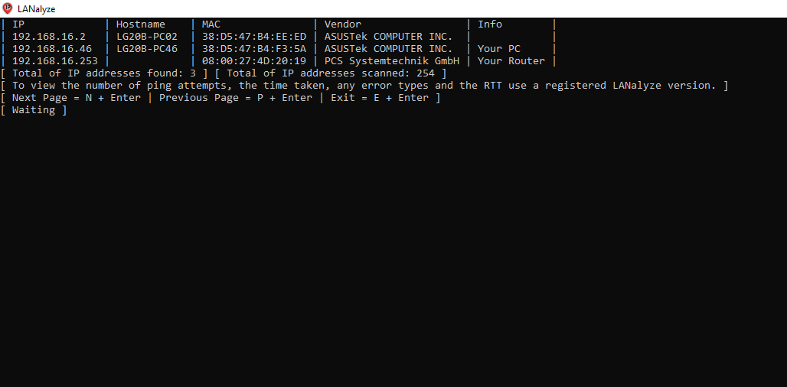
Screenshot 6
LANalyze
LANalyze (formerly MapPing) is a Command Line tool that takes up less than 650 KB of storage space and does not alter the registry. This makes it convenient to utilize directly from a USB flash drive. With LANalyze, you have the option to save your results in a TXT or CSV file, or even both. It's worth noting that LANalyze is optimized for analyzing wired local area networks (LANs), which is similar to other programs. However, when used with wireless LANs or hybrid networks, the results may vary due to various factors, such as the availability of repeaters, the quality of devices used, the distance from the router, and the strength of the wireless signal.

Slide 20
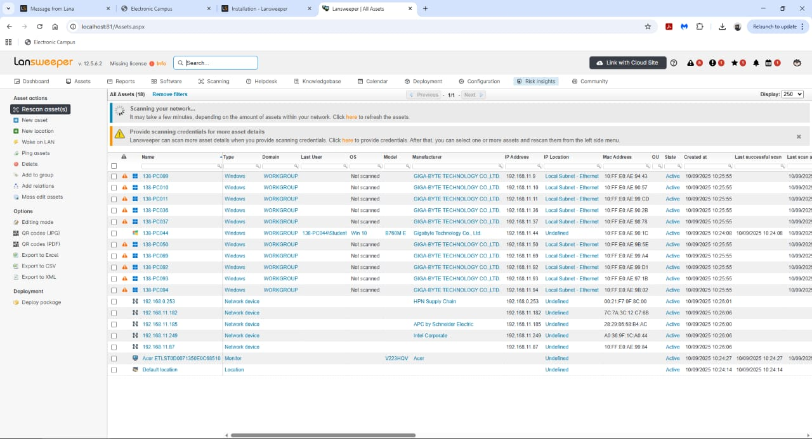
6. Screenshot 7

Slide 21
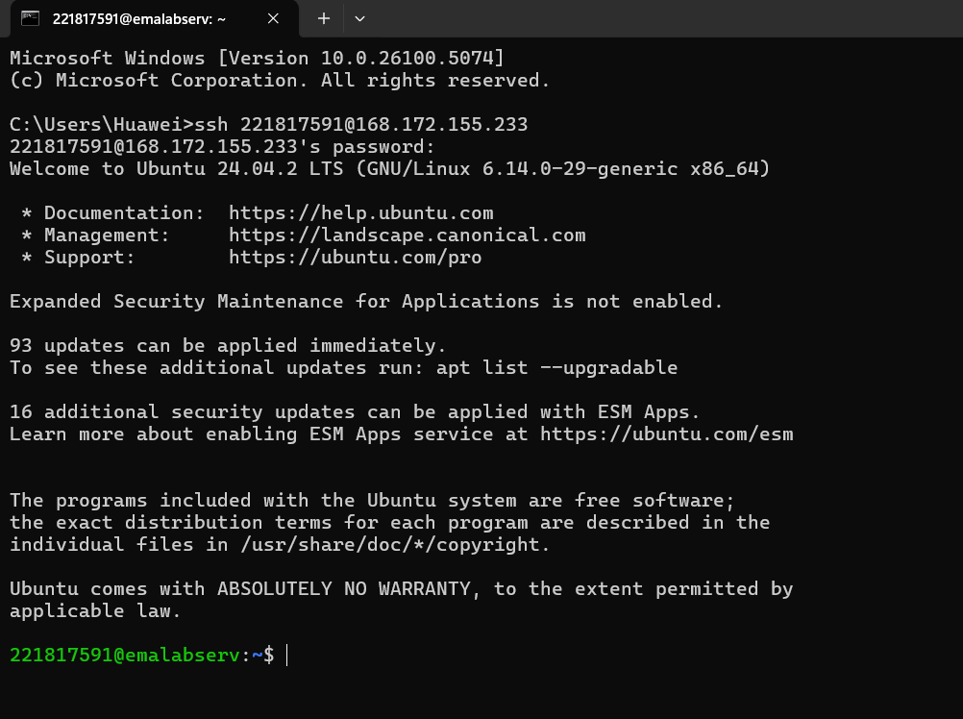
7. emalabserv

Slide 22
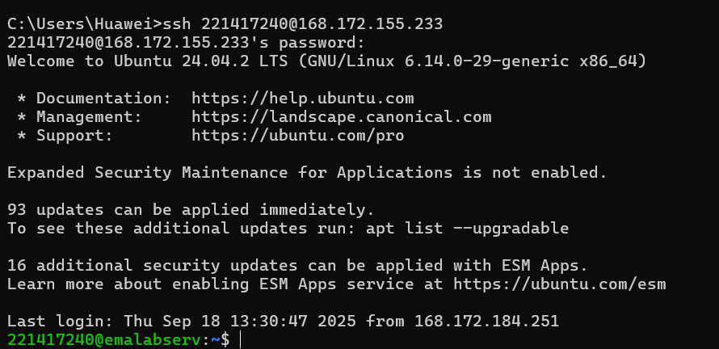
2.

Slide 23
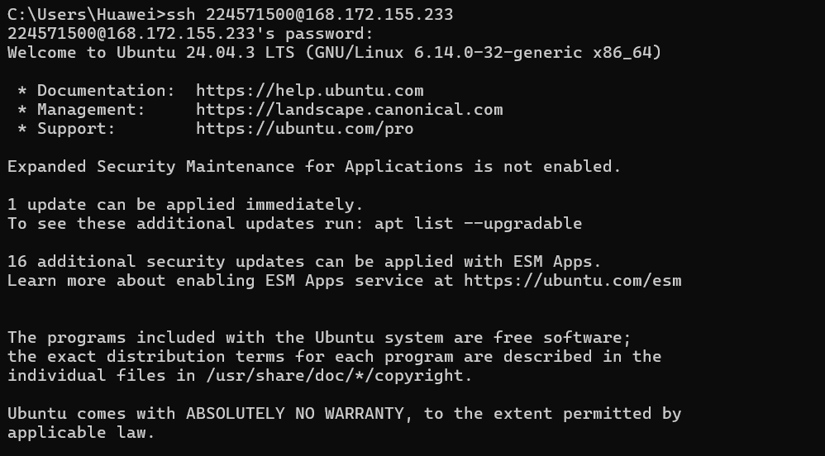
3

Slide 24
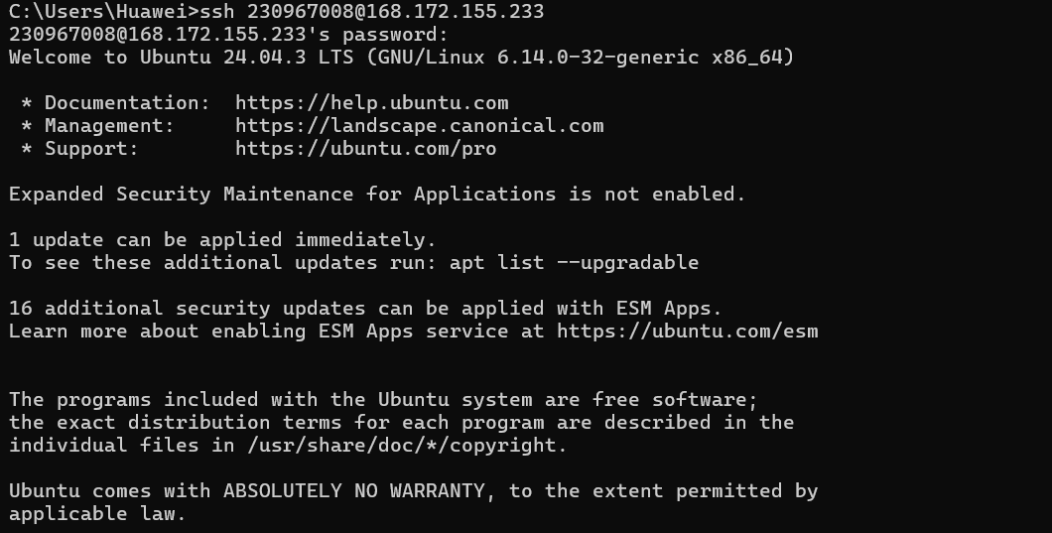
4

Slide 25
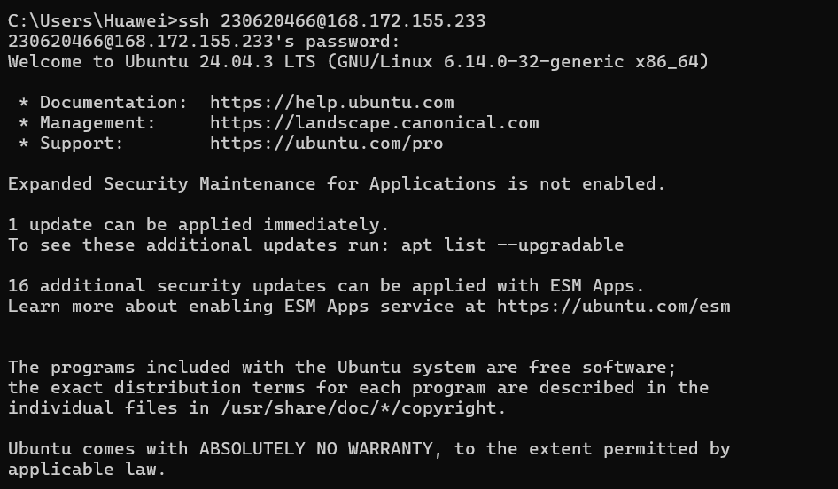
5

Slide 26
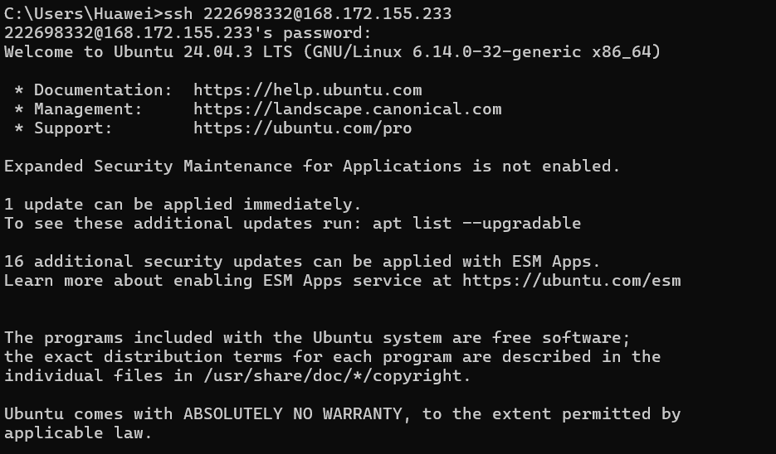
6

Slide 27
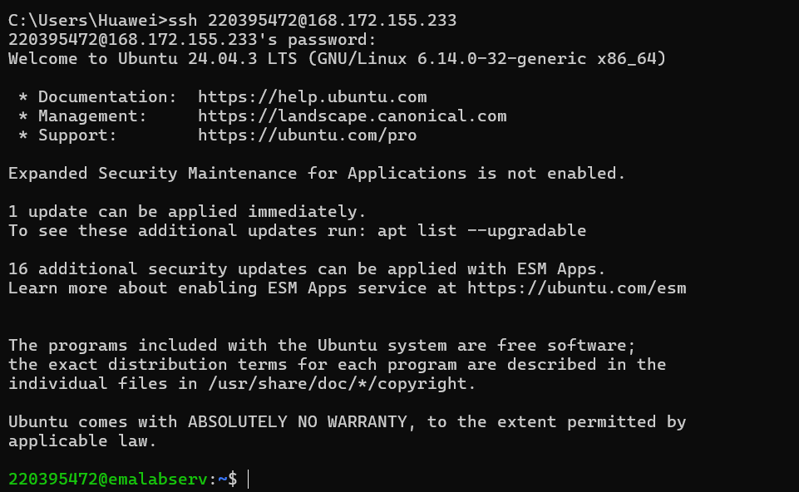
7

Slide 28
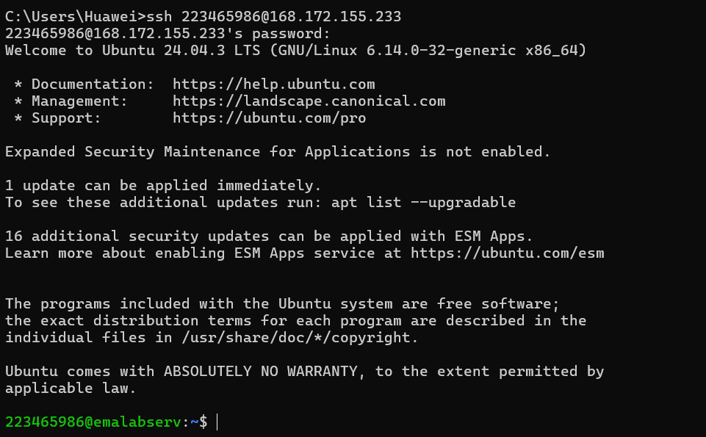
8

Slide 29
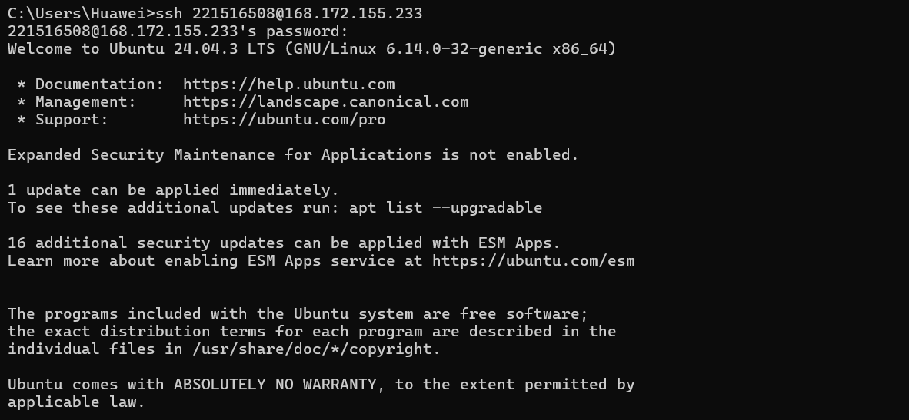
9

Slide 30

7.2 End

