Slide 1
ORS_FIGHTER
M.G CHAUKE
221417240

Slide 2
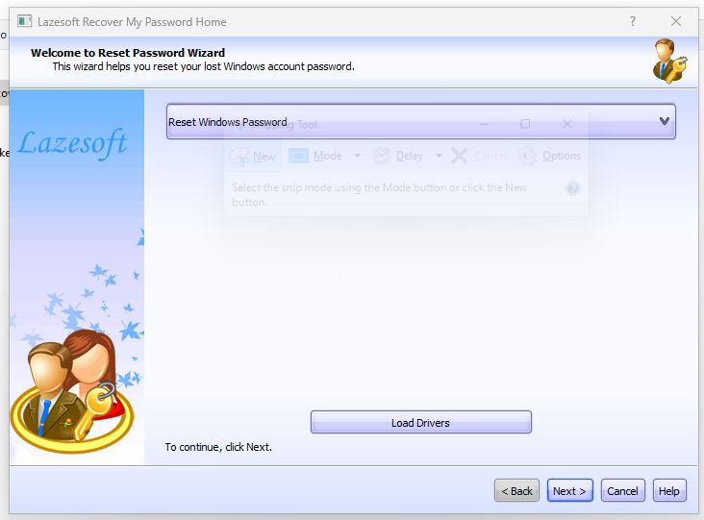
2a

Slide 3
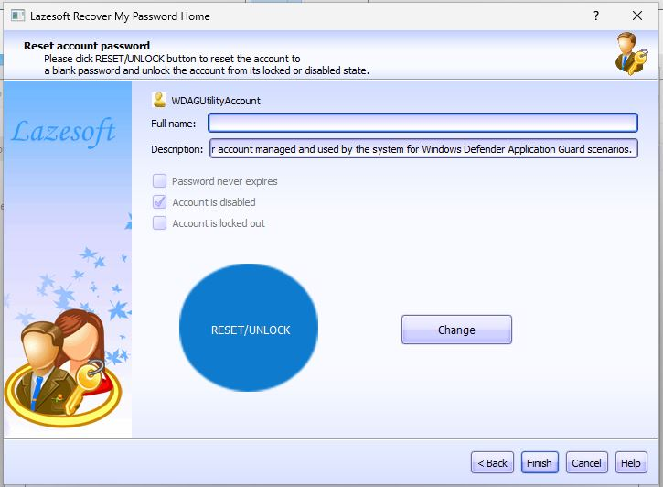
2b

Slide 4
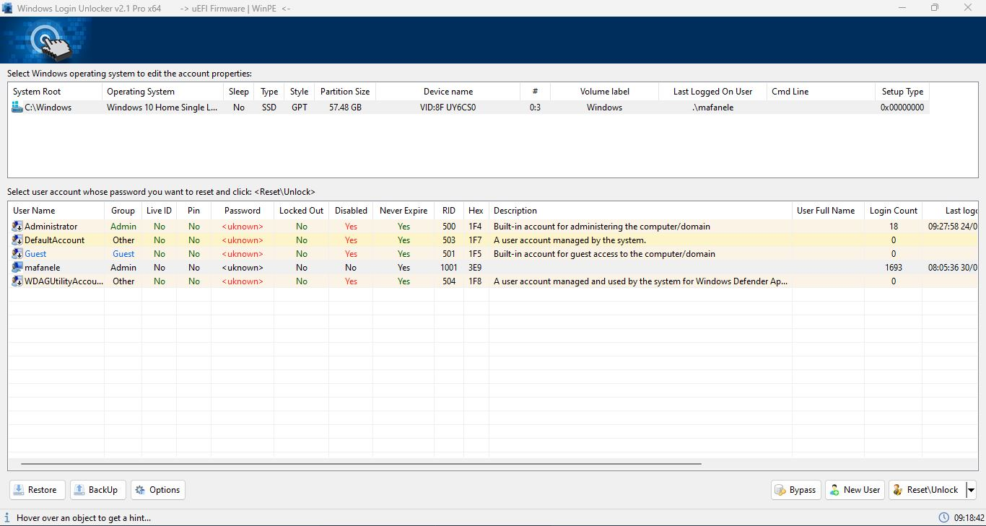
2c

Slide 5
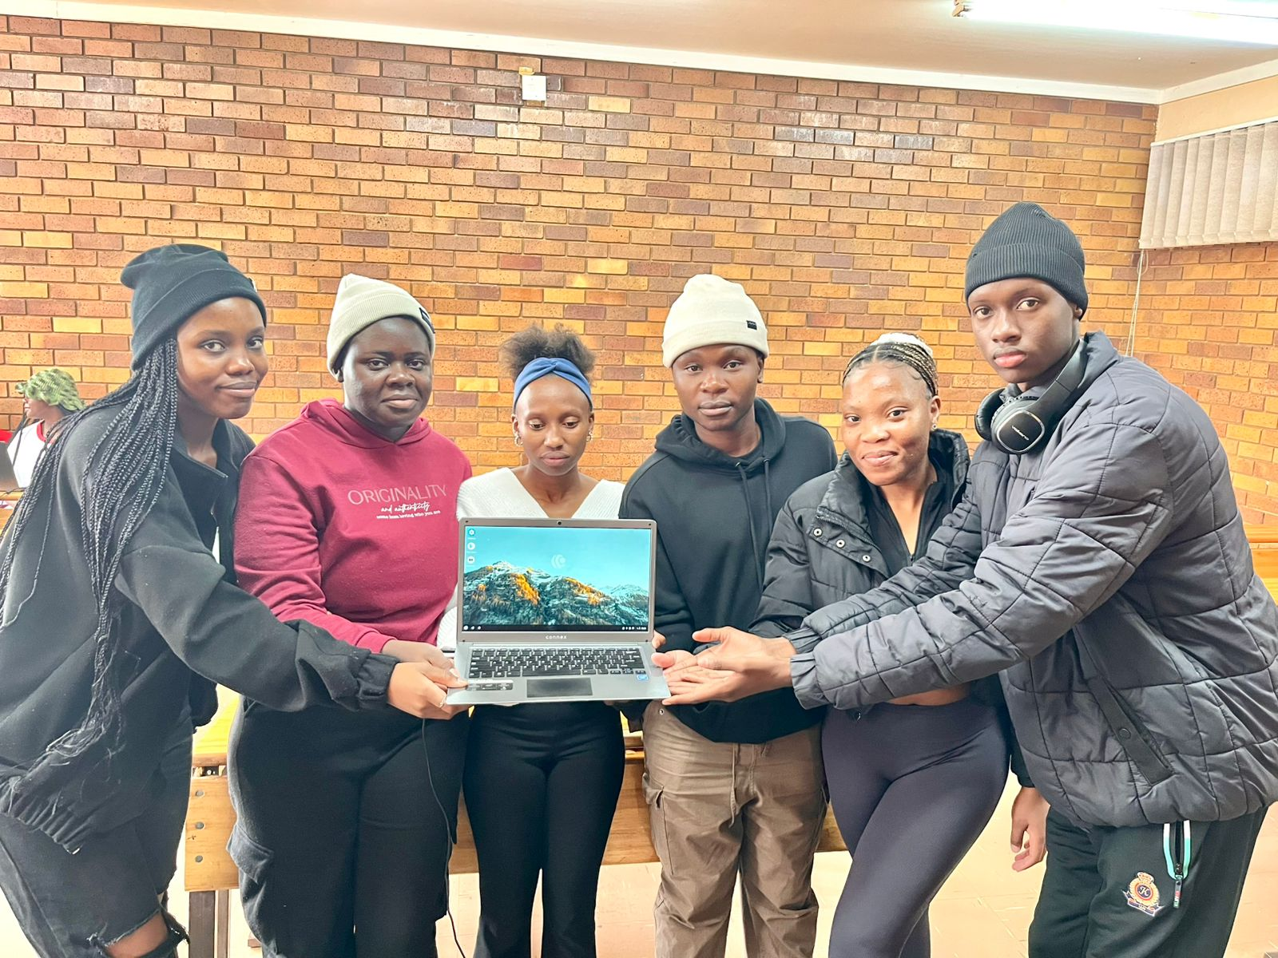
TASK 1 myself on headphones my project participants

Slide 6
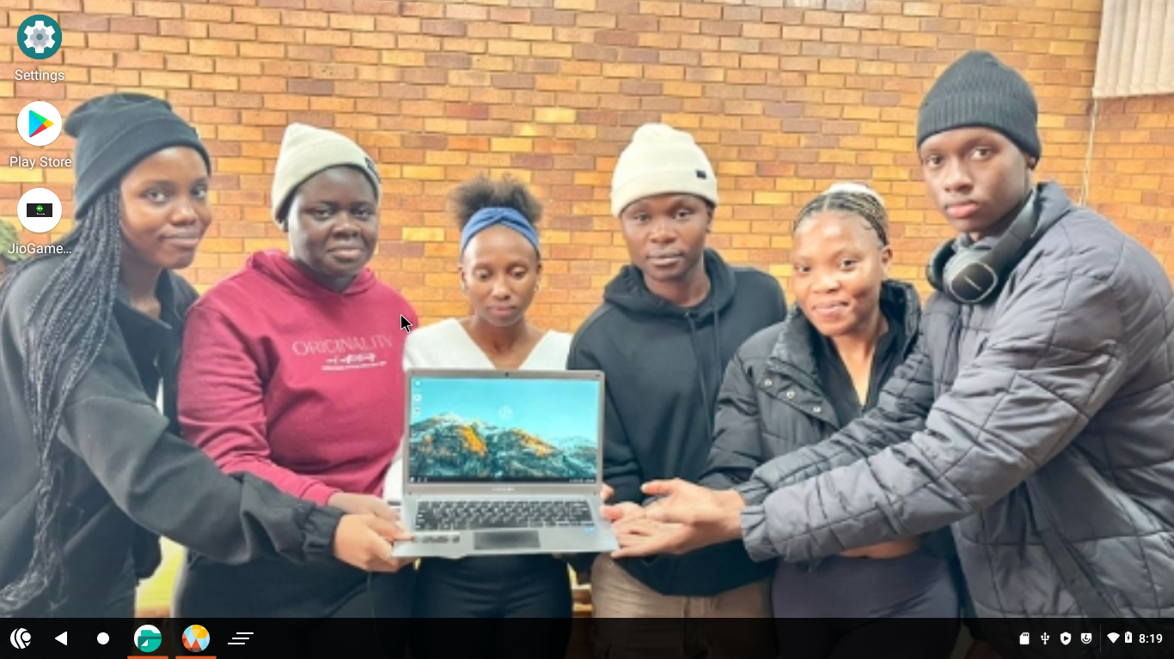
Screenshot2 myself on headphones my project participants

Slide 7
1.6
PrimeOS transforms a PC into an Android-powered desktop, allowing users to run Android apps
and games natively with the performance advantages of a desktop environment, making it ideal
for gamers and those who want a mobile-like experience on their computers. In contrast,
EndlessOS is designed for offline use, featuring a simple interface and a vast library of
pre-installed educational and productivity content, making it perfect for users in areas with
limited or no internet access, such as schools or remote communities.

Slide 8
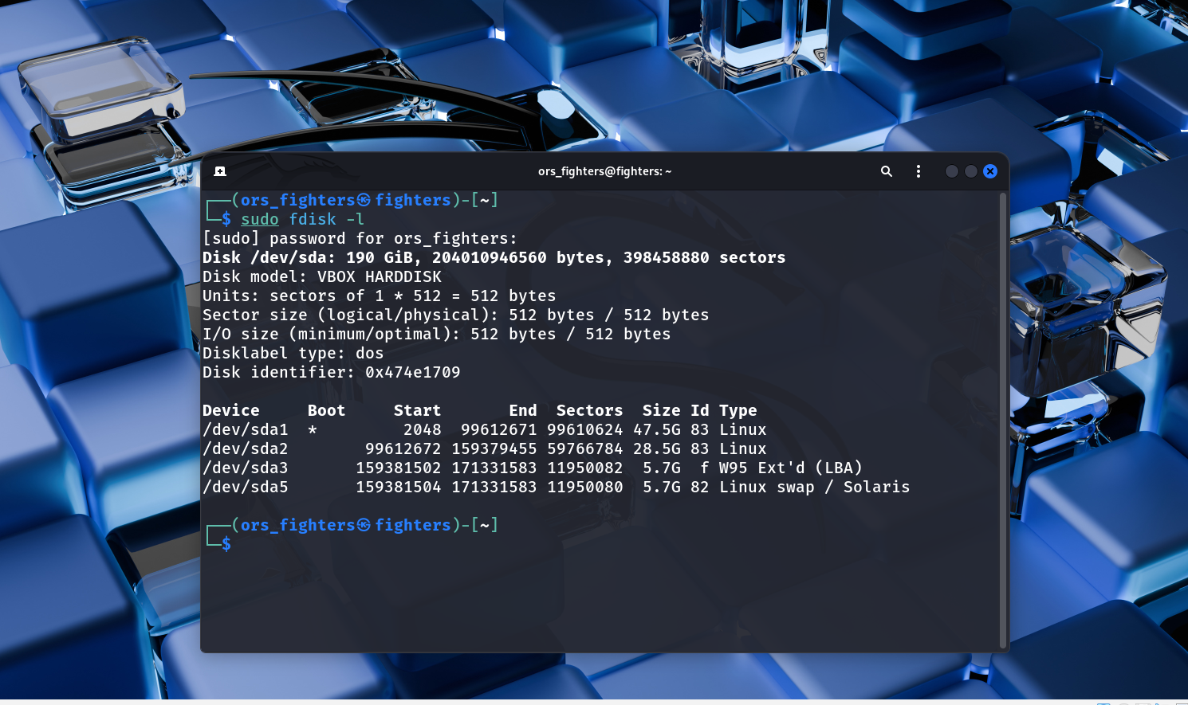
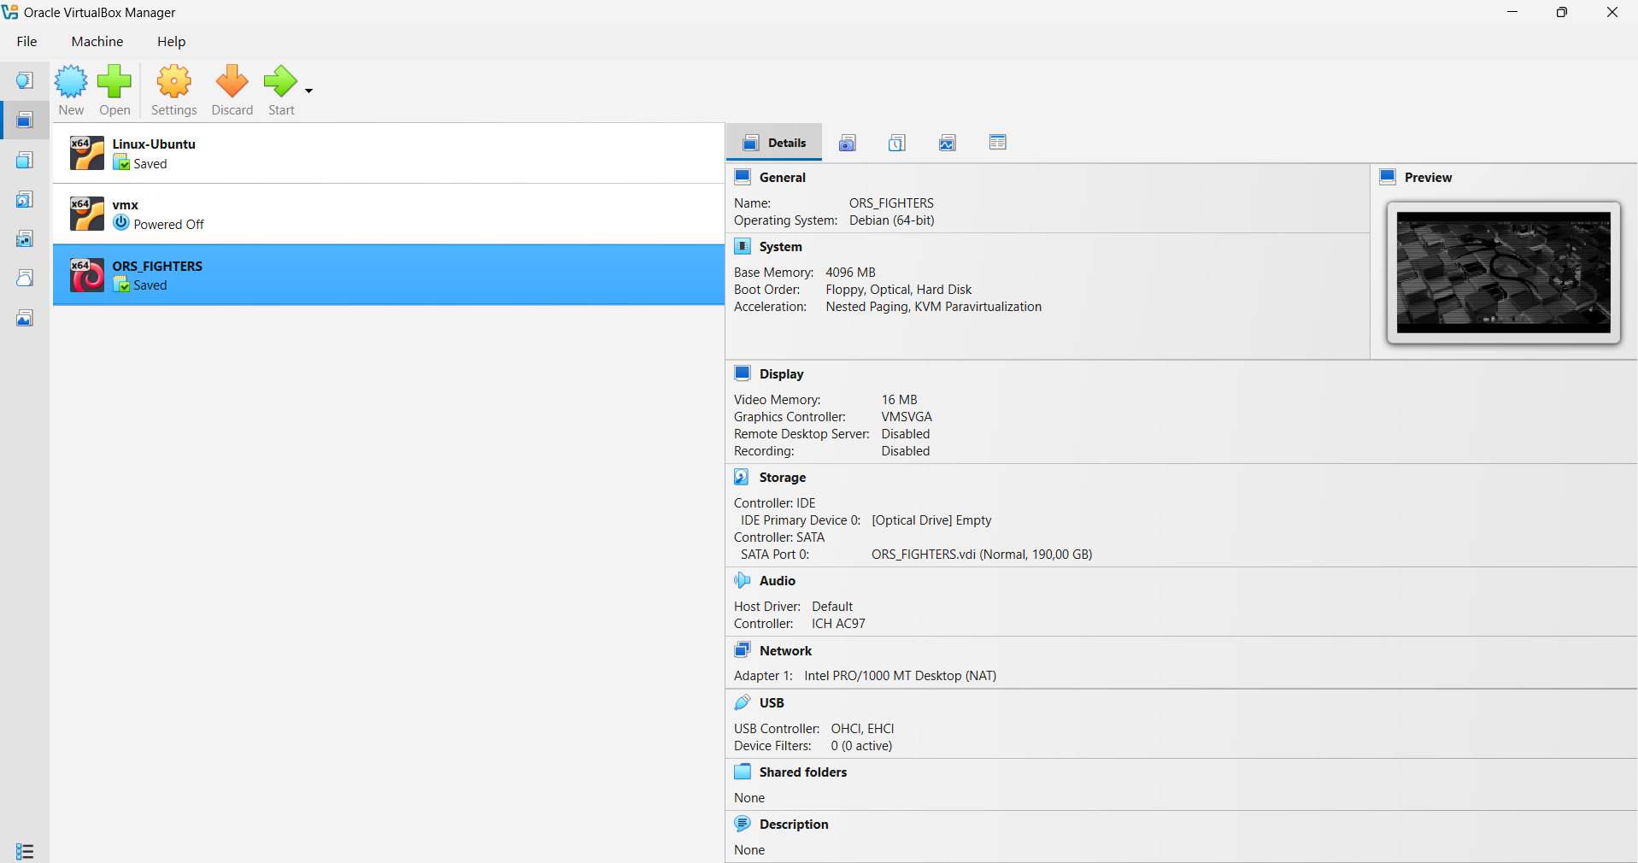
2. Screenshot4

Slide 9
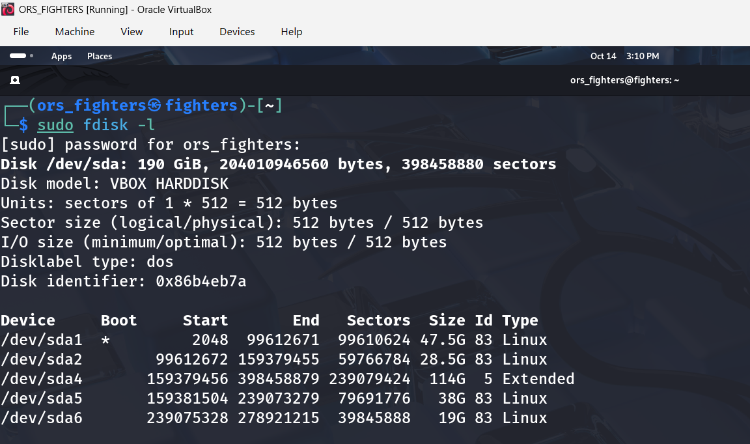
Screenshot6

Slide 10
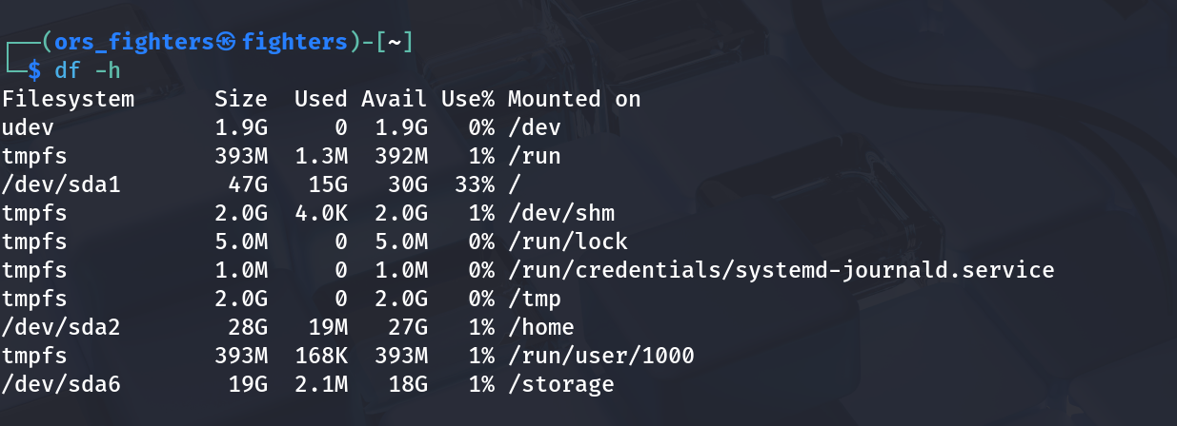
Screenshot7

Slide 11
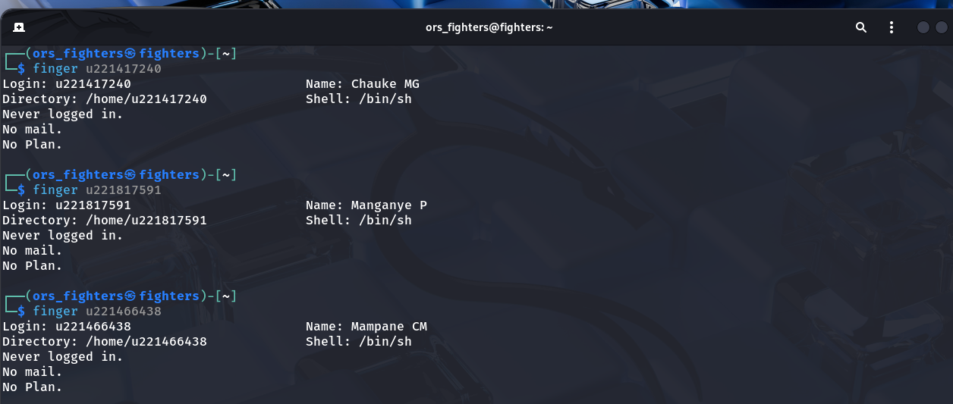
Screenshot8a

Slide 12
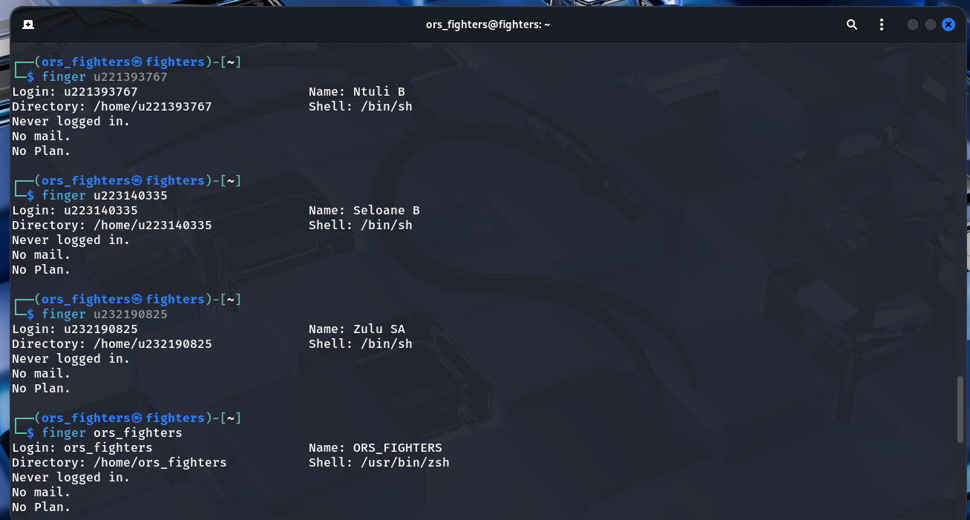
Screenshot8b

Slide 13
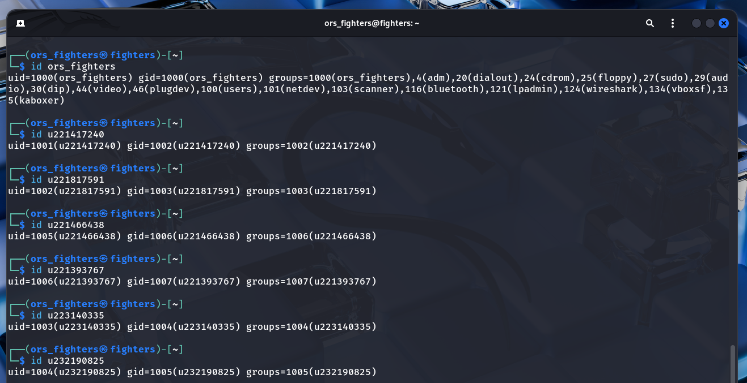
Screenshot9a

Slide 14
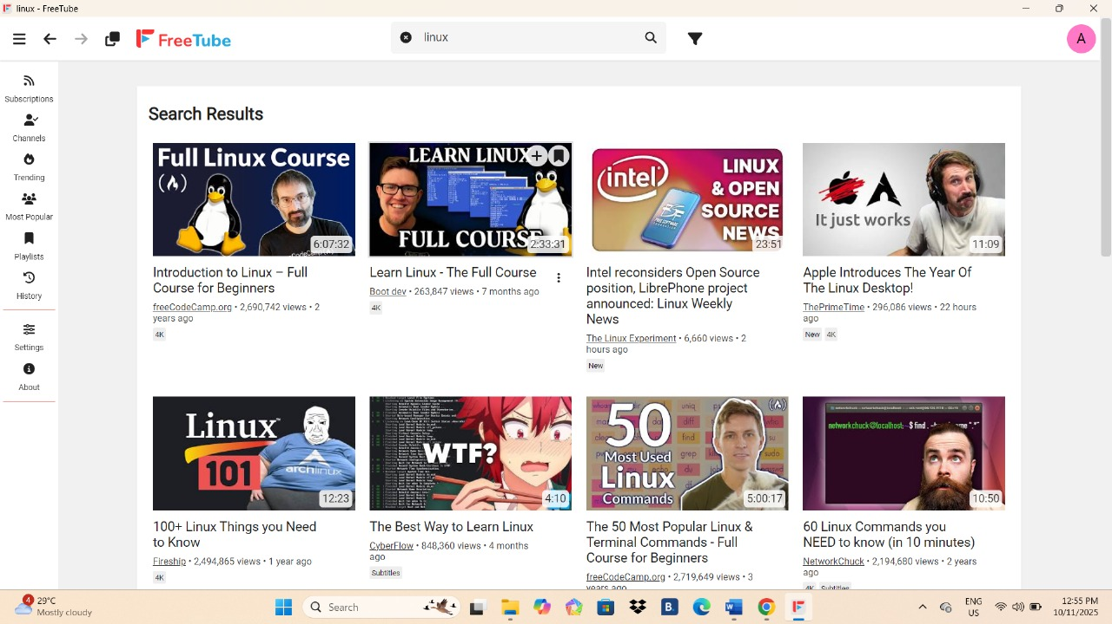
Screenshot10

Slide 15
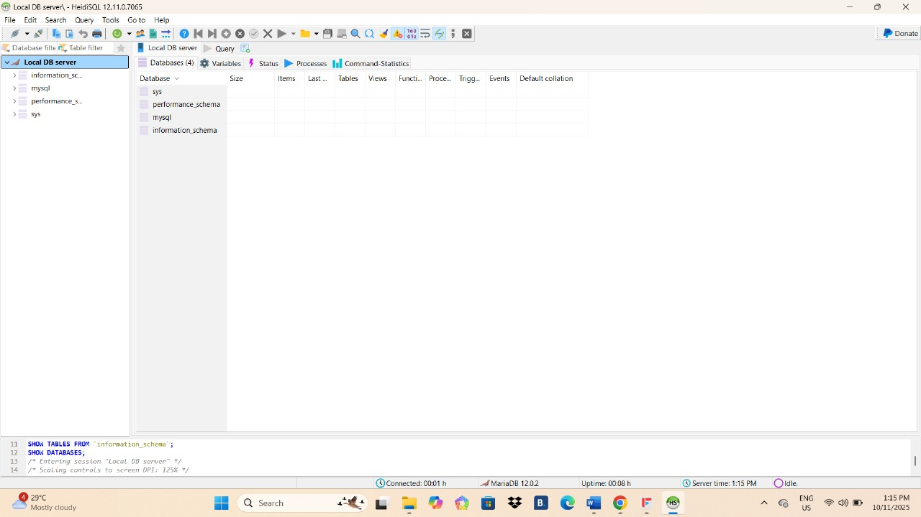
Screenshot11

Slide 16
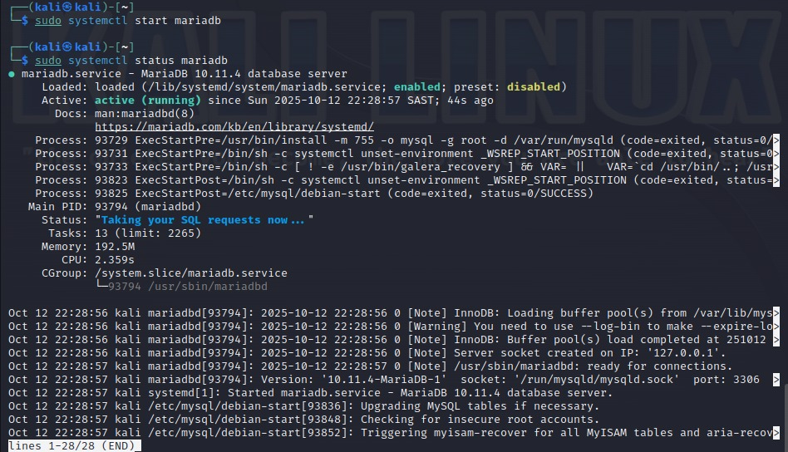
Screenshot12

Slide 17
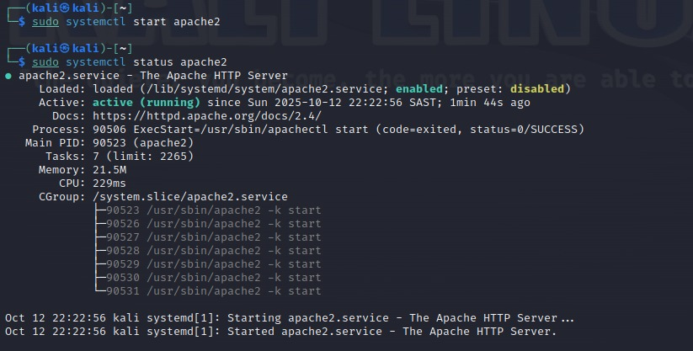
Screenshot13

Slide 18
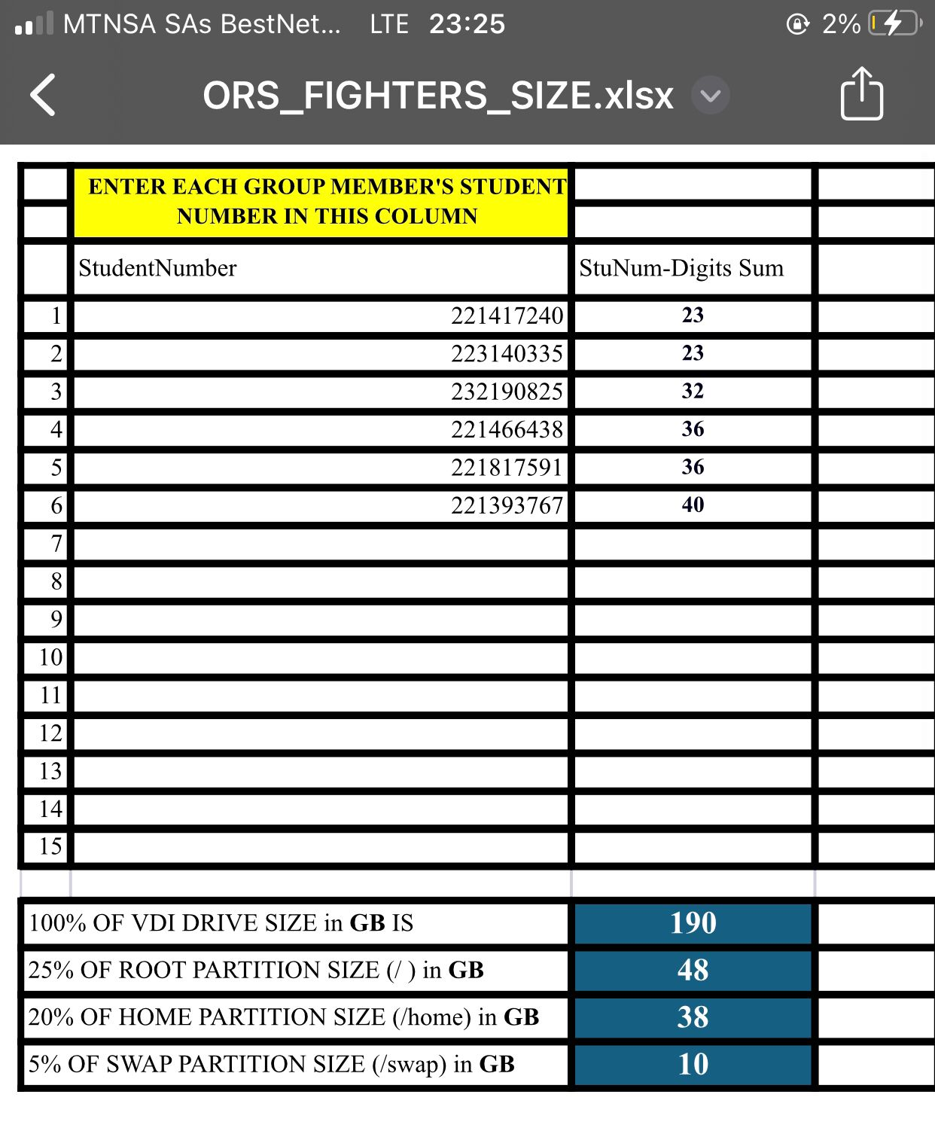
vdi

