Slide 1

Blackjack Design
Colton, Bahaa, Gavin, Khai
Notes:
Notes subject to change

Slide 2
Blackjack Design
Colton, Bahaa, Gavin, Khai
Notes:
!! THIS SLIDE IS ONLY USED FOR ANIMATION

Slide 3
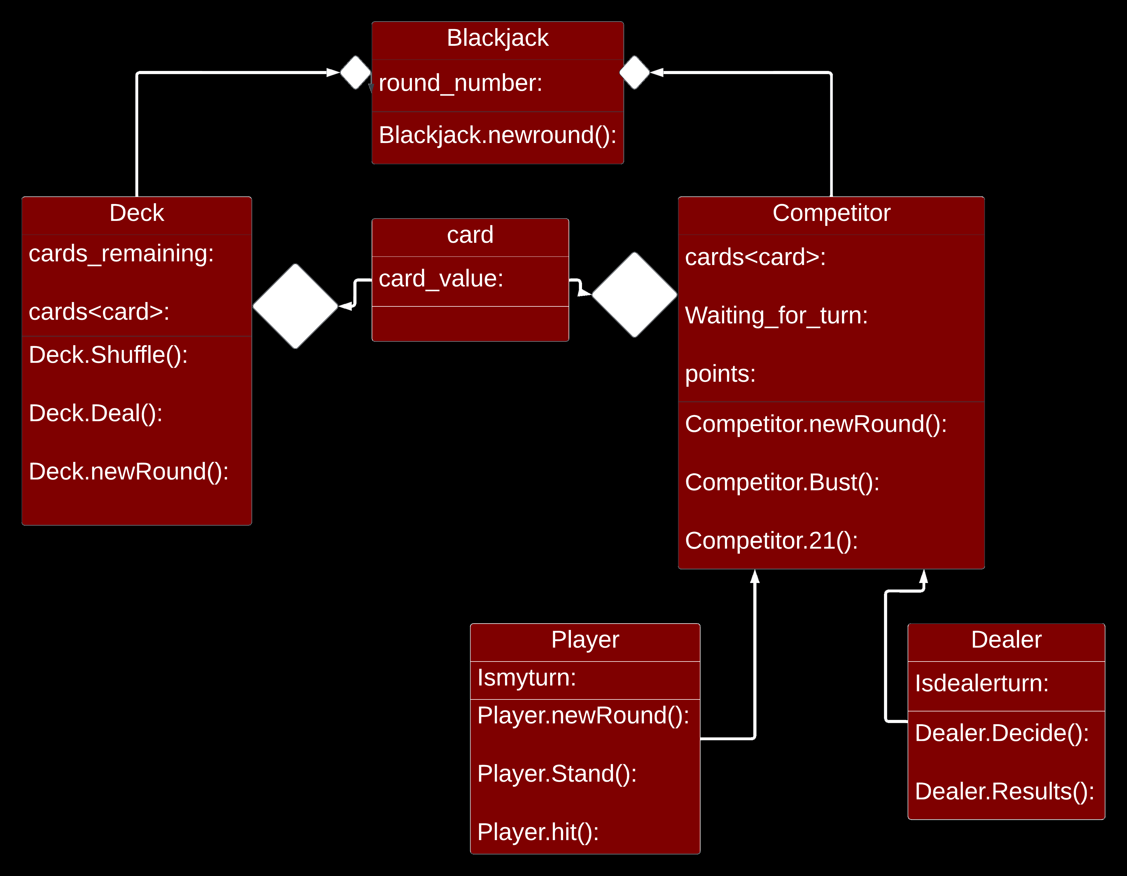
Overview
Seems like a higher-level class diagram
Limiting the feature set down to just the game (Omitting networking/login features)
(insert Domain Model Diagram Here)

Slide 4
Class
More detailed than Domain model diagram
Includes member type and protections
Includes operation types and protections

Slide 5


Use Case
Bet
- Loops for multiple plays.
-Flip cards = Resolve of the game.
Cards Dealt
Hit/Stay
Customer
Flip Cards
Dealer
Leave/Go Again

Slide 6
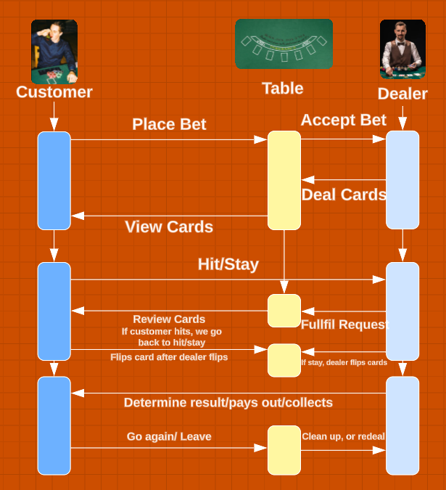
Sequence
- Different kind of flow of the loop.
- Table as a middle piece

