Slide 1
Issue to Results
Colton S.

Slide 2
Problem
Rapid Decline in Sales

Slide 3
Discovery Process
Bad data
Better analytics
Enhanced Reports
Better Dashboards

Slide 4
Discovery Process
Solution
Bad data
Enhanced Reports
Insights
Better analytics
Better Dashboards

Slide 5
01
Bad Data

Slide 6
How?
Bad Data
Multiple Possible Causes
No Quality Control
Broken Software
Purposeful (Not Likely)
Remedy Process

Slide 7
Data Warehouse
Better analytics
Faster Structure
No effect on customers

Slide 8
All the data
Enhanced Reports
Nothing left out
Have detailed reports
However
Time
Static

Slide 9
Quick Results
Better Dashboards
High and low level
Interactive
Dynamic

Slide 11
01
Bad Data

Slide 12
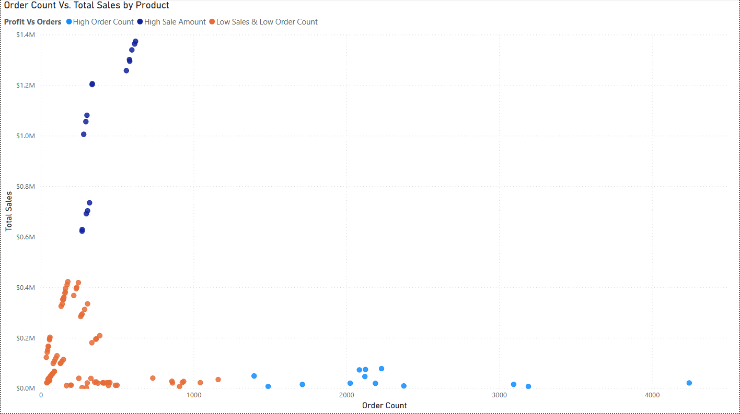
Where at?
Current
Distinct High Profit
Distinct High Orders

Slide 13
Where to?
New categories
More demand

