Slide 1

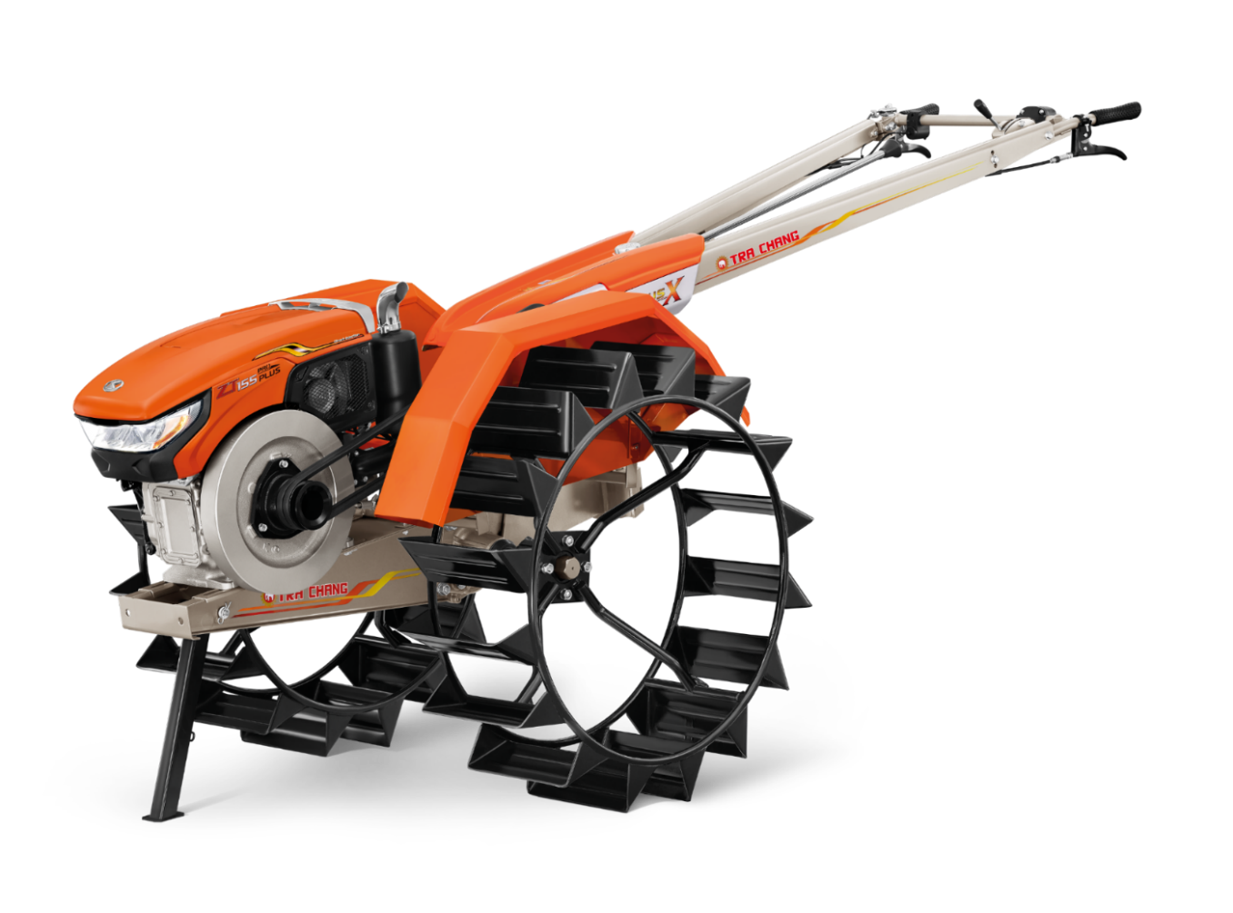
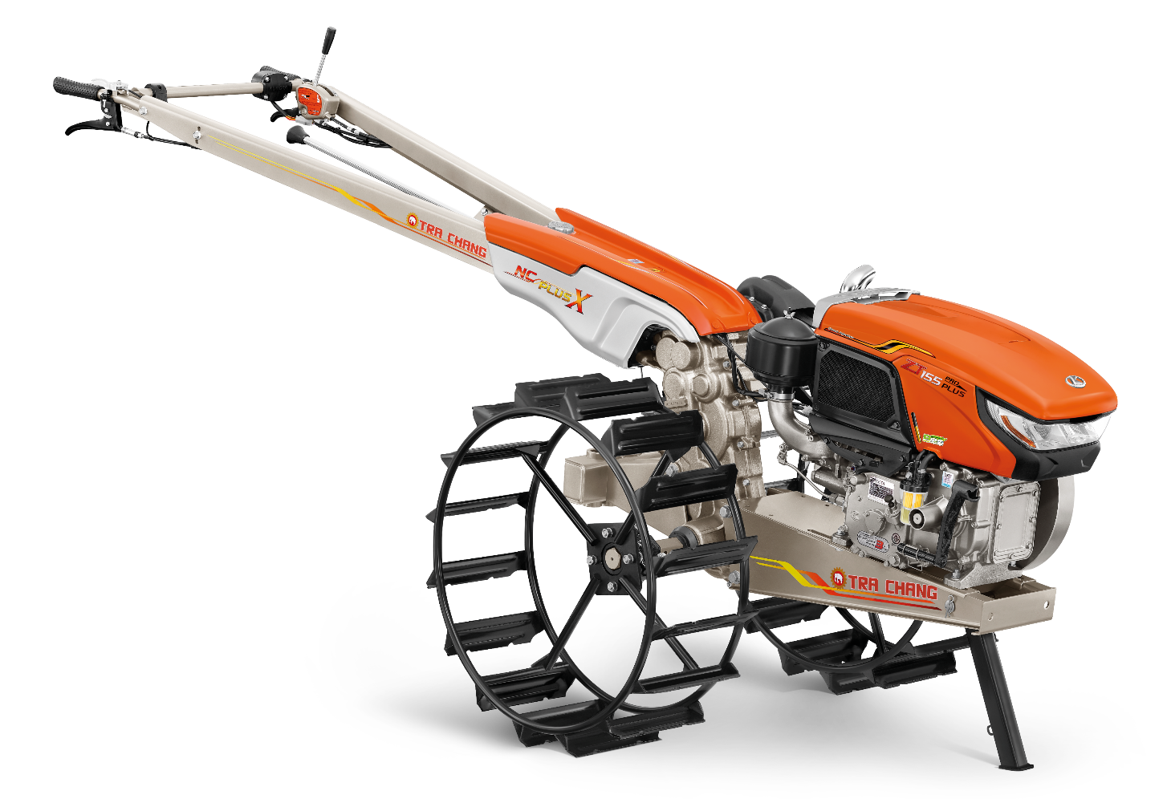
The steps for assembling TRA CHANG power tiller

Slide 2

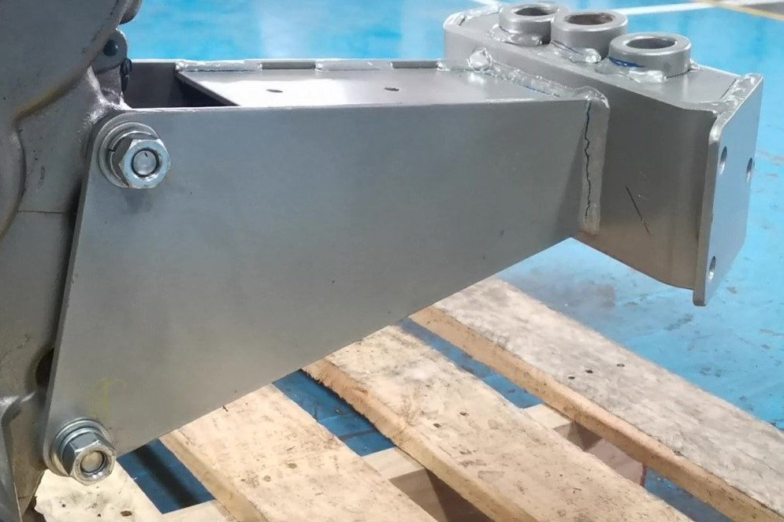
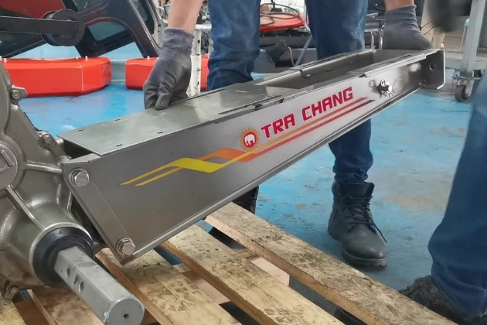
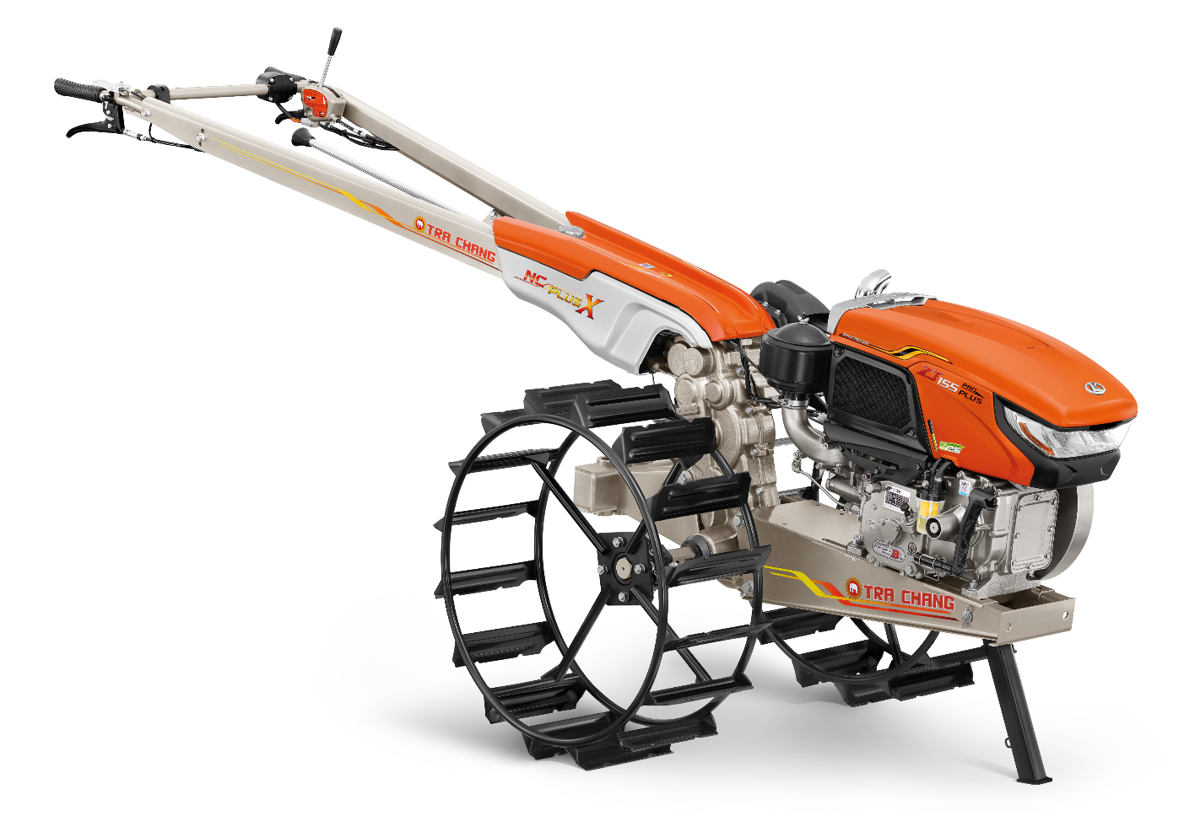
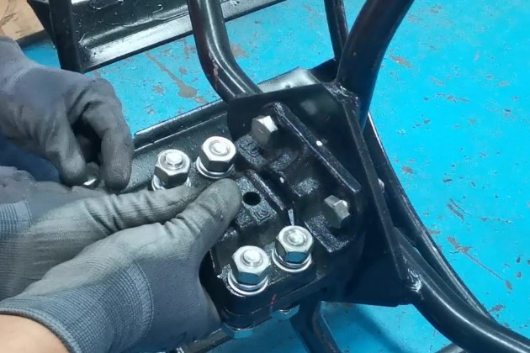
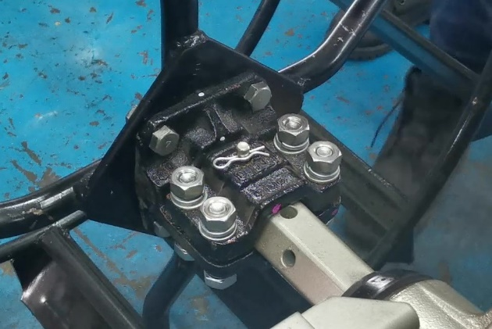
How to assemble
1
2
Assemble the hitch
(Hitch must on the left side of power tiller)
Assemble the frame front
3
4
Correct wheel assembly, The wheel blades must point to back of power tiller.
Assemble the cage wheels
Assemble the wheel to the wheel axle.

Slide 3
The steps for assembling KUBOTA diesel engine with TRA CHANG power tiller

Slide 4
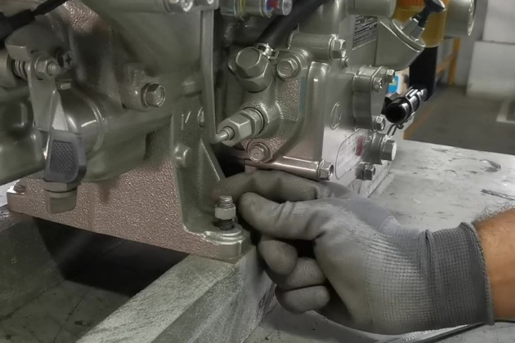
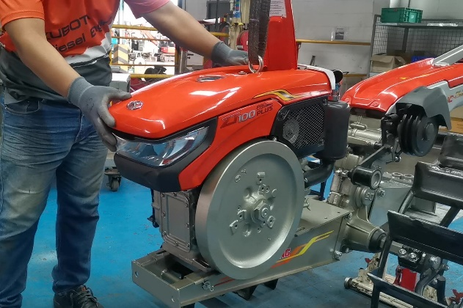
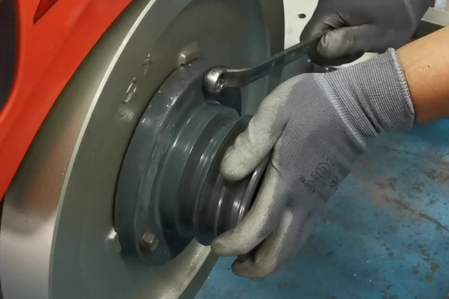
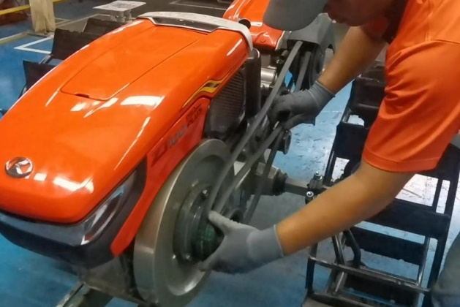
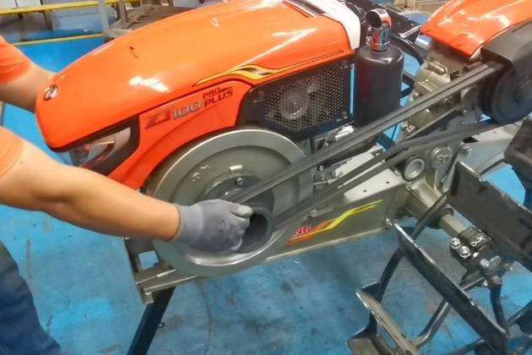
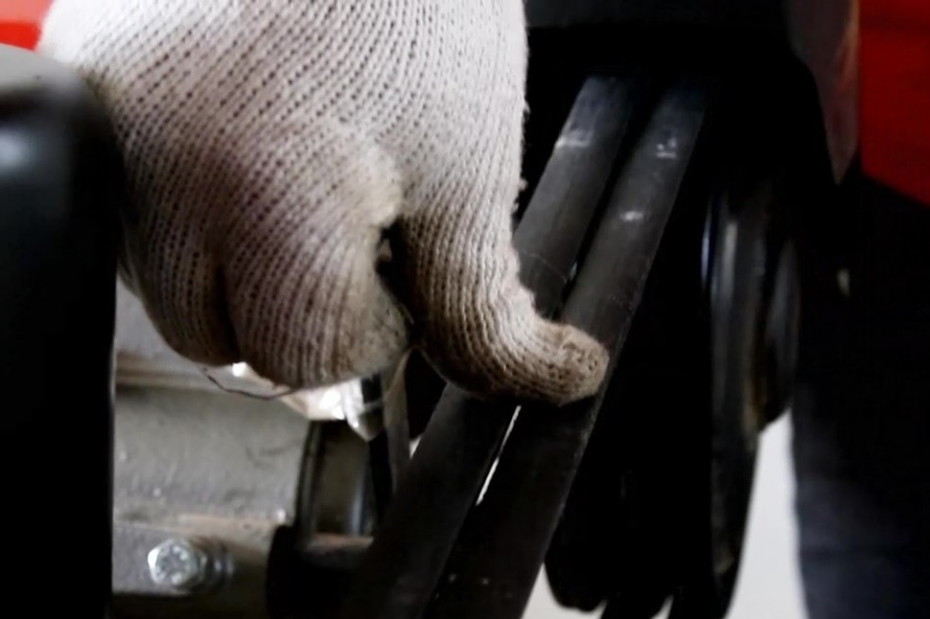
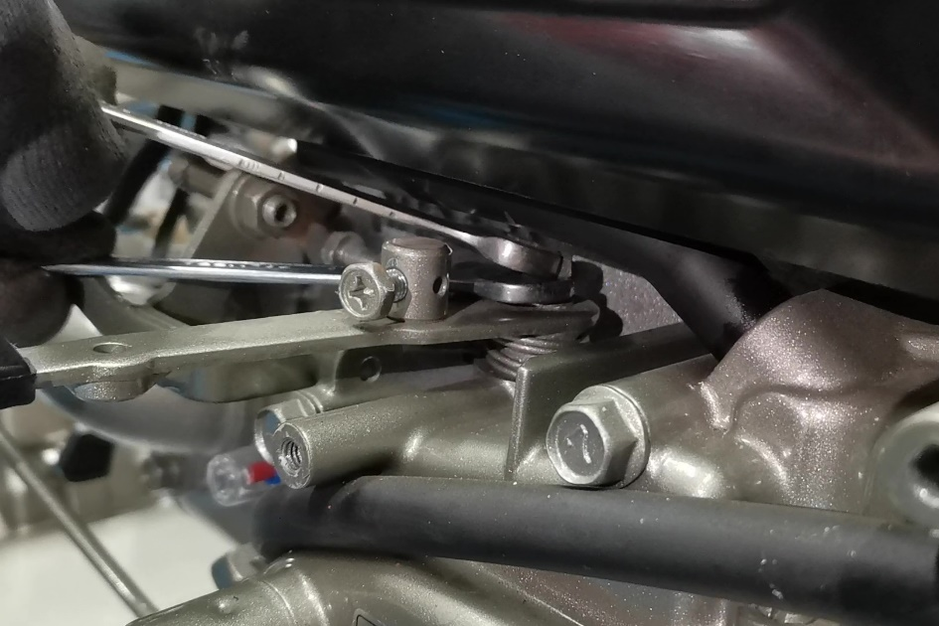
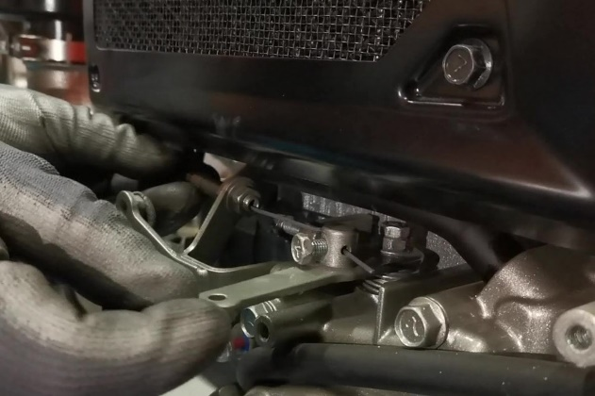
How to assemble
1
2
3
4
Remove the engine from the stand.
Assemble the engine to the chassis of the power tiller and tighten the engine nut
Attach the pulley to the flywheel.
Attach the belt to the pulley on the power tiller and the engine.
5
6
7
8
Pull the engine to the front.
Keep the belt tight and tighten the nut.
Adjust the tension of the belt
about 22-28 mm by tightening
or loosen the nut.
Loosen 2 nuts at accelerator allowing the accelerator lever to work independently. Then tighten again.
Attach the accelerator cable to the accelerator lever and tighten the nut

