Slide 1

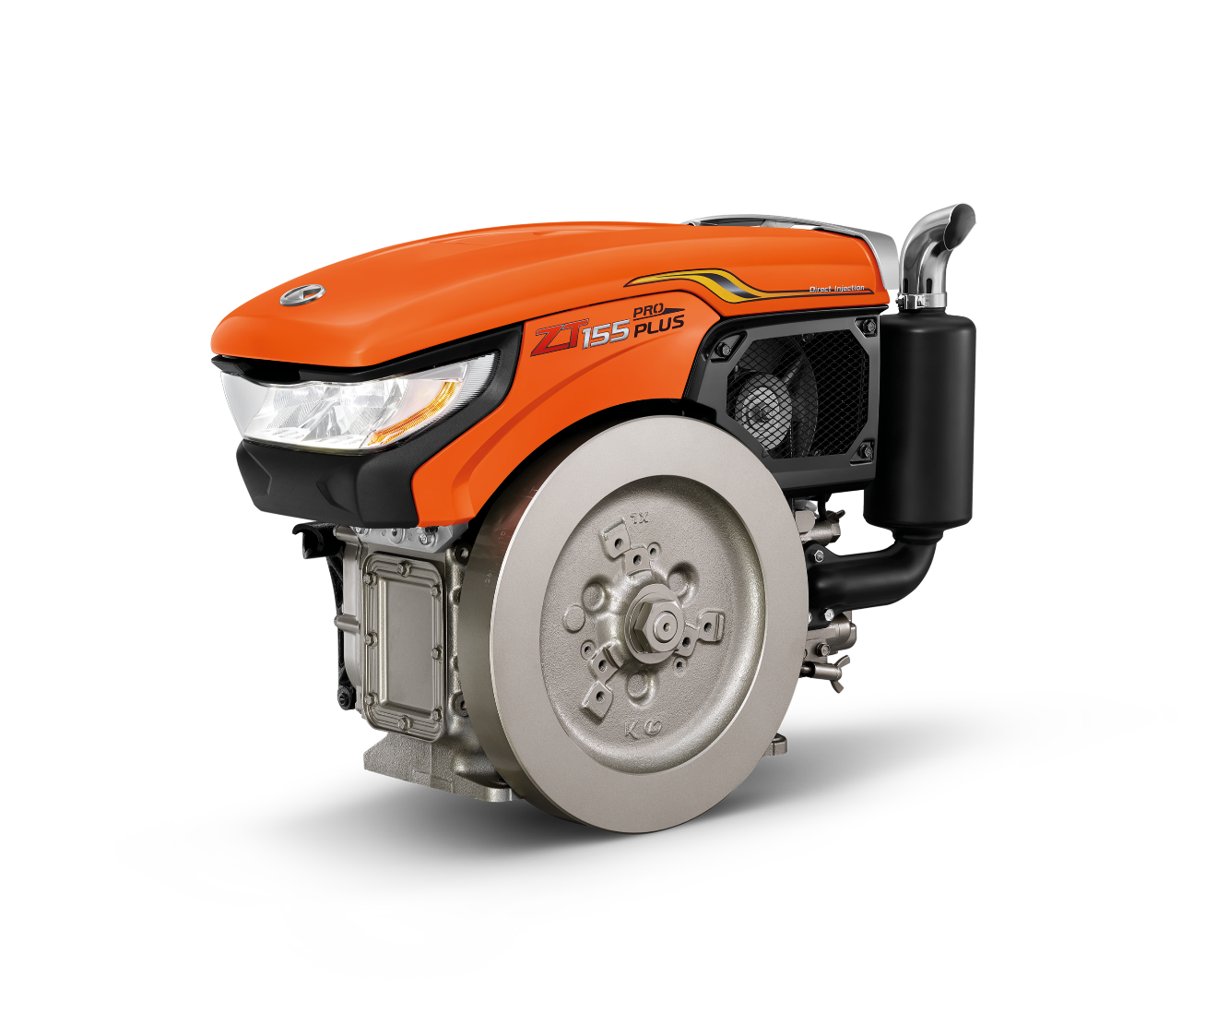
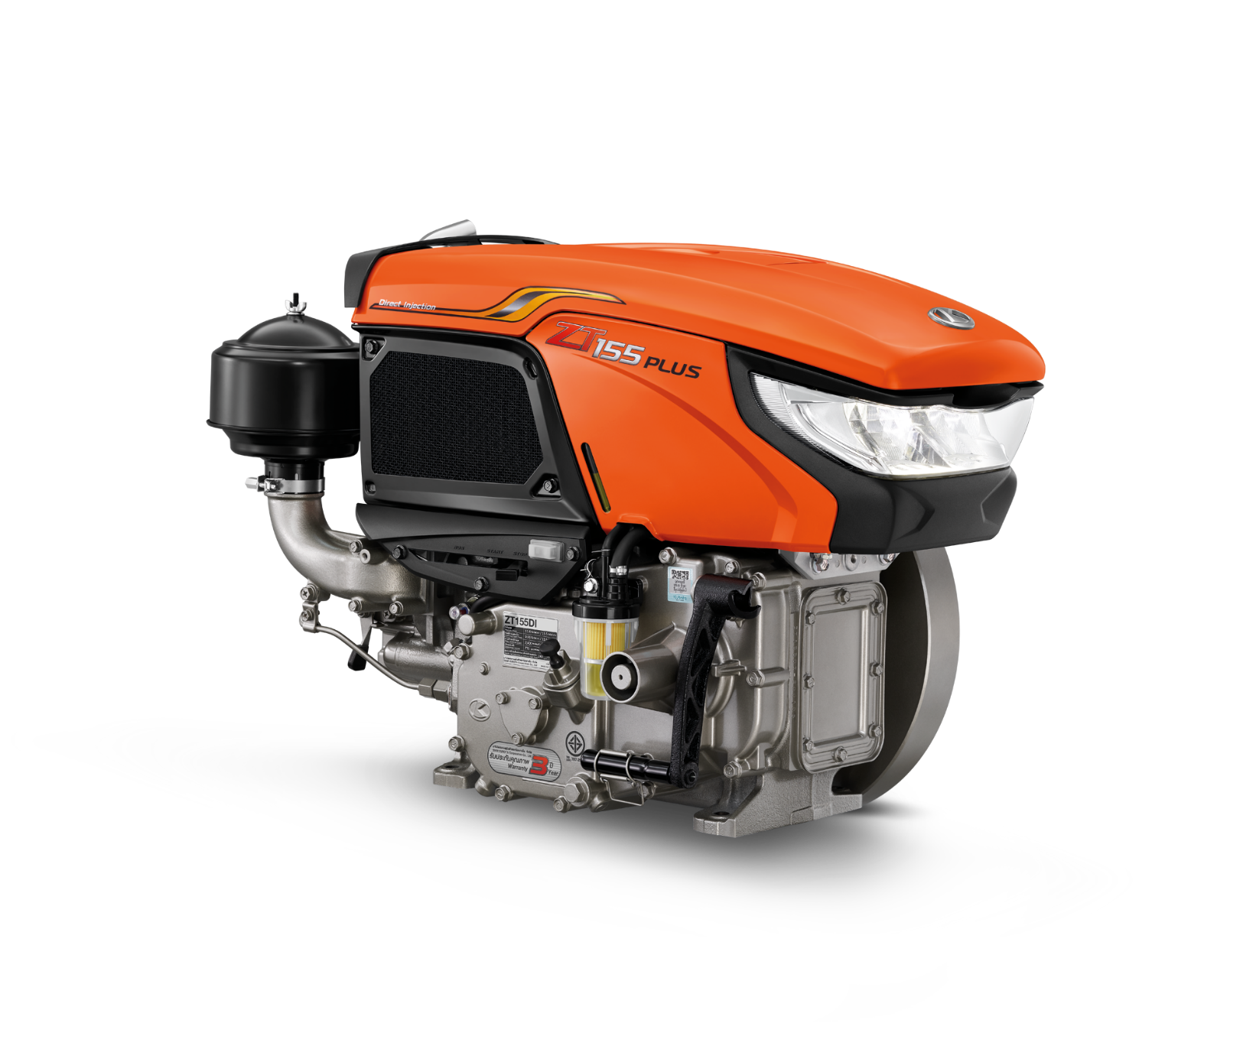
How to maintenance your
KUBOTA diesel engine

Slide 2


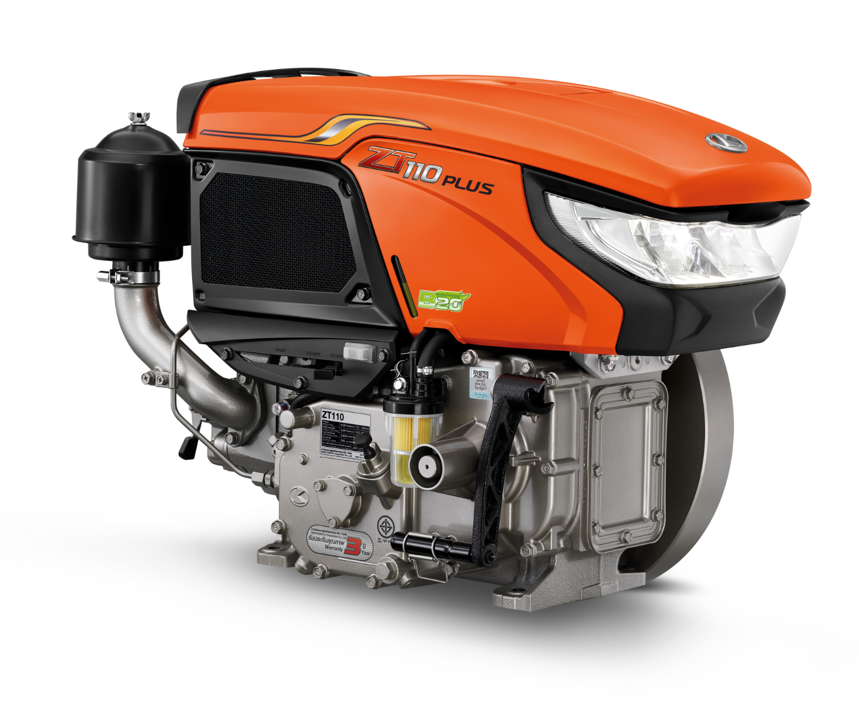
Key points to maintenance
5 Key Points
1) the air filter
2) the fuel system
3) the engine oil
4) the cooling water system
5) the fan belt

Slide 3
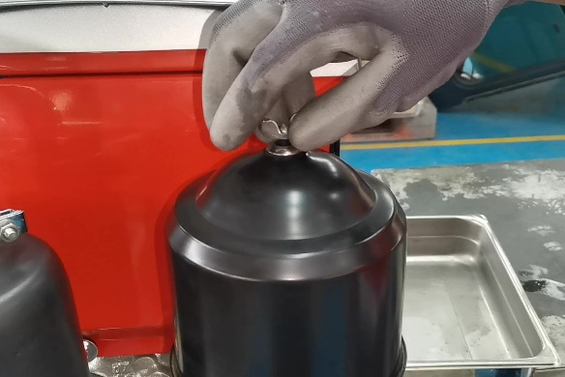
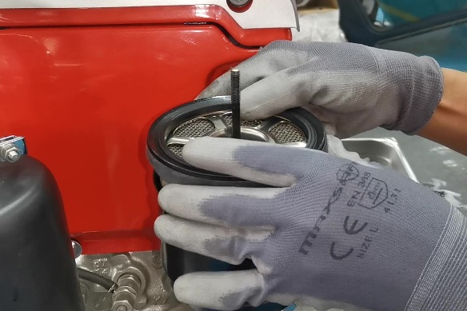
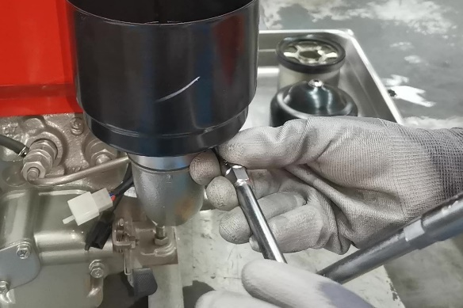
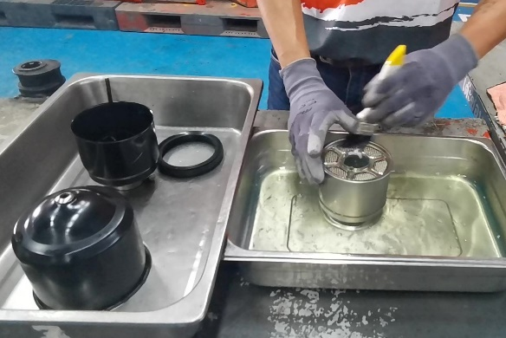
1. Maintenance the air filter system
• Maintenance daily before use your engine.
Process :
1) Clean the pot and air filter every 100 hours or every month
2) Loosen the nut and remove the pot cover then pull out the air filter
3) Remove the air filter by loosening the No.10 nut
4) Clean the air filter by using diesel and gently tap to remove the dirt then use the blower to make it dry.
5) For the air filter pot can be cleaned by diesel or water mixed with detergent then make it dry before assemble
6) Before assembling, Fill up TRA CHANG engine oil to the specified limit then tighten the No.10 nut
7) Reassemble the air filter and filter pot cover then tighten the nut.

Slide 4
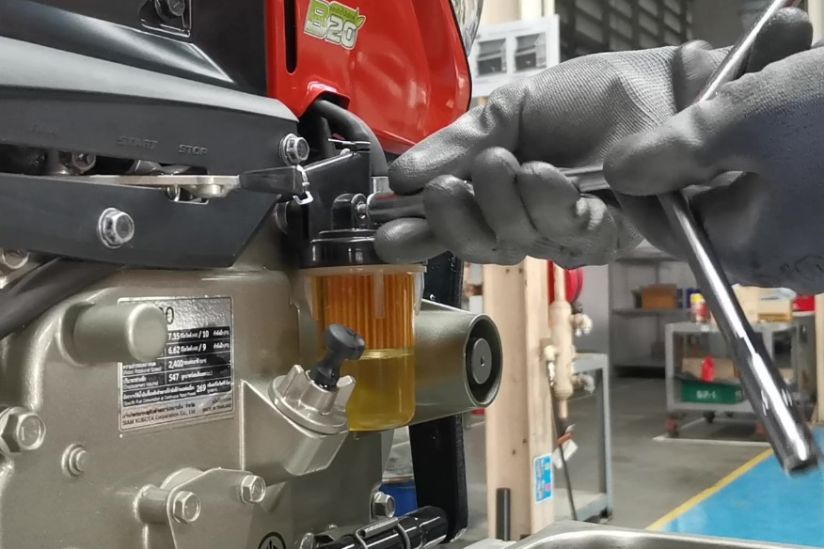
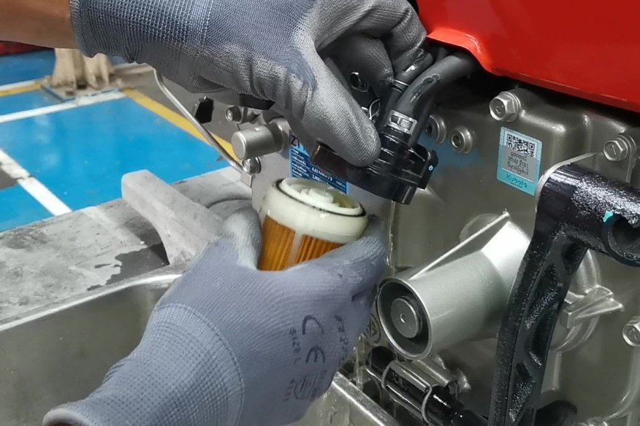
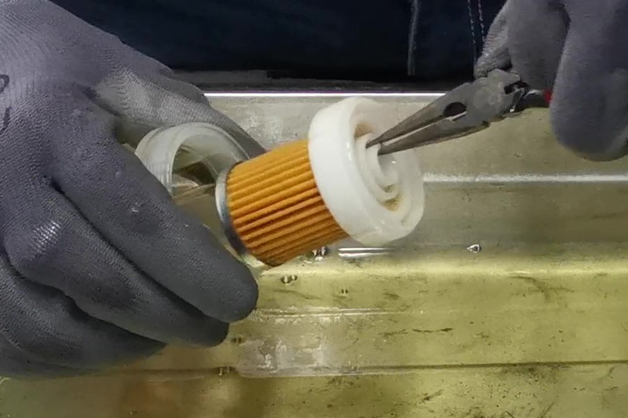
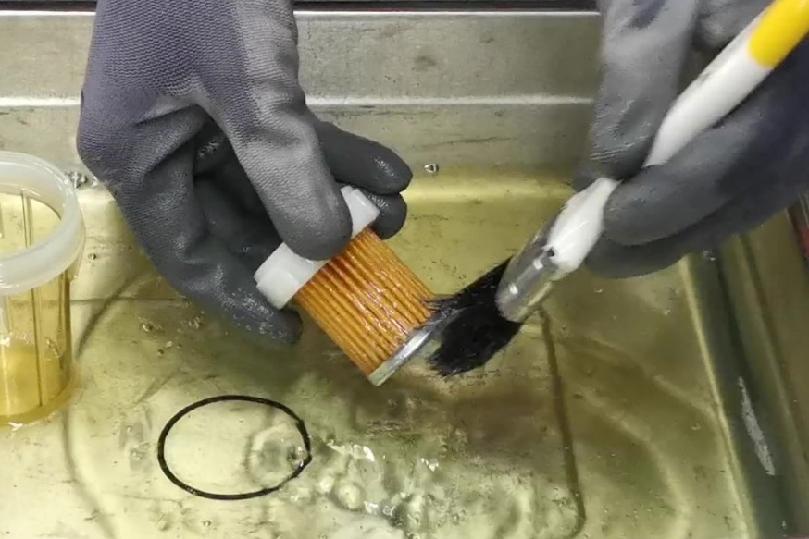
2. Maintenance the fuel system
• Maintenance every time before use your engine.
Process :
1) Clean the fuel filter every 100 hours or every month
2) If there is dirt or water in the oil, clean immediately
3) Change fuel filter every 400 hours
4) Remove the nut of the fuel filter
5) Turn the fuel filter cup out. Then use pliers to pull the fuel filter apart.
6) Clean the filter cup and fuel filter. by tapping or using a brush then make it dry by blower
7) If the filter is clogged or torn change immediately
8) Assemble the fuel filter to the filter cup.
9) Be sure to put an op-ring on the top of the filter.
10) Assemble the fuel filter cup back firmly and tighten the nut No.10 to lock the fuel filter tightly

Slide 5
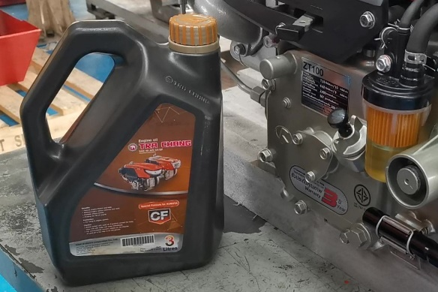
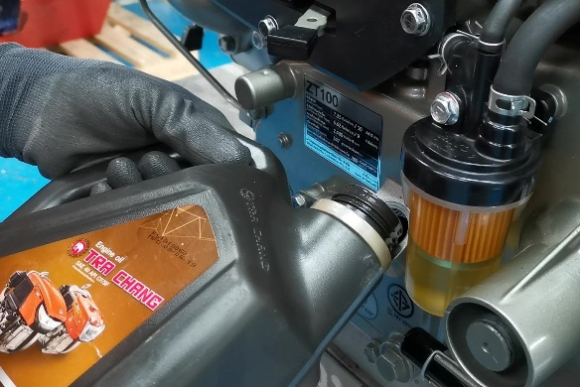
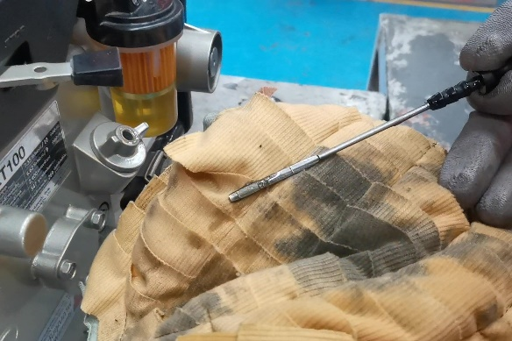
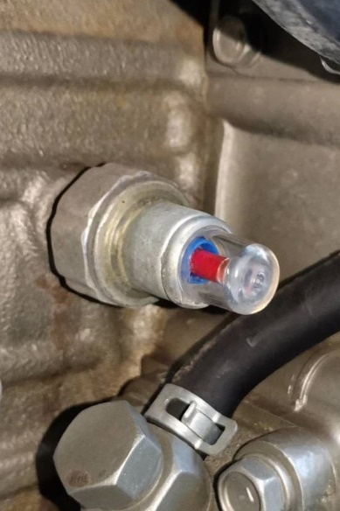
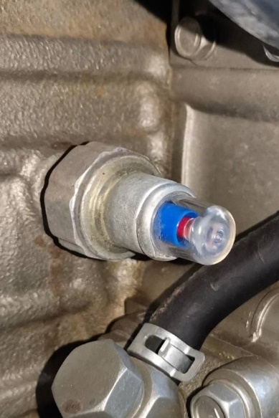
3. Maintenance the engine oil
For new engine, please change the engine oil after used for the first 50 hours.
After that change the engine oil every 100 hours.
Process :
Remove the oil drain plug and let the engine oil drain completely
Clean the engine oil filter by diesel
Put the oil drain plug and tighten
Fill up the TRA CHANG engine oil (SAE40 API CF)
The engine oil level must not be higher than the upper scale and not lower than the lower scale.

Slide 6
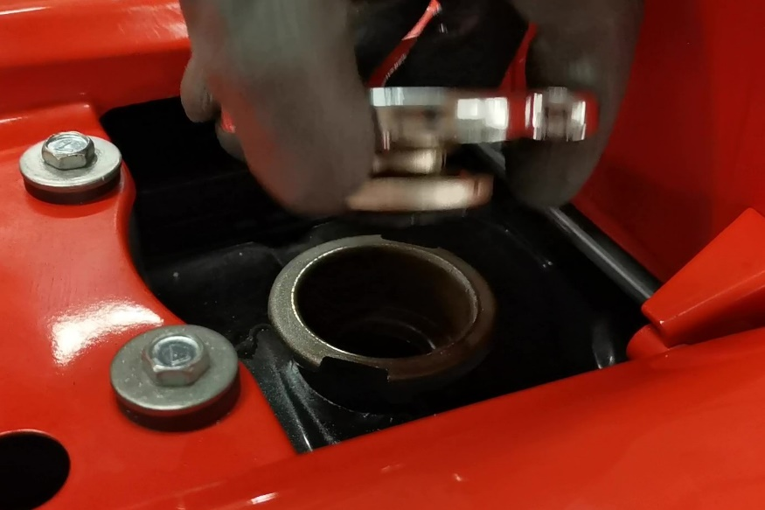
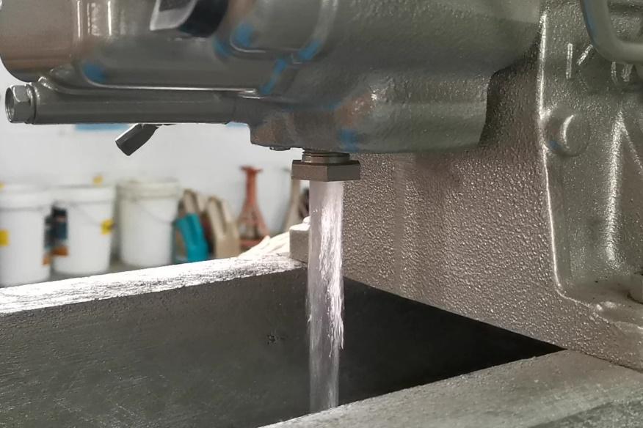
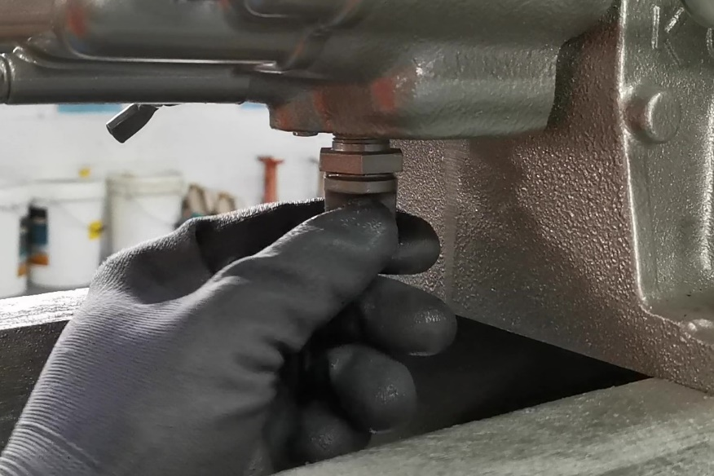
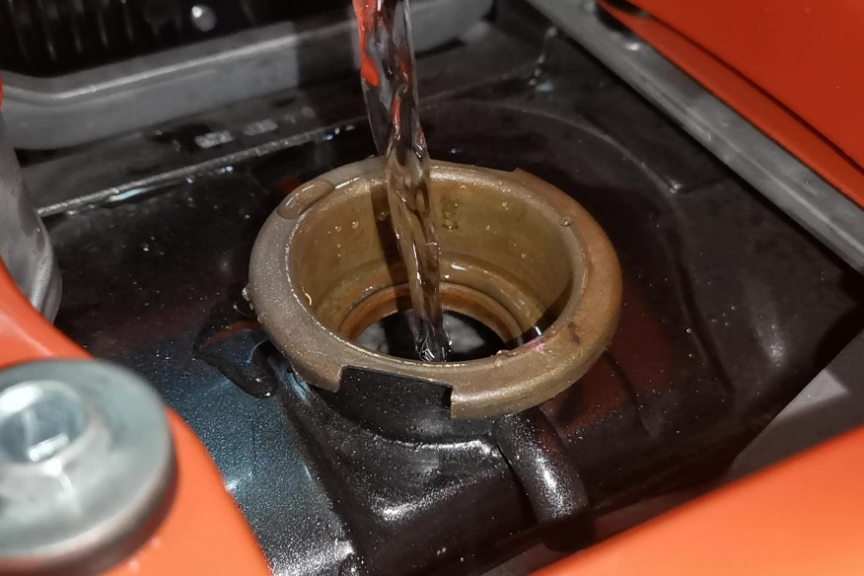

4. Maintenance the cooling water system
• Drain the water in the radiator every 3 months in case of adding rust proof powder
• every month in case of don't add rust proof powder
Process :
While draining the water, it is recommended to open the radiator cap to make the water drained faster
Remove the drain plug and let the water drain out completely, Then tighten the drain plug.
Add 1 bag of rust proof powder and fill the clean water.
Tighten the cap.
Caution
Do not use groundwater or canal water because it will cause the radiator to have sediment and cause the radiator to clog

Slide 7
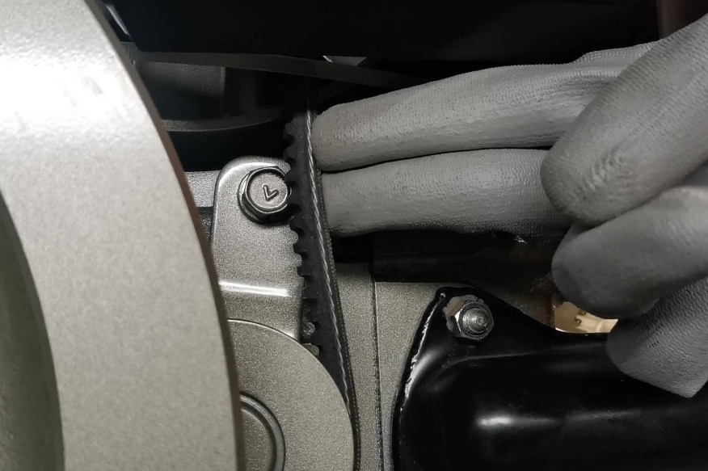
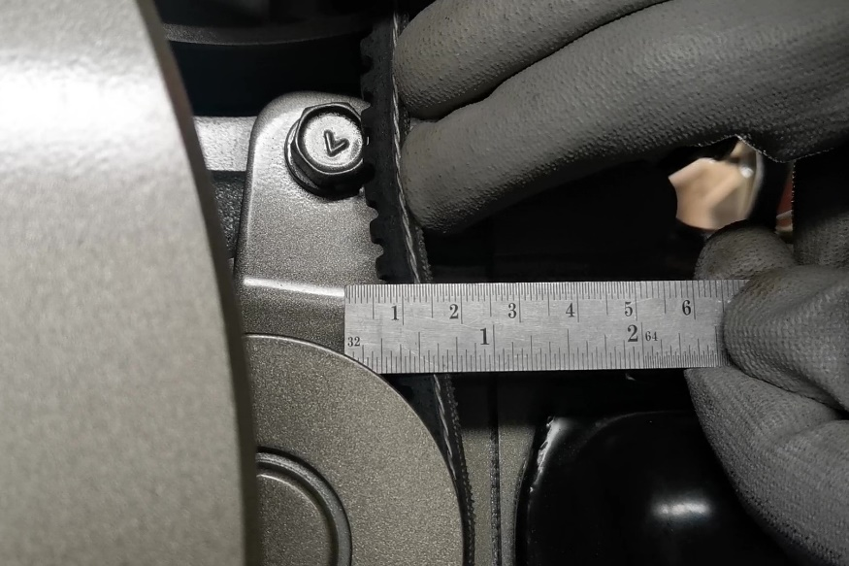
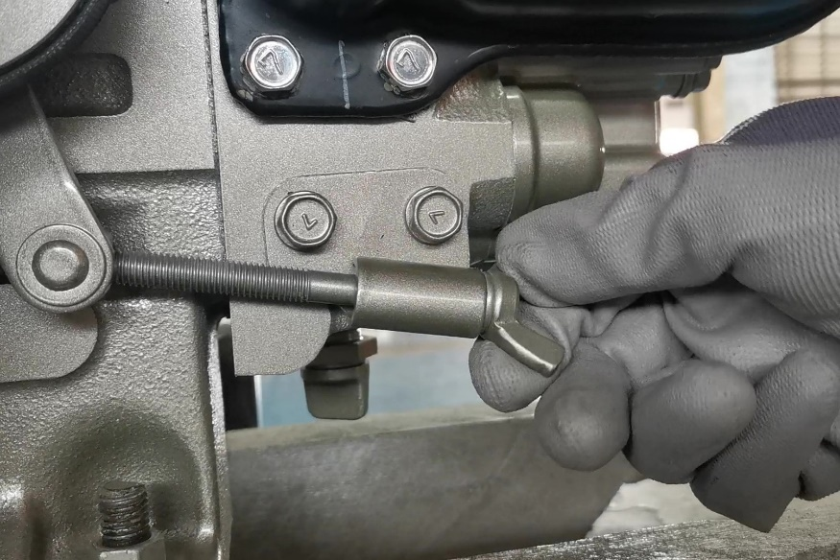
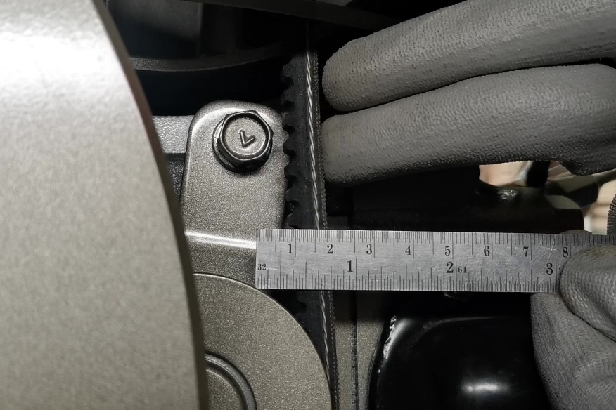
5. Maintenance the fan belt
• Check before use every time
Process :
The appropriate tension is 10 mm.-15 mm.
If the belt is cracked or torn, replace it immediately.
Caution
* if the belt breaks during use This will cause the engine to heat up and cause overheating.

