Slide 1


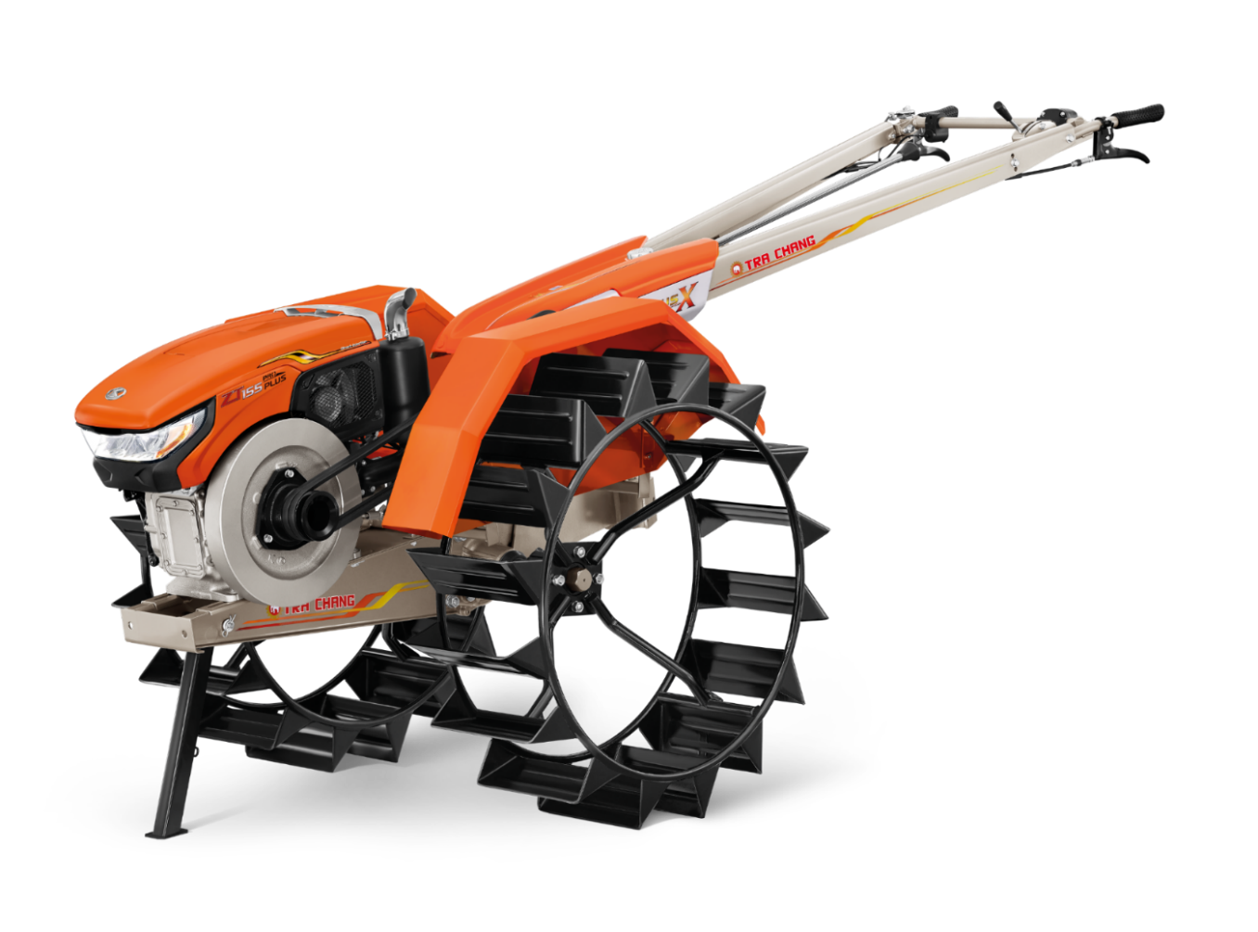
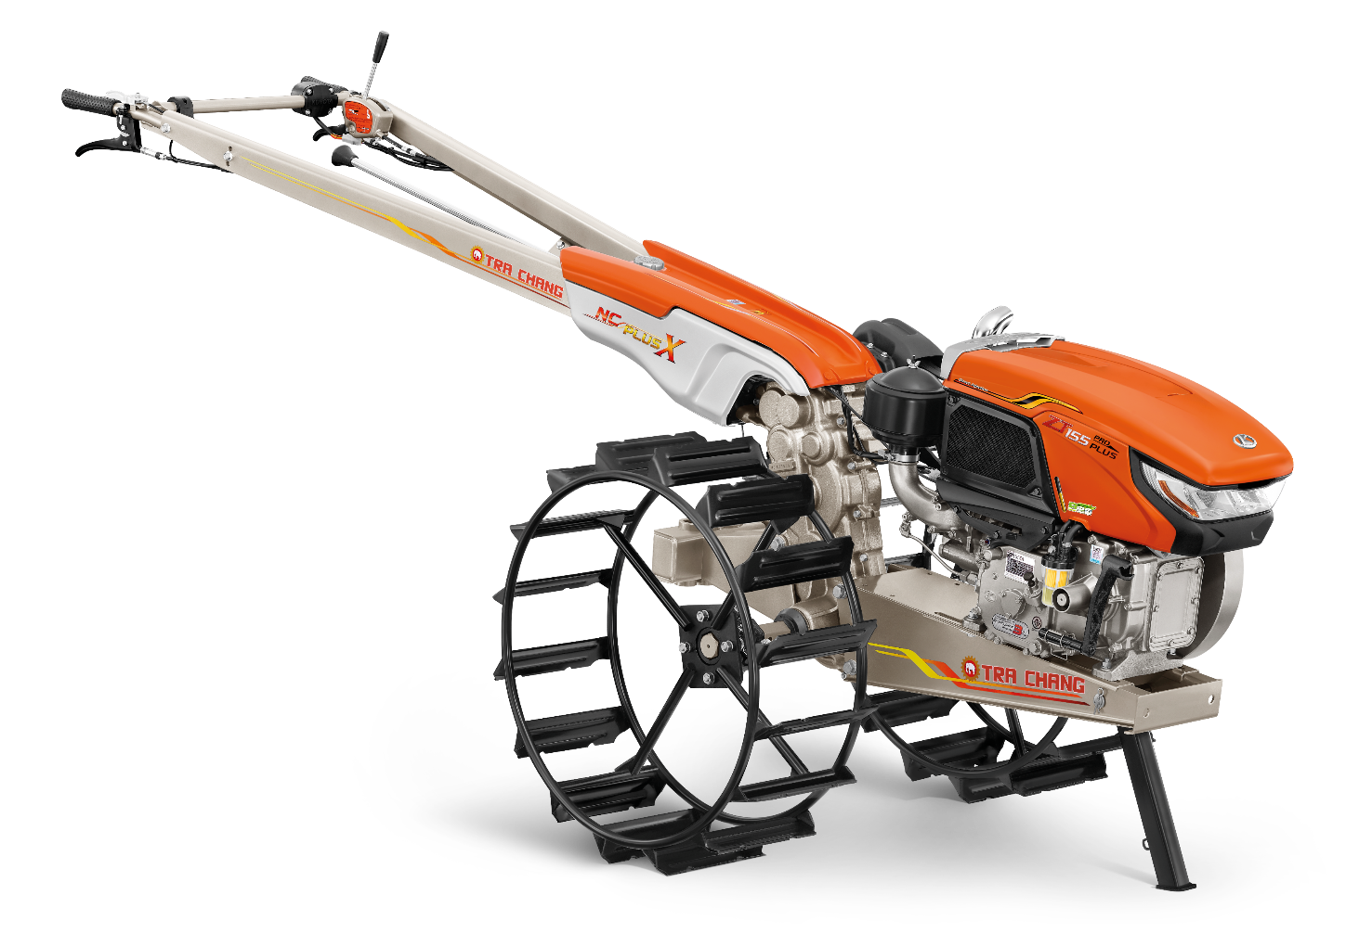
How to maintenance
Power tiller

Slide 2


How to maintenance Power tiller
5 key points
1) How to check the transmission oil
2) Adjusting the steering lever
3) Adjusting the clutch free play
4) Adjusting the brake free play
5) Adjusting the belt tension

Slide 3
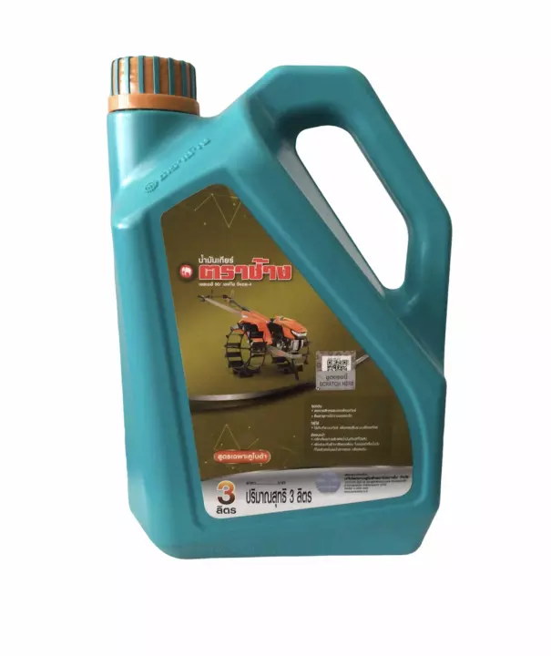
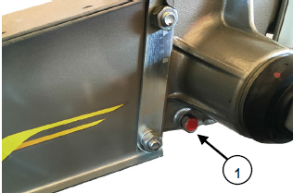
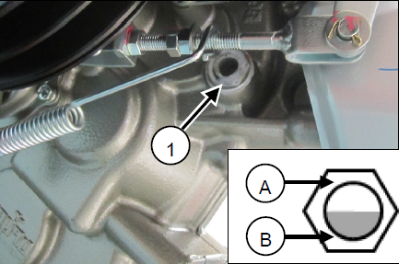
1) How to check the transmission oil
Period :
For the new TRA CHANG power tiller, change the transmission oil after used for 50 hours.
After that change the gear oil every 500 hours.
Transmission oil plug
Process :
Use TRA CHANG gear oil (SAE90 API GL-4)
The level of gear oil should in the middle of level indicator
Close the lid tightly to prevent dust or water from getting inside.
Transmission oil level

Slide 4
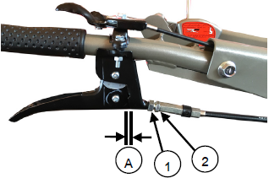
2) Adjusting the steering lever
Process :
Steering lever free play = 1-2 mm.
Loosen the nut No.12 and No.14 then rotate the adjuster and check the steering lever free play
Lubricate the left-right steering lever.
(1) Nuts
(2) Adjustor
(A) Free play = 1-2 mm.

Slide 5
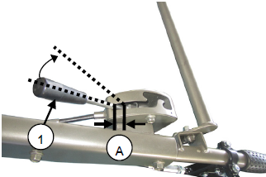
3) Adjusting the clutch free play
Process :
Main clutch lever free play = 15-20 mm
Loosen the clutch cable lock nut and turn the main clutch cable adjustor.
Then recheck the clutch free play"
(1) Clutch lever
(A) Free play = 15-20 mm

Slide 6
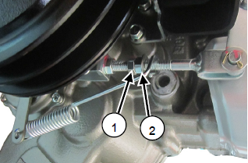
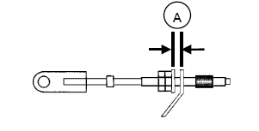
4) Adjusting the brake free play
Process :
The brake free play at clutch lever = 5-9 mm.
The brake free play = 3-5 mm.
Pull the main clutch lever to the “DISENGAGED” position.
Adjust the brake free play by adjusting the brake adjustment lock nut as required and tighten it
(1) Nut to lock
(2) Nut to adjusting
* Always lubricate the brake cable to extend the lifetime
* Turn the rubber cap to close the hole after lubricate
(A) Free play 3-5 mm

Slide 7
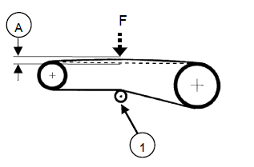
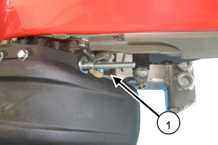
Adjusting the belt tension
Process :
ADJUSTING THE BELT TENSION
Belt tension 30-40 mm.
Tighten the belt tension adjusting wing bolt to lift up the pulley until the belt is stretched
If the belt is cracked or torn, replace it immediately.
(1) Engine pulley (A) Belt tension
30-40 mm.
(1) Belt tension
adjustor

