Slide 1


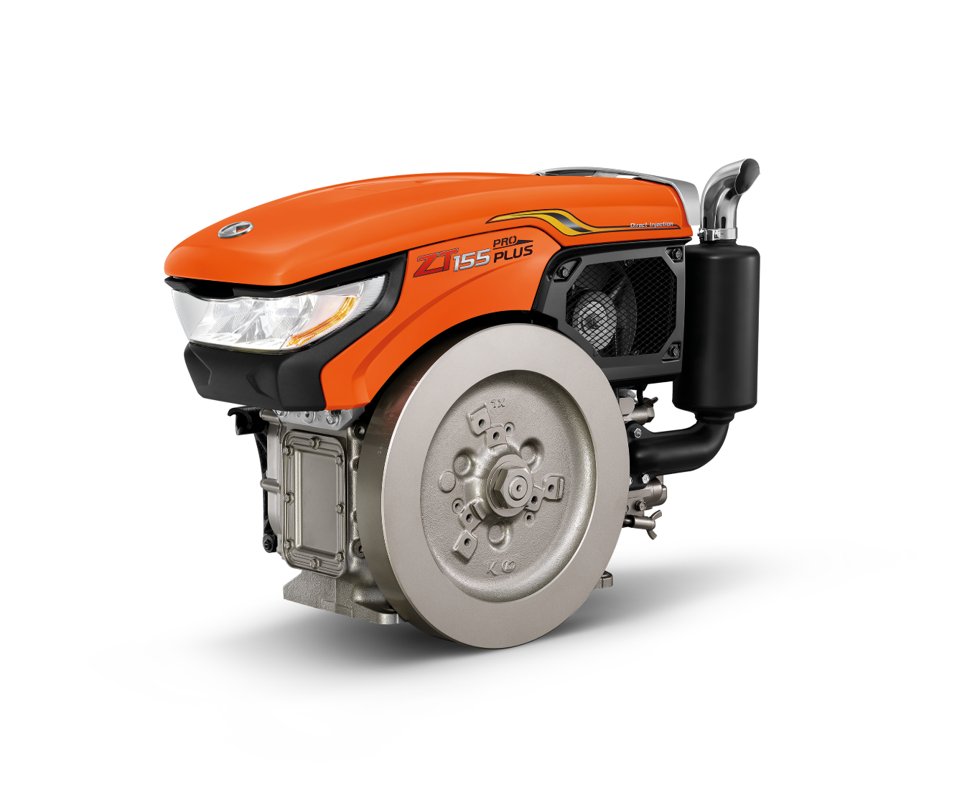
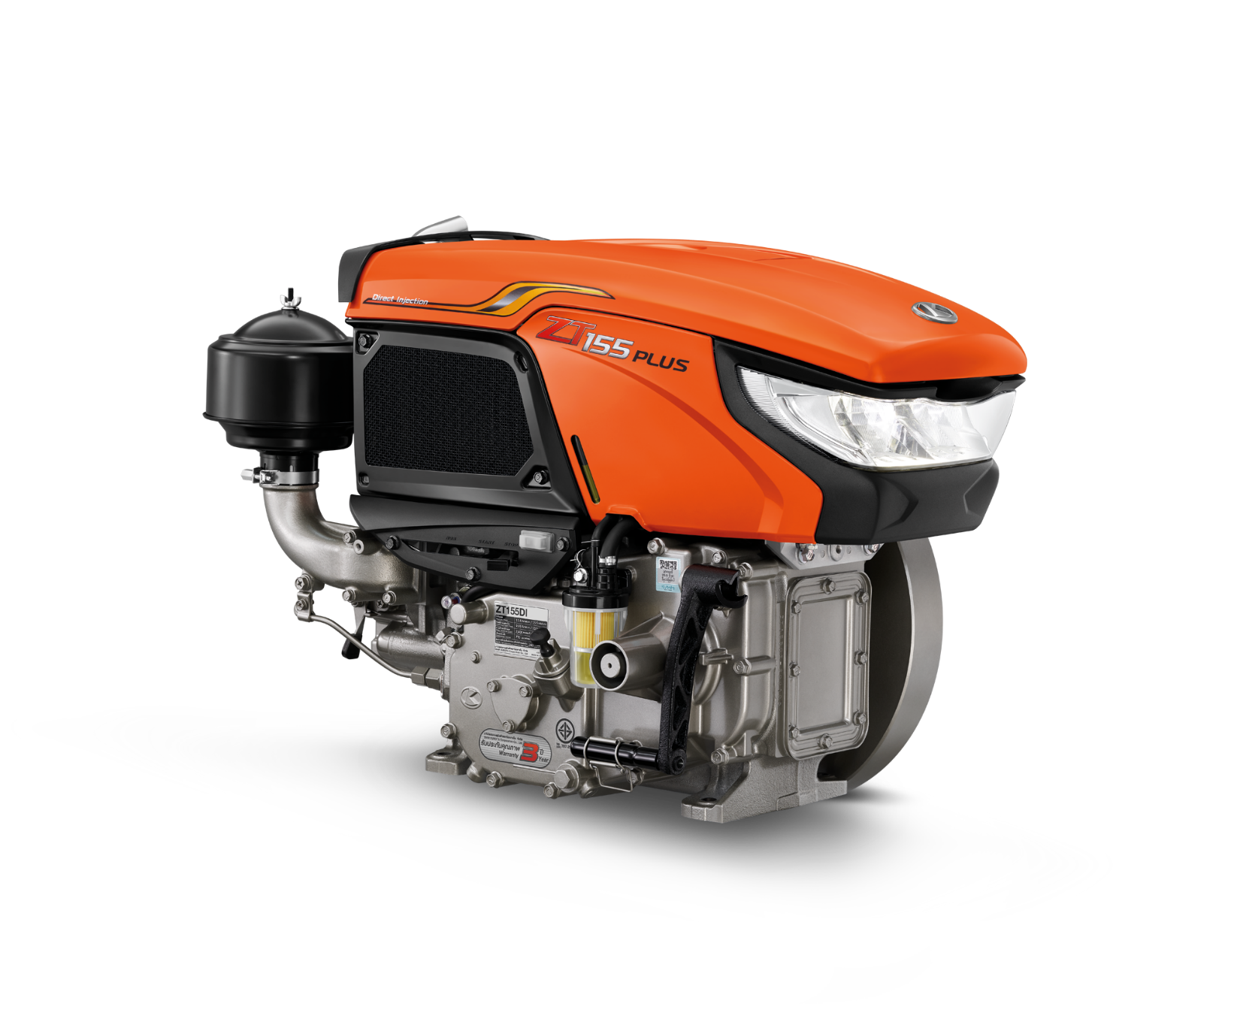
How to check your KUBOTA diesel engine ZT Plus before operation

Slide 2


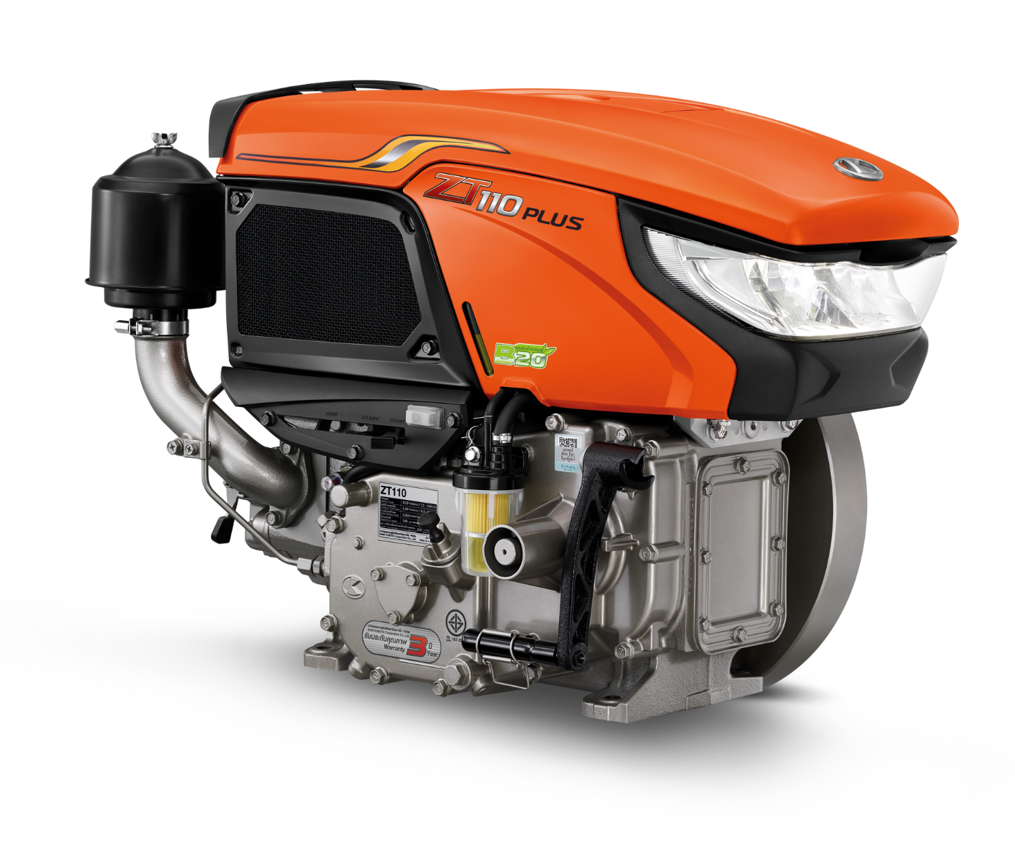
Points to check before operate KUBOTA engine
5 Key Points
1) the air filter
2) the fuel system
3) the engine oil
4) the cooling water system
5) the fan belt

Slide 3
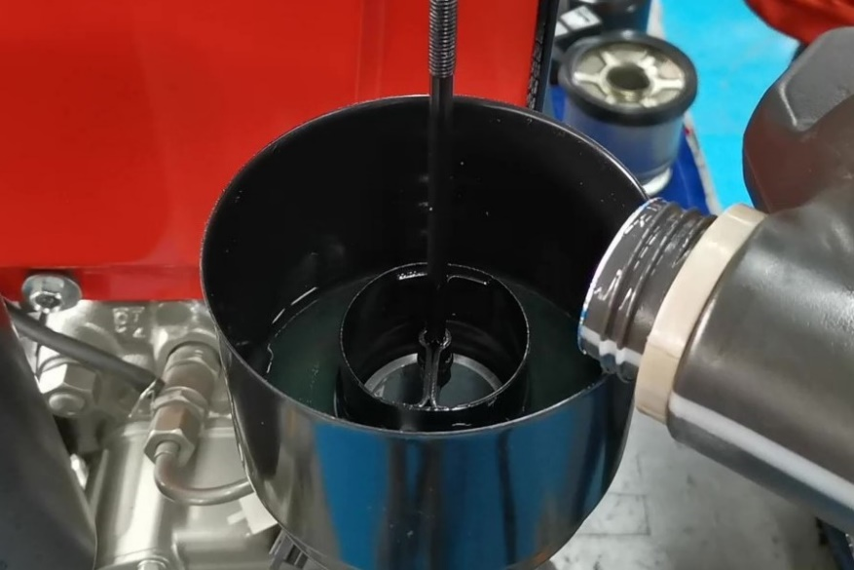
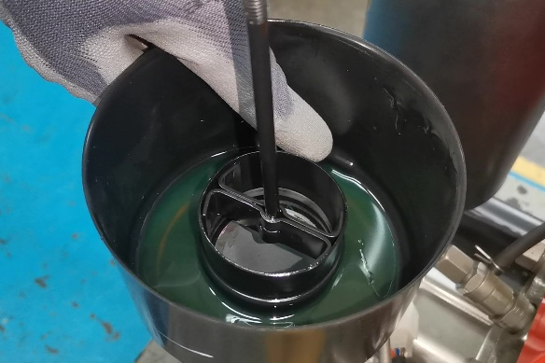
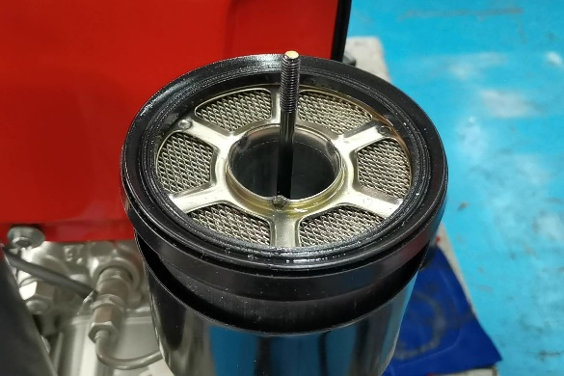
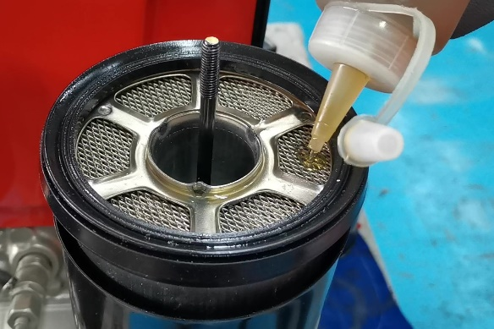
1. How to check the air filter
Air filter : Filters dust in the air from entering the engine to protect the internal parts from wear
Process :
1) Fill the engine oil into filter pot
2) For suitable engine oil level. Please notice a mark indicating the level of engine oil.
3) Put on the air filter and be careful the rubber ball from tearing.
4) Put the engine oil on the air filter to catch the dust

Slide 4
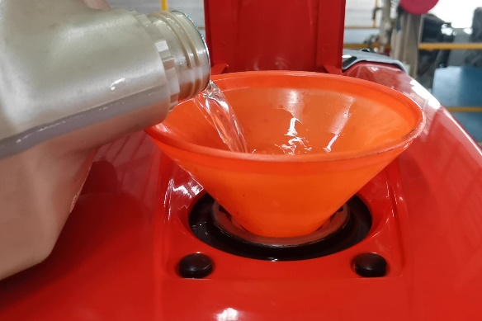
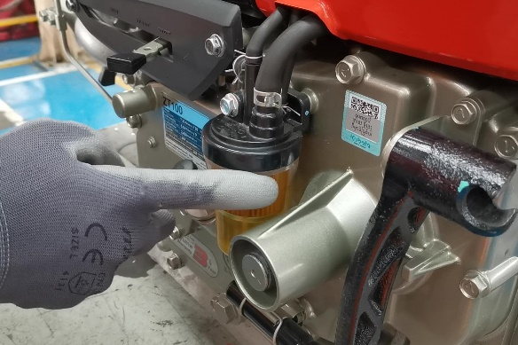
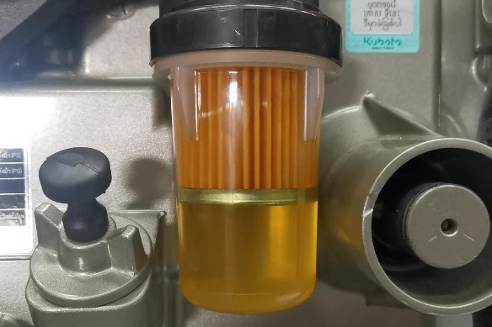
2. How to check the fuel system
Fuel System :
The engine will work with fuel mixed with air in a limited space and get the heat from the piston sliding up to compress, causing an explosion. The engine can work.
Process :
1) Use clean fuel and no need to remove the filter while refueling
2) Check for leaks around the filter. There must be no water and impurities mixed in the oil.

Slide 5

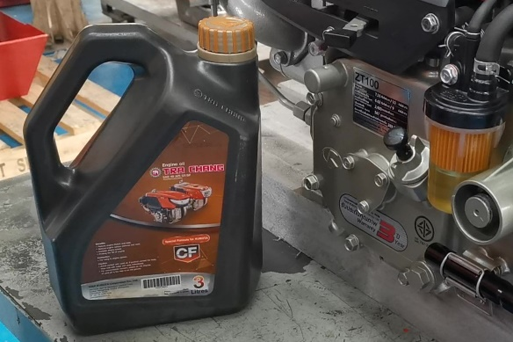
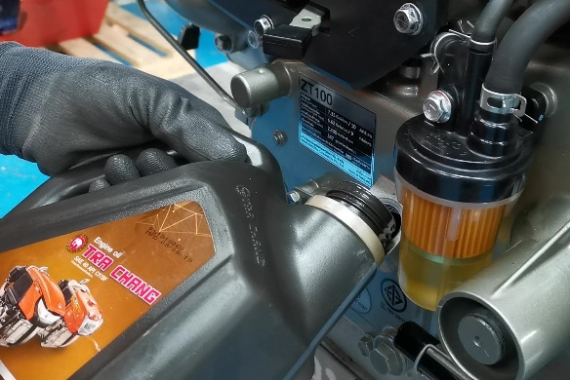
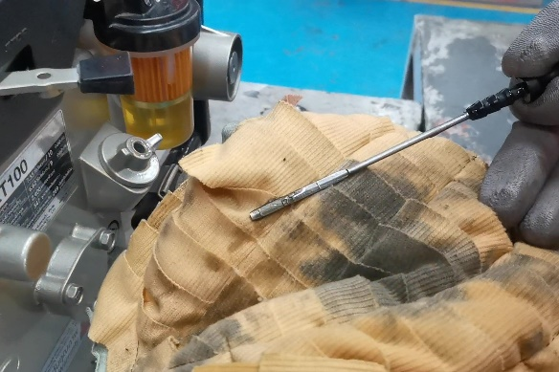
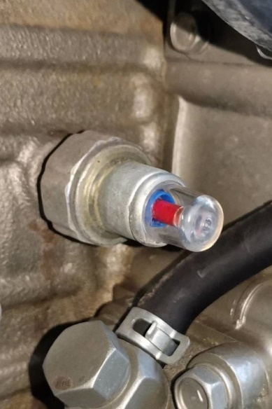
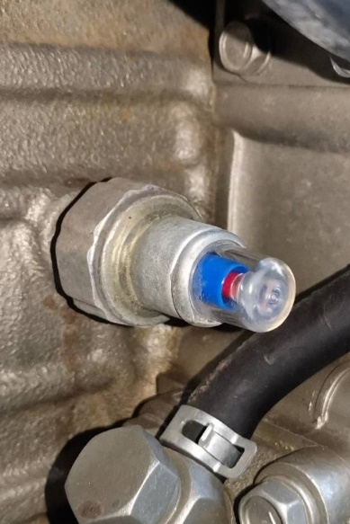
3. How to check the engine oil
Lubrication system:
Helps prevent wear and allows parts to rotate or move without
jamming It is also a cooling aid that occurs inside the engine.
Process :
1) Use TRA CHANG engine oil (SAE40)
2) Add about 2.7-2.8 liters of engine oil.
3) Please notice the engine oil level must not be higher than the upper scale and not lower than the lower scale.
- Before use, the engine should be started and idle for 15-20 minutes to keep the oil lubricated throughout the engine
- Observe the oil pressure check point. If blue moves to cover red indicates that the engine lubrication system is working normally.

Slide 6
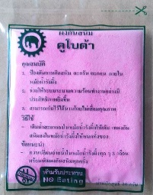
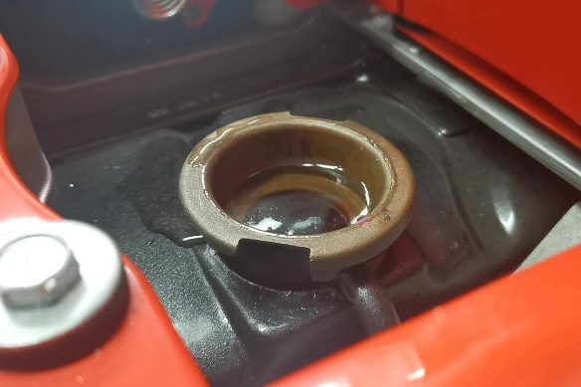
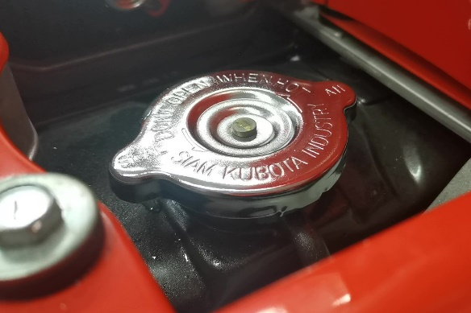
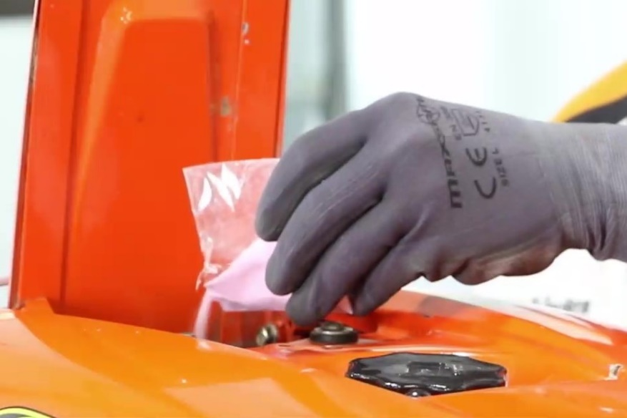
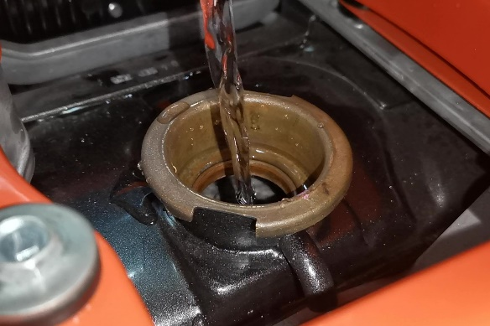
4. How to check the cooling water system
Process :
Do not use groundwater or canal water because it will cause the radiator to have sediment and cause the radiator to clog
1) Put rust proof powder
2) Fill up with clean water

Slide 7
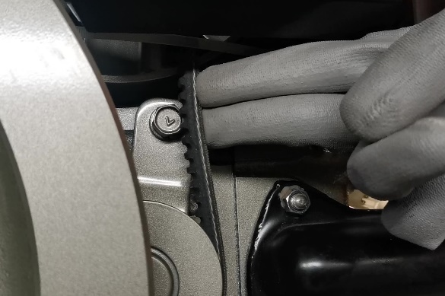
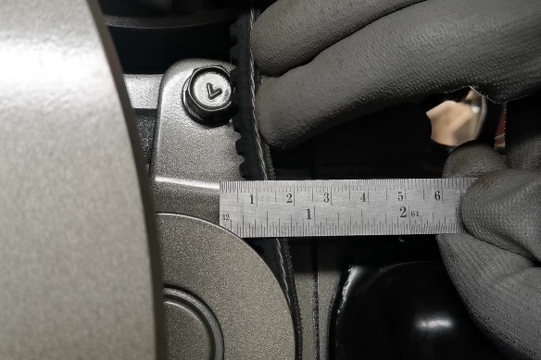
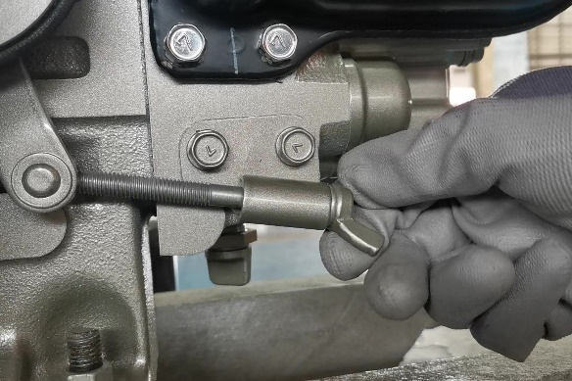
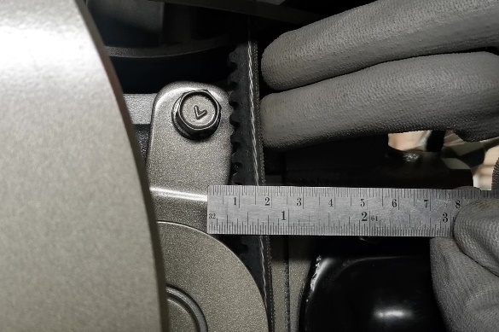
4. How to check the fan belt
Process :
1) Use your finger to press down on the center of the belt. to see the tension of the belt
2) The appropriate tension is 10 mm.-15 mm.
3) If the belt is too tight or slack, please adjust according to 10 mm.-15 mm.

Slide 8
How to start KUBOTA diesel engine correctly

Slide 9

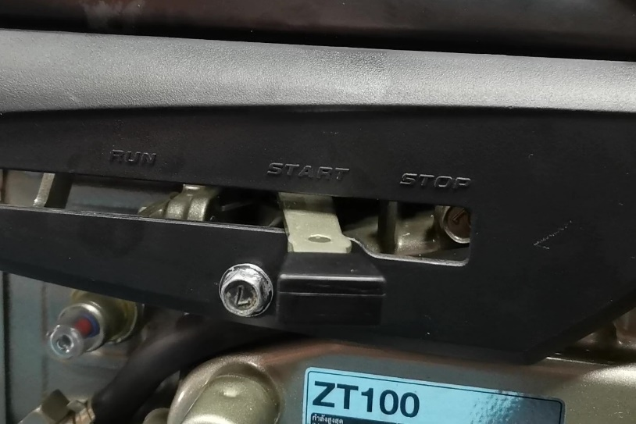
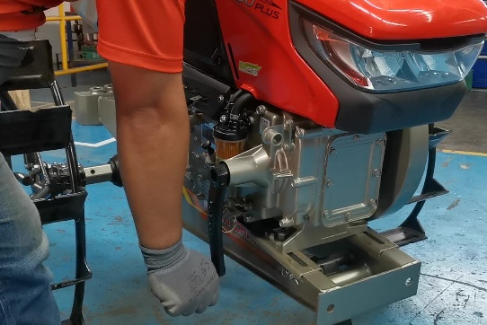
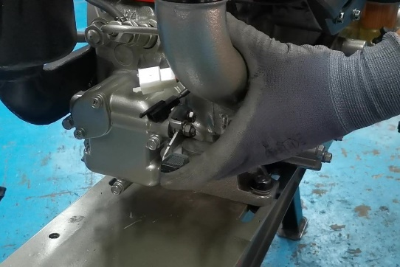
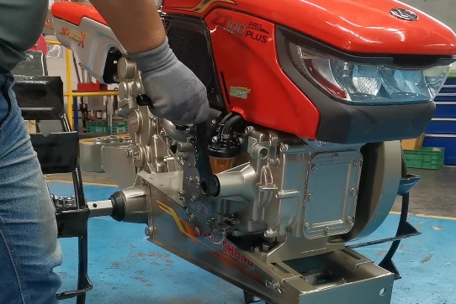

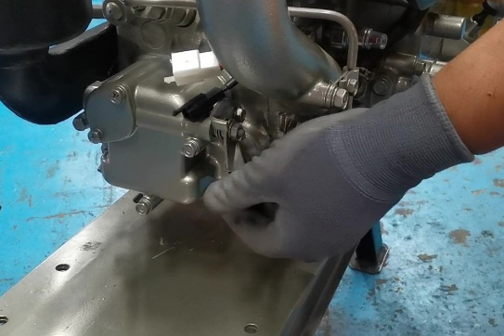
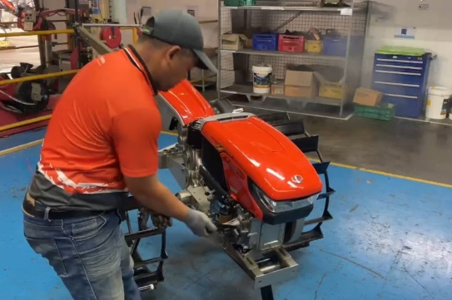
How to start KUBOTA diesel engine correctly
1
2
1) Move the accelerator pedal to the starting position.
2) Attach the hand lever to the engine starter shaft.
3) Spin the hand lever in a clockwise direction
4) If the handle of hand lever is on top, please remove it.
5) Put the hand lever on the starter shaft by allowing the handle at the bottom
6) Lift the valve lever and spin the engine hand lever 3-5 laps
7) Release the valve lever and continue spinning the engine hand lever.
3
4
Caution
5
6
- Hold the hand lever tightly after your engine is started to protect the engine hand lever swing out causing danger. The engine hand lever will be free and come off by itself.
- Do not release the valve lever and stop spinning the hand lever because it will cause the engine to kick back (smoke will be released at the air filter) the engine will spin in opposite way.
- if the engine kick back, remove the filter to check. If there is soot, clean the air filter or if the filter is damaged, replace the filter with a new one.

