Slide 1
Chapter 2: Database Design
Database Systems
Session 1:
Entity Relationship Model

Slide 2
Outline
1
Database Design Process
2
Entity Relationship Model
3
Constructing an Entity Relationship Model
4
The Enhanced Entity Relationship Model

Slide 3
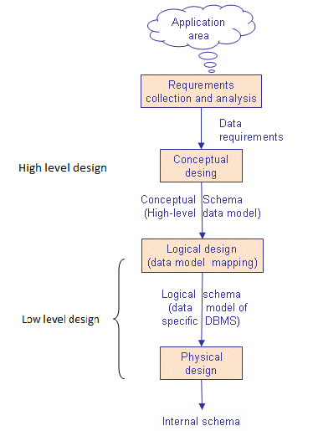
Database Design Process

Slide 4
Requirements Collection and Analysis
Is a preliminary stage to database design.
The process of collecting and analyzing information about the part of the organization that is to be supported by the database system, and using this information to identify the requirements for the new system.
The outcome of this phase is a user requirements specification.

Slide 5
High level design
Conceptual database design: is the process of constructing a data model from the information collected in the requirements analysis phase.
  It is independent of any particular DBMS at high level design.
  It construct an entity relationship model (ERM)
  ERM includes entities that are represented in the database, attributes of the entities, the relationships among the entities, and constraints on the entities and relationships.
Notes:
independent of all physical considerations (the target DBMS software, application programs, programming languages, hardware platform,…)

Slide 6
Low level design
The process of moving from an abstract data model to the implementation of the database proceeds in two ﬁnal design phases:
  Logical design
  Physical design

Slide 7
Low level design
Logical design:
  We must choose a DBMS to implement our database design, and map the high level conceptual data model in the previous phase onto a logical data model of the chosen DBMS (relational, network, hierarchical, object-oriented)
  We will only consider relational DBMS
  Convert an ER diagram from the conceptual model into a relational schemas in normal form using Normalization.
    Normalization is used to check the entity relationship model and help eliminate redundancy and other anomalies in the database.

Slide 8
Low level design
Physical design:
  Describes how the database is to be implemented:
    Creating a set of relational tables and the constraints on these tables from the information presented in the logical data model;
    Identifying the speciﬁc storage structures and access methods for the data to achieve an optimum performance for the database system;
    Designing security protection for the system.
Notes:
Building indexes on some tables and clustering some tables,
identify dierent user groups and dierent roles played by various users (e.g., the development team for a product, the customer
support representatives, the product manager). For each role and user group, we must identify the parts of the database that they must be able to access and the parts of the database that they should not be allowed to access, and take steps to ensure that they can access only the necessary parts.

Slide 9
Entity Relationship Model
ERM is a high level data model used for developing the conceptual design of the database.
The ER model also has an associated diagrammatic representation, the ER diagram, which can express the overall logical structure of a database graphically
Many various notations used with ERD—the original Chen notation and the newer Crow’s Foot and UML notations.
  The Chen notation favors conceptual modeling.
  The Crow’s Foot notation favors a more implementation-oriented approach
  The UML notation can be used for both conceptual and implementation modeling.

Slide 10
Entity Relationship Model
ERM has 3 basic concepts:
  Entity
  Attributes
  Relationships

Slide 11
Entity
An entity is a person, a place, an object, an event, or a concept in the user environment about which the organization wishes to maintain data.
An entity has a noun name.
Example:
    Person: Student, teacher, employee, author,..
    Place: store, classroom, warehouse,…
    Object: Movie, product, car, book,..
    Event: Sale, Registration, Reservation
    Concept: Account, Course

Slide 12
Entity
An entity type (or entity set) is a collection of entities that share the common properties, or characteristics.
  Example: the entity type student might represent the set of all students in the university.
An entity instance is a single occurrence of an entity type.
  For example, there is one EMPLOYEE entity type in most organizations, but there may be hundreds (or even thousands) of instances of this entity type stored in the database.

Slide 13
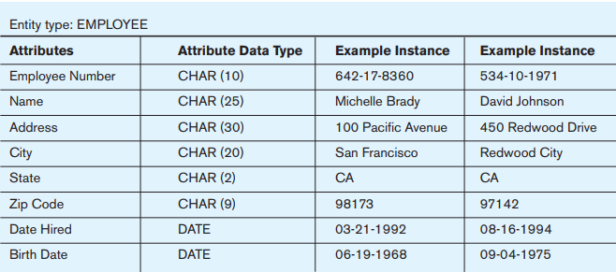
Entity
Example: Entity type versus Entity instance
An employee type Employee with 2 instances

Slide 14
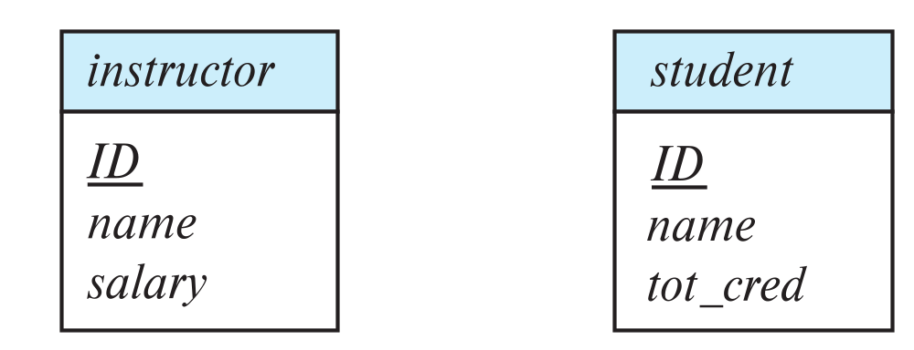
Entity
In an E-R diagram, the entity name is placed inside the box representing the entity type
Primary key is underlined.

Slide 15
Entity
There are two types of entities; weak and strong entity types.
  A strong entity type is one that exists independently of other entity types.
    Instances of a strong entity type always have a unique characteristic (called an identifier)—that is, an attribute or a combination of attributes that uniquely distinguish
    each occurrence of that entity.
  A weak entity type is an entity type whose existence depends on some other entity type
    The entity type on which the weak entity type depends is called the identifying owner
    A weak entity type does not typically have its own identifier

Slide 16
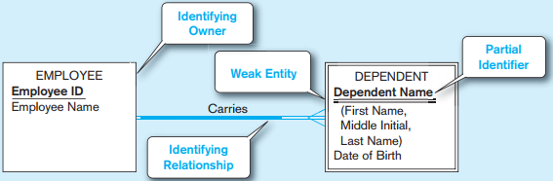
Entity
Example: Weak entity in ERD
  Carries relationship is the identifying relationship (indicated by the double line)
  The attribute Dependent Name serves as a partial identifier (indicated by double underline)

Slide 17
Attribute
Attributes are properties or characteristics of an entity type.
An attribute has a noun name
  Example:
    Student: Student ID, Student Name, Home Address, Phone Number, Major
    Automobile: Vehicle ID, Color, Weight
    Employee: Employee ID, Employee Name, Skill
In E-R diagrams, we represent an attribute by placing its name in the entity it describes.
Attributes may also associated with relationships.

Slide 18
Attribute
Attributes have a domain which is the set of possible values for a given attribute, or domain is the set of permitted values for each attribute
  Example:
    for the gender attribute consists of only two possibilities: M or F
    for grade is 0 to 10

Slide 19
Identifier Attribute
Attribute types:
  Identifier Attribute
  Required and Optional attribute
  Simple and Composite attribute
  Single-valued and Multivalued attribute
  Stored and Derived attribute

Slide 20
Identifier Attribute
Identifier (Key)–an attribute (or combination of attributes) that uniquely identifies individual instances of an entity type. That is, no two
instances of the entity type may have the same value for the identifier attribute.
  Ex: Student ID is an identifier of Student entity type.
Candidate Identifier–an attribute that could be a key…satisfies the requirements for being an identifier
  Student Name is not a candidate identifier, because many students may potentially have the same name.

Slide 21
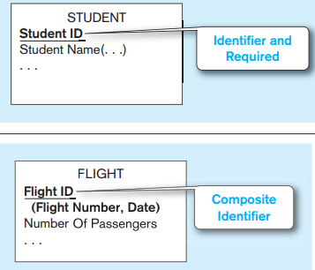
Identifier Attribute
Simple versus Composite Identifier
  A composite identifier is an identifier that consists of a composite attribute.
The identifier is boldfaced
and underlined

Slide 22
Identifier Attribute
Some entities may have more than one candidate identifier. The following criteria for selecting identifiers:
  Will not change in value
  Will not be null
  No intelligent identifiers (e.g., containing locations or people that might change)
  Substitute new, simple keys for long, composite keys

Slide 23
Null values
In some cases, particular entity may not have an
applicable value for an attribute. Null can also designate that an attribute value is unknown.
Two cases:
  The attribute value is missing.
  Ex: Height attribute is NULL.
  It is not known whether the attribute value exist.
  Ex: College degree – some people may have it and some not

Slide 24
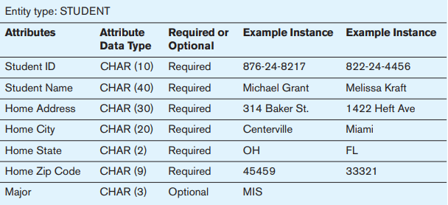
Simple & Composite Attribute
Required attribute is an attribute that must have a value in it.
An optional attribute that may not have a value in it and can be left blank.
Example:
Notes:
The reasoning for making an attribute required is to ensure that data are collected for that particular characteristic.

Slide 25
Simple & Composite Attribute
Simple Attribute
  Attribute that have not been divided into subparts
  Simple (Atomic) attributes
    Ex: Age, City, Postal Code
Composite Attributes
  Can be divided into smaller subparts, which represent more basic attributes with independent meaning.
    Ex: Name can broken down into component attributes: first_name, middle_initial, last_name

Slide 26
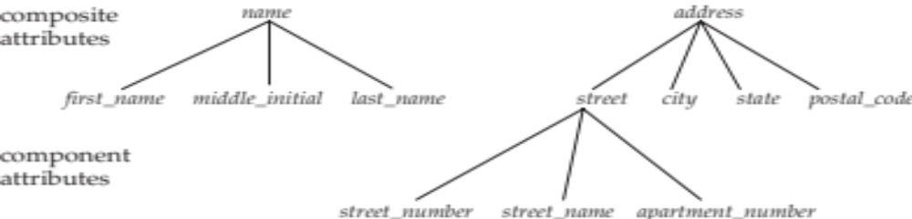
Simple & Composite Attributes
Composite attributes
  Example: name, address
  The decision about whether to subdivide an attribute
  into its component parts depends on whether users will need to refer to those individual components, and hence, they have organizational meaning.
  Most drawing tools do not have a notation for composite attributes, so you simply list all the component parts
Notes:
a user can either refer to Address or refer to one of its components, such as Street Address

Slide 27
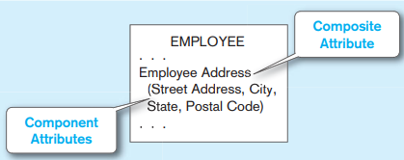
Simple & Composite Attributes
Composite attributes
  Most drawing tools do not have a notation for composite attributes, so you simply list all the component parts
Notes:
a user can either refer to Address or refer to one of its components, such as Street Address

Slide 28
Single valued & Multivalued Attributes
Single Valued Attributes
  Can only have one value for the particular entity.
  Ex: A student can have only one ID number
Multivalued Attributes
  Attributes that can have many values
  Ex: A student can have more than one phone number, one skill
Multivalued and composite are different concepts.
  A multivalued attribute, may occur multiple times
  for each employee
  Composite attributes, each of which occurs once for each employee, but which have component, more atomic attributes

Slide 29
Single valued & Multivalued Attributes
Multivalued Attributes
  Other E-R diagramming tools may use an asterisk (*) after the attribute name, or
  you may have to use supplemental documentation to specify a multivalued attribute

Slide 30
Stored & Derived Attributes
Stored Attributes
  The date_of_birth is the stored attribute
Derived attributes
  Can be computed from other attributes
  Example: age is derived from date_of_birth.
  Age is called derived attribute

Slide 31
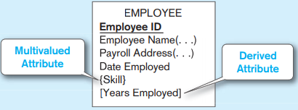
Example
E-R diagram with identifier, multivalued, and derived attributes

Slide 32
Relationship
A relationship is an association among several entities
A relationship set is a set of relationships of the same type.
A relationship has a verb phrase name
Two entities can have more than one type of relationship between them (multiple relationships)

Slide 33
Relationship
Relationship type and relationship instance
  A relationship type is a meaningful association between (or among) entity types
    The relationship type is modeled as lines between entity types
  A relationship instance is an association between entity instances

Slide 34
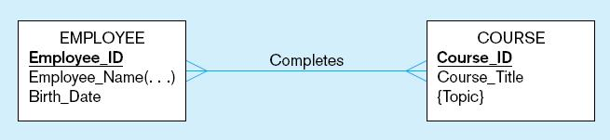
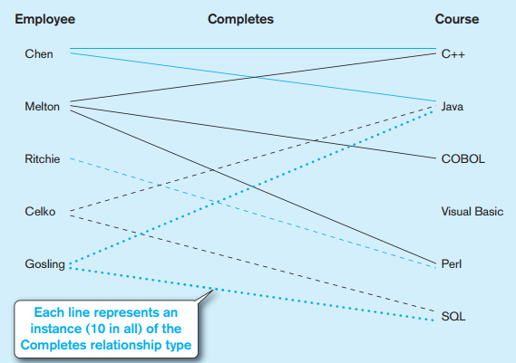
Example Relationship type and Relationship instances
a) Relationship type
b) Relationship instances
Notes:
each employee may complete any number
of courses (zero, one, or many courses), whereas a given course may be completed by
any number of employees (nobody, one employee, many employees)

Slide 35
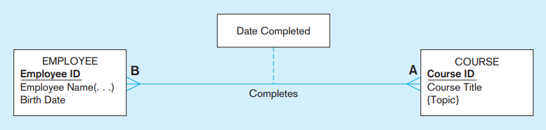
Relationship
Attributes on relationship
  Relationships can have attributes which describe features pertaining to the association between the entities in the relationship
  Example: Date Completed is a property of the relationship Completes, rather than a property of either Employee or Course entity.

Slide 36
Relationship
Associative Entity
  Associative entity is an entity type that associates
  the instances of one or more entity types and contains attributes that are peculiar to the relationship between those entity instances.
  Associative entities are sometimes referred to as gerunds, because the relationship name (a verb) is usually converted to an entity name that is a noun.

Slide 37
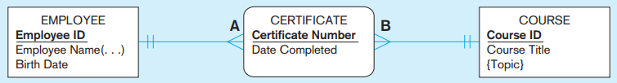
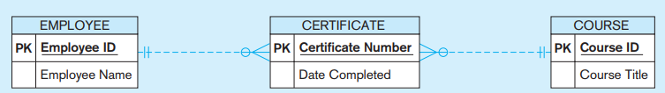
Relationship
Associative Entity
  Example: An associative entity Certificate
    Note that there are no relationship names on the lines between an associative entity and a strong entity
  An associative entity Certificate using Visio

Slide 38
Degree of a Relationship set
The degree of the relationship set is the number of entity types that participate in a relationship.
  Unary relationship, are also called Recursive relationship, which exists when association is maintained within a single entity (degree 1)
  Binary relationship: exists when two entities are associated (degree 2)
    Most relationship sets in a database system are binary.
  Ternary relationship: exists when three entities are associated (degree 3)
Relationships between more than three-entity types are rare.

Slide 39
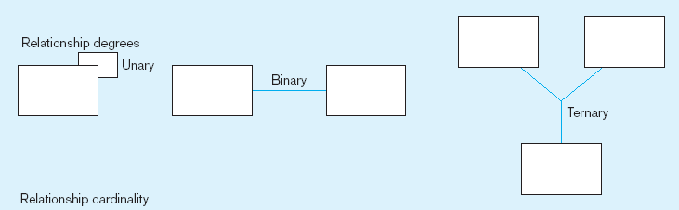
Degree of a Relationship set
One entity related to another of the same entity type
Entities of two different types related to each other
Entities of three different types related to each other

Slide 40
Cardinality constraints
Cardinality constraint, or cardinality ratios, express the number of entities to which another entity can be associated via a relationship type.
Mapping cardinalities are most useful in describing binary relationship set
For a binary relationship set the mapping cardinality must be one of the following types:
  One to one
  One to many
  Many to many

Slide 41

Cardinality constraints
One to one
  An entity in A is associated with at most one entity in B, and an entity in B is associated with at most one entity in A.

Slide 42
Cardinality constraints
One to many
  An entity in A is associated with any number (zero or more) of entities in B. An entity in B, however, can be associated with at most one entity in A.

Slide 43

Cardinality constraints
Many to many
  An entity in A is associated with any number (zero or more) of entities in B, and an entity in B is associated with any number (zero or more) of entities in A.

Slide 44
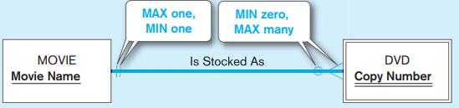
Cardinality constraints
Minimum Cardinality
  is the minimum number of instances of entity B that may be associated with each instance of entity A
Maximum Cardinality
  is the maximum number of instances of entity B that may be associated with each instance of entity A
Ex:

Slide 45


Example of Cardinality constraints
One-to-One relationship
  one department chair—a professor—can chair only one department, and one department can have only one department chair.
One-to-Many relationship
  Each painting is painted by one and only one painter, but each painter could have many paintings.

Slide 46
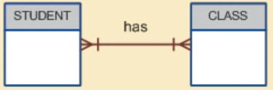
Example of Mapping Cardinalities
Many-to-Many relationship
  Each CLASS can have many STUDENTs, and each STUDENT can take many CLASSES.

Slide 47
Optional and Mandatory Participation
Participation determines whether all or only some entity occurrences participate in a relationship.
Participation in a relationship can be optional (or Partial) or mandatory (or Total) participation.
  Mandatory participation:
    all entity occurrences are involved in a particular relationship.
    Minimum cardinality is one
  Optional participation:
    only some entities may not participate in a particular relationship.
    Minimum cardinality is zero

Slide 48
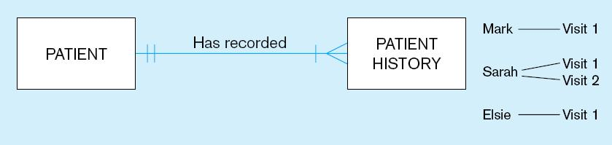
Optional and Mandatory Participation
Ex1:
A patient history is recorded for one and only one patient
A patient must have recorded at least one history, and can have many

Slide 49
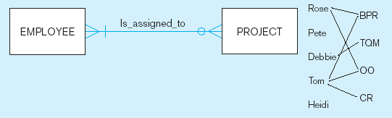
Optional and Mandatory Participation
Ex2:
A project must be assigned to at least one employee, and may be assigned to many
An employee can be assigned to any number of projects, or may not be assigned to any at all

Slide 50
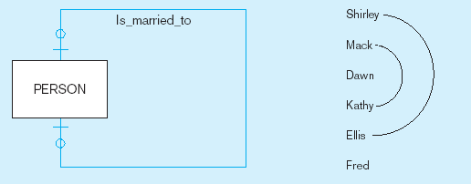
Optional and Mandatory Participation
Ex2:
A person is married to at most one other person, or may not be married at all

Slide 51
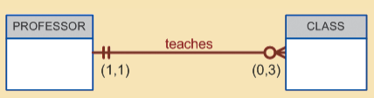
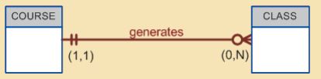
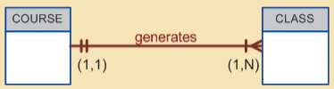
Optional and Mandatory Participation
Another examples
  An optional CLASS entity in the relationship “PROFESSOR teaches CLASS”:
  CLASS is optional to COURSE
  COURSE and CLASS in a mandatory relationship:

Slide 52
Optional and Mandatory Participation
Example: Identifying relationship, cardinality between entities:
Customer and Order
Product and Category
Employee and Dependent
Employee and Department
Instructor and Class

Slide 53
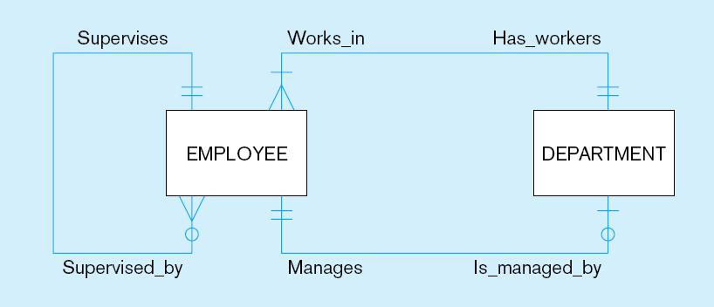
Multiple Relationships Between Entity Types
There may be more than one relationship between the same entity types in a given organization
Ex: Employees and departments
  One relationship associates employees with the department in which they work.
  The second relationship associates each department with the employee who manages that department.
Notes:
One relationship associates employees with the department in which they work. This relationship is
one-to-many in the Has Workers direction and is mandatory in both directions. That is, a
department must have at least one employee who works there (perhaps the department
manager), and each employee must be assigned to exactly one department.
The second relationship between EMPLOYEE and DEPARTMENT associates each
department with the employee who manages that department.

Slide 54
Weak Entity
A weak entity set is an entity which is existence-dependent; that is, it cannot exist without the entity with which it has a relationship.
An entity set that is not a weak entity set is termed a strong entity set.
The weak entity has a primary key that is partially or totally derived from the parent entity (or strong entity) in the relationship.

Slide 55
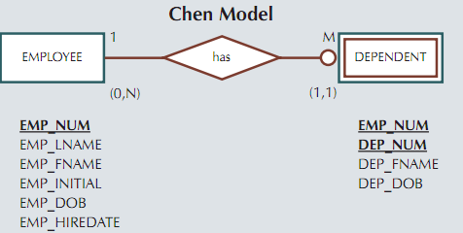
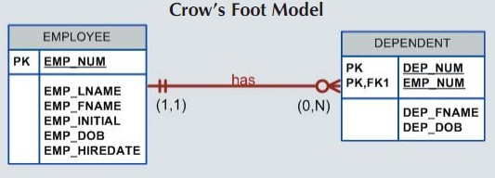
Weak Entity
Example

Slide 56
Constructing an ER model
Before beginning to draw the ER model, read the requirements specification carefully.
Identify entities
  List all entity types (These are the object of interest in the system)
  Remove duplicate entities (Also do not include the system as an entity type)
List the attributes of each entity
Mark the primary keys
  Which attributes uniquely identify instances of that entity type?
  This may not be possible for some weak entities.
Notes:
Also do not include the system as an entity type
e.g. if modelling a library, the entity types might be books, borrowers, etc.
The library is the system, thus should not be an entity type.

Slide 57
Constructing an ER model
Define the relationships
  Examine each entity type to see its relationship to the others.
Describe the cardinality and optionality of the relationships
  Examine the constraints between participating entities.
Remove redundant relationships
  Examine the ER model for redundant relationships.
ER modelling is iterative, so expect to draw several versions. Note that there is no one right answer to the problem, but some solutions are better than others!

Slide 58
Exercises
Ex1: Company organized into DEPARTMENT.
An university has several departments. Each department employs many employees, but each employee works in one department only.
An employee can supervise many other employees, but an employee may have only one supervisor.
Each department offers many courses. A course can be a pre-requisite of many other courses, but a course may have only one pre-requisite.

Slide 59
Exercises
Ex2: Company organized into DEPARTMENT.
Each department has unique name and a particular employee who manages the department. Start date for the manager is recorded. Department may have several locations.
A department controls a number of PROJECT. Projects have a unique name, number and a single location.
Company’s EMPLOYEE name, ssno, address, salary, sex and birth date are recorded. An employee is assigned to one department, but may work for several projects (not necessarily controlled by her dept). Number of hours/week an employee works on each project is recorded; The immediate supervisor for the employee.
Employee’s DEPENDENT are tracked for health insurance purposes (dependent name, birthdate, relationship to employee).

Slide 60
The Enhanced Entity Relationship Model (EERM)
The term enhanced entity relationship (EER) model (or the Extended entity relationship model) is used to identify the model that has resulted from extending the original E-R model with these new modeling constructs.
A Diagram using this model is called an EER diagram (EERD)
The most important modeling construct incorporated in the EER model is supertype/subtype relationships
discriminator

Slide 61
The Enhanced Entity Relationship Model (EERM)
An entity supertype is a generic entity type that is related to one or more entity subtypes.
The entity supertype contains common characteristics, and the entity subtypes each contain their own unique characteristics.

Slide 62
Supertype/Subtype relationship
An example: Suppose that an organization has three basic types of employees: hourly employees, salaried employees, and contract consultants.
  Hourly employees Employee Number, Employee Name, Address, Date Hired, Hourly Rate
  Salaried employees Employee Number, Employee Name, Address, Date Hired, Annual Salary, Stock Option
  Contract consultants Employee Number, Employee Name, Address, Date Hired, Contract Number, Billing Rate

Slide 63
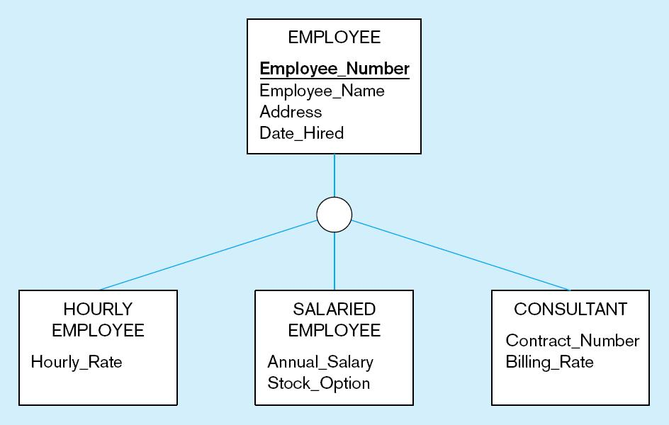
Supertype/Subtype relationship
All employee subtypes will have emp_number, name, address, and date hired
Each employee subtype will also have its own attributes

Slide 64
Supertype/Subtype relationship
The property of inheritance enables an entity subtype to inherit the attributes and relationships of the supertype.
Relationships at the supertype level indicate that all subtypes will participate in the relationship.
The instances of a subtype may participate in a relationship unique to that subtype. In this situation, the relationship is shown at the subtype level.

Slide 65
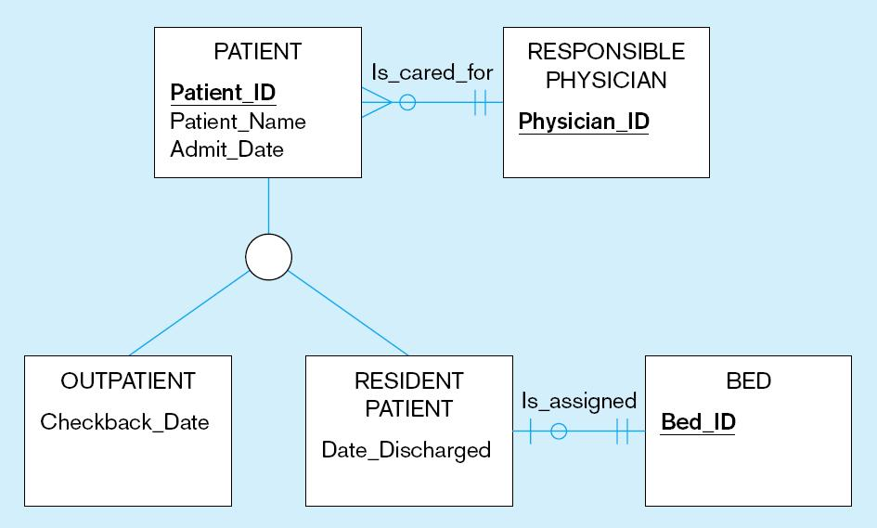
Example: Supertype/subtype relationships in a hospital
Both outpatients and resident patients are cared for by a responsible physician
Only resident patients are assigned to a bed

Slide 66
Generalization and Specialization
Generalization:
  The process of defining a more general entity type from a set of more specialized entity types.
  BOTTOM-UP process
  Based on grouping common characteristics and relationships of the subtypes
Specialization:
  The process of defining one or more subtypes of the supertype and forming supertype/subtype relationships.
  TOP-DOWN process
  Based on grouping unique characteristics and relationships of the subtypes

Slide 67
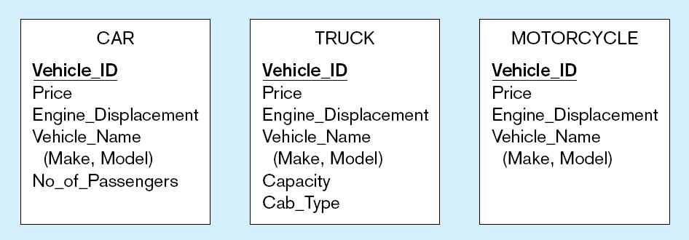
Example of generalization
a) Three entity types: CAR, TRUCK, and MOTORCYCLE
All these types of vehicles have common attributes

Slide 68
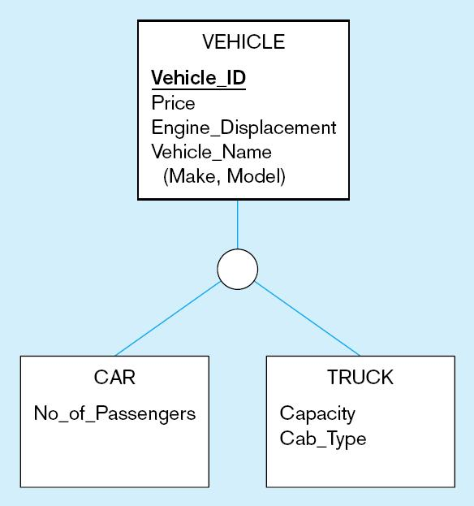
Example of generalization(cont.)
b) Generalization to VEHICLE supertype
So we put the shared attributes in a supertype
Note: no subtype for motorcycle, since it has no unique attributes

Slide 69
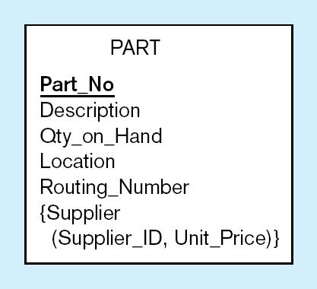
Example of specialization
a) Entity type PART
Only applies to manufactured parts
Applies only to purchased parts

Slide 70
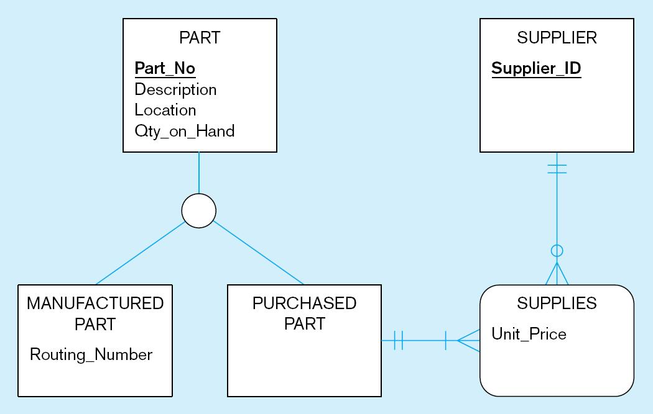
Example of specialization (cont.)
b) Specialization to MANUFACTURED PART and PURCHASED PART
Created 2 subtypes
Note: multivalued attribute was replaced by an associative entity relationship to another entity

Slide 71
Completeness Constraint
The completeness constraint specifies whether each entity supertype occurrence must also be a member of at least one subtype.
The completeness constraint can be partial or total.
  Partial completeness
    Symbolized by a circle over a single line
    Some supertype occurrences are not members
  Total completeness
    Symbolized by a circle over a double line
    Every supertype occurrence must be member of at least one subtype

Slide 72
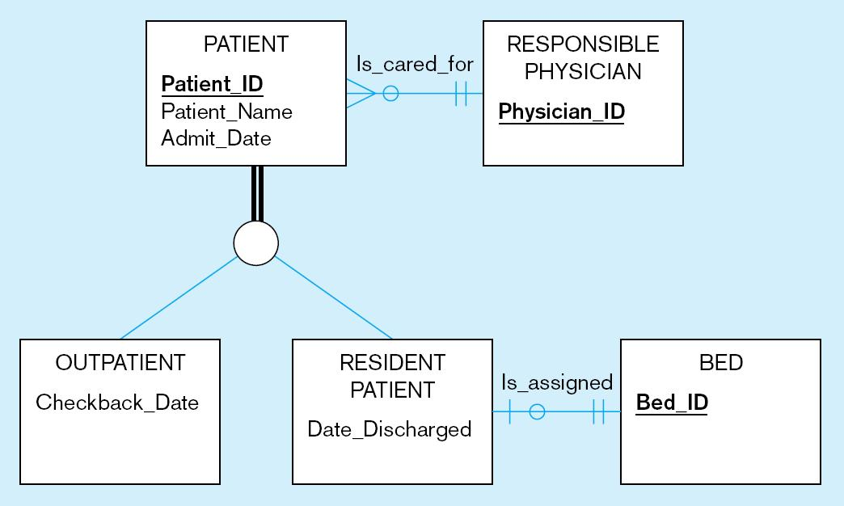
Examples of completeness constraints
a) Total specialization rule
A patient must be either an outpatient or a resident patient

Slide 73
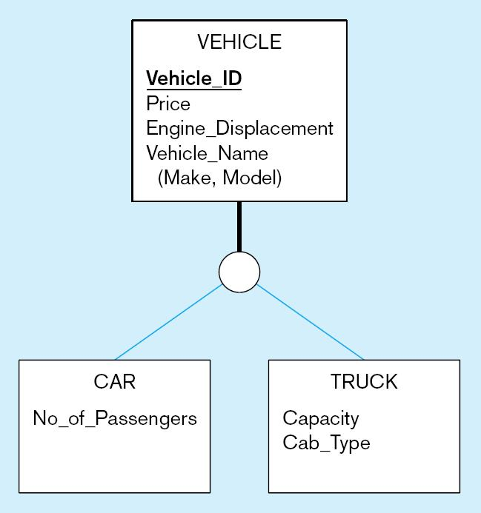
Examples of completeness constraints (cont.)
b) Partial specialization rule
A vehicle could be a car, a truck, or neither

Slide 74
Subtype Discriminator
An attribute in supertype entity whose value determines the target supertype(s)
Default comparison condition for subtype discriminator attribute is equality comparison
Subtype discriminator may be based on other comparison condition

Slide 75
Disjoint and Overlapping Constraints
Disjoint subtypes
  Also called nonoverlapping subtypes
  Subtypes that contain unique subset of supertype entity set, in other words, each entity instance of the supertype can appear in only one of the subtypes
  In an ERD, disjoint subtypes are indicated by the letter d inside the category shape
Overlapping subtypes
  Subtypes that contain nonunique subsets of supertype entity set, that is, each entity instance of the supertype may appear in more than one subtype.
  In an ERD, illustrates overlapping subtypes with the letter o inside the category shape.
Notes:
Disjoint subtypes: an employee (supertype) who is a pilot (subtype) can appear only in the PILOT subtype, not in any of the
other subtypes.
Overlapping: For example, in a university environment, a person may be an employee,
a student, or both. In turn, an employee may be a professor as well as an administrator.
Because an employee may also be a student, STUDENT and EMPLOYEE are overlapping subtypes of the supertype PERSON, just as PROFESSOR and ADMINISTRATOR
are overlapping subtypes of the supertype EMPLOYEE.

Slide 76
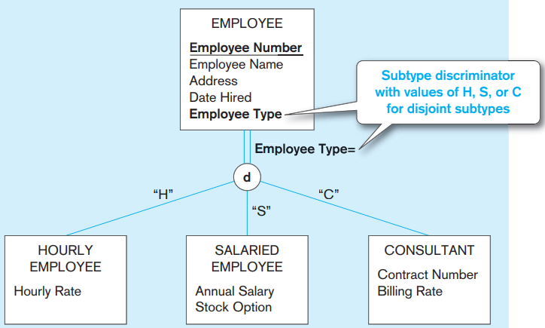
Example: a subtype discriminator
(disjoint rule)
Employee_Type is called the subtype discriminator

Slide 77
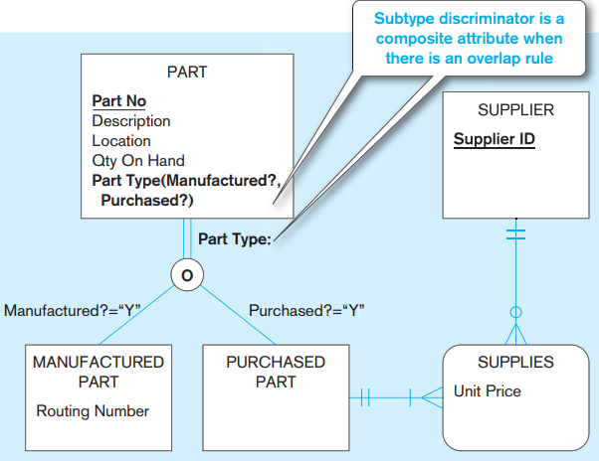
Example: Subtype discriminator (overlap rule)

Slide 78
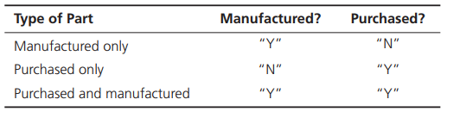
Example: Subtype discriminator (overlap rule)
A new attribute named Part Type has been added to PART. Part Type is a composite attribute with components Manufactured? and Purchased?
Each of these attributes is a Boolean variable (i.e., it takes on only the values yes, “Y,” and no, “N”).
When a new instance is added to PART, these components are coded as follows:

Slide 79
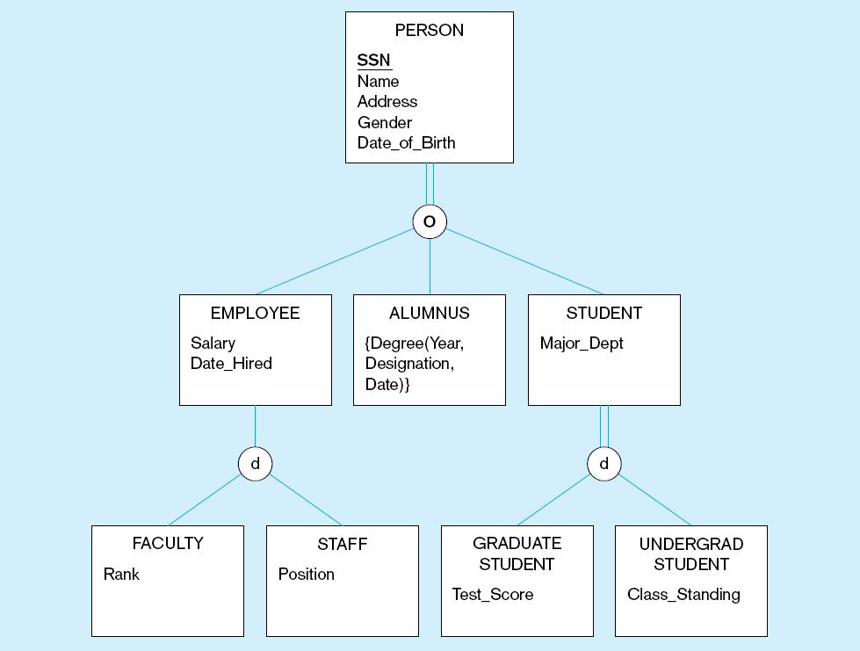
Example of supertype/subtype hierarchy

Slide 80
Entity Clusters
EER diagrams are difficult to read when there are too many entities and relationships
=>Solution: Group entities and relationships into entity clusters
Entity cluster: Set of one or more entity types and associated relationships grouped into a single abstract entity type

Slide 81
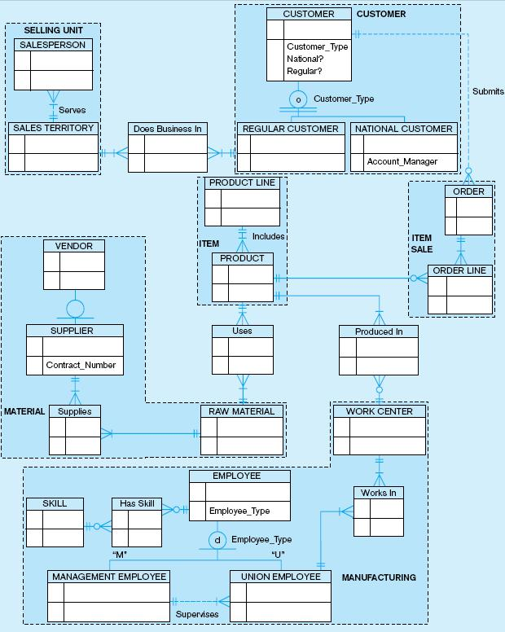
Possible entity clusters for Pine Valley Furniture in Microsoft Visio
Related groups of entities could become clusters

Slide 82
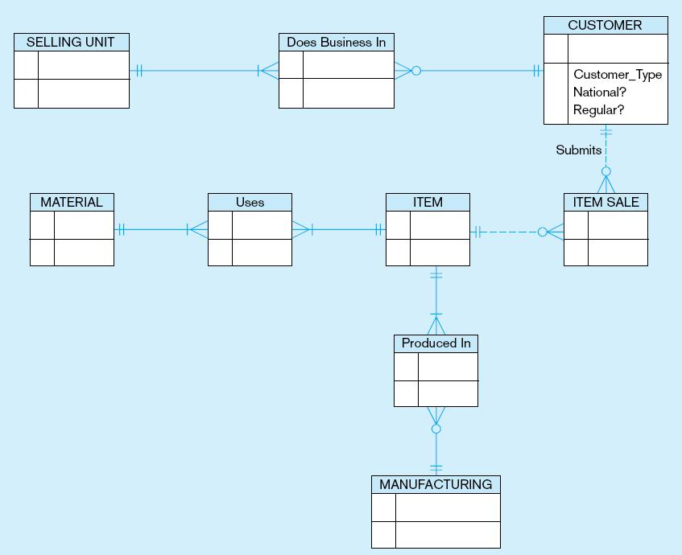
EER diagram of PVF entity clusters
More readable, isn’t it?

Slide 83
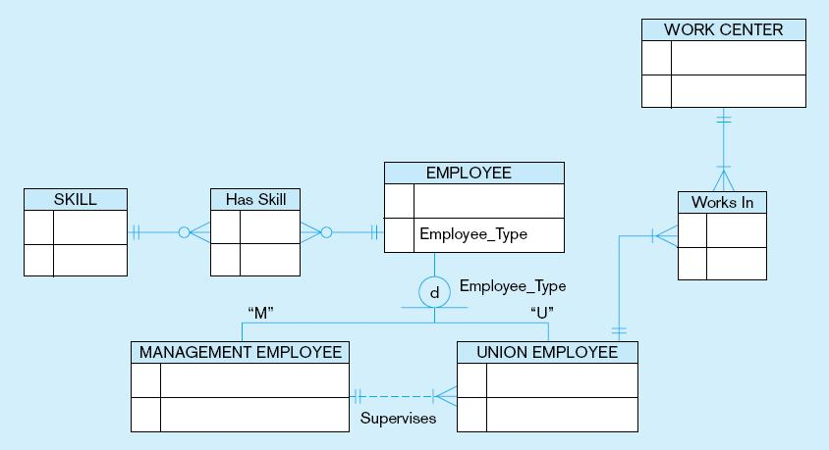
Manufacturing entity cluster
Detail for a single cluster

Slide 84
Exercise
The database keeps track of three types of persons: employees, alumni, and students. A person can belong to one, two, or all three of these types. Each person has a name, SSN, sex, address, and birth date.
Every employee has a salary, and there are three types of employees: faculty, staff, and student assistants. Each employee belongs to exactly one of these types. For each alumnus, a record of the degree or degrees that he or she earned at the university is kept, including the name of the degree, the year granted, and the major department. Each student has a major department.

Slide 85
Exercise
Each faculty has a rank, whereas each staff member has a staff position. Student assistants are classified further as either research assistants or teaching assistants, and the percent of time that they work is recorded in the database. Research assistants have their research project stored, whereas teaching assistants have the current course they work on.
Students are further classified as either graduate or undergraduate, with the specific attributes degree program (M.S., Ph.D., M.B.A., and so on) for graduate students and class (freshman, sophomore, and so on) for under- graduates.

Slide 86
Thank You !

