Slide 1
Chapter 2: Database Design
Database Systems
session 3:
Relational Algebra

Slide 2
Outline
1
Relational Algebra
2
Select and Product
3
Cartesian product
4
Inner Join and Outer Join
5
Set Operations
1

Slide 3
Relational Algebra
The relational algebra consists of a set of operations that take one or two relations as input and produce a new relation as their result.
Fundamental Operations
  Unary Operation: operate on one relation
    Select σ
    Project ∏
    Rename ρ
  Binary Operations: operate on pairs of relations
    Union ∪ , Intersection ∩
    Set different –
    Cartesian product x
    Join operations

Slide 4
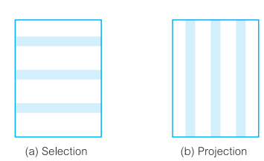
Selection and Project
Unary operation

Slide 5
Select Operation
The select operation selects tuples that satisfy a given predicate.
Notation: σ _{p} (r)
p is called the selection predicate

Slide 6
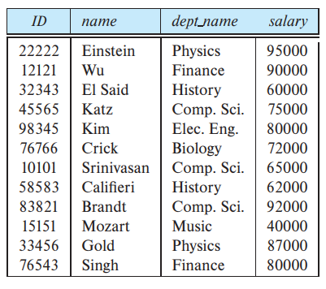
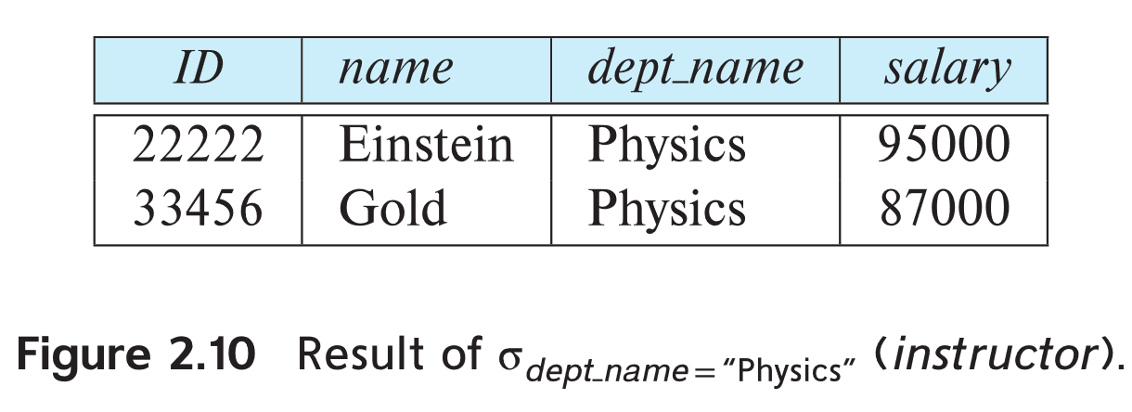
Select Operation
Example: select those tuples of the instructor relation where the instructor is in the “Physics” department.
Query
Result
Instructor relation
  σ _{dept_name=“Physics”} (instructor)

Slide 7
Select Operation
We allow comparisons using =, ≠, <, ≤, >, and ≥ in the selection predicate.
we can combine several predicates into a larger predicate by using the connectives and (∧), or (∨), and not (¬)

Slide 8
Select Operation
Example: Find the instructors in Physics with a salary greater $90,000, we write:
  Query:
  Result:

Slide 9
Project Operation
Project operation selects certain columns from the
table and discards the other columns.
Notation:
∏ _{A1,A2,A3 ….Ak} (r)
where A₁, A₂, …, A_{k} are attribute names and r is a relation name.
The result is defined as the relation of k columns obtained by erasing the columns that are not listed
Duplicate rows removed from result, since relations are sets

Slide 10
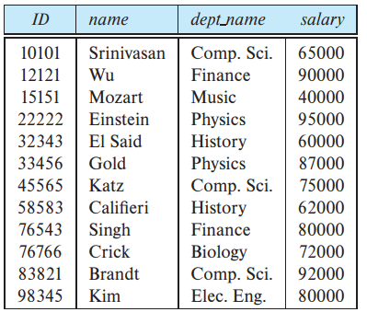
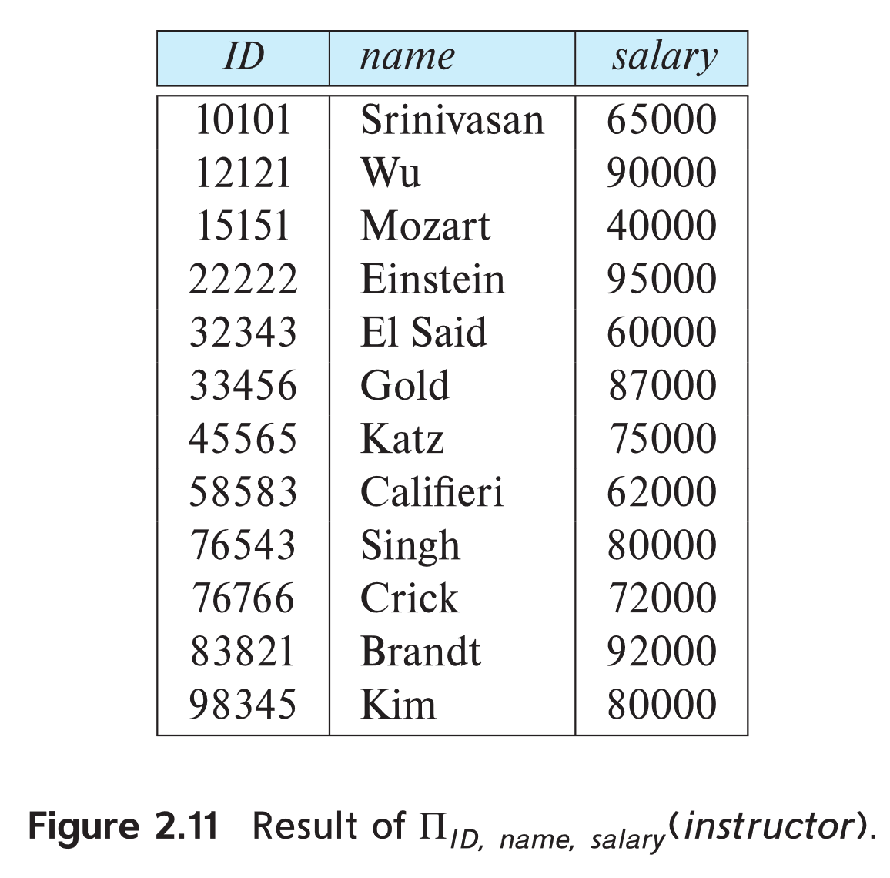
Project Operation
Example: eliminate the dept_name attribute of instructor relation
  Query
  ∏_{ID, name, salary} (instructor)
  Result:

Slide 11
Composition of Relational Operations
The result of a relational-algebra operation is relation and therefore of relational-algebra operations can be composed together into a relational-algebra expression.
Consider the query -- Find the names of all instructors in the Physics department.
∏_{name}(σ _{dept_name} _{=“Physics”} (instructor))
Instead of giving the name of a relation as the argument of the projection operation, we give an expression that evaluates to a relation.

Slide 12
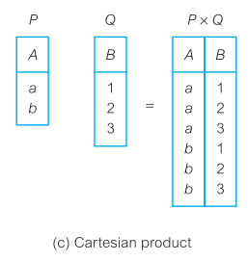
Cartesian-Product Operation
The Cartesian-product operation (denoted by X) allows us to combine information from any two relations.
We write the Cartesian product of relations P and Q
as P × Q

Slide 13
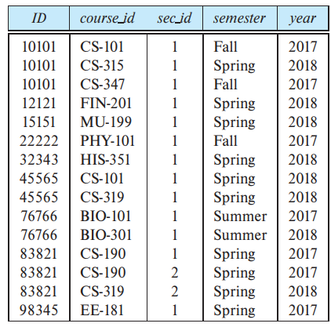
Cartesian-Product Operation
Example: the Cartesian product of the relations instructor and teaches is written as:
instructor X teaches
instructor
teaches

Slide 14
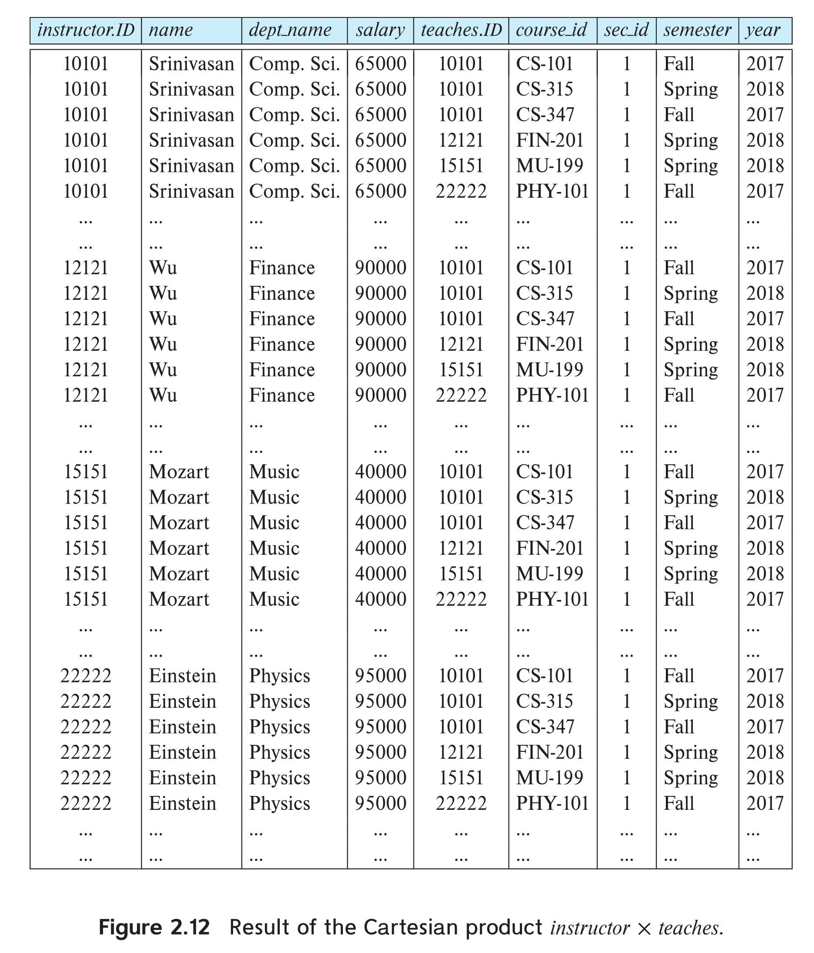
Cartesian-Product Operation
Result:

Slide 15
Cartesian-Product Operation
We construct a tuple of the result out of each possible pair of tuples: one from the instructor relation and one from the teaches relation.
Since the instructor ID appears in both relations we distinguish between these attribute by attaching to the attribute the name of the relation from which the attribute originally came.
  instructor.ID
  teaches.ID
Assume that we have n₁ tuples in instructor and n₂ tuples in teaches, so there are n₁ ∗ n₂ tuples in r

Slide 16
Join Operation
The Cartesian-Product
instructor X teaches
associates every tuple of instructor with every tuple of teaches.
Most of the resulting rows have information about instructors who did NOT teach a particular course.

Slide 17
Join Operation
To get only those tuples of “instructor X teaches” that pertain to instructors and the courses that they taught, we write:
σ _{instructor.id = teaches.id} (instructor x teaches ))
  We get only those tuples of “instructor X teaches” that pertain to instructors and the courses that they taught.
The result of this expression, shown in the next slide

Slide 18
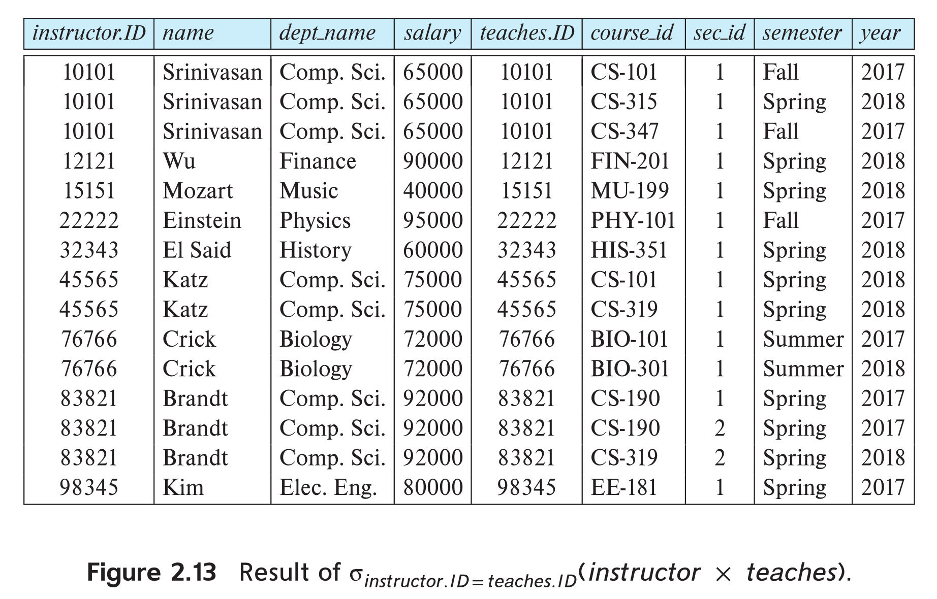
Join Operation
The table corresponding to:
σ _{instructor.id = teaches.id} (instructor x teaches))

Slide 19
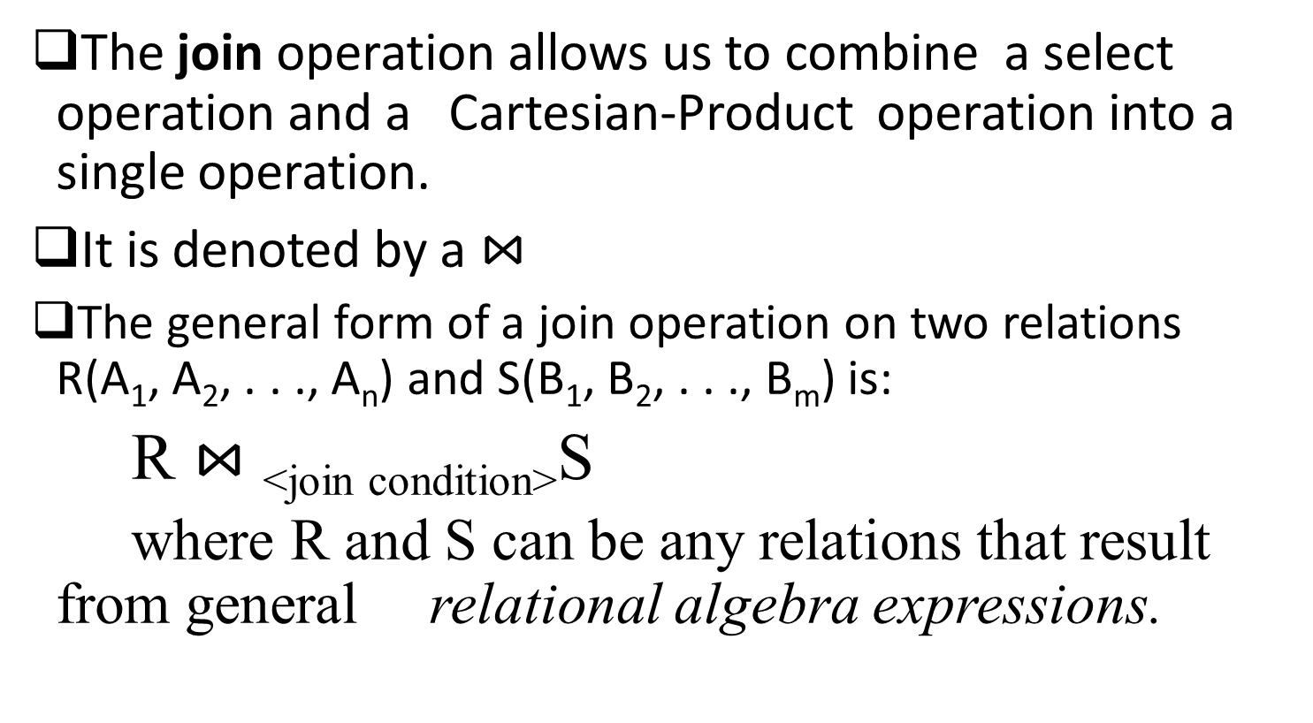
Join Operation

Slide 20
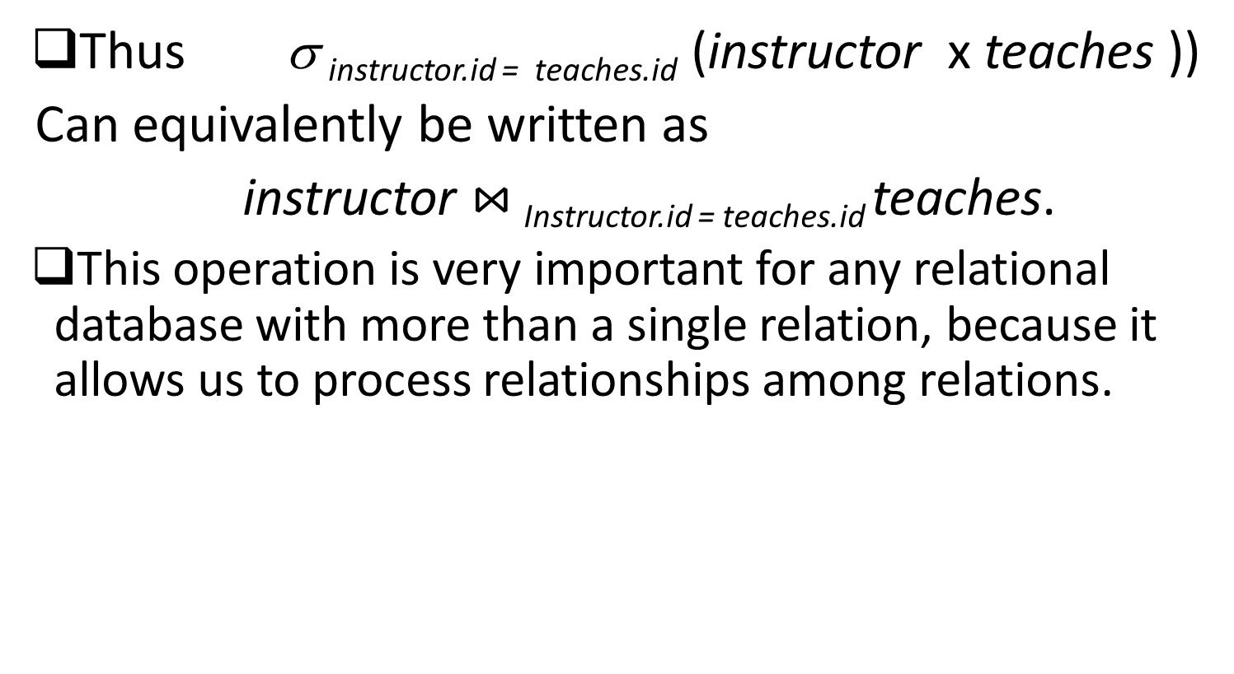
Join Operation

Slide 21
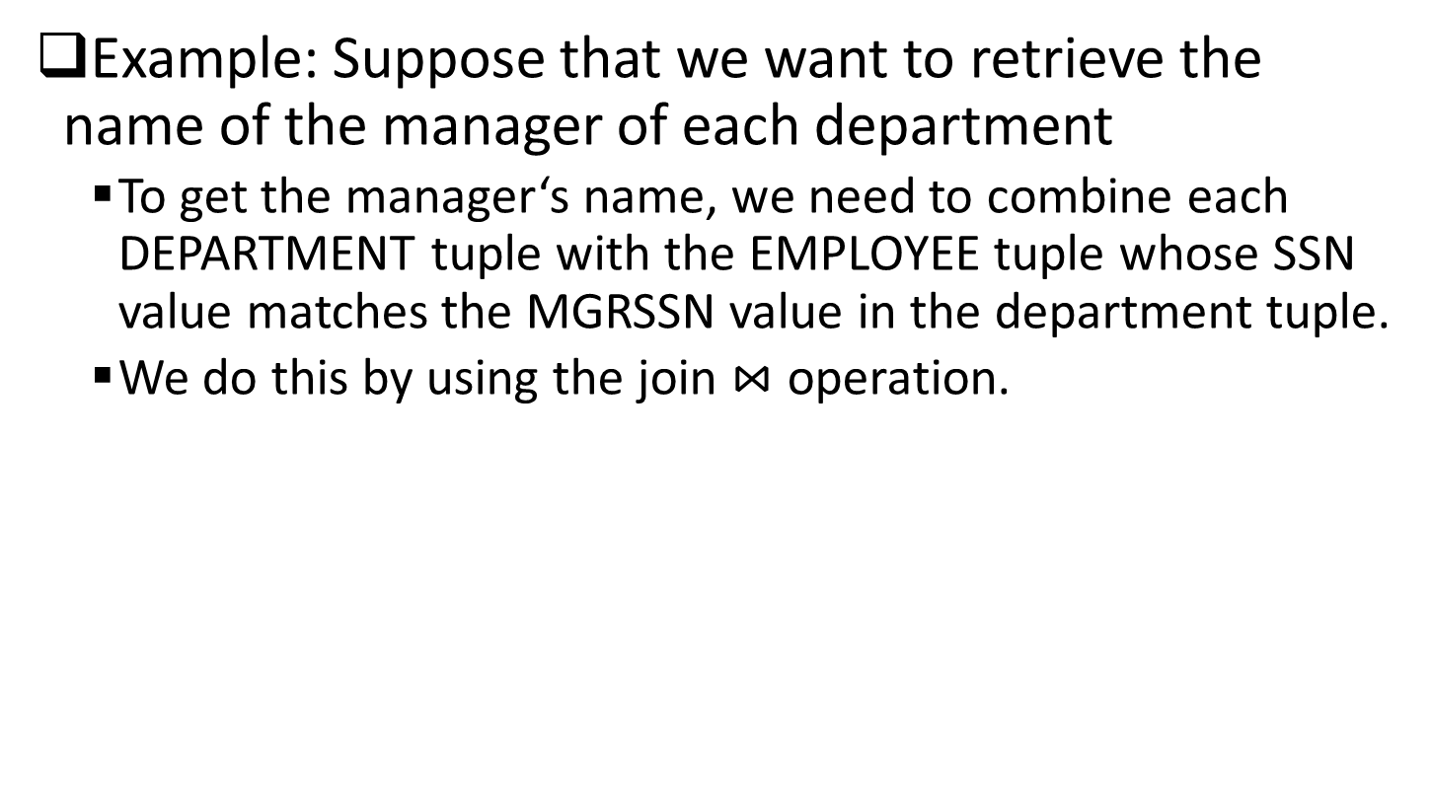
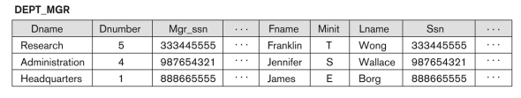
Join operator

Slide 22

Outer Joins
In Inner Join, we matched rows are returned and unmatched rows are not returned.
But, in outer join, we include those tuples which meet the given condition along with that, we also add those tuples which do not meet the required condition.
There are three types of outer joins:
  Left outer join
  Right outer join
  Full outer join

Slide 23
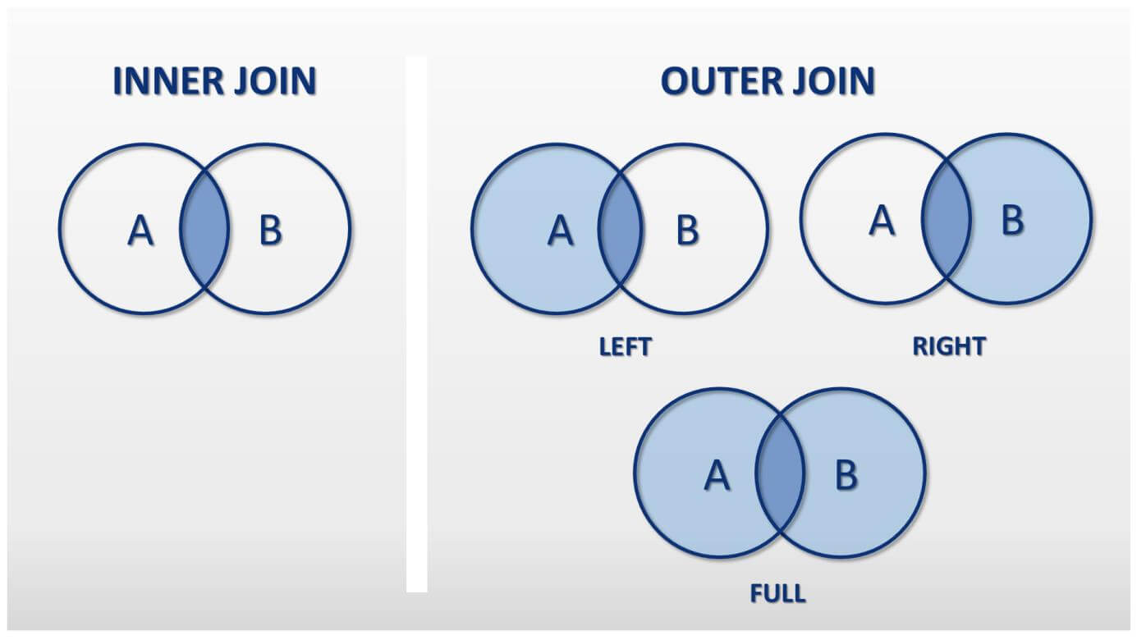
Outer Joins

Slide 24
Left Outer Join
Left Outer Join : A _{<join condition>} B
Ensures that all tuples in the in the relation A are present in the result set.
The tuples in A without matching tuples in B are filled with null values for B’s attributes

Slide 25
Left Outer Join example
Students Courses
stud# name course course# name
100 Fred PH PH Pharmacy
200 Dave CM CM Computing
400 Peter EN CH Chemistry
Students _{<course = course#>} Courses
Result:
stud# Students.name course course# Courses.name
100 Fred PH PH Pharmacy
200 Dave CM CM Computing
Peter EN NULL NULL

Slide 26
Right Outer Join
Right Outer Join: A _{<join condition>} B
Reverse of left outer join.
Retrieves all tuples of B and null values for attributes of A in non-matching tuples of B

Slide 27
Right Outer Join example
Students Courses
stud# name course course# name
100 Fred PH PH Pharmacy
200 Dave CM CM Computing
400 Peter EN CH Chemistry
Students _{<course = course#>} Courses
Result:
stud# Students.name course course# Courses.name
100 Fred PH PH Pharmacy
200 Dave CM CM Computing
NULL NULL NULL CH Chemistry

Slide 28
Full Outer Join
Full Outer Join: A _{<join condition>} B
Ensures that all tuples of A and B are present in the result set

Slide 29
Full Outer Join Example
Students Courses
stud# name course course# name
100 Fred PH PH Pharmacy
200 Dave CM CM Computing
400 Peter EN CH Chemistry
Students _{<course = course#>} Courses
Result:
stud# Students.name course course# Courses.name
100 Fred PH PH Pharmacy
200 Dave CM CM Computing
400 Peter CN NULL NULL
NULL NULL NULL CH Chemistry

Slide 30
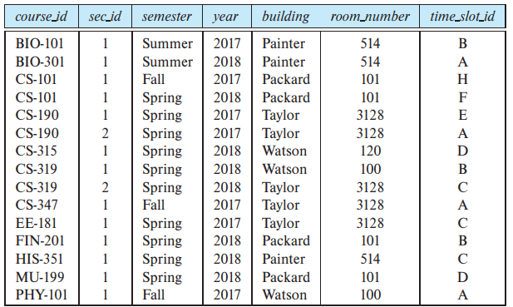
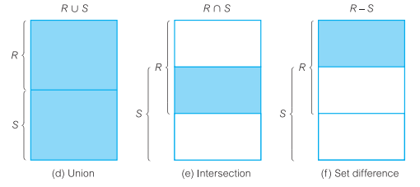
Set operations
Example
Section relation

Slide 31
Union Operation
The union operation allows us to combine two relations
Notation: r ∪ s
For r ∪ s to be valid.
1. r, s must have the same arity (same number of attributes)
2. The attribute domains must be compatible (example: 2nd column of r deals with the same type of values as does the
  2nd column of s)

Slide 32
Union Operation
Example: to find all courses taught in the Fall 2017 semester, or in the Spring 2018 semester, or in both
∏_{course_id} (σ _{semester=“Fall” Λ year=2017} (section)) ∪
∏_{course_id} (σ _{semester=“Spring” Λ year=2018} (section))
The result of this expression, shown in the next slide

Slide 33
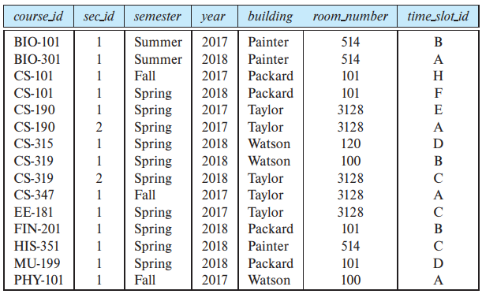
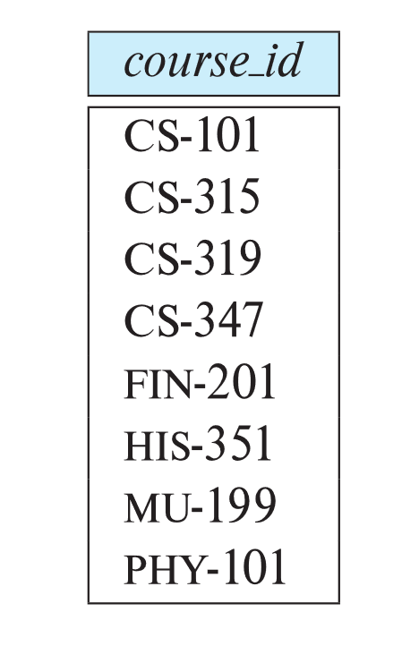
Union Operation
section relation result

Slide 34
Set-Intersection Operation
The set-intersection or intersection operation allows us to find tuples that are in both the input relations.
Notation: r ∩ s
Assume:
  r, s have the same arity
  attributes of r and s are compatible

Slide 35
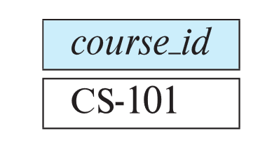
Set-Intersection Operation
Example: Find the set of all courses taught in both the Fall 2017 and the Spring 2018 semesters.
∏_{course_id} (σ _{semester=“Fall” Λ year=2017} (section)) ∩
∏_{course_id} (σ _{semester=“Spring” Λ year=2018} (section))
  Result:

Slide 36
Set Difference Operation
The set-difference operation allows us to find tuples that are in one relation but are not in another.
Notation r – s
Set differences must be taken between compatible relations.
  r and s must have the same arity
  attribute domains of r and s must be compatible

Slide 37

Set Difference Operation
Example: to find all courses taught in the Fall 2017 semester, but not in the Spring 2018 semester
∏_{course_id} (σ _{semester=“Fall” Λ year=2017} (section)) −
∏_{course_id} (σ _{semester=“Spring” Λ year=2018} (section))
Result:

Slide 38
The Rename Operation
The results of relational-algebra expressions do not have a name that we can use to refer to them. The rename operator, ρ , is provided for that purpose
The expression:
ρ_{x} (E)
returns the result of expression E under the name x
Another form of the rename operation:
ρ_{x(A1,A2, .. An)} (E)

Slide 39
Equivalent Queries
There is more than one way to write a query in relational algebra.
Example: Find information about courses taught by instructors in the Physics department with salary greater than 90,000
Query 1
σ _{dept_name=“Physics”} ∧ _{salary > 90,000} (instructor)
Query 2
σ _{dept_name=“Physics”} (σ _{salary > 90.000} (instructor))
The two queries are not identical; they are, however, equivalent -- they give the same result on any database.

Slide 40
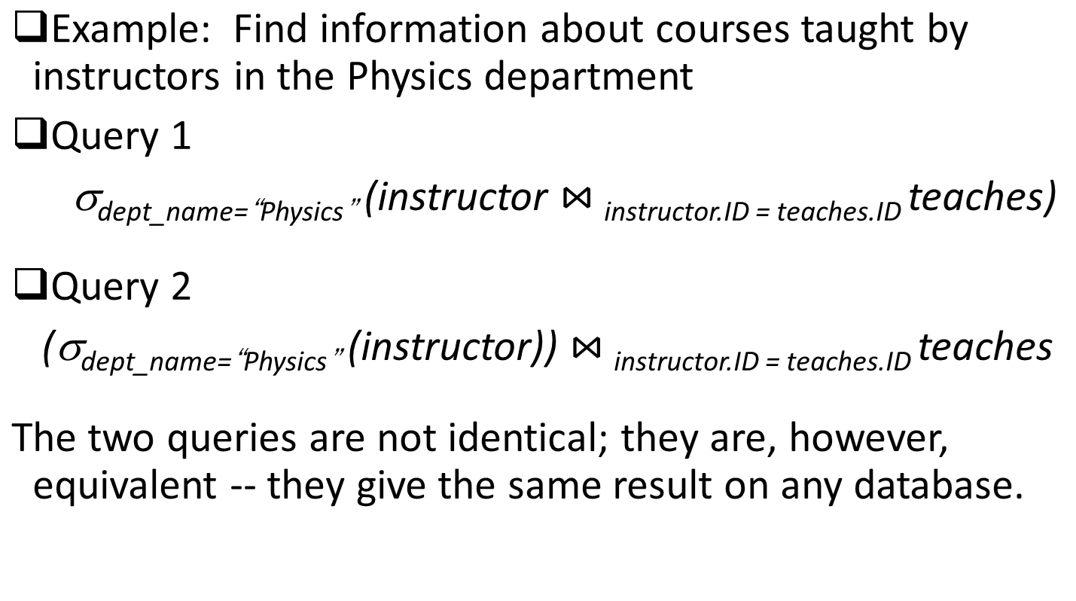
Equivalent Queries

Slide 41
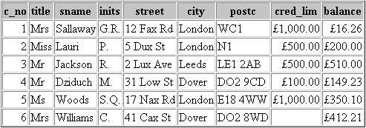
Exercises
Example: Customer
Ex1:
Query 1: List customers whose cred_lim is greater than £500.
Query 2: List customers whose cred_lim is greater than £500 and lives in London.

Slide 42
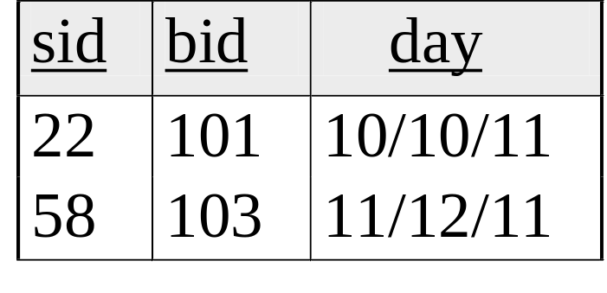
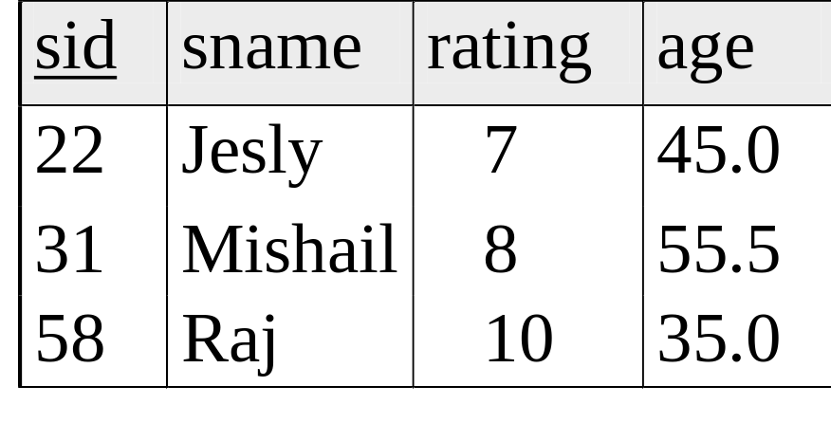
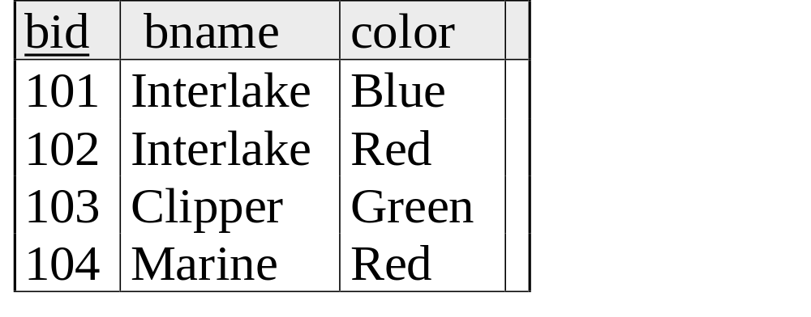
Exercises
Reserves
Ex2
1.Find names of sailors who’ve reserved boat #103
2.Find names of sailors who’ve reserved a red boat
3.Find sailors who’ve reserved a red or a green boat
4.Find sailors who’ve reserved a red and a green boat
5. Find the names of sailors who’ve reserved all boats
sailors
Boats

Slide 43
Thank You !

