Slide 1
Chapter 3: Relational Model Normalization
Database Systems
session 1:
Normalization and Functional Dependency

Slide 2
Outline
1
Normalization
2
Functional Dependency
3
Armstrong’s axiom
4
Closure of a set attributes
5
Super Key and candidate key
1

Slide 3
Introduction to Normalization
Transforming EER diagrams into relations often results in well-structured relations.
  However, how do you recognize a poor table structure, and how do you produce a good or well-structured table?
  There is no guarantee that all anomalies are removed after the transformation.
  The answer to these questions involves normalization
Normalization is a formal process for deciding which attributes should be grouped together in a relation so that all anomalies are removed.
Normalization is the process of successively reducing relations with anomalies to produce smaller, well-structured relations

Slide 4
Introduction to Normalization
Purpose of Normalization
  1. Minimize data redundancy, thereby avoiding anomalies and conserving storage space
  2. Simplify the enforcement of referential integrity constraints
  3. Make it easier to maintain data (insert, update, and delete)
  4. Provide a better design that is an improved representation of the real world and a stronger basis for future growth

Slide 5
Data Redundancy and Update Anomalies
Well-Structured Relations
  A relation that contains minimal data redundancy and allows users to insert, delete, and update rows without causing data redundancy
Data redundancy is the duplication of same data in the table. The redundant data increases the size of database and creates issues called update anomalies which may leads to data inconsistency and inaccuracy.

Slide 6
Data Redundancy and Update Anomalies
Relations that have redundant data may have problems called update anomalies.
Three types of update anomalies
  Insertion Anomaly–adding new rows forces user to create duplicate data
  Deletion Anomaly–deleting rows may cause a loss of data that would be needed for other future rows
  Modification Anomaly–changing data in a row forces changes to other rows because of duplication

Slide 7
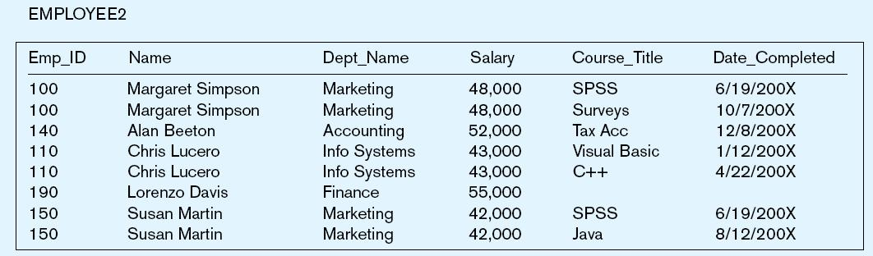
Data Redundancy and Update Anomalies
Example: Employee2 Relation
Answer–Yes: Unique rows and no multivalued attributes
Question–Is this a relation?
Question–What’s the primary key?
Answer–Composite: Emp_ID, Course_Title

Slide 8
Data Redundancy and Update Anomalies
Anomalies in this Relation
  Insertion–can’t enter a new employee without having the employee take a class
  Deletion–if we remove employee 140, we lose information about the existence of a Tax Acc class
  Modification–giving a salary increase to employee 100 forces us to update multiple records
Why do these anomalies exist?
  Because there are two themes (entity types) in this one relation. This results in data duplication and an unnecessary dependency between the entities

Slide 9
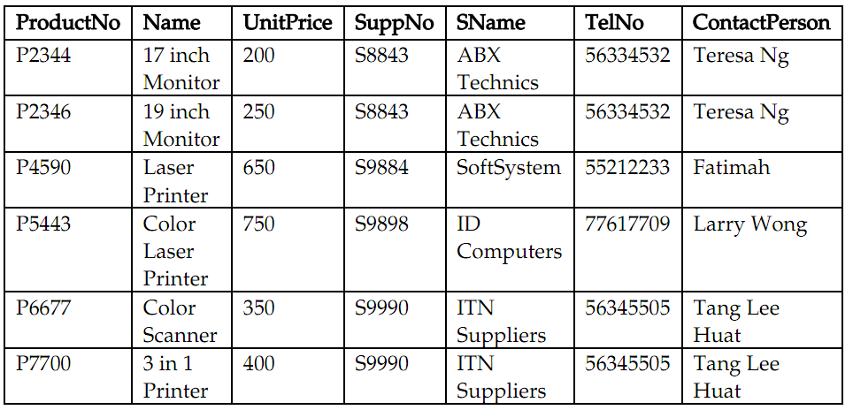
Data Redundancy and Update Anomalies
Another example: Product2 relation
  Is the Product2 relation redundant data?

Slide 10
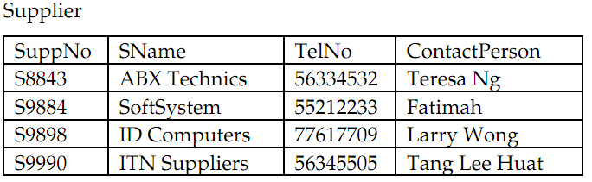
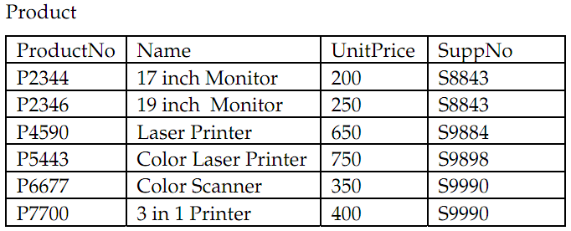
Data Redundancy and Update Anomalies
  One solution to deal with this problem is to decompose the relation into smaller relations so that redundancy can be minimized.
  2 relation: Product and Supplier, they are link together using the supplier number

Slide 11
Functional dependency
A functional dependency is a constraint between two attributes or two sets of attributes in which one attribute or group of attributes determines the value of another.
For any relation R, attribute B is functionally
dependent on attribute A if for each value of A determines only one value of B.
The functional dependency of B on A, written A→ B

Slide 12
Functional dependency
Examples:
  Employe ID determines employee name
  empID → empName
  Project number determines project name and location
  pNumber → { pName, pLocation}
  Employee ID and Project number determine the hours per week that the employee work on the project
  { empID, pLocation} →hours

Slide 13
Functional dependency
In other words:
Let A , B be sets of attributes in a relation R
We write A → B or say A functionally determines B
if for any tuples t₁ and t₂:
t₁[A] = t₂[A] implies t₁[B] = t₂[B]
“If any 2 tuples of R agree on attribute A value, then they must also agree on B value”

Slide 14
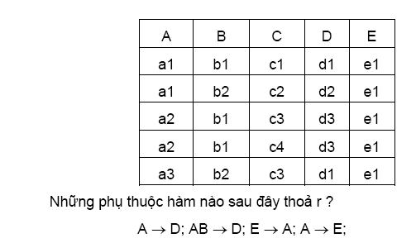
Functional dependency
Example: On relation R, check whether these following FDs exist or not?
A->D
AB->D
E->A
A->E?

Slide 15

Characteristics of Functional Dependency
Diagrammatic representation
Determinant attribute A
  Is an attribute or a group of attributes on the left-hand side of the arrow in a functional dependency
B is the dependent attribute

Slide 16
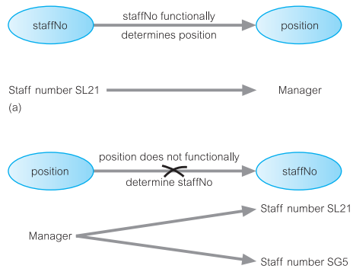
Characteristics of Functional Dependency
Example:
staffNo functionally determines position
(staffNo → position)
(b) position does not functionally determine staffNo (position → staffNo)

Slide 17
Characteristics of Functional Dependency
Three type of Functional Dependency
  Full Functional Dependency:
    A → B is a fully dependency if B is fully functionally dependent on A, but not on any proper subset of A.
  Partial Functional Dependency
    Occurs the determinant is only part of the primary key
    Ex: if (A, B) → (C, D), B → C and (A,B) is a primary key, then
    B → C is a partial dependency
  Transitive Functional Dependency
    Occurs when an attribute is functionally dependent on another non-prime attribute.
    Ex: X → Y, Y → Z, and X is the primary key, then X → Z is a transitive dependency because X determines the value of Z via Y.

Slide 18
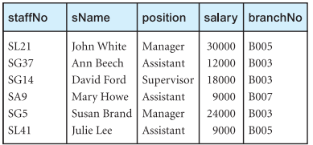
Characteristics of Functional Dependency
Example 1: Staff relation
  staffNo → branchNo: is a full functional dependency
  staffNo, sName → branchNo: is not a full functional dependency, because branchNo is also functionally dependent on a subset of (staffNo, sName), namely staffNo

Slide 19
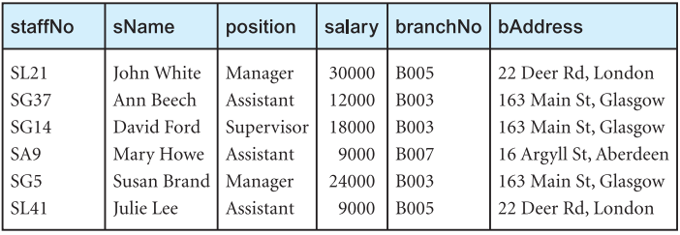
Characteristics of Functional Dependency
Example 2: StaffBranch relation
  These following functional dependencies:
  staffNo → sName, position, salary, branchNo, bAddress
  branchNo → bAddress
  => StaffNo → bAddress is a transitive functional dependency

Slide 20
Characteristics of Functional Dependency
Main characteristics of functional dependency used in normalization:
  There is a one-to-one relationship between the attribute(s) on the left-hand side (determinant) and those on the right-hand side of a functional dependency
  They hold for all time
  The determinant has the minimal number of attributes necessary to maintain the dependency with the attribute(s) on the right-hand side.

Slide 21
Armstrong’s axiom
Given that X, Y, and Z are sets of attributes in a relation R, three simple rules:
  Reflexivity: If Y is a subset of X (or X ⊇ Y),
  then X → Y
  Reflexivity property is also known as trivial dependency
  Augmentation: If X → Y, then XZ → YZ
  Transitivity: If X → Y and Y → Z, then X → Z

Slide 22
Armstrong’s axiom
From these rules, we can derive these rules:
Union: If X → Y and X → Z, then X → YZ
Decomposition: If X → YZ, then X → Y and X → Z
Pseudo transitivity:
If X → Y and YZ → W, then XZ → W
Accumulation: If X → YZ and Z → V, then X → YZV
Extension: If X → Y and W → Z, then WX → YZ

Slide 23
Armstrong’s axiom
Example: Provide 3 FDs
1. {Name} → {Color}
2. {Category} → {Dept.}
3. {Color, Category} → {Price}
Inferred FD | Which Rule did we apply ?
4. {Name, Category} -> {Name} | Reflexivity (1)
5. {Name, Category} -> {Color} | Transitive (4 -> 1)
6. {Name, Category} -> {Category} | Reflexivity (1)
7. {Name, Category -> {Color, Category} | Union(5,6)
8. {Name, Category} -> {Price} | Transitive (7 -> 3)

Slide 24
Closure of a set of Attributes
Closure of a set of attributes X with respect to F is the set X ⁺ of all attributes that are functionally determined by X.
Example:
  Let us consider a relation R(A,B,C,D) and functional dependency set F = { A -> B, C -> D, B -> C}.
  Then (AB)⁺ is attribute closure of (AB) is all the attributes determined by AB together.
  (AB)⁺ = { A, B, C, D}, because A, B are added to set from reflexive property, C and D by transitive property.

Slide 25
Closure of a set of Attributes
Algorithm: Determining X⁺, the Closure of the set of attribute X under F
  X⁺= X;
  repeat
    oldX⁺= X⁺;
    for each functional dependency Y→ Z in F do
    If X⁺ ⊃ Y then X⁺ = X⁺ ∪ Z;
  until (X⁺ = oldX⁺);
Notes:
Thuật toán tìm bao đóng:
Tính liên tiếp tập các tập thuộc tính X₀,X₁,X₂,... theo phương pháp sau:
Bước 1: X₀ = X
Bước 2: lần lượt xét các phụ thuộc hàm của F
Nếu Y→Z có Y ⊆ X_{i} thì X_{i+1} = X_{i} ∪Z
Loại phụ thuộc hàm Y → Z khỏi F
Bước 3: Nếu ở bước 2 không tính được X_{i+1} thì X_{i} chính là bao đóng của X
Ngược lại lặp lại bước 2

Slide 26
Closure of a set of Attributes
Example: R (A, B, C, D, E, G, H)
F= {B→A; DA→CE; D→H; GH→ C; AC→D}
X= {AC}=> X⁺= {AC}⁺
    X⁽⁰⁾ = {A,C} , {A,C}→{D}
    X⁽¹⁾ = {A,C,D}, {A, D}→{C,E}
    X⁽²⁾ = {A,C,D,E}, {D}→{H}
    X⁽³⁾ = {A,C,D,E,H}
    X⁺= X⁽³⁾
So, {AC}+ = {A, C, D, E, H}
    X = {B, D} ->X⁺?
Notes:
Compute {A,B}⁺ = {A, B, C, D, E}
Compute {A, F}⁺ = {A, B, C, D, E, F}

Slide 27
Closure of a set of Attributes
Example:
name → color
category → department
color, category → price
Closures:
name⁺ = {name, color}
{name, category}⁺ = {name, category, color, department, price}
color⁺ = {color}
Notes:
Compute {A,B}⁺ = {A, B, C, D, E}
Compute {A, F}⁺ = {A, B, C, D, E, F}

Slide 28
Closure of a set of Attributes
Ex1: R (A, B, C, D, E, F)
  F = {AB → C; AD → E; B→ D; AF → B}
  Compute {AB}⁺; {AF}⁺
Ex2: R(A,B,C,D,E,G)
  F = { A → C; A → EG; B → D; G → E}
  Compute {AB}⁺; {CGD}⁺
Notes:
Compute {A,B}⁺ = {A, B, C, D, E}
Compute {A, F}⁺ = {A, B, C, D, E, F}

Slide 29
Closure of a set of Attributes
Why Do We Need Closure?
With closure we can find all FD’s easily
In order to verify whether or not a functional dependency X → Y could be derived from a set F of FDs, the following simple test could be applied
  Compute X⁺
  Check if Y ∈ X⁺

Slide 30
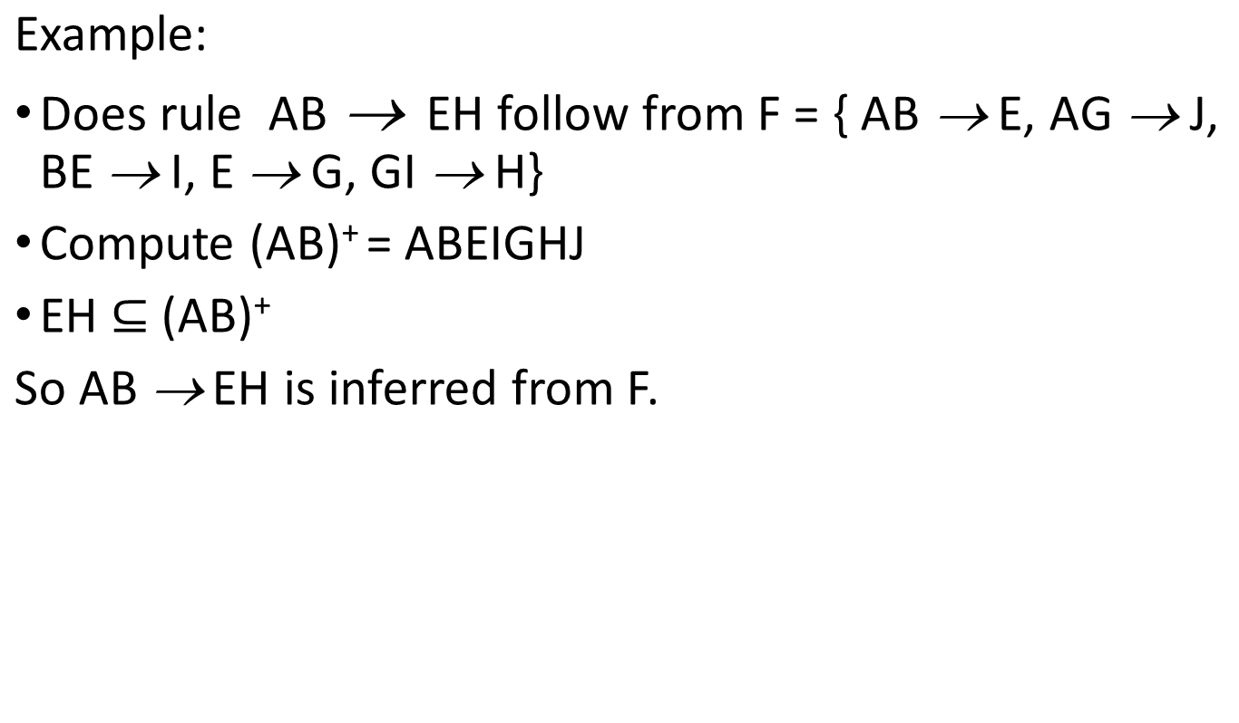
Closure of a set of Attributes

Slide 31
Super key and candidate key
Super Key: A set of attributes that uniquely determines all the attributes of a relation is known as super key.
A set X of attributes in R is a super key of R if and only if X⁺ contains all attributes of R. In other words, X is a super key if and only if it determines all other attributes.
Example: Let a relation R(A,B,C,D) if A is a super key of the relation then A -> B, A -> C and A -> D (A determines all the attributes (A, B, C, D))

Slide 32
Super key and candidate key
Candidate key: A candidate key is also a super key but it is minimal. That is, there is no proper subset of candidate key that is super key.
If we remove any attribute from candidate key it cannot determine all the attributes of the relation.

Slide 33
Finding Super Key or Candidate Key
For each set of attributes X
1. Compute X+
2. If X⁺ = set of all attributes then X is a super key
3. If X is minimal, then it is a key

Slide 34
Finding Super Key or Candidate Key
Product(name, price, category, color)
{name, category} → price
{category} → color
What is a key?

Slide 35
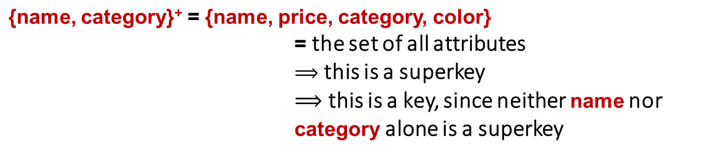
Example of Finding Super Key or Candidate Key
Product(name, price, category, color)
{name, category} → price
{category} → color

Slide 36
Example of Finding Super Key or Candidate Key
R(A,B,C,D) and F = { A -> B, C -> D}.
  Let A⁺ = {A, B}
  B⁺ = {B }
We can check other attribute closure to find out whether they determine all attributes or not.
  {AC} ⁺ = ( A,C,B, D)
  {ABCD}⁺ = (A B C D)
  {ABC} ⁺ = (A B C D)
So, AC, ABCD, ABC are super keys. And AC is a minimal which is essential to determine all attributes, so it is a candidate key.

Slide 37
An efficient algorithm to finding candidate Keys
Suppose L contains those attributes that occur only on the left-hand side of FDs (or L is the set of attribute not occurred on the right- hand side of any FD)
Suppose R contains those attributes that occur only on the right-hand side of FDs
Suppose M contains those attributes that occur on both side of FDs
We only focus only on L and M to find all keys
Tip: The attributes that are not in right-hand side of FDs are the essential components of candidate key

Slide 38
Example
Given R (A, B, C, D)
F = {AB→C, C→B, C→D}
What are all the super keys of R?
  L = A
  M = B, C
  R = D
  Compute L: A⁺= A
  Try adding B in M to A⁺, compute AB⁺= ABCD, so AB is a super key.
  Try adding C in M to A+, compute AC⁺ = ABCD, so AC is super key.
  =>AB, AC are also candidate keys.
Observe that prime attribute are A, B, C and non-prime is D attribute.

Slide 39
Example
Given R(A,B,C,D,E)
F= {A->C, C->BD, D->A}
What are all the super keys, candidate keys of R?
Observe that E doesn’t appear on the right hand side of any FDs. So every candidate keys must contain E. And B only appears on the right hand side, so no candidate keys contain B.
L = E
M = A, C, D
R = B
We have L⁺= E⁺= E so E is not a super key.
Try to testing AE, CE, DE
AE+= AECBD so AE is a super key and also a candidate key since neither A nor E is a super key.
Similar to the above, CE, DE are also candidate keys.

Slide 40
Exercises
For each Ex1, Ex2:
  What are all the keys of R?
  What are all the super-keys for R that are not candidate keys?
Ex1: R (A, B, C, D)
F = {BC→D, D→A, A→B}
Ex2: R (A, B, C, D)
F = {AD→B, AB→C, BC→D, CD→A}

Slide 41
Thank You !

