Slide 1
Chapter 3: Relational Model Normalization
Database Systems
session 2:
Normal forms

Slide 2
Outline
1
Introduction to Normal Forms
2
The process of normalization
3
1NF, 2NF, 3NF
4
BCNF
1

Slide 3
Normal forms
Normalization works through a series of stages called normal forms.
The first normal form (1NF), second normal form (2NF), and third normal form (3NF).
From a structural point of view, 2NF is better than 1NF, and 3NF is better than 2NF.
For most purposes in business database design, 3NF is as high as you need to go in the normalization process.
  Highest level of normalization is not always most desirable

Slide 4
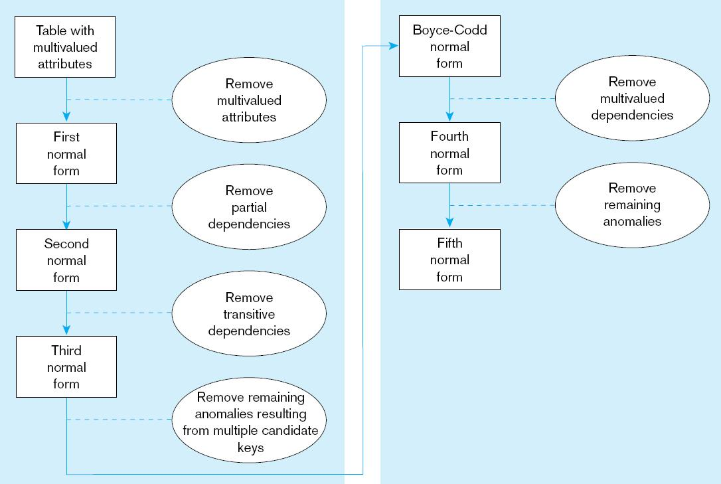
The process of normalization

Slide 5
First Normal Form (1NF)
A relation is in first normal form (1NF) if:
  No multivalued attributes or no repeating groups in the table. In other words, each row/column intersection contains one and only one value, not a set of values (Every attribute value is atomic)
  A primary key has been defined, which uniquely identifies each row in the relation
All relations are in 1st Normal Form

Slide 6
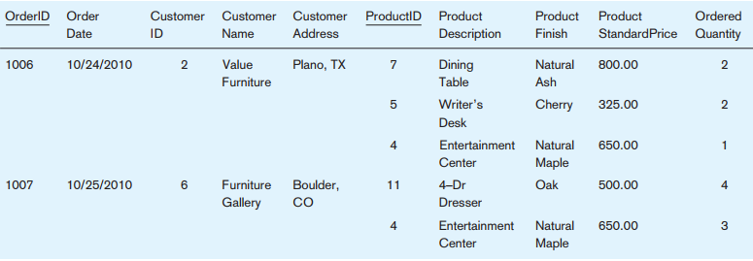
First Normal Form (1NF)
Example: Invoice tabular
Table with multivalued attributes, not in 1st normal form
Note: this is NOT a relation
Notes:
Ex: 1006 contains three repeating groups, corresponding to the three products on
that order.

Slide 7
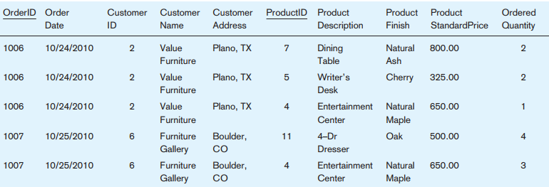
First Normal Form (1NF)
Removing repeating groups
  =>Invoice table with no multivalued attributes and unique rows

Slide 8

First Normal Form (1NF)
Select the primary key
There are four determinants in INVOICE, and their functional dependencies are the following:
  The only candidate key for INVOICE is the composite key consisting of the attributes OrderID and ProductID.
=>The invoice is in 1NF, but not a well-structured one
Notes:
Why do we know these are the functional dependencies? These business rules come
from the organization.
Notice that the only attribute that depends on the full key is OrderedQuantity. All of the other functional dependencies are either partial dependencies or transitive dependencies

Slide 9
First Normal Form (1NF)
Anomalies in the table:
  Insertion–if new product is ordered for order 1007 of existing customer, customer data must be re-entered, causing duplication
  Deletion–if we delete the Dining Table from Order 1006, we lose information concerning this item's finish (Natural Ash) and price ($800.00).
  Update–changing the price of product ID 4 requires update in several records
Why do these anomalies exist?
  Because there are multiple entity types in one relation. This results in duplication and an unnecessary dependency between the entities

Slide 10
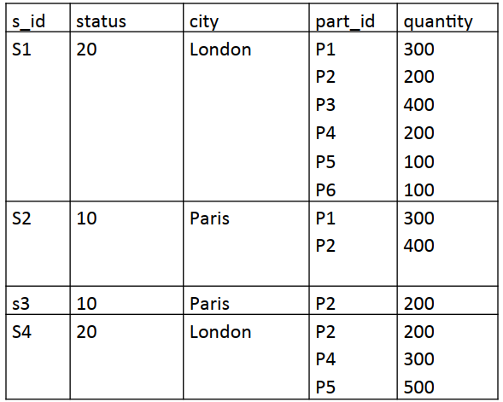
First Normal Form (1NF)
Ex: Is the supplier table in 1NF?

Slide 11
Second Normal Form (2NF)
A relation is in second normal form (2NF) if:
  It is in 1NF
  There is no partial dependency.
A partial functional dependency exists when a non-key attribute is functionally dependent on part (but not all) of the primary key
If a relation in 1NF has a primary key with single attribute, it is automatically in 2NF.

Slide 12
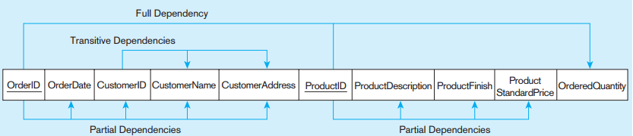
Second Normal Form (2NF)
Functional dependency diagram for INVOICE
  Primary key for relation is (OrderID,ProductID)
  There are following partial dependencies
Therefore, it is NOT in 2nd Normal Form

Slide 13
Second Normal Form (2NF)
To convert a relation with partial dependencies to 2NF, the following steps are required:
  Create a new relation for each primary key attribute (or combination of attributes) that is a determinant in a partial dependency. That attribute is the primary key in the new relation.
  Move the non-key attributes that are dependent on this primary key attribute (or attributes) from the old relation to the new relation

Slide 14
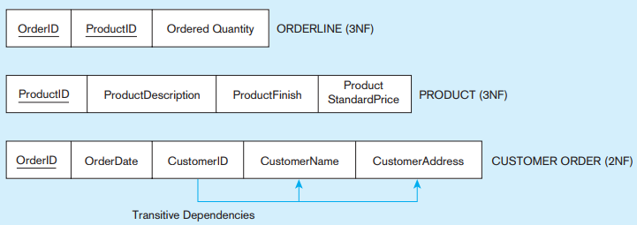
Second Normal Form (2NF)
Removing partial dependencies
Partial dependencies are removed, but there are still transitive dependencies

Slide 15
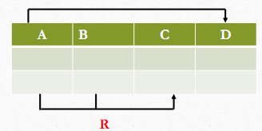
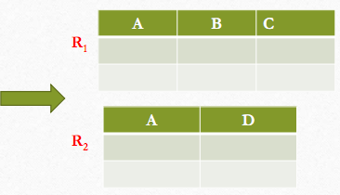
Exercises
Ex1: Consider a relation R(A,B,C,D) with
F = { AB -> C, A -> D}. Test whether R is in 2NF or not.
=> AB is an only candidate key. Why?
A and B are called prime attributes and C and D are non-prime attributes.
AB -> C satisfies 2NF. But, A -> D is partial dependency.
So, R is not in 2NF. Therefore, decomposing relation into 2 relations R1(A,B,C) and R2(A, D). R1,R2 is in 2NF.

Slide 16
Exercises
Consider the following relations, check whether them are in 2NF or not. If not, decompose it into 2NF.
Ex2: The relation R(A,B,C,D) and
F = { AB -> C, B -> D}.
Ex3: The relation R(A,B,C,D,E) and
F = { AB -> C, A -> D, B -> E}.

Slide 17
Third Normal Form (3NF)
A relation is in third normal form (3NF) if:
  It is in 2NF
  There is no transitive dependency.
A transitive dependency in a relation is a functional dependency between the primary key and one or more non-key attributes that are dependent on the primary key via another non-key attribute
In the other words, a transitive dependency exists when a non-key attribute can determine
another non-key attribute

Slide 18

Third Normal Form (3NF)
There are 2 transitive dependencies in CustomerOrder relation:
  Both CustomerName and CustomerAddres are uniquely identified by CustomerID but CustomerID is not part of the primary key.

Slide 19
Third Normal Form (3NF)
Removing transitive dependencies by the following steps:
  For each non- key attribute(s) that is a determinant in a relation, create a new relation. That attribute (s) becomes the primary key of the new relation.
  Move all of the attributes that are functionally dependent on the primary key of the new relation from the old to the new relation.
  Primary key in the new relation serve as a foreign key in the old relation.

Slide 20
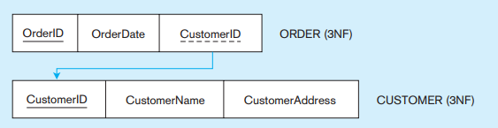
Third Normal Form (3NF)
The results of applying the steps to the relation CustomerOrder
The CustomerOrder relation is divided into 2 relations Customer and Order =>These relation are in 3NF

Slide 21
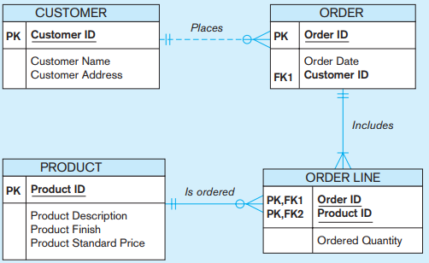
Third Normal Form (3NF)
A relational schema showing these four relations and their associations in ERD

Slide 22
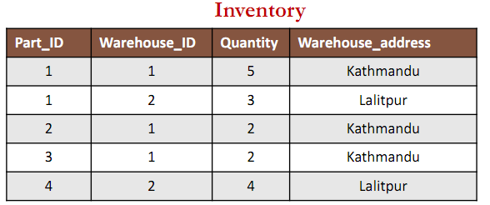
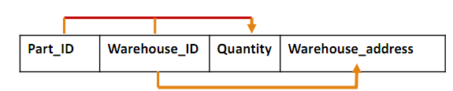
Exercises
Ex1: Is the Inventory relation in 3 NF?
The dependency is shown below:

Slide 23
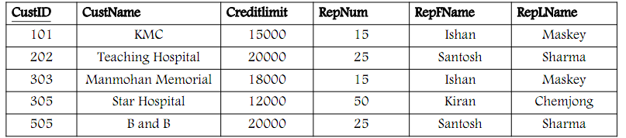

Exercises
Ex2: Is the Customer relation in 3 NF?
The dependency is shown below:

Slide 24
Exercises
Are the following relations in 3NF? If not, decompose them into 3NF.
Ex3: Consider a relation R(A,B,C,D) with
FDs { AB -> C, C -> D}.
Ex4: Consider the relation R(A,B,C,D, E)
and F = { AB -> C, B ->D, D ->E }.

Slide 25
Boyce-codd Normal Form (BCNF)
A relation is in BCNF if:
  It is in 3NF
  For every functional dependency X-> Y, X (called determinant) should be the candidate key of the relation.
BCNF can be violated only when the table contains more than one candidate key.
When a table contains only one candidate key, the 3NF and the BCNF are equivalent.

Slide 26
Boyce-codd Normal Form (BCNF)
Example 1: Is the following relation in BCNF?
R(A, B, C, D)
F= { A ->BCD; BC ->AD; D->B}
Above relation is in 3NF. Why?
2 Candidate keys is A and BC. Why?
But FD: D->B, D is not a candidate key.
So the relation R violates BCNF.
Thus, we break the relation R into 2 relation R1(A, D, C) and R2 (D, B), then R1, R2 are in BCNF.

Slide 27
Boyce-codd Normal Form (BCNF)
Ex2: Is the following relation in BCNF?
R(A, B, C, D)
F= { AB ->CD; AC ->BD; C->B}
Above relation is in 3NF (no partial dependencies and no transitive dependencies - the C->B: one key/prime attribute determines another key/prime attribute)
2 Candidate keys is AB and AC
And FD: C->B, C is not a candidate key.
So the relation R violates BCNF. Thus, we break the relation R into 2 relation R1 and R2, then R1, R2 are in BCNF with R1(A, C, D), R2 (C,B)

Slide 28
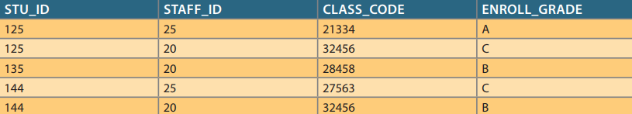
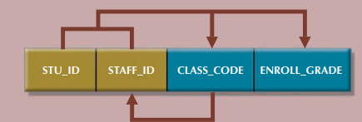
Boyce-codd Normal Form (BCNF)
Ex3: Is the Student relation in BCNF?
  With FDs:
  {Stu_ID, Staff_ID} -> {Class_code, Enroll_Grade}
  Class_Code ->Staff_ID

Slide 29
Boyce-codd Normal Form (BCNF)
=> 2 problems with the Student relation:
  Update anomaly: if a different staff member is assigned to teach class 32456, two rows will require updates
  deletion anomaly: if student 135 drops class 28458, information about who taught that class is lost
The relation has 2 candidate keys: {Stu_ID, Staff_ID} and {StudentID, Class_Code}
  And Class_Code ->Staff_ID violates BCNF.
So, decomposition to BCNF into 2 relations with Student(Stu_ID, Class_Code, Enroll_Grade} and Class(Class_Code, Staff_ID}

Slide 30
BCNF (Boyce-Codd Normal Form)
Ex4: Consider the relation R(A,B,C,D) and
F = { AB -> C, C -> D}. Is the relation in BCNF?
=>AB is only one candidate key. Why?
A,B are key/prime attributes and C,D are non-key/non-prime attributes.
C -> D is transitive dependency (a non-key attribute determine another non-key attribute). So, R is not in 3NF. Therefore, R is not in BCNF as well.
To convert to 3NF, decompose R into two relations R1(A,B,C) and R2(C,D). Now the relations will be in BCNF as well.

Slide 31
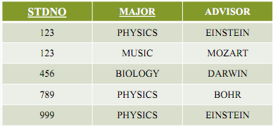
Exercises
Determine whether the following relations is in BCNF or not? If not, decompose the relation with its NF.
Ex1: Determine whether relation R(A,B,C) with
F = { AB -> C, C -> A}
Ex2: The relation StudMajor( StdNo, Major, Advisor)
with FDs {StdNo, Major -> Advisor, Advisor -> Major }.

Slide 32
Thank You !

