Slide 1
Chapter 4: Structured Query Language (SQL)
Database Systems
Session 1:
Introduction to SQL, DDL, DML

Slide 2
Outline
1
Introduction to SQL
2
DDL Statements
3
DML Statements with INSERT/UPDATE/DELETE

Slide 3

Introduction to SQL
Pronounced “S-Q-L” by some and “sequel” by others
Pronounced “S-Q-L” by some and “sequel” by others
  SQL is a Nonprocedural language
The standard for relational database management systems (RDBMS).
Notes:
RDBMS: A database management system that manages data as a collection of tables in which all relationships are represented by common values in related tables

Slide 4
History of SQL
1970–Edgar E. Codd develops relational database concept
1974-1979–System R with Sequel (later SQL) created at IBM Research Lab
1979–Oracle markets first relational DB with SQL
1986–ANSI (American National Standards Institue) SQL standards were first published
1989, 1992, 1999, 2003, 2006, 2008, 2011 and 2016–Major ANSI standard updates
Current–SQL is supported by most major database vendors

Slide 5
Purpose of SQL Standard
Specify syntax/semantics for data definition and manipulation
Define data structures
Enable portability
Specify minimal (level 1) and complete (level 2) standards
Allow for later growth/enhancement to standard

Slide 6
Benefits of a Standardized Relational Language
Reduced training costs
Productivity
Application portability
Application longevity
Reduced dependence on a single vendor
Cross-system communication
Notes:
Reduced training costs Training in an organization can concentrate on one
language. A large labor pool of IS professionals trained in a common language
reduces retraining for newly hired employees.
• Productivity IS professionals can learn SQL thoroughly and become proficient
with it from continued use. An organization can afford to invest in tools to help
IS professionals become more productive. And because they are familiar with the
language in which programs are written, programmers can more quickly maintain
existing programs.
• Application portability Applications can be moved from machine to machine
when each machine uses SQL. Further, it is economical for the computer software
industry to develop off-the-shelf application software when there is a standard
language.
• Application longevity A standard language tends to remain so for a long time;
hence there will be little pressure to rewrite old applications. Rather, applications
will simply be updated as the standard language is enhanced or new versions of
DBMSs are introduced.
• Reduced dependence on a single vendor When a nonproprietary language is
used, it is easier to use different vendors for the DBMS, training and educational
services, application software, and consulting assistance; further, the market for
such vendors will be more competitive, which may lower prices and improve
service.
• Cross-system communication Different DBMSs and application programs can
more easily communicate and cooperate in managing data and processing user
programs.

Slide 7
SQL Commands
SQL commands
3 types:
Data Definition
Language(DDL)
Data Manipulation
Language(DML)
Data Control
Language(DCL)
Define the database:
- CREATE, ALTER, DROP
TABLES, VIEWS, INDEXES
- ESTABLISHING
CONSTRAINTS
Maintain and query
the database:
- UPDATING, INSERTING,
DELETING AND
QUERYING DATA
Control the database:
- GRANT OR REVOKE
PRIVILEGES TO
ACCESS THE
DATABASE
- COMMITING DATA

Slide 8
Data Definition Language(DDL)
DDL statements are used to define a database
Major CREATE statements:
  CREATE DATABASE – create a new database
  CREATE SCHEMA–defines a portion of the database owned by a particular user
  CREATE TABLE–defines a table and its columns
  CREATE VIEW–defines a logical table from one or more views

Slide 9
Creating a database
Two tasks must be completed:
  create the database structure
  create the tables that will hold the end-user data
First task
  RDBMS creates the physical files that will hold the database
  Tends to differ substantially from one RDBMS to another

Slide 10
Creating a database
A SQL Server database can be created, altered and dropped by one of two following methods:
  Using the designer with SQL Server Management Studio (SSMS) or
  Using a Query
After creating database, 2 files are generated:
  .MDF file – Data file (contains actual data)
  .LDF file _ Transaction Log file ( used to recover the database)

Slide 11
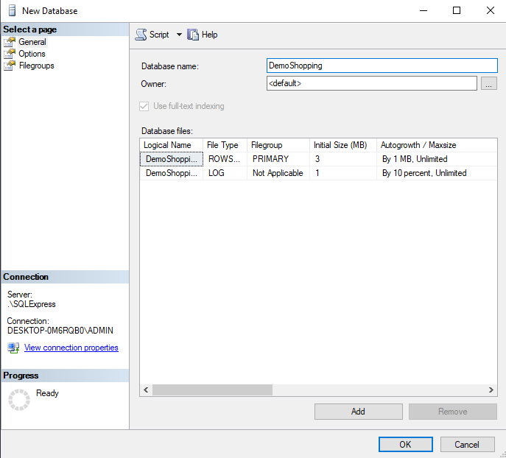
Creating a new database
Using designer:
  Right-click to Database
  menu, choose New Database
Using a Query: Ctrl +N
  To create a new query
  Syntax:
  Example:
  Click Execute button to
  create the DemoShopping database.
CREATE DATABASE DatabaseName
CREATE DATABASE DemoShopping

Slide 12

Creating a new database
Using the database
  Click the combobox to
  choose the database
  Use Query
  Syntax:
  Example
Right-click to the database, choose Properties,
click Files to know database files
USE DatabaseName
USE DemoShopping

Slide 13
Altering/Deleting a Database
To alter an existing database:
  Syntax:
  Example:
To drop a database
  Syntax:
  Example:
  Dropping a database will delete the LDF and MDF files.
ALTER DATABASE OldDatabase MODIFY NAME = NewDatabase
ALTER DATABASE DemoShopping MODIFY NAME = DemoShopping2
DROP DATABASE TheDatabase
DROP DATABASE DemoShopping2

Slide 14
Creating the Database Schema
Schema: logical database structure
  Is a group of database objects- such as tables and indexes – that are related to each other.
Authentication
  Process through which the DBMS verifies that only registered users are able to access the database
  Log on to the RDBMS using a user ID and a password created by the database administrator
Syntax:
Ex:
  Example (For most RDBMS, it is optional)
  CREATE SCHEMA AUTHORIZATION <creator>
CREATE SCHEMA AUTHORIZATION vku

Slide 15
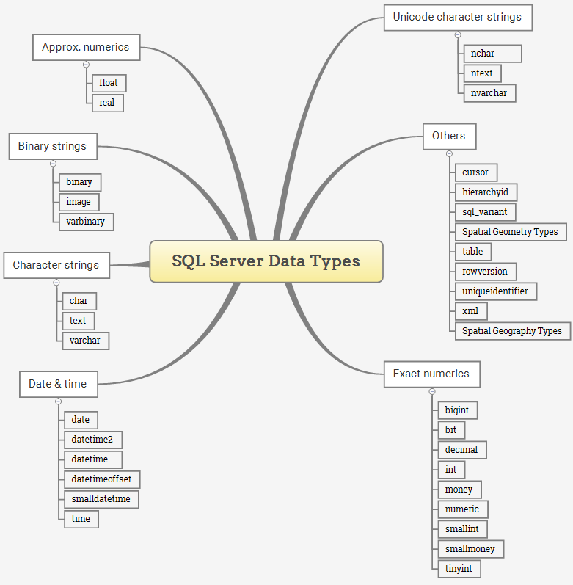
Some Common SQL Data Types
Notes:
Exact numeric data types store exact numbers such as integer, decimal, or monetary amount.
The bit store one of three values 0, 1, and NULL
The int, bigint, smallint, and tinyint data types store integer data.
The decimal and numeric data types store numbers that have fixed precision and scale. Note that decimal and numeric are synonyms.
The money and smallmoney data type store currency values.
https://www.techonthenet.com/sql_server/datatypes.php
exact numeric data types:
The approximate numeric data type (float(n), Real) stores floating point numeric data. They are often used in scientific calculations.

Slide 16
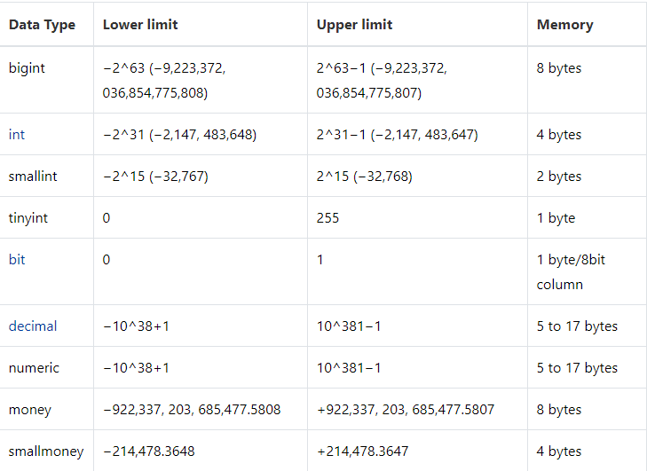
Some Common SQL Data Types
Exact numeric data types:

Slide 17
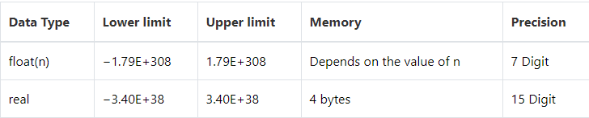
Some Common SQL Data Types
Approximate numeric data types:
The approximate numeric data type stores floating point numeric data. They are often used in scientific calculations.

Slide 18
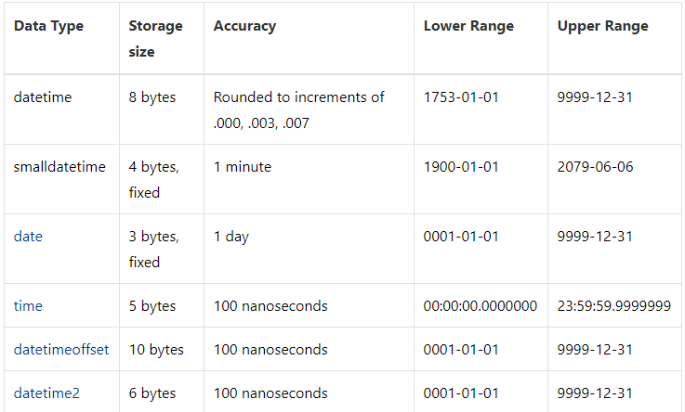
Some Common SQL Data Types
Date & Time data types

Slide 19
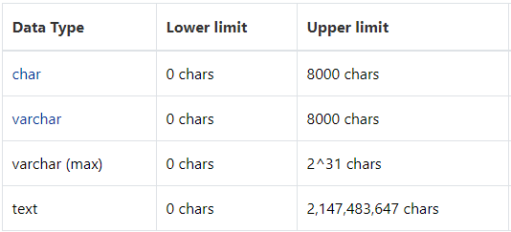
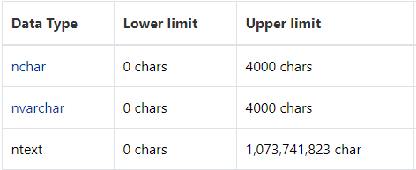
Some Common SQL Data Types
Character strings data types
Character strings data types allow you to store either fixed-length (char) or variable-length data (varchar).
Unicode character string data types store either fixed-length (nchar) or variable-length (nvarchar)

Slide 20
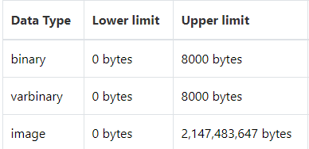
Some Common SQL Data Types
Binary string data types
The binary data types stores fixed and variable length binary data.
Notes:
https://www.techonthenet.com/sql_server/datatypes.php
Exact numeric data types store exact numbers such as integer, decimal, or monetary amount.
The bit store one of three values 0, 1, and NULL
The int, bigint, smallint, and tinyint data types store integer data.
The decimal and numeric data types store numbers that have fixed precision and scale. Note that decimal and numeric are synonyms.
The money and smallmoney data type store currency values.
https://www.techonthenet.com/sql_server/datatypes.php
exact numeric data types:
The approximate numeric data type (float(n), Real) stores floating point numeric data. They are often used in scientific calculations.

Slide 21
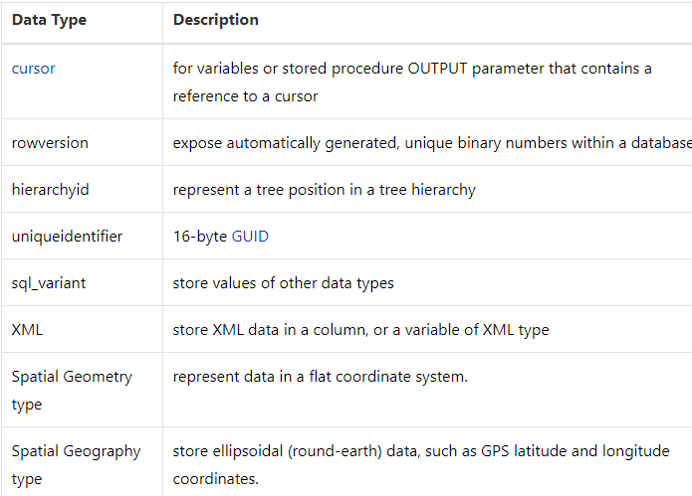
Some Common SQL Data Types
Other data types
Notes:
https://www.techonthenet.com/sql_server/datatypes.php
Exact numeric data types store exact numbers such as integer, decimal, or monetary amount.
The bit store one of three values 0, 1, and NULL
The int, bigint, smallint, and tinyint data types store integer data.
The decimal and numeric data types store numbers that have fixed precision and scale. Note that decimal and numeric are synonyms.
The money and smallmoney data type store currency values.
https://www.techonthenet.com/sql_server/datatypes.php
exact numeric data types:
The approximate numeric data type (float(n), Real) stores floating point numeric data. They are often used in scientific calculations.

Slide 22
SQL Constraints
A constraint is a mechanism that may be used to limit the values entered into a column.
CONSTRAINTS
NOT NULL
CHECK
FOREIGN KEY
PRIMARY KEY
DEFAULT
UNIQUE

Slide 23
SQL Constraints
Primary Key Constraints
  Is a way to enforce Entity Integrity
  Ensures that values in a primary key column are unique and not null.
  A primary key can be one column or combination of columns
Foreign key Constraints
  Is a way to enforce Referential integrity
  Ensures that if the foreign key contains a value, that value must refer to an existing value in the parent table.
  The parent table in such a parent–child relationship should be created first so that the child table will reference an existing parent table when it is created

Slide 24
SQL constraints
NOT NULL constraint
  Ensures that a column does not accept nulls
UNIQUE constraint
  Ensures that all values in a column are unique
  you can have many UNIQUE constraints per table, but only one PRIMARY KEY constraint per table.
DEFAULT constraint
  Assigns a value to an attribute when a new row is added to a table
CHECK constraint
  is a kind of domain integrity
  Validates data when an attribute value is entered

Slide 25
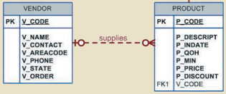
Creating a Table with foreign key constraint
Example:
    Each product is supplied by only a single vendor.
    A vendor may supply many products
    PRODUCT is optional to VENDOR.
    Some vendors have never supplied a product (VENDOR is optional to PRODUCT)
Notes:
Because the PRODUCT table contains a foreign key that references the VENDOR table, we have already created the VENDOR table first.

Slide 26
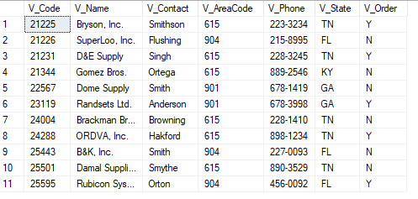
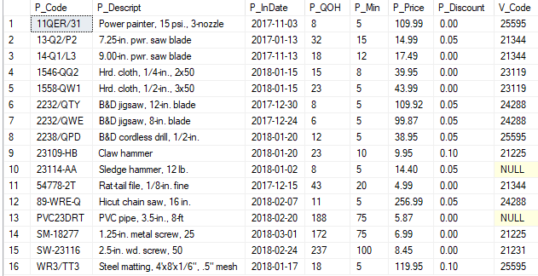
The Vendor and Product tables
Vendor table
Product table

Slide 27
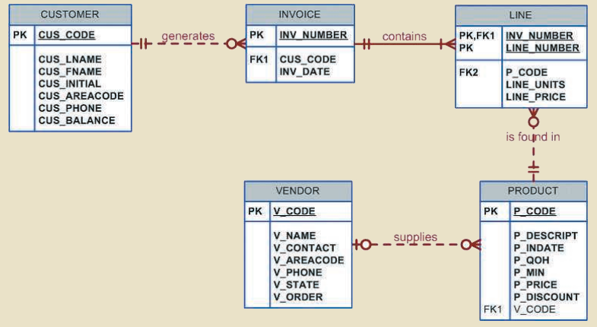
The Database Model
Example

Slide 28
The Database Model
The database model reflects the following business rules:
  A customer may generate many invoices. Each invoice is generated by one customer.
  An invoice contains one or more invoice lines. Each invoice line is associated with one invoice.
  Each invoice line references one product. A product may be found in many invoice lines.
  A vendor may supply many products. Some vendors do not yet supply products.
  If a product is vendor-supplied, it is supplied by only a single vendor.
  Some products are not supplied by a vendor.

Slide 29
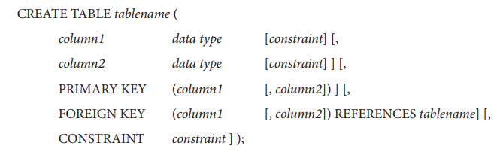
Creating a table
Creating a simple table using syntax:
Data Types can be string, numeric, and date/time. Not all data types are supported by every relational database vendors.
To make the SQL code more readable:
  one line per column definition,
  SQL keywords should be upper-case letters
  User-deﬁned words should be lower-case letters

Slide 30
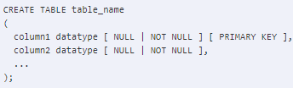
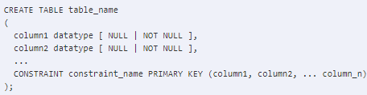
Creating a Table with primary key constraint
Syntax 1:
Syntax 2: you can named for constraint

Slide 31
Creating a table with primary key constraint
CREATE TABLE Vendor (
V_Code INT PRIMARY KEY,
V_Name VARCHAR(35) NOT NULL,
V_Contact VARCHAR(15) NOT NULL,
V_AreaCode CHAR(3) NOT NULL,
V_Phone CHAR(8) NOT NULL,
V_State CHAR(2) NOT NULL,
V_Order CHAR(1) NOT NULL
)
Example:
Or
CREATE TABLE Vendor (
V_Code INT NOT NULL,
V_Name VARCHAR(35) NOT NULL,
V_Contact VARCHAR(15) NOT NULL,
V_AreaCode CHAR(3) NOT NULL,
V_Phone CHAR(8) NOT NULL,
V_State CHAR(2) NOT NULL,
V_Order CHAR(1) NOT NULL,
CONSTRAINT PK_Vendor PRIMARY KEY (V_Code)
)
Primary keys can never have NULL values
Notes:
Because the PRODUCT table contains a foreign key that references the VENDOR table,
create the VENDOR table first.

Slide 32
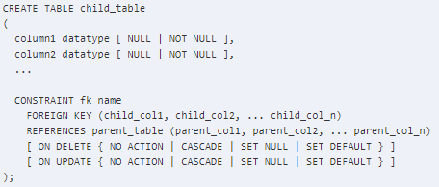
Creating a Table with foreign key constraint
Syntax

Slide 33
Creating a Table with foreign key constraint
CREATE TABLE Vendor (
V_Code INT NOT NULL,
…
V_Order CHAR(1) NOT NULL,
CONSTRAINT PK_Vendor PRIMARY KEY(V_CODE)
)
Example
Primary key of parent table
CREATE TABLE Product (
P_Code VARCHAR(10) NOT NULL,
P_Descript VARCHAR(35) NOT NULL,
P_InDate DATE NOT NULL,
P_QOH INT NOT NULL,
P_Min INT NOT NULL,
P_Price DECIMAL(8,2) NOT NULL,
P_Discount DECIMAL(8,2) NOT NULL,
V_Code INT NULL,
CONSTRAINT PK_Product PRIMARY KEY (P_Code),
CONSTRAINT FK_Product_Vendor_Vcode
FOREIGN KEY (V_Code) REFERENCES Vendor)
Foreign key of child_table

Slide 34
Foreign key constraint with Delete and Update rules
DELETE AND UPDATE rules in SQL Server foreign key can be use with the following options:
NO ACTION (the default)
  Error message would be generated, and no action is performed
CASCADE
  if the parent record is deleted/updated, associated records in child table are also deleted/updated.
SET NULL
  if the parent record is deleted/updated, associated records in child table are set to null
  Foreign key column should allow NULL values
SET DEFAULT
  if the parent record is deleted/updated, associated records in child table are set to default value specified in column definition.
  Also default value should be present in primary key column.

Slide 35
Foreign key constraint with Delete and Update rules
CREATE TABLE Product (
P_Code VARCHAR(10) NOT NULL,
P_Descript VARCHAR(35) NOT NULL,
P_InDate DATE NOT NULL,
P_QOH INT NOT NULL,
P_Min INT NOT NULL,
P_Price DECIMAL(8,2) NOT NULL,
P_Discount DECIMAL(8,2) NOT NULL,
V_Code INT NULL,
CONSTRAINT PK_Product PRIMARY KEY (P_Code),
CONSTRAINT FK_Product_Vendor_Vcode
FOREIGN KEY (V_Code) REFERENCES Vendor
ON UPDATE CASCADE
)
Example
  ON UPDATE CASCADE specification ensures that if you make a change in any V_CODE in VENDOR table that will result in that value changing in the PRODUCT table to match.

Slide 36
Creating a table with DEFAULT, CHECK, UNIQUE constraint
Example: CUSTOMER table
CREATE TABLE Customer (
  CUS_Code INT PRIMARY KEY,
  CUS_Lname NVARCHAR(30) NOT NULL,
  CUS_Fname NVARCHAR(30) NOT NULL,
  CUS_Initial CHAR(1),
  CUS_AreaCode CHAR(3)
  DEFAULT '615' NOT NULL
  CHECK(CUS_AreaCode IN('615','713','931')),
  CUS_Phone CHAR(8) NOT NULL,
  CUS_Balance DECIMAL DEFAULT 0.00,
  CONSTRAINT UQ_CUS_LName_FName
  UNIQUE (CUS_Lname, CUS_Fname)
)

Slide 37
Creating a table with constraints
Invoice table
  the DEFAULT constraint assigns a default date to a new invoice
  the CHECK constraint validates that the invoice date is greater than January 1, 2016
CREATE TABLE Invoice (
  INV_Number INT PRIMARY KEY,
  CUS_CodeINT NOT NULL,
  INV_Date DATETIME DEFAULT CURRENT_TIMESTAMP NOT NULL,
  CONSTRAINT FK_Inv_Cus_CusCode FOREIGN KEY(CUS_Code) REFERENCES Customer,
  CONSTRAINT CK_INVDate CHECK (INV_Date > '2016-01-01')
)

Slide 38
Creating a table with constraints
Invoice table has
  a composite primary key (INV_NUMBER, LINE_NUMBER)
  a UNIQUE constraint
  in INV_NUMBER and P_CODE to ensure that the same product is not ordered twice in the same invoice.
CREATE TABLE Line (
  INV_Number INTEGER NOT NULL,
  LINE_Number NUMERIC(2,0) NOT NULL,
  P_Code VARCHAR(10) NOT NULL,
  LINE_Units DECIMAL(9,2) DEFAULT 0.00 NOT NULL,
  LINE_Price DECIMAL(9,2) DEFAULT 0.00 NOT NULL,
  PRIMARY KEY (INV_Number,LINE_Number),
  FOREIGN KEY (INV_Number) REFERENCES Invoice ON DELETE CASCADE,
  FOREIGN KEY (P_Code) REFERENCES Product(P_Code),
  CONSTRAINT UQ_Line UNIQUE(INV_Number, P_Code))
Some primary keys are composite– composed of multiple attributes

Slide 39
Altering a table
Use ALTER TABLE statement is used to
  To add a column to an existing table:
  To change the data type of a column in a table
  To drop a column
ALTER TABLE table_name
ADD column_name datatype
ALTER TABLE table_name
ALTER COLUMN column_name datatype
ALTER TABLE table_name
DROP COLUMN column_name

Slide 40
Altering a table
Use ALTER TABLE statement is also used to
  To add a constraint to an existing table:
  To remove a constraint
Show all constraints in a table
ALTER TABLE table_name
ADD CONSTRAINT constraint_name constraint_type syntax
ALTER TABLE table_name
DROP CONSTRAINT constraint_name;
exec sp_helpconstraint 'table_name'

Slide 41
Altering a table with examples
To add column for a table
  Add a column named CUS_Address to the Customer table
To add constraints for a table
  Add a primary key for Vendor table if you forget to create it. Note: you only create a primary key on column(s) that are already defined as NOT NULL
  Add a foreign key for Product table
ALTER TABLE dbo.Customer
ADD CUS_Address NVARCHAR(50) DEFAULT N'Đà Nẵng'
ALTER TABLE Vendor
ADD CONSTRAINT PK_Vendor PRIMARY KEY(V_Code)
ALTER TABLE Product
ADD CONSTRAINT FK_Product_Vendor_Vcode
FOREIGN KEY (V_Code) REFERENCES Vendor
ON UPDATE CASCADE

Slide 42
Removing a table
DROP TABLE statement removes the specified table from a database
Syntax
  Default option is RESTRICT, the table will not be dropped if there are any dependent objects, such as views or constraints, that currently reference the table.
  If CASCADE is specified, all dependent objects will also be dropped as the table is dropped.
DROP TABLE Table_name [RESTRIC|CASCADE]

Slide 43
Removing a table
Example:
Many RDBMSs allows users to retain the table’s structure but remove all of the data that have been entered in the table with its TRUNCATE TABLE command
  Syntax:
  Example
  TRUNCATE TABLE Customer
DROP TABLE Table_name [RESTRIC|CASCADE]
TRUNCATE TABLE Table_name

Slide 44
Auto-increment
Auto-increment allows a unique number to be generated automatically when a new record is inserted into a table.
Often this is the primary key field that we would like to be created automatically every time a new record is inserted.

Slide 45
Auto-increment
To create an identity column for a table:
  seed is the value of the first row loaded into the table.
  increment is the incremental value added to the identity value of the previous row.
The default value of seed and increment is 1.
Example:
CREATE TABLE Employee
(
Emp_ID int PRIMARY KEY IDENTIY(1,1),
LastName nvarchar(255) NOT NULL,
FirstName nvarchar(255),
Address nvarchar(255),
)

Slide 46
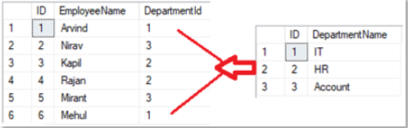
Exercises
Ex1: Create the following tables (Employee, Department)
  Use Auto-increment
  apply 4 rules: No action, Cascade, set null, set default.

Slide 47
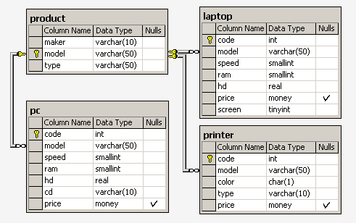
Exercises
Ex2: Create a database scheme that consists of four tables:
Product(maker, model, type)
PC(code, model, speed, ram, hd, cd, price)
Laptop(code, model, speed, ram, hd, screen, price)
Printer(code, model, color, type, price)
Notes:
The Product table contains data on the maker, model number, and type of product ('PC', 'Laptop', or 'Printer'). It is assumed that model numbers in the Product table are unique for all makers and product types. Each personal computer in the PC table is unambiguously identified by a unique code, and is additionally characterized by its model (foreign key referring to the Product table), processor speed (in MHz) – speed field, RAM capacity (in Mb) - ram, hard disk drive capacity (in Gb) – hd, CD-ROM speed (e.g, '4x') - cd, and its price. The Laptop table is similar to the PC table, except that instead of the CD-ROM speed, it contains the screen size (in inches) – screen. For each printer model in the Printer table, its output type (‘y’ for color and ‘n’ for monochrome) – color field, printing technology ('Laser', 'Jet', or 'Matrix') – type, and price are specified.

Slide 48
Exercises
Ex3: Create a database named BookDB
  Use the SQL statements to create the tables: Books (BookID, BookTitle, CopyRight, Year), Authors (AuthorID, AuthorFName, AuthorMName, AuthorLName, DateOfBirth, Gender, Address) and AuthorBook (BookID, AuthorID)
  Set the constraints for the tables

Slide 49
INSERT Statement
INSERT command is used to enter data into a table.
  Example:
Note for INSERT statement
  The row contents are entered between parentheses
  Character (string) and date values must be entered between apostrophes ( ’ ).
  Numerical entries are not enclosed in apostrophes.
  Attribute entries are separated by commas.
  A value is required for each column in the table.
INSERT INTO Vendor (V_Code,V_Name,V_Contact,V_AreaCode,V_Phone,V_State,V_Order) VALUES(21225,'Bryson, Inc.','Smithson','615','223-3234','TN','Y')

Slide 50
INSERT Statement
You do not need to specify the column (s) name if you are adding values for all the columns of the table. However, make sure the order of the values is in the same order as the columns in the table.
Inserting Rows with Null Attributes with NULL keyword when all the attribute values must be specified
INSERT INTO Vendor VALUES(21225,'Bryson, Inc.','Smithson','615','223-3234','TN','Y')
INSERT INTO Product
VALUES ('BRT-345','Titanium drill bit','18-Oct-15', 75, 10, 4.50, 0.06, NULL)
Notes:
'18-Oct-15 or 10-1-2015

Slide 51
INSERT Statement
Inserting Rows with Optional Attributes
  Rather than declaring each attribute as NULL in the INSERT command, you can indicate just the attributes that have required values.
  Example: assume that the only required attributes for the PRODUCT table are P_Code and P_Descript
You can insert more than one record at a time.
  Example
INSERT INTO Product(P_Code, P_Descript)
VALUES('BRT-345','Titanium drill bit')
INSERT INTO Vendor VALUES
(21226,'SuperLoo, Inc.','Flushing','904','215-8995','FL','N'),
(21231,'D&E Supply‘ ,'Singh' ,'615','228-3245','TN','Y'),
(21344,'Gomez Bros.' ,'Ortega' ,'615','889-2546','KY','N')

Slide 52
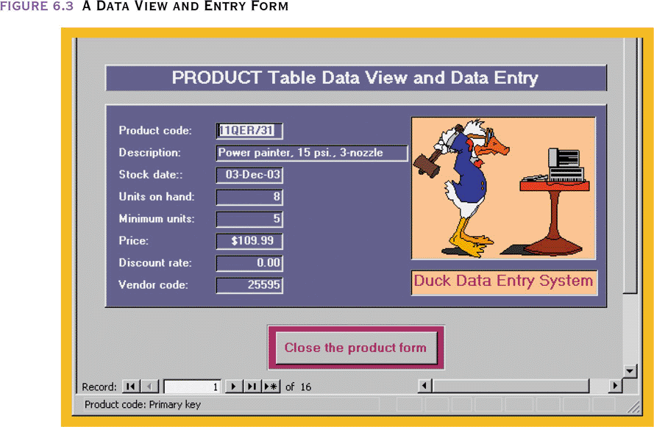
INSERT Statement
End-user applications are best created with utilities to create a form-based data view and entry screen

Slide 53
INSERT Statement
SQL Server automatically uses the following value for the column that is available in the table but does not appear in the column list of the INSERT statement:
  The next incremental value if the column has an IDENTITY property.
  The default value if the column has a default value specified.
  The NULL if the column is nullable
  The calculated value if the column is a computed column.
  The current timestamp value if the data type of the column is a timestamp data type

Slide 54
INSERT Statement
Any changes made to the table contents are not physically saved on disk until
  Database is closed
  Program is closed
  COMMIT command is used
Saving table changes by
COMMIT;
  Will permanently save any changes (such as rows added, attributes modified, and rows deleted) made to any table in the database

Slide 55
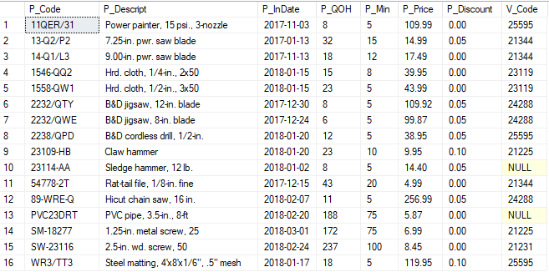
The content of Product table

Slide 56

Update statement
The UPDATE statement is used to modify the existing records in a table.
  Value1, value2,…can be an expression.
  If more than one attribute is to be updated in the row, separate the corrections with commas.
  The WHERE clause is optional, that specifies which record(s) that should be updated.
  If you omit the WHERE clause, all records in the table will be updated!

Slide 57
Update statement
Example
Use can use the command to list contents of table
UPDATE Product
SET P_InDate = '01-18-2016'
WHERE P_Code = '13-Q2/P2'
UPDATE Product
SET P_InDate = '01-18-2016', P_Price = 17.99, P_Min = 10
WHERE P_CODE = '13-Q2/P2'
SELECT * FROM Product

Slide 58
UPDATE statement
Restoring Table Contents by ROLLBACK statement
  Used restore the database to its previous condition
  Only applicable if COMMIT command has not been used to permanently store the changes in the database
Syntax
Use BEGIN TRANSACTION before DML commands before using ROLLBACK command.
COMMIT and ROLLBACK only work with data manipulation commands that are used to add, modify, or delete table rows
  ROLLBACK;

Slide 59
DELETE statement
The DELETE statement is used to delete existing records in a table.
  The WHERE clause is optional, that specifies which record(s) should be deleted.
  If you omit the WHERE clause, all records in the table will be deleted!

Slide 60
DELETE statement
Example
DELETE FROM Product
WHERE P_Code = 'BRT-345'
DELETE FROM Product
WHERE P_Min = 5

Slide 61
DELETE statement
TRUNCATE vs DELETE
  TRUNCATE is a DDL whereas DELETE is a DML
  You can use WHERE clause(conditions) with DELETE but you can't use WHERE clause with TRUNCATE
  You can't rollback data in TRUNCATE but in DELETE you can rollback data
  TRUNCATE is faster than DELETE.

Slide 62
Exercises
Complete the previous exercise with DML commands.

Slide 63
Thank You !

