Slide 1
Chapter 4: Structured Query Language (SQL) session 2
DML with SELECT, VIEW
Database Systems

Slide 2
Outline
1
DML with SELECT statement
2
Aggregate Functions
3
ORDER BY, GROUP, HAVING
4
VIEW

Slide 3
SELECT Statement
The SELECT Statement is used to retrieve data from a database table.
The basic syntax of SELECT Statement:
  SELECT identifies what columns to be projected into the table that will be the results of the command
  FROM identifies which table (s) needed to process the query
  WHERE: restricts the query to rows that meet conditions, the WHERE clause is optional.
    SELECT columnlist
    FROM tablelist
    [ WHERE conditionlist ]

Slide 4
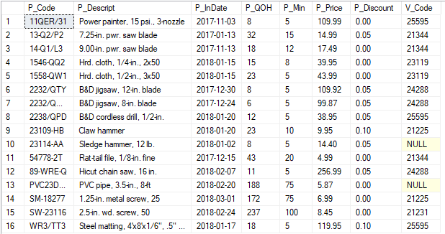
SELECT Statement
The contents of Product table:

Slide 5

SELECT Statement
Example: Showing the description, date, and price of products with a vendor code of 21344
  Result:
SELECT P_Descript, P_InDate, P_Price, V_Code
FROM Product
WHERE V_Code = 21344

Slide 6
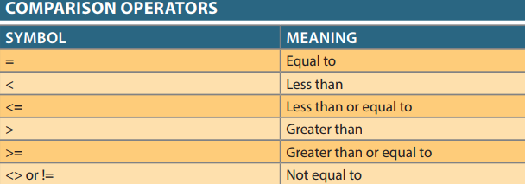
SELECT Statement
Using asterisk ( * ) to select all columns in the table
The comparison operators can be used to restrict output
SELECT * FROM Product

Slide 7
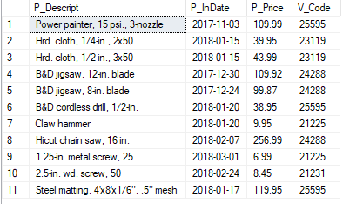
SELECT Statement
Example: lists all of the rows of the product for which the vendor code is not 21344.
  Result:
SELECT P_Descript, P_InDate, P_Price, V_Code
FROM Product
WHERE V_Code <> 21344

Slide 8
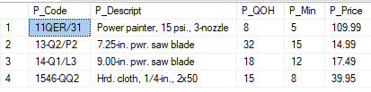
SELECT Statement
Using Comparison Operators on Character Attributes
  String (character) comparisons are made left-to-right ASCII character comparison
  Result:
SELECT P_Code, P_Descript, P_QOH, P_Min, P_Price
FROM Product
WHERE P_Code < '1558-QW1'

Slide 9
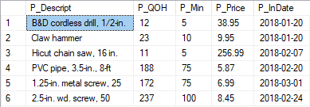
SELECT Statement
Using Comparison Operators on Dates
  Using yyyy-mm-dd format for date
  Result:
SELECT P_Descript, P_QOH, P_Min, P_Price, P_InDate
FROM Product
WHERE P_InDate >= '2018-01-20'

Slide 10
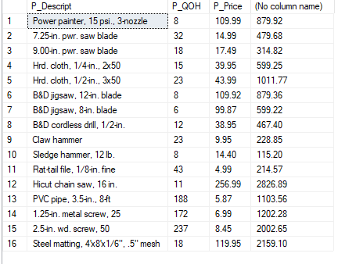
SELECT Statement
Using Computed Columns and Column Aliases
  Example: determine the total value of each of the products
  Result
SELECT P_Descript, P_QOH, P_Price, P_QOH * P_Price
FROM Product

Slide 11
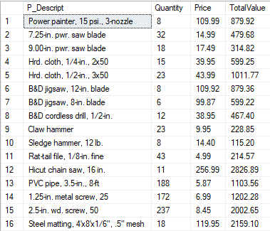
SELECT Statement
Using Alias
  Alias: alternate name given to a column or table in any SQL statement to improve the readability
    Is useful with calculations
    There can also be the optional AS keyword between the column/table name and alias
SELECT P_Descript, P_QOH AS Quantity, P_Price Price,
P_QOH * P_Price AS TotalValue
FROM Product

Slide 12
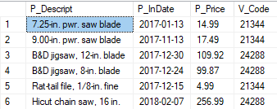
SELECT Statement
Logical Operators: AND, OR, NOT
SELECT P_Descript, P_InDate, P_Price, V_Code
FROM Product
WHERE V_Code = 21344 OR V_Code = 24288

Slide 13
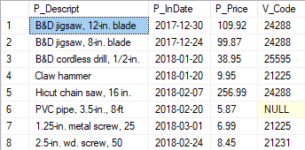
SELECT Statement
Logical Operators: AND, OR, NOT
  You can combine the logical OR with the logical AND to place further restrictions on the output
SELECT P_Descript, P_InDate, P_Price, V_Code
FROM Product
WHERE (P_Price < 50 AND P_InDate > '2018-01-15')
OR V_Code = 24288

Slide 14
SELECT Statement
Special Operators
  BETWEEN - Used to check whether an attribute value is within a range.
  IS NULL - Used to check whether an attribute value is null
  LIKE - Used to check whether an attribute value matches a given string pattern
  IN - Used to check whether an attribute value matches any value within a value list
  EXISTS - Used to check whether a subquery returns any rows

Slide 15
SELECT Statement
Special operators
  BETWEEN
SELECT * FROM Product
WHERE P_Price BETWEEN 50.00 AND 100.00
SELECT * FROM Product
WHERE P_Price>= 50.00 AND P_Price<= 100.00

Slide 16

SELECT Statement
Special operators
  IS NULL
  NULL is a special property of an attribute that represents the absence of any value
SELECT P_Code, P_Descript, V_Code
FROM Product
WHERE V_Code IS NULL

Slide 17
SELECT Statement
Special operators
  LIKE
    The LIKE special operator is used in conjunction with wildcards to find patterns within string attributes.
    use the percent sign ( % ) and underscore ( _ ) wildcard characters
      % matches any substring.
      _ matches one character
Notes:
'J%' includes Johnson, Jones, Jernigan, July, and J-231Q.
'Jo%' includes Johnson and Jones.
'%n' includes Johnson and Jernigan.
'_23-456-6789' includes 123-456-6789, 223-456-6789, and 323-456-6789.
'_23-_56-678_' includes 123-156-6781, 123-256-6782, and 823-956-6788.
'_o_es' includes Jones, Cones, Cokes, totes, and roles.

Slide 18

SELECT Statement
Special operators
  LIKE
SELECT V_Name, V_Contact, V_AreaCode, V_Phone
FROM dbo.Vendor
WHERE V_Contact LIKE 'Smith%'
Notes:
SELECT *FROM
WHERE VENDOR
V_CONTACT LIKE 'Johns_n';

Slide 19
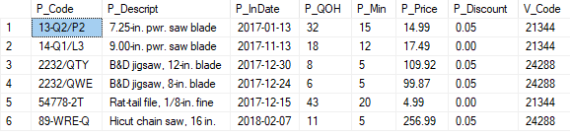
SELECT Statement
Special operators
  IN
    All of the values in the list must be of the
    same data type.
SELECT *
FROM Product
WHERE V_Code IN (21344, 24288)
SELECT *
FROM Product
WHERE V_Code = 21344 OR V_Code = 24288
Notes:
Can use NOT IN operator

Slide 20
SELECT Statement
Special operators
  EXISTS
    Is used to check if a subquery returns any rows, run the main query; otherwise, do not.
    EX: list all vendors but only if there are products with the quantity on hand, and less than double the minimum quantity
SELECT *
FROM Vendor
WHERE EXISTS(SELECT*FROM Product WHERE P_QOH < P_Min * 2)
Notes:
the following query will list all vendors, but only if there are products to order
SELECT *FROM dbo.Vendor
WHERE EXISTS (SELECT * FROM Product
WHERE P_QOH <= P_MIN AND Vendor.V_Code = Product.V_Code)

Slide 21


SELECT Statement
Use DISTINCT keyword to eliminates all duplicate rows in the table resulting from the query
SELECT V_Code
FROM Product
SELECT DISTINCT V_Code
FROM Product

Slide 22
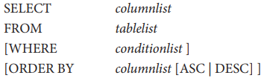
Sorting Results: The ORDER BY Clause
ORDER BY clause is used to sort the result set in ascending (ASC) or descending (DESC) order. the default order is ascending.
  Syntax:
  If the ordering column has nulls, they are listed either first or last, depending on the RDBMS.
  The ORDER BY clause must always be listed last in the SELECT command sequence.

Slide 23
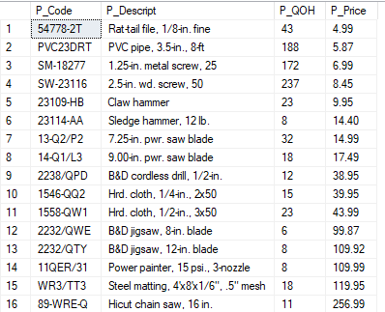
Sorting Results: The ORDER BY Clause
Example:
SELECT P_Code, P_Descript, P_QOH, P_Price
FROM dbo.Product
ORDER BY P_Price

Slide 24
Sorting Results: The ORDER BY Clause
Result

Slide 25
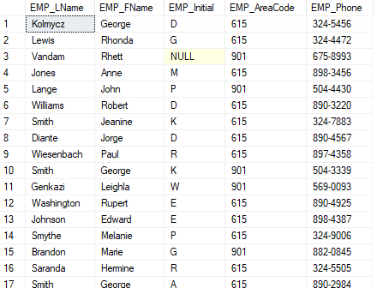
Sorting Results: The ORDER BY Clause
EMPLOYEE Table Contents

Slide 26
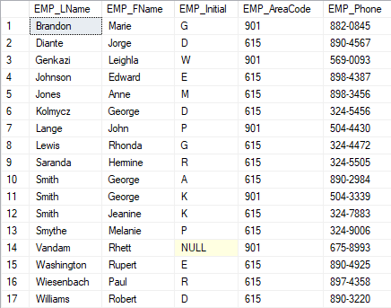
Sorting Results: The ORDER BY Clause
Cascading order sequence
SELECT EMP_LName, EMP_FName, EMP_Initial, EMP_AreaCode, EMP_Phone
FROM Employee
ORDER BY EMP_LName, EMP_FName, EMP_Initial
Notes:
Can use column positions in the select list; ou need to see only a few
of them use LIMIT keyword

Slide 27
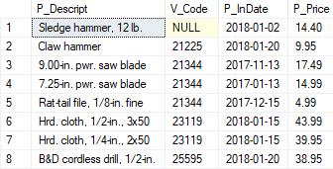
Sorting Results: The ORDER BY Clause
Descending order
SELECT P_Descript, V_Code, P_InDate, P_Price
FROM Product
WHERE P_InDate < '2018-01-21' AND P_Price <= 50.00
ORDER BY V_Code, P_Price DESC

Slide 28
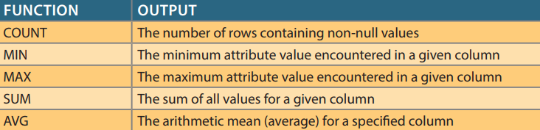
Aggregate Functions
An aggregate function allows you to perform a calculation on a set of values to return a single scalar value
Syntax

Slide 29
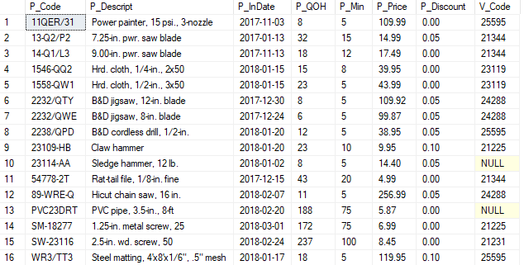
The contents of Product table

Slide 30
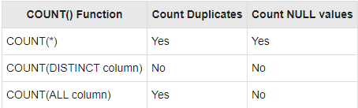
Aggregate Functions
COUNT
  The default is ALL

Slide 31



Aggregate Functions
COUNT
  COUNT(*) returns the number of total rows from the query, including the rows that contain nulls.
SELECT COUNT(V_Code) AS 'Số lượng V_Code'
FROM dbo.Product
SELECT COUNT( DISTINCT V_Code) AS 'Số lượng V_Code'
FROM dbo.Product
SELECT COUNT(*)
FROM dbo.Product
Notes:
SELECT COUNT(P_CODE)
FROM PRODUCT and SELECT COUNT(*) FROM PRODUCT will yield the same answer
because there are no null values in the P_CODE primary key column.

Slide 32


Aggregate Functions
MAX/MIN
SELECT MAX(P_Price) AS 'Max Price'
FROM dbo.Product
SELECT P_Code, P_Descript, P_Price
FROM Product
WHERE P_Price = (SELECT MAX(P_Price) FROM Product)

Slide 33

Aggregate Functions
SUM
SELECT SUM(P_QOH * P_Price) AS TOTVALUE
FROM Product

Slide 34

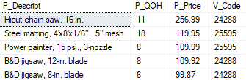
Aggregate Functions
AVERAGE
SELECT AVG(P_Price) AS AveragePrice
FROM Product
SELECT P_Descript,P_QOH, P_Price, V_Code
FROM Product WHERE P_Price > (SELECT AVG(P_Price)FROM Product)
ORDER BY P_Price DESC

Slide 35
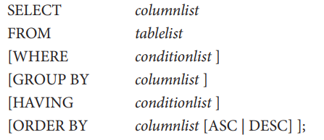
GROUP BY Clause
GROUP BY is particularly useful when paired with aggregate functions.
The GROUP BY clause allows you to arrange the rows returned by SELECT statement in groups. The groups are determined by the columns that you specify in the GROUP BY clause.
Syntax:

Slide 36
GROUP BY Clause
The GROUP BY clause is valid only when used in conjunction with one of the SQL aggregate functions: COUNT, MIN, MAX, AVG, SUM
The above command will result an error:
SELECT V_Code, P_Code
FROM Product
GROUP BY V_Code

Slide 37
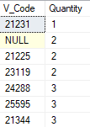
GROUP BY Clause
The command will should be written
SELECT V_Code, COUNT(P_Code) AS Quantity
FROM Product
GROUP BY V_Code
ORDER BY Quantity

Slide 38
HAVING Clause
The HAVING clause is often used with the GROUP BY clause in the SELECT statement to filter group of rows based on a specified condition.
The WHERE clause is used to restrict the rows that you select. But the HAVING clause is used to restrict groups.

Slide 39
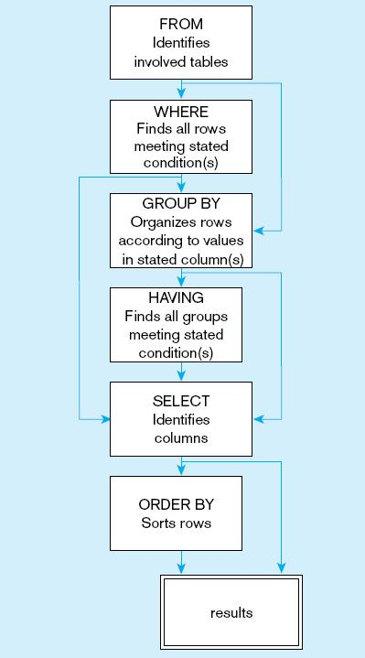
SQL statement processing order

Slide 40
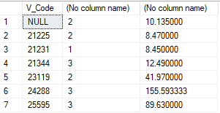

HAVING Clause
With HAVING clause
SELECT V_Code,COUNT(P_Code),AVG(P_Price)
FROM Product
GROUP BY V_Code
SELECT V_Code,COUNT(P_Code),AVG(P_Price)
FROM Product
GROUP BY V_Code
HAVING AVG(P_Price)<10

Slide 41
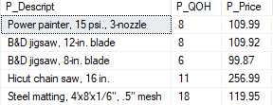
Virtual Tables: View
View: provides users controlled access to tables
  It is a virtual table based on a SELECT query
  Logical table exists only in memory
  Can be treated as though it were a real table
CREATE VIEW Price50 AS
SELECT P_Code, P_Descript, P_QOH, P_Price
FROM dbo.Product
WHERE P_PRICE > 50.00
WITH CHECK OPTION
SELECT * FROM Price50

Slide 42
Virtual Tables: View
WITH CHECK OPTION
  will cause UPDATE or INSERT statements on that view to be rejected when those statements would cause
  updated or inserted rows to be removed from the view.
  This option can be used only with updateable views.
UPDATE Price50
SET P_Price = 20.5
WHERE P_Code = '11QER/31'
Will result an error message due to CHECK OPTION constraint.

Slide 43
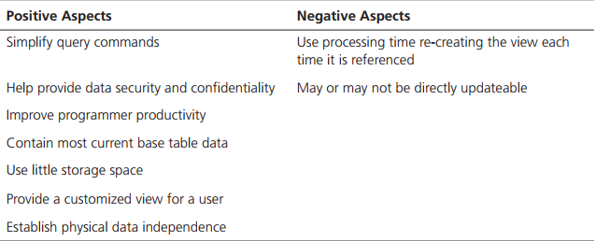
Virtual Tables: View
Advantages/Disadvantages of Views

Slide 44
Thank You !

