Slide 1
Chapter 4: Structured Query Language (SQL) session 3
SubQuery and Multiple Table joins
Database Systems

Slide 2
Outline
1
SubQuery
2
Multiple Table joins

Slide 3
SubQuery
Subquery is a query inside another query
  A subquery can be nested inside a SELECT, INSERT, UPDATE or DELETE statement or inside another subquery.
  A subquery is usually added within the WHERE clause of another SQL SELECT statement.
In a subquery SELECT statement, can not include:
  the keyword DISTINCT in the SELECT phrase,
  an ORDER BY phrase.

Slide 4
Subquery
Subqueries can be:
  Noncorrelated subqueries (Self-contained subqueries)
    have no dependency on outer query
    execute once for the entire outer query
  Correlated subqueries
    depend on values from outer query
    execute once for each row returned by the outer query
    Can use the EXISTS operator

Slide 5
Subquery
A subquery is must be enclosed within parentheses
Subquery can return:
  One single value (Scalar Subquery) - One column and one row
  A list of values (Multi-Valued Subquery) - One column and multiple rows
  A virtual table - Multicolumn, multirow set of values
  No value - Output of the outer query might result in an error or a null empty set

Slide 6
Subquery
The most common type of subquery uses an inner SELECT subquery on the right side of a WHERE comparison expression (WHERE subqueries)
A subquery can be used within a SQL data manipulation language (DML) statement such
as INSERT, UPDATE, or DELETE

Slide 7
WHERE Subqueries
Syntax
The subquery (inner query) executes once before the main query.
The result of the subquery is used by the main query (outer query).
SELECT column_list
FROM table
WHERE expression OPERATOR
(SELECT column_list
FROM table)

Slide 8
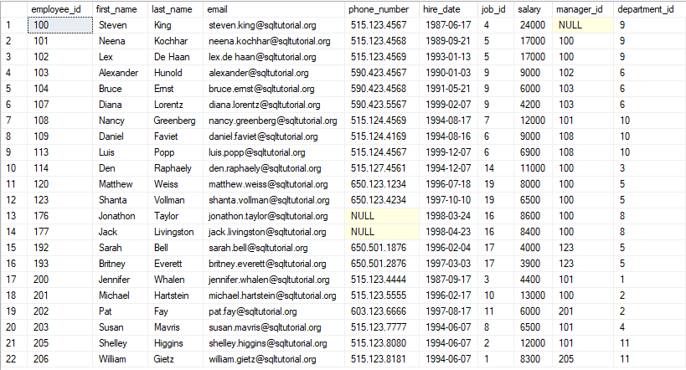
The contents of Employees table

Slide 9
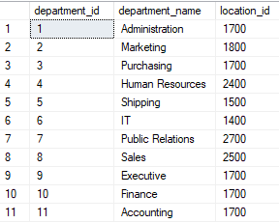
The contents of Departments table

Slide 10
Scalar Subquery
The Scalar sub query returns one single value to outer query
  Uses operators: can be >, <, =, >=, or <=, <>
  Value generated by the subquery must be of a comparable data type
If the query returns multiple values, the DBMS will generate an error.
If inner query returns an empty set, result is converted to NULL

Slide 11
Scalar Subquery
Syntax
SELECT ......
FROM ......
WHERE ...... θ
( SELECT ......
FROM ......
WHERE ...... )
θ
can be
=
<>
>
>=
<
<=
Must ensure that the subquery returns a SINGLE VALUE,
i.e. a table of one row and one column, or an ERROR results.

Slide 12

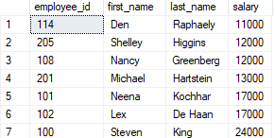
Scalar Subquery
Example
SELECT employee_id, first_name, last_name, salary
FROM Employees
WHERE salary >(SELECT AVG(salary) FROM employees)
ORDER BY salary
Inner query
results

Slide 13
Multi-Valued Subquery
Multi-valued subquery returns multiple values to the outer query
Query uses the set comparion operators (IN, ALL, ANY).
SYMBOL | MEANING
IN | Equal to any member in a list
ANY | Return rows that match any value on a list
ALL | Return rows that match all values in a list

Slide 14
Multi-Valued Subquery
Syntax:
θθ
can be
IN
NOT IN
θ ANY
θ ALL
EXISTS
NOT EXISTS
SELECT ......
FROM ......
WHERE ...... θθ
( SELECT ......
FROM ......
WHERE ...... )
θ is any of =, <>, >, >=, <, <=
The subquery can return MULTIPLE VALUES,
i.e. one column of many rows.
However there is no problem if only one row is returned.

Slide 15
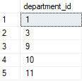
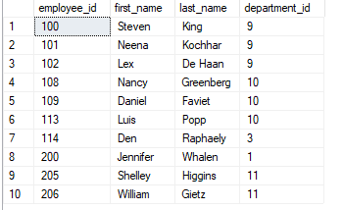
Multi-Valued Subquery with IN
Example
SELECT employee_id, first_name, last_name, department_id
FROM Employees
WHERE department_id IN (SELECT department_id
FROM departments
WHERE location_id = 1700)
Can’t use ‘=’ comparison.
Subquery can return many
department_id
Inner query
results

Slide 16
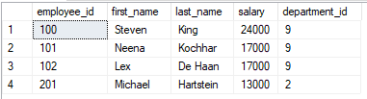
Multi-Valued Subquery with ALL
Example
SELECT employee_id, first_name, last_name, salary, department_id
FROM Employees
WHERE salary > ALL (SELECT salary
FROM employees
WHERE department_id = 10)
AND department_id<>10
If ‘>’ is true for
every value,
ALL returns true,
else false.

Slide 17
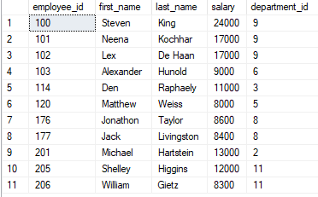
Multi-Valued Subquery with ANY
Example
SELECT employee_id, first_name, last_name, salary, department_id
FROM Employees
WHERE salary > ANY (SELECT salary
FROM employees
WHERE department_id = 10)
AND department_id<>10
If ‘>’ is true for
at least one value,
ANY returns true,
else false.

Slide 18
EXISTS/NOT EXISTS
When a subquery is used with the keyword EXISTS, it functions as an existence test
  True or false only – no rows passed back to outer query
EXISTS evaluates to TRUE or FALSE
  If any rows are returned by the subquery, EXISTS returns TRUE
  If no rows are returned, EXISTS returns FALSE
Syntax:
WHERE [NOT] EXISTS (subquery)

Slide 19
EXISTS/NOT EXISTS
The keyword EXISTS does not follow a column name or other expression
The SELECT list of a subquery introduced by EXISTS typically only uses an asterisk (*)

Slide 20
EXISTS/NOT EXISTS
Example: Show all the employees information if there is at least one employee with a salary in excess of 200,000
SELECT employee_id, first_name, last_name, salary, department_id
FROM Employees
WHERE EXISTS (SELECT * FROM employees WHERE salary > 200000)
The SELECT list typically only
uses an asterisk because no data
will be returned

Slide 21
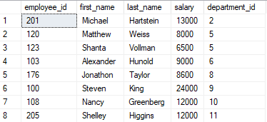
Correlated subqueries
Example 1: Finds all employees whose salary is higher than the average salary of the employees in their departments:
SELECT employee_id, first_name, last_name, salary, department_id
FROM employees e
WHERE salary > (SELECT AVG(salary) FROM employees
WHERE department_id = e.department_id)
Notes:
For each employee, the database system has to execute the correlated subquery once to calculate the average salary of the employees in the department of the current employee.

Slide 22

Correlated subqueries
Example 2: returns all departments which have no employees:
SELECT
department_id, department_name
FROM
departments d
WHERE NOT EXISTS( SELECT * FROM employees e
WHERE e.department_id = d.department_id)

Slide 23
Correlated subqueries
Example 3: Which departments have exactly 2 employees working on them ?
SELECT * FROM Departments d
WHERE 2 = (SELECT count(*) FROM employees e
WHERE e.department_id = d.department_id)

Slide 24
Subqueries in FROM clause
Example: Get the maximum of the average departmental salaries.
SELECT FORMAT(MAX( AvSal ),'C2') AS MaxAvSal
FROM ( SELECT department_id, ROUND(AVG( Salary),2) AS AvSal
FROM employees
GROUP BY department_id ) AS Emp_Averages
This is a useful way of applying
an aggregate function to the result
of an aggregate function.

Slide 25
Subqueries in SELECT clause
Example: Get the additional amount of salary that each employee receives over and above the minimum company salary.
SELECT employee_id, first_name, last_name,
( Salary - ( SELECT Min(Salary)
FROM employees ) ) AS Additional
FROM employees
This is a useful way of doing a scalar calculation in each row
that requires the resulting value of an aggregation.

Slide 26
Multiple Table joins

Slide 27
Multiple Tables Joins
Ability to combine (join) tables on common attributes is most important distinction between a relational database and other databases
Join clause is used to combine rows from two or more tables, based on a related column between them.
Join is generally composed of an equality comparison between the foreign key and the primary key of related tables

Slide 28
Multiple Tables Joins
Type of joins
  Equijoin or Inner Join
  Self join
  Outer join
  Cross Join

Slide 29
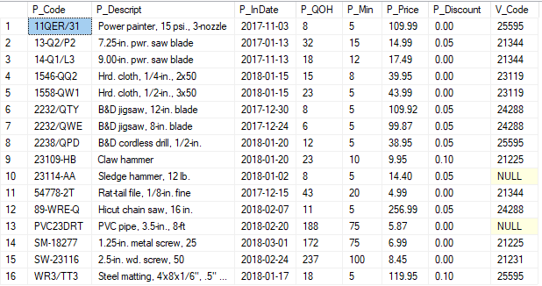
The contents of Product table

Slide 30
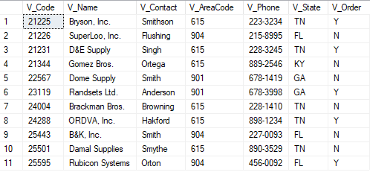
The contents of Vendor table

Slide 31
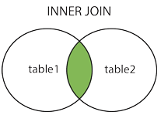
Inner Join
Also called as Equijoin
  This join combines the rows retrieved from two or more tables, based on a common field between them.
  This join creates a new result table by combining columns values of the tables based upon the join condition.
  To join n tables together, you need a minimum of n-1 join conditions
Uses an equality operator (=) to join tables.
INNER JOIN or simply JOIN is used in the query

Slide 32
Inner join
The INNER JOIN keyword selects all rows from tables as long as there is a match between the columns
ANSI syntax
You can join more than two tables based upon the join conditions.
SELECT column_name(s)
FROM table1
INNER JOIN table2
ON table1.column_name = table2.column_name

Slide 33
Inner join
Example
Or use EquiJoin based on equality V_Code (old-style join)
SELECT Product.P_Descript, Product.P_Price, Vendor.V_Name, Vendor.V_Contact,Vendor.V_AreaCode, Vendor.V_Phone
FROM Product INNER JOIN Vendor
ON Product.V_Code = Vendor.V_Code
SELECT Product.P_Descript,Product.P_Price,Vendor.V_Name, Vendor.V_Contact,Vendor.V_AreaCode, Vendor.V_Phone
FROM Product, Vendor
WHERE Product.V_Code = Vendor.V_Code

Slide 34
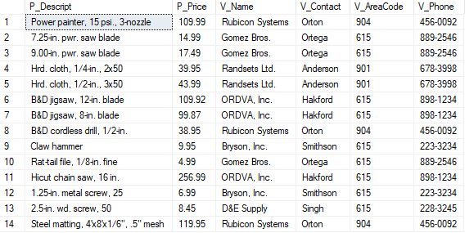
Inner join
Result

Slide 35
Inner join
Joining Tables With a Alias
  An alias may be used to identify the source table from which the data is taken
SELECT P.P_Descript,P.P_Price,V.V_Name, V.V_Contact,V.V_AreaCode, V.V_Phone
FROM Product P INNER JOIN Vendor V
ON P.V_Code = V.V_Code

Slide 36
Self Join
A Self join or Recursive Join is a type of SQL join which is used to join a table to itself.
The table has a Foreign key that references its own Primary key.
An alias is especially useful when a table must be joined to itself in a recursive query to avoid column ambiguity.

Slide 37
Self Join
Example: list of all employees with their managers
names by joining the EMP table to itself.
SELECT E.EMP_Num, E.EMP_LName, E.EMP_MGR, M.EMP_LName
FROM EMP E
INNER JOIN EMP M
ON E.EMP_MGR = M.EMP_Num
ORDER BY E.EMP_MGR

Slide 38
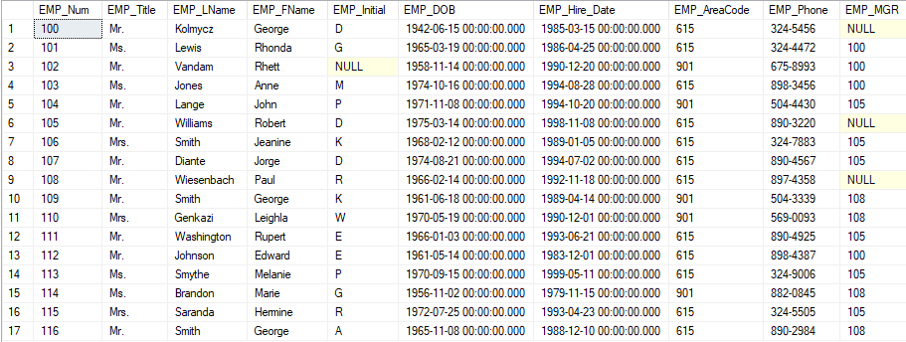
The content of Emp table

Slide 39
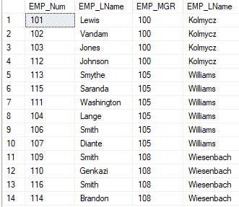
Self Join
Result

Slide 40
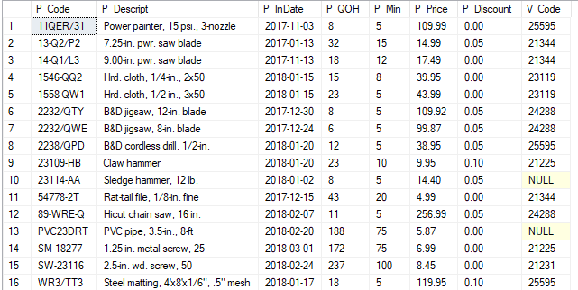
The content of Product table

Slide 41
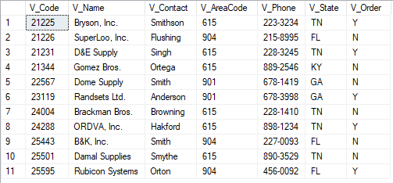
The content of Vendor table

Slide 42
Outer join
Outer join is a join in which rows that do not have matching values in common columns are also included in the result table .
Null values appear in columns where there is not a match between tables
Outer join
  Left outer join
  Right outer join
  Full outer join
Notes:
https://www.sqlshack.com/sql-outer-join-overview-and-examples/

Slide 43
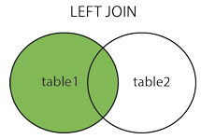
Left Outer Join
In Left outer join (or Left Join)
  Returns all rows from the left table (table1) and the matching rows from the right table (table2)
  If no records match from the left table, it shows those records with NULL values
Syntax:
SELECT column_name(s)
FROM table1
LEFT JOIN table2
ON table1.column_name = table2.column_name

Slide 44
Left Outer Join
Example: Show V_Code, V_Name for all vendors listed in the Vendor table. Include P_Code, P_Descript even if there is no product for that vendor.
SELECT V.V_Code, V_Name, P.P_Code, P.P_Descript
FROM VENDOR V LEFT JOIN PRODUCT P
ON V.V_Code = P.V_Code

Slide 45
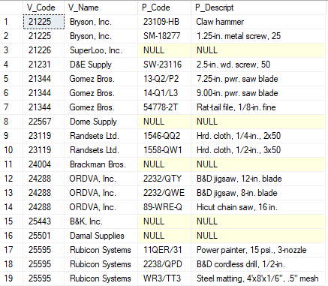
Left Outer Join
Result

Slide 46
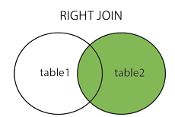
Right Outer Join
In Right outer join (or Right Join)
  Returns all rows from the right table (table2) and the matching rows from the left table (table1)
  If no records match from the right table, it shows those records with NULL values
Syntax
SELECT column_name(s)
FROM table1
RIGHT JOIN table2
ON table1.column_name = table2.column_name

Slide 47
Right Outer Join
Example: Show P_Code, P_Descript for all products listed in the Product table. Include V_Code, V_Name even if there is no Vendor for that product.
SELECT P.P_Code, P.P_Descript, P.V_Code, V_Name
FROM VENDOR V RIGHTJOIN PRODUCT P
ON V.V_Code = P.V_Code

Slide 48
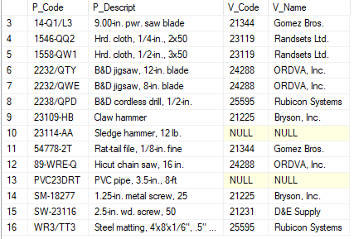
Right Outer Join
Result

Slide 49
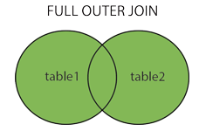
Full Outer Join
Full Outer Join or Full Join
  returns all records when there is a match in left (table1) or right (table2) table records.
Syntax
SELECT column_name(s)
FROM table1
FULL OUTER JOIN table2
ON table1.column_name = table2.column_name
WHERE condition

Slide 50
Full Outer Join
Example: List P_Code, P_Descript, V_Code and V_Name of all products and vendors, regardless of whether or not the products have vendor or the vendors supply the products.
SELECT P.P_Code, P.P_Descript, V.V_Code, V_Name
FROM VENDOR V FULL JOIN PRODUCT P
ON V.V_Code = P.V_Code

Slide 51
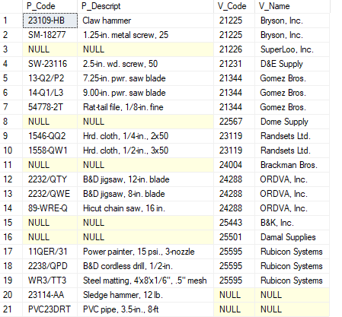
Full Outer Join
Result

Slide 52
Cross Join
A cross join performs a relational product (also known as the Cartesian product) of two
tables
SELECT column_name(s)
FROM table1
CROSS JOIN table2

Slide 53
Cross Join
Example
Or using other syntax (all DBMSs use this style)
SELECT P.P_Code, P.P_Descript, V.V_Code, V_Name
FROM VENDOR V CROSSJOIN PRODUCT P
SELECT P.P_Code, P.P_Descript, V.V_Code, V_Name
FROM VENDOR V, PRODUCT P

Slide 54
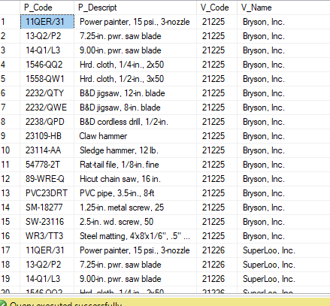
Cross Join
The command performs a cross join of the VENDOR and PRODUCT tables that generates 176 rows. (There are 11 vendor rows and 16 product rows, yielding 11 × 16 = 176 rows.)
Some rows of the
result
Notes:
https://www.w3resource.com/sql-exercises/

Slide 55
Thank You !

