Slide 1
Chapter 5
T-SQL Programming
Database Systems
Session 1:
Introduction, Variables, Control-Flow statements

Slide 2
Outline
1
Introduction to T-SQL Programming
2
Using Variables
3
Control-Flow statements

Slide 3
Introduction to T-SQL Programming
T-SQL
  Stands for Transact-SQL
  It is an extension to SQL
  It is a procedural language used on both Microsoft SQL Server and Sybase SQL Server systems.
It is a full-featured programming language that dramatically extends the power of SQL.

Slide 4
Introduction to T-SQL Programming
The language provides programmers with a broad range of features, including:
  A rich set of data types, including specialized types for identifiers, timestamps, images, and long text fields
  Local and global variables
  Fully programmable server objects like views, triggers, stored procedures, and batch command files
  Conditional processing
  Exception and error handling
  Full transaction control

Slide 5

Introduction to T-SQL Programming
SQL and T-SQL are the query languages used to manipulate the database and are an important part of the DBMS.
What are the differences between SQL and T-SQL?
Notes:
. T-SQL has more features and more functions than what are specified in the SQL standard. SQL is almost a subset of T-SQL, so if you know T-SQL, you also know standard SQL, because it contains almost all of the features of standard SQL. The difference between SQL and T-SQL is that the latter has more features intended to help you in making query writing easier, quicker, and more efficient. So if you work in MS SQL Serve, you use T-SQL.
https://techdifferences.com/difference-between-sql-and-t-sql.html

Slide 6
Using Variables
Variables are the object which acts as a placeholder to a memory location. Variable hold single data value.
In MS SQL, there are 2 types of variables:
  Local variable
    A user declares the local variable.
    A local variable starts with @.
    Every local variable scope has the restriction to the current batch or procedure within any given session.
  Global variable
    The system maintains the global variable. A user cannot declare them.
    The global variable starts with @@
    It stores session related information.

Slide 7
Using Variables
Before using any variables, they must be declared variable using DECLARE statement.
Syntax
Example
You can declare multiple variables in one statement, separated by commas
DECLARE @variable_name [AS] datatype
DECLARE @Product_name NVARCHAR(30)
DECLARE @Product_Id int = 7
DECLARE @Product_name NVARCHAR(30), @Product_Id int

Slide 8
Using Variables
By default, variables are initially set to Null
You can assign a value to a variable
  DECLARE statement
  Using SET
    Must declare a variable first.
    Each variable requires a separate SET statement.
  Using SELECT
    Must declare a variable first.
    Can assign a value to multiple variables separated by the comma

Slide 9
Using Variables
Example to assign value to a variable
  By DECLARE
  By SET/SELECT
DECLARE @Product_name NVARCHAR(30) = N'Bút chì', @Product_Id int = 7
PRINT @Product_name
PRINT @Product_Id
DECLARE @Product_name NVARCHAR(30), @Product_Id int
SET @Product_name = N'Bút chì'
SET @Product_Id = 7
PRINT @Product_name + N' với id =' + CAST(@Product_Id AS NVARCHAR(30))
SELECT @Product_name = N'Bút chì', @Product_Id = 7

Slide 10
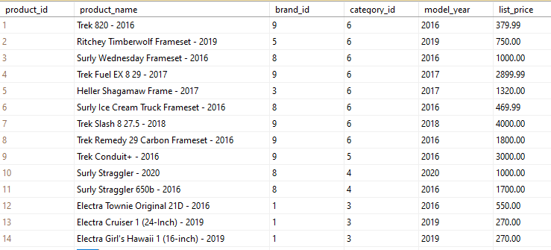
The contents of Products table

Slide 11
Using Variables
Get value from a subquery by SET/SELECT
  A subquery must return one value
  When subquery returns zero row as a result, the variable is assigned NULL value
DECLARE @Product_name NVARCHAR(30)
SET @Product_name = (SELECT product_name FROM products WHERE product_id = 1)
PRINT @Product_name
You can replace SET by SELECT

Slide 12

Using Variables
Using variables in a query
Result
DECLARE @Product_id INT
SET @Product_id = 1
SELECT product_name, model_year, list_price
FROM products
WHERE product_id = @Product_id
ORDER BY product_name

Slide 13

Using Variables
Using variables in a query
  Storing query result in a variable
Result
DECLARE @product_count int
SET @product_count = (
SELECT
COUNT(*)
FROM
products
)
SELECT @product_count AS 'Number of Products'

Slide 14

Using Variables
Using variables in a query
  Selecting a record into variables
  Result
DECLARE @product_name VARCHAR(MAX), @list_price DECIMAL(10,2)
SELECT @product_name = product_name,@list_price = list_price
FROM products
WHERE product_id = 1
SELECT @product_name AS product_name,
@list_price AS list_price

Slide 15
Using Global variables
Global variables are pre-defined system functions. Their names begin with an @@ prefix
Some common global variables
  @@IDENTITY
  @@ERROR
  @@ROWCOUNT
  @@TOTAL_ERRORS
  @@SERVERNAME

Slide 16


Using Global variables example
Example
  @@IDENTITY is used to get the last value inserted into an IDENTITY column by an insert statement.
  Example: get the last inserted product_id which is the identity column in previous product table
INSERT INTO products
VALUES('Electra - 2020', 1, 3, 2020, 2000)
GO
SELECT @@IDENTITY AS NewProductId
SELECT @@rowcount as 'Number of Rows affected'

Slide 17
Control-Flow statements
IF/ IF…ELSE statement
CASE statement
WHILE statement

Slide 18
IF/IF…ELSE statement
IF statement
IF…ELSE statement
IF boolean_expression
BEGIN statement_block
END
IF Boolean_expression
BEGIN Statement block
END
ELSE
BEGIN Statement block
END

Slide 19
IF/IF…ELSE statement
Example
DECLARE @product_count int
SET @product_count = (SELECT COUNT(*) FROM products WHERE list_price >1000)
IF @product_count > 0
BEGIN
PRINT 'The products have price are greater than 100'
SELECT product_id, product_name, list_price
FROM products
WHERE list_price >1000
END
ELSE
BEGIN
PRINT 'There is no product that has price is less than or equal to 1000'
END

Slide 20
CASE statement
Syntax
  The CASE statement always goes in the SELECT clause
  CASE must include the following components: WHEN, THEN, and END. ELSE is an optional component.
CASE
WHEN condition1 THEN result1
WHEN condition2 THEN result2
WHEN conditionN THEN resultN
ELSE result
END

Slide 21
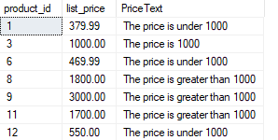
CASE statement
Example
SELECT product_id, list_price,
CASE
WHEN list_price > 1000 THEN 'The price is greater than 1000'
WHEN list_price = 1000 THEN 'The price is 1000'
ELSE 'The price is under 1000'
END AS PriceText
FROM products
WHERE model_year = 2016

Slide 22
WHILE statement
Syntax
In WHILE, you can use
  BREAK statement to exit from the WHILE LOOP
  CONTINUE to restart the WHILE LOOP from the beginning
WHILE Boolean_expression
BEGIN
statement_block
END

Slide 23
WHILE statement
Example
DECLARE @Counter INT , @MaxId INT,
@ProductName NVARCHAR(100)
SELECT @Counter = min(product_id) , @MaxId = max(product_id)
FROM products
WHERE model_year= 2016
WHILE(@Counter IS NOT NULL
AND @Counter <= @MaxId)
BEGIN
SELECT @ProductName = product_name
FROM products WHERE product_id = @Counter
PRINT CONVERT(VARCHAR(MAX),@Counter) + '. product name is ' + @ProductName
SET @Counter = @Counter + 1
END

Slide 24
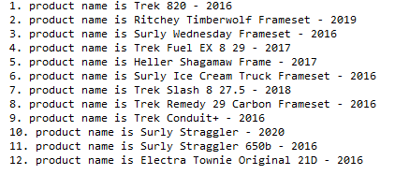
WHILE statement
Result

Slide 25
Thank You !

