Slide 1
Chapter 5
T-SQL Programming
Database Systems
Session 2:
Function, Store procedure, Trigger

Slide 2
Outline
1
Function
2
Store procedures
3
Trigger

Slide 3
Functions
A function is a set of SQL statements that perform a specific task.
The main purpose of function is code reusability.
  If you have to repeatedly write large SQL scripts to perform the same task, you can create a function that performs that task.
  Next time instead of rewriting the SQL, you can simply call that function.
A function accepts inputs in the form of parameters and returns a value.

Slide 4
Functions
Some rules when creating functions in SQL Server
  A function must have an unique name
  Functions only work with select statements
  Functions compile every time.
  Functions must return a value or result.
  Functions only work with input parameters.
  Try and catch statements are not used in functions

Slide 5
Functions
SQL Server supports two types of functions:
  User-Defined function (also call UDF): 3 types
    Scalar Valued Functions: returns a single value
    Inline table-valued function: returns a table
    Multi-statement table-valued function: returns a table and can have more than one T-SQL statement.
  System Defined function (Built-in function)
Syntax
CREATE FUNCTION [schema_name.]function_name(parameter_list)
RETURNS data_type
AS
BEGIN statements
RETURN value
END

Slide 6

Scalar Valued Functions
Example:
Calling a scalar function
CREATE FUNCTION fn_Sale(
@quantity INT, @list_price DEC(10,2), @discount DEC(4,2))
RETURNS DEC(10,2)
AS
BEGIN
RETURN @quantity * @list_price * (1 - @discount)
END
SELECT
dbo.fn_Sale(10,100,0.1) sale

Slide 7
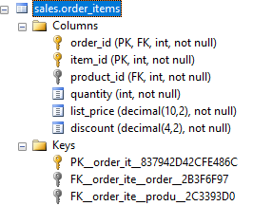
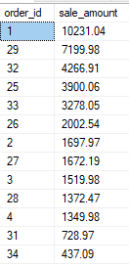
Scalar Valued Functions
Calling the function to get the sale of sales of sales orders in the order_items table
SELECT
order_id,
SUM(dbo.fn_Sale(quantity, list_price, discount)) sale_amount
FROM
sales.order_items
GROUP BY
order_id
ORDER BY
sale_amount DESC

Slide 8
Inline Table-Valued Functions
Returns data of a table type whose values is derived from a single SELECT statement.
  Example
  Executing an inline table-valued functions
CREATE FUNCTION fn_getProducts()
RETURNS TABLE
AS
RETURN SELECT * FROM products
SELECT * FROM fn_getProducts()

Slide 9

Inline Table-Valued Functions
Example the function requires input parameters
  Executing an inline table-valued functions
CREATE FUNCTION fn_ProductInYear(@model_year INT)
RETURNS TABLE
AS
RETURN
SELECT product_name,model_year, list_price
FROM products
WHERE model_year = @model_year
SELECT
product_name, list_price
FROM fn_ProductInYear(2017)

Slide 10
Multi-statement table-valued function
The function can take one or more paramenters and returns a table.
You must define the table structure that is being returned.
After creating this type of user-defined function, we can use it in the FROM clause of a T-SQL command.

Slide 11

Multi-statement table-valued function
Example
    Executing a table-valued functions
CREATE FUNCTION fn_rowOfTables() RETURNS
@table table (TableName varchar(50), rows_count int)
AS
BEGIN
DECLARE @num int
SELECT @num = count(product_id) FROM products
INSERT INTO @table values('My product', @num)
IF @@ROWCOUNT =0
BEGIN
INSERT INTO @table VALUES('', 'No row is added')
END
RETURN
END
SELECT * FROM fn_rowOfTables()

Slide 12
Alter/drop a function
You can modify an existing scalar function by ALTER FUNCTION
You can delete an existing scalar function by DROP FUNCTION
ALTER FUNCTION [schema_name.]function_name(parameter_list)
RETURNS data_type
AS
BEGIN statements
RETURN value
END
DROP FUNCTION [schema_name.]function_name

Slide 13
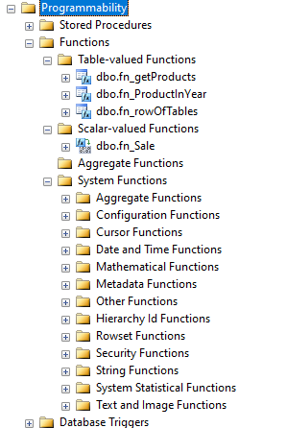
Functions
You can you can find the functions under Programmability -> Functions of the database that you’re working

Slide 14
System Defined function
  System Defined function or Built-in function. Some common functions:
    CAST – cast a value of one type to another.
    CONVERT – convert a value of one type to another.
    CHOOSE – return one of the two values based on the result of the first argument.
    ISNULL – replace NULL with a specified value.
    ISNUMERIC – check if an expression is a valid numeric type.
    IIF – add if-else logic to a query.

Slide 15
System Defined function
    TRY_CAST – cast a value of one type to another and return NULL if the cast fails.
    TRY_CONVERT – convert a value of one type to another and return the value to be translated into the specified type. It returns NULL if the cast fails.
    TRY_PARSE – convert a string to a date/time or a number and return NULL if the conversion fails.
    Convert datetime to string – show you how to convert a datetime value to a string in a specified format.
    Convert string to datetime – describe how to convert a string to a datetime value.
    Convert datetime to date – convert a datetime to a date.

Slide 16
Example
  Convert datetime to string
    Syntax
    Example: display the current date with dd/mm/yyyy format
CONVERT(VARCHAR, datetime [,style])
SELECT CONVERT(VARCHAR, GETDATE(),103) AS 'Now'
Notes:
https://www.mssqltips.com/sqlservertip/1145/date-and-time-conversions-using-sql-server/

Slide 17

Example
  Using IFF function
    Example: returns the corresponding order status based on the status number in order table
SELECT
IIF(order_status = 1,'Pending',
IIF(order_status=2, 'Processing',
IIF(order_status=3, 'Rejected',
IIF(order_status=4,'Completed','N/A')
)
)
) order_status,
COUNT(order_id) order_count
FROM orders
GROUP BY
order_status;
Notes:
https://www.mssqltips.com/sqlservertip/1145/date-and-time-conversions-using-sql-server/

Slide 18
Store Procedures
SQL Server stored procedure (SP) is a batch of statements grouped as a logical unit and stored in the database.
Procedure is stored in cache area of memory when the stored procedure is created so that it can be used repeatedly. SQL Server does not have to recompile it every time the stored procedure is run.
It can accept input parameters, return output values as parameters, or return success or failure status messages

Slide 19
Store Procedures vs SQL
SQL Statement
Stored Procedure
Creating
Check syntax
Compile
First Time
- Check syntax
- Compile
Execute
Return data
First Time
Execute
Return data
Second Time
- Check syntax
- Compile
Execute
Return data
Second Time
Execute
Return data

Slide 20
Store Procedures
Benefits of SP
  Reusable
  It can be easily modified
  Performance
  Reduced network traffic
  Security
Notes:
https://www.sqlshack.com/sql-server-stored-procedures-for-beginners/

Slide 21
Store Procedures
There are two types of stored procedures available in SQL Server:
  User defined stored procedures
  System stored procedures

Slide 22
Store Procedures
Naming conventions for stored procedures
  It is a good idea to come up with a standard prefix to use for your stored procedures: usp_ , sp , usp…
  Do not use sp_ as a prefix
    This is a standard naming convention that is used in the master database
  Give the action that the stored procedure takes and then give it a name representing the object it will affect.
    uspInsertProduct
    uspGetProductById
    spValidateProduct
  Consider using the schema that you will use when saving the objects. The schema is useful if you want to keep all utility like objects together
Notes:
One of the things you do not want to use as a standard is "sp_". This is a standard naming convention that is used in the master database. If you do not specify the database where the object is, SQL Server will first search the master database to see if the object exists there and then it will search the user database. So avoid using this as a naming convention.

Slide 23
Store Procedures
Example: create a store procedure that returns a list of products from the products table
  Executing the sp or
CREATE PROCEDURE uspProductList
AS
BEGIN
SELECT product_name, list_price
FROM products
ORDER BY product_name
END2
EXECUTE sp_name
EXEC sp_name
EXEC uspProductList

Slide 24
Store Procedures
Modifying an existing stored procedure
  By using the ALTER PROCEDURE statement.
Deleting a stored procedure
  using the DROP PROCEDURE or DROP PROC statement:
ALTER PROCEDURE uspProductList
AS
BEGIN
SELECT *
FROM products
ORDER BY product_name
END
DROP PROCEDURE sp_name
DROP PROCEDURE sp_name

Slide 25
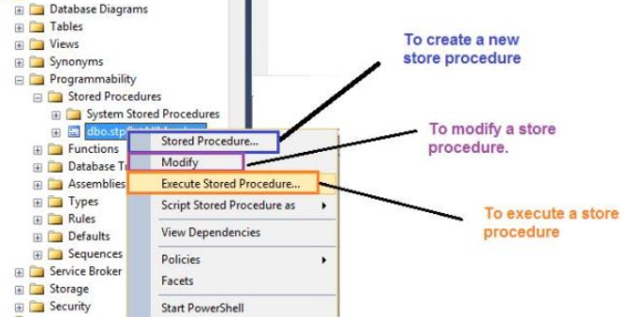
Store Procedures
From the UI for SP

Slide 26
Store Procedures
Parameters in SPs are used to pass input values and return output values. There are two types of parameters:
  Input parameters – By default, pass values to a stored procedure.
  Output parameters - Return values from a stored procedure, use OUTPUT keyword

Slide 27

Store Procedures
Example: SELECT query SP with parameters
  Executing the SP
CREATE PROCEDURE uspGetProductByName
@productName nvarchar(30)
AS
BEGIN
SET NOCOUNT ON
SELECT * FROM products
WHERE product_name LIKE '%'+@productName+'%'
END
EXEC uspGetProductByName @productName = 'Electra'
Notes:
-- SET NOCOUNT ON added to prevent extra result sets from
-- interfering with SELECT statements.

Slide 28
Store Procedures
Example: INSERT query SP with parameters
CREATE PROC uspInsertProduct
@category_id INT, @brand_id INT,
@pro_name VARCHAR(50), @year INT,
@pro_price DECIMAL(10,2) = 0
AS
BEGIN
DECLARE @checkExist int
SELECT @checkExist = category_id FROM products
WHERE category_id = @category_id
IF (@checkExist IS NULL)
BEGIN
PRINT 'This product category does not exist in system!'
RETURN
END
INSERT INTO products
VALUES (@pro_name,@brand_id,@category_id, @year, @pro_price)
END
Notes:
-- SET NOCOUNT ON added to prevent extra result sets from
-- interfering with SELECT statements.

Slide 29
Store Procedures
Executing the SP
Default Parameter Values
  In most cases it is always a good practice to pass in all parameter values, but sometimes it is not possible.
  So you can assign value to parameter with NULL or an valid value
  So with default parameter, you don’t need to pass in a parameter value when you execute the SP
EXEC uspInsertProduct @category_id =6, @brand_id = 1,
@pro_name = 'Heller 2020',@year = 2020,
@pro_price = 1000

Slide 30
Store Procedures
Exercises: create and execute store procedures:
  To update/delete a products
  To find products with product price whose list prices are in range of min and max list prices and the product name also contain a piece of text that you pass in.
  To insert an order and order items tables

Slide 31
Store Procedures
SP with OUTPUT parameter
CREATE PROCEDURE uspGetProductCount
@productName nvarchar(30), @productCount int OUTPUT
AS
SELECT @productCount = count(*)
FROM products
WHERE product_name LIKE @productName +'%'

Slide 32

Store Procedures
Executing the SP with OUTPUT parameter
  First we are going to declare a variable, execute the stored procedure
  Then select the returned valued.
DECLARE @product_Count INT
EXEC uspGetProductCount @productName= 'Su', @productCount = @product_Count OUTPUT
SELECT @product_Count AS 'Number of Product'

Slide 33
Store Procedures
You can use TRY-CATCH statement with error handling in SQL Server
Example
CREATE PROCEDURE uspTryCatchTest
AS
BEGIN TRY
SELECT 1/0
END TRY
BEGIN CATCH
SELECT ERROR_NUMBER() AS ErrorNumber
,ERROR_SEVERITY() AS ErrorSeverity
,ERROR_STATE() AS ErrorState
,ERROR_PROCEDURE() AS ErrorProcedure
,ERROR_LINE() AS ErrorLine
,ERROR_MESSAGE() AS ErrorMessage;
END CATCH

Slide 34
Trigger
A trigger is a special type of stored procedure that is executed automatically as part of a data modification.
A trigger is created on a table and associated with one or more actions linked with a data modification (INSERT, UPDATE, or DELETE).
When one of the actions for which the trigger is defined occurs, the trigger fires automatically

Slide 35
Trigger
Following are some examples of trigger uses:
  Maintenance of duplicate and derived data
  Complex business rules
  Cascading referential integrity
  Complex defaults
  Implement complex security authorizations
Disadvantages of trigger
  It increases the overhead of the database server.
  Providing an extended validation, not replacing all the validation which can be done only by the application layer.
  SQL triggers are executed from the client applications, which will be challenging to figure out what is happening in the database layer.

Slide 36
Trigger
There are two types of triggers:
  DDL (Data Definition Language) triggers: triggers fires upon events that change the structure (like creating, modifying or dropping a table)
  DML (Data Modification Language) triggers. This is the most used class of triggers. The firing event is a data modification statement; it could be an insert, update or delete statement either on a table or a view. DML triggers have different types:
    FOR or AFTER [INSERT, UPDATE, DELETE]: These types of triggers are executed after the firing statement ends (either an insert, update or delete).
    INSTEAD OF [INSERT, UPDATE, DELETE]: the INSTEAD OF triggers executes instead of the firing statement.

Slide 37
Deleted and Inserted tables
When you create a trigger, you have access to two temporary tables (the deleted and inserted tables).
They are referred to as tables, but they are different from true database tables. They are stored in memory—not on disk.

Slide 38
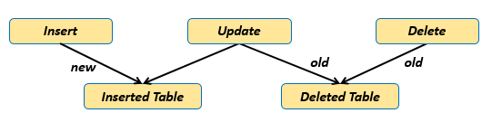
Deleted and Inserted tables
When the insert, update or delete statement is executed. All data will be copied into these tables with the same structure.
The values in the inserted and deleted tables are accessible only within the trigger. Once the trigger is completed, these tables are no longer accessible.
Update
old

Slide 39
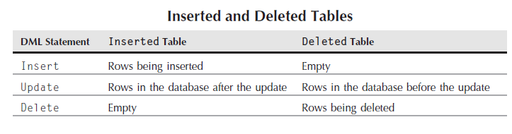
Deleted and Inserted tables
The following table shows the content of the INSERTED and DELETED tables before and after each event:

Slide 40
Trigger
Syntax
  [before | after]: This specifies when the trigger will be executed.
  {insert | update | delete}: This specifies the DML operation.
  on [table_name]: This specifies the name of the table associated with the trigger.
  [sql_statements]: is one or more Transact-SQL used to carry out actions once an event occurs.
CREATE TRIGGER [schema_name.]trigger_name
ON table_name
{FOR | AFTER | INSTEAD OF} {[INSERT] [,] [UPDATE] [,] [DELETE]}
AS
{sql_statements}

Slide 41

DML Trigger Example
Product table
CREATE TABLE Product
(
product_id INT PRIMARY KEY IDENTITY,
product_name varchar(30) NOT NULL,
unit_price DECIMAL(10,2) NOT NULL,
quantity INT NOT NULL
)

Slide 42
DML Trigger Example
Product_history table
CREATE TABLE Product_history
(
Id INT PRIMARY KEY IDENTITY,
Product_history varchar(200) NOT NULL,
update_at DATETIME NOT NULL,
operation VARCHAR(30) NOT NULL
CHECK (operation IN ('INSERT','DELETE'))
)

Slide 43

DML Trigger Example
Create a simple trigger that prevent DML on product table
When we insert, update or delete in a table in a database then the following message appears
CREATE TRIGGER triggerTestDML
ON product
FOR INSERT, UPDATE, DELETE
AS
PRINT 'You can not insert, update, delete this product table'
ROLLBACK
GO

Slide 44
DML Trigger Example
INSERT trigger
CREATE TRIGGER UTRG_Product_Insert
ON Product
FOR INSERT
AS
BEGIN
DECLARE @product_id int, @product_name varchar(40), @unit_price DECIMAL(10,2)
SELECT @product_id = product_id, @product_name = product_name, @unit_price = unit_price FROM inserted
INSERT INTO Product_history VALUES('New product with Id ' + cast (@product_id As varchar(40)),GETDATE(), 'INSERT')
END
INSERT INTO Product VALUES('P555',1000,20)

Slide 45
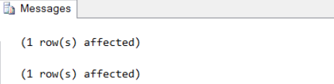
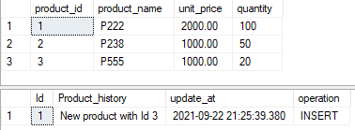
DML Trigger Example
INSERT INTO Product VALUES('P555',1000,20)
  After insert a row into Product table, the trigger will be occur.
SELECT * FROM dbo.Product
SELECT * FROM dbo.Product_history

Slide 46
DML Trigger Example
Exercises
  Create trigger for Update/Delete?
  Or create 1 trigger for INSERT/UPDATE/DELETE event occur against the product table in one trigger?

Slide 47
INSTEAD OF trigger
The INSTEAD OF triggers are the DML triggers that are fired instead of the triggering event such as the INSERT, UPDATE or DELETE events.
So, when you fire any DML statements such as Insert, Update, and Delete, then on behalf of the DML statement, the instead of trigger is going to execute.
In real-time applications, Instead Of Triggers are used to correctly update a complex view.

Slide 48
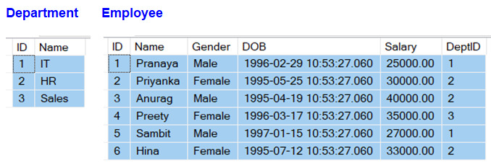
INSTEAD OF trigger
Example: Department and Employee tables
Notes:
CREATE TABLE Department
(
ID INT PRIMARY KEY,
Name VARCHAR(50)
)
GO
-- Populate the Department Table with test data
INSERT INTO Department VALUES(1, 'IT')
INSERT INTO Department VALUES(2, 'HR')
INSERT INTO Department VALUES(3, 'Sales')
-- Create Employee Table
CREATE TABLE Employee
(
ID INT PRIMARY KEY,
Name VARCHAR(50),
Gender VARCHAR(50),
DOB DATETIME,
Salary DECIMAL(18,2),
DeptID INT
)
GO
-- Populate the Employee Table with test data
INSERT INTO Employee VALUES(1, 'Pranaya', 'Male','1996-02-29 10:53:27.060', 25000, 1)
INSERT INTO Employee VALUES(2, 'Priyanka', 'Female','1995-05-25 10:53:27.060', 30000, 2)
INSERT INTO Employee VALUES(3, 'Anurag', 'Male','1995-04-19 10:53:27.060',40000, 2)
INSERT INTO Employee VALUES(4, 'Preety', 'Female','1996-03-17 10:53:27.060', 35000, 3)
INSERT INTO Employee VALUES(5, 'Sambit', 'Male','1997-01-15 10:53:27.060', 27000, 1)
INSERT INTO Employee VALUES(6, 'Hina', 'Female','1995-07-12 10:53:27.060', 33000, 2)
GO

Slide 49
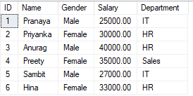
INSTEAD OF trigger
Let create a view
Get data from the view
CREATE VIEW vwEmployeeDetails
AS
SELECT emp.ID, emp.Name, Gender, Salary, dept.Name AS Department
FROM Employee emp
INNER JOIN Department dept
ON emp.DeptID = dept.ID

Slide 50
INSTEAD OF trigger
Insert a record into the view vwEmployeeDetails by executing the following query.
Will recieve an error message: ‘View or function vwEmployeeDetails is not updatable because the modification affects multiple base tables.’
=>Use INSTEAD OF trigger
INSERT INTO vwEmployeeDetails VALUES(7, 'Saroj', 'Male', 50000, 'IT')

Slide 51
INSTEAD OF trigger
CREATE TRIGGER tr_vwEmployeeDetails_InsteadOfInsert
ON vwEmployeeDetails
INSTEAD OF INSERT
AS
BEGIN
DECLARE @DepartmenttId int
-- First Check if there is a valid DepartmentId in the Department Table for the given Department Name
SELECT @DepartmenttId = dept.ID
FROM Department dept
INNER JOIN INSERTED inst
on inst.Department = dept.Name
--If the DepartmentId is null then throw an error
IF(@DepartmenttId is null)
BEGIN
RAISERROR('Invalid Department Name. Statement terminated',16, 1)
RETURN
END
-- Finally insert the data into the Employee table
INSERT INTO Employee(ID, Name, Gender, Salary, DeptID)
SELECT ID, Name, Gender, Salary, @DepartmenttId
FROM INSERTED
End
After executing the trigger, the record is inserted into the view and the Employee table.

Slide 52
INSTEAD OF trigger
Exercises
  Create INSTEAD OF trigger for Update/Delete operations

Slide 53
Thank You !

