Slide 1
Chapter 1
Introduction https://github.com/Giga85/Database.git
Database Systems

Slide 2
Outline
1
Database
2
DBMS
3
Data Model
4
View of Data

Slide 3
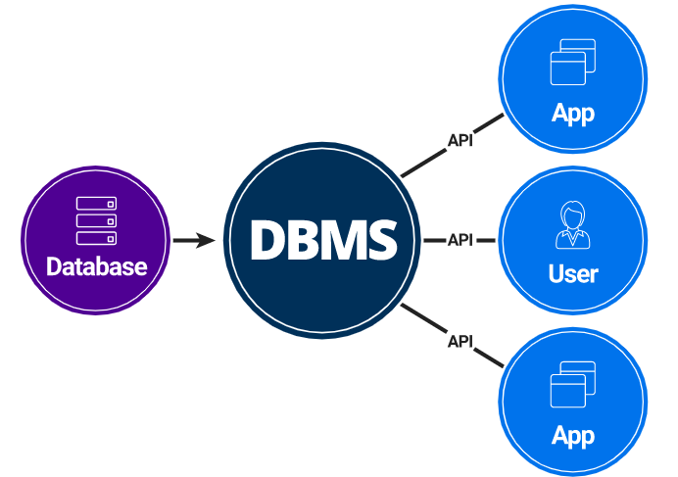
Database Systems
What is Database?
What is Database Management System (DBMS) ?

Slide 4
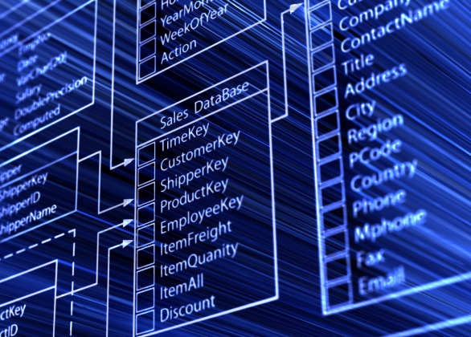
What is a database?
A database is a collection of data, contains information relevant to an enterprise.
A database is an organized collection of data.
A database is a collection of information that is organized so that it can easily be accessed, managed, and updated.

Slide 5
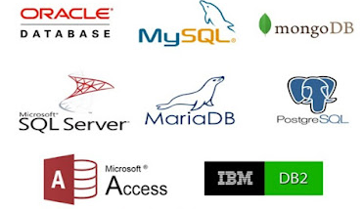
What is a DBMS?
Database management system (DBMS) is a special software application that interacts with the user, other applications, and the database itself to capture and analyze data.
E.g: Some popular DBMS

Slide 6
DBMS purpose
To store data properly
To provide simultaneous access to the data for many users
To delimit the access to the data for different users
To prevent data from loss
To provide a way to store and retrieve database information that is both convenient and efficient.

Slide 7
Database systems
Database systems are used to manage collections of data that are:
  Highly valuable
  Relatively large
  Accessed by multiple users and applications, often at the same time.
A modern database system is a complex software system whose task is to manage a large, complex collection of data.
Databases touch all aspects of our lives

Slide 8
Database Applications Examples
Enterprise Information
  Sales: customers, products, purchases
  Accounting: payments, receipts, assets
  Human Resources: Information about employees, salaries, payroll taxes.
Manufacturing: management of production, inventory, orders, supply chain.
Banking and finance
  customer information, accounts, loans, and banking transactions.
  Credit card transactions
  Finance: sales and purchases of financial instruments (e.g., stocks and bonds; storing real-time market data
Universities: registration, grades

Slide 9
Database Applications Examples
Airlines: reservations, schedules
Telecommunication: records of calls, texts, and data usage, generating monthly bills, maintaining balances on prepaid calling cards
Web-based services
  Online retailers: order tracking, customized recommendations
  Online advertisements
Document databases
Navigation systems: For maintaining the locations of varies places of interest along with the exact routes of roads, train systems, buses, etc.

Slide 10
Purpose of Database Systems
In the early days, database applications were built directly on top of file systems, which leads to:
Data redundancy and inconsistency: data is stored in multiple file formats resulting induplication of information in different files
Difficulty in accessing data
  Need to write a new program to carry out each new task
Data isolation
  Multiple files and formats
Integrity problems
  Integrity constraints (e.g., account balance > 0) become “buried” in program code rather than being stated explicitly
  Hard to add new constraints or change existing ones

Slide 11
Purpose of Database Systems (Cont.)
Atomicity of updates
  Failures may leave database in an inconsistent state with partial updates carried out
  Example: Transfer of funds from one account to another should either complete or not happen at all
Concurrent access by multiple users
  Concurrent access needed for performance
  Uncontrolled concurrent accesses can lead to inconsistencies
    Ex: Two people reading a balance (say 100) and updating it by withdrawing money (say 50 each) at the same time
Security problems
  Hard to provide user access to some, but not all, data
Database systems offer solutions to all
the above problems

Slide 12
University Database Example
Data consists of information about:
  Students
  Instructors
  Classes
Application program examples:
  Add new students, instructors, and courses
  Register students for courses, and generate class rosters
  Assign grades to students, compute grade point averages (GPA) and generate transcripts

Slide 13
Data Models
Underlying the structure of a database is the data model: a collection of conceptual tools for describing
  Data
  Data relationships
  Data semantics
  Consistency constraints

Slide 14
Data Models
There are a number of different data models:
  Relational model
  Entity-Relationship data model (mainly for database design)
  Object-based data models (Object-oriented and Object-relational)
  Semi-structured data model (XML)
Other older models:
  Network model
  Hierarchical model

Slide 15
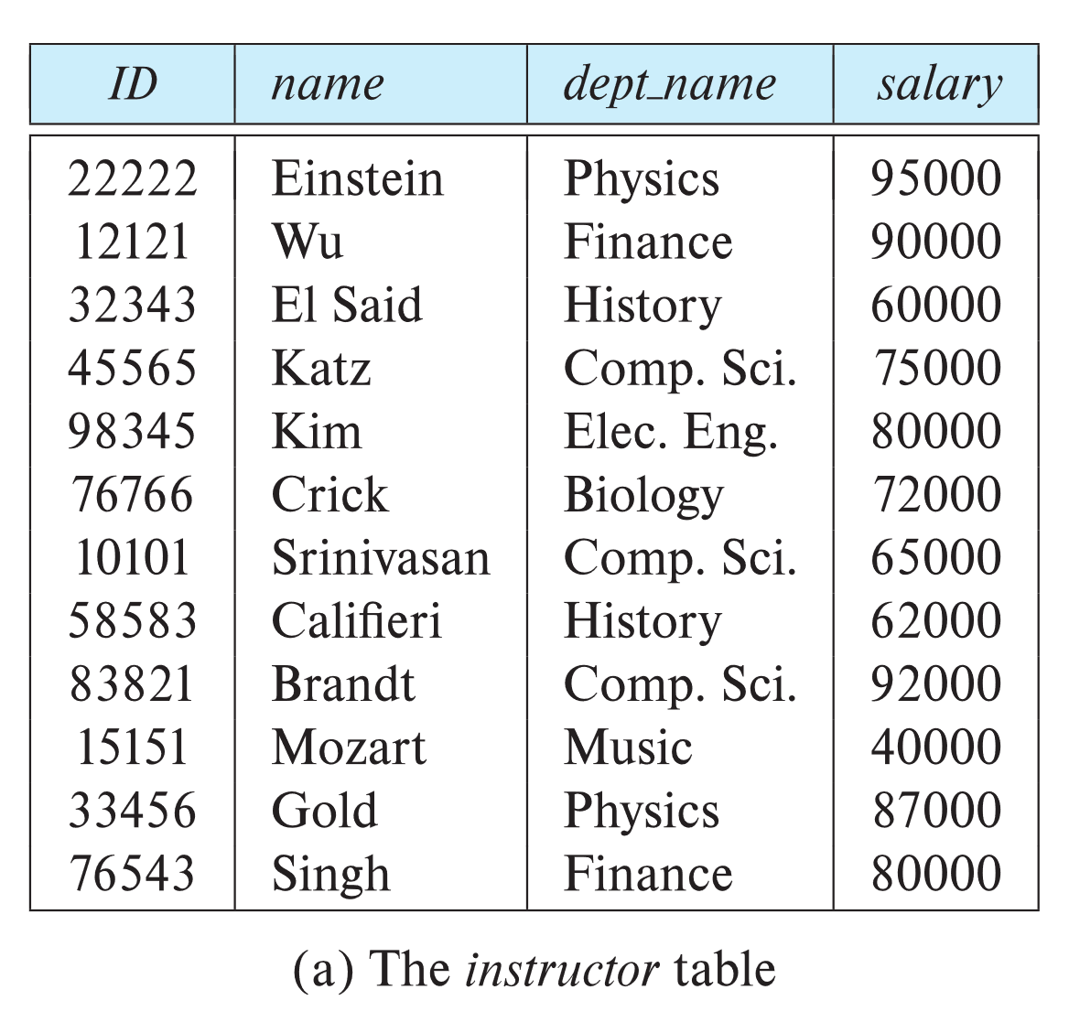
Relational Model
Example of tabular data in the relational model:
Columns
Rows
The relational model uses a collection of tables to represent both data and the relationships among those data.
Each table has multiple columns, and each column has a unique name.
Tables are also known as relations.

Slide 16
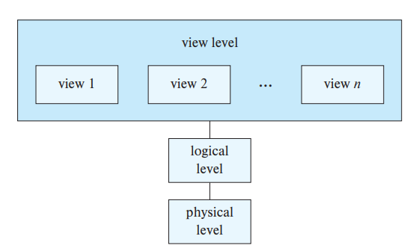
View of Data
Levels of data abstraction, to simplify users’ interactions with the system:
  The three levels of data abstraction:

Slide 17
Data Abstraction
Physical level: the lowest level of abstraction describes how the data are actually stored.
Logical level: describes what data are stored in the database, and what relationships exist among those data. E.g: Describe the type of a record instructor with 4 fields:
type instructor = record
ID : char(5);
name : char(20);
dept_name : char(20);
salary : numeric(8,2);
end;
View level: The highest level of abstraction describes only part of the entire database. The system may provide many views for the same database. Views can also hide information (such as an employee’s salary) for security purposes.

Slide 18
RDBMS
RDBMS which stands for relational database management system, is a program that lets users create, update, and administer a relational database.
Are used in most commercial projects

Slide 19
RDBMS installation
Install RDBMS Server
  Microsoft SQL Server 2014 Express
Install client application for querying data
  Microsoft SQL Server Management studio

Slide 20
Thank You !

