Slide 1
Overall Architecture

Slide 2
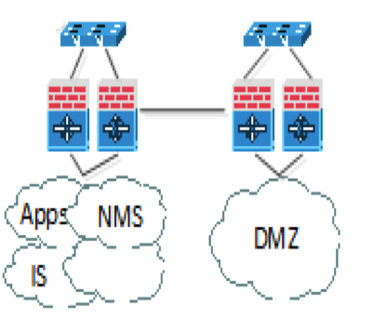



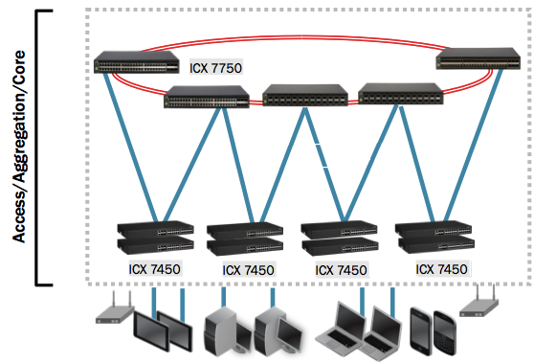
Overall Physical Diagram
Current StarHub
Corporate Network
Other Networks
MPLS
MediaHub
NextGen DCN
Core Router
MediaHub Corporate Network
SSLVPN
UAC/RADIUS
VCS
Fabric
10G
10G
10G
10G
Servers/Blades
IP Storage
Servers/Blades
Servers/Blades
StarHub Corporate User
Management
Cluster
Storage
Cluster
Compute/Edge
Cluster
NFV Racks
Notes:
Before we review the Multi-fabric VCS architecture, let us look at some building blocks for the architecture.
We are first going to look at the Datacenter POD or point-of-delivery
In an SDDC built with VMware NSX, we categorize the server infrastructure based on their roles in the network.
Here we have the Management, Infrastructure and Compute cluster
The role of the management rack is to host the software management infrastructure for the NFV racks which includes NSX and vCenter components
The role of the compute racks is to host the physical and virtual workloads for the datacenter
The physical servers themselves can be single or dual homed to the leaf switches.

Slide 3
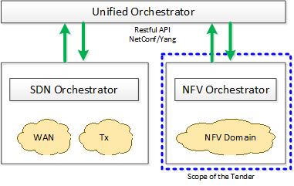
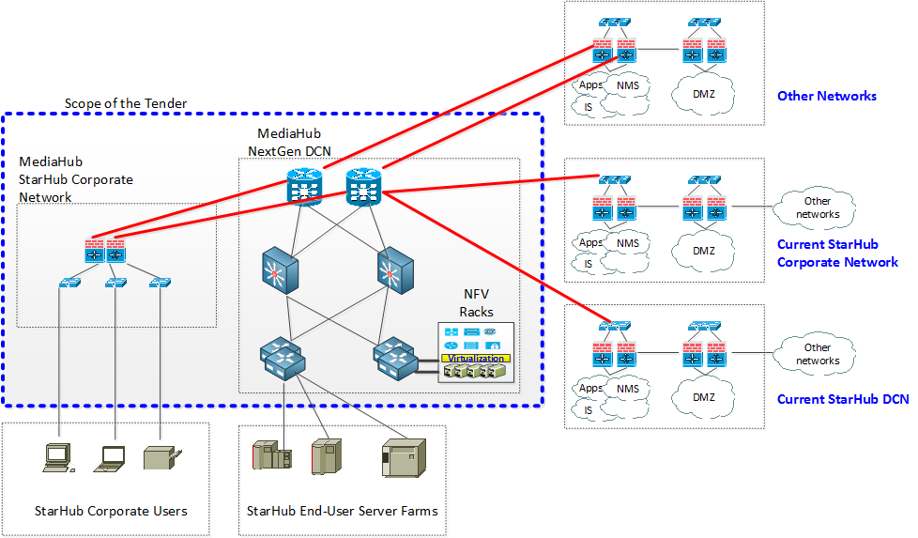
STARHUB Requirements Overview

Slide 4
Network Function Virtualization (NFV)

Slide 5










NFVI Logical Topology
VLAN
VXLAN
MPLS WAN
PE Routers
(Existing)
CE Routers
(Multi-VRF Capable)
Being associated
to VRF-vCPE
Being trunked through
Brocade VCS fabric
Physical Firewalls
Spine Routers
(Brocade VCS Fabric)
Legacy hardware appliance
which cannot be virtualized
External VLAN 1xxx
(pre-provisioned VLAN)
VLAN 2xxx
To be auto provisioned when on-boarding
External VLAN 3xxx
(Existing VLANs)
Leaf Switches
(Hardware VTEP enabled)
Tenant-X
(VPN-vCPE)
Tenant-A
Tenant-B
Tenant-Y

Slide 6






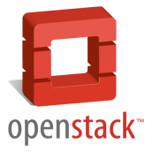



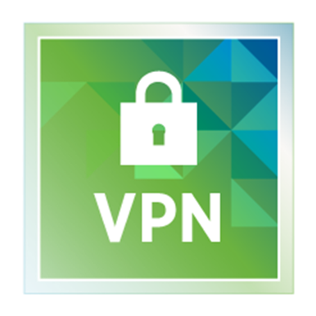








NFVI Physical Topology
Compute Cluster(s)
(OpenStack 50%)
Edge Cluster
(OpenStack 50%)
NFVO/VNFM
NSX Manager
(VIO)
Tenant 1#
Tenant 2#
Tenant 1#
Tenant 2#
VMware Integrated
OpenStack (VIO)
vCenter Server
(VIO)
NSX Controllers
Brocade SDN
Controller
vCenter Server
(for mgmt.)
VXLAN Transport
(vIO)
vROPS
Log-Insight
NSX Manager
(for mgmt)
Media-Hub Underlay Network (Brocade)
Brocade vRouter
VXLAN Transport
(vCD)
EMC VIPR
NSX Manager
(for vCD)
3rd party VNFM
3rd party Mgmt VMs
vCloud Director
(vCD)
Tenant 1#
Tenant 2#
Tenant 1#
Tenant 2#
vCenter Server
(for vCD)
NSX Controllers
Management Cluster
Compute Cluster(s)
(VMware 50%)
Edge Cluster
(VMware 50%)

Slide 7
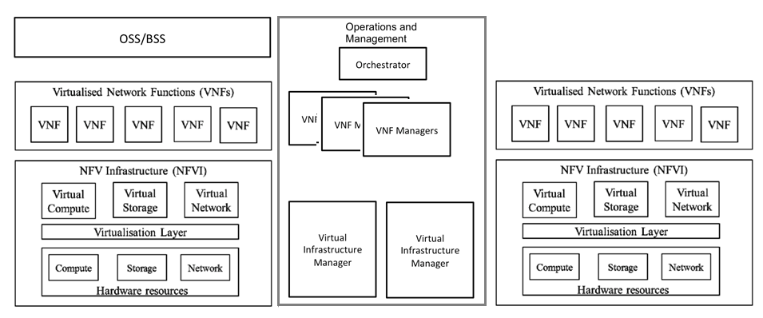


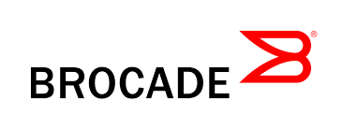
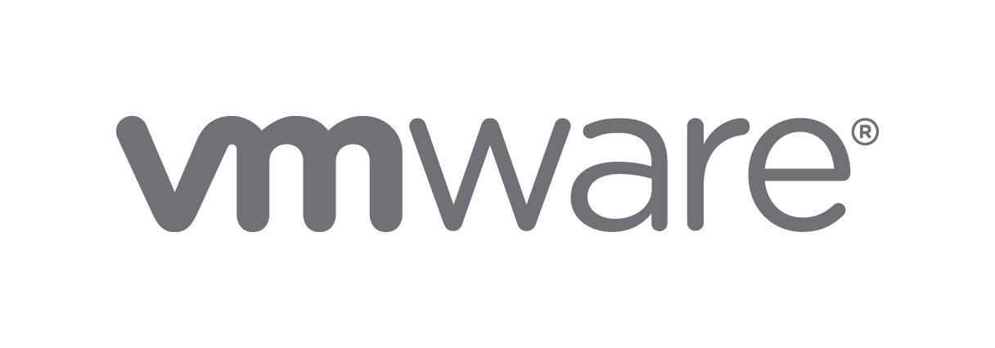


NFVI For StarHub
Current VMW Portfolio
Management and Control Interfaces

Slide 8












vCD Workflow (50% VMware)
Unified
Orchestrator
WAN/RAN/…
Controllers
WAN
Service Portal
VNFM(s)
NFV racks of
NextGen DCN
(50% VMware)
VNF A
NFVO
VNF B
L2
L2
VNF C
By VMware
vCloud Director
NSX Manager
NSX Controllers
L2
L2
L2
L2
L2
vROPS
vCenter Server
L2
By VMware
ESXi
ESXi
ESXi
NSX-v
NSX-v
NSX-v
ESXi
ESXi
ESXi
Underlay
Network
Management Cluster
Compute & Edge Cluster

Slide 9
VIO Workflow (50% OpenStack)
Unified
Orchestrator
WAN/RAN/…
Controllers
WAN
Service Portal
VNFM(s)
NFV racks of
NextGen DCN
(50% OpenStack)
VNF A
NFVO
VNF B
L2
L2
VNF C
By VMware
NSX Manager
NSX Controllers
L2
VIO
L2
L2
L2
L2
vROPS
vCenter Server
L2
By VMware
ESXi
ESXi
ESXi
NSX-v
NSX-v
NSX-v
ESXi
ESXi
ESXi
Underlay
Network
Management Cluster
Compute & Edge Cluster

Slide 10
VMware
Backup Slides

Slide 11






















VMware NSX
Logical Switching
NSX vSwitch
Logical Routing
Hypervisor
NSX vSwitch
> Fast service innovation
> Fast network provisioning
> Native HA
> Native LAN extension
> Service agility
> Operational efficiencies
> Hardware Independency
Hypervisor
NSX vSwitch
Load
Balancing
NSX vSwitch
Hypervisor
NSX vSwitch
Physical to Virtual
Hypervisor
NSX vSwitch
Hypervisor
Hypervisor
NSX vSwitch
Firewalling & Security
Hypervisor
NSX vSwitch
Hypervisor
One-Click Deployment via Cloud Management Platform

Slide 12





Disaster Recovery by SRM
Automated Recovery
minimizes downtime (RTO) from local or site failures
Reliability
Non-disruptive DR Test
vCenter-1 (mgmt.)
SRM-1
vCenter-2 (mgmt.)
SRM-2
Storage
Replication
DC-Site1
(Protected Site)
DC-Site2
(Recovery Site)

Slide 13
Workflow

Slide 14


New Service Creation
VNF service templates are modelled in a TOSCA format using the Cloudify Blueprint builder or through TOSCA yaml files
Model is stored in the Service Catalogue, when a customer requests service provisioning it is done based on the service template
Service template includes:
Infrastructure requirements (VMs, images, volumes, networks)
Relationships (dependencies, connectivity)
Operational processes for lifecycle events:
Deployment
Configuration
Monitoring
Scaling
Healing
Teardown
Means to communicate with the VMs in the service (SSH/REST/CLI/etc)
Tosca Blueprint
Builder
Service
Catalogue

Slide 15

Service Provisioning Workflow
Service Portal
1
Provision Service
by choosing catalog item previously created
Service = Server+FW+LB+External Network
Trigger each component creation
Detect required resources based on service template
Cloudify NFVO
REST API
Service Orchestrator
4
Resources
Check resource availability for tenant based on service details
2
3
Service Catalog
Service Chaining
Service Workflow
Trigger resource creation (server, FW, LB)
7
Policy Controller
5
Trigger logical network creation (backed by VXLAN)
App Controller
Network Controller
Service Policy
Application Policy
3rd party VNFM
Cloudify VNFM
VNF catalog
Lifecycle
Monitor
Start deployment workflow for VNFs
Brocade ODL Controller
8
Configuration pushed through SSH
VCD plugin
VIO Plugin
Mmgt Pack
10
vCloud Director
VMware Integrated Openstack
VNFs
9
6
Create network
VNFs
vSphere
NSX
Scale I/O
vSphere
NSX
Scale I/O
VNFs
Create servers
Underlay Network
VCS Fabric
Log Insight
vROPS
vRealize Orchestrator
VMware
NFVI
EMC VIPR Storage
Notes:
1. Provision Service through the service portal (choose catalog item)
created by cloud admin / tenant admin
provisioned by tenant admin probably (RBAC)
2. Cloudify NFVO gets the service from the catalog and checks resource availability for the tenant in the underlying VCD/VIO based on the service template
3. Service = Chain Server 1 – FW 1 – LB1 – External Network
Trigger creation of each component:
1. Logical network backed by VXLAN
Network controller -> NSX (would VIM lose track of the inventory? need to check)
2. Server creation
Same as 3 but no config pushed to server
3. LB
=VMs creation + SW + CONFIG workflow
Through app controller -> VNFM -> VCD -> vCenter (vSphere)
Configuration pushed through SSH
configuration profile is included in the service template
Associated to the newly created VXLAN
2. FW
=VMs creation + SW + CONFIG workflow
FW rule based on server IP and SLB IP
represented as outputs in the service template
Associated to the newly created VXLAN
Associated to the previously created external network

Slide 16
Service Scaling Workflow
Service Portal
Cloudify NFVO
REST API
Service Orchestrator
Resources
Service Catalog
Service Chaining
Service Workflow
Service policy for monitoring and scaling is configured into the controller via the service template
Reconfiguration of other components (e.g. add new VM IP to LB)
App Controller
6
Policy Controller
1
Network Controller
Service Policy
Application Policy
3
Threshold reached (e.g. CPU>50%)
Trigger scale workflow
Continuous monitoring of VIM level and service level, metrics are aggregated and checked for thresholds
Cloudify VNFM
2
3rd party VNFM
VNF catalog
Lifecycle
Monitor
Brocade ODL Controller
VCD plugin
VIO Plugin
Mmgt Pack
Configuration pushed through SSH
4
5
vCloud Director
VMware Integrated Openstack
VNFs
Provision VM
VNFs
vSphere
NSX
Scale I/O
vSphere
NSX
Scale I/O
VNFs
Underlay Network
VCS Fabric
Log Insight
vROPS
vRealize Orchestrator
VMware
NFVI
EMC VIPR Storage
Notes:
Orchestration Layer
Starting with Service Portal , users can manage the services and infra through it
Templates based on TOSCA, YANG or HEAT
Within the Cloudify Software, different components :
Service Orchestrator, responsible for the service catalogs, workflows, and chaining (firewall plus UTM )
Network controller portion – orchestration of underlay network , the integration points will be to NSX or Brocade Vyatta SDN Controller (RestAPI)
Policy controller for the different types of rules and authentications
App Contorller for the different types of VNF to be used
The VNFM (VNF MANAGER) portion of Cloudify has intensive integration with VMWARE VCD and VIO via internal API development
1. Provision Service through the service portal (choose catalog item)
created by cloud admin / tenant admin
provisioned by tenant admin probably (RBAC)
2. Cloudify NFVO gets the service from the catalog and checks resource availability for the tenant in the underlying VCD/VIO based on the service template
3. Service = Chain Server 1 – FW 1 – LB1 – External Network
Trigger creation of each component:
1. Logical network backed by VXLAN
Network controller -> NSX (would VIM lose track of the inventory? need to check)
2. Server creation
Same as 3 but no config pushed to server
3. LB
=VMs creation + SW + CONFIG workflow
Through app controller -> VNFM -> VCD -> vCenter (vSphere)
Configuration pushed through SSH
configuration profile is included in the service template
Associated to the newly created VXLAN
2. FW
=VMs creation + SW + CONFIG workflow
FW rule based on server IP and SLB IP
represented as outputs in the service template
Associated to the newly created VXLAN
Associated to the previously created external network
Scaling of VNF service
1. Policy controller includes service policy for monitoring and scaling
2. Montoring is done in VIM level + service level
3. Policy controller sees threshold breached
4. Triggers scaling request to application controller
5. triggers provision new service VM + config to VCD
6. Reconfiguration of relevant components as needed (use case based, depending on scaling definition in service model)
7. e.g. Add new VM IP to LB
Combining Application VNF definition + vCD VIM KPIs
TOSCA (NFVO+VNFM) + vCD VIM data entities, correlation mapping between VM and VNF applications (vIMS, vCPE, vEPC etc.)
CENX Service Assurance (KPIs, SLAs and business intelligence) based on vCD, vROPs metrics
Lifecycle management for any VNF deployment

Slide 17
Monitoring Matrix

Slide 18
Monitoring Matrix
Performance Management
Fault Management
- Auto Scaling function
- Collection Method: SSH, Telnet, plugins, & etc.
- Collected Data: Application or Infrastructure KPI
- Auto Heal function
- Checking of Service availability
- Detection Method:
- SNMP, plugins, SSH/Telnet
Cloudify
(VNF)
vRealized
Operations &
Log Insight
(Infra)
- Performance Monitoring and Analytics (vSphere, OS, Application & etc.)
- Dashboards and Reports
- Methods:
- Vendor Packages
- SNMP adapter
- Faults Alert
- Intelligent Analysis Operations
- Methods:
- Vendor Packages
- Syslog
Notes:
Alert Method: Email, SNMP traps, Rest API

Slide 19
Configuration Management
VMware
vSphere host profile
Cloudify
Will be available
Notes:
Configuration settings that are shared by a group of VMware vSphere hosts are stored in a host profile. Once the host profile has been created, it can be attached to one or more vSphere hosts or clusters. Once attached, the host configuration is compared against the host profile and any deviations are reported. Administrators associate host profiles with other hosts and clusters, ensuring consistency. Any drift in configurations can be corrected automatically.

Slide 20
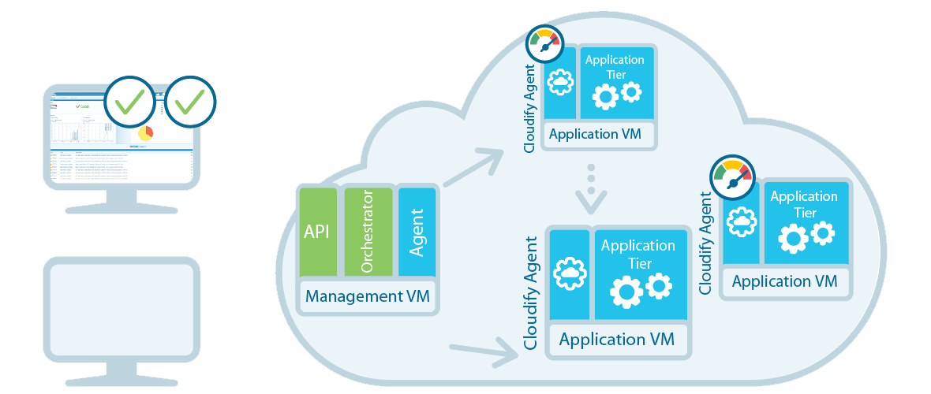
Performance Monitoring
Cloudify (VNF)
Monitoring data aggregation from different sources (VNF, VIM, NMS)
Intelligent auto-scale add additional resources following a breach of SLA

Slide 21
Performance Monitoring
vRealize Operations (Infra)
Monitor infrastructure performance
Management Pack for OpenStack 1.5
Management Pack for NSX for vSphere 2.0
Management Pack™ for vCloud Director™
Management pack for vRealize Log Insight
Management Pack for VMware vCenter Server
Brocade IP Analytics Pack for VMware vRealize Operations
EMC Storage Analytics Management Pack
EMC ViPR Analytics Pack for VMware vCenter Operations Management Suite
SNMP adapter for appliances
Notes:
vROps delivers virtualization with consistent management, purpose-built to get the best performance, availability and efficiency from your infrastructure and applications from day one.
SNMP adapter for Fortinet & Pulse Secure

Slide 22
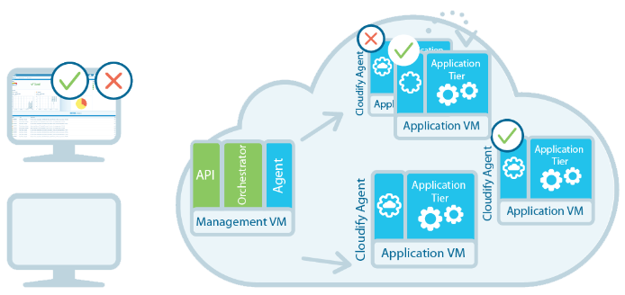
Fault Management
Cloudify
Monitor service health and availability
Intelligent auto-heals crashed middleware or lost VMs, including service setup on re-provisioned infrastructure
Notes:
vROps delivers virtualization with consistent management, purpose-built to get the best performance, availability and efficiency from your infrastructure and applications from day one.

Slide 23
Fault Management
vRealize Log Insight
Brocade IP Content Pack for vRealize Log Insight
Openstack Content Pack
NSX for vSphere Content Pack
vCD Log Insight Content Pack
VMware - vSphere Content Pack
vRA 6.1+ Log Insight Content Pack
Syslog for other appliances
Notes:
vROps delivers virtualization with consistent management, purpose-built to get the best performance, availability and efficiency from your infrastructure and applications from day one.

Slide 24
END
Notes:
vROps delivers virtualization with consistent management, purpose-built to get the best performance, availability and efficiency from your infrastructure and applications from day one.

Slide 25




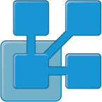
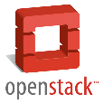







vRealize Operations
Quality of
Service
Operational
Efficiency
⇧
⇧
vRealize Operations
Operations Console
Extensibility
Integrated Management Disciplines
Management
Packs
Performance
Availability
Capacity
APIs
Log Analytics
App Visibility
Reporting/ Alerting
Analytics
SDK
Resilient, Scale-Out, Next-Gen Platform
vSphere
Windows
Linux
Physical
Virtual & OS
Cloud Management
Notes:
vROps delivers virtualization with consistent management, purpose-built to get the best performance, availability and efficiency from your infrastructure and applications from day one.

Slide 26
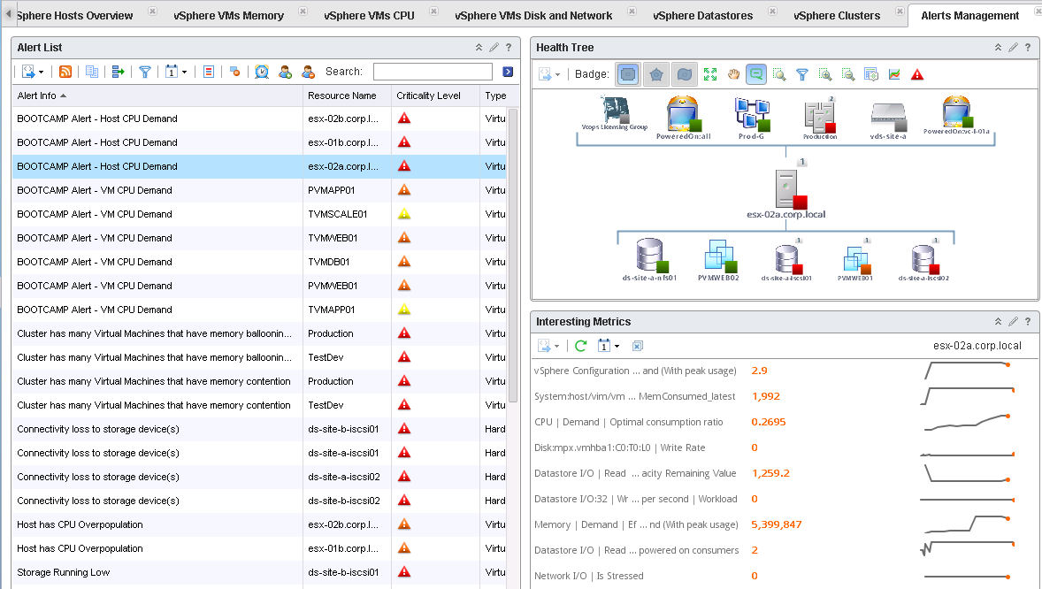
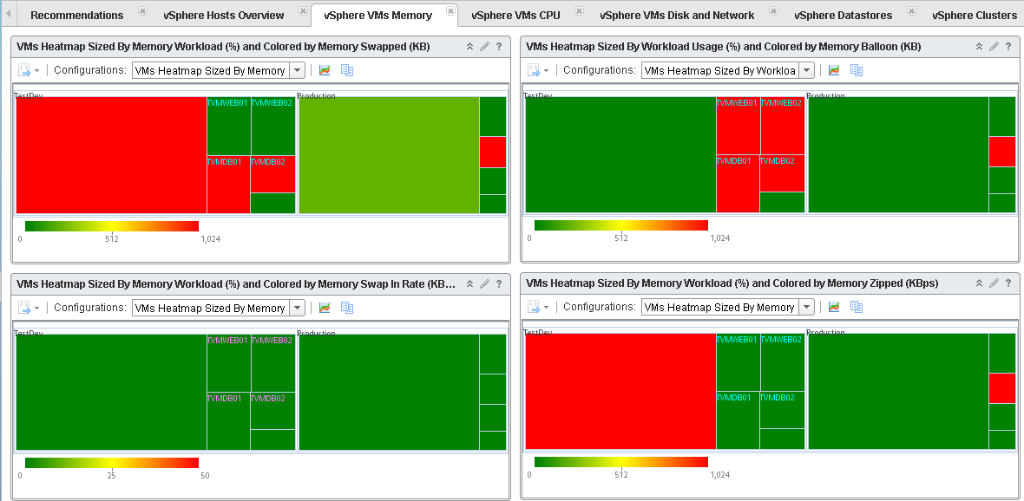
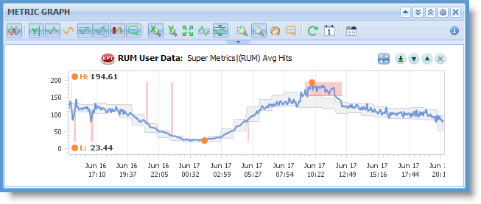
vRealize Operations Manager
Monitored object relationships
Customised dashboards using numerous widgets
Analytics & dynamic thresholds

Slide 27
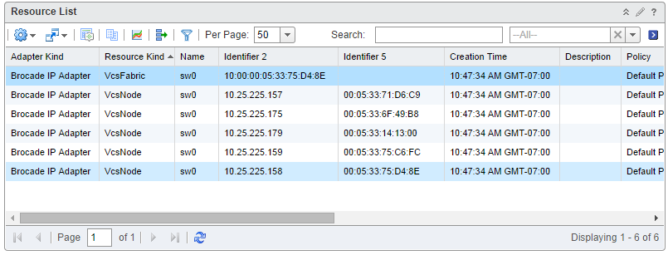
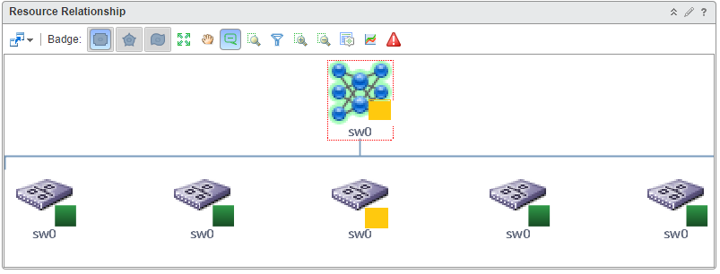
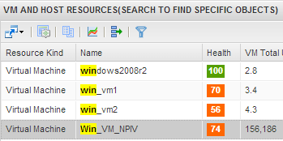
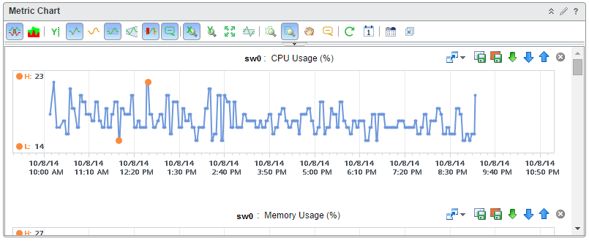
vRealize Integration: Brocade IP Analytics Pack
Maximize virtual network availability with physical network analytics
Health
74
VM connected to Fabric is being affected by dropped packets
Check ports are enabled for jumbo frames
Ensure the network is configured for VXLAN
Gain visibility into the physical topology
Optimize performance and availability
Admin drills down to switch with low health to find which port is causing the issue. Notices high CPU utilization causing degraded health status.
Notes:
The IP Analytics Pack for vRealize Operations allow customers to quickly troubleshoot any VCS issues by drilling down from the VM or application perspective which is usually the the problems user face.
It provides a single pane of glass for managing virtual and physical assets.

Slide 28
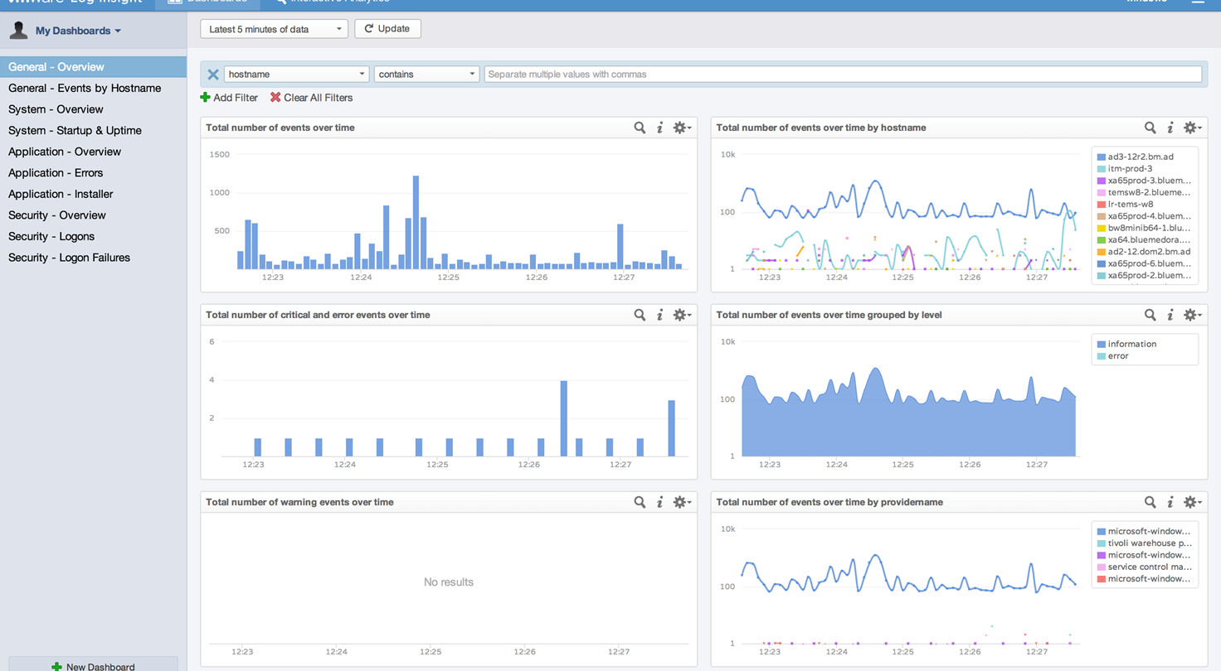
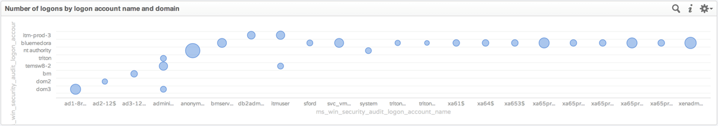
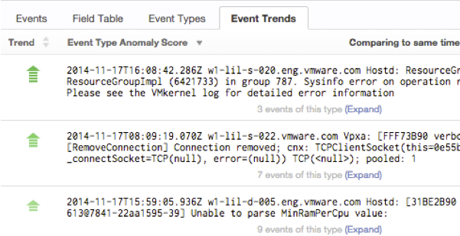
vRealize LogInsight
Visualise and anlayse all your log data to accelerate RCA
Machine Learning helps to identify anomalies, trends

Slide 29
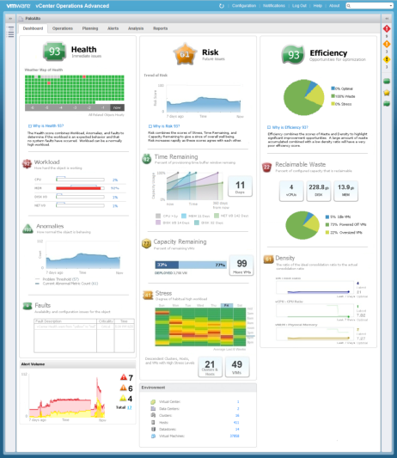
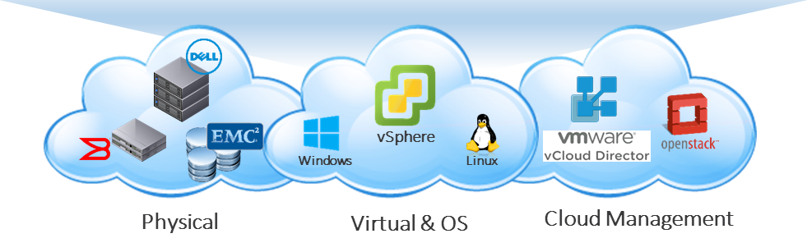
Why vRealize Operations for monitoring…
1
Purpose built for Cloud era
Self-learning predictive analytics and smart alerts
Capacity optimization across virtual and physical stack
Scale-out architecture to support Cloud scale
2
Single pane of glass
Accelerate root cause analysis across the full infra stack
From summary dashboards to detailed logs fully integrated
3
Fast time to value
Fast and easy deployment as a virtual appliance
Purpose built management packs for simple 3rd party integration

