Slide 1


Supervised and unsupervised learning with Johnson & Johnson ticketing database
Ignacio Palma, Jairo Melo, Jamil Mahboob and Vikram Khade
York University
ML1000, Project presentation
22 March , 2019

Slide 2
Introduction
Motivation / Objective :

Slide 3
Supervised Learning
Techniques used.

Slide 4
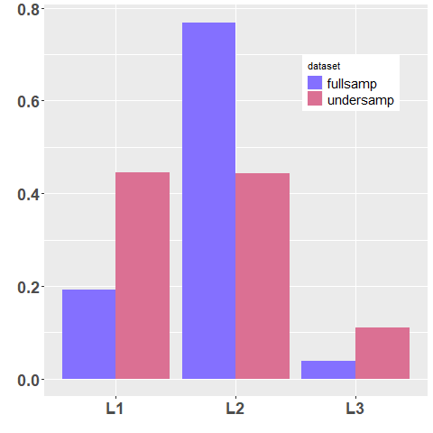
Clustering
Partitioning around Medoids (PAM)
We are looking for clusters dominated by L3 level. Such clusters are not found.
…. since the dataset is dominated by L2.
Solution : Majority under sampling Level 1
and Level 2.

Slide 5
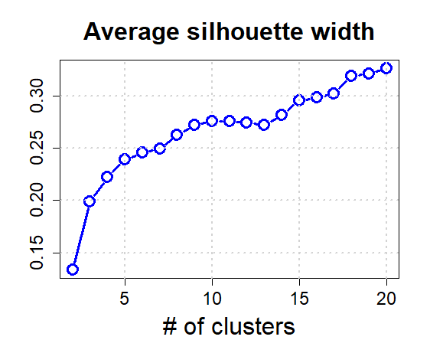
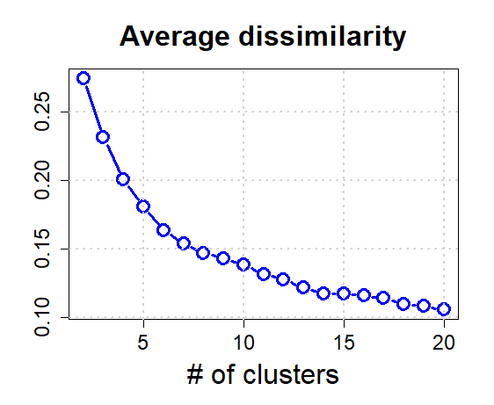

Slide 6
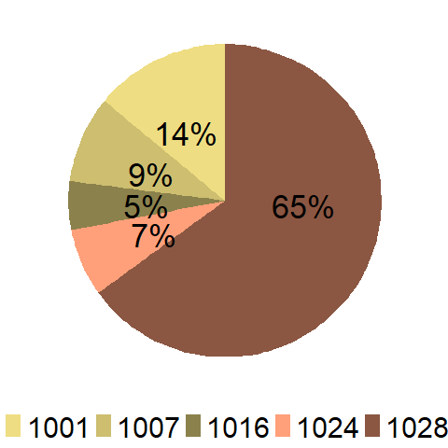
Region feature for a particular cluster
We have to inspect 20 x 8 piecharts !
A convenient visualization tool is the
heatmap.

Slide 7
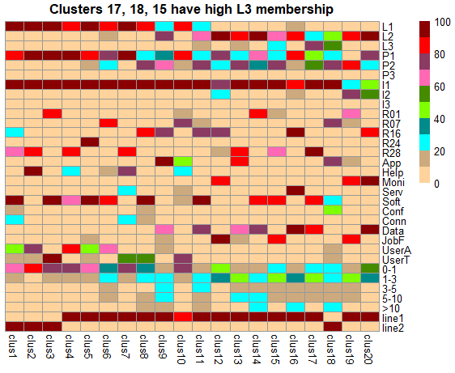
Res_category
ndays

Slide 8
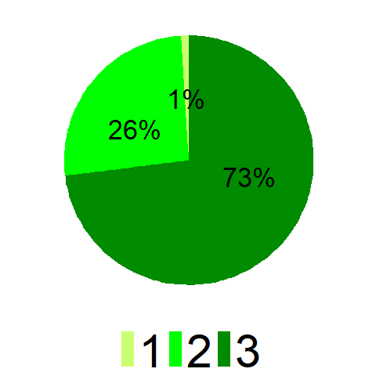
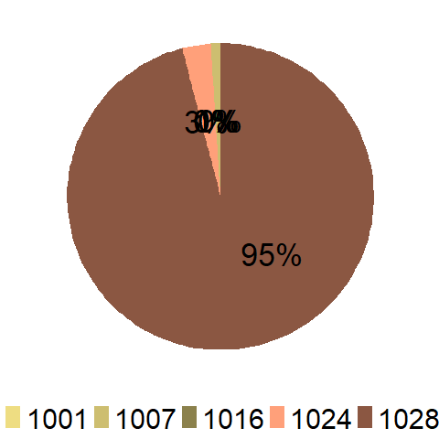
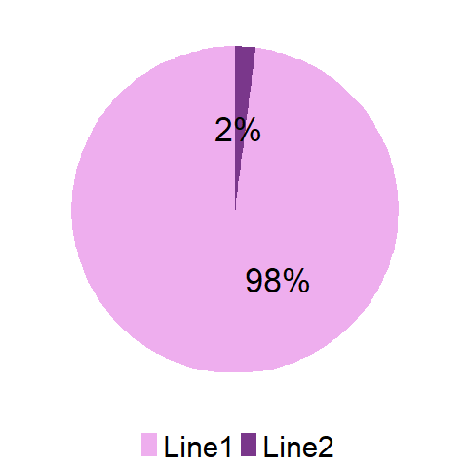
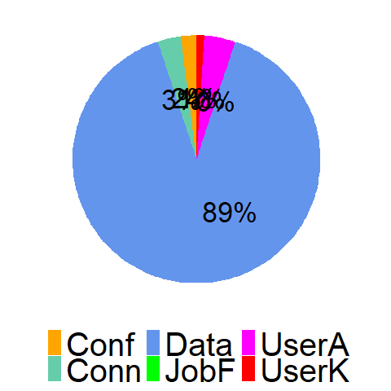
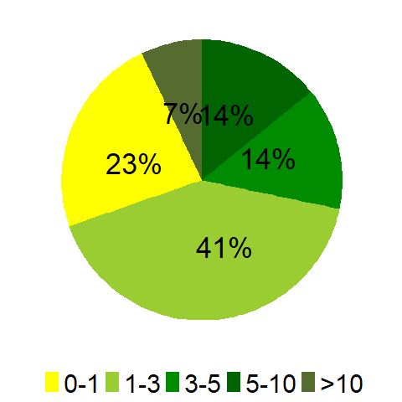
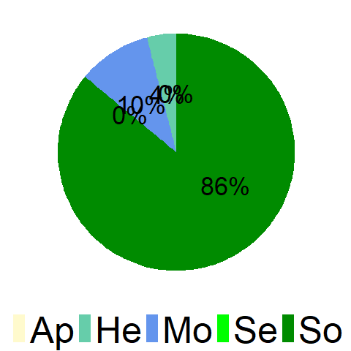
C
L
U
S
T
E
R
17

Slide 9
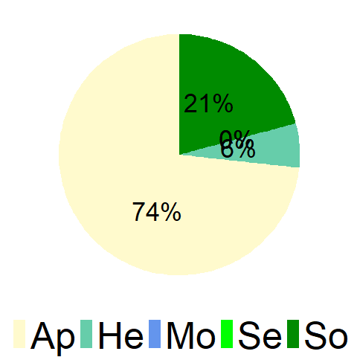
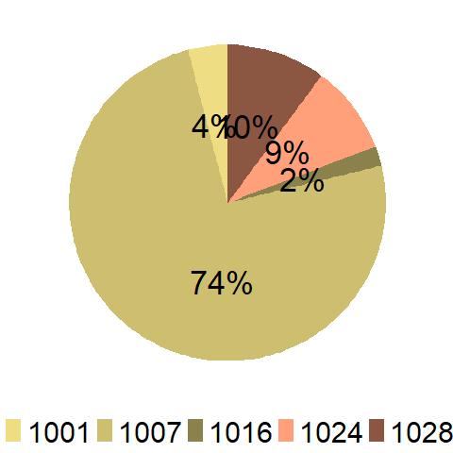
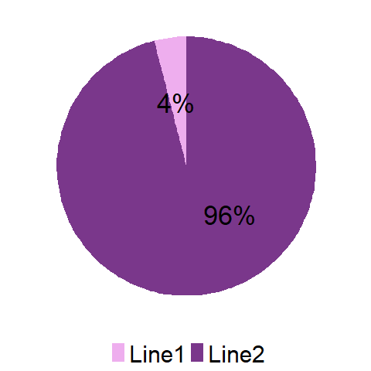
17
18

Slide 10
Recommendation
Cluster # | Level | Priority | Impact | App_category | Res_category | Region | Prod_line | ndays
17 | L3 | P1 & P2 | I1 | Software | Data Issues | 1028 | Line 1 | Mixed
18 | L2 & L3 | P2 | I1 | Application | Configuration | 1007 | Line 2 | Mixed
15 | L2 | P2 | I1 | Software | Job failure | 1028 | Line 1 | Mixed
J&J should look into the above segments for cost cutting by
devising strategies to push L2 & L3 tickets to L1.

Slide 11
Conclusions
Recommend Random Forest for predicting group level and performance.
Recommend segment given by cluster 8 for further analysis to J&J.

