Slide 1

Trading Settlement Demo
November 2011

Slide 2
Trading Settlement Demo
This demo illustrates a simple trading system leveraging GigaSpaces across all system components:
Data tier
Messaging Tier
Web Tier
The demo illustrates:
Scalability
Elasticity
High-Availability
Low Latency
Main Features Used:
Remoting
Eventing (Light Complex processing)
Asynchronous persistency
Transparent web Session Clustering
Elastic PU

Slide 3
Trading Settlement Demo
Demo Architecture and , components and their relationship.
Matching process and how the polling container is used?
How data is partitioned? (routing field implementation)
How the business logic accessing the data (DAO)?
How Space Document is used?
How Web session is maintained?
How data mapped to database tables ? (hbm files)
How the app scales? (Using Elastic PU and admin API)
How to install , build and deploy?

Slide 4
Architecture
Blotter client
http
Servlet
Feeder
Matching
Matching
Primary 1
Primary 2
Mirror
Messaging
Monitor
Matching
Matching
Backup 1
Backup 2
async
Scalable Elastic In-Memory Data and Processing Grid
DB

Slide 5
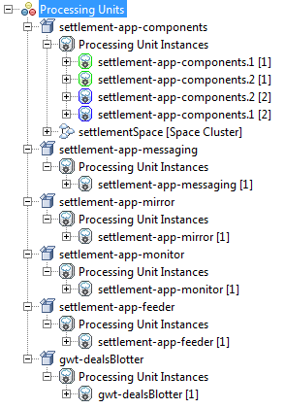
Processing Units

Slide 6
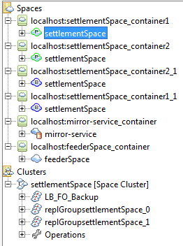
Spaces

Slide 7
Module Relationships
Messaging PU
External Systems
Feeder PU
Matching PU
Matching Polling Container
New trades
Fix Event (on matching )
Web PU
Settlement
Space
async
Mirror PU
trade count
Monitor PU
elastic scaling
async

Slide 8
Operations
Matching
Fields: trading party, counter-party, instrument, matched flag, bug/sell flag
Transaction: get matches, write matched deals to space, set matched trades (in space) to processed
Data partitioning
Hash based on trading party and counter-party
Web session data
Stored in space, 1 object per client

Slide 9
Trade Matching Processor
@EventDriven @Polling(gigaSpace = "gigaSpace") @TransactionalEvent(transactionManager="transactionManager")
public class TradeMatchingProcessor {
@EventTemplate
public SQLQuery<Trade> getUnprocessedTrade() {
SQLQuery<Trade> template = new SQLQuery<Trade>(Trade.class, "processed = false");
return template;
}
@SpaceDataEvent
public Trade onEvent(Trade trade) throws Exception {
SQLQuery<Trade> template =
new SQLQuery<Trade>(Trade.class, "instrument = '" + trade.getInstrument() +
"' and counterparty = '" + trade.getTradingParty() +
"' and tradingParty = '" + trade.getCounterparty() +
"' and matched = false and buySellFlag = " +
(trade.getBuySellFlag().equals("B") ? "'S'" : "'B'"));
Trade[] matchingTrades = gigaSpace.readMultiple(template, Integer.MAX_VALUE);
trade.setProcessed(true);
return trade;
}

Slide 10
Settlement App DAO
public interface SettlementAppDAO {
MatchedDeal[] getMatchedDeals(String entity);
MatchedDeal[] getMatchedDeals(String entity, String counterparty);
Trade[] getTrades(String entity, String counterparty);
SpaceDocument saveDocument(SpaceDocument document);
Trade saveTrade(Trade trade);
Trade[] getCounterpartyTrades(String entity, String counterparty);
void clearUnmatchedTrades();
}

Slide 11
Elastic Processing Unit
When number of matched deals = 50, memory capacity is increased:
Specify memory increase through admin API
XAP automatically provisions new processing containers and rebalances processing units
Scaling down is the reverse process
For more info: http://www.gigaspaces.com/wiki/display/XAP8/Elastic+Processing+Unit

Slide 12
Routing Field implementation
@SpaceClass
public class Trade implements Serializable {
…
@SpaceRouting
public String getRouting() {
if (tradingParty == null) {
return null;
}
String[] entities = new String[] {tradingParty,counterparty};
Arrays.sort(entities);
routing = entities[0] + "-" + entities[1];
return routing;
}
}

Slide 13
Elastic PU
pu = gsm.deploy(new ElasticStatefulProcessingUnitDeployment(archiveFile)
.singleMachineDeployment()
.memoryCapacityPerContainer(CONTAINER_MEMORY_CAPACITY_MB,MemoryUnit.MEGABYTES)
.maxMemoryCapacity(MAX_MEMORY_CAPACITY_MB,MemoryUnit.MEGABYTES)
//initial scale
.scale(new ManualCapacityScaleConfigurer().
memoryCapacity(INITIAL_MEMORY_CAPACITY_MB,MemoryUnit.MEGABYTES).create())
);

Slide 14
Space Document
For saving matched deals
Deal ID
Routing string
Buy-side party
Sell-side party
MatchedDeal object

Slide 15
The MatchedDeal Space Document
public class MatchedDeal extends SpaceDocument {
public String getDealId() {
return getProperty("DealId");
}
public MatchedDeal setDealId(String dealId) {
setProperty("DealId", dealId);
return this;
}
}

Slide 16
Mapping POJOs to Database
<hibernate-mapping>
<class
name="com.gigaspaces.settlement.model.Trade"
table="TRADE"
mutable="true">
<id
name="tradeId"
column="TRADE_ID"
type="java.lang.String">
<generator class="assigned">
</generator>
</id>
<property
name="tradingParty"
type="java.lang.String"
update="true"
insert="true"
column="trading_party"
/>
…………

Slide 17
Web Session Management
HTTP Session maintained in memory
Using Local cache running within the web app
Session maintained using the following:
jetty.sessions.spaceUrl=jini://*/*/settlementSpace?useLocalCache

Slide 18
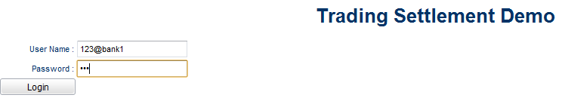
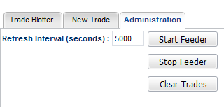
Run Demo
Full instructions on how to build and deploy in readme file
Login
Start feeder
After @ sign must be the trading party, eg bank1, cust1, bank2, cust2
Change refresh interval to speed up or slow down feeder
After it scales up when unmatched trades=50, clear trades to scale back down

Slide 19
Future Enhancements
More sophisticated matching
Scale the web tier dynamically
Deploy on the cloud via GigaSpaces Cloudify

