Slide 1
Forecasting predictive outcomes of the T20 International Cricket and T20 Club Cricket Competitions Matches Using Machine-Learning Django Flutter
Submitted By: Taufiq Al Hasib Sadi Gigawashu Das Israt Jerin Md.Ekramul Haq | Faculty Advisor: Dr. Mohammad Monirujjaman Khan Associate Professor ECE Department

Slide 2
Project Goals
Score Prediction or Forecasting Likely Scores
Win Probability or Victory Likelihood (Considering First Innings Batting Team)
Win Probability or Victory Likelihood (Considering Second Innings Batting Team)

Slide 3
Considered Tournaments
Men’s T20 International (Men’s T20i)
Women’s T20 International (Women’s T20i)
Bangladesh Premier League (BPL)
Indian Premier League (IPL)
Big Bash League (BBL)
Women’s Big Bash League (WBBL)
T20 Blast
Pakistan Super League (PSL)
Lankan Premier League (LPL)
Caribbean Premier League (CPL)
Men’s Super Smash
Women’s Super Smash
Women's Cricket Super League (WCSL)

Slide 4
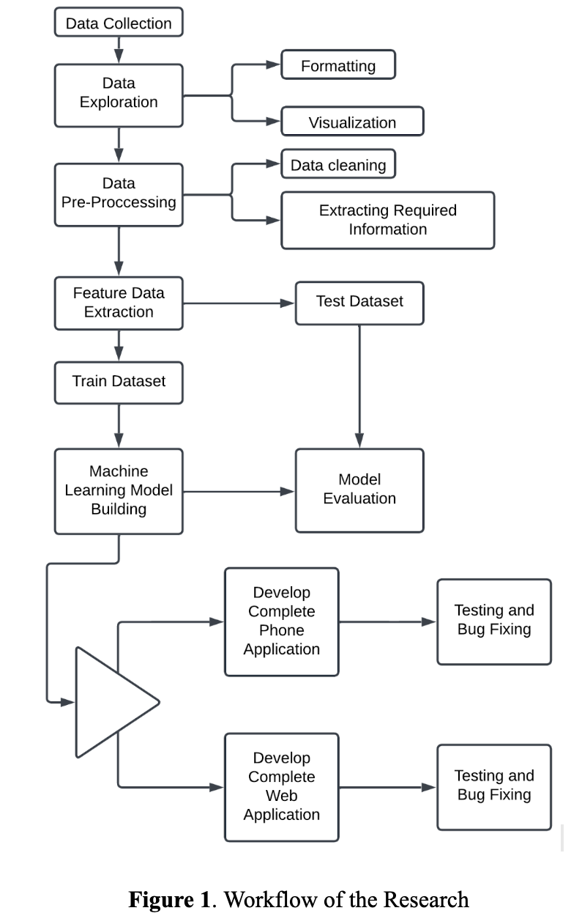
Workflow
From the Data Collection process to the building and evaluation of machine learning models, everything has been done.
The current plan is the development of web and phone applications, testing and bug fixing, application deployment on servers, report writing, and preparation for capstone.
Work Done
Current Work

Slide 5
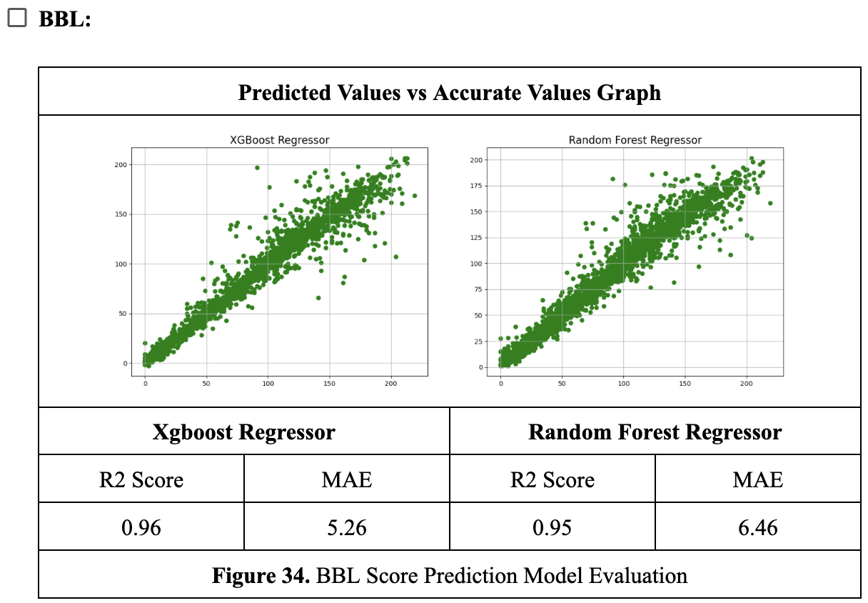
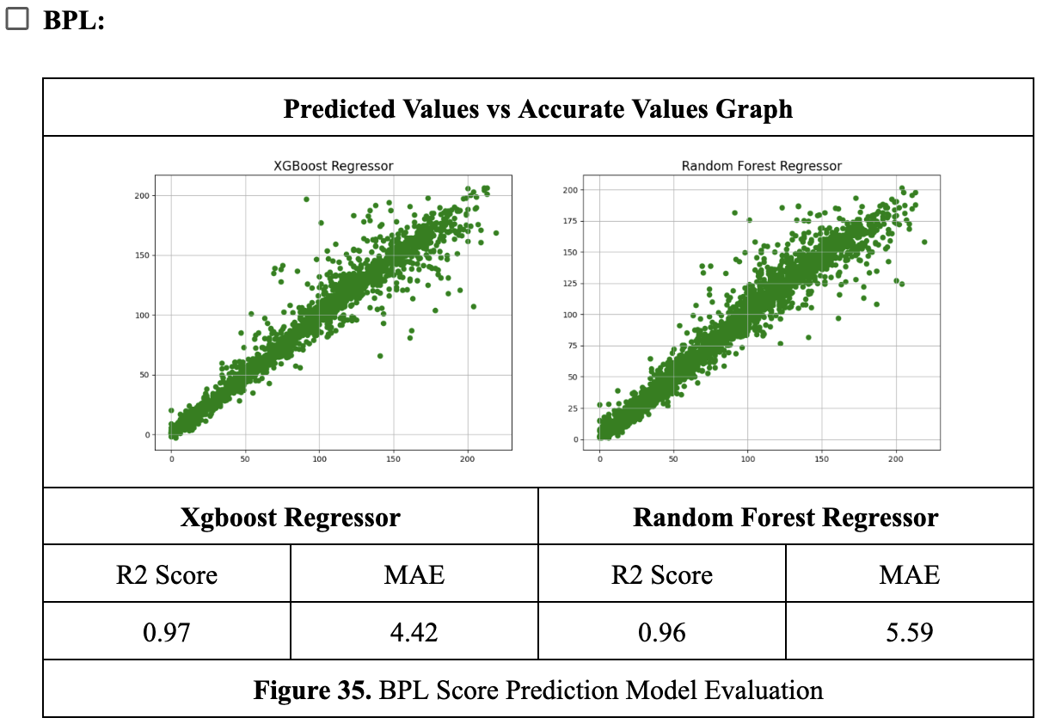
Results of Previous Works
Results and Discussion
First Innings Score Prediction Models

Slide 6
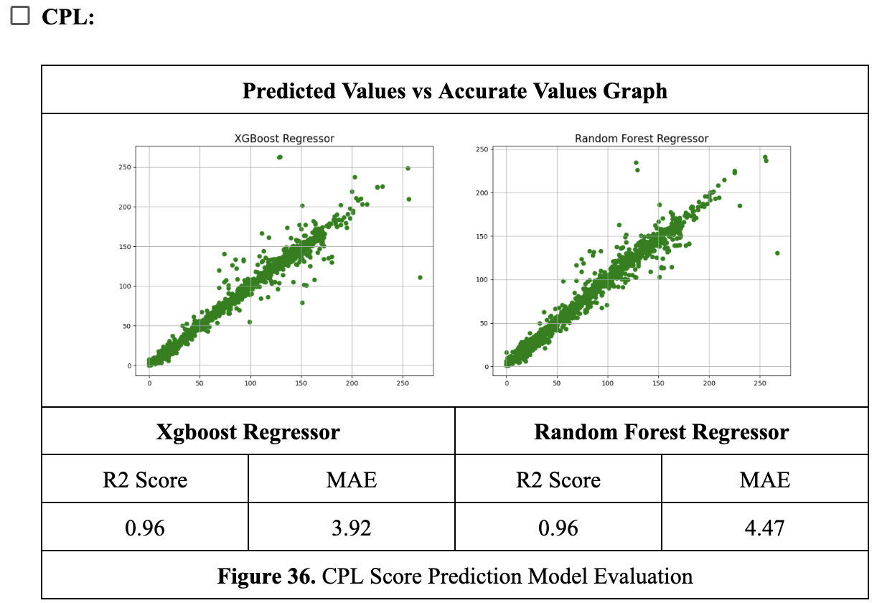
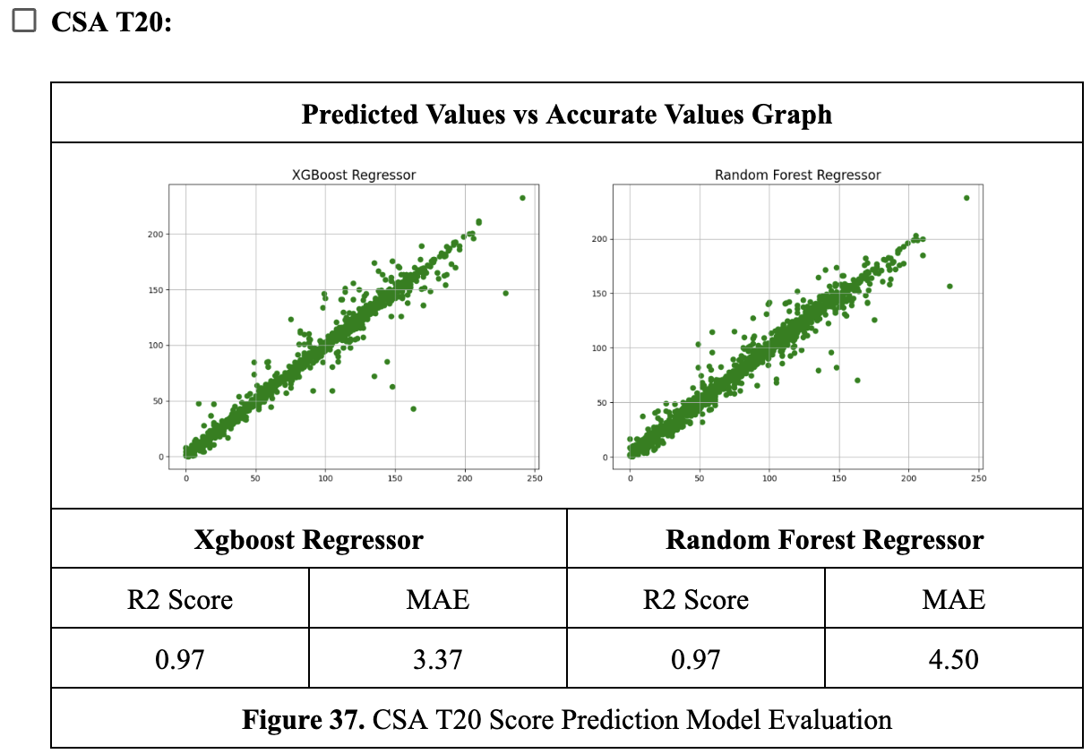
Results of Previous Works

Slide 7
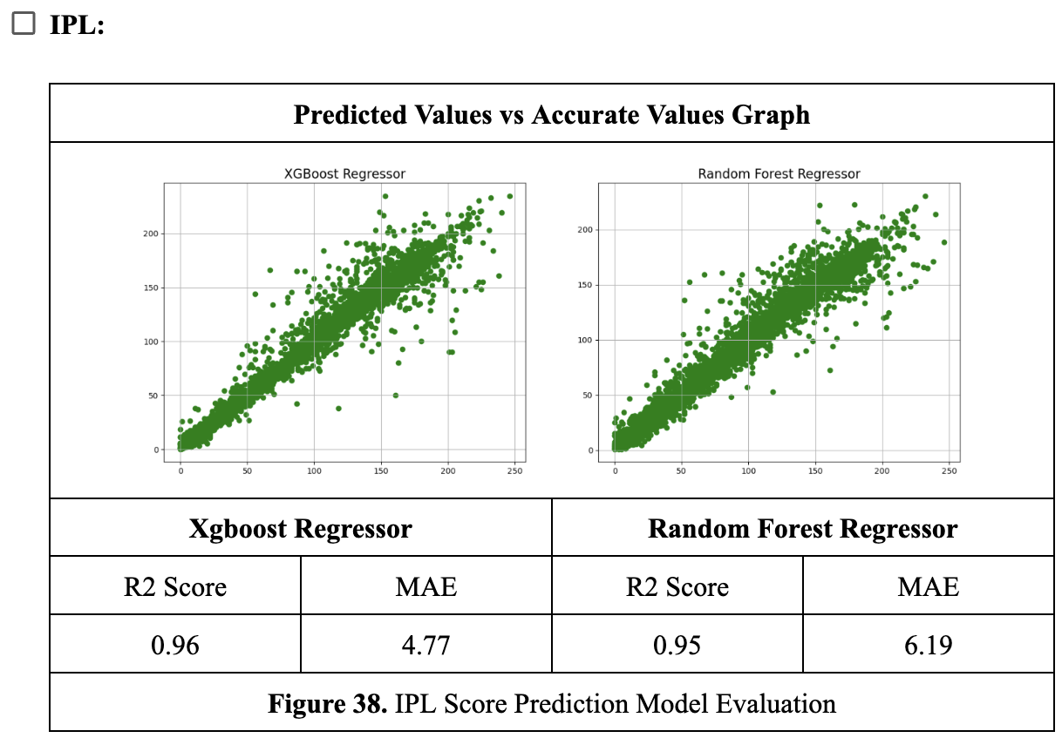
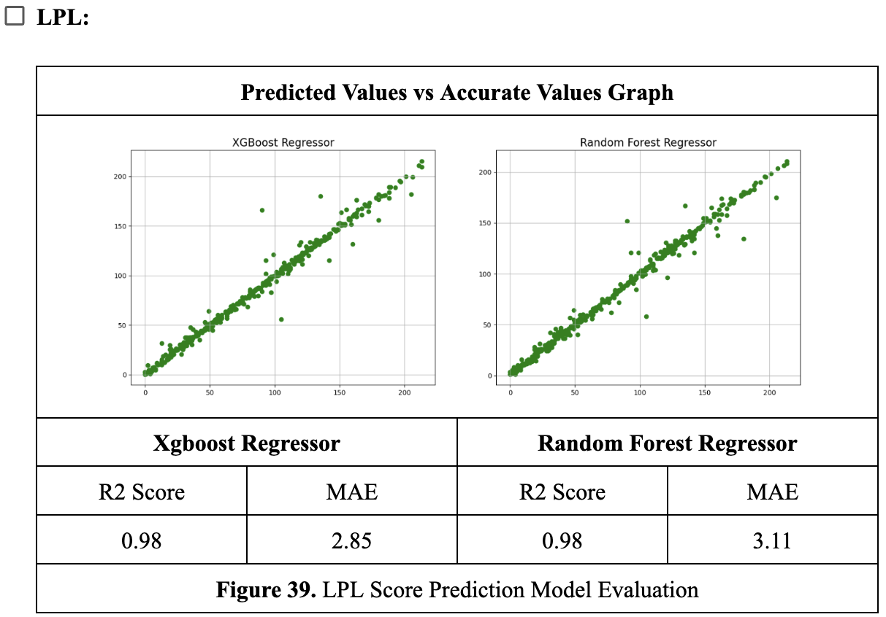
Results of Previous Works

Slide 8
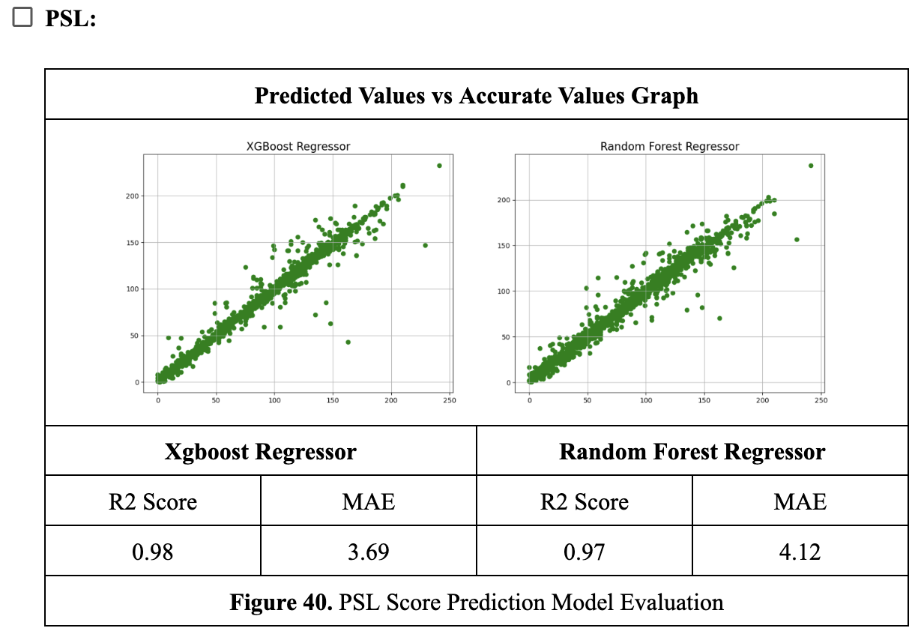
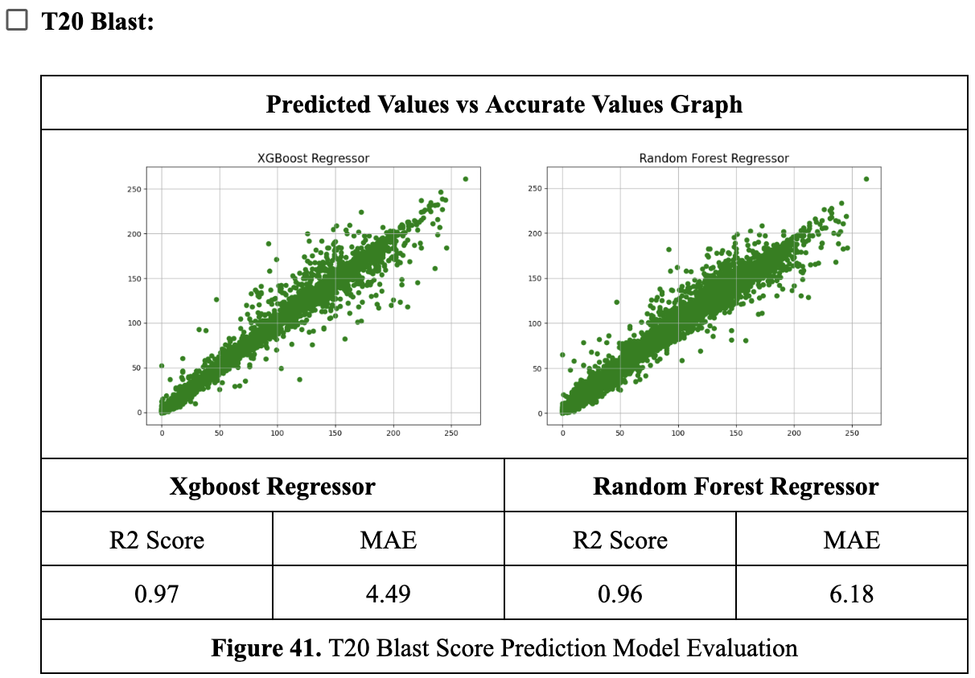
Results of Previous Works

Slide 9
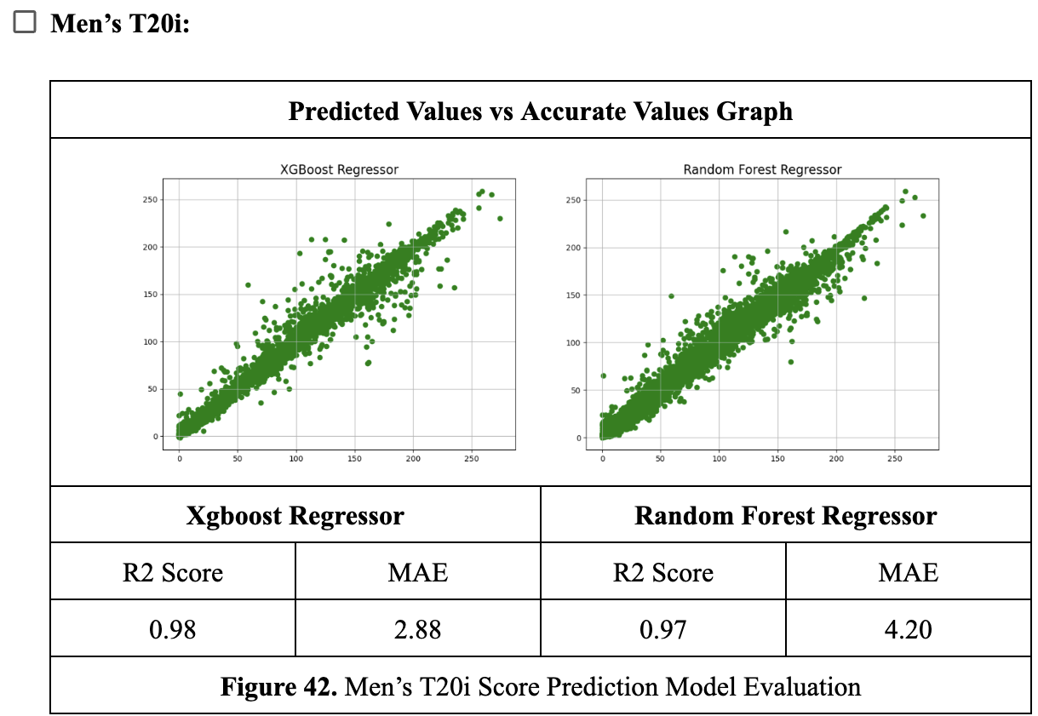
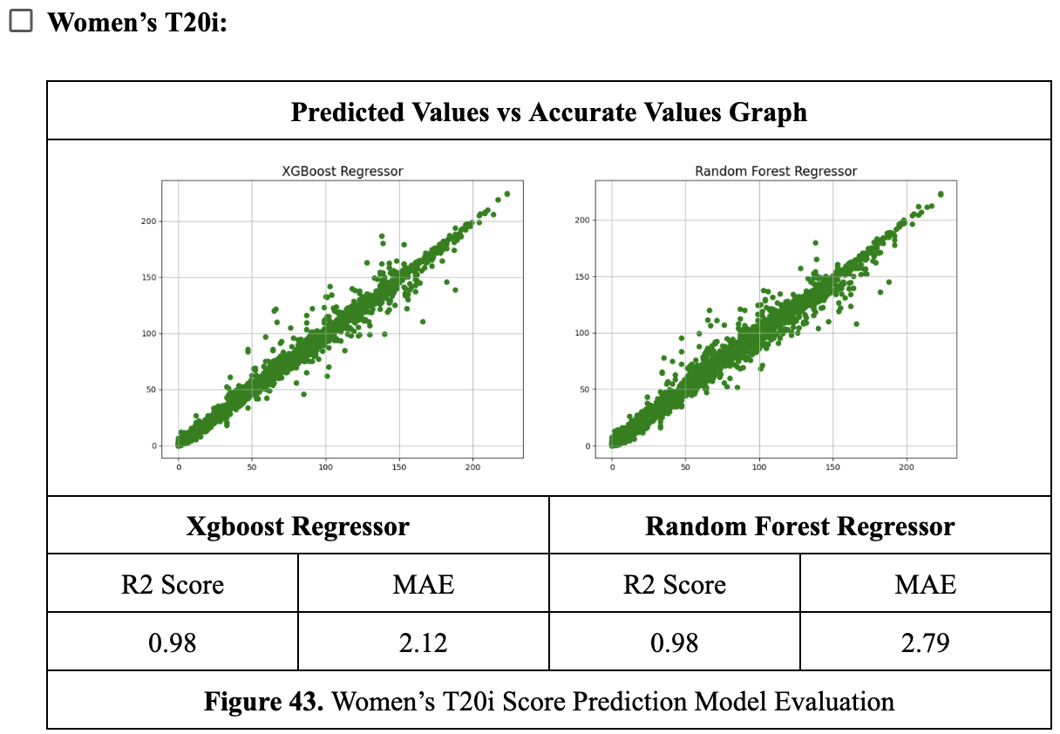
Results of Previous Works

Slide 10
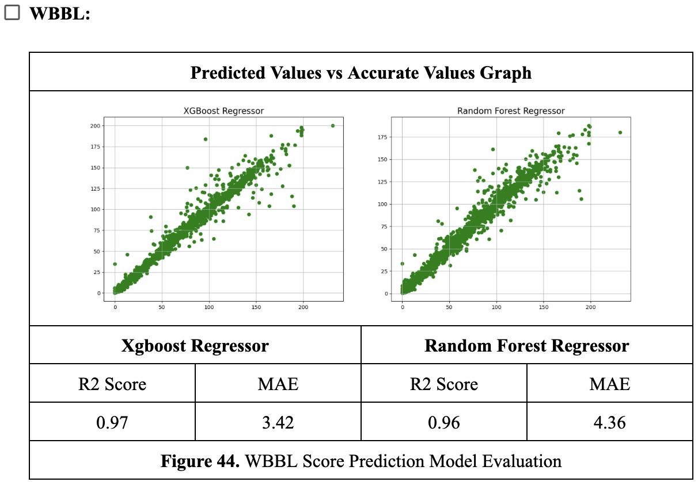
Results of Previous Works

Slide 11
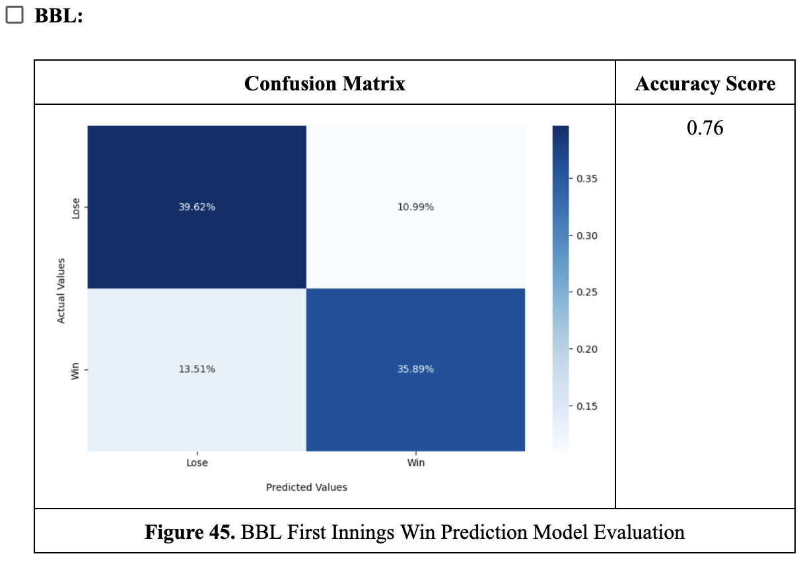
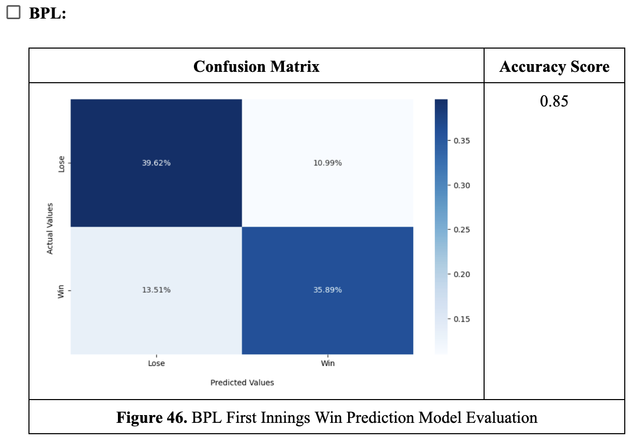
Results of Previous Works
First Innings Win Prediction Models

Slide 12
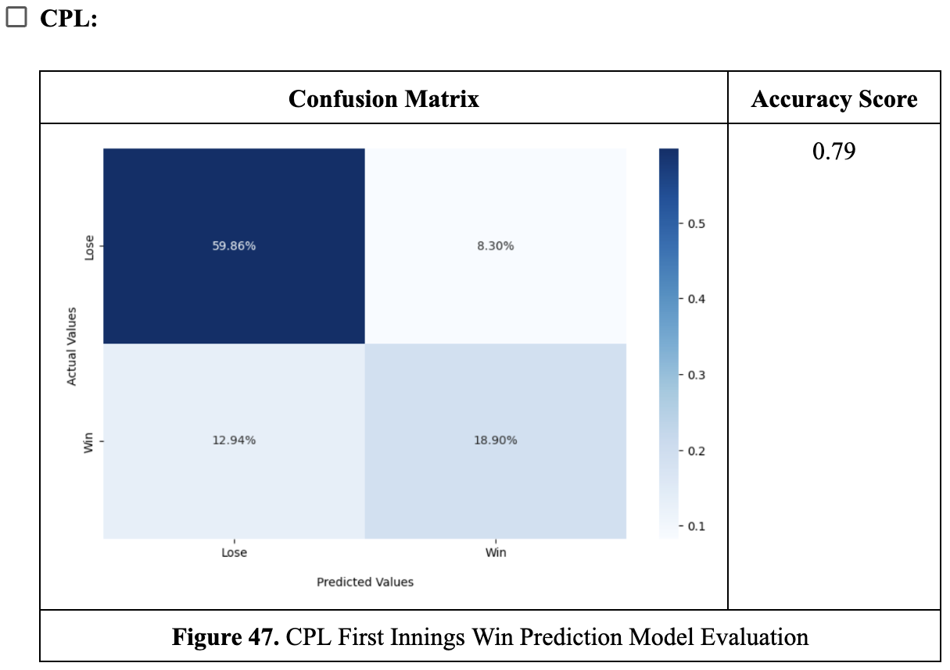
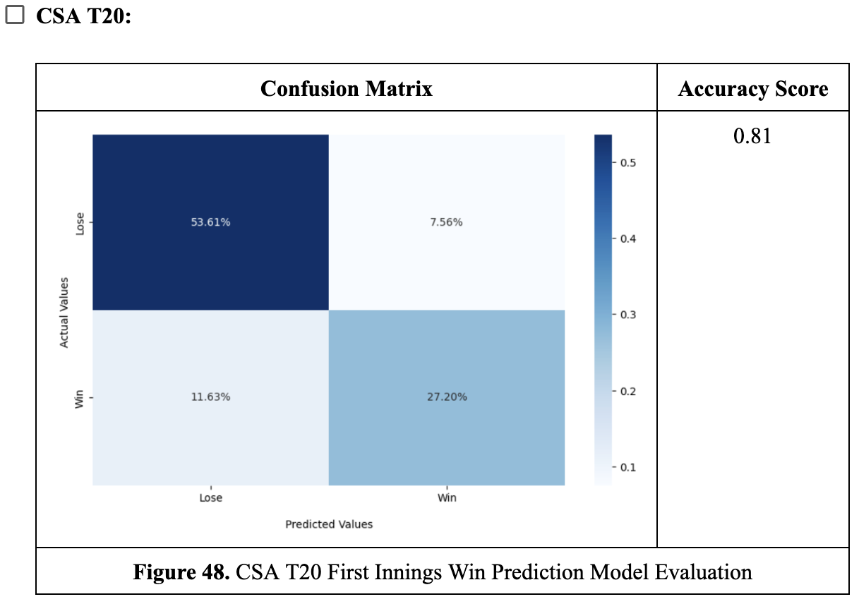
Results of Previous Works

Slide 13
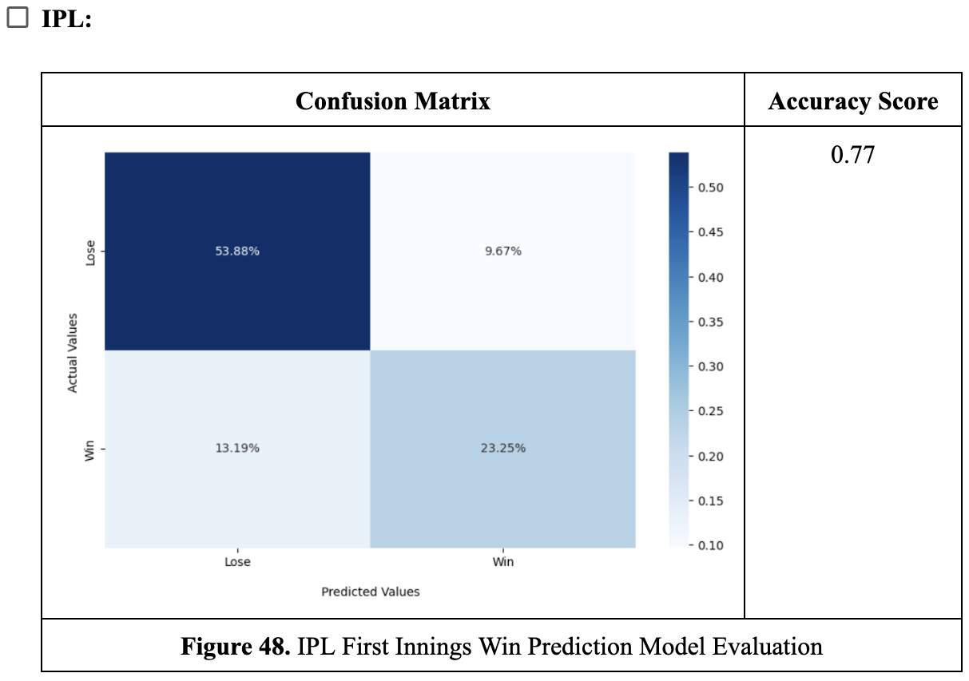
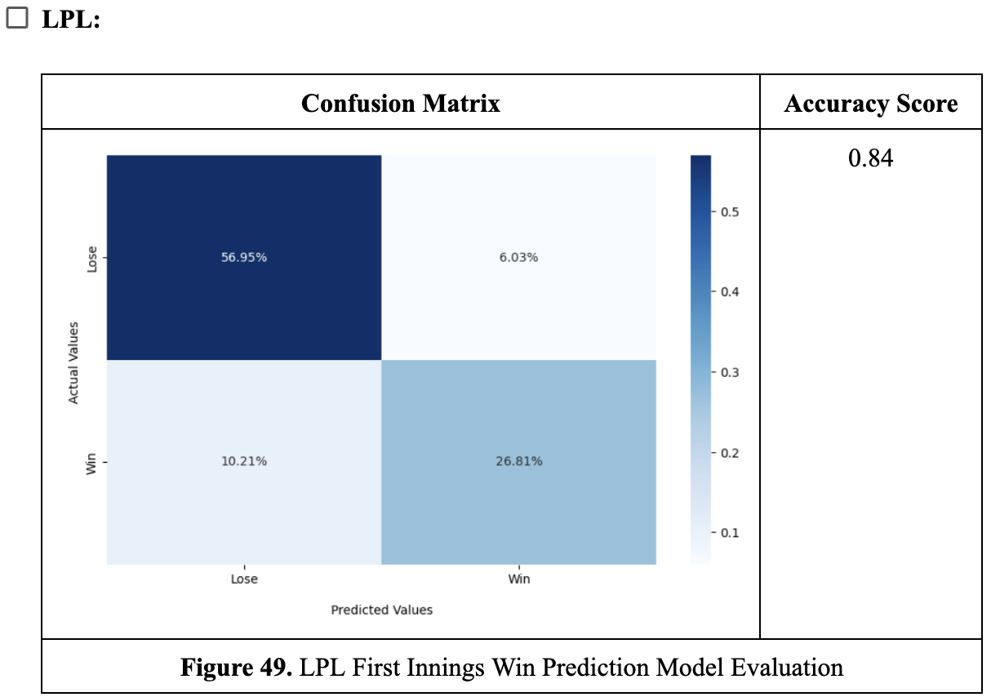
Results of Previous Works

Slide 14
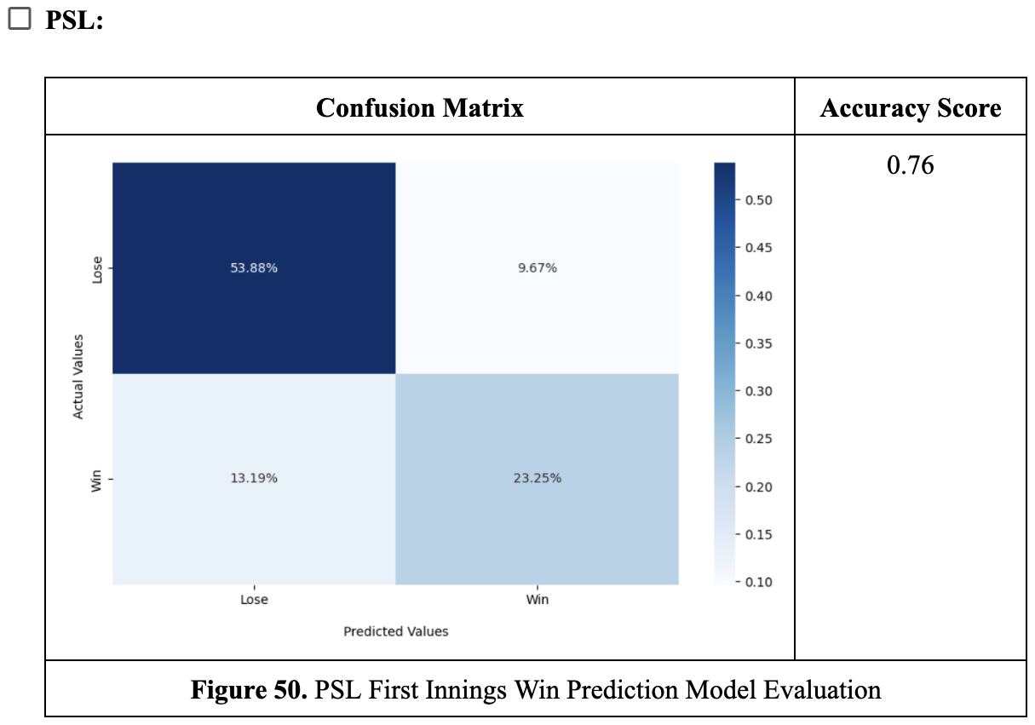
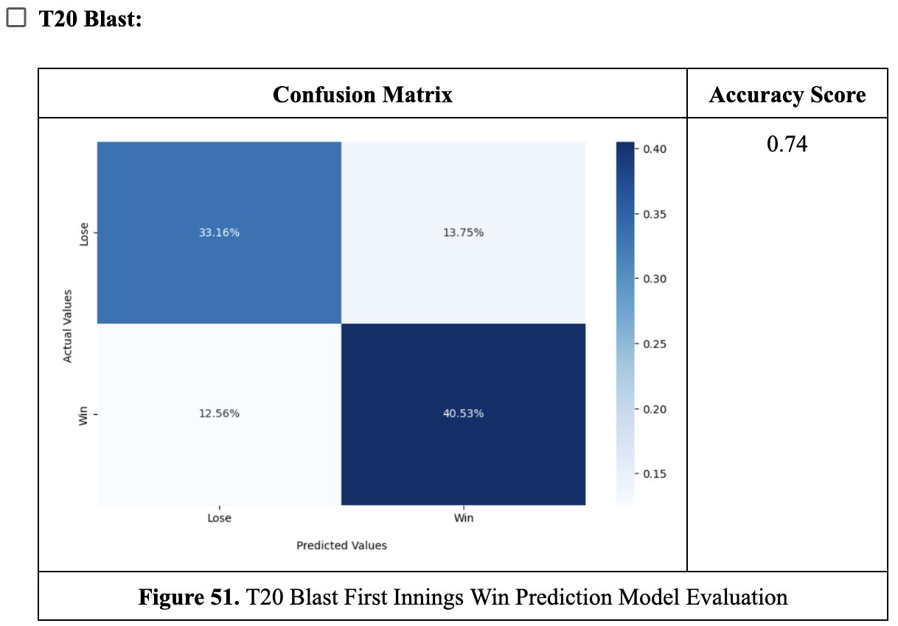
Results of Previous Works

Slide 15

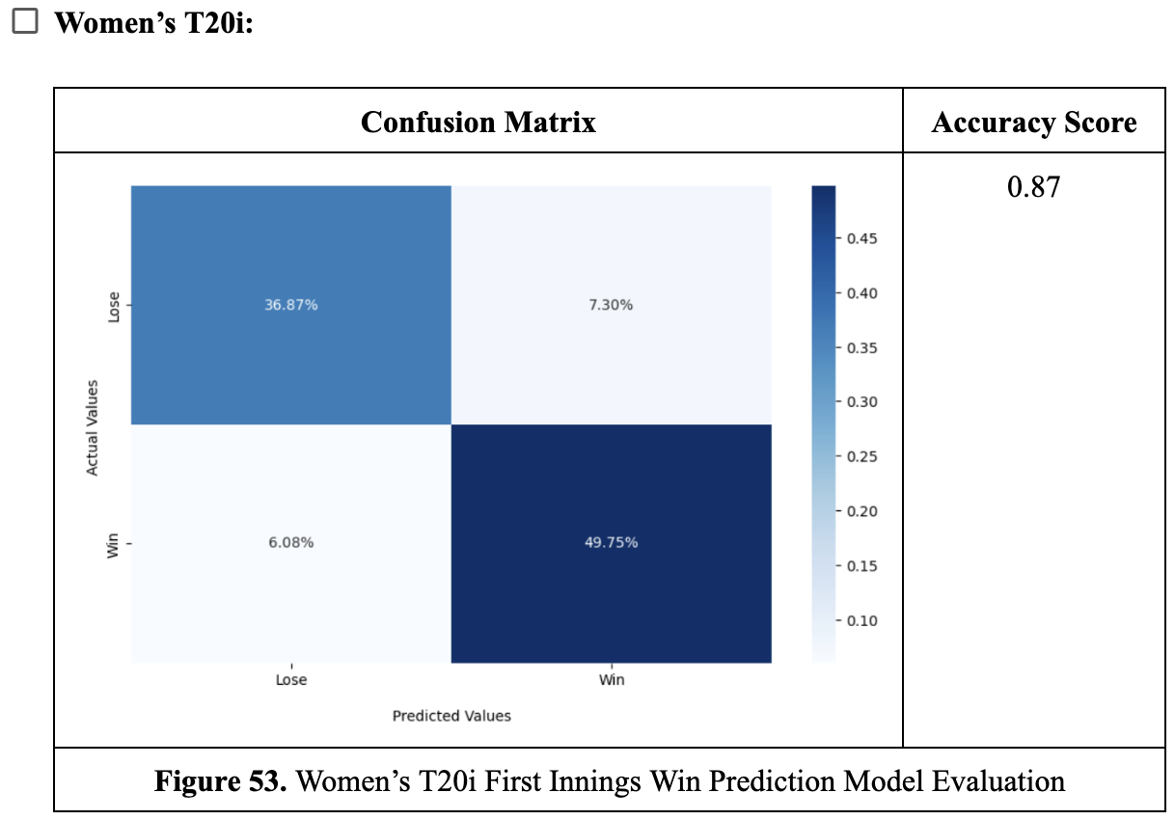
Results of Previous Works

Slide 16
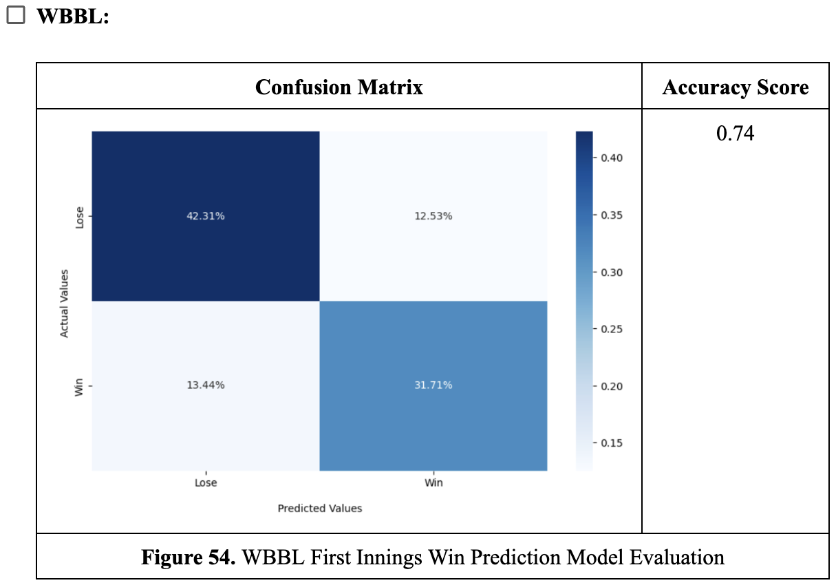
Results of Previous Works

Slide 17


Results of Previous Works
Second Innings Win Prediction Models

Slide 18
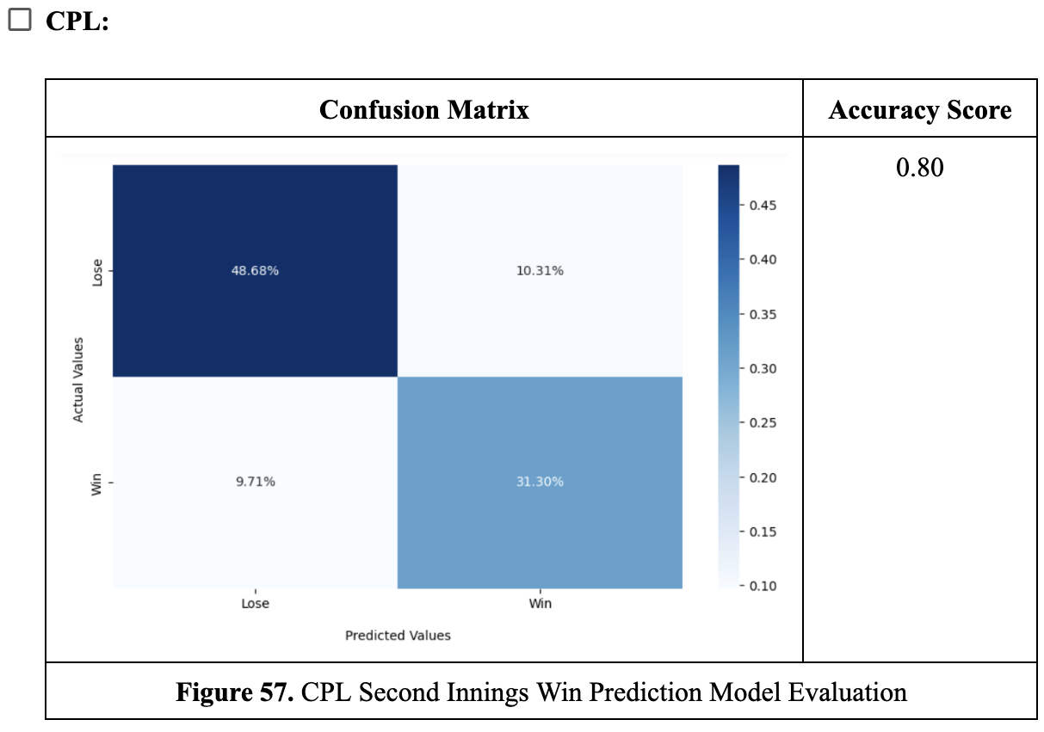
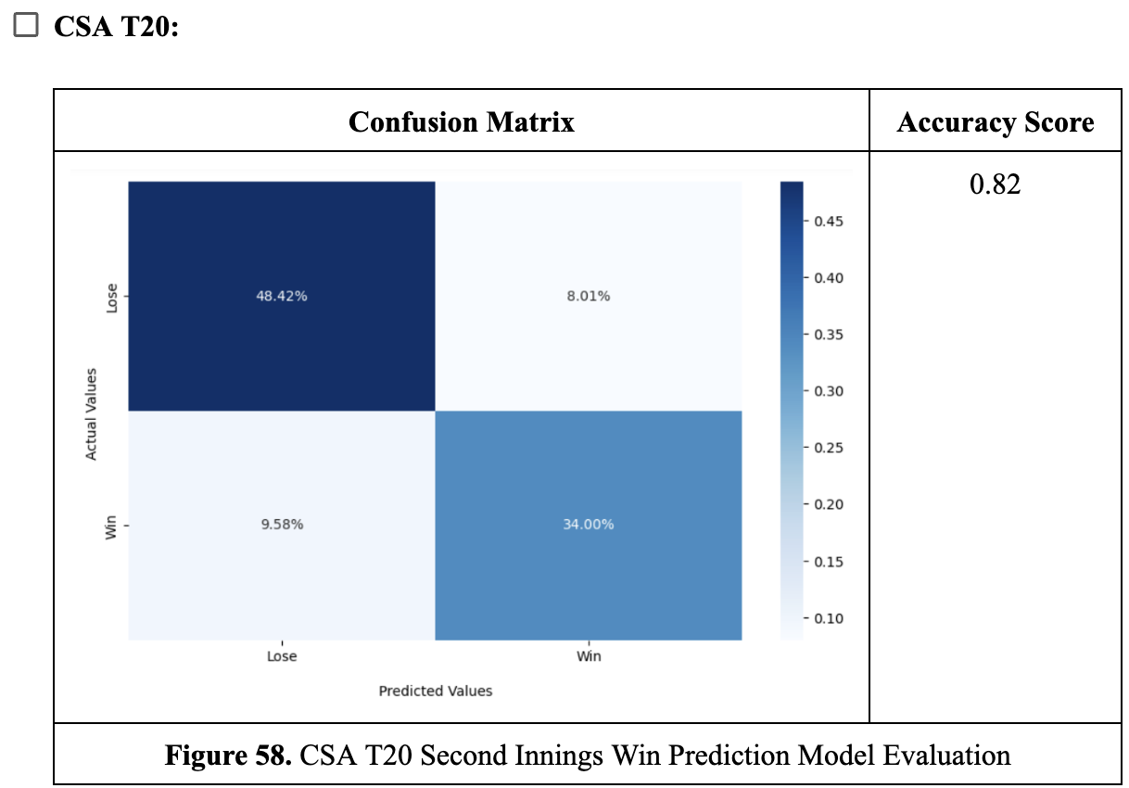
Results of Previous Works

Slide 19
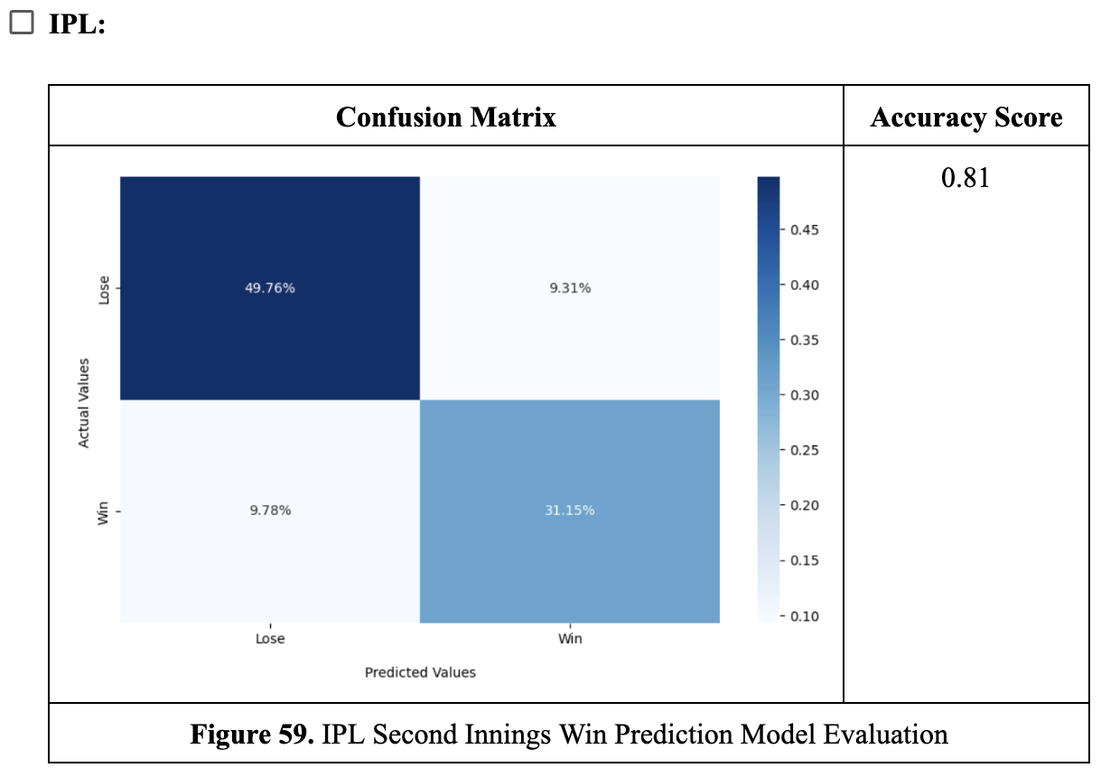
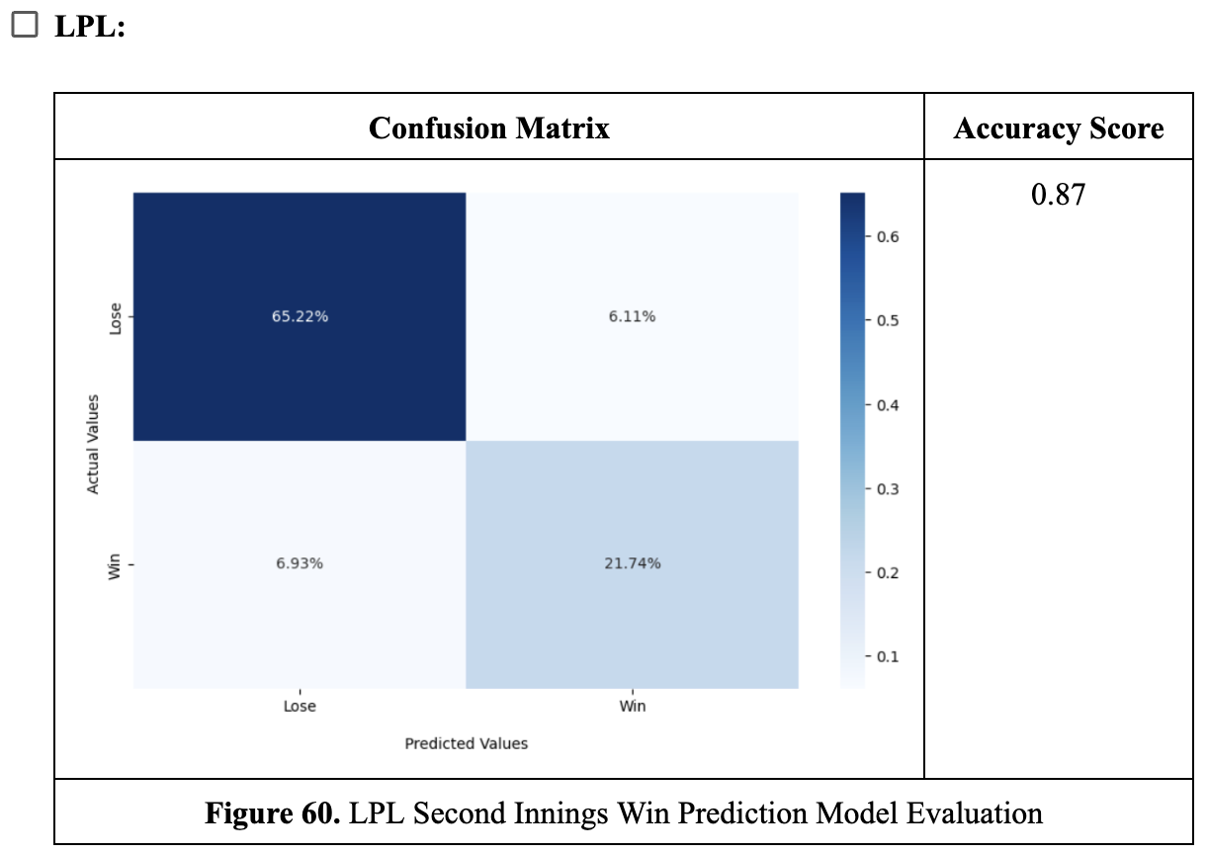
Results of Previous Works

Slide 20
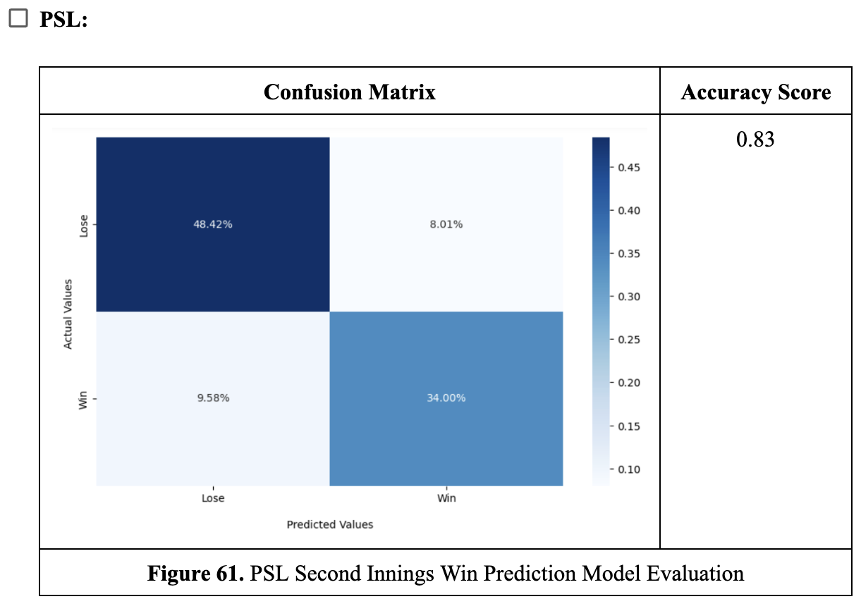

Results of Previous Works

Slide 21

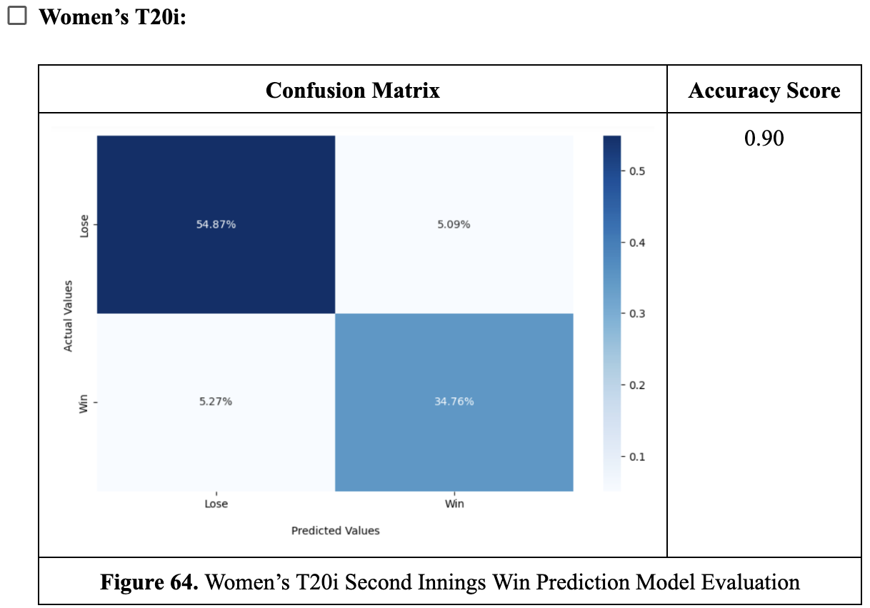
Results of Previous Works

Slide 22

Results of Previous Works

Slide 23
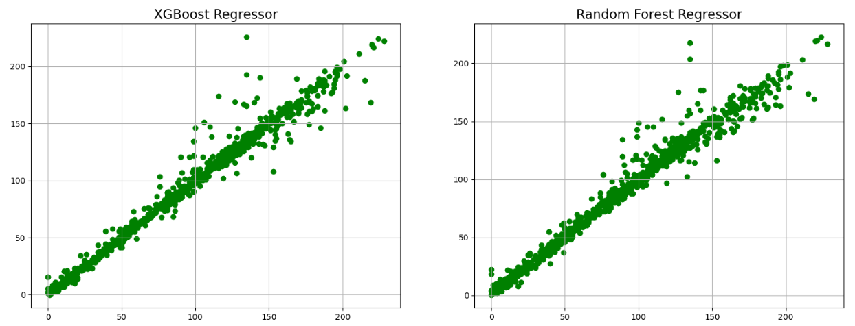
Result of Recent Work
Men’s Super Smash
First Innings Score Prediction Model

Slide 24
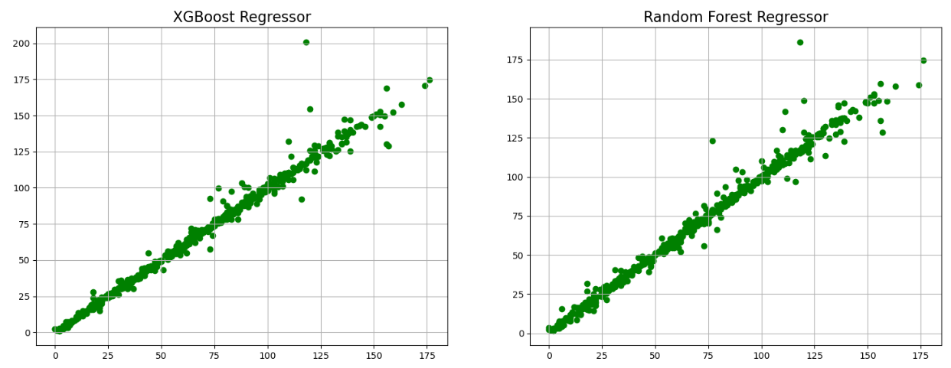
Result of Recent Work
Women’s Super Smash
First Innings Score Prediction Model

Slide 25
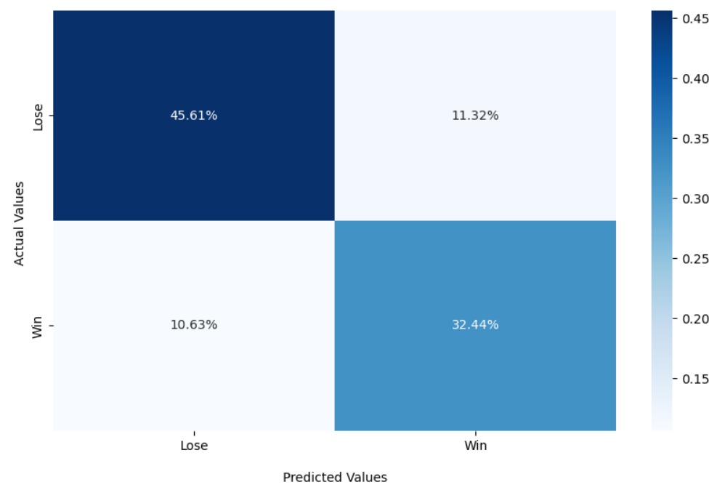
Result of Recent Work
Men’s Super Smash

Slide 26
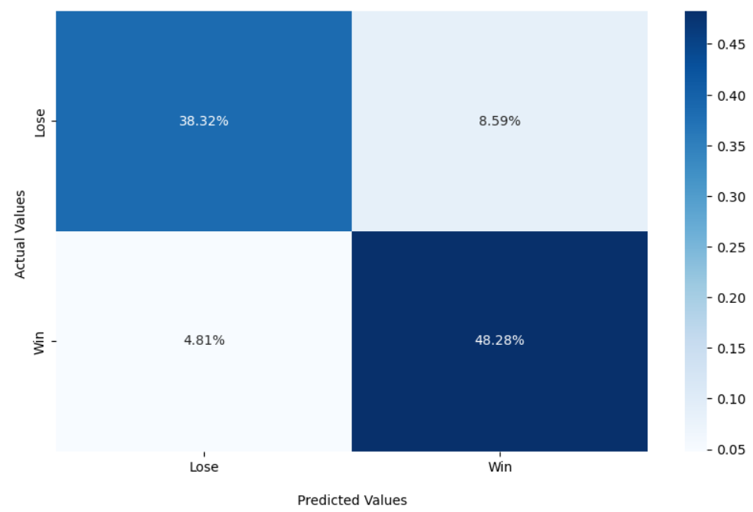
Result of Recent Work
Women’s Super Smash

Slide 27
Result of recent work
Men’s Super Smash score prediction
Women’s Super Smash score prediction
Xgboost Regressor |  | Random Forest Regressor
R2 Score | MAE | R2 Score | MAE
0.98 | 3.75 | 0.97 | 4.55
Xgboost Regressor |  | Random Forest Regressor
R2 Score | MAE | R2 Score | MAE
0.98 | 2.14 | 0.98 | 2.38

Slide 28


Result of recent work
Men’s Super Smash First Innings
Women’s Super Smash First Innings
Accuracy Score
0.78
Accuracy Score
0.87

Slide 29
Result of recent work
Men’s Super Smash Second Innings
Women’s Super Smash Second Innings
Accuracy Score
0.84
Accuracy Score
0.89

Slide 30
Thanks

