Slide 1


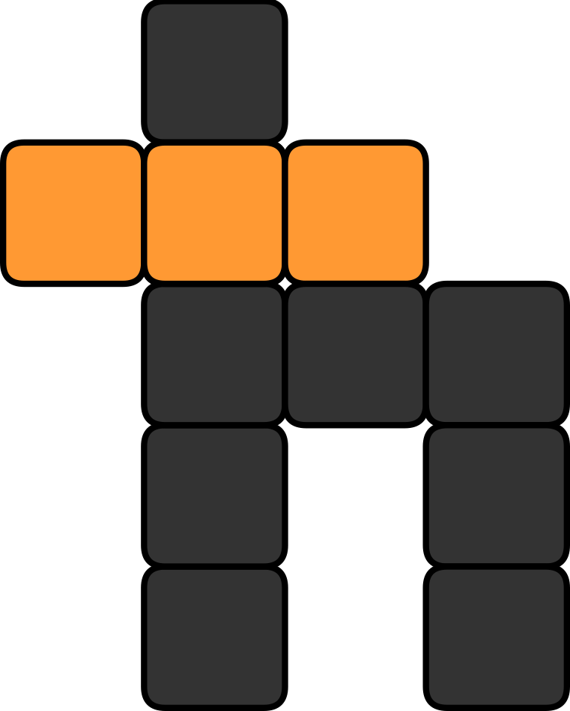
Jin-Guo Liu (刘金国)
IOP (中科院物理所)
<cacate0129@iphy.ac.cn>
Your Own Photo
Rank my talk
Scan using wechat
1 RBM: worst
10 RBM: best
Your Own Wechat Barcode for Payment
Research field:
Tensor network
Machine learning
Quantum circuit
My expertise is:
I got my eyes on:
Combinatorial optimization
Software engineering
Quantum generative modeling
Supported by num.v2nobel.com

