Slide 1
Ladies That Code
Lesson 3: SQL (continued)

Slide 2


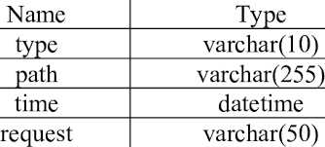
SQL Dates
DATE: YYYY-MM-DD
DATETIME: YYYY-MM-DD HH:MI:SS
SMALLDATETIME: YYYY-MM-DD HH:MM:SS
TIMESTAMP: a unique number
Notes:
be sure that the format of the date you are trying to insert, matches the format of the date column in the database
you can compare two dates easily if there is no time component involved!
to keep your queries simple and easy to maintain, do not allow time components in your dates!
What are dates being used for (example)

Slide 3
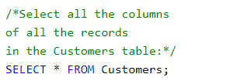

Comments
Single Line
Multi Line

Slide 4

Null Values
A field with a NULL value is a field with no value.
If a field in a table is optional, then it will be saved with a NULL value if no value is provided.
Note: A NULL value is different from a zero value or a field that contains spaces. A field with a NULL value is one that has been left blank during record creation!
NULL values cannot be tested with comparison operators (=, <, or <>).

Slide 5
SELECT
SELECT Statement
SELECT DISTINCT Statement
SELECT TOP Statement

Slide 6


SELECT Statement
The SELECT statement is used to select data from a database.
The data returned is stored in a result table, called the result-set.

Slide 7

SELECT DISTINCT Statement
The SELECT DISTINCT statement is used to return only distinct (different) values.
Inside a table, a column often contains many duplicate values; and sometimes you only want to list the different (distinct) values.
Notes:
Distinct:
Gets different values
Used for when there are duplicates

Slide 8

SELECT TOP Clause
The SELECT TOP clause is used to specify the number of records to return.
The SELECT TOP clause is useful on large tables with thousands of records. Returning a large number of records can impact performance.
Notes:
Top:
Gets top values
Useful in large tables

Slide 9

WHERE Clause
The WHERE clause is used to filter records.
It extracts the records that fulfill a specified condition only.
The WHERE clause is not only used in SELECT statement, but also in UPDATE and DELETE statements etc.
Use IS NULL and IS NOT NULL operators instead.

Slide 10
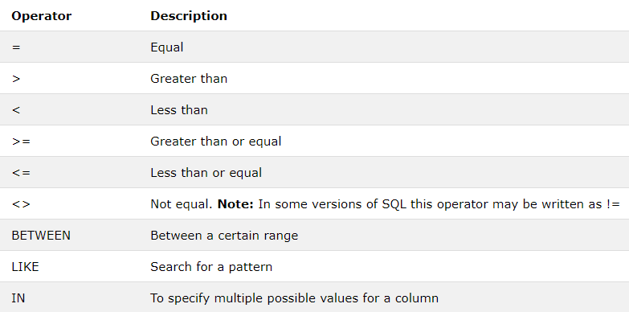
Operators in the WHERE clause

Slide 11
AND, OR and NOT Operators
Combines a series of WHERE clauses
They filter records based on more than one condition
AND displays a record if all the conditions separated by AND are TRUE.
OR displays a record if any of the conditions separated by OR is TRUE.
NOT displays a record if the condition(s) is NOT TRUE.

Slide 12

AND

Slide 13

OR

Slide 14

NOT

Slide 15

ORDER BY Keyword
ORDER BY sorts the result-set in an ascending or descending order.
By default, the ORDER BY keyword sorts the records in ascending order. Use the DESC keyword to order the records in descending order.

Slide 16

ORDER BY Syntax

Slide 17

INSERT INTO Statement
The INSERT INTO statement is used to insert new records in a table.
The ID column in any table is usually an auto-increment field. This means that it will be automatically generated when a new record is inserted into the table.

Slide 18
SQL Injection
SQL injection is a code injection technique that might destroy your database.
SQL injection is one of the most common web hacking techniques.
SQL injection is the placement of malicious code in SQL statements, via web page input.
SQL injection usually occurs when you ask a user for input, like their username/user id, and instead of a name/id, the user gives you an SQL statement that you will unknowingly run on your database.

Slide 19

SQL Injection Examples (1)
Expected UserID
1 = 1: TRUE

Slide 20
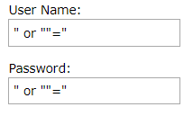

SQL Injection Examples (2)
“” = “”: TRUE
Batch Statements

Slide 21
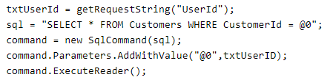
SQL Injection Prevention

Slide 22
Links
Reference: https://www.w3schools.com/sql/default.asp
Exercises: https://www.w3resource.com/sql-exercises/
Do exercise number: 1, 6, 7 and 8

Slide 23
Next Lesson
SQL Update/Delete
SQL Min and Max
SQL Count, Avg, Sum
SQL Like
SQL Wildcards
SQL In
SQL Between
SQL Select Into
SQL Insert Into Select

Slide 24
The End
Q & A?

