Slide 1
SQL Lesson 5
Janine Lodewick

Slide 2
Today’s lesson
Lesson 4 data recap
SQL Aliases
SQL Joins
SQL Inner Join
SQL Left Join
SQL Right Join
SQL Full Join
SQL Self Join
SQL Group By
SQL Null Functions

Slide 3
From lesson 4
CREATE database ltc;
CREATE TABLE ltc.Students (
StudentId INT NOT NULL AUTO_INCREMENT PRIMARY KEY,
StudentName VARCHAR(255) NOT NULL,
Grade INT NOT NULL,
TermMark INT NOT NULL);
INSERT INTO ltc.Students(StudentName, Grade, TermMark)
VALUES ('Jerry Smith', 3, 95),
('Kelly Miller', 4, 60 ),
('Frankie Joseph', 3, 20 ),
('Jenna Miller', 5, 50),
('Raj Patel', 5, 75 ),
('Susan White', 4, 80),
('Polly Summers', 3, 90);

Slide 4
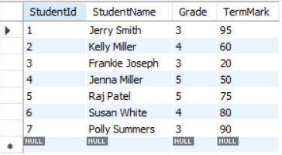
From lesson 4
SELECT * FROM ltc.Students

Slide 5
Let’s add teachers
CREATE TABLE ltc.Teachers (
TeacherId INT NOT NULL AUTO_INCREMENT PRIMARY KEY,
Name VARCHAR(255) NOT NULL,
Grade INT NOT NULL);
INSERT INTO ltc.Teachers(Name, Grade)
VALUES ('Mrs Dlamini', 4),
('Mr Moodley', 5),
('Mrs Pillay', 6),
('Mr Bones', 7),
('Mrs Mbali', 8);

Slide 6
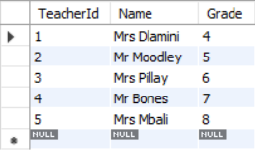
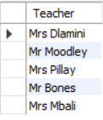
ALIASes
SELECT * FROM ltc.teachers
SELECT Name as Teacher FROM ltc.teachers

Slide 7
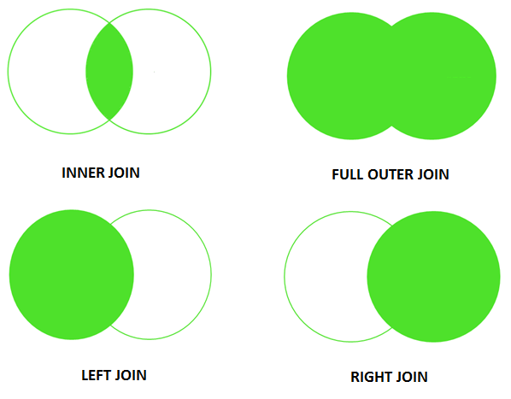
joins

Slide 8
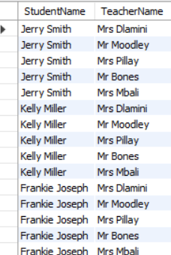
JOINs
SELECT StudentName, Name AS TeacherName
FROM ltc.Students, ltc.Teachers

Slide 9
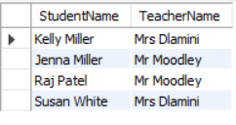
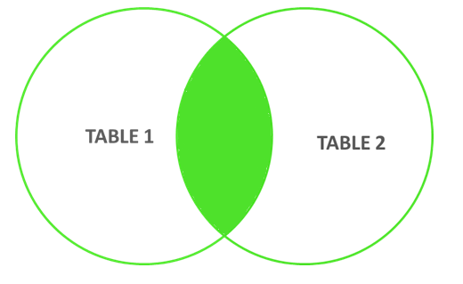
JOINs
SELECT StudentName, Name AS TeacherName
FROM ltc.Students, ltc.Teachers
WHERE ltc.students.Grade = ltc.Teachers.Grade

Slide 10
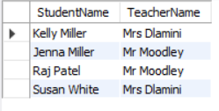
Inner join
SELECT StudentName, Name AS TeacherName
FROM ltc.Students
INNER JOIN ltc.Teachers
ON ltc.students.Grade = ltc.Teachers.Grade

Slide 11
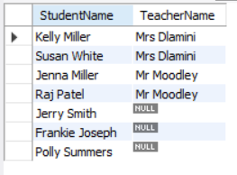
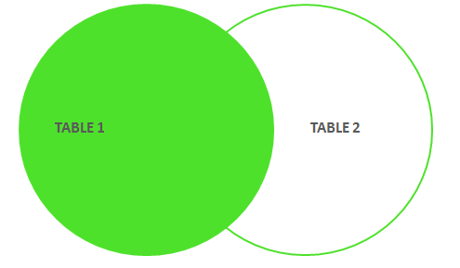
Left join
SELECT StudentName, Name AS TeacherName
FROM ltc.Students
LEFT JOIN ltc.Teachers
ON ltc.students.Grade = ltc.Teachers.Grade

Slide 12
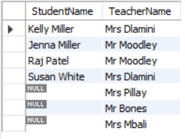
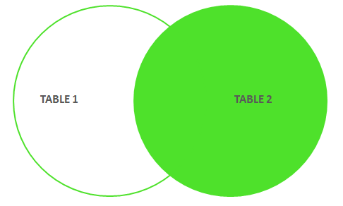
Right join
SELECT StudentName, Name AS TeacherName
FROM ltc.Students
RIGHT JOIN ltc.Teachers
ON ltc.students.Grade = ltc.Teachers.Grade

Slide 13
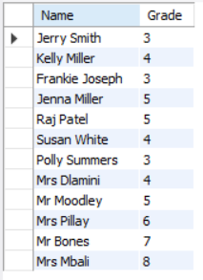

FULL join / union
SELECT StudentName AS Name, Grade
FROM ltc.Students
UNION
SELECT Name, Grade
FROM ltc.Teachers

Slide 14
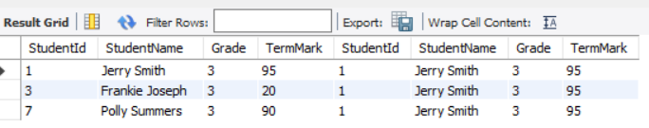
Self join
SELECT *
FROM ltc.students AS grd3Students
LEFT JOIN ltc.Students AS studentJerry
ON grd3Students.Grade = studentJerry.Grade
WHERE studentJerry.StudentName = 'Jerry Smith'

Slide 15

Group by
SELECT Count(*) AS NumberOfStudents
FROM ltc.Students

Slide 16
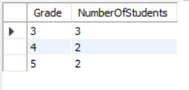
Group by
SELECT Grade, Count(*) AS NumberOfStudents
FROM ltc.Students
GROUP BY Grade

Slide 17
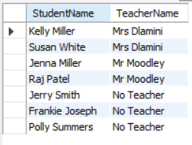
Null functions
SELECT StudentName, Name AS TeacherName
FROM ltc.Students
LEFT JOIN ltc.Teachers
ON ltc.students.Grade = ltc.Teachers.Grade
SELECT StudentName, IFNULL(Name, 'No Teacher') AS TeacherName
FROM ltc.Students
LEFT JOIN ltc.Teachers
ON ltc.students.Grade = ltc.Teachers.Grade

Slide 18
Questions?

