Slide 1

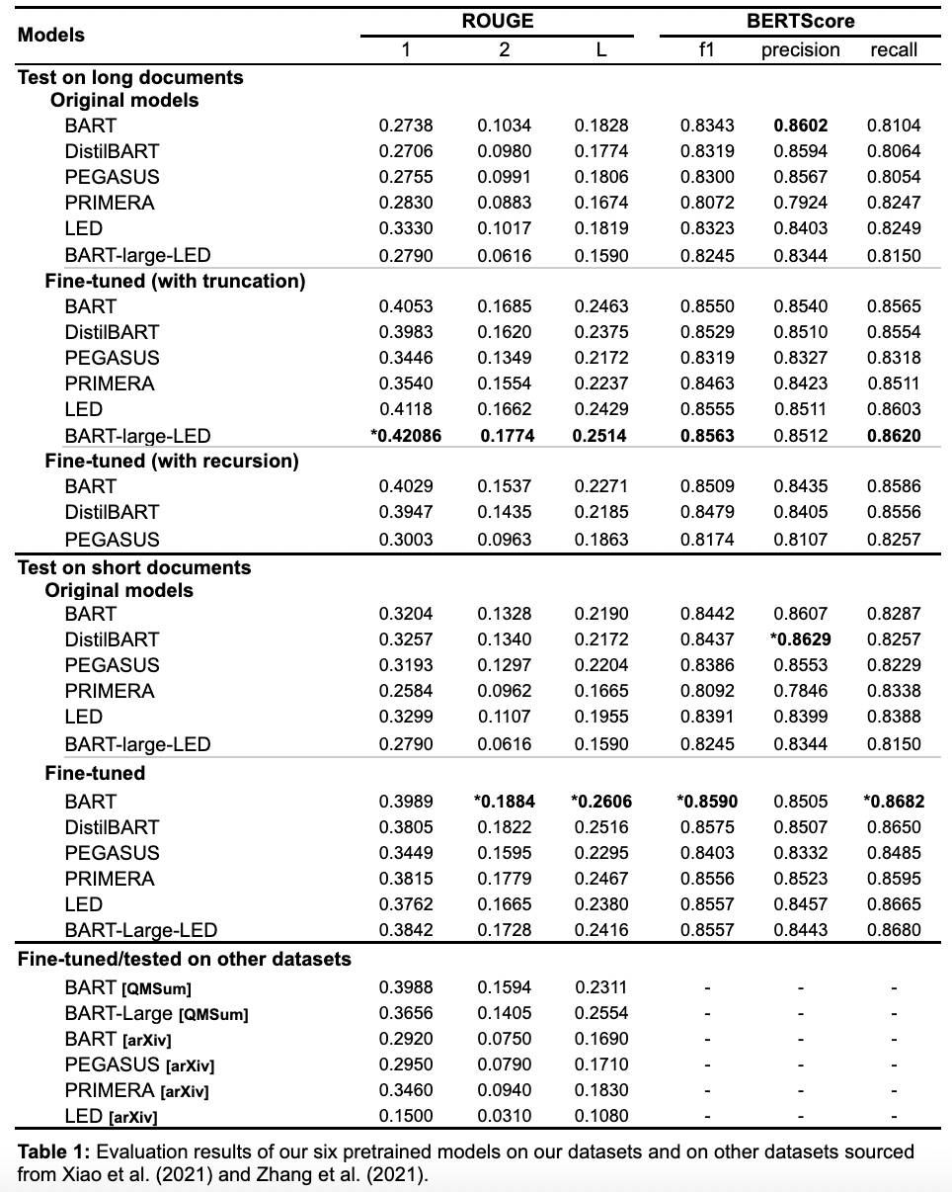
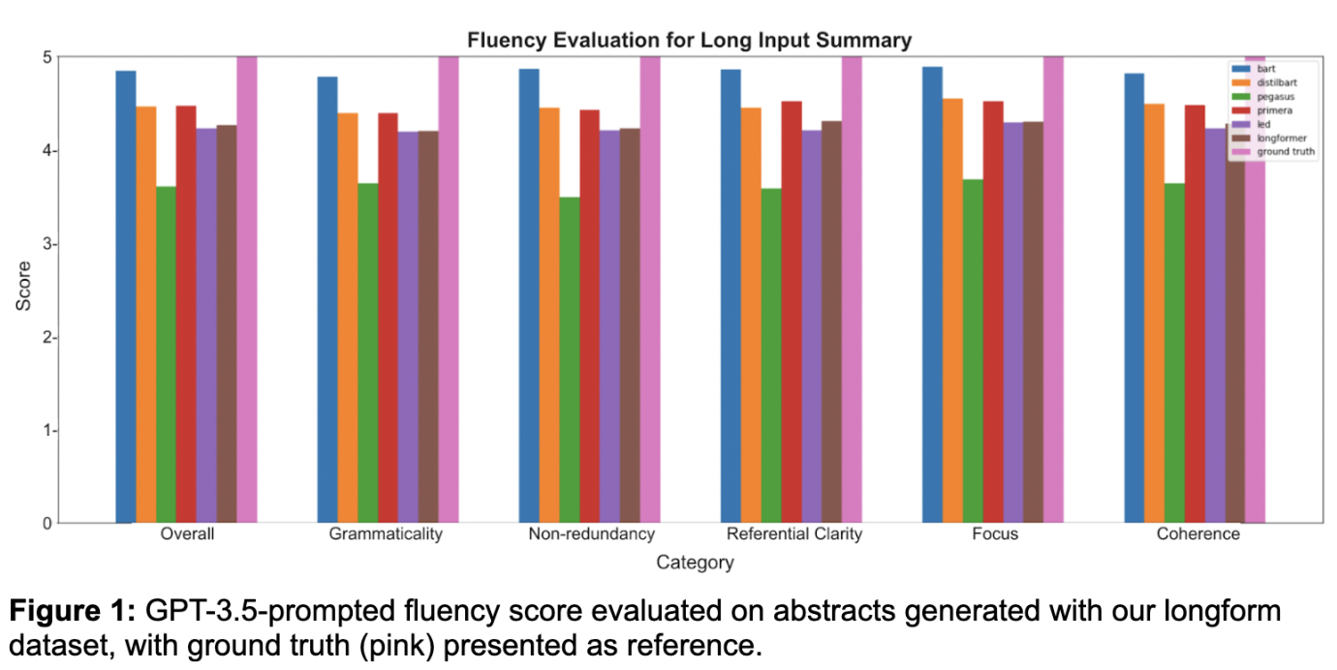
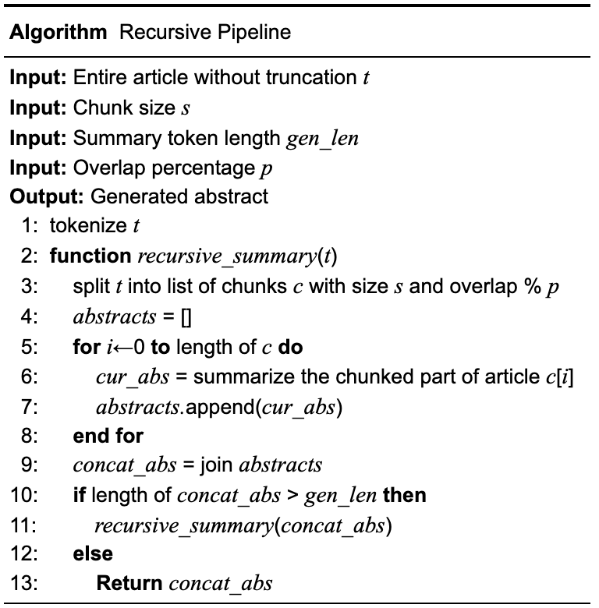
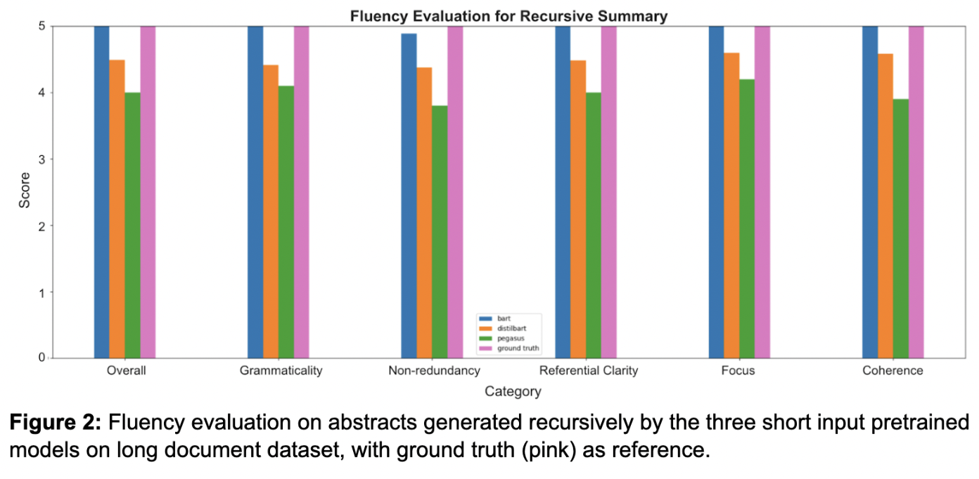
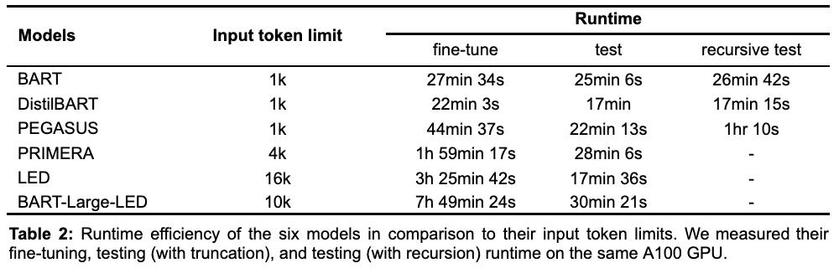
Automatic Summarization for Long Biomedical Documents
Research Questions
1
2
Recursive Summarization
Automatic Fluency Metric
Chung-Fan Tsai (tsai1@uni-potsdam.de)
Supervisor: Lisa Raithel from DFKI (lisa.raithel@dfki.de)
https://github.com/Gigi1111/Recursive-Summarization-for-Long-Biomedical-Documents
Instead of developing longer input models,
can we efficiently summarize texts longer than a model’s input limit?
Is there a cost-effective evaluation metric
that judges summaries beyond its extractive capability?
Previous studies often adopt truncation when summarizing long texts that exceed a model’s input limit, which forces models to summarize only with partial text.
Alternatively, we see the non-stop development of models with longer input limit. However, is it necessary and is it efficient and accessible for projects with less computing resources?
To gain an overview on short and long input models’ performance and runtime, we compare 3 summarization methods: (1) full article summary without truncation using long input models, (2) partial article summary with truncation, and (3) recursive summary using full article.
For the comparison, we devised a recursive pipeline that allows short input models to recursively summarize chunks of articles that fit the input limit of the model. Each chunk is designed to have a percentage of overlap with its previous and next chunks, ensuring cohesion and coherence in the generated abstracts. Note that we found the best overlap to be 20% with hyperparameter tuning.
In summarization tasks, ROUGE has historically been adopted as the main, sometimes even the only, metric, despite many studies highlighting its imitations, notably its inability to assess semantic coherence and fluency (Akter et al., 2022). While additional metrics such as BERTscore have been adopted, they are still incapable of capturing the aspects of paraphrasing and abstraction (Zhang et al., 2019; Yuan et al., 2021).
Until now, manual evaluation has been essential to mitigate such oversights, despite its high cost and ongoing issues with reproducibility and tunability (Han et al., 2021). Recent studies have shown that GPT models can rank generated texts in a way that closely resembles human evaluation (Meyer et al., 2022; Sottana et al., 2023).
To encourage research projects with limited time and funding, and to allow reproducibility and flexibility, we propose a GPT prompted fluency metric according to the five criteria outlined by the Document Understanding Conference (Dang et al., 2007): grammaticality non-redundancy, referential clarity, focus, and structure & coherence. Moreover, we conducted cost analysis to show how affordable it is, and our manual fluency evaluation on sampled abstracts also shows (1) disparity among evaluators and (2) the general alignment of GPT to human scores.
bart
distilbart
pegasus
primera
led
longformer
ground truth
bart
distilbart
pegasus
ground truth

