Slide 1
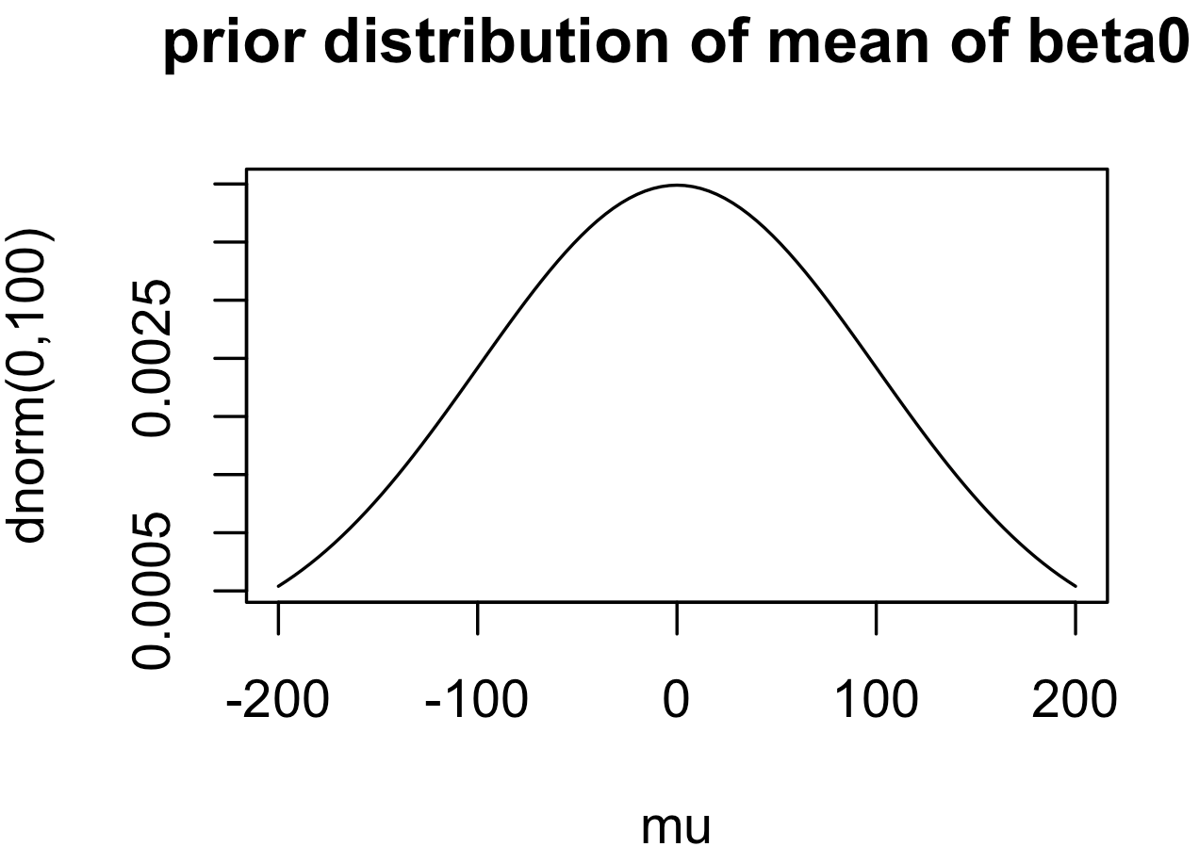
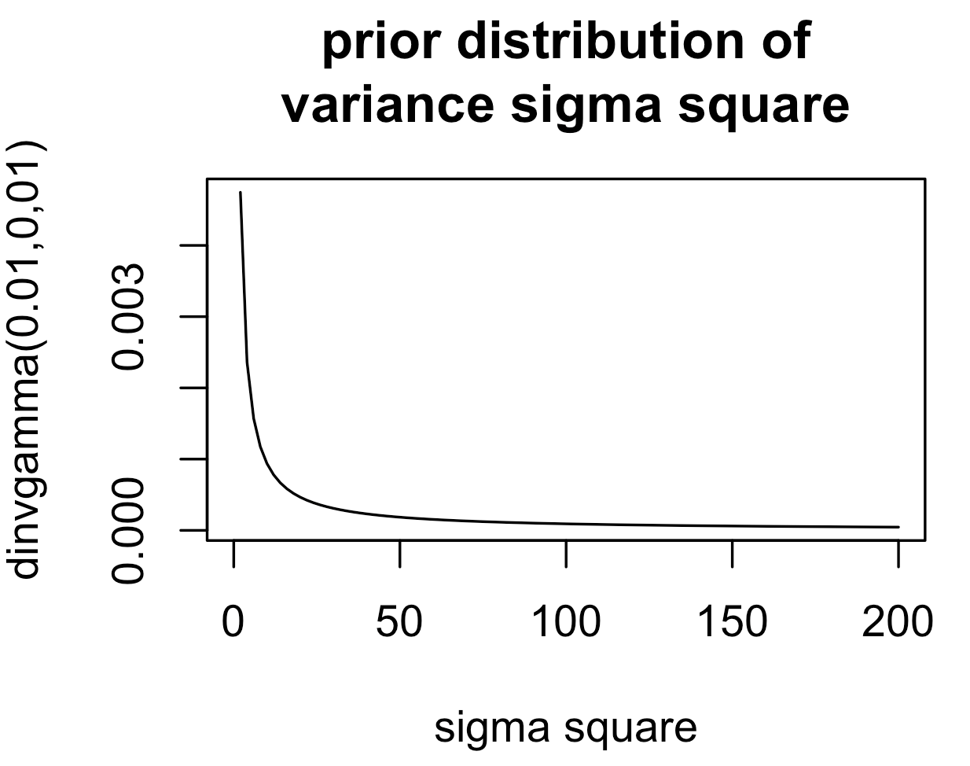
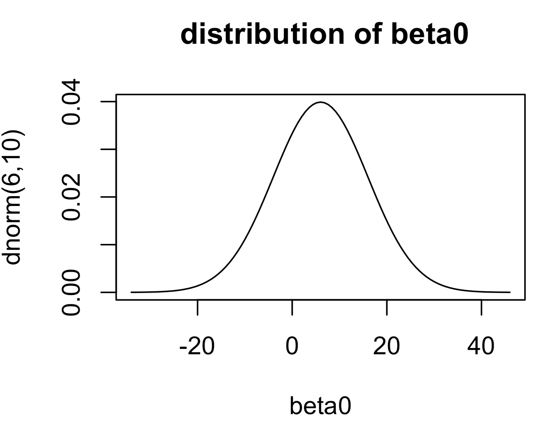
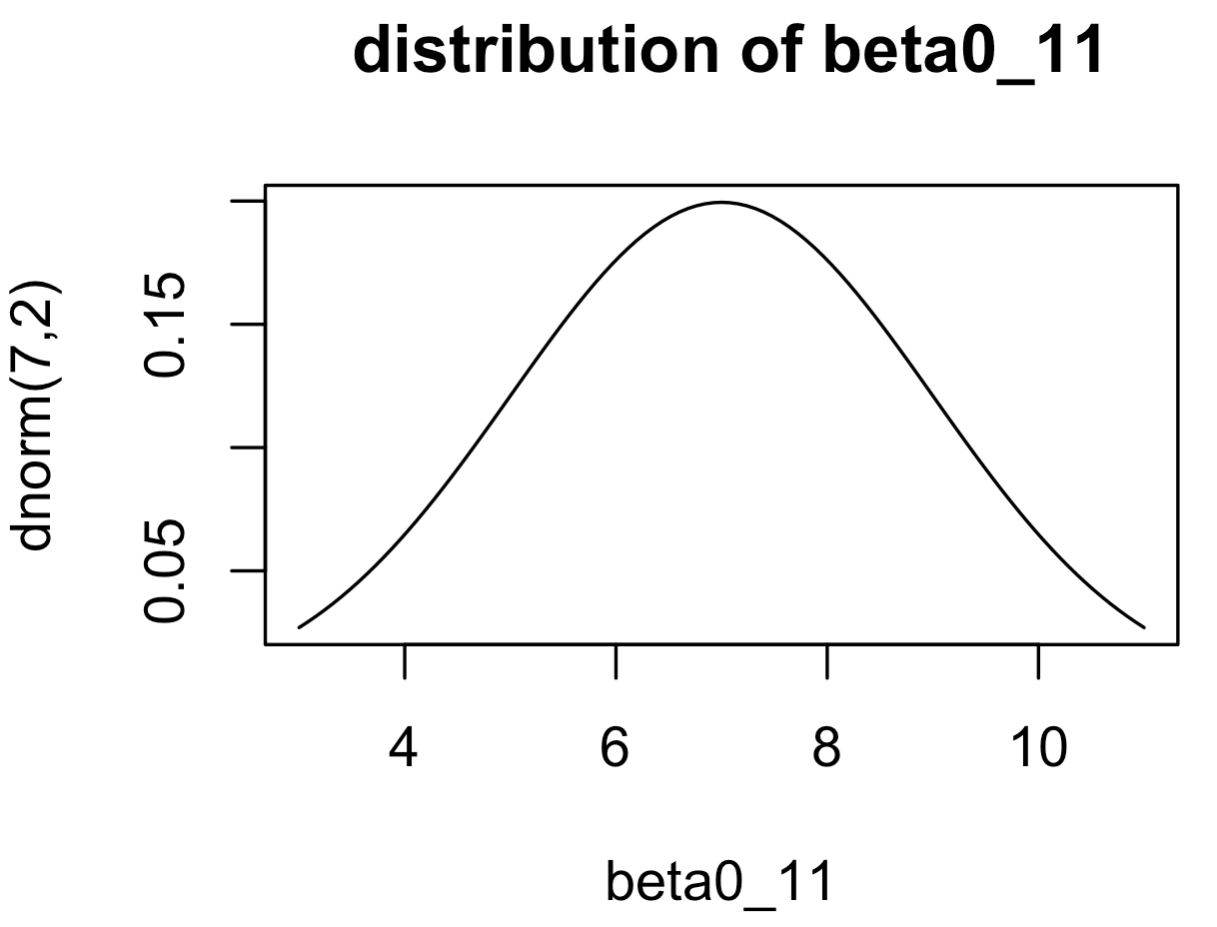
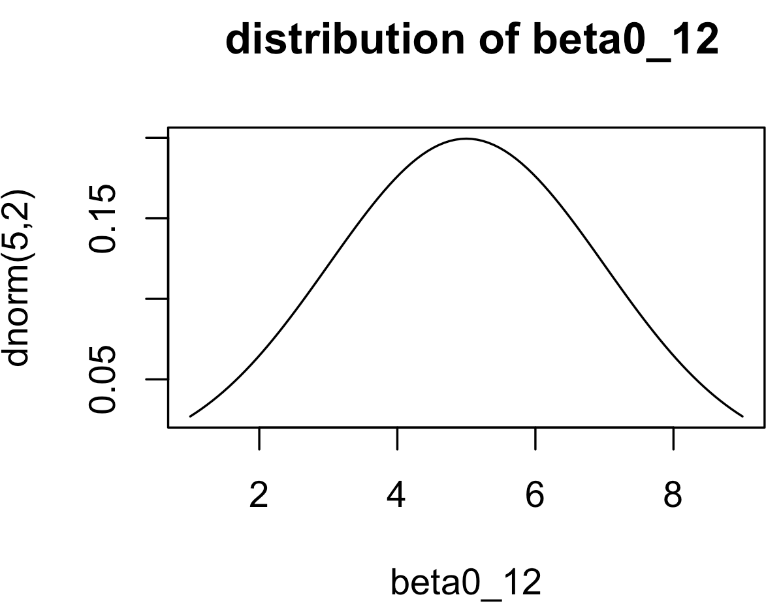
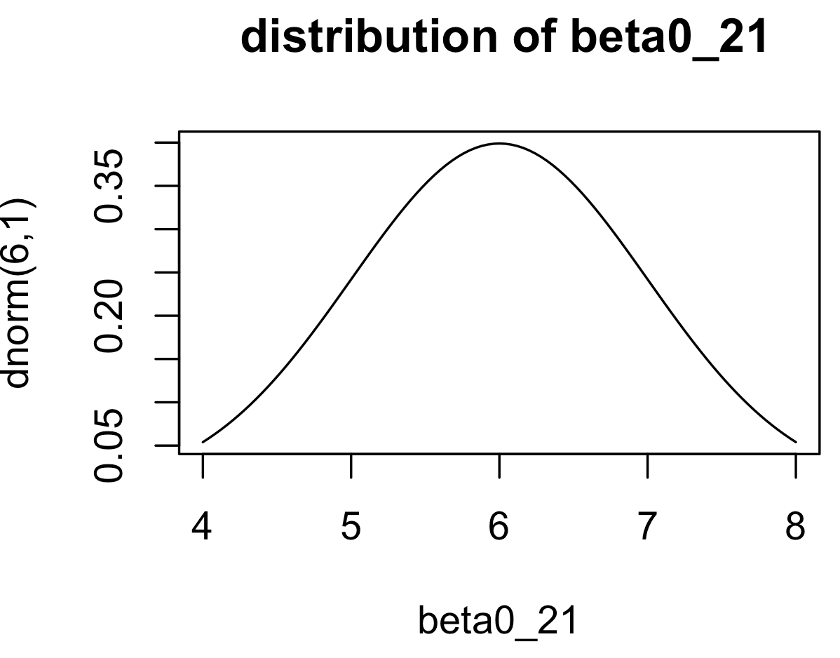
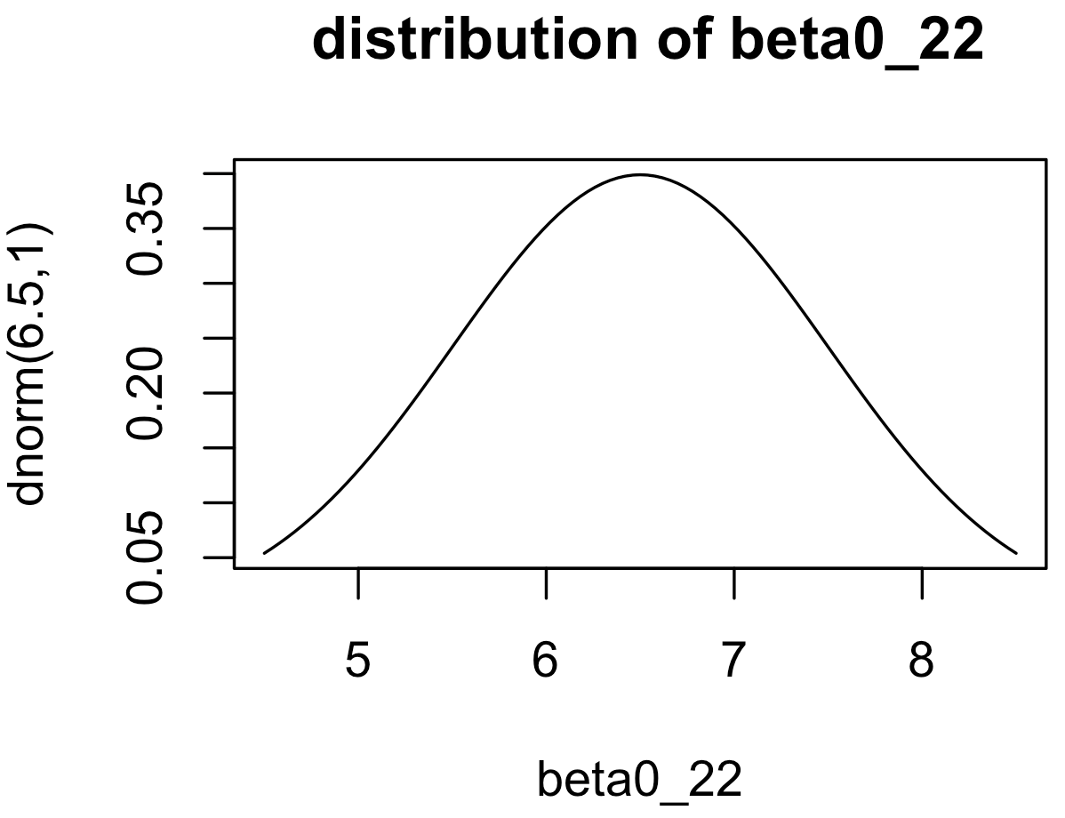
priors
population level
subject level
posterior
distributions

Slide 2
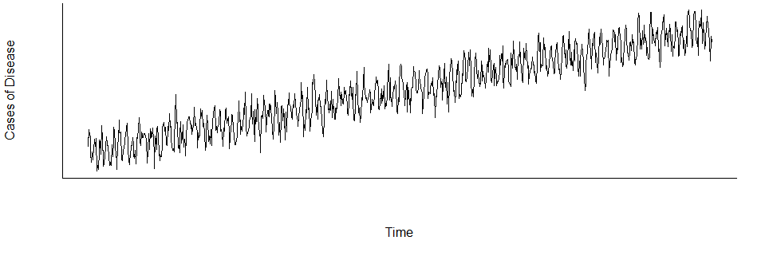
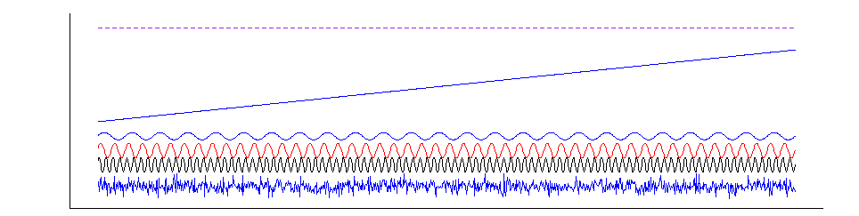

Respiratory hospitalizations
$$=$$
Intercept
Trend
Influenza hospitalizations
RSV hospitalizations
Seasonal fluctuation
Random noise
Courtesy of Dan’s lecture note
Notes:
To estimate RSV associated hospitalization, we disentangle signals from the time-series of Respiratory hospitalizations
Intercept- hospitalization risk in each group
Trend – change of health seeking behavior
Se
asonal fluctuation caused by different pathogens and reasons
Random noises

Slide 3
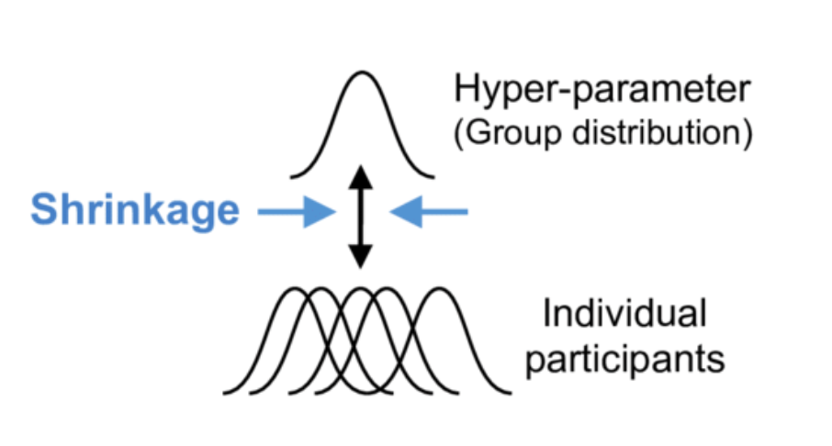
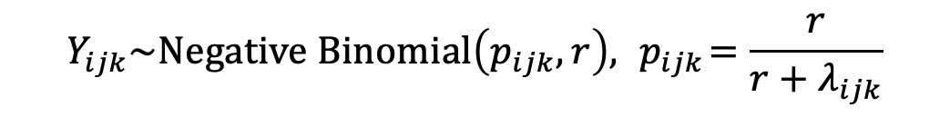
The model structure of our hierarchical Bayesian regression is given as:
$$Y_{ijk}\sim Negative Binomial\left(p_{ijk},r\right), { p}_{ijk}=\frac{r}{r+λ_{ijk}}$$
$$λ_{ijk}=β_{0jk}+α_{1g\left(i\right)}+α_{2m\left(i\right)}+β_{1jk}RSV_{ik}+β_{2g\left(i\right)jk}{Flu}_{ik}$$
groups
Intercept
yearly variations
monthly variations
group-specific effect of RSV
group-specific effect of flu
(varies by epidemiologic year)
RSV hospitalizations in children < 2 years old
time i
age group j
SES group k
Notes:
We estimated the age- and SES-specific incidence of RSV hospitalizations.
𝑌_𝑖𝑗𝑘 denotes the number of all-cause respiratory hospitalizations at time i, in age group j, and SES group k
pools information across all groups leading to a reduction in uncertainty while still allowing for differences between groups.
; the expected value of $Y_{ijk}$ is $λ_{ijk}$;
We have the parameters capture …
The hierarchical structure provides advantages compared with fitting these models individually by group. The identity link ensures that each covariate has an additive, rather than a multiplicative, effect on the outcomes of interest [24, 25]. Monthly and yearly dummy variables were used to adjust for seasonality and temporal trends, respectively. Our model used seasonal dummy variables instead of polynomial time trends or sinusoidal curves because the seasonal dummy variable resulted in significantly improved model fit as measured by deviance information criterion (DIC) (Table S1) [17, 18, 26]. The model had a negative binomial likelihood and identity link.
The parameter $r>0$ serves as an overdispersion parameter with $r→∞$ indicating that the mean and variance are the same, as in a typical Poisson regression framework
$α_{1g\left(i\right)}$ represents an intercept term that varies by epidemiologic year, where g(i) is a function that maps time to epidemiologic year (defined from July in the previous year to June in the next year); $α_{2m\left(i\right)}$ represents a similar intercept term which varies by month, where m(i) is a function that maps time to the corresponding month category
age group j and SES group k

