Slide 1

BlockChain: Tendermint Logic simulation

Slide 2
Introduction to Tendermint This project Comparison with Tendermint Code Explanation Conclusion and future work
Table of contents:

Slide 3
Introduction to Tendermint
Tendermint is a software that can replicate applications securely and consistently across multiple machines. From a security perspective, even if 1/3 of the random nodes in a distributed system go down, Tendermint can still ensure that the distributed system operates normally. In addition, in terms of data consistency, the failed nodes can see the same transaction log and calculate the same state. Safe and consistent replication is a fundamental problem in distributed systems and plays a key role in many applications, such as monetary systems, elections, and infrastructure orchestration systems.
Distributed systems need to be able to tolerate nodes being offline or failing, which is called Byzantine fault tolerance. The Byzantine fault tolerance theory has a long history, and the successful implementation of blockchain technology, such as Bitcoin and Ethereum, has made the theory popular in the computer field. Blockchain technology focuses on the evolution of Byzantine fault tolerance by combining peer-to-peer (P2P) networks and cryptographic authentication. Transactions are batched into blocks, and each block is connected to the previous block through cryptographic hashing to form a chain, which is why the technology is named Blockchain.

Slide 4
Features of Tendermint
Tendermint Core:
This is Tendermint’s consensus engine. It functions on Proof of Stake (PoS), where a selected node from a validator set proposes the new block to be added to a blockchain. Other Validators must then vote before the block goes through. Multiple systems on Tendermint can view the same transactions at the same time and in the same order.Furthermore, since one cannot always detect malicious intent, Tendermint maintains security using Byzantine Fault Tolerance. BFT is a mechanism that allows for the Consensus to be resistant to up to ⅓ malicious nodes.
Application Blockchain Interface (ABCI):
This is the Tendermint toolkit of ready-to-use software for replicating or launching blockchains. Tendermint is unlike most major blockchains in that it has a modular architecture in contrast with the popular monolithic architecture. Its modular architecture makes it possible for a wide range of applications and their different languages to be integrated with the Tendermint core. ABCI is a major part of tendermint’s networking layer, a channel for all transactions and interactions. Any application Layer logic must go through to ABCI to reach the consensus engine. Furthermore, ABCI supports any programming language on application logic layers connected to it.

Slide 5
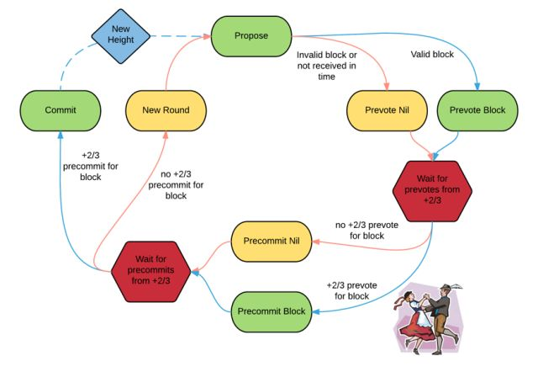
How Tendermint works
There are two roles in the protocol:
(1) Validator: a role or node in the protocol. Different validators have different powers in the voting process.
(2) Proposer: generated by validators in turn.
As can be seen from the figure, to successfully submit a block, two stages of voting must be performed, called pre-vote and pre-commit. When more than 2/3 of the validators have pre-committed the same block in the same round of proposals, the block will be submitted.
Due to reasons such as offline or network delays, the proposer may fail to propose a block. This situation is also allowed in Tendermint, because the validator will wait for a certain period of time before entering the next round of proposals to receive the block proposed by the proposer.

Slide 6
How Tendermint works
To summarize briefly, tendermint is mainly divided into three stages:
1.Propose: Select the proposer to broadcast the block.
2.Prevote: Validators check the block and vote.
3.Precommit: Submit the block after the vote is passed.

Slide 7
This project
This is a simplified Tendermint implementation, designed to allow for learning the tendermint workflow while exploring the Byzantine Fault Tolerant consensus mechanism.
The main goal of the project is to simulate the behavior of distributed nodes. Implement core consensus logic (proposal, pre-voting, submission). And support basic status updates and transaction pool functions.

Slide 8
Project architecture design
Network Layer
(src/network/p2p.py)
P2PNode(node1)
···
P2PNode(nodeN)
Network
Consensus Layer
(src/consensus/state_machine.py)
ValidatorSet
ConsensusState
···
ConsensusState
Message Handling
Byzantine Nodes
State Layer
(src/state/app.py)
StateStore
Mempool
SimpleApp
App State (key-value)
Blocks (committed)

Slide 9
Workflow of this project
ValidatorSet
User
Mempool
ConsensusState
Network
SimpleApp
StateStore

Slide 10
1.User submits transaction
Trigger point: User submits transaction to a node through the interface.
Module call:
Mempool.add_tx(tx):
Convert transaction object to JSON string and store it in txs list. Transaction pool manages storage and extraction of multiple transactions.
Output result: Transaction enters transaction pool and waits for proposer to package.
2. Propose Step
Trigger point: The proposer node of the current round.
Module call:
ConsensusState.broadcast_proposal():
Get transaction data from Mempool.get_txs() and generate a block.
Use compute_block_hash() to calculate the block hash and fill the block header.
Broadcast proposal message (Message type: propose).
Data flow:
The proposal message is propagated to other nodes through Network.send_message().
3. Prevote Step
Trigger point: The node receives a proposal message.
Module call:
ConsensusState.handle_propose():
Verify whether the height, round, and hash of the proposed block are correct. If legal, enter the prevote stage.
ConsensusState.broadcast_prevote():
If the block is legal, broadcast the Prevote message supporting the block. If the block is illegal, broadcast an empty Prevote message.
Data flow:
Prevote messages are broadcast via Network.send_message().
4. Precommit Step
Trigger point: The node receives enough pre-vote messages.
Module call:
ConsensusState.handle_prevote():
Collect pre-votes to determine whether 2/3 support a block. If the threshold is reached, enter the pre-vote phase.
ConsensusState.broadcast_precommit():
Broadcast the Precommit message for the block.
5. Block Commit (Commit Step)
Trigger point: The node receives enough commit vote messages.
Module call:
ConsensusState.handle_commit():
Call StateStore.commit_block() to commit the block to local storage.Call SimpleApp.apply_block() to update the state.
StateStore.commit_block():
Add the block to the blockchain storage.
Traverse the transactions in the block and update app_state.
Output result:
The block is successfully submitted and the system status update is completed.
Workflow of this project in detail

Slide 11
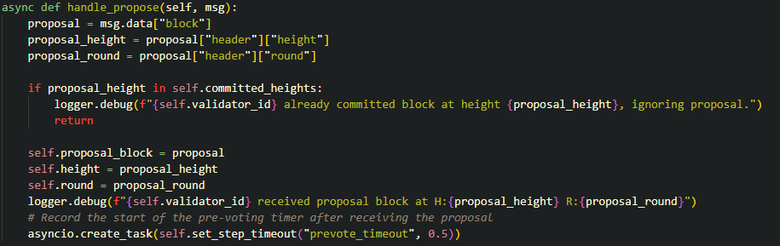
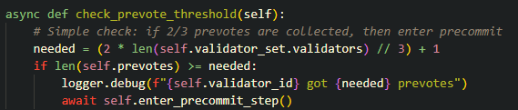
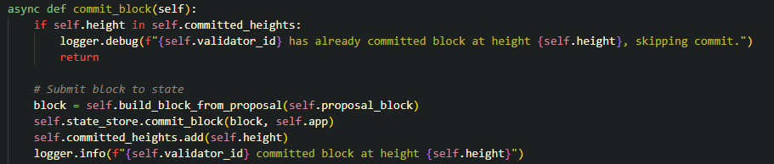
Module Introduction
ConsensusState: consensus state machine
(src/consensus/state_machine.py)
Core code functions
Implement the core logic of the consensus algorithm, including proposal, pre-voting, and submission voting.
Manage the current status of the node (height, height round, etc.).
Process received messages and advance the status according to the consensus logic.
State management:
Manage the current state of the node through the properties height, round and step.
Use proposal_block to temporarily store the proposed block, and prevotes and precommits to store votes.
Message processing:
handle_propose: Verify the proposed block and start the pre-voting stage.
handle_prevote: Process the pre-vote and check whether the voting threshold reaches 2/3.
handle_precommit: Check the submission vote and trigger the block submission.
State update:
commit_block: Submit the verified block to the state storage, update the node state, and enter the next height.

Slide 12
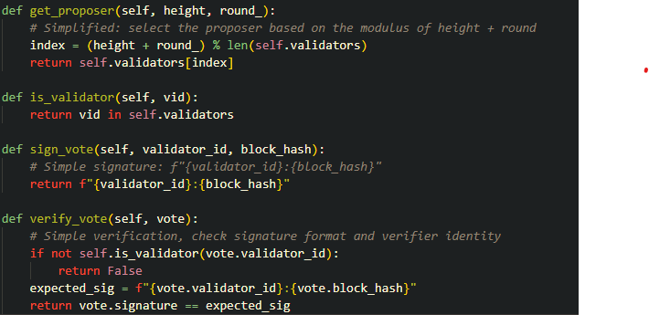
ValidatorSet: Validator Management (src/consensus/validator.py)
Core Code Functions
Proposer Selection:
Use height and round to calculate the current proposer.
Voting Signature and Verification:
Use sign_vote to generate a simple signature for the vote.
Use verify_vote to verify the legitimacy of the signature.

Slide 13
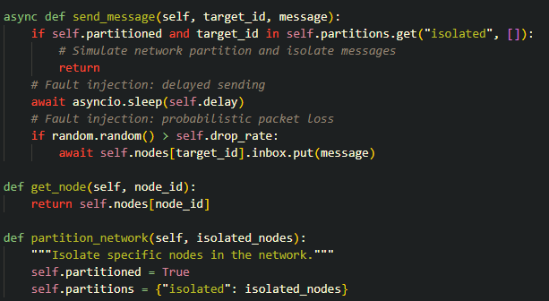
P2PNode & Network: Network simulation (src/network/p2p.py)
Core code functions
Message passing:
send_message simulates delay and packet loss behavior.
Each node receives messages through the inbox queue.
Network partitioning:
Supports isolating some nodes to prevent them from sending or receiving messages.

Slide 14
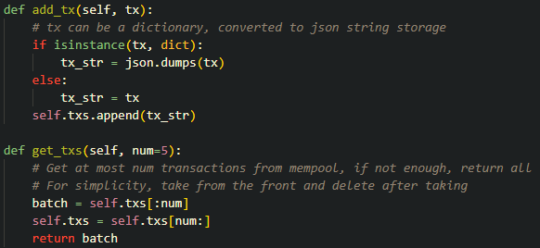
Mempool: Simple transaction pool (src/state/mempool.py)
Core code functions
Transaction management:
Supports adding transactions to the pool.
Extract a specified number of transactions from the pool for packaging.

Slide 15
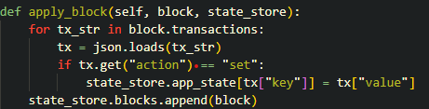
StateStore: State storage (src/state/store.py, src/state/app.py)
Core code functions
Block submission:
Write the block to the storage through commit_block.
Use apply_block to apply the transactions in the block to the state.

Slide 16
Comparison with Tendermint
Commonalities
Same core idea:
BFT consensus logic.
Modular design (separation of consensus and state).
Functional implementation:
Proposer selection logic.
Message processing and inter-node communication.
Differences
Unimplemented functions:
ABCI interface: does not provide a standard protocol between applications and consensus engines.
Network protocol: does not implement the Gossip protocol, only simulates message propagation.
Fast synchronization: the node cannot quickly synchronize the state after startup.
Simplified parts:
Signature and verification logic: use simple string simulation.
State storage: only supports key-value state updates.

Slide 17
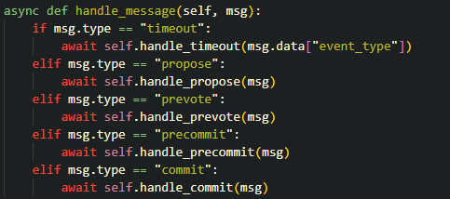
Code Explanation
ConsensusState: Consensus state machine
Function overview
Implement the core consensus logic, including processing proposals, pre-voting, submission and other steps.
Manage node status: height (block height), round (consensus round), step (current stage).
Coordinate the consensus process between nodes through message processing (handle_message).
Key implementation
Message processing:
handle_propose: Receive and verify the proposed block and start the pre-voting stage.
handle_prevote: Collect pre-votes and check whether the 2/3 threshold is reached.
handle_precommit: Collect submission votes and trigger block submission.
Timeout processing:
Timeout triggers step conversion, such as entering pre-voting from the proposal stage.
State update:
Call commit_block to submit the block and broadcast the submission message.

Slide 18

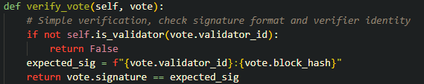
Code Explanation
ValidatorSet: Validator Management
Function Overview
Manage the identity of validators and select proposers.
Verify the legitimacy of the vote (signature and identity authentication).
Key Implementation
Proposer Selection:
Calculate the proposer index using height and round.
Signature and Verification:
Generate and verify voting signatures to ensure legitimacy.

Slide 19
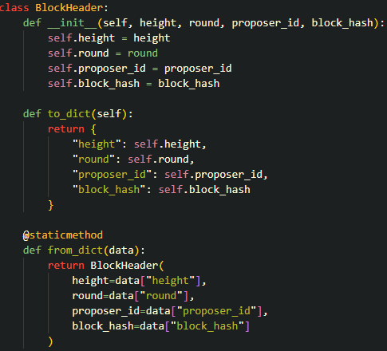
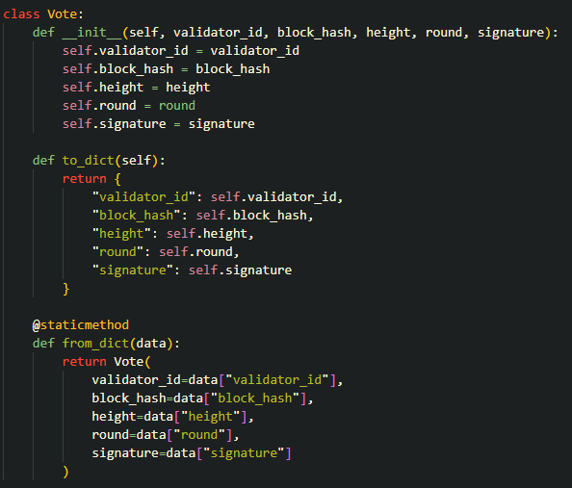
Code Explanation
Block and Vote: Data structure
Function overview
Block and Vote provide the basic structure of blocks and votes.
Support serialization and deserialization for easy transmission between nodes.
Key implementation
BlockHeader:
Contains the metadata of the block (height, round, proposer ID, block hash).
Provides dictionary conversion methods to_dict and from_dict.
Vote:
Contains validator ID, block hash, height, round and signature.

Slide 20
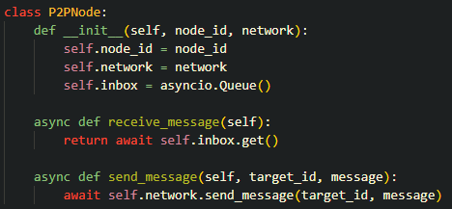
Code Explanation
P2PNode and Network: Network simulation
Function overview
Provide communication mechanism between nodes.
Simulate network delay, packet loss rate and network partition.
Key implementation
Node communication:
Use asynchronous queue inbox to store received messages.
Messaging between nodes is implemented through send_message method.
Network failure:
Simulate delay and packet loss by setting delay and drop_rate parameters.
Support partition isolation nodes to prevent messages from being sent or received.

Slide 21
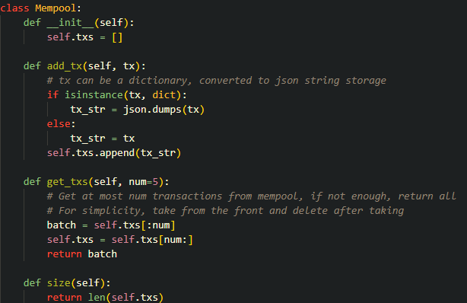
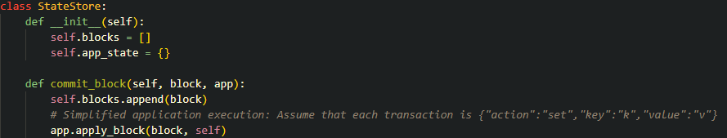
Code Explanation
Mempool and StateStore: state and transaction management
Function overview
Mempool:
Manage transaction pool, support transaction addition and batch extraction.
Provide interfaces add_tx and get_txs.
StateStore:
Save the state of the blockchain and the application state.
Receive blocks and apply transactions through commit_block.

Slide 22
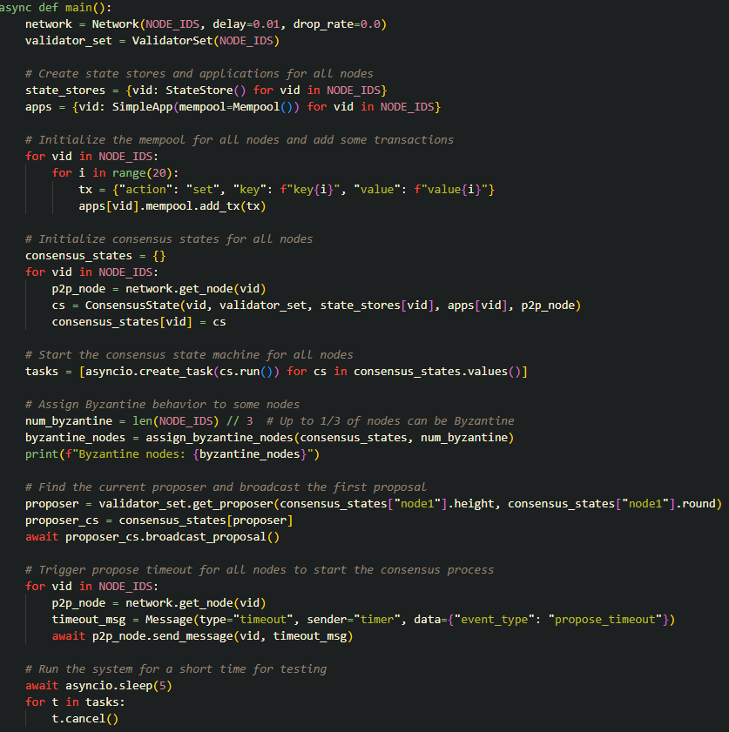
Code Explanation
Main program logic
Function overview
Integrate various modules, initialize network, state and consensus logic.
Simulate distributed node operation.
Key implementation
Initialize nodes:
Create independent StateStore, SimpleApp and ConsensusState instances
for each node.
Start consensus process:
Broadcast proposal message.
Simulate timeout trigger process.

Slide 23
Conclusion and future work
Conclusion
Implementation of Tendermint core consensus process
Implementation content: This project reproduces the core logic of Tendermint, including the Propose, Prevote, and Precommit phases, as well as message communication between distributed nodes.
Simplified implementation suitable for teaching and verification
Simplified Tendermint implementation written, with clear modularization and easy analysis.
Simulates challenges in real distributed systems such as network delay, packet loss, and Byzantine nodes.
Understand the message synchronization problem between nodes.
Explore how the system reaches consensus when some nodes are unreliable (Byzantine behavior).

Slide 24
Future work
Improvement direction
1. Introduce encrypted signatures and strict verification logic
Problem: The current voting signature uses a simple string simulation, lacking real encryption and security verification.
Improvement: Use asymmetric encryption algorithms (such as ECDSA) to generate and verify signatures to ensure the immutability of voting messages.
Introduce validator authentication based on public and private key pairs to increase the security of the system.
2. Implement a complete ABCI interface
Problem: The current state management of the project is directly bound to the application logic, lacking a standardized interface.
Improvement: Implement Tendermint's Application Blockchain Interface (ABCI) to decouple the consensus layer from the application layer. Support external applications to provide state update logic (such as smart contracts) through ABCI.
3. Network layer optimization
Problem: The current network implementation simulates delays and packet loss, but lacks more complex behavior support.
Improvement: Implement the Gossip protocol: optimize the efficiency of message propagation so that each message only needs to be transmitted a limited number of times to reach the entire network. Dynamic partitioning and node crash simulation: support more complex network failure scenarios for testing the robustness of the system.
4. Support fast synchronization
Problem: After a new node joins, it cannot quickly synchronize the current blockchain status.
Improvement: Implement Tendermint's Fast Sync mechanism to enable new nodes to quickly join the network by downloading blockchain snapshots.
5. Improve concurrent performance
Problem: The current system runs through a single-threaded asynchronous task, with low performance.
Improvement: Use multi-threading or multi-process technology to achieve parallel transaction processing and consensus calculation.
Optimize transaction pool management to support higher transaction throughput.

Slide 25
Thanks for your attention

