Slide 1
CSCI 43018 • RESEARCH PROJECT
Intelligent Drug Sales Forecasting
and Healthcare Insights
with Artificial Intelligence
Category-wise pharmaceutical demand planning in Sri Lanka
Bope Ranasinghage Gihan Lakmal
SUPERVISOR
CS/2020/015
Prof. N. G. J. Dias
B.Sc. Honours in Computer Science
Faculty of Computing and Technology • University of Kelaniya
Source: Final_1 thesis, cover and Chapters 3–6
CS/2020/015 | UNIVERSITY OF KELANIYA
FINAL YEAR PROJECT • SEPTEMBER 2026
01
Notes:
TARGET TIME: 30 seconds.
Good morning. I am Bope Ranasinghage Gihan Lakmal, CS/2020/015. My project is Intelligent Drug Sales Forecasting and Healthcare Insights with Artificial Intelligence, supervised by Professor N. G. J. Dias. I developed a category-wise forecasting application for pharmaceutical demand planning. I will explain the data, implemented methods, recorded results and practical application, followed by the main limitations.
EVIDENCE: Final_1 thesis, cover and Chapters 3–6

Slide 2
OVERVIEW
From the research problem to the application
01
Problem & objectives
02
Data & methodology
03
System implementation
04
Results & explanation
05
Demonstration & conclusion
CS/2020/015 | UNIVERSITY OF KELANIYA
FINAL YEAR PROJECT • SEPTEMBER 2026
02
Notes:
TARGET TIME: 20 seconds.
The presentation follows five stages: the problem and objectives; the dataset and methods; the application architecture; the experimental findings; and the demonstration, limitations and conclusion. The planned speaking time is under twenty minutes, including the embedded walkthrough. Detailed results and implementation notes are available in hidden backup slides for the panel discussion.
EVIDENCE:

Slide 3
PROBLEM
The problem: planning stock from changing sales
Understocking
Overstocking
Forecasting challenge
Insufficient stock
Unmet demand
Reactive purchasing
Capital tied up
Storage pressure
Risk of expiry
Different category patterns
Limited real data
Need for understandable outputs
Research question: how can historical sales support usable, category-wise forecasting?
Source: Thesis §§1.2–1.6; data/raw/C1.csv–C8.csv
CS/2020/015 | UNIVERSITY OF KELANIYA
FINAL YEAR PROJECT • SEPTEMBER 2026
03
Notes:
TARGET TIME: 50 seconds.
The project addresses pharmaceutical sales forecasting as a stock-planning problem. Too little stock can leave demand unmet; too much stock ties up working capital and can lead to expiry. Different drug categories have different demand levels and patterns, so a single forecasting method may not work equally well for every category. The research question is how to compare multiple forecasting approaches and make their outputs accessible through a usable application. The implemented forecasts use category sales history. Regional deployment is the intended application context; the bundled dataset does not contain separate region identifiers.
EVIDENCE: Thesis §§1.2–1.6; data/raw/C1.csv–C8.csv

Slide 4
OBJECTIVES
Objectives and the delivered scope
01
Prepare
Organise and inspect category-wise weekly sales.
02
Predict
Implement statistical, boosted-tree and sequence models.
03
Compare
Assess MAE, RMSE, MAPE and recorded timing.
04
Deliver
Provide forecasts, plots and explanations in a web application.
Source: Thesis §1.4; model_metrics.json; services/ and src/models/
CS/2020/015 | UNIVERSITY OF KELANIYA
FINAL YEAR PROJECT • SEPTEMBER 2026
04
Notes:
TARGET TIME: 45 seconds.
The main aim was to implement an AI-based drug sales forecasting system. I organised weekly sales into eight categories, implemented several model families, compared the seven models for which saved metrics are available, and exposed the forecasting and explanation functions through a web application. The research also contains experimental advanced-AI components. I distinguish those extensions from the core models with recorded comparative results. The practical contribution is the integrated forecasting workflow and category-level analysis, rather than a claim that a new forecasting algorithm has been invented.
EVIDENCE: Thesis §1.4; model_metrics.json; services/ and src/models/

Slide 5
LITERATURE
Related work motivates a broader comparison
Study
Relevant contribution
Role in this project
Ekanayake et al., 2025 [1]
SARIMA + Flask drug-sales application
Earlier categorical forecasting work
Ke et al., 2017 [2]
Efficient gradient-boosted trees
LightGBM model comparison
Hewamalage et al., 2021 [3]
Review of recurrent forecasting models
LSTM / GRU comparison
Project extension: multi-model comparison + explanations + modular application services.
Source: Ekanayake et al. (2025), local paper; Ke et al. (2017) [2]; Hewamalage et al. (2021) [3]
CS/2020/015 | UNIVERSITY OF KELANIYA
FINAL YEAR PROJECT • SEPTEMBER 2026
05
Notes:
TARGET TIME: 60 seconds.
The directly related 2025 paper by Ekanayake and colleagues, including myself, used SARIMA with a Flask application for categorical drug sales. That provides the earlier project context. Ke and colleagues introduced LightGBM as an efficient gradient-boosted tree method, supporting its inclusion in the comparison. Hewamalage, Bergmeir and Bandara reviewed recurrent networks for time-series forecasting, motivating the LSTM and GRU comparisons. The present project extends the earlier category-wise application through additional model families, explanation support and modular services. I am not claiming that forecasting dashboards or model comparison are absent from all prior research.
EVIDENCE: Ekanayake et al. (2025), local paper; Ke et al. (2017) [2]; Hewamalage et al. (2021) [3]

Slide 6
DATA
The dataset: eight weekly sales series
8
517
2014–2023
50:50
drug categories
weeks per category
stored date range
real / synthetic*
12 Jan 2014 → 03 Dec 2023
Source context
One date + one sales value in each category file.
No missing cells; no duplicate dates; consistent 7-day spacing.
Two Kurunegala pharmacies
plus synthetic augmentation
*Student-confirmed approximate mix; row-level source labels and regional identifiers are unavailable.
Source: data/raw/C1.csv–C8.csv; thesis §3.2; student confirmation, 13 Sep 2026
CS/2020/015 | UNIVERSITY OF KELANIYA
FINAL YEAR PROJECT • SEPTEMBER 2026
06
Notes:
TARGET TIME: 65 seconds.
The dataset consists of eight category CSV files, each with 517 weekly observations, covering 12 January 2014 to 3 December 2023. The final data was described as an approximately equal mixture of real sales from two pharmacies in Kurunegala and synthetic data, which I confirmed when preparing these slides. The CSV files do not label individual rows by source, so exact real-versus-synthetic row counts cannot be independently separated. Across the eight files there are 4,136 category-week values, not 4,136 independent dates. The files have no missing cells or duplicate dates and all adjacent dates are seven days apart. There is no pharmacy or region column, so the measured results concern categories rather than regional generalisation.
EVIDENCE: data/raw/C1.csv–C8.csv; thesis §3.2; student confirmation, 13 Sep 2026

Slide 7
METHODOLOGY
A model-specific preparation and forecasting pipeline
Load & order
Build inputs
Train / load
Return output
Category CSV
Date + sales
5 lags / 10-step windows
or dated series
Model + scaler
Category-specific paths
Sales-scale result
Plot + explanation
Lag input example
[ y(t−1), y(t−2), y(t−3), y(t−4), y(t−5) ] → y(t)
Implementation detail: LightGBM currently retrains locally during forecasting for artifact compatibility.
Source: src/utils/preprocessing.py; src/models/{lightgbm,lstm,gru,transformer}_model.py
CS/2020/015 | UNIVERSITY OF KELANIYA
FINAL YEAR PROJECT • SEPTEMBER 2026
07
Notes:
TARGET TIME: 70 seconds.
Each CSV is parsed as an ordered time series. The input representation then depends on the model. XGBoost and LightGBM use five previous sales observations as lag features. LSTM, GRU and the standard Transformer use ten-observation sequences in their default paths. Statistical models use the dated series directly. LightGBM and the main sequence models apply MinMax scaling, and predictions are transformed back to the original sales scale. Model files and scalers are stored for reuse where supported. One current exception is LightGBM: its forecasting function retrains a small local model because saved native artifacts are not portable across all local builds. This slide shows the implemented preparation process; it does not assert that the archived benchmark used a verified common held-out split.
EVIDENCE: src/utils/preprocessing.py; src/models/{lightgbm,lstm,gru,transformer}_model.py

Slide 8
METHODOLOGY
Statistical and machine learning methods
Statistical models
Boosted-tree models
SARIMAX: autoregressive / seasonal structure
Evaluator: (1,0,0) × (1,0,0,7)
Prophet: dated trend and seasonality inputs
XGBoost: regression on 5 lag features
LightGBM: 5 normalised lag features
Current defaults: 31 leaves, 0.05 learning rate, 100 boosting rounds
Seasonal period 7 means seven observations in this weekly dataset; defaults are not tuned-run provenance.
Source: src/evaluation/model_evaluation.py; src/models/{sarimax,prophet,xgboost,lightgbm}_model.py
CS/2020/015 | UNIVERSITY OF KELANIYA
FINAL YEAR PROJECT • SEPTEMBER 2026
08
Notes:
TARGET TIME: 60 seconds.
SARIMAX and Prophet provide statistical comparisons. The evaluator configures SARIMAX with order one-zero-zero and seasonal order one-zero-zero-seven. Because the input rows are weekly, that seasonal period is seven observations, not seven days. Prophet receives a date column named ds and target named y. The two machine-learning approaches are XGBoost and LightGBM, both using lagged sales values. XGBoost is a boosted-tree regressor. The current LightGBM function uses MinMax-normalised lags, 31 leaves, learning rate 0.05 and 100 boosting rounds. These are implementation defaults; I do not claim the separate optimisation JSON was used to produce every saved metric.
EVIDENCE: src/evaluation/model_evaluation.py; src/models/{sarimax,prophet,xgboost,lightgbm}_model.py

Slide 9
METHODOLOGY
Deep learning uses sequences of past sales
LSTM
GRU
Transformer
10-observation windows
2 recurrent layers
64 hidden units
Dropout: 0.1
10-observation windows
2 recurrent layers
64 hidden units
Dropout: 0.1
10-observation windows
Model dimension: 64
4 attention heads
2 encoder layers
TFT, N-BEATS and Informer are additional implementations; no comparable saved benchmark is reported.
Source: src/models/{lstm,gru,transformer,tft,nbeats,informer}_model.py; model_metrics.json
CS/2020/015 | UNIVERSITY OF KELANIYA
FINAL YEAR PROJECT • SEPTEMBER 2026
09
Notes:
TARGET TIME: 60 seconds.
The standard LSTM and GRU implementations use two recurrent layers with 64 hidden units and dropout of 0.1. A linear output layer predicts the next sales value from the last hidden output. Their default input window contains ten weekly observations. The standard Transformer uses a model dimension of 64, four attention heads and two encoder layers, followed by a scalar prediction head. Predictions can be fed back recursively to obtain additional steps. The repository also contains TFT, N-BEATS and Informer implementations. However, those three do not have results in the saved seven-model comparison. N-BEATS is a separate forecasting architecture and should not be classified as a Transformer model.
EVIDENCE: src/models/{lstm,gru,transformer,tft,nbeats,informer}_model.py; model_metrics.json

Slide 10
NEW STACKING EXPERIMENT
Stacking now has measured forecasting results
Method in the new experiment
Mean MAE
Mean RMSE
Stacking / Ridge
30.2059
36.0614
Equal average
24.2382
29.4752
XGBoost
24.7716
30.4166
LSTM
26.4038
32.9673
GRU
25.7002
30.6456
Last-value baseline
35.0069
40.7899
XGBoost + LSTM + GRU forecasts → Ridge combiner → one result per future week
New, separate chronological test: stacking beats the naive baseline, but not simple averaging.
Source: src/evaluation_results/stacking_results.json; src/models/stacking_model.py; new run, 13 Sep 2026
CS/2020/015 | UNIVERSITY OF KELANIYA
FINAL YEAR PROJECT • SEPTEMBER 2026
10
Notes:
TARGET TIME: 50 seconds.
Stacking has now been implemented and evaluated using XGBoost, LSTM and GRU as base models, combined by StandardScaler and Ridge regression. Three expanding chronological blocks provide thirty out-of-fold prediction rows to train the combiner. For each category, the first 507 weeks are available for training, and the last ten weeks, from 1 October to 3 December 2023, are reserved for testing. Stacking achieved average MAE 30.2059 and RMSE 36.0614. It improved over the last-value naive baseline, but equal averaging and the individual bases were better on mean absolute error in this experiment. These are new results from a different protocol and must not be directly ranked against the thesis's original seven-model table.
EVIDENCE: src/evaluation_results/stacking_results.json; src/models/stacking_model.py; new run, 13 Sep 2026

Slide 11
IMPLEMENTATION
A modular application connects users and models
Web UI • FastAPI / Jinja / JavaScript
API gateway
Forecast
Training
Explainability
Advanced AI
Prediction + plots
Model / scaler artifacts
SHAP / fallback
Experimental modules
Shared CSV data • trained model files • scalers • result artifacts
Component view: the current gateway forecast endpoint calls shared forecasting code directly.
Source: services/; apps/api_gateway/main.py; infra/docker/; infra/kubernetes/
CS/2020/015 | UNIVERSITY OF KELANIYA
FINAL YEAR PROJECT • SEPTEMBER 2026
11
Notes:
TARGET TIME: 55 seconds.
The current web application is served by FastAPI with Jinja templates and browser-side JavaScript. The frontend sends requests through the gateway. The repository separates forecasting, training, explanation and advanced-AI code into services. In the current gateway implementation, the forecast endpoint directly calls the shared forecasting function, so the diagram represents component responsibilities and not a claim that every request makes a network hop to a separate process. Saved models, scalers and CSV data support these components. Docker Compose and Kubernetes configuration are included, but this presentation does not claim a measured production deployment or a completed load test.
EVIDENCE: services/; apps/api_gateway/main.py; infra/docker/; infra/kubernetes/

Slide 12
EVALUATION
Evaluation: distinguish the original and new experiments
MAE
RMSE
MAPE
Average absolute error
Lower is better
Emphasises large errors
Lower is better
Percentage error
Sensitive to small actuals
Original benchmark + new stacking holdout
Overall values = arithmetic mean of the eight category metrics.
New stacking test: 507 training weeks + 10 untouched test weeks. Original benchmark limitations remain.
Source: src/evaluation/model_evaluation.py; model_metrics.json; performance_summary.json
CS/2020/015 | UNIVERSITY OF KELANIYA
FINAL YEAR PROJECT • SEPTEMBER 2026
12
Notes:
TARGET TIME: 65 seconds.
The presentation contains two separate experiments. The original saved benchmark compares seven models across eight categories and has a target-alignment and full-series fitting limitation. Its results remain labelled as archived. The new stacking experiment trains its base models and scalers only on earlier records, uses three chronological validation blocks to train Ridge, and reserves the final ten weeks as an untouched test. Stacking, equal averaging, the three bases and a naive baseline are compared on exactly the same test dates in this new run. Both sets use mean category MAE and RMSE, but their different training and evaluation procedures prevent direct cross-table ranking. MAPE is undefined if a held-out actual is zero.
EVIDENCE: src/evaluation/model_evaluation.py; model_metrics.json; performance_summary.json

Slide 13
RESULTS
Original benchmark: LightGBM leads on absolute error
LightGBM
23.3728
LightGBM
LSTM
24.0362
GRU
24.1104
23.3728
XGBoost
25.4679
average MAE
Transformer
28.8908
28.9163
SARIMAX
30.4946
32.5682
average RMSE
Prophet
Mean category MAE • original sales scale • lower is better
Original experiment only: these numbers are not directly comparable to the new stacking test.
Source: performance_summary.json; values checked against category means in model_metrics.json
CS/2020/015 | UNIVERSITY OF KELANIYA
FINAL YEAR PROJECT • SEPTEMBER 2026
13
Notes:
TARGET TIME: 65 seconds.
This chart orders the seven models by average MAE. LightGBM has the lowest recorded MAE of 23.3728 and RMSE of 28.9163, followed by LSTM and GRU on both absolute-error metrics. XGBoost has an average MAE of 25.4679. SARIMAX and Prophet have larger absolute errors in these saved results. The choice of metric matters: Transformer has the lowest average MAPE at 53.6691 percent, even though it is not best on MAE or RMSE. Because category scales differ and the evaluation has the limitation described on the previous slide, these figures are descriptive comparisons of the archived experiment, not a guarantee of future performance.
EVIDENCE: performance_summary.json; values checked against category means in model_metrics.json

Slide 14
RESULTS
Original benchmark: the best model varies by category
Category
Lowest recorded MAE model
MAE
No universal winner
C1
GRU
9.8758
C2
Prophet
13.1088
C3
Prophet
10.2570
LSTM leads in 3 of 8 categories.
LightGBM leads on average MAE and RMSE.
C4
LightGBM
72.6065
C5
LSTM
24.8986
C6
LSTM
3.1634
C7
XGBoost
26.0462
C8
LSTM
13.8154
A deployment model-selection rule still needs an independent validation and test period.
Source: src/evaluation_results/model_metrics.json; minimum MAE within each category
CS/2020/015 | UNIVERSITY OF KELANIYA
FINAL YEAR PROJECT • SEPTEMBER 2026
14
Notes:
TARGET TIME: 55 seconds.
The category-level comparison shows why the application supports model choice. GRU has the lowest recorded MAE for C1. Prophet is lowest for C2 and C3, LightGBM for C4, LSTM for C5, C6 and C8, and XGBoost for C7. That means LSTM leads in three categories while LightGBM leads on average. C4 has a much larger error scale than C6, so an average absolute error can be influenced by higher-volume categories. Selecting a model from the same results used to judge it is descriptive; a production selection rule would require separate validation and later testing. These category winners do not establish the best model for an unobserved pharmacy or region.
EVIDENCE: src/evaluation_results/model_metrics.json; minimum MAE within each category

Slide 15
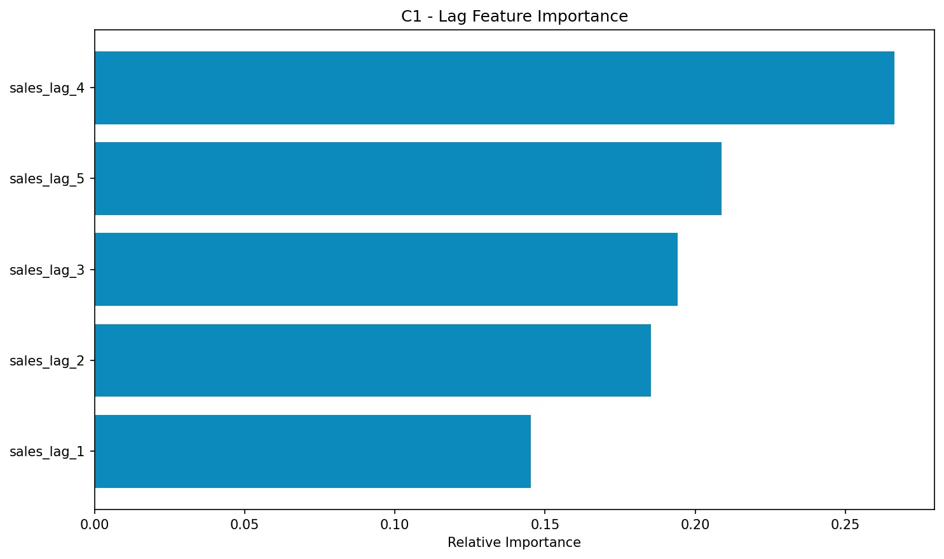
EXPLAINABILITY
Explainability must name the method actually returned
Saved C1 example
sales_lag_4
0.2664
normalised importance
Method: fallback
lag importance
This output ranks lag importance; it is neither a causal effect nor a local SHAP attribution.
Source: Saved fallback_importance_C1_xgboost_20260712_042311.png; shap_explainer.py §§411–458; thesis §4.4
CS/2020/015 | UNIVERSITY OF KELANIYA
FINAL YEAR PROJECT • SEPTEMBER 2026
15
Notes:
TARGET TIME: 55 seconds.
The explanation service attempts SHAP-based interpretation and also provides a fallback. This saved example is explicitly labelled fallback_lag_importance. Its top feature is sales_lag_4 with a normalised importance of approximately 0.2664. The fallback uses model feature importance where available, otherwise normalised absolute correlations with the target. It therefore gives a relative ranking of lag features. It does not establish that a particular lag caused demand, and it is not equivalent to a signed local SHAP explanation of an individual prediction. The application should report which method was returned so users can interpret the chart correctly.
EVIDENCE: Saved fallback_importance_C1_xgboost_20260712_042311.png; shap_explainer.py §§411–458; thesis §4.4

Slide 16
RESEARCH EXTENSIONS
Advanced AI modules are experimental extensions
Module
Available evidence
Interpretation
Neural architecture search
C1 run: 8 architectures evaluated
Small search; scaled metrics
Federated learning
2 simulated clients; 1 FedAvg round
Local demonstration
Meta-learning
Adaptation code; recorded MAML untrained
No demonstrated benchmark gain
Causal analysis
Recorded temporal-feature correlations
Association, not causal proof
Implemented extension does not imply independently validated improvement in forecasting accuracy.
Source: nas_results_C1_1783854913.json; fed_results_C1_iid_1783854914.json; causal_discovery_C1.json; thesis §§4.5,4.8
CS/2020/015 | UNIVERSITY OF KELANIYA
FINAL YEAR PROJECT • SEPTEMBER 2026
16
Notes:
TARGET TIME: 55 seconds.
Beyond the core forecast comparison, the repository contains advanced research modules. A saved C1 neural architecture search evaluated eight architectures. Its losses are on a scaled series and cannot be directly compared with the sales-scale MAE table. A recorded federated test used two simulated clients and one FedAvg round; this is not a field trial across independent pharmacies. Meta-learning and adaptation workflows are implemented, but the recorded status says the MAML model was not trained at that point. The causal-analysis output includes correlations with time features; this does not establish causal effects. These components demonstrate implemented research workflows, without a verified comparative accuracy gain for the main forecast benchmark.
EVIDENCE: nas_results_C1_1783854913.json; fed_results_C1_iid_1783854914.json; causal_discovery_C1.json; thesis §§4.5,4.8

Slide 17
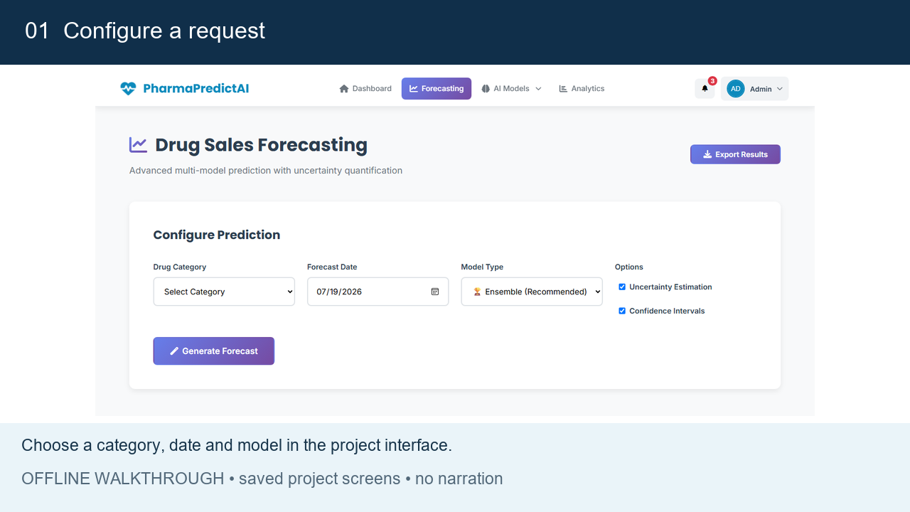
APPLICATION
Application demonstration • embedded offline walkthrough
Click to play • 45 seconds • saved screens, historical lookup and explanation
Source: Project UI screenshot; C1 historical output chart; saved C1 fallback explanation; 45-second silent MP4
CS/2020/015 | UNIVERSITY OF KELANIYA
FINAL YEAR PROJECT • SEPTEMBER 2026
17
Notes:
TARGET TIME: 85 seconds.
I will now play a 45-second silent walkthrough assembled from the project interface and saved outputs. First, the interface allows the user to choose a category, date and forecasting method. Second, the recorded historical example requests C1 on 15 January 2018 and returns the nearest stored weekly observation, 14 January 2018, with sales of 28.33. This is a historical lookup, not a prediction of an unseen value. Third, the explanation example shows the saved fallback importance chart. The film uses archived screens and does not show a fresh live backend run. The following hidden backup slide includes the same screens if video playback is unavailable. Click the video to start; it has no audio.
EVIDENCE: Project UI screenshot; C1 historical output chart; saved C1 fallback explanation; 45-second silent MP4

Slide 18
VERIFICATION
Stacking passes functional and chronological checks
17 checks passed
Stacking API check
Application output
16 Python tests
1 JavaScript UI test
Chronology + horizon checks
Artifact integrity + errors
C1 request: 11 Dec 2023
Weekly end: 17 Dec 2023
Forecast: 53.0036
HTTP status: 200
Actual recorded sales chart
Measured holdout errors
No invented accuracy score
Unsupported intervals omitted
All 8 stacking artifacts produce finite forecasts. The separate holdout measures forecasting error.
Source: tests/test_stacking.py; tests/test_services_smoke.py; tests/test_stacking_ui.cjs; stacking_integration_checks.json
CS/2020/015 | UNIVERSITY OF KELANIYA
FINAL YEAR PROJECT • SEPTEMBER 2026
18
Notes:
TARGET TIME: 40 seconds.
The updated implementation passed sixteen Python tests, covering the existing service smoke checks and new stacking checks, plus one JavaScript UI test. Tests verify that future holdout values do not enter model fitting, each horizon is combined separately, weekly date conversion is correct, and missing or stale artifacts fail explicitly. All eight full-history model bundles were also loaded and generated finite ten-week forecasts. A real gateway request for C1 on 11 December 2023 returned approximately 53.0036 for the corresponding weekly endpoint, 17 December. The stacking interface now uses actual historical values and recorded held-out scores, rather than the old placeholder metrics and charts. This integration check is separate from the unseen-future evaluation.
EVIDENCE: tests/test_stacking.py; tests/test_services_smoke.py; tests/test_stacking_ui.cjs; stacking_integration_checks.json

Slide 19
LIMITATIONS & FUTURE WORK
Limitations define the next research steps
Current limitation
Next step
Hybrid data; no source / regional labels
Collect traceable, region-labelled pharmacy histories
Original benchmark horizon / split issues
New stacking is aligned; repeat for the other models
Older API routes use day counts as steps
Stacking uses weeks; extend the fix to older routes
Low sales destabilise percentage error
Add suitable scaled errors and inspect low-volume cases
Operational stock-out reduction, cost savings and real multi-pharmacy generalisation remain unmeasured.
Source: CSV audit; src/evaluation/model_evaluation.py; forecast_service/app/forecasting.py; thesis §§5.6,6.7
CS/2020/015 | UNIVERSITY OF KELANIYA
FINAL YEAR PROJECT • SEPTEMBER 2026
19
Notes:
TARGET TIME: 65 seconds.
There are four main limitations. First, the dataset contains synthetic augmentation and has neither source labels nor region identifiers, so future work needs traceable real data from more pharmacies. Second, the original archived evaluator still needs a consistent chronological design. The new stacking experiment now uses an untouched ten-week test and chronological meta-training, but that fix does not retroactively validate the older results. Third, stacking now converts dates to weekly horizons and limits predictions to its trained ten-step horizon. Older model routes still need the same date alignment correction. Fourth, low-volume series make percentage errors unstable. The full C6 series contains 46 zeros, although this does not mean all are in the evaluation window. Future evaluation should add suitable low-volume metrics and simple naive baselines. Real inventory impact has not yet been measured.
EVIDENCE: CSV audit; src/evaluation/model_evaluation.py; forecast_service/app/forecasting.py; thesis §§5.6,6.7

Slide 20
CONCLUSION
Conclusion: a working platform with clear research findings
Delivered
A category-wise forecasting and explanation application.
Observed
Stacking works; simple averaging is better in the new holdout.
Next
Strengthen future-period validation and real pharmacy evaluation.
Source: Thesis Chapters 4–6; saved evaluation artifacts and implementation audit
CS/2020/015 | UNIVERSITY OF KELANIYA
FINAL YEAR PROJECT • SEPTEMBER 2026
20
Notes:
TARGET TIME: 45 seconds.
The project delivered a category-wise forecasting platform with a web interface, model comparison, stored artifacts and explanation support. In the saved seven-model comparison, LightGBM has the lowest average MAE and RMSE. Category-wise results show that the lowest-error model changes across categories. Explainability is useful when its returned method and limits are explicit. The new stacking experiment now has a consistent future holdout: its mean MAE is 30.2059, compared with 24.2382 for equal averaging. The next priority is broader real-data evaluation, followed by testing the system in pharmacy operations. The system provides a foundation for demand planning, while actual reductions in shortages or wastage remain future outcomes to measure.
EVIDENCE: Thesis Chapters 4–6; saved evaluation artifacts and implementation audit

Slide 21
REFERENCES
Selected references
[1]
S. B. Ekanayake, M. Nasmeen, G. Lakmal, P. Vimanshani and A. Perera. “Predicting medical drug sales in a specific area for categorical drugs using time series forecasting.” SCSE, 2025. Local project copy.
[2]
G. Ke et al. “LightGBM: A Highly Efficient Gradient Boosting Decision Tree.” Advances in Neural Information Processing Systems 30, 2017, pp. 3146–3154.
[3]
H. Hewamalage, C. Bergmeir and K. Bandara. “Recurrent Neural Networks for Time Series Forecasting: Current Status and Future Directions.” International Journal of Forecasting, 37(1), 2021, pp. 388–427.
[4]
B. R. G. Lakmal. Final-year thesis, CS/2020/015, University of Kelaniya, 2026; accompanying source code, category CSVs and saved evaluation JSON files.
Source: Local project paper; NeurIPS proceedings; International Journal of Forecasting; final thesis and repository
CS/2020/015 | UNIVERSITY OF KELANIYA
FINAL YEAR PROJECT • SEPTEMBER 2026
21
Notes:
TARGET TIME: 10 seconds.
These are the key sources cited in the talk. Reference one is the directly related categorical drug-sales paper stored with the project. References two and three support the selected machine-learning and recurrent modelling methods. The exact project figures come from the thesis, source code and saved JSON files identified in the notes and accompanying evidence report.
EVIDENCE: Local project paper; NeurIPS proceedings; International Journal of Forecasting; final thesis and repository

Slide 22
ACKNOWLEDGEMENT & QUESTIONS
Thank you
Questions & discussion
Bope Ranasinghage Gihan Lakmal • CS/2020/015
With thanks to Prof. N. G. J. Dias
and the Faculty of Computing and Technology, University of Kelaniya
CS/2020/015 | UNIVERSITY OF KELANIYA
FINAL YEAR PROJECT • SEPTEMBER 2026
22
Notes:
TARGET TIME: 10 seconds.
Thank you to Professor N. G. J. Dias for his guidance, to the Faculty of Computing and Technology, and to the people who supported the project. Thank you for listening. I welcome the panel's questions. Hidden backup slides contain exact metrics, model settings, category mapping, evaluation details and the offline demonstration screens.
EVIDENCE:

Slide 23
BACKUP A
Complete recorded model metrics
Model
MAE
RMSE
MAPE (%)
Time (s)
LightGBM
23.3728
28.9163
73.9233
0.1074
LSTM
24.0362
29.5830
62.6915
0.1260
GRU
24.1104
29.7559
63.9476
0.1067
XGBoost
25.4679
29.9704
86.4031
0.0343
Transformer
28.8908
36.5221
53.6691
0.2426
SARIMAX
30.4946
38.4108
56.0618
0.1498
Prophet
32.5682
37.6763
88.0285
0.8725
XGBoost has the lowest recorded mean time (0.0343 s); current paths and hardware may differ.
Source: src/evaluation_results/performance_summary.json
CS/2020/015 | UNIVERSITY OF KELANIYA
Q&A BACKUP
23
Notes:
Q&A BACKUP — skip during the timed talk.
Use this table for numerical questions. The errors and timings are arithmetic averages across eight categories. Timing is taken from the archived evaluator; it includes path-specific loading and computation and is not a controlled current-production latency benchmark. The source data is preserved at four decimals. Different metrics give different rankings.
EVIDENCE: src/evaluation_results/performance_summary.json

Slide 24
BACKUP B
Implementation defaults and category mapping
Model
Current default
XGBoost
5 lags; squared-error objective; 100 rounds
LightGBM
5 lags; 31 leaves; lr 0.05; 100 rounds
LSTM / GRU
10 steps; 2 layers; hidden 64; dropout 0.1
Transformer
10 steps; d=64; 4 heads; 2 encoder layers
C1 → M01AB C2 → M01AE C3 → N02BA C4 → N02BE
C5 → N05B C6 → N05C C7 → R03 C8 → R06
Source: src/models/; data/raw/pharama weekly sales copy.csv and C1.csv–C8.csv
CS/2020/015 | UNIVERSITY OF KELANIYA
Q&A BACKUP
24
Notes:
Q&A BACKUP — skip during the timed talk.
These settings were read from current source files. They are not asserted to be the exact configurations behind all archived metrics. XGBoost and LightGBM use five lags; the standard LSTM, GRU and Transformer use ten-step windows. The category-to-code mapping is checked by comparing all values in each C1–C8 file with the corresponding column in the combined CSV. The codes identify drug categories; they are not regional labels.
EVIDENCE: src/models/; data/raw/pharama weekly sales copy.csv and C1.csv–C8.csv

Slide 25
BACKUP C
How to interpret the evaluation limitation
Available evaluator
Required validation design
Targets: final 10 actual observations
Some predictions: beyond the full series
SARIMAX: fit on the full series
Result: no common verified holdout
Choose a chronological cutoff
Fit models / scalers on earlier data
Forecast the same future weeks
Compare aligned actuals; repeat origins
Keep the archived results as recorded evidence; rerun a corrected protocol before stronger accuracy claims.
Source: src/evaluation/model_evaluation.py lines 42–80; model-specific forecast functions
CS/2020/015 | UNIVERSITY OF KELANIYA
Q&A BACKUP
25
Notes:
Q&A BACKUP — skip during the timed talk.
The thesis describes chronological train–test separation. The available evaluator sets actual_values to the last ten observations, fits SARIMAX on the complete series and requests predictions over its final ten indices. Several other functions instead read the full CSV and predict beyond its end. That compares different effective horizons and does not prove an unseen-future holdout. Correct evaluation should choose a cutoff, fit preprocessing and each model using only earlier observations, generate the same ten future weekly timestamps, and score against aligned actuals. Repeat across origins if data allows. The presentation does not invent a split percentage or claim a rerun.
EVIDENCE: src/evaluation/model_evaluation.py lines 42–80; model-specific forecast functions

Slide 26
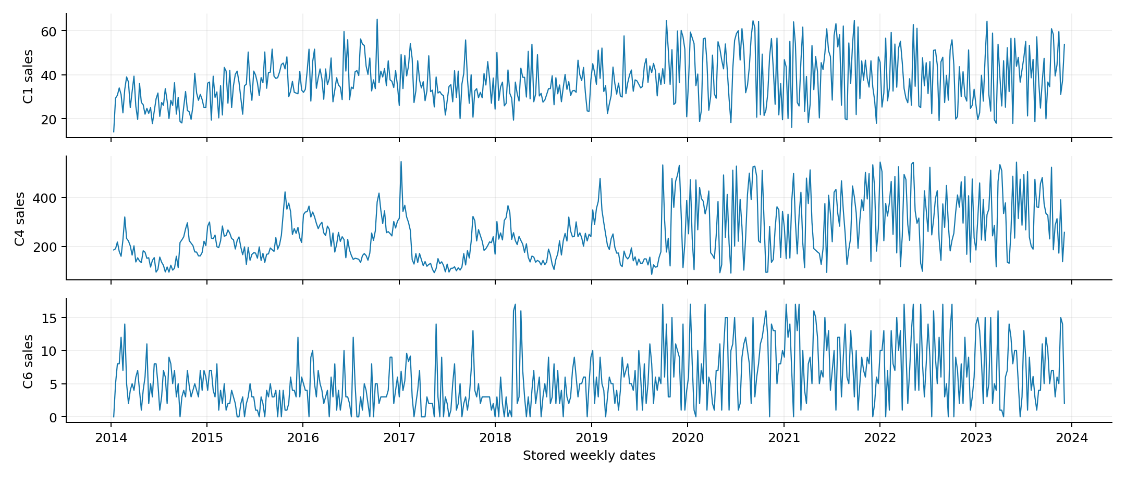
BACKUP D
Dataset profiles: different scales and demand patterns
Source: data/raw/C1.csv, C4.csv, C6.csv
CS/2020/015 | UNIVERSITY OF KELANIYA
Q&A BACKUP
26
Notes:
Q&A BACKUP — skip during the timed talk.
These are descriptive plots of the bundled CSV values, not predictions. Each panel uses its own sales axis. The full dataset has 46 zero values in C6; this should not be confused with the number of zeros in any evaluation window. Source mix is student-confirmed at approximately 50:50. Exact row provenance remains unavailable.
EVIDENCE: data/raw/C1.csv, C4.csv, C6.csv

Slide 27
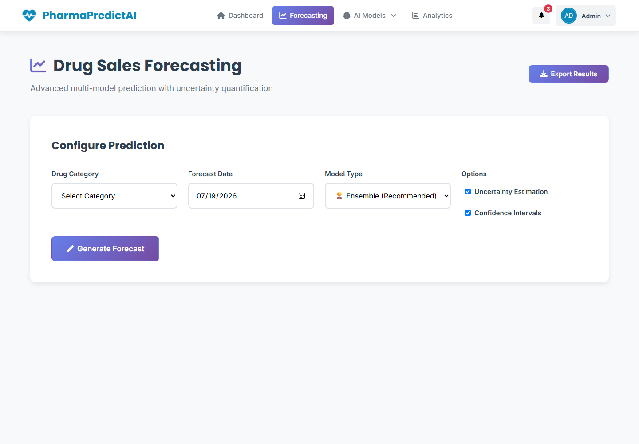
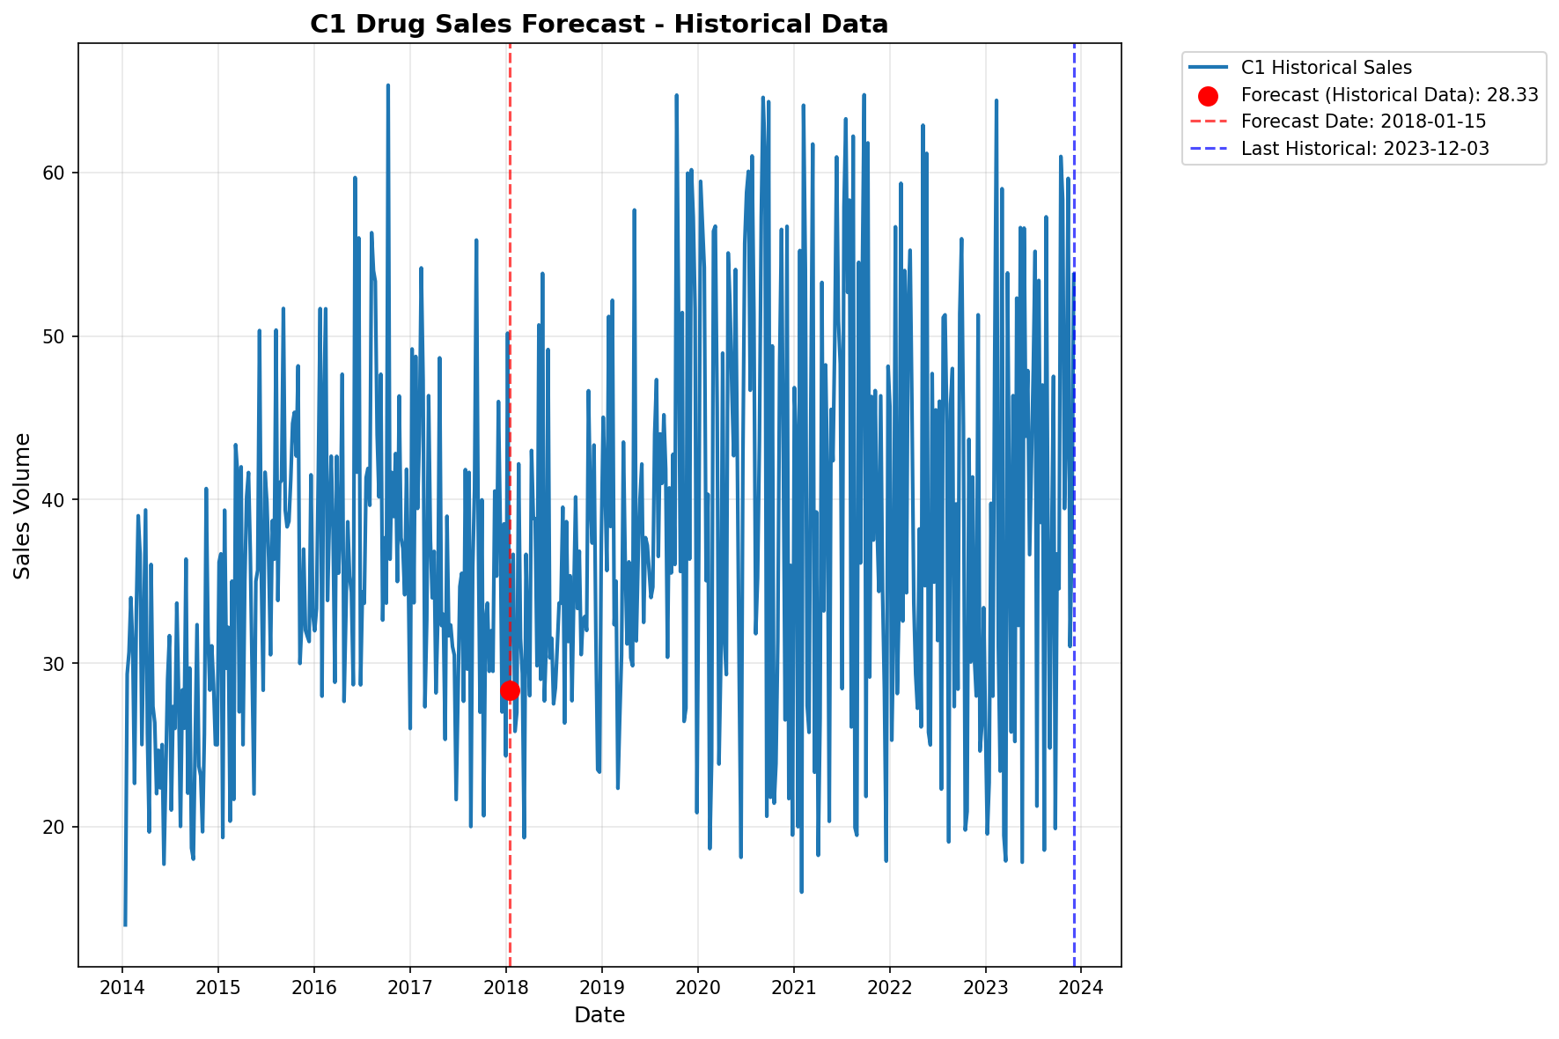
BACKUP E
Demonstration fallback: saved project screens
Saved historical lookup: C1 → 28.33 on 14 Jan 2018; this demonstrates retrieval and presentation.
Source: Project UI screenshot and C1_2018_01_15_xgboost_forecast.png
CS/2020/015 | UNIVERSITY OF KELANIYA
Q&A BACKUP
27
Notes:
Q&A BACKUP — skip during the timed talk.
Use these static images if the embedded MP4 cannot play. The interface is a saved project screen. The chart shows the historical C1 lookup: requested date 2018-01-15, nearest observation 2018-01-14, sales 28.33. This is not a future forecast or an accuracy test. The saved importance chart is available on the main explainability slide.
EVIDENCE: Project UI screenshot and C1_2018_01_15_xgboost_forecast.png

