Slide 1
Circle Drawing Algorithm

Slide 2
Bresenham Algorithm
In this algorithm, we sample at unit interval and determine the nearest pixel on circle path each step.
In this first quadrant of circle from X = 0 to X = Y the slope of the curve varies from 0 to 1
So we take unit step in positive X-direction over this octant and using a decision parameter. We can determine which of the two possible Y - position is closer to the circle path at each step

Slide 3
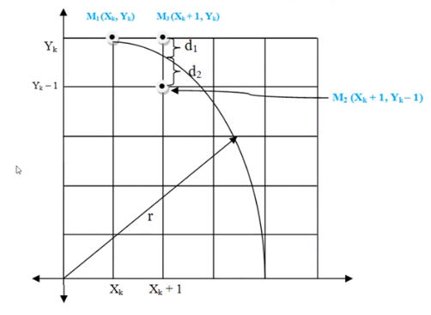

Slide 4
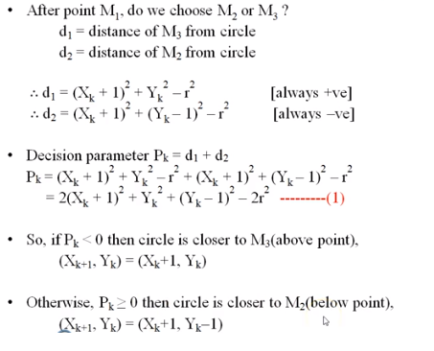
Bresenham Algorithm

Slide 5
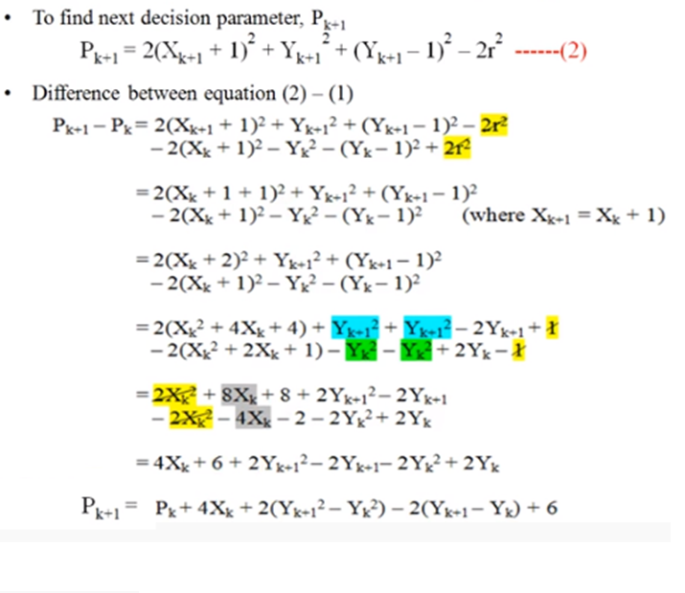
Bresenham Algorithm

Slide 6
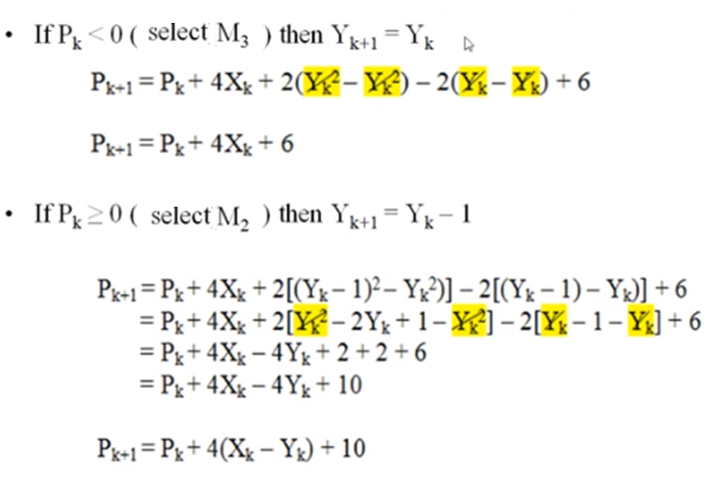
Bresenham Algorithm

Slide 7
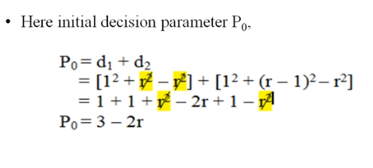
Bresenham Algorithm

Slide 8
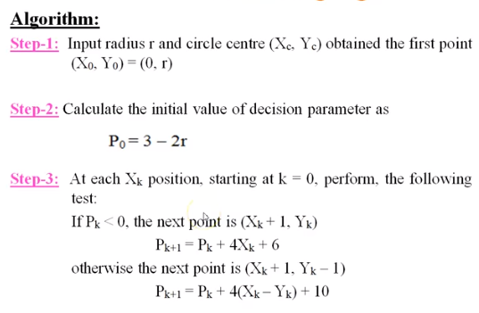
Bresenham Algorithm

Slide 9
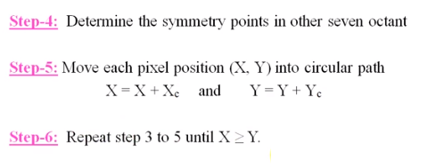
Bresenham Algorithm

Slide 10
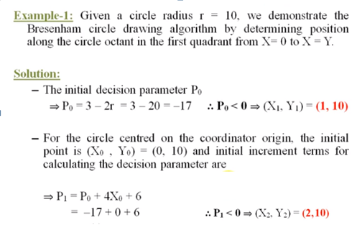
Bresenham Algorithm

Slide 11
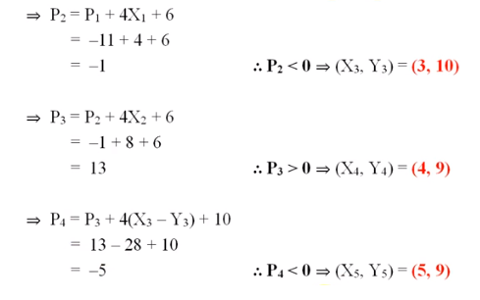
Bresenham Algorithm

Slide 12
Bresenham Algorithm

Slide 13
Bresenham Algorithm

Slide 14
Bresenham Algorithm

