Slide 1

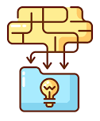
Web scraping
Detailed company profiles

Slide 2
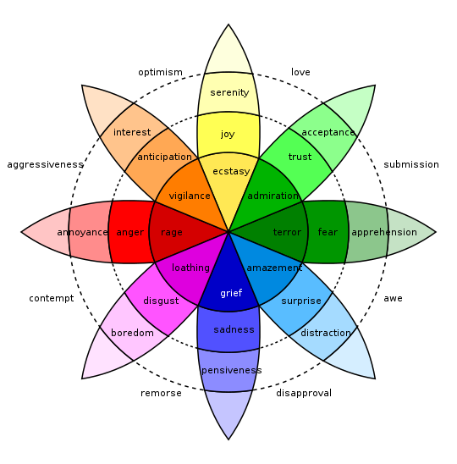
Sentence to token embedding comparison
Emotion Profile:
{Joy : 0.530,
Trust : 0.455,
Anticipation : 0.048..}
Preceding neighbourhood
I’m relaxed after the radiation therapy.
feeling extremely
relaxed
Keywords:
“relaxed”(extremely)
Modifier and Negation Lexicons
Intensity rectification

Slide 3



Slide 4
Emotion AWARE framework
Given Input Text
INFORMATION EXTRACTION MODULE
Text embedding construction
Sentence and word tokenization
Part of Speech Tagging
Text modifier extraction
Negational term extraction
DEEP LEARNING MODULE
AWARE CORE
Language Model
Labelled Dataset
Finetuned Language Model
Input text embedding
Finetuning
Intensity Quantification
Emotion Embedding Space
Embedding Generator
Keyword Extraction
Emotional embeddings
Modifier resolution
LEXICON CONSTRUCTION MODULE
Negation resolution
Emotion Lexicon
Nearest n neighbours
Seed Words
Emotion word lists
Neighbour Identification
Seed Word Expander
AWARE OUTPUTS
Modifier Lexicon
Negation Lexicon
Multi-facet Emotion Profile with intensities
Emotion Keyword Extraction for Explainability

Slide 5
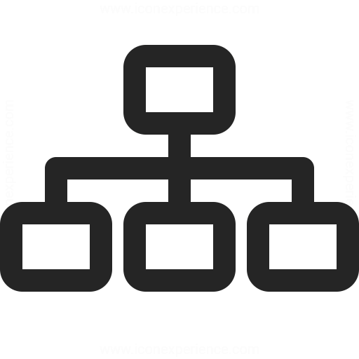
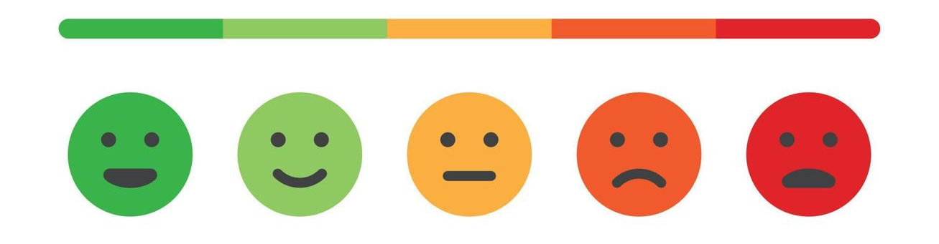

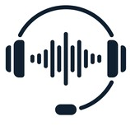




Theme extraction
Deep emotion Analysis
Speech-to-text with Azure speech studio
Call metadata and statistical analysis
Demographic analysis
Call text
Emotion trend analysis
Interactive call analysis dashboard

Slide 6
Parsing PDF files
Per participant, per section emotion extraction with Plutchik and L and M emotion lexicons
Segment the document
Compare emotion results with the market variables.
Extract information such as meeting call participants, meeting sections(Presentation, QnA)
Emotion trend analysis
Quantify emotional agreement/conflicts in the meeting
Financial transcripts
Participant to utterance mapping
Document parsing and information extraction
Deep emotion Analysis

Slide 7
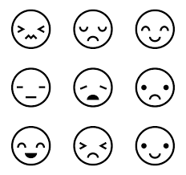
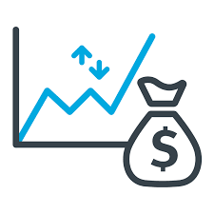
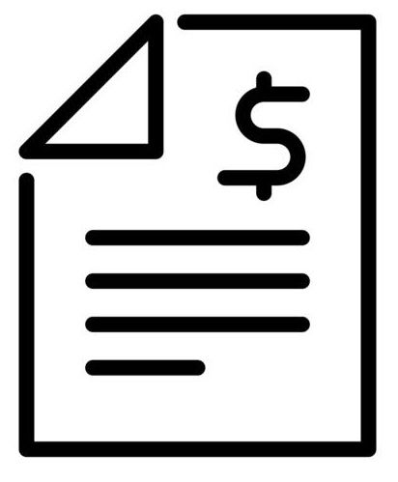

Slide 8
