Slide 1
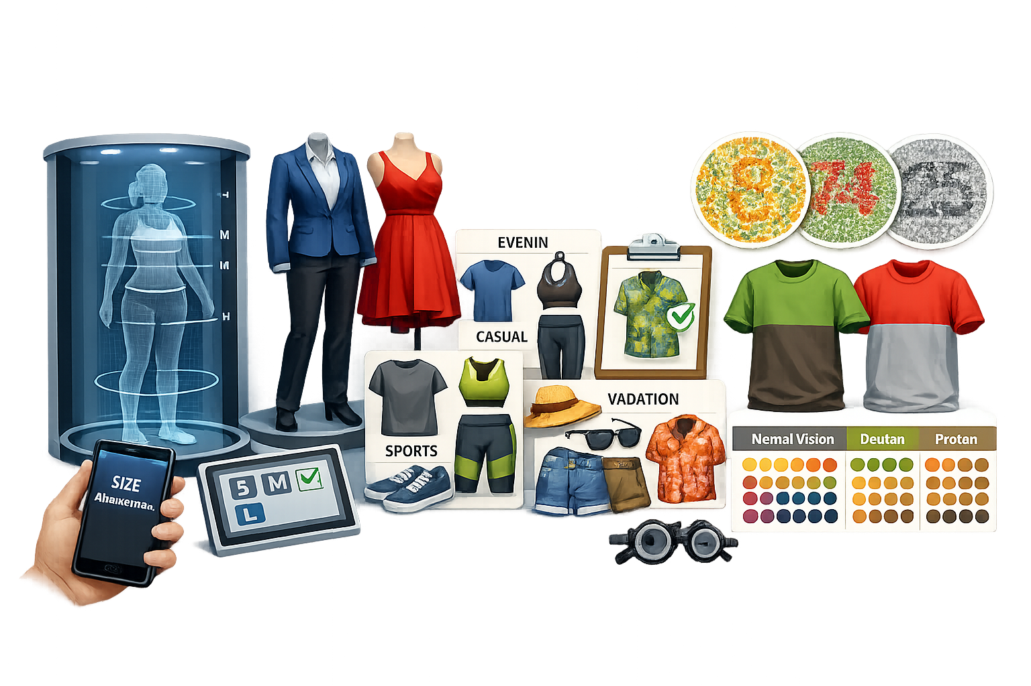
Inclusive Al Fashion Stylist with Measurement and Color-Blind Safety Analysis
R26-ISE-001

Slide 2
Panel Comments in PP1
Comment | How we fix it
IT22259820 - get accurate images for the measurements. | I collected individual straight-standing images of each participant to improve the accuracy of the measurements.
IT22260192 -the matching doesn't give correct output. | For PP2, using an improved dataset to develop a accurate outfit recommendation system after dataset issues affected the PP1 model’s output.
IT22098698 - the matching doesn't give correct output. improve it for many colours. | Improve the model for multi-color outfits as well
IT22242372—Good. improve this to the vivid colour cloths | Improved the color identification by enhancing the dataset to provide more accurate names for vivid and diverse clothing colours.

Slide 3
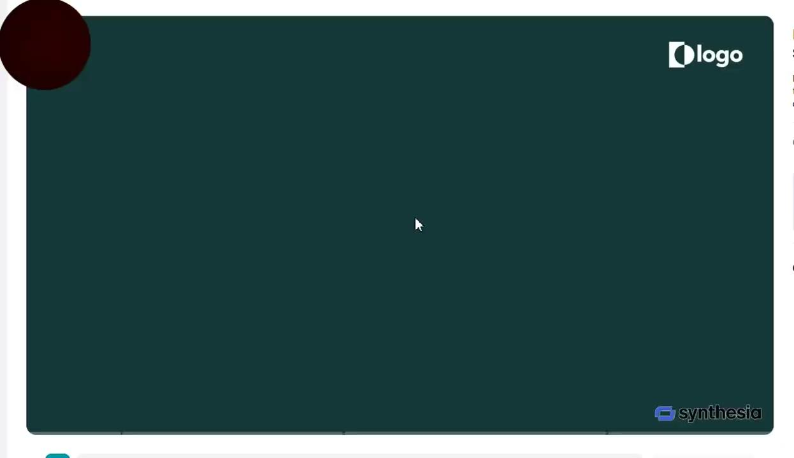

Slide 4
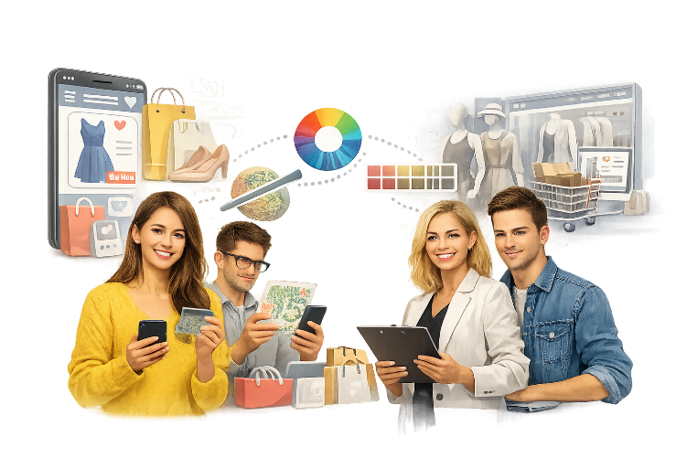
Problem
Many people struggle to choose the right clothing sizes and occasion-appropriate outfits when shopping, while those people with Color Vision Deficiency (CVD) who cannot accurately distinguish certain colors and matching outfit colors when selecting clothing.
Stakeholders
Fashion retailers, E-commerce platforms,individuals with CVD
Measurable pain point
Without proper size, difficulty choosing suitable outfits, and color guidance, users experience dissatisfaction and frequent returns and CVD individuals face exclusion from an accessible and confident shopping experience for many users.

Slide 5
Research Gap
no existing fashion platform fully serves both normal users and CVD-affected individuals together
Existing fashion systems provide limited personalization by considering users’ individual characteristics and preferences.
There is a lack of an integrated and accessible AI-based approach that addresses the diverse needs of users throughout the clothing selection process.
Objectives
Create a body measurement-based clothing size prediction.
Occasion-based outfit recommendation system.
AI-powered color identification for CVD uders.
Color-safe outfit combination recommendations.
User-Friendly and accessible interface for all users.

Slide 6
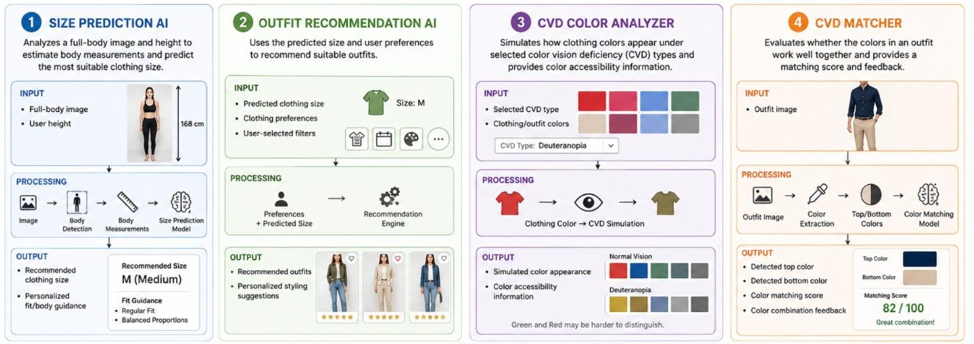
Solution Overview + Architecture

Slide 7
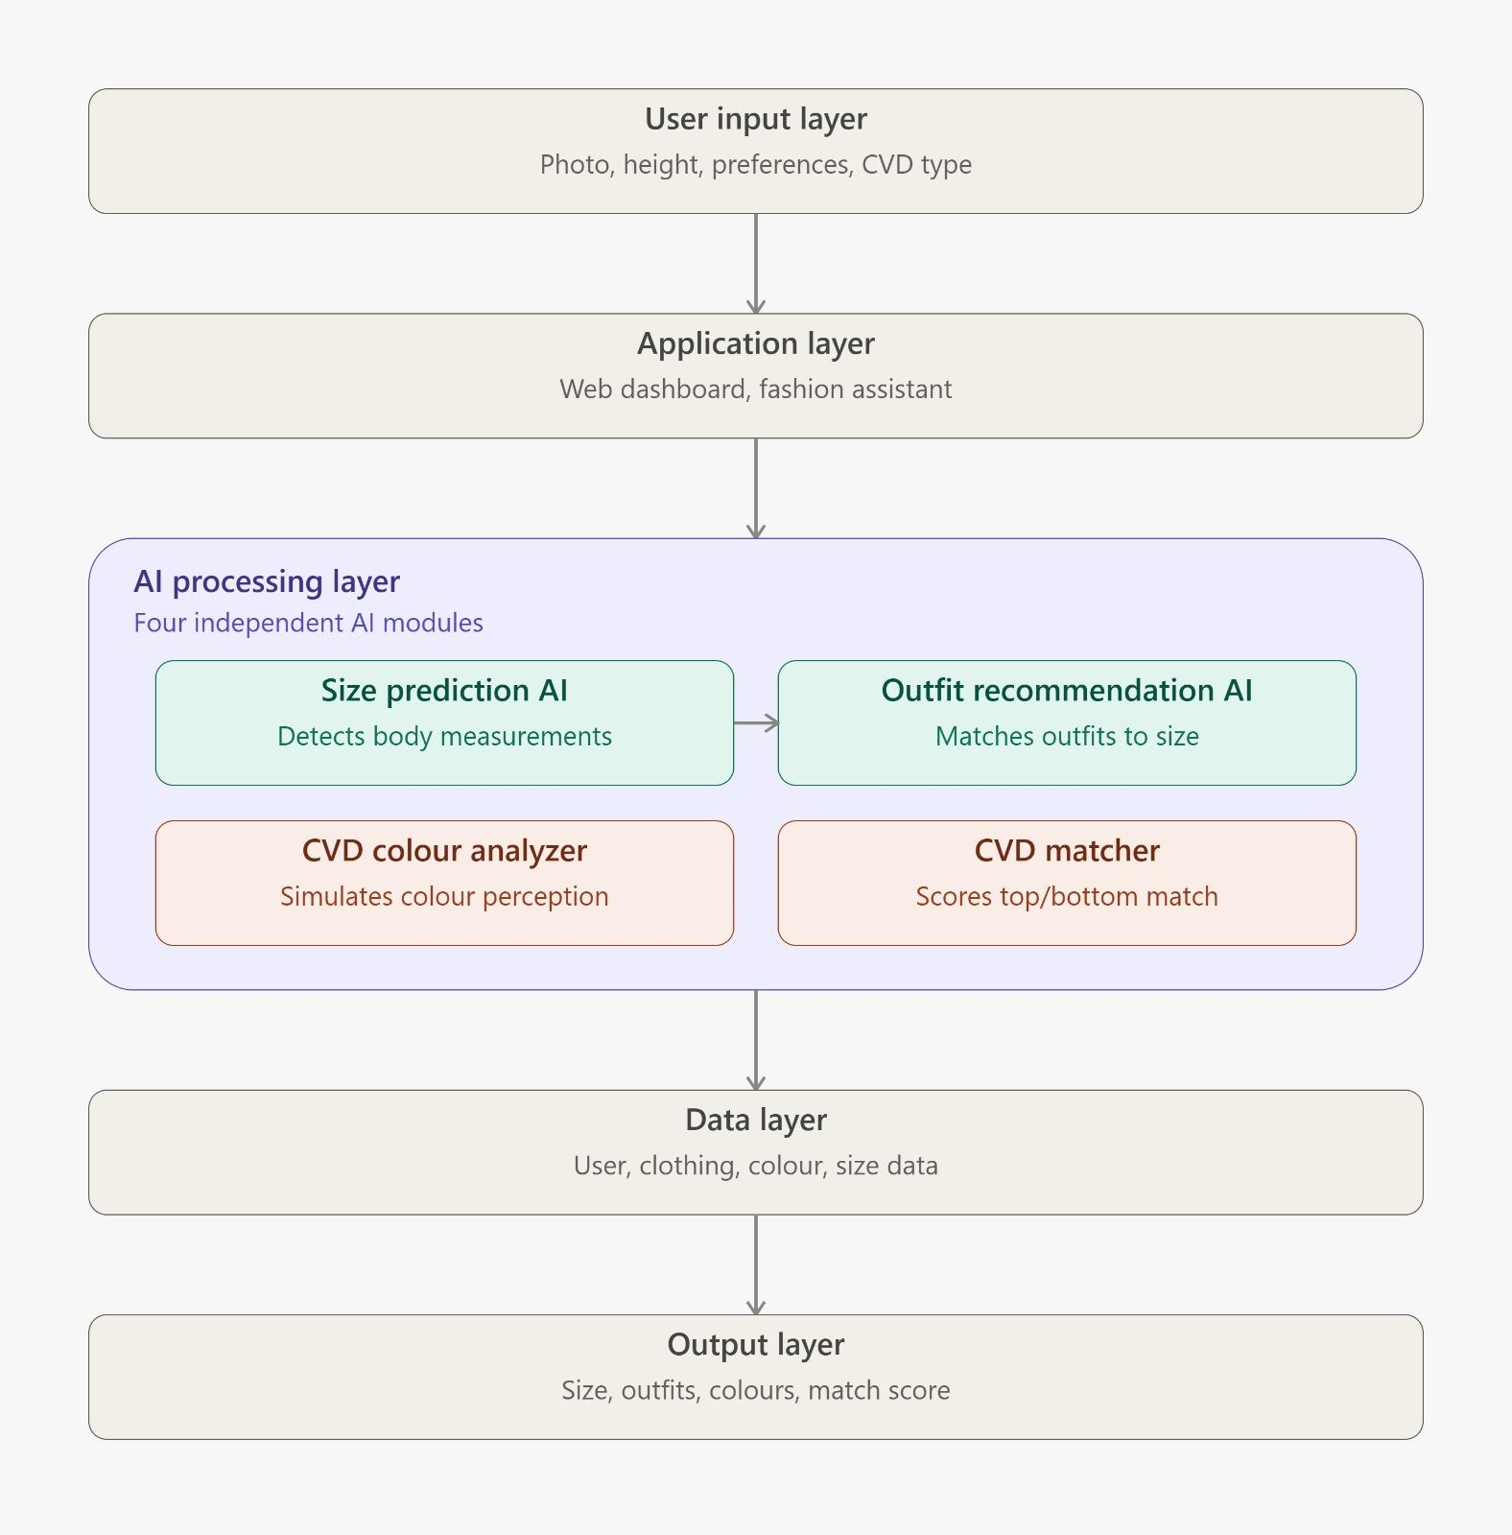

Slide 8
Integration and completion status
Function | Integration Status | Completion Status
AI-based virtual intelligent Size recommendation | Integrated | 90%
Intelligent text-driven fashion recommendation | Integrated | 90%
AI-driven color assist for color vision deficiency | Integrated | 90%
Adaptive outfit matching | Integrated | 90%

Slide 9
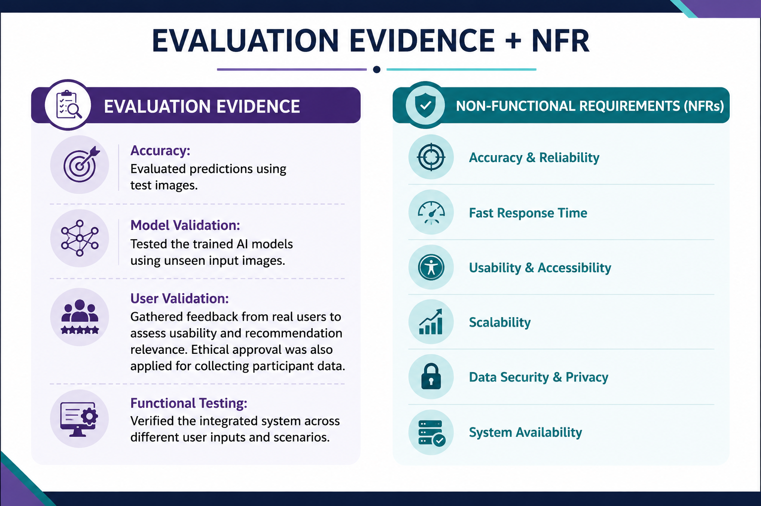

Slide 10
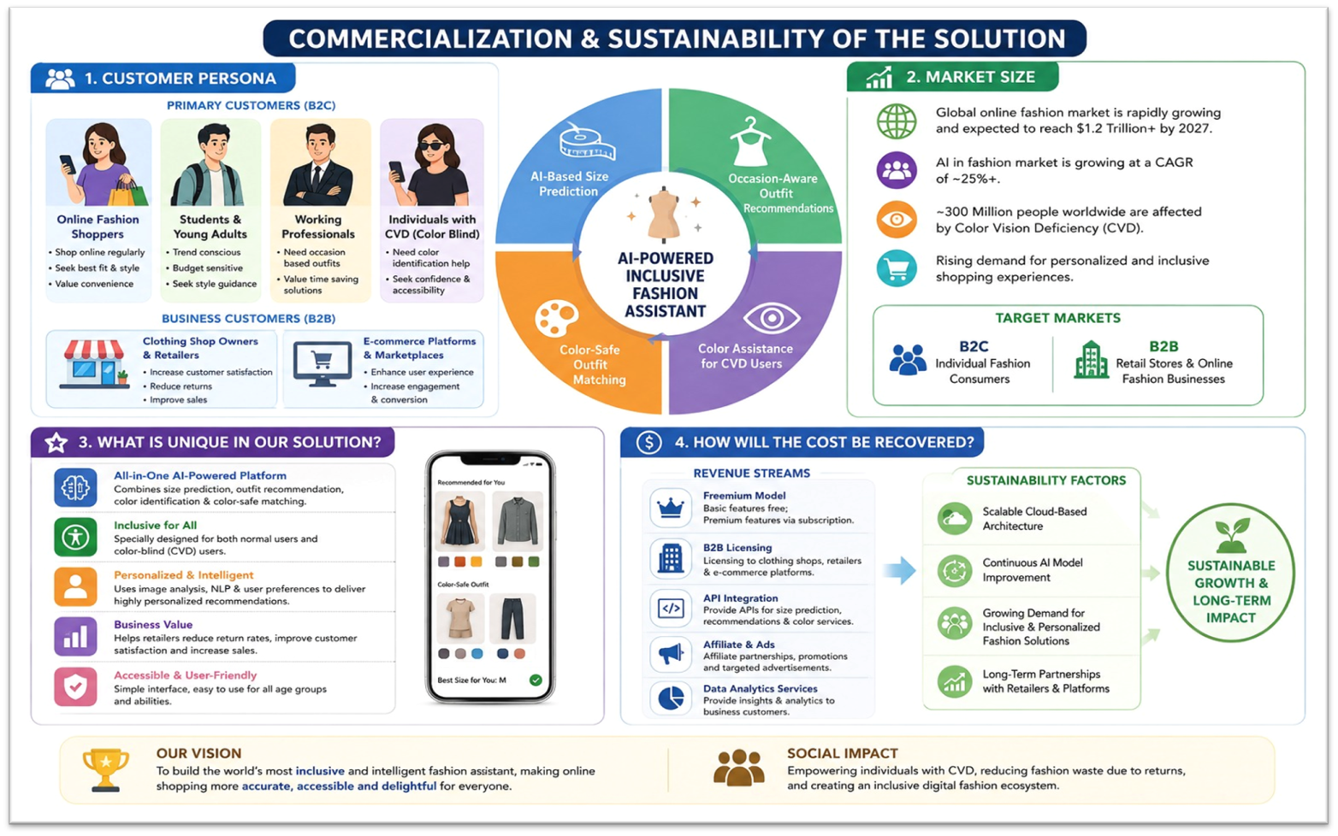
Commercialization

