Slide 1

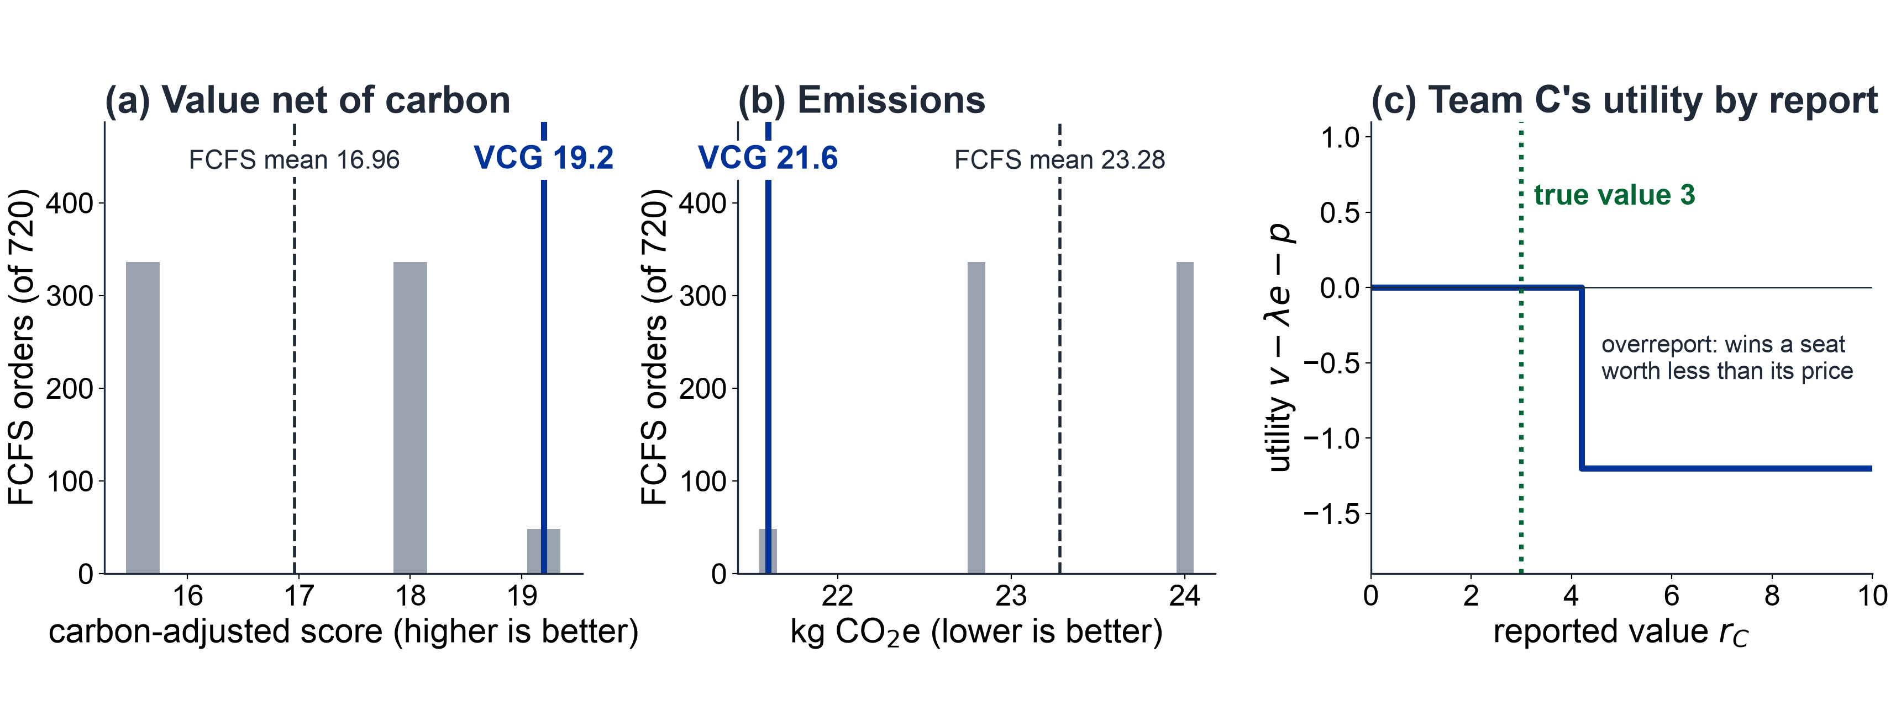


COMSCI / ECON 206 | PS2 RESEARCH SYMPOSIUM | FALL 2026
Can a carbon-aware VCG rule allocate shared
GPU-hours better than first come, first served?
Mustafa Ayub Khan, Temur Akhtamjonov, Gihun Lee | Team FP5
Course instructor: Professor Luyao Zhang
REVIEW-READY v1 · SEP 27, 2026
KEY MESSAGE
A published, carbon-aware VCG rule beats or ties all 720 FCFS arrival orders on value net of carbon (19.2 vs. 16.96 mean),
cuts emissions per unit of value (0.72 vs. 0.81 kg), and keeps truthful reporting optimal, but serves fewer teams (4 vs. 4.93).
01 Question & model
02 Design & evidence
03 Impact & dialogue
Research question & verified gap
1 Question
Value- and carbon-aware allocation of 100 GPU-h?
2 Model
Static game, private values; DSIC benchmark
3 Test
Exact VCG vs. 720 FCFS orders; misreport sweep
4 Evidence
GitHub + Colab: computed. HF play: planned
5 Revision
Utility charges own carbon; FCFS → 720 orders
Practical impact: a real-world case
Question: How should a university allocate scarce shared GPU-hours when each team privately knows its project value, but requests and emissions are public?
Setting: AI demand outpaces compute budgets; queues ignore both value and carbon. Stakeholders: research teams, cluster administrators, the public.
Gap: FAIR-Compute [5] studies fair, efficient allocation of federated research compute. We add an exactly solved VCG rule with carbon in the objective, plus a public audit.
Case: a university's shared GPU cluster (e.g., a lab pool at DKU); no adoption yet.
Decision: replace queue order with a published, re-runnable rule and a carbon weight λ.
Benefits / risks: high-value projects run first and allocations become auditable; λ can penalize compute-heavy research, and fewer teams are served.
Before adoption: credits need a real future cost; pilot reported values against ex-post outcomes.
Correction: public audit log; λ revised through reviews.
Strategic model & foundations
Players: six teams A–F; each reports rᵢ of its private value vᵢ ∈ [1, 10].
Public: GPU request dᵢ, emissions eᵢ = 0.24 dᵢ kg CO₂, capacity K = 100, carbon weight λ = 0.5.
Timing: one simultaneous sealed report (static, incomplete information).
Payoff: uᵢ = vᵢ − λeᵢ − pᵢ if selected, else 0.
Solution: truthful rᵢ = vᵢ is dominant (DSIC, so also BNE) [1–4], because each team bears its own carbon penalty.
Figure 1. Research design. Tested (computed): exact VCG over all 64 groups vs. random-order FCFS over all 720 orders, and a misreport sweep for every team. Planned: classroom Hugging Face play recording reports, predictions, and reflections.
Interdisciplinary evidence
Behavioral science
Players hold a private value, report, predict their selection, then see payments, utility, and a what-if curve; each copies a result line to a shared sheet.
Boundary: no plays collected yet; rivals are simulated.
Computer Science
Exact 64-group VCG and 720-order FCFS; python colab/run_simulation.py reproduces the committed outputs; unit tests pass.
Integration: building the Space's what-if curve exposed that utility vᵢ − pᵢ rewards overreporting, so the model now charges each team its own carbon.
Three complementary lenses
Game theory: Teams cannot benefit by lying about their value, so truthful reporting is the best strategy.
Social choice: We choose the set of teams that gives the highest total benefit while accounting for limited GPU capacity and carbon costs.
Mechanism design: Instead of first-come-first-served, we use a transparent scoring rule and VCG payments. Changing the carbon weight changes which teams receive GPUs.
Limitations & next test
Limitation: one synthetic instance; λ and 0.24 kg/GPU-h are assumptions; true values cannot be verified.
Next test: pilot comparing reported values with ex-post project outcomes at a scale beyond exact search.
Question for reviewers: how should λ be set, and who should set it?
Auction or allocation comparison
Figure 2. FCFS outcomes across all 720 arrival orders vs. VCG (a, b), and Team C's utility for every report (c).
Interpretation: VCG picks the highest-value, lowest-carbon group (A, B, D, E: value 30, 21.6 kg); no FCFS order beats it, but FCFS serves more teams on average.
Verification: python colab/run_simulation.py reproduces the outputs; 5 unit tests pass; notebook 7/7 checks PASS; commit d93fc2e.
Evidence status: computed from one synthetic instance; behavioral play is planned, not observed.
Resource: 100 GPU-hours; private values vᵢ; sealed value reports rᵢ.
Rules: choose the feasible group S* maximizing Σ(rᵢ − λeᵢ) over all 64 groups; each winner pays pᵢ = W*₋ᵢ − (sum of the other winners' scores), where W*₋ᵢ is the best total without i (×10 credits); one round.
Compared: random-order FCFS (all 720 orders) vs. carbon-aware VCG.
Analogy stops: credits are non-transferable, values cannot be verified, and exact search does not scale.
SEP 28 Symposium, peer evaluation & case impact
SEP 30 Final update
Acknowledgments
Selected references
OPEN MATERIALS
Instructor: Professor Luyao Zhang. Software: Python, Jupyter and Google Colab, matplotlib, Hugging Face Spaces. AI: Claude Code (Claude Opus 5.5) assisted the Space, notebook, tests, and figures; The authors are responsible for all content.
[1] Vickrey, W. (1961). Counterspeculation, auctions, and competitive sealed tenders. J. Finance 16(1), 8–37. doi:10.1111/j.1540-6261.1961.tb02789.x
[2] Clarke, E. H. (1971). Multipart pricing of public goods. Public Choice 11, 17–33. doi:10.1007/BF01726210
[3] Groves, T. (1973). Incentives in teams. Econometrica 41(4), 617–631. doi:10.2307/1914085
[4] Harsanyi, J. C. (1968). Games with incomplete information played by Bayesian players, II. Mgmt. Sci. 14(5), 320–334. doi:10.1287/mnsc.14.5.320
[5] Zachariadis, K. E., et al. (2026). FAIR-Compute: A roadmap for fair and efficient allocation of federated digital research infrastructure. arXiv:2607.28290
Hugging Face: https://huggingface.co/spaces/dku-comsci-econ206-2026/PS2_Team_A
GitHub: https://github.com/GihoonE/COMPSCI206-PS2 (commit d93fc2e)
A0 landscape · 1189 × 841 mm | QR codes: left Hugging Face Space, right GitHub repository.
Notes:
COMSCI/ECON 206 PS2 clean A0 poster template.
Brand guide: https://dku-web-admissions.s3.cn-north-1.amazonaws.com.cn/dkumain/wp-content/uploads/mainsite/2022/05/brand-guide-compressed_2021.pdf, linked from https://www.dukekunshan.edu.cn/media/. Guide pp. 5, 6, 12, 14, and 15 establish logo clear space/proportions, unchanged logo artwork, application colors #003399 and #006633 plus white, and Calibri as the office system font when InterstatePlus cannot be used. Official logo asset: https://www.dukekunshan.edu.cn/wp-content/uploads/2021/08/large_dku-Logo.png.
Calibri is specified in the editable PowerPoint. The exported PDF uses Carlito, a metric-compatible open-source substitute because Calibri is unavailable in the export environment. Re-export from PowerPoint with Calibri for institution-font-exact output.
Clean and annotated versions share all element positions. Keep A0 landscape 1189 x 841 mm, 100% print scale. Text and figure/QR placeholders are editable; preserve the embedded logo unchanged and keep at least half its height as clear space. Instructor belongs below authors, not in the author list. Replace all placeholders with actual work; distinguish observed results, inferences, and planned tests. QR codes are optional but full public URLs and tested access are required. References must be full and traceable; acknowledgments must name actual contributions and AI assistance. Sep 28: symposium, peer evaluation and real-world case impacts. Sep 30: final update. The PS1-style paper, LaTeX, and learning pathway are unchanged.

