Slide 1
Recap
https://realpython.com/intro-to-python-threading/#working-with-many-threads

Slide 2
Today
Hands on
Using threadpoolexecutor
Task queues

Slide 3
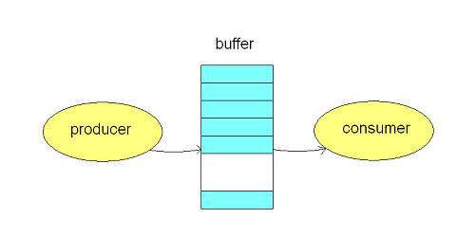
Producer / consumer
queue.Queue
queue.put
queue.get

Slide 4
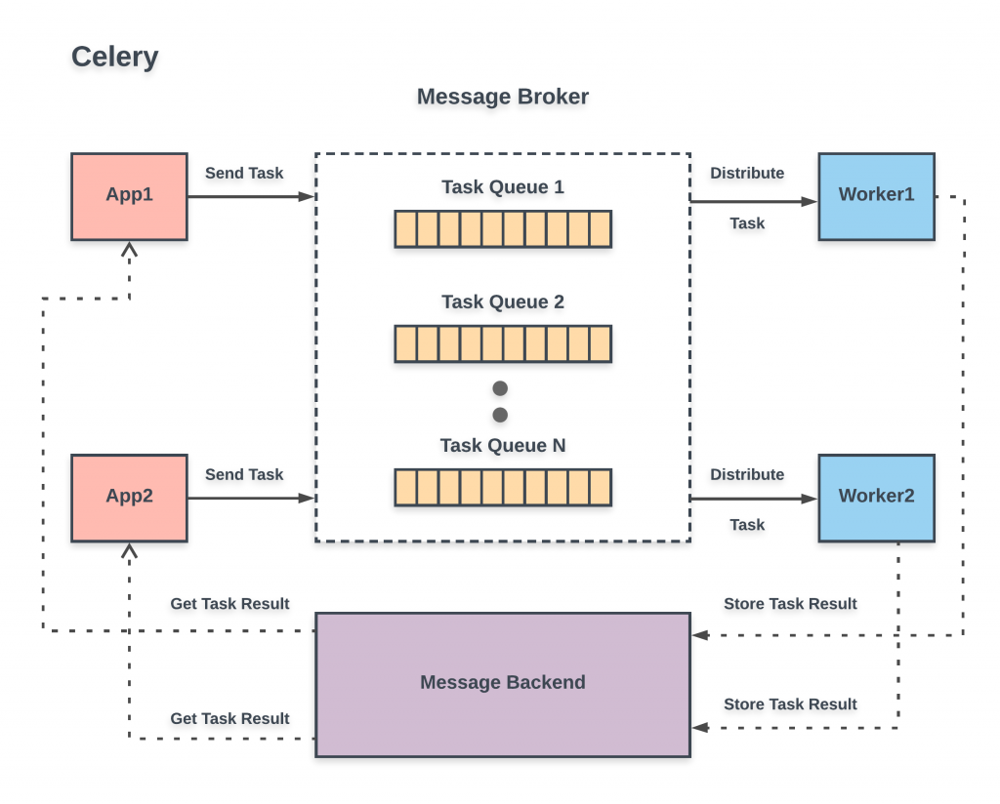
Task queue

Slide 5
Doing multiple things at once
 | Threads | Processes | Asynchronous | Distribution
What | One process, one memory “space”, multiple executors | Multiple programs running | Using event loop to react to system events | Multiple computers cooperate
Examples | threading module | Multiprocessing, subprocess, xargs | “async def”, javascript | Celery, Airflow, Hadoop, Spark, SQS
Advantages |  | No race conditions
Disadvantages |  | No easy communication | Needs different modules, not always intuitive

