Slide 1
9-channel relay board
Gijs Jackers Electronica-ICT PXL Digital

Slide 2
Content
Main components
How does it work
Case
Problems
Notes:
1 MAIN COMPONENTS
2 HOW DOES IT WORK
3 CASE
4 PROBLEMS

Slide 3
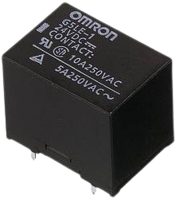
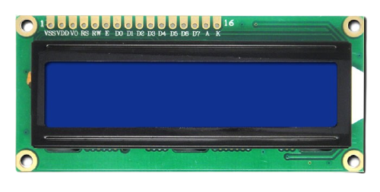
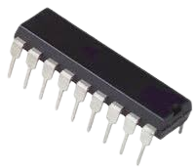
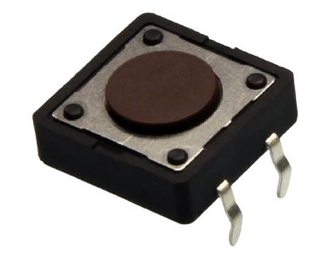
Main components
Relays
Push buttons
LCD
IC
Notes:
1 RELAY
2 PUSH BUTTONS
3 LCD
4 ICS

Slide 4
Relays
Electrical switch
Up to 250V
Latching relays
Notes:
ELECTRICAL SWITCH
> A SIGNAL WILL LET THEM TOGGLE THERE STAT
THEY CAN HANDLE A LOAD UP TO 250V DC
LATCHING RELAYS
>SIGNAL (12V) TO POWER
>SIGNAL TO POWER OFF

Slide 5
Push button
Push = signal
Notes:
IF THE BUTTON IS PUSHED A SIGNAL IS BEING SENT TO THE IC
THE IC KNOWS WHICH BUTTONS IS PUSHED SO IT KNOWS WHICH RELAY TO TOGGLE

Slide 6
LCD
Displays state relays
ON / OFF
Notes:
THE LCD DISPLAYS THE STATE OF THE RELAYS
THEY ARE EIGHTER ON OR OFF
SHOWS ALL 9 RELAYS STATES

Slide 7
IC
integrated circuit
The brains
Notes:
IC OR INTEGRATED CIRCUIT
CALLED THE BRAINS
CONTROLS EVERY THING
IT KNOWS …
➔ WITCH BUTTON IS PUSHED
WITCH RELAY TO TOGGLE
SENDS THE INFORMATION TO THE LCD

Slide 8
How does it work?
Input: 12VDC
IC2
Signal from button
Relay
Screw connector
Notes:
1) 12V INPUT
2) POWERS THE SYSTEM
3) SIGNAL FROM BUTTON GOS TO IC2
4) IC2 -> TO TOGGLE BETWEEN ON AND OFF
5) THE RELAY THEN LETS THE POWER TO THE SCREW CONNECTOR

Slide 9
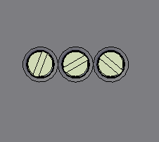
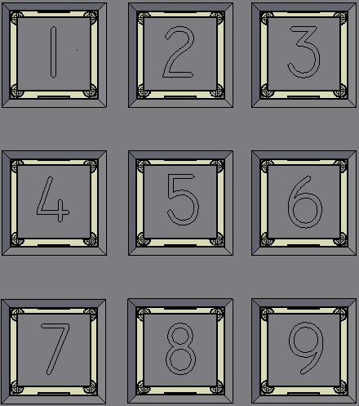
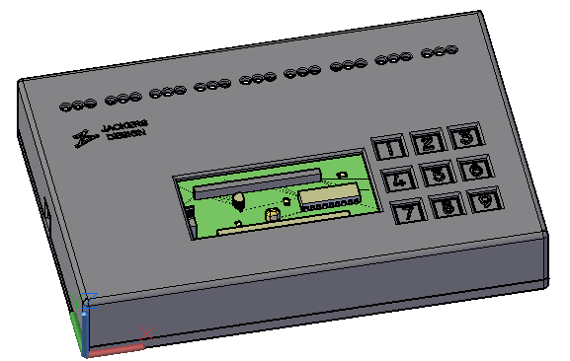
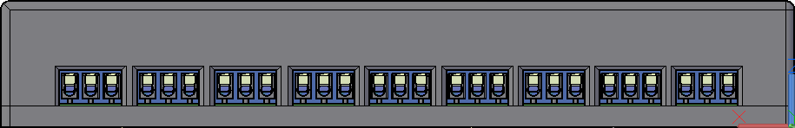
Case
2
4
1
3
Notes:
1 PICTURE ONE: THE OVERALL LAYOUT OF THE CASE
2 PICTURE TWO:
A CLOSE UP OF THE ACCESS HOLES TO THE SCREWS OF THE SCREW CONNECTOR,
FOR TIGHTENING THE WIRE TO THE METAL
3 PICTURE TREE: THE 9 SCREW CONNECTORS
4 PICTURE FOUR: A CLOSE UP FROM THE NUMPAD OF THE PUSH BUTTONS

Slide 10
Problems
Footprint to small
LCD socket
IC1 not connected
Notes:
THE PROBLEMS THAT I ENCOUNTERED WHILE MAKING THE PROJEC
FOOTPRINT TO SMALL OF SOME COMPONENTS
SOLUTION ONE: CHANGING THE LAYOUT OF THE HOLES BY DESIGNING A NEW FOOTPRINT
SOLUTION TWO: CHANGING THE FOOTPRINT FOR DIFFERENT COMPONENT WITH THE SAME SPECS

Slide 11
QUESTIONS?

