Slide 1


DSL compilation with kiama
Gijsbert van Vliet
Maart 2022

Slide 2
Introduction
Background
Internal vs external DSL
Compiler steps
Kiama

Slide 3

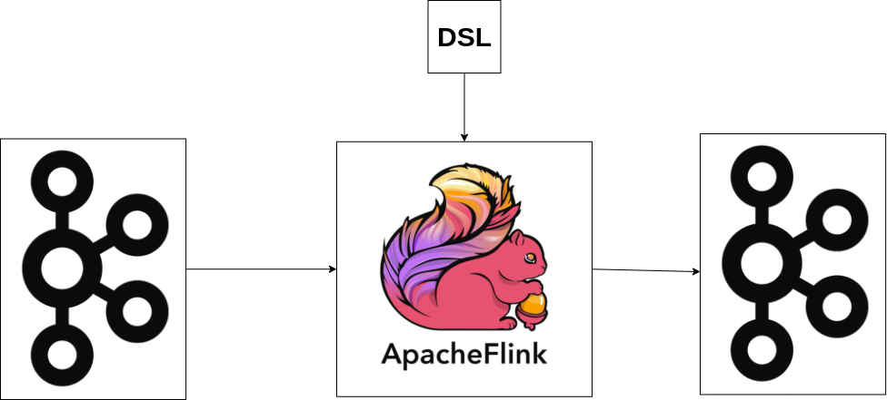
Background

Slide 4
Internal vs external DSL
An internal DSL is actual scala code with a different syntax compared to actual scala.
An external DSL is interpreted and parsed to scala code.

Slide 5

Internal vs external DSL‘s
For internal use
Internal DSL
Scala is particularly good at creation of internal DSL’s.
The scala compiler and IntelliJ help with things like:
Syntax highlighting
Many compile time validations
External DSL
Requires implementation of most of the compilation steps by the writer of the compiler
More freedom in DSL syntax design
No JDK and working sbt required, only JRE and compiler jar with some configs
IntelliJ and vscode still provide tools for syntax highlighting

Slide 6

Compiler steps

Slide 7
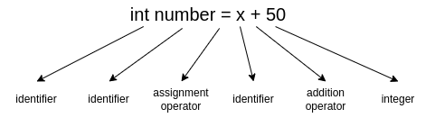
Lexical analyzer
Primary functions:
Identify tokens
Classify tokens
Identify tokens which are not part of the language

Slide 8
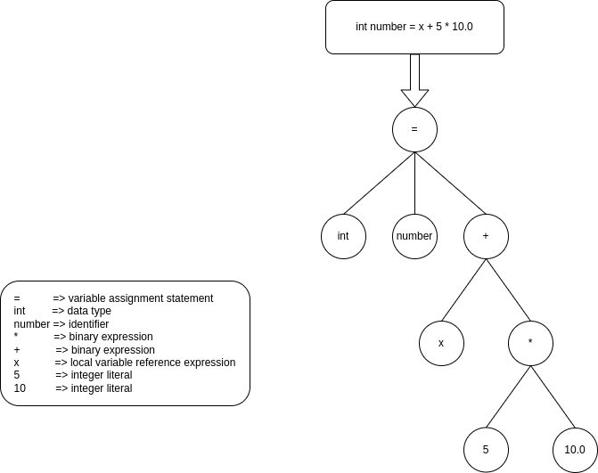
Syntax analyzer
Primary functions:
Create Abstract Syntax Tree (AST)
Validate structure of tokens

Slide 9
Semantic analyzer
Primary functions:
Check for data type mismatches
Check for correctness of input argument for function expressions and the like.
Check for dead variables or local variable references with no origin.

Slide 10
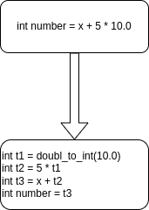
Intermediate code generation
Primary functions:
Generates code that will be easier to translate into source code later on.
Allows maintaining precedence ordering of source language.

Slide 11
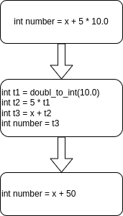
Code optimization
Primary functions:
Improve execution speed of generated code
Remove unused variable assignments
Prematurely optimizes expressions

Slide 12
Code generation
Primary functions:
Allocate memory locations for variables
Generate relocatable machine code

Slide 13
Kiama
Kiama is a lightweight functional scala framework used for compilation of external DSL’s.
It provides functionality like:
A parser to convert DSL source code to AST objects (lexical and syntax analyzer compilation steps)
Tree traversing and rewriting logic (very useful in semantic analyzer and optimization steps)
Option to keep track of originating positions (in the DSL source code) of AST nodes
Pretty printer functionality to convert AST back to text

Slide 14
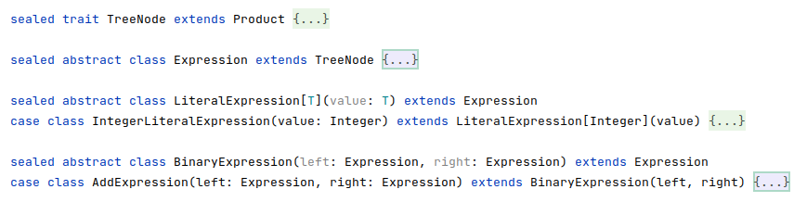
Kiama AST node definitions

Slide 15

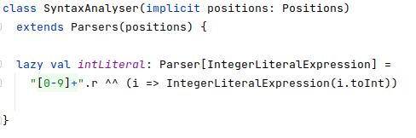

Kiama parsing

Slide 16
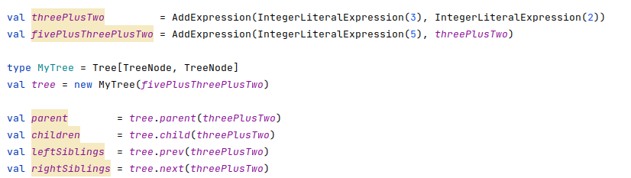
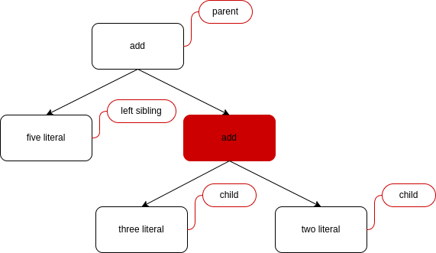
Kiama tree relations
5 + (3 + 2)

Slide 17
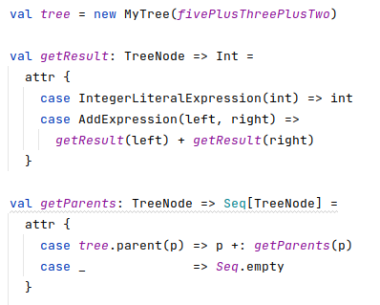
Kiama attributes
Kiama supplies attributes which is similar to a function on tree nodes.
Unlike functions, a kiama attribute will also cache results.

Slide 18
Kiama tree rewriting
In Kiama the tree can be rewritten.
Replacing or even removing certain nodes.
This is done using strategies:
A strategy can be used to rewrite a tree using the rewrite method:
A strategy is said to:
Fail: if it returns None
Succeed: if it returns Some(...)
Basic predefined strategies are:
Id: which always succeed and returns the original term
Fail: which always fails

Slide 19


Strategies from functions
Kiama always uses the following shortcut for partial functions:
Strategies can be created as follows:
Note that strategy method will fail whenever f cannot be applied or it returns None.
One can also use rules to define a strategy:
Note that rulef can never fail.

Slide 20

Combining strategies
Multiple strategies can be combined in order to define new strategies:
p <+ q: tries to apply p to a node. If it succeeds, return outcome of p, else try to apply q and return that result
p <* q: tries to apply p and, if it succeeds, it will apply q to the outcome of p

Slide 21
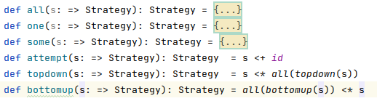
Strategy traversals
Strategies also define the order in which the tree is traversed when applying the strategy to do a rewrite:
all: tries to apply s to all children of the node in left to right order. If it succeeds for all children, replace them all with result of s and succeed
one: is similar, but succeeds as soon as s succeeds for one of the children
some: is similar, but tries to apply s to all children and simply replaces those for which s succeeded
attempt: tries to apply s to all (sub)nodes, and returns original node if s fails
topdown: applies s to given node and then in topdown fashion to all its children
bottomUp: applies s bottom fashion up to all nodes

Slide 22
Good and bad points of kiama
For internal use
Upsides
Elegant api
Lightweight
Performant
Good documentation
Downsides
Issue with duplicate nodes in a tree
Unclear errors thrown by kiama parser
Positions get lost in rewrites

Slide 23
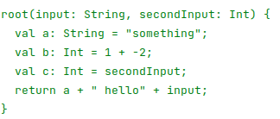
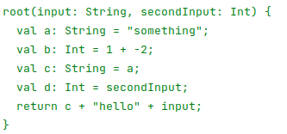
Example project
I created example project¹⁾ that parses, validates, optimizes and executes DSL‘s that look like this:
1) https://github.com/GijsbertvanVliet/kiamaDsl;

Slide 24




Example project
I created example project¹⁾ that parses, validates, optimizes and executes DSL‘s that look like this:
Here all tree traversal related logic is only <150 lines of code
1) https://github.com/GijsbertvanVliet/kiamaDsl;

Slide 25
Conclusion
Kiama is not perfect, but it‘s good at what it does
Very useful for any tree-like structured data one might encounter and need to traverse

Slide 26
Any questions?

