Slide 1
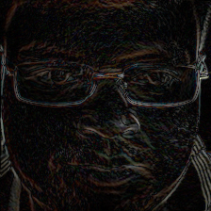
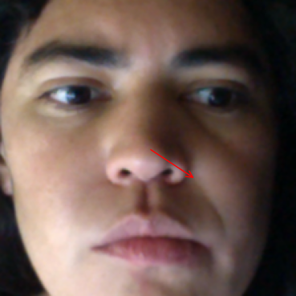


Imperceptible Backdoor Attacks on Deep Regression Models
Gijs van de Meene
Delft University of Technology
Introduction
Gaze estimation
WaNets backdoor attack
Deep learning's rise has brought valuable applications but also significant security risks, especially with pretrained models. These models can be backdoored during training to behave normally until triggered by specific patterns, posing threats across various tasks like image and speech recognition, or language processing. A specific backdoor called the WaNets backdoor attack is notable for its imperceptibility
While most research targets classification models, this study focuses on gaze estimation using deep regression models. It examines whether these models are similarly vulnerable and how the attacks compare in terms of imperceptibility.
A regression model is needed to perform the attack where we want to compare the results in both a poisoned and a clean environment. To allow full control over the process we train our own model, in particular one that performs gaze estimation.
The second objective is to implement the WaNets backdoor attack and use it to poison the training data.
This attack applies a very subtle distortion to the input that is generally very hard to see with the naked eye.
To show the images are distorted, a residual image is required.
Original
Warped
Residual image
Results
Training a model using a clean data set
Implementation requirements
The goal of this research is to determine how vulnerable regression models are to backdoor attacks compared to classification models which have already been subject to a lot of research. This leaves us with the first objective:
Training a gaze estimation model
Additionally, we want to measure how it is affected by the WaNets backdoor attack. Requiring the second necessity:
Implementing the attack

