Slide 1
CSE3000
progression

Slide 2
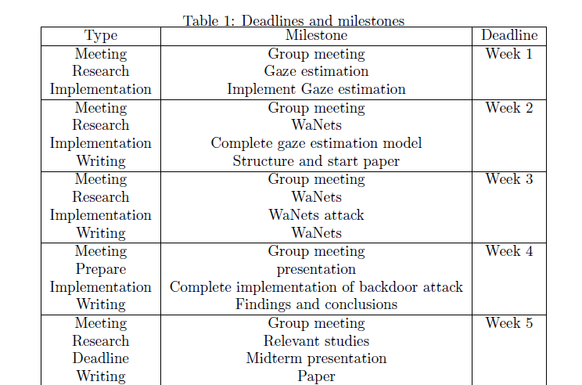

Slide 3
Implementation
planned
completed
Week 1 & 2:
Gaze estimation model
Week 3 & 4:
WaNets backdoor implementation
Gaze estimation model
Achieved angular error:
WaNets implementation
Implemented image warping
Not yet used to poison a model

Slide 4
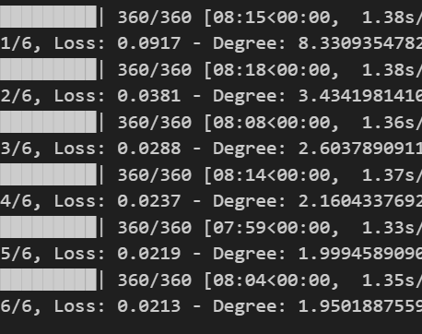
Gaze estimation
Problems:
Wrong data set
Wrong colour channel ordering
Results
Angular error

Slide 5
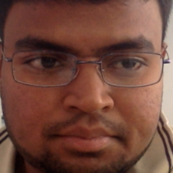
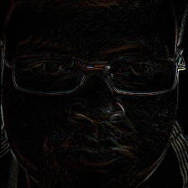

WaNets backdoor attack
Problems:
Verification of the implementation
Designed to be imperceptible
Create a residual similar to the creators’ paper

Slide 6
Writing
planned
completed
Paper structure
Findings and conclusion on implementation
introduction

Slide 7
Research
planned
completed
Gaze estimation
WaNets backdoor attack
Gaze estimation
WaNets backdoor attack

