Slide 1

Functional Programming
Actually, the basics isn't that weird

Slide 2
Overview
Background
Programming Paradigms
FP Concept
Advanced techniques
Example
Basic techniques

Slide 3

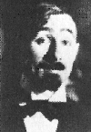
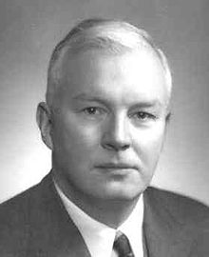
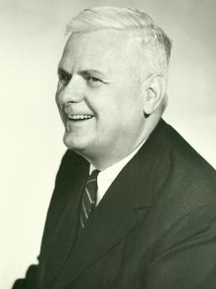

Background
Haskell Curry
Alonzo Church
Moses Schönfinkel
Notes:
Built from Lambda Calculus, developed in 1930's by Alonzo Church.
Also co-developed by Moses Schönfinkel and Haskell Curry in 1920s/1930s
In 1937 Turing proved that the lambda calculus and Turing machines are equivalent models of computation
First language was LISP in 1950s, at MIT. Wasn't "pure". Some cite "Information Processing Language" from 1956 as first.
Today, we have Common List, Scheme, Clojure, Worlfram Lang, Racket, Erlang, OCaml, Haskell, F# and more.

Slide 4

Programming Paradigms Procedural Programming
BASIC / C / Bash / Lua
Ordered statements
Separate data and logic
"Natural thought flow"

Slide 5
Programming Paradigms Object Oriented Programming
C++ / Java / C#
Mutating object state
Combine data and logic
Polymorphism / Inheritence
"Natural object abstraction"

Slide 6
Programming Paradigms Functional Programming
Common LISP / Haskell / Erlang
Functional separation
Separate data and logic
"Natural behaviour abstraction"

Slide 7

FP Concepts
Immutability & Pure functions
Separating functions and data
First-class functions
High-order functions
Partial application / Currying
Recursion
Closure, Functors, Monads
Functional Composition

Slide 8


Basic Techniques
Immutability & Pure Functions
Separating Functions and Data
First-class Functions
Functional Composition

Slide 9

Basic Techniques
Immutability & Pure Functions
Constant values
Do not modify function arguments
Do not modify deep references
Return modified copies

Slide 10
Basic Techniques
Separating Functions and Data
Functions and data are different
Functions consume data
Don’t attach functions to specific objects

Slide 11
Basic Techniques
First-class Functions
Functions can be treated as data
Assign functions to variables
Pass functions as arguments
Pass functions as return values

Slide 12
Basic Techniques
Functional Composition
One function calls several functions
Abstracts away sequence of behaviours

Slide 13


Example

Slide 14

Advanced Techniques
High-order Functions
Partial Application / Currying
Recursion & Tail-recursion
Closure, Functors, Monads

Slide 15

Advanced Techniques
High-order Functions
A function that receive or return functions
Function that views functions as data

Slide 16
Advanced Techniques
Partial Application / Currying
Applying arguments in steps
Scopes previous arguments for future use
A “function factory”

Slide 17
Advanced Techniques
Recursion
A function which calls itself
Base case
Return result of recursive call
Tail recursion optimization

Slide 18
Advanced Techniques
Closure, Functors, Monads
Fancy words for mostly simple concepts
Closure – Child scopes has access to parent scope
Functors – Wrapper(s) which can be mapped
Monads – Functor(s) which can be flatMapped

Slide 19
Summary
Background
Programming Paradigms
FP Concept
Advanced techniques
Example
Basic techniques
Immutability &Pure functions
Separating functions and data
First-class functions
High-order functions
Partial application / Currying
Recursion & Tail-recursion
Closure, Functors, Monads
Functional Composition

