Slide 1
DevOps Experts
Containers Orchestration
Modi Tamam

Slide 2
Container Orchestration

Slide 3
Why do we need container orchestrator?
Docker solves the problem of making sure everything is in place for a process to run, but it doesn’t have much to say about how a container fits into a full system. It also doesn’t address questions about load balancing, container lifecycles, health, or readiness. And it’s silent about how to surface a scalable, fault-tolerant, and reliable service.

Slide 4
What is Container Orchestration
Container orchestration is all about managing the life cycles of containers, especially in large, dynamic environments. Software teams use container orchestration to control and automate many tasks:
Provisioning and deployment of containers
Redundancy and availability of containers
Scaling up or removing containers to spread application load evenly across host infrastructure

Slide 5
What is Container Orchestration
Movement of containers from one host to another if there is a shortage of resources in a host, or if a host dies
Allocation of resources between containers
External exposure of services running in a container with the outside world
Load balancing of service discovery between containers
Health monitoring of containers and hosts
Configuration of an application in relation to the containers running it

Slide 6
Container Orchestration Tools
Docker Swarm - Docker Swarm provides native clustering functionality for Docker containers, which lets you turn a group of Docker engines into a single, virtual Docker engine.
Mesosphere Marathon - Marathon is a container orchestration framework for Apache Mesos that is designed to launch long-running applications. It offers key features for running applications in a clustered environment.
Kubernetes - Kubernetes is an orchestration system for Docker containers. It handles scheduling and manages workloads based on user-defined parameters.

Slide 7
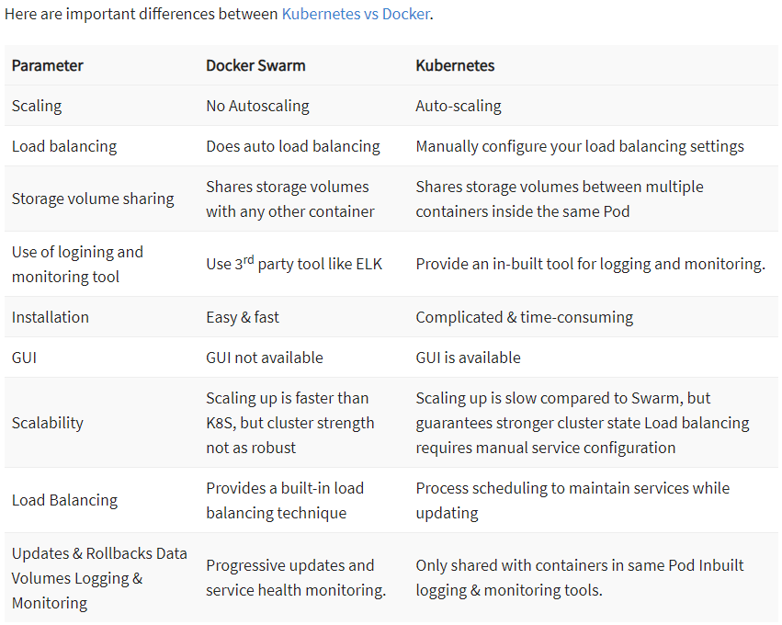

Slide 8
Kubernetes Basics
Cluster: It is a collection of hosts that helps you to aggregate their available resources into a usable pool.
Master: A collection of components which make up the control panel of Kubernetes.
Node: It is a single host which is capable of running on a physical or virtual machine. A node should run both kube-proxy, minikube, and kubelet which are considered as a part of the cluster.
Namespace: It is a logical cluster or environment. It is a widely used method which is used for scoping access or dividing a cluster.

Slide 9
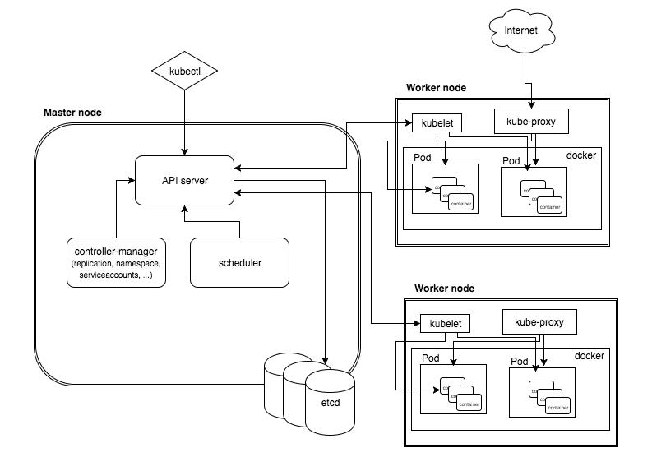
Kubernetes Architecture

Slide 10
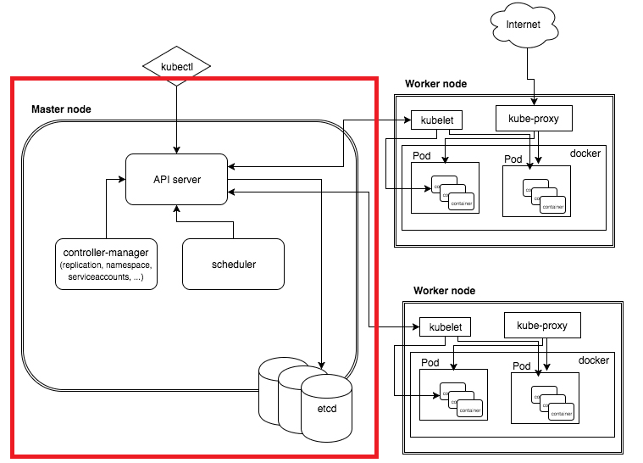
Master Components
Entry point for all kind of administrative tasks.
Master components provide the cluster’s control plane.
Master components can be run on any machine in the cluster.
Master components can be api server, etcd, scheduler.

Slide 11
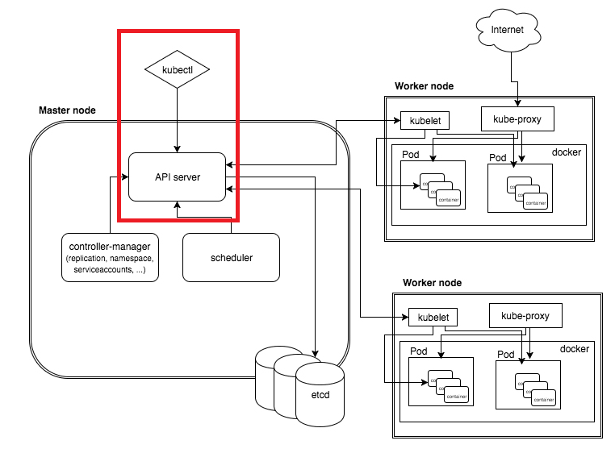
Kube-APIServer
The API server is a component of the Kubernetes control plane that exposes the Kubernetes API. The API server is the front end for the Kubernetes control plane.

Slide 12
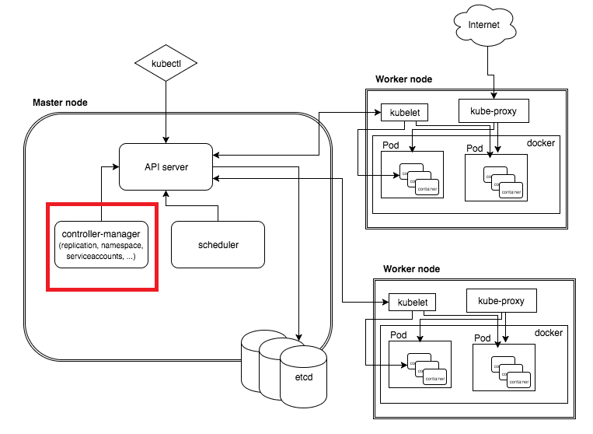
Control Plane Components
Control plane component that runs controller processes.
Some types of these controllers are:
Node controller.
Job controller.
Endpoints controller.
Service Account & Token controllers.
Notes:
Node controller: Responsible for noticing and responding when nodes go down.
Job controller: Watches for Job objects that represent one-off tasks, then creates Pods to run those tasks to completion.
Endpoints controller: Populates the Endpoints object (that is, joins Services & Pods).
Service Account & Token controllers: Create default accounts and API access tokens for new namespaces.

Slide 13
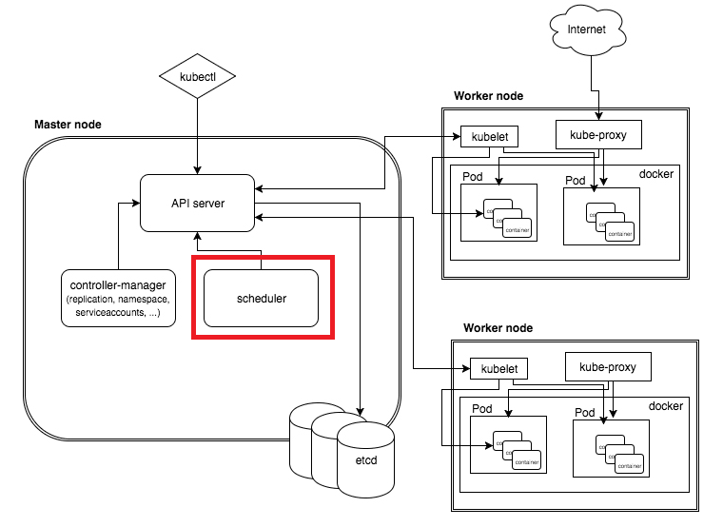
Scheduler
Control plane component that watches for newly created Pods with no assigned node, and selects a node for them to run on.
Factors taken into account for scheduling decisions include: individual and collective resource requirements, hardware/software/policy constraints, affinity and anti-affinity specifications, data locality, inter-workload interference, and deadlines.

Slide 14
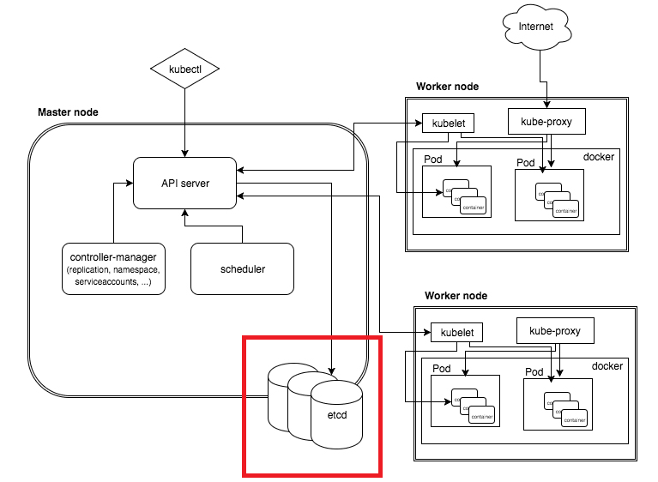
etcd
Consistent and highly-available key value store used as Kubernetes' backing store for all cluster data.

Slide 15
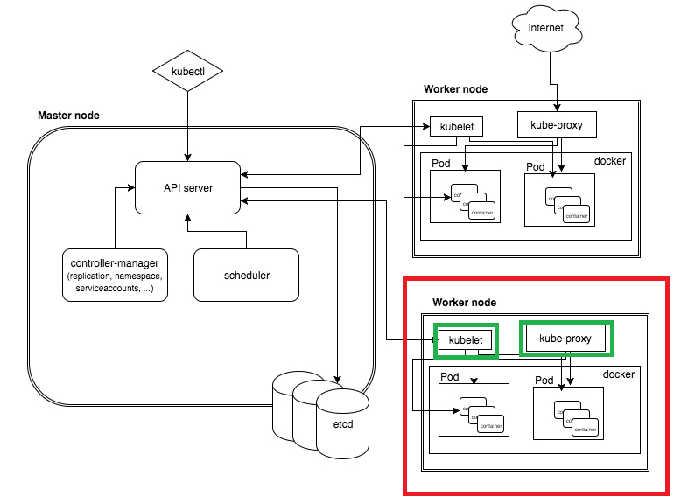
Kubernetes Architecture
Node components
Node components run on every node, maintaining running pods and providing the Kubernetes runtime environment.
Node components can be kubelet, proxy and container runtime

Slide 16
Working With Kubernetes
To work with Kubernetes, you use Kubernetes API objects to describe your cluster’s desired state
You describe what applications or other workloads you want to run, what container images they use, the number of replicas, what network and disk resources you want to make available, and more.
You set your desired state by creating objects using the Kubernetes API, typically via the command-line interface, kubectl.
You can also use the Kubernetes API directly to interact with the cluster and set or modify your desired state.

Slide 17
Environment Setup

Slide 18
Kubectl CLI
Use the Kubernetes command-line tool, kubectl, to deploy and manage applications on Kubernetes.
Using kubectl, you can inspect cluster resources.
With Kubectl you can also create, delete, and update components within your kubernetes cluster.

Slide 19
Kubectl CLI
Kubectl command allows us to work in two methods:
Declarative.
Ad Hoc commands.
When working in declarative way we will create a YAML file that will describe our kubernetes components and kubectl will be used to deploy, update or remove them from our cluster.
When working in Ad Hoc commands we will run specific commands against our kubernetes cluster.

Slide 20
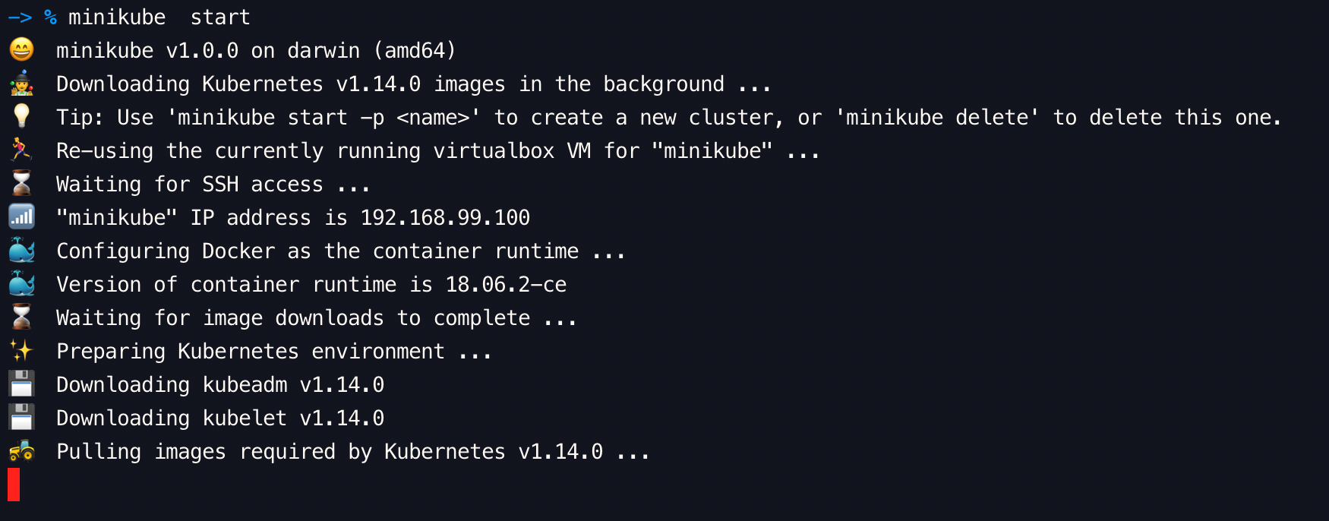
Kubectl CLI
Open CMD / Terminal:
Run minikube start

Slide 21
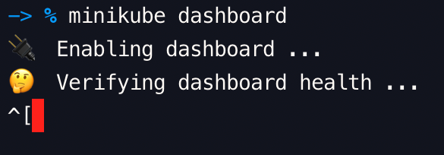
Kubectl CLI
Open CMD / Terminal:
Run minikube dashboard

Slide 22
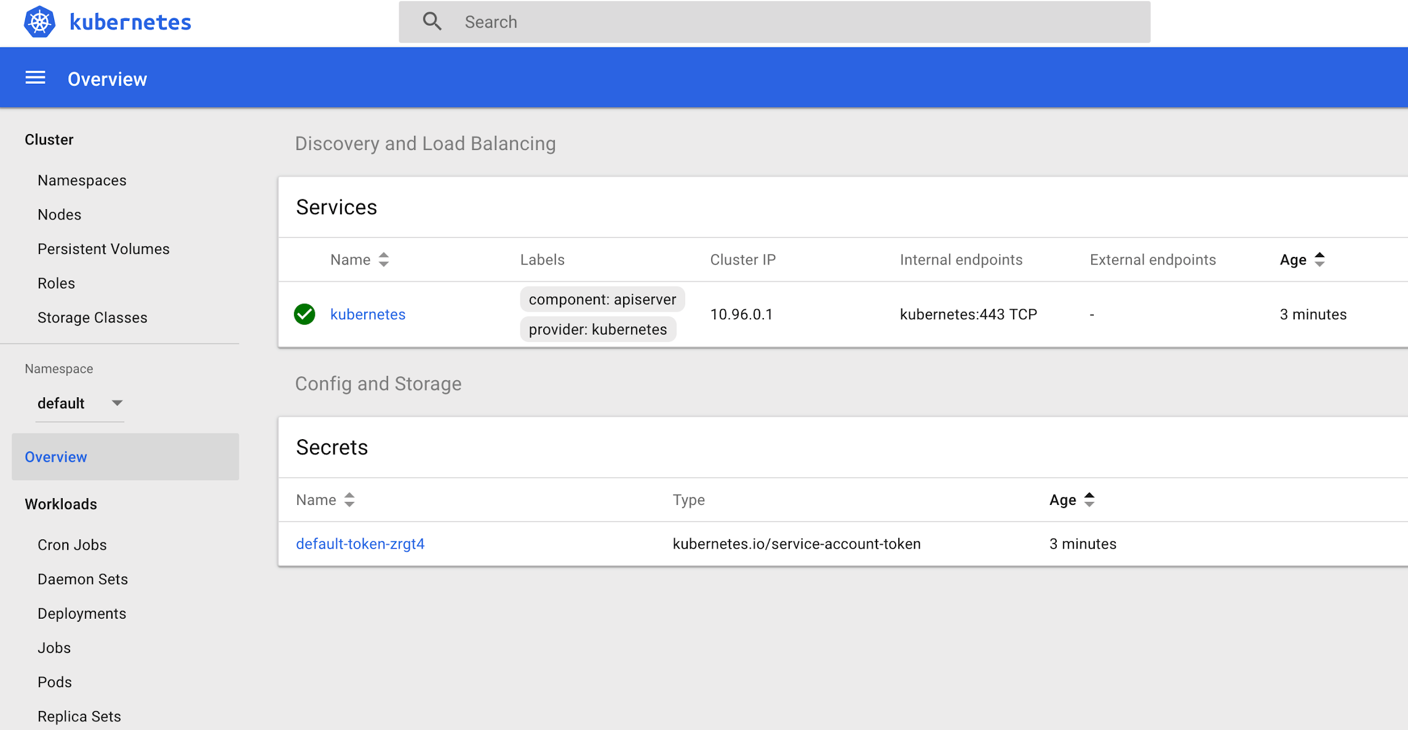

Slide 23
Kubernetes Nodes
A Node is a worker machine in Kubernetes and may be either a virtual or a physical machine, depending on the cluster. Each Node is managed by the control plane. A Node can have multiple pods, and the Kubernetes control plane automatically handles scheduling the pods across the Nodes in the cluster. The control plane's automatic scheduling takes into account the available resources on each Node.
Every Kubernetes Node runs at least:
Kubelet, a process responsible for communication between the Kubernetes control plane and the Node; it manages the Pods and the containers running on a machine.
A container runtime (like Docker) responsible for pulling the container image from a registry, unpacking the container, and running the application.

Slide 24
Kubernetes Nodes
kubectl get nodes
kubectl describe node minikube

Slide 25
Kubernetes Pods
A pod is a group of one or more containers (such as Docker containers), with shared storage/network, and a specification for how to run the containers.
A pod’s contents are always co-located and co-scheduled, and run in a shared context.
A pod models an application-specific “logical host” - it contains one or more application containers which are relatively tightly coupled — in a pre-container world, being executed on the same physical or virtual machine would mean being executed on the same logical host.

Slide 26
Kubernetes Pods Example
Under kubernetes-demo-part-1/init/commands.txt:
Running a redis instance
Running and exposing NGINX
Manual/Unmanaged setup.

Slide 27
Kubernetes Deployments
A Deployment controller provides declarative updates for Pods and ReplicaSets.
You describe a desired state in a Deployment object, and the Deployment controller changes the actual state to the desired state at a controlled rate.
You can define Deployments to create new ReplicaSets, or to remove existing Deployments and adopt all their resources with new Deployments.

Slide 28
Kubernetes Deployment Exercise
deployment/commands.txt

Slide 29
Kubernetes Services
An abstract way to expose an application running on a set of Pods as a network service.
With Kubernetes you don't need to modify your application to use an unfamiliar service discovery mechanism. Kubernetes gives Pods their own IP addresses and a single DNS name for a set of Pods, and can load-balance across them.
Motivation
Pods are non permanent resources.
In a Deployment, the set of Pods running in one moment in time could be different from the set of Pods running that application a moment later.
This leads to a problem: which IP address to connect to?

Slide 30
Kubernetes Services Exercise
The set of Pods targeted by a Service is (usually) determined by a Label Selector.
Notes:
The long story: https://kubernetes.io/docs/tutorials/kubernetes-basics/expose/expose-intro/

Slide 31
Exercise
Deploy nginx and expose it using deployment and service objects.

Slide 32
Exercise
Demonstrate K8 service and load balancing capabilities:
Write a flask application that returns the application’s host ip
Wrap the application in a docker image.
Deploy the application on your K8 cluster instance.
Scale it out to 3 instances.
Expose your application to the external world (outside of the cluster).
Perform API calls that will demonstrate load balancing.

Slide 33
Kubernetes Deployments
The following are typical use cases for Deployments:
Create a Deployment to rollout a ReplicaSet.
Change the state of pods group
Rollback to an earlier Deployment revision if the current state of the Deployment is not stable.
Scale up the Deployment to facilitate more load.
Use the status of the Deployment as an indicator that a rollout has stuck.
Clean up older ReplicaSets that you don’t need anymore.
kubectl create deployment hello-node --image=k8s.gcr.io/echoserver:1.4

Slide 34
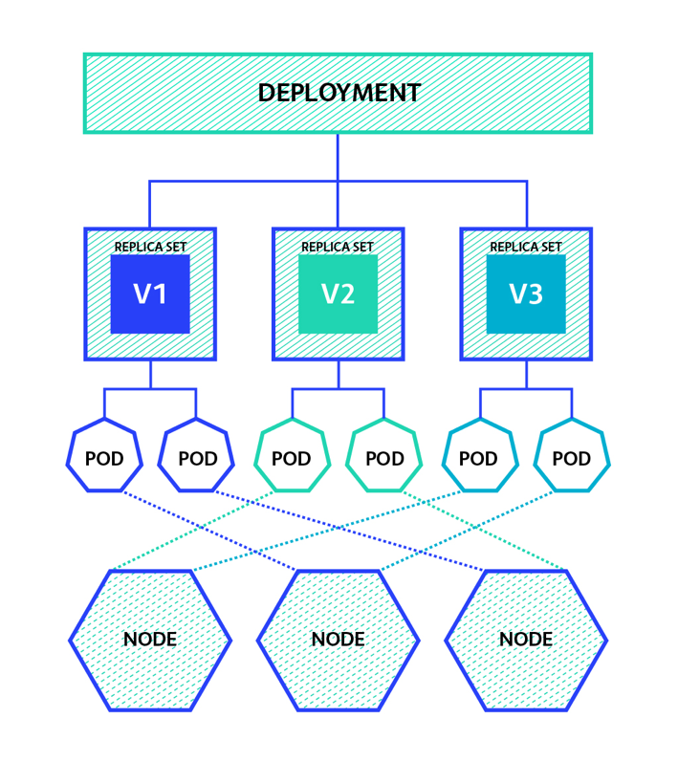
Kubernetes Components Hierarchy

Slide 35
services-networking/ingress
https://kubernetes.io/docs/concepts/services-networking/ingress/

Slide 36
How do you define a Kubernetes service?
Services are defined in YAML, as are all Kubernetes objects. Suppose you deployed pods running a back-end service to process data coming from a web front end. To expose a service named ‘service-backend’ on the deployment ‘deployment-backend’ you would use:
apiVersion: v1
kind: Service
metadata:
name: service-backend
spec:
ports:
- port: 4000
protocol: TCP
targetPort: 333
selector:
run: deployment-backend
type: ClusterIP
The service ‘service-backend’ will be created, and any pod in the cluster can access it on their port 333 via http://service-backend:4000, or at the cluster’s IP address using port 4000.
Kubernetes services can also be created using the ‘kubectl expose’ command, which does not require a YAML file. The same service can be created using the command:
kubectl expose deployment deployment-backend - - port=333- - target-port=4000 - - name=service-backend

Slide 37
Workloads examples
kubectl create deployment hello-node --image=gcr.io/hello-minikube-zero-install/hello-node
kubectl get deployments
kubectl describe deployment hello-node
kubectl get pods
kubectl scale deployment/hello-node --replicas=3
kubectl get all
kubectl expose deployment hello-node --type=ClusterIP --port=8080
kubectl get services

Slide 38
Exercise
Deploy a MySQL pod container using the kubectl run command.
Write a YAML file that deploys MySQL pod container.
Write a YAML file to setup a service that expose the MySQL pod port (3306) on port 33006 on your machine host.
Edit the guestbook to deploy 3 redis slave replicas
Add the following label: appname: guestbook
Edit frontend-service.yaml to select the frontend deployment by that previous label.

Slide 39
Ingress Controllers
In order for the Ingress resource to work, the cluster must have an ingress controller running.
Unlike other types of controllers which run as part of the kube-controller-manager binary, Ingress controllers are not started automatically with a cluster. Use this page to choose the ingress controller implementation that best fits your cluster.
Kubernetes as a project supports and maintains AWS, GCE, and nginx ingress controllers.

