Slide 1
DevOps Experts
Linux
Modi Tamam

Slide 2
History and background
Kenneth Lane Thompson (born February 4, 1943) is an American pioneer of computer science. Thompson worked at Bell Labs for most of his career where he designed and implemented the original Unix operating system.

Slide 3
Linux
Linux is a family of free and open-source software operating systems built around the Linux kernel.
Linux is actually an umbrella term for multiple OS’s that are based on UNIX.
Typically, Linux is packaged in a form known as a Linux distribution (or distro for short) for both desktop and server use (such as: Ubuntu, Red hat, CentOS, Fedora, OpenSuse and many more).
The defining component of a Linux distribution is the Linux kernel, an operating system kernel first released on September 17, 1991, by Linus Torvalds.
Many Linux distributions use the word "Linux" in their name.

Slide 4
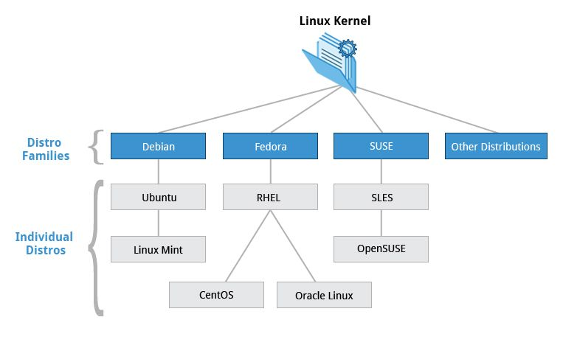

Slide 5
Intro
Linux is one of the most popular in the powering smart cars, android devices, supercomputers, home appliances, enterprise servers and more.
Linux is actually an umbrella term for multiple OS’s that are based on UNIX.

Slide 6
Linux
The Free Software Foundation uses the name GNU/Linux to refer to the operating system family, as well as specific distributions, to emphasize that most Linux distributions are not just the Linux kernel, and that they have in common not only the kernel, but also numerous utilities and libraries, a large proportion of which are from the GNU project.

Slide 7
Virtual Box
In order to use Ubuntu OS on our computer we have 2 options:
Installing it as an OS alongside our Windows OS (Dual boot).
Using virtual machine (Oracle Virtual box/ VMware).
To simplify our work, we are going to use the second option using Oracle VirtualBox which can be found online https://www.virtualbox.org/wiki/Downloads

Slide 8
Virtual Box
VirtualBox is powerful Cross-platform Virtualization Software.
"Cross-platform" means that it installs on Windows, Linux, Mac OS X and Solaris x86 computers.
And "Virtualization Software" means that you can create and run multiple Virtual Machines, running different operating systems, on the same computer at the same time.
For example, you can run Windows 7 and Linux Ubuntu on your Windows 10 machine.

Slide 9
Virtual Box
Each virtual machine has a all the abilities of a regular computer includes:
Motherboard Options
CPU options
RAM options
Drives (CD/Floppy, Hard disks)
Audio
Network
And more..

Slide 10
Shell and Terminal

Slide 11
Terminal
It's a program called a terminal emulator.
This is a program that opens a window and lets you interact with the shell.
There are a bunch of different terminal emulators you can use.

Slide 12
Shell
Shell is a program that takes commands from the keyboard and gives them to the operating system to perform.
In the old days, it was the only user interface available on a Unix-like system such as Linux.
On most Linux systems a program called bash.

Slide 13
Shell
Installed Shells
cat /etc/shells
command programming language for UNIX-like systems, defined by the POSIX standards.
sh on POSIX Systems
POSIX is a family of standards defined by IEEE for vendors to make operating systems compatible. Thus, it helps us develop cross-platform software for multiple operating systems by following a set of guidelines. sh conforms to these standards.
On most Linux systems, sh is a symlink to the actual implementation of Bourne Shell. We can verify it through the following command: file -h /bin/sh

Slide 14
Bash
Bash is a Unix shell and command language written by Brian Fox for the GNU Project as a free software replacement for the Bourne shell. First released in 1989, it has been used as the default login shell for most Linux distributions. A version is also available for Windows 10 via the Windows Subsystem for Linux.
The .bashrc file is a script file that’s executed when a user logs in. The file itself contains a series of configurations for the terminal session. This includes setting up or enabling: coloring, completion, shell history, command aliases, and more.

Slide 15
Sudo
Sudo stands for either "substitute user do" or "super user do" and it allows you to elevate your current user account to have root privileges temporarily.
This is different from “su” which is not temporary.
Using sudo is a good way to protect the user’s computer from being used as a tool for exploitation.

Slide 16
What is root privileges?
The root account is the most privileged on the system and has absolute power over it.

Slide 17
Package manager
Apt is a command line frontend for the dpkg packaging system and is the preferred way of managing software from the command line for many distributions.
Apt-get operates on a database of known, available software.
It performs installations, package searches, and many other operations.
Due to this fact, before beginning any packaging operations with apt-get, we need to ensure that our local copy of the database is up-to-date.
Update the database with the following command. Apt-get requires administrative privileges for most operations:
Here are a few operations:
Install a package: sudo apt-get install package1
Upgrade a package: sudo apt-get remove package1

Slide 18
Exercise:
Install python 3.10
Instal a command line utility to monitor vital resources in real time.
Configure the columns presented - add the memory graph.

Slide 19
Commands

Slide 20
Pipe in Linux
The Pipe is a command in Linux that lets you use two or more commands such that output of one command serves as input to the next.
The symbol ‘|’ denotes a pipe.

Slide 21
Symlink
A symlink (also called a symbolic link) is a type of file in Linux that points to another file or a folder on your computer. Symlinks are similar to shortcuts in Windows.
ln -s <path to the file/folder to be linked> <the path of the link to be created>
unlink <path-to-symlink>

Slide 22
Commands - Find
First thing we need to do is understand how find works. Here are some of the key options:
-o : the OR operation to string multiple search criteria together
-name : find files by name
-iname : find files by name, ignoring case
-type f : find only files
-type d : find only directories
-size : find by size
-mtime : find by modified time
find &HOME -iname .bashrc -type f -size -1024M

Slide 23
File system - Navigation
Basic commands are: ls, pwd, cd
When you first open the terminal, you are in the home directory of your user.
To know which directory you are in, you can use the “pwd” command.
It gives us the absolute path, which means the path that starts from the root.
The root is the base of the Linux file system. It is denoted by a forward slash( / ).
The user directory is usually something like "/home/username".

Slide 24
ls, cd
Use the "Is" command to know what files are in the directory you are in.
You can see all the hidden files by using the command “ls - a”.
Use the "cd" command to go to a directory.
For example, if you are in the home folder, and you want to go to the /john/downloads folder, then you can type in “cd /john/downloads”.
Remember, this command is case sensitive, and you have to type in the name of the folder exactly as it is.

Slide 25
mkdir, rmdir, rm, touch
Use the mkdir command to create a folder or a directory.
For example, if you want to make a directory called “a”, then you can type “mkdir a”.
Use rmdir to delete a directory (will work only on empty directories).
To delete a directory containing files, use rm.
The touch command is used to create a file.
It can be anything, from an empty txt file to an empty zip file. For example, “touch users.txt”.

Slide 26
cp vs mv
Use the cp command to copy files through the command line.
It takes two arguments: The first is the location of the file to be copied, the second is where to copy.
For example: cp users.txt /users/users/music
mv will move the file instead of only copying it – mv users.txt /users/users/music

Slide 27
Echo, cat
echo command in linux is used to display a line of text/string on standard output or a file.
For example, if you want to create a new text file or add to an already made text file, you just need to type in, “echo hello world >> new.txt”.
The cat command is used to display the contents of a file, and it's usually used to easily view programs.
For example cat users.txt will print the text file content to terminal.

Slide 28
Text Editors

Slide 29
Vi, vim and nano
Linux has a few text editors.
They can all achieve a similar functionality, but they work differently.
VI – (for visual editor)
Vi is the first one and its initial release date was 1976.
VIM – ("vi improved")
As the name suggest it adds lot of functions to the original vi interface.
Nano
nano has always been known to be user-friendly when it comes to terminal text editors.
To edit a text file, simply, call the desired editor and the file name Sudo <vi / vim / nano> users.txt

Slide 30
vi
Let's start with VI edit: vi <file_name>
While working with the vi editor, we usually come across the following two modes:
Command mode − This mode enables you to perform administrative tasks such as saving the files, executing the commands, moving the cursor, cutting and pasting the lines or words.
Insert mode − This mode enables you to insert text into the file. Everything that's typed in this mode is interpreted as input and placed in the file.

Slide 31
vi
vi always starts in the command mode.
To enter text, you must be in the insert mode for which simply type i
To get out of the insert mode, press the Esc key, which will take you back to command mode.
To save press :wq
Lets try the following instructions: open file (vi ) press i (to enter insert mode) type anything press esc (to change back to command mode) type :wq (to save and exit)
In case vi is called on a file that does not exist it will create it once we save the file.

Slide 32
vim
vim has everything vi has. To open a file with Vim, use: vim Vim adds onto those features. Here are a some of the extended vim features:
Vim includes support (syntax highlighting, code folding, etc) for several popular programming languages (C/C++, Python)
Vim includes multilevel undo/redo.
Vim allows the screen to be split for editing multiple files.
Vim includes a built in diff for comparing files (vimdiff).
Vim doesn’t come by default in Ubuntu, to get it we will need to install it: sudo apt-get install vim

Slide 33
nano
Nano is the easiest most user-friendly editor.
One of the cool things about nano, is the fact that when you want to use “control” mode, you will use the combination of the Ctrl key with any key, without pressing the control key, it will be using the “insert” mode.
To use Nano, type: nano 1.txt
In order to go to a line use arrows
To save and exit press the file press Ctrl+X and then y Nano also gives us the ability to search text inside the file using Ctrl+W

Slide 34
Tar, zip and unzip
Tar is used to work with tarballs (or files compressed in a tarball archive) in the Linux command line.
It has a long list of uses. It can be used to compress and uncompress different types of tar archives like .tar, .tar.gz, .tar.bz2,etc
zip is used to compress files into a zip archive, and unzip to extract files from a zip archive.
For example: zip -r tip_calc.zip tip_calc

Slide 35
Exercise
Go to /tmp
Create a folder called ‘ex1’ and enter it
Create two files:
Myfirstfile.txt
Mysecondfile.txt
Use echo to put some content into them
Use tar to wrap it up.
Notes:
lesson_8/tar-directory-content.sh

Slide 36
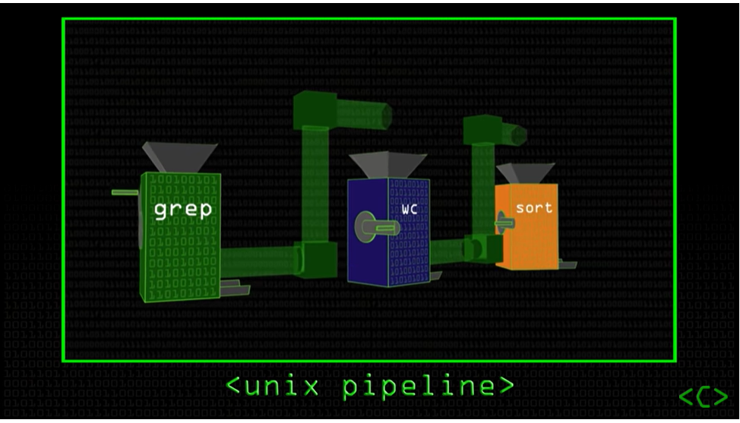
Grep

Slide 37
Grep
Grep is one of the important command that you should learn thoroughly.
Grep stands for Global regular expression print
Grep is used to search text files with regular expressions (shortly regex).
It prints the lines matching the given pattern in a text file.
If no file is given, grep will recursively search the given pattern in the files in current directory.
note that grep is case-sensitive

Slide 38
Egrep
egrep stands for extended grep. It is similar to "grep -E" command. It will do all the things that grep will do. However, It provides some additional functionalities, such as using complicated regex, than the normal grep command does out of the box.

Slide 39
Exercise:
Refer the grep/file.txt as input.
Filter out the lines that contains the word ‘hello’.
Sort the result and print it to console.
Notes:
cat grep/file.txt | grep -v hello -i | sort -r

Slide 40
Bash - Aliases
An alias is a (usually short) name that the shell translates into another (usually longer) name or command. Aliases allow you to define new commands by substituting a string for the first token of a simple command. They are typically placed in the ~/.bashrc (bash) or ~/.tcshrc (tcsh) startup files so that they are available to interactive subshells.

Slide 41
Exercise:
Add shortcut for ‘clear’ command.

Slide 42
chmod
chmod is used to change the permissions of files or directories.
On Linux and other Unix-like operating systems, there is a set of rules for each file which defines who can access that file, and how they can access it.
These rules are called file permissions or file modes.
The command name chmod stands for "change mode", and it is used to define the way a file can be accessed. permissions defines the permissions for the:
Owner of the file (the "user")
Members of the group who owns the file (the "group")
Anyone else ("others").

Slide 43
chmod
There are two ways to represent these permissions: with symbols (alphanumeric characters), or with octal numbers (the digits 0 through 7).
Let's say you are the owner of a file named myfile, and you want to set its permissions so that:
The user (owner) can read, write, and execute it.
Members of your group can read and execute it.
And others may only read it.
To achieve it we will run the command chmod 754 myfile
Here the digits 7, 5, and 4 each individually represent the permissions for the user, group, and others in that order.

Slide 44
chmod
Each digit is a combination of the numbers 4, 2, 1, and 0:
4 stands for "read"
2 stands for "write"
1 stands for "execute"
0 stands for "no permission."
7 is the combination of permissions 4+2+1 (read, write, and execute),
5 is 4+0+1 (read, no write, and execute).
4 is 4+0+0 (read, no write, and no execute).

Slide 45
chmod
For example:
chmod 777 foldername will give read, write, and execute permissions for everyone.
chmod 700 foldername will give read, write, and execute permissions for the user only.
chmod 327 foldername will give write and execute (3) permission for the user, w (2) for the group, and read, write, and execute for the users.

Slide 46
Chown
In Linux, there may be times when you might want to change the owner and group-related information for a file or directory.
change the owner of a file
chown [user-name] [file-name]
change the group of a file
chown :[group-name] [file-name]

Slide 47
Exercise
Create two users named user1 and user2.
Create a shell script.
Enable both users to run the script.

