Slide 1
DevOps Experts
Class 7
Modi Tamam

Slide 2
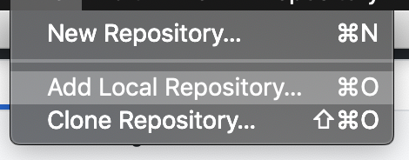
Working with Github Desktop

Slide 3
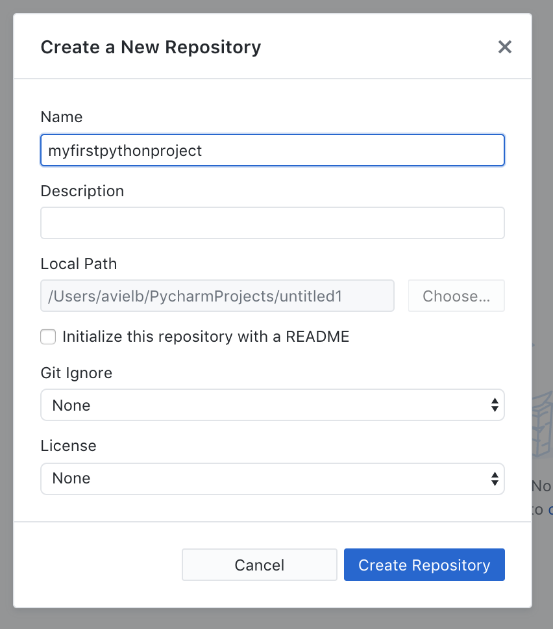
Working with Github Desktop

Slide 4
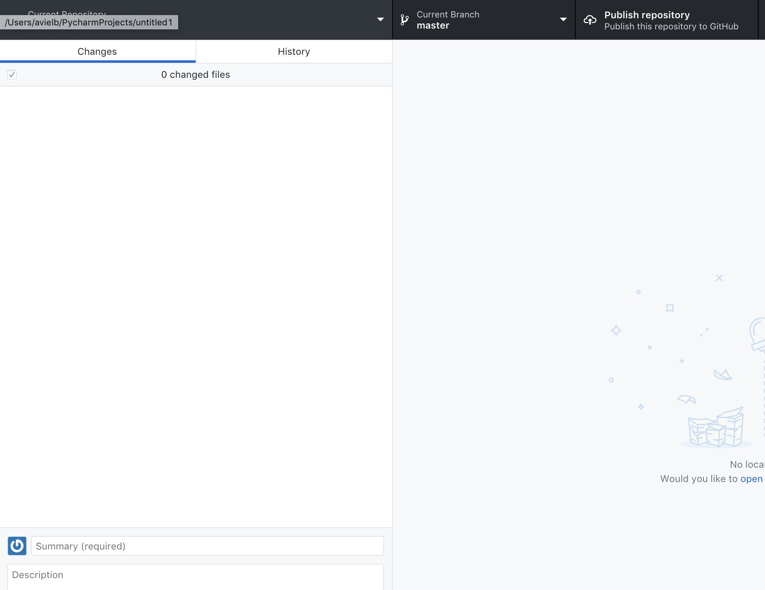
Working with Github Desktop

Slide 5
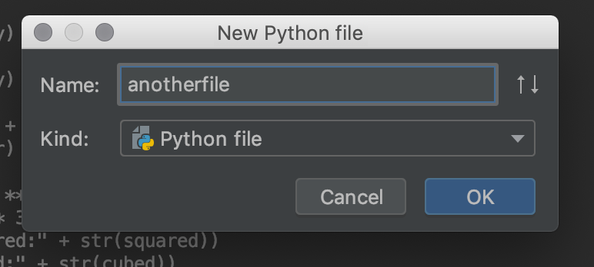
Working with Github Desktop
Add another file to your project

Slide 6
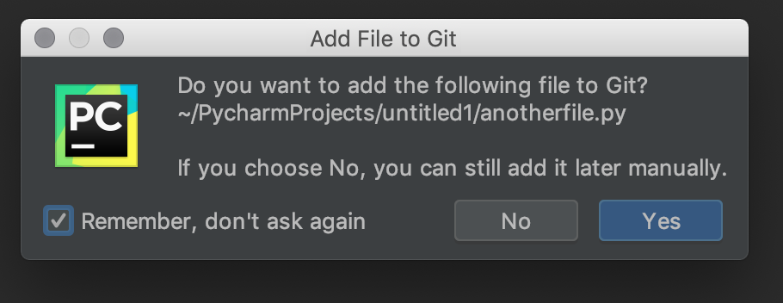
Working with Github Desktop
And click yes:

Slide 7
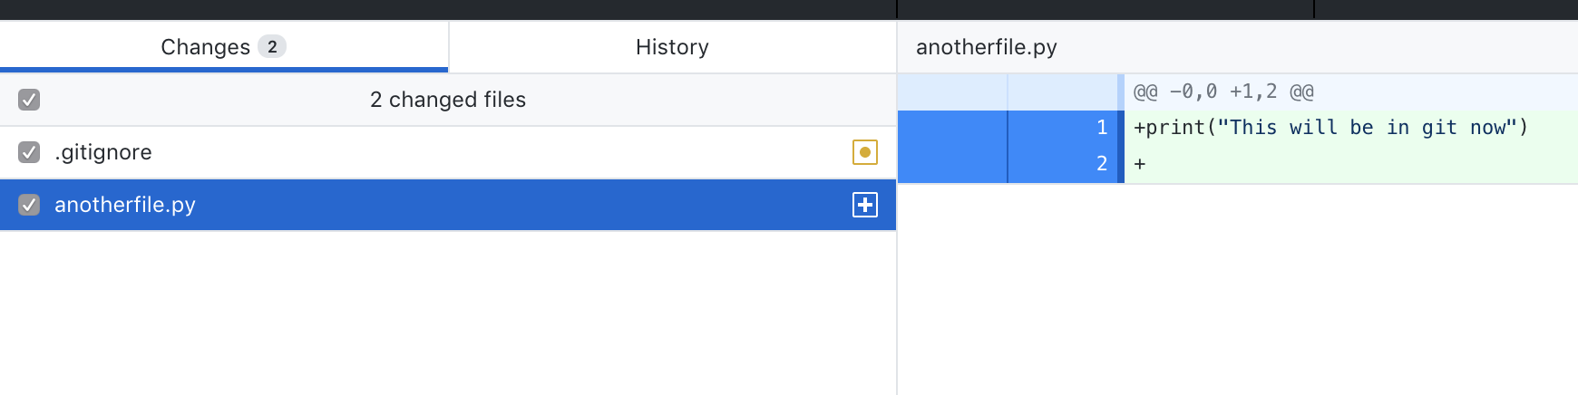
Working with Github Desktop
Write a commit message and commit.

Slide 8
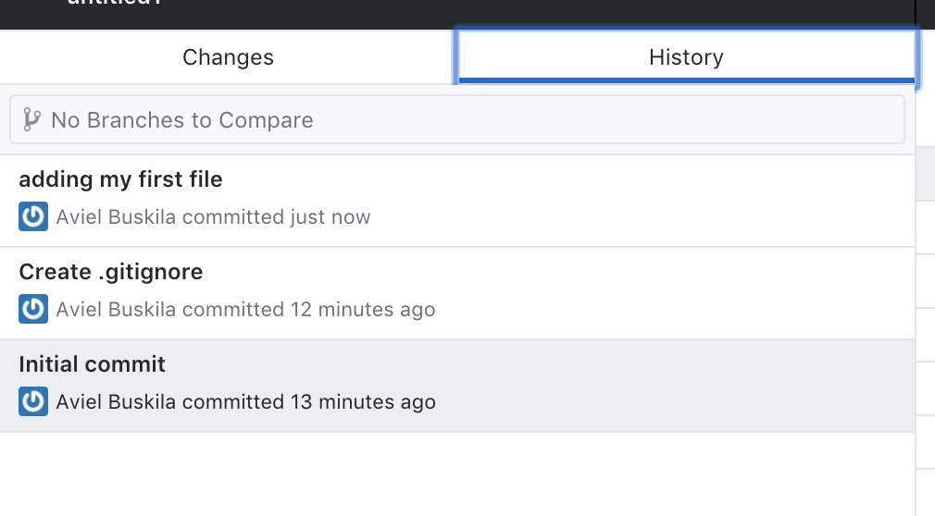
Working with Github Desktop

Slide 9
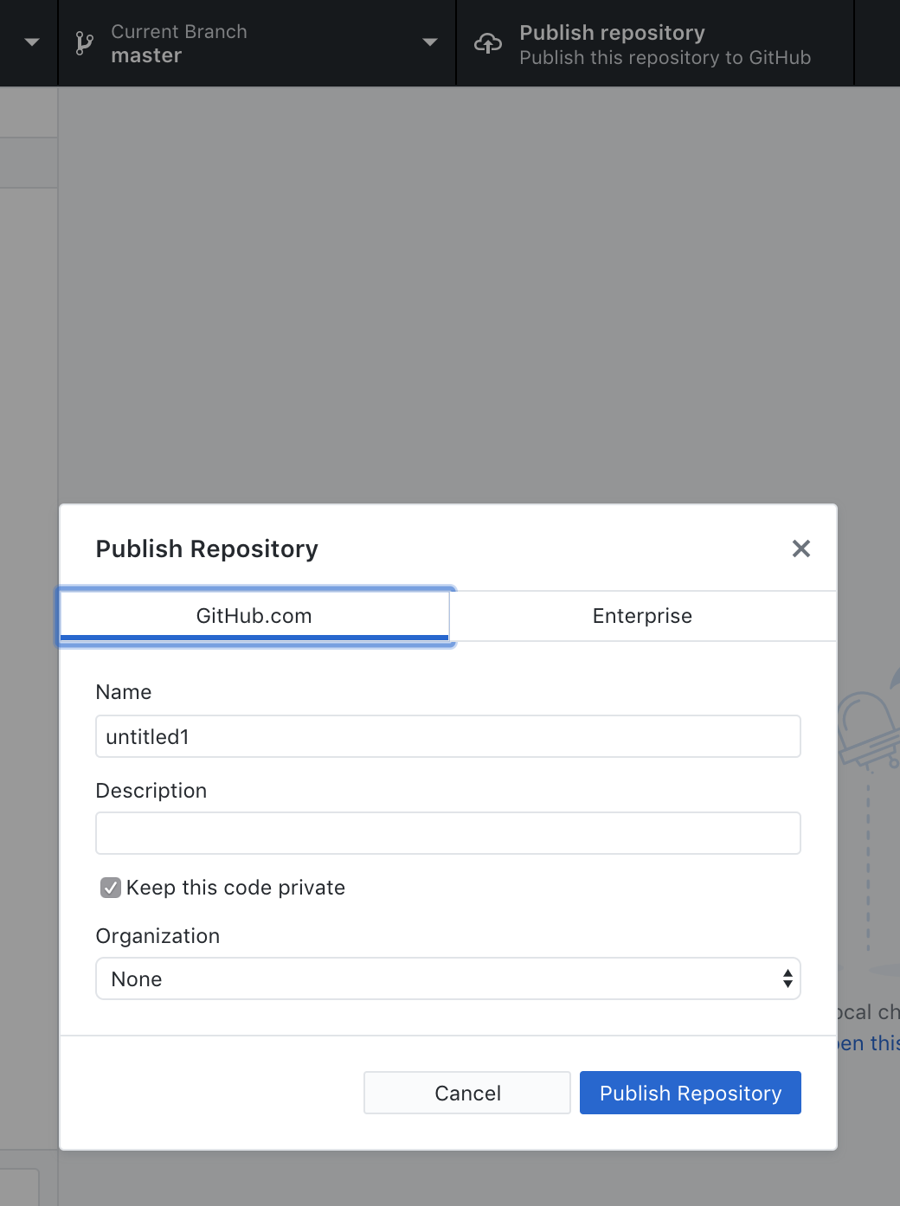
Working with Github Desktop
Do the following and uncheck “keep this code private”

Slide 10
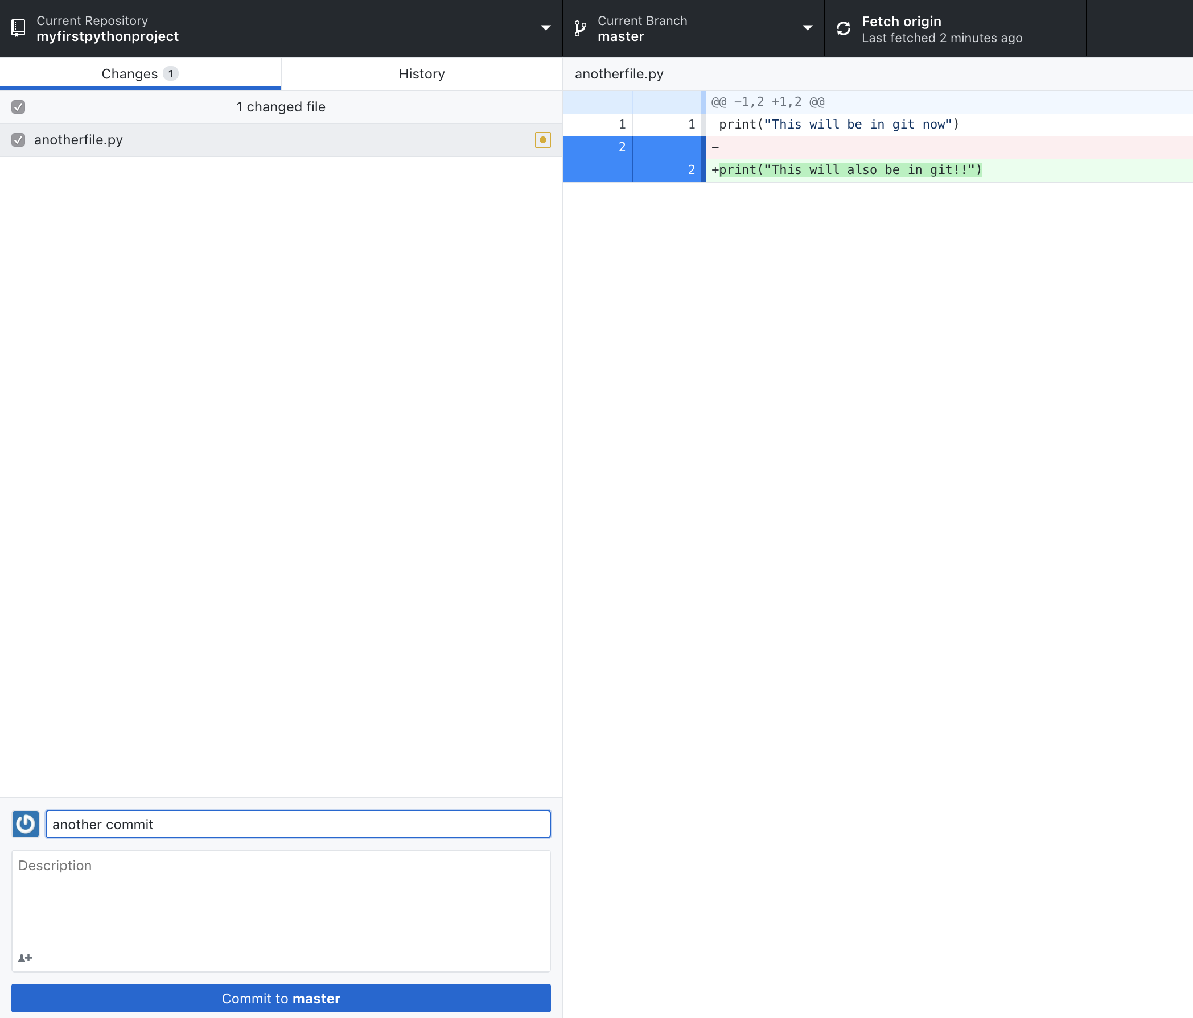
Working with Github Desktop
Now add another change to you file, again commit

Slide 11
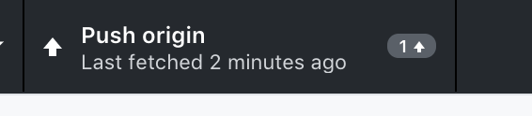
Working with Github Desktop
Now we can push the new code also to github:

Slide 12
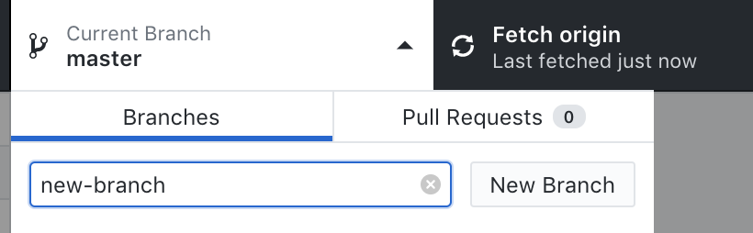
Working with Github Desktop
To create a new branch:

Slide 13

Working with Github Desktop
Now add a change only to your branch and publish it

Slide 14
Working with Github Desktop
Now, in order to merge my branch safely through github, I will need to use a “Pull Request”. A pull request is a mechanism operated by github that allows us to have safe and clean of conflict issues. Many times DevOps engineers use pull requests as the place used to run pre merge tests, integrations, code reviews and what not.

Slide 15
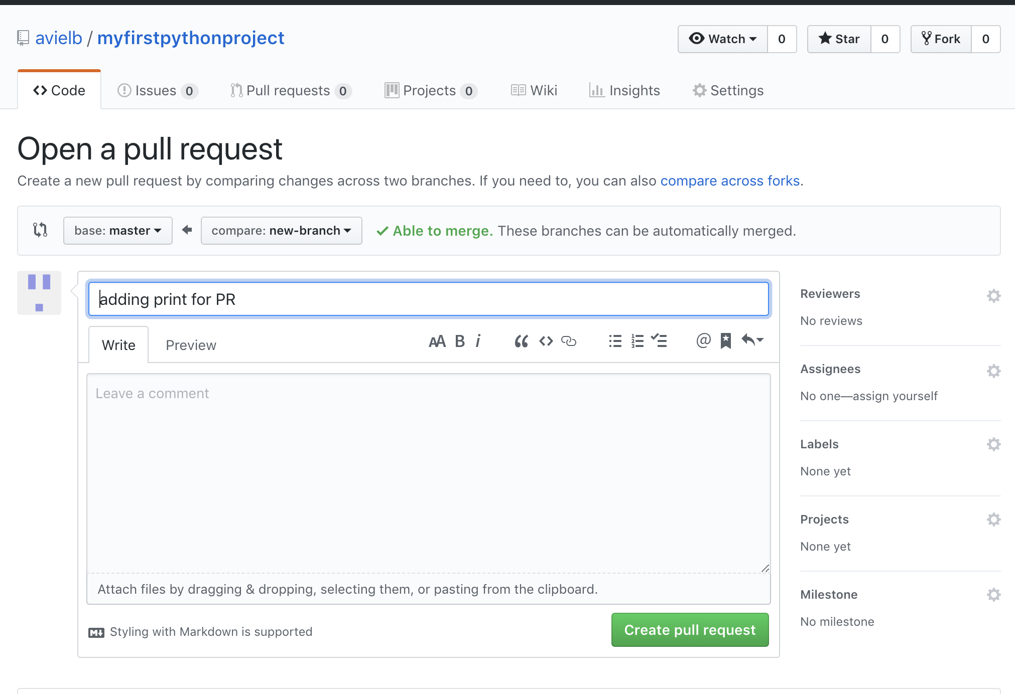
Connect Github with PyCharm

Slide 16
About Code Review
When a developer is finished working on an issue, another developer looks over the code and considers questions like:
Are there any obvious logic errors in the code?
Looking at the requirements, are all cases fully implemented?
Does the new code continuous existing style guidelines?
Usually a pull request will only be able to pass after another reviewer approved it.

Slide 17
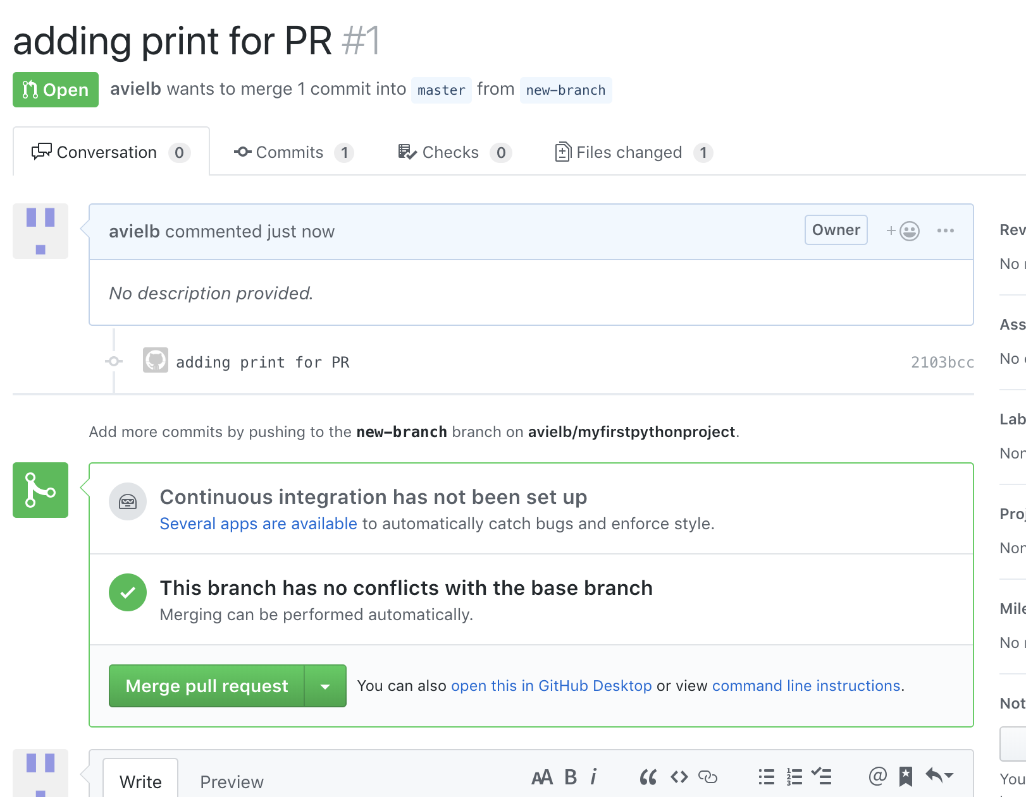
Approving a Pull Request

Slide 18
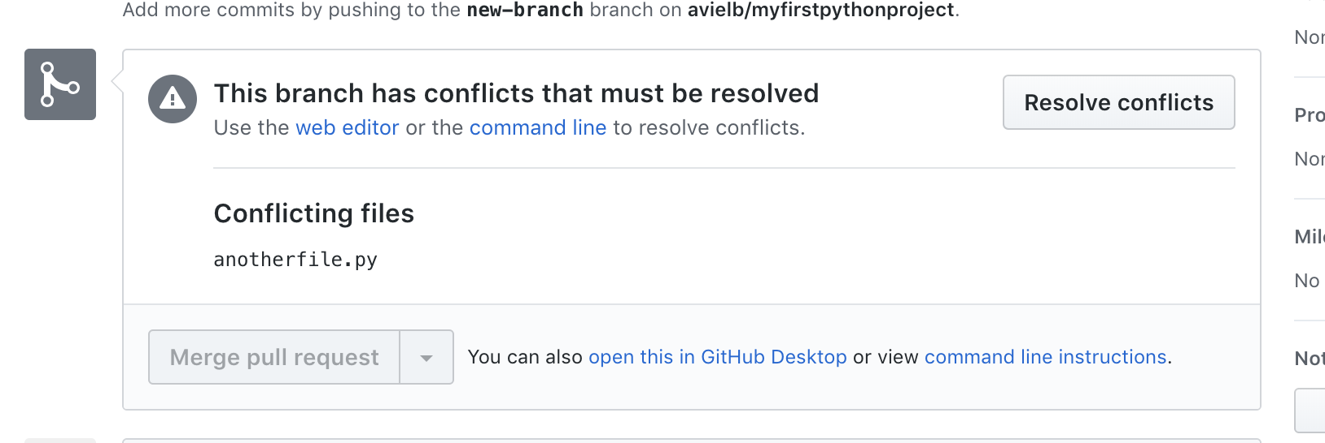
Conflicts
But in many cases we can have conflicts like here:

Slide 19
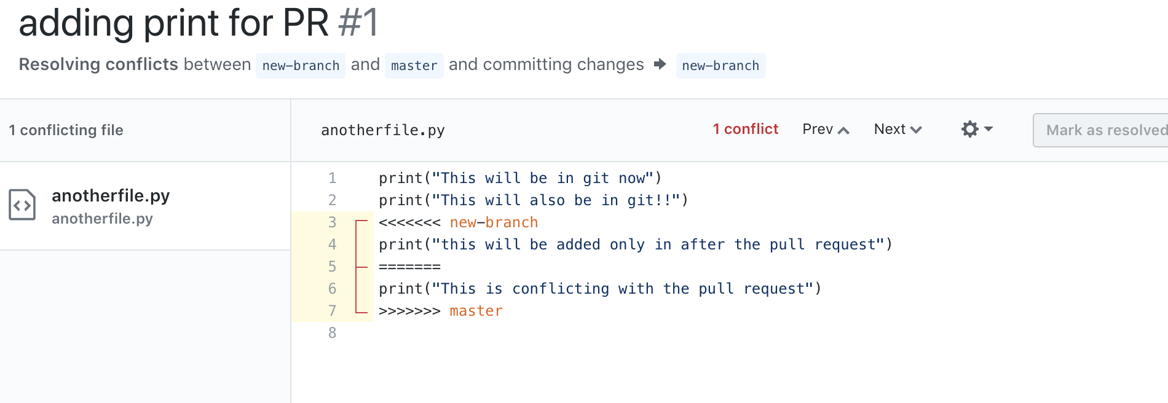
Resolving Conflicts

Slide 20
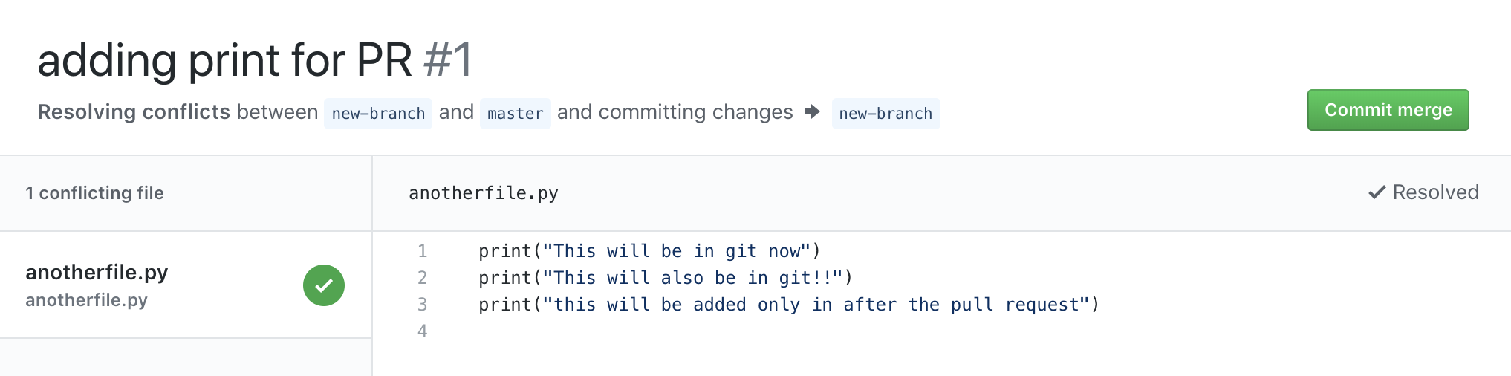

Slide 21
Exercise #1
Create repository (set it as a public repository).
Add a JenkinsFile to the repository
Publish to github.
Create a Jenkins job that polls master and runs a certain step.

Slide 22
Using Git as a build trigger
Many times we will want to start our tests once a new code was pushed.
For example when a new code is committed to production, we will want our test to run immediately, so issues can be discovered ASAP.
To achieve it, enter your Jenkins job (remember what it is?) and do the following changes:
Under “source code management” check Git option and enter your Git address and credentials of necessary (In Github there are no credentials because it is public).

Slide 23
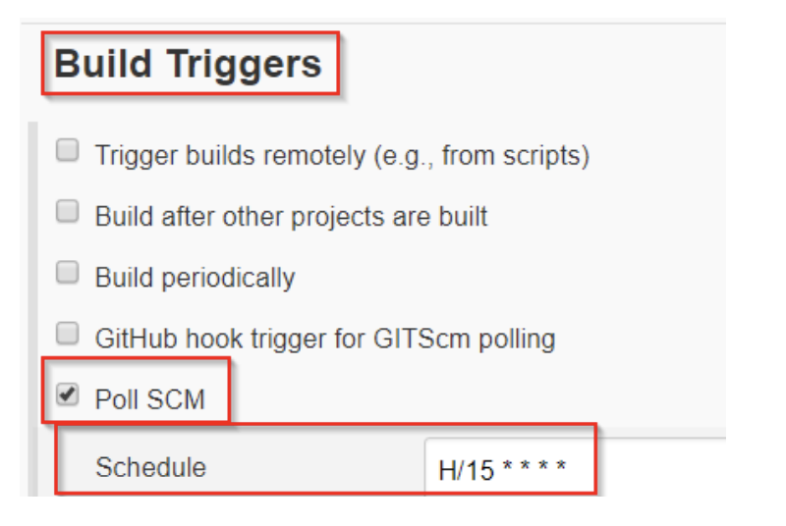
Using Git as a build trigger
Under build triggers choose “Poll SCM” (Source Control Management)
Then choose every how long the job will check for a new commit.
The example will basically check every 15 minutes if a commit Was performed into your Git repository, if so, your job will run automatically

Slide 24
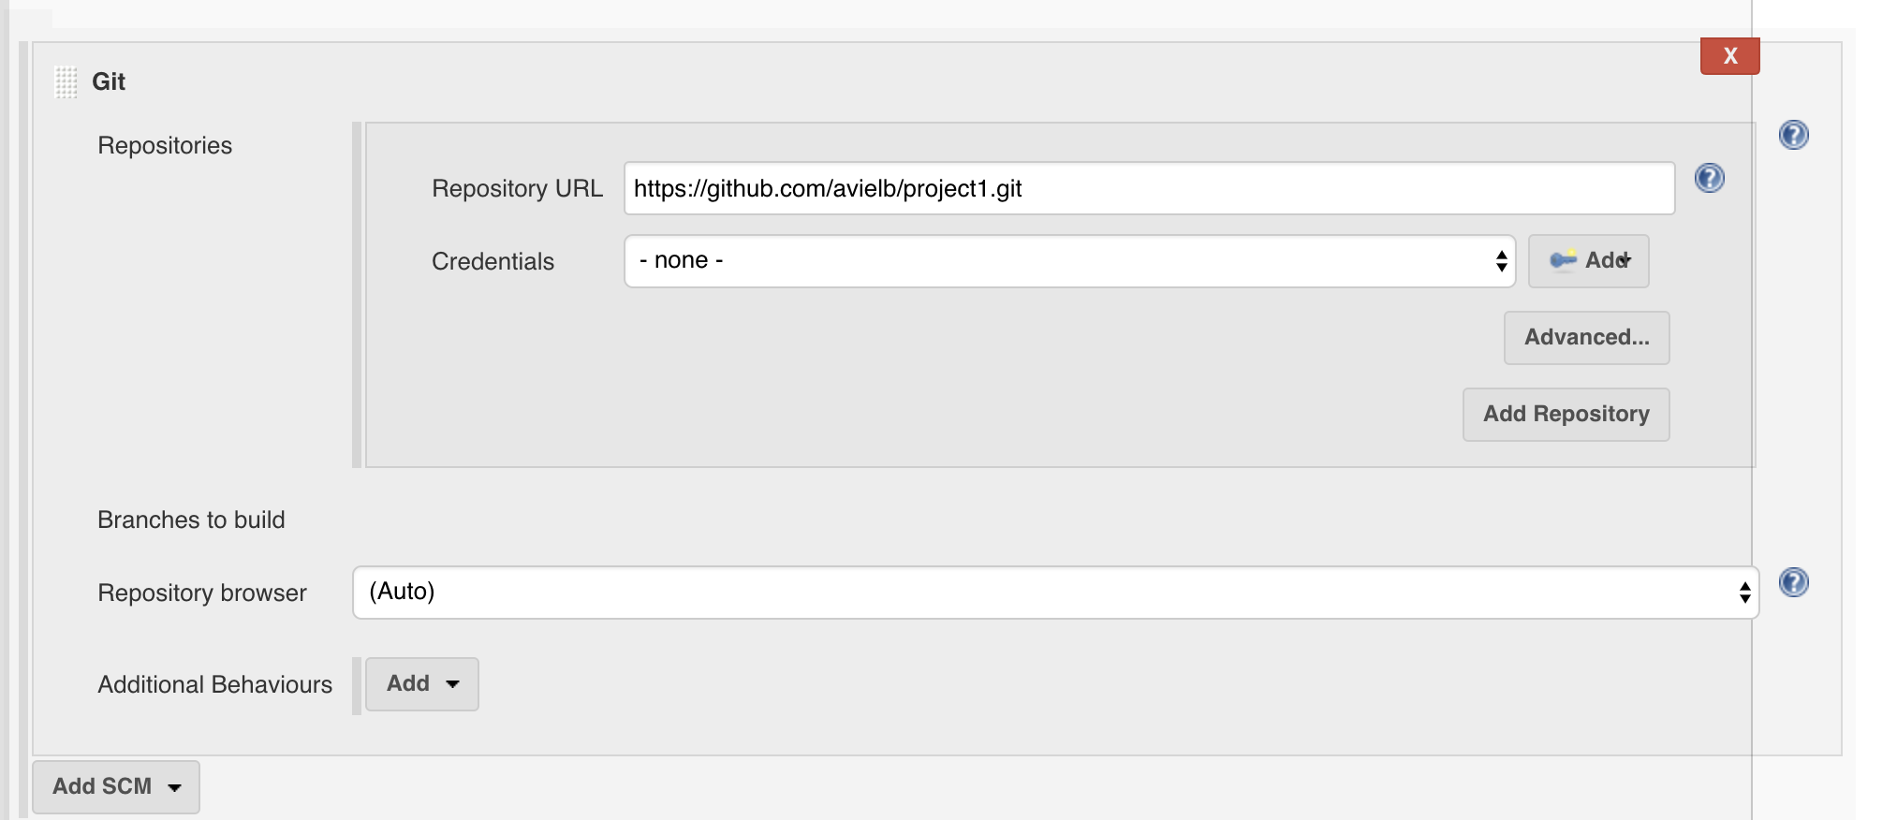
Using Git as a build trigger

Slide 25
Using Jenkins SCM pipeline
A jenkins pipeline can be stored as part of your git repository and executed by your jenkins. This way your application can consist also the jenkins pipeline used in order to build it.
In order to do it add the following:
Add jenkins.groovy pipeline to your repository
Create a new pipeline in your jenkins
Choose “pipeline script from SCM”
Add the path to your pipeline in your git repository.

Slide 26
Exercise
Create a python project called project1, add a script that prints “hello” and call it myapp.py
Create a git repository and push the code to github
Create a pipeline that listens to changes on your repository to branch master, the pipeline will download the repository and runs the script myapp.py.
Create a pipeline that listens to changes on your repository to any branch that starts with “feature”, the pipeline will try to run the script and will fail accordingly.
Push a new branch named feature_1 and verify that the pipeline was triggered as expected.
Add those pipeline to your repository.
Notes:
%ERRORLEVEL%

Slide 27
Common git workflows and practices
Feature branching - Short-living feature branches
Forking - Fork locally, merge remotely
Git flow workflow - develop and master branch
Trunk Based Development - One branch to rule them all
https://learnxinyminutes.com/docs/git/ - handy git tutorial

